Slide 1
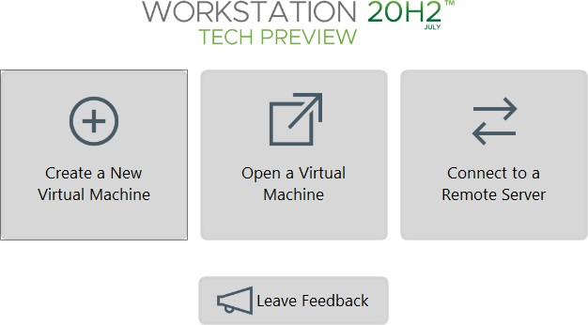
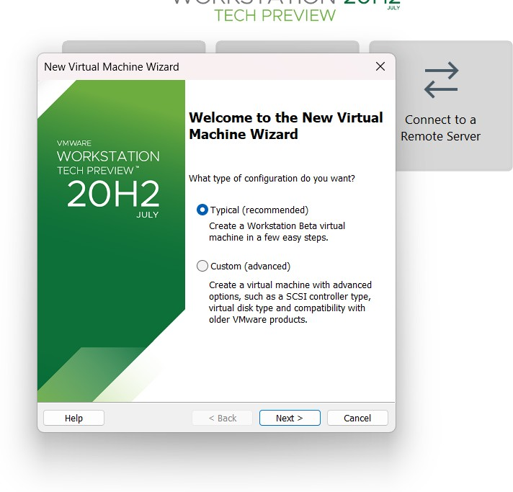
Experiment-7
Create a Virtual Machine with 1 CPU, 2GB RAM and 15GB storage disk using a Type 2 Virtualization Software.

Slide 2
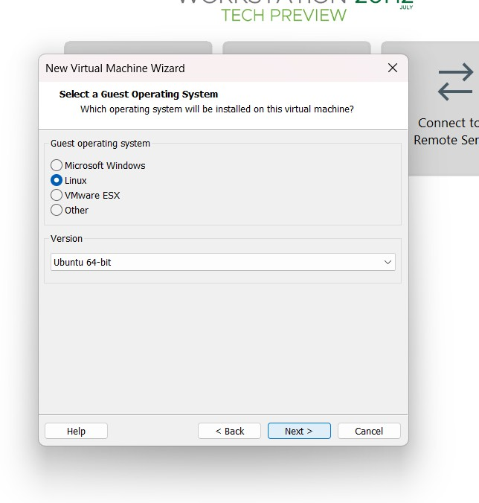
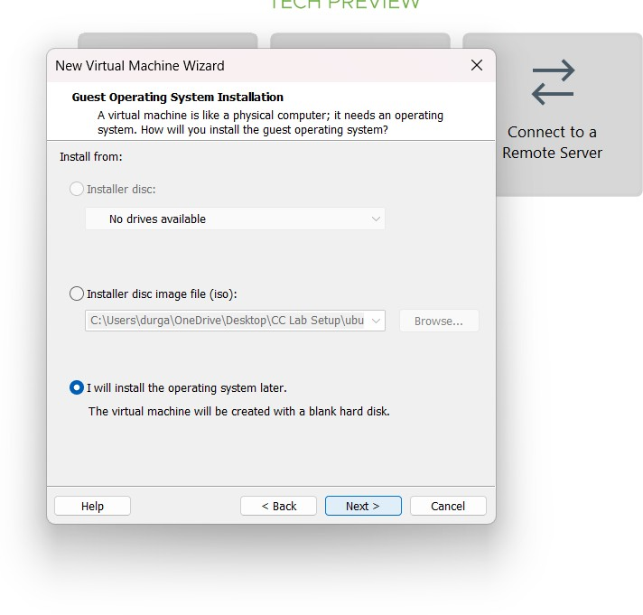

Slide 3
