Slide 1
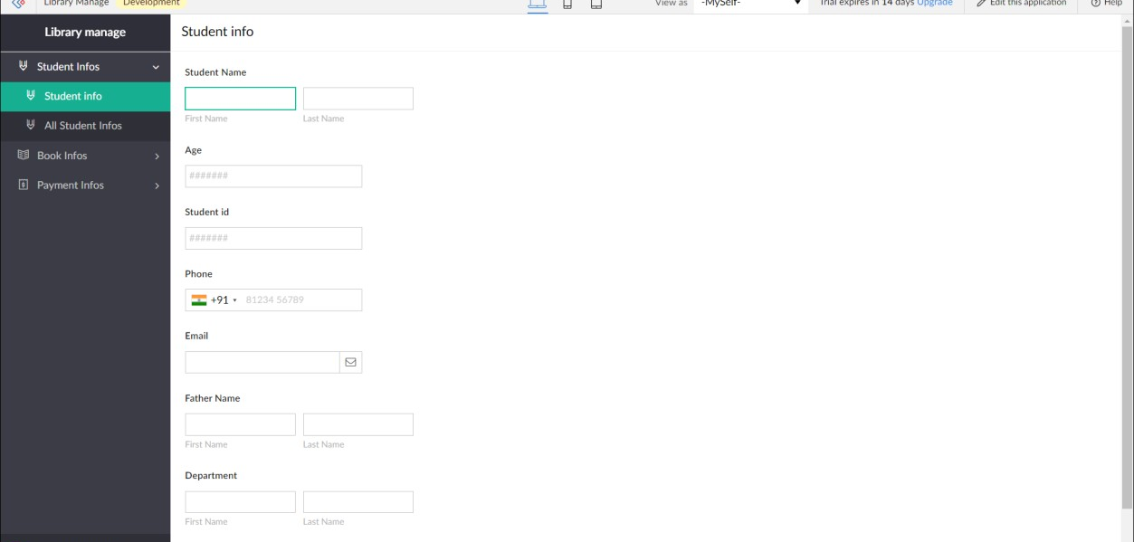
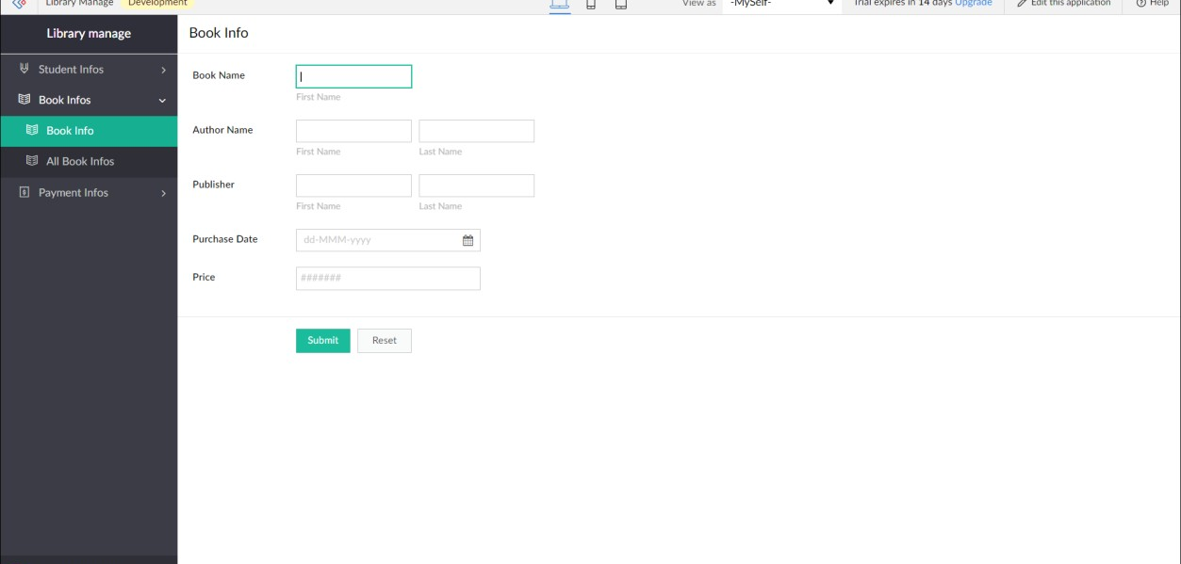
Experiment-4
Create a simple cloud software application for Library book reservation system for SIMATS library using any Cloud Service Provider to demonstrate SaaS

Slide 2


