Slide 1

Predict the total number of bags in sortation one
Mani Sai Deeraj Marru.

Slide 2

Presentation Overview
Analysis Objectives
Data Description
Data Wrangling
Exploratory Data Analysis
Modelling

Slide 3
Analysis Objectives
To predict the total number of bags in priority sortation “One” based on available information provided, six hours before a scheduled departure flight.

Slide 4
Purpose of Priority Sortation “One” Bags
To assist appropriate cargo planning based on scarce resources.
To minimize misconnected bags between flights.
To increase efficiency in unloading & offload cargo bags from flights.
To optimize proper allocation of cargo baggage between flights.

Slide 5
Overview of Data
American Airlines raw dataset consisted of 72,054 rows of flight information that were collected from January 1 to January 14, 2023. The dataset contained 66 fields that include details regarding the checked luggage at every gate, flight destinations, departure date and time, Count of bags based on different sortation priority, and plane type among other information. This dataset also has limited information on ticked passengers based on different times of the year.

Slide 6
Description of Variables
Target Variable:
ArrConxSortOneBags - Count of bags based on priority sortation “One”. These are the bags with the less connected flights and first to leave the airplane.
Independent Variables:
ChkFltDate Eqpt type ArrConxSortOnePaxs FltName ArrConxPaxIn6Hr

Slide 7
Data Wrangling
In the "Eqpt Type" column, observed that there are 3 NA records, those were excluded for further analysis.
Extracted flight code from the “flight key”.
The "FltName" column has been split into Four separate columns named "Source" ,"Destination“, “BankType” and “ BankNumber” based on the values within it.
"ArrConxBag" converted this column from object data type to integer datatype.

Slide 8
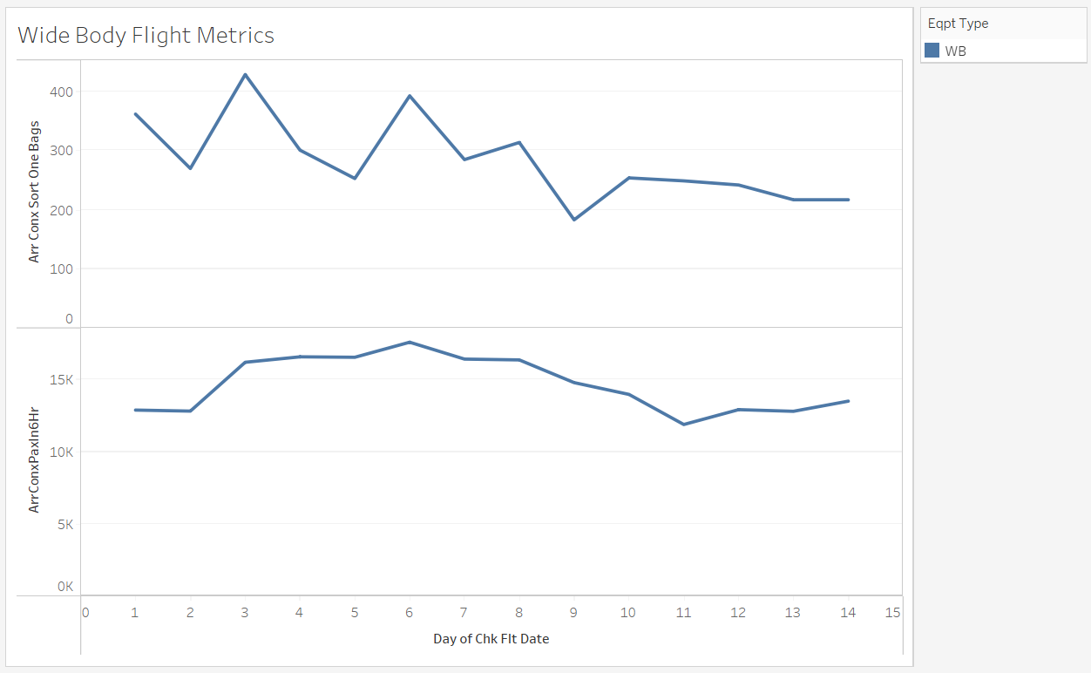
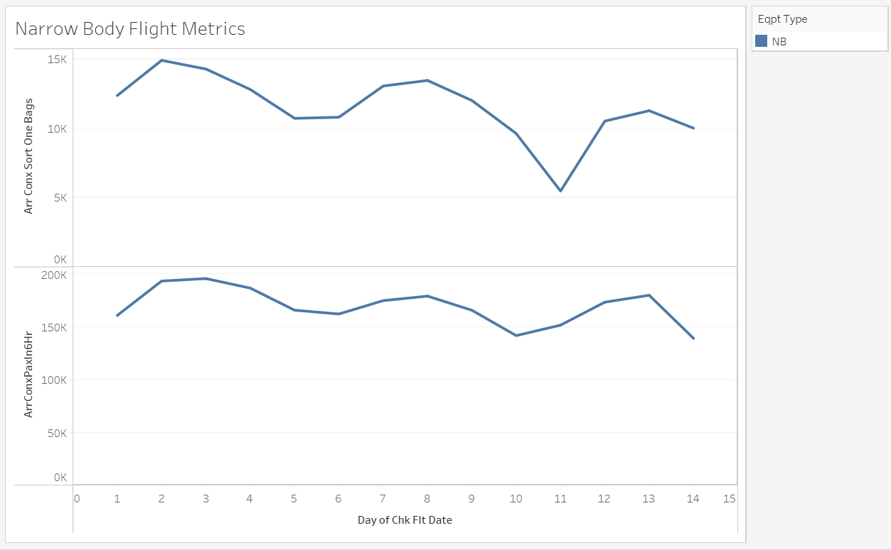
The line graph above shows “Wide Body” & “Narrow Body” bags vs passengers ticketed 6 hours to departure connecting to another flight. The trend shows increases and decreases based on days of the month.

Slide 9
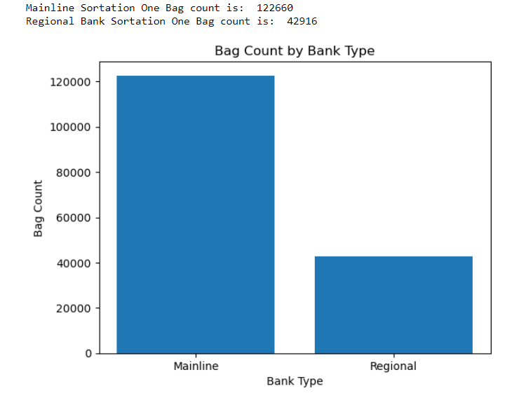
Bag Count by Bank Type
Based on the chart, it appears that American Airlines operates more flights on mainline routes than on regional routes.

Slide 10
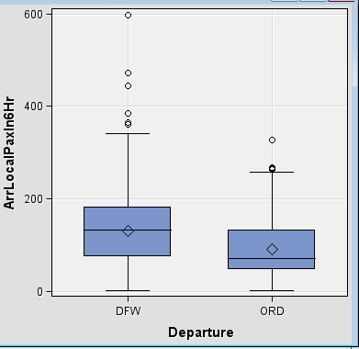
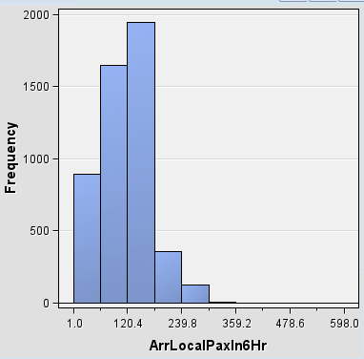
Comparison between DFW and ORD
The boxplot above compares the departure of flights and ticketed passengers between two airports. However, the histogram is not normally distributed due to inconsistency ticketed passengers prior six hours before departure.

Slide 11
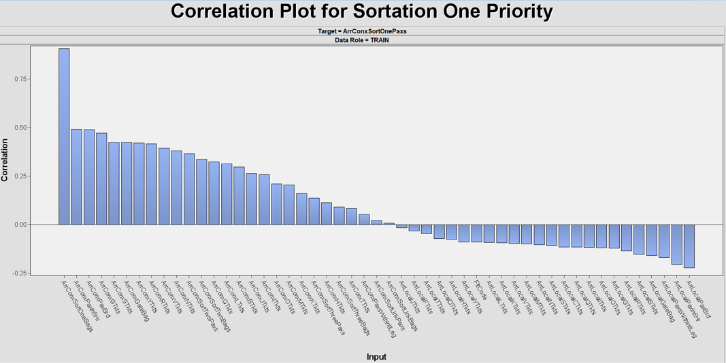
Correlation Plot for Sortation One Priority

Slide 12
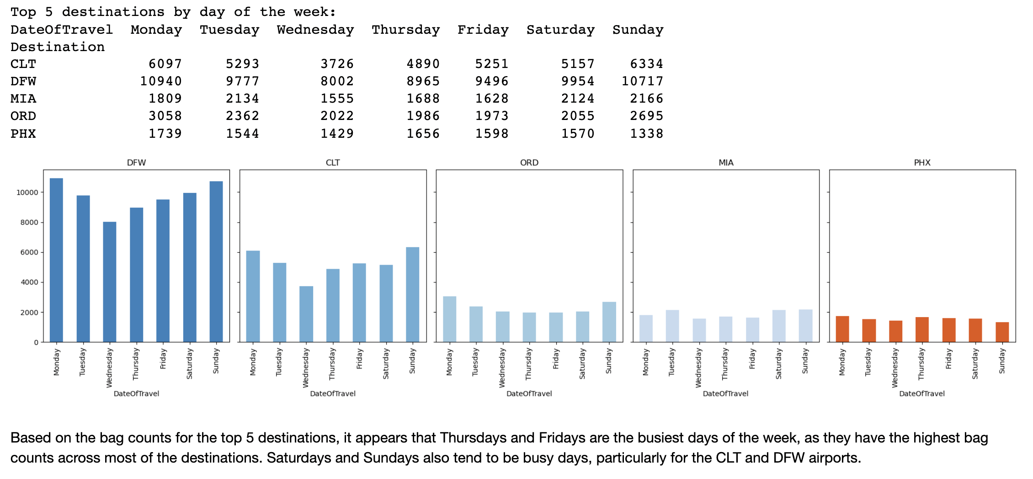
Top 5 destinations by day of the week

Slide 13
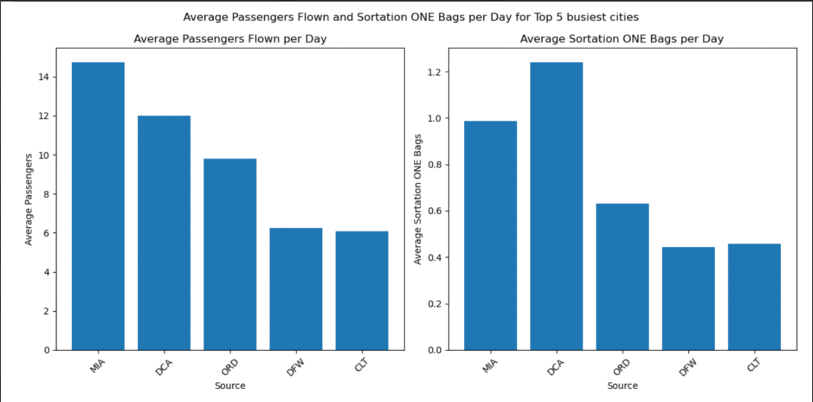

Slide 14
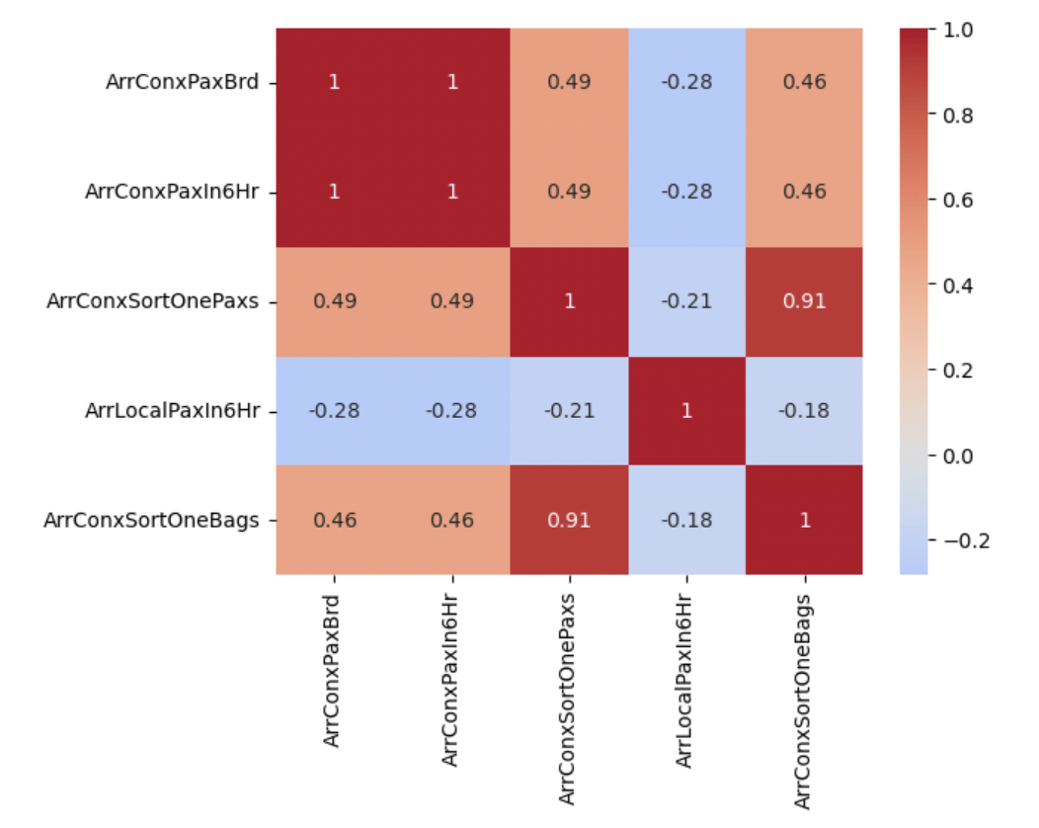
Correlation Analysis
We have selected five key variables that are relevant to our problem statement and have examined their correlations using a correlation matrix.
This matrix provides insights into the relationships among these variables, helping us understand how they are interconnected.

Slide 15
Modelling Techniques
Model1 - Gradient Boosting :
This approach utilizes the resampling of data and it highlights the most important variable, it helps in partitioning algorithm to search for a partition of the data which is optimal in terms of the value of a single variable and this approach utilizes the resampling of data.
Model 2 – Bagging and Boosting:
Bagging and Boosting is an automatic way to build bagging and boosting trees and it uses resampling with residual-based weights.
Model 3 – Decision Tree Regressor:
The Decision Tree Regressor is a powerful algorithm that utilizes a decision tree structure to predict the target variable. It works by recursively partitioning the data based on the values of different features, aiming to create subsets that are as homogeneous as possible in terms of the target variable.

Slide 16
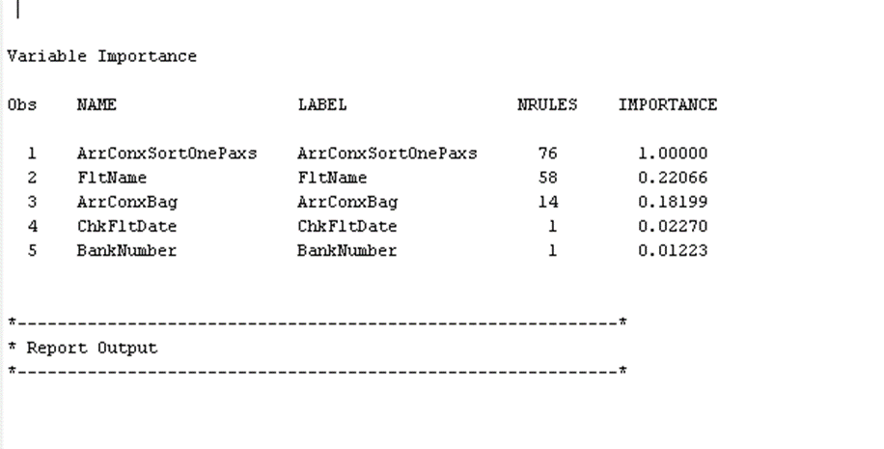
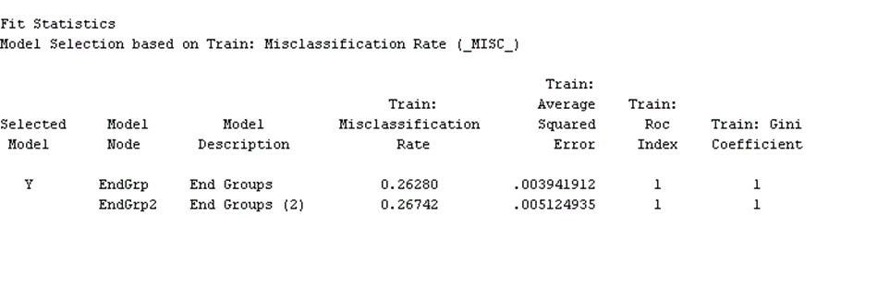
Modeling Techniques
Model- 1 Model -2

Slide 17
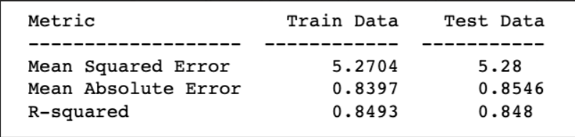
Model Performance Metrics
Our model's performance was evaluated using three key metrics: Mean Squared Error, Mean Absolute Error, and R-squared.
Mean Squared Error indicating the average squared difference between the predicted and actual values.
The Mean Absolute Error representing the average absolute difference between the predicted and actual values.
The R-squared value indicating that our model explains approximately 84.93% of the variance in the target variable.
These metrics demonstrate that our model performs consistently well on both the training and test data, indicating its effectiveness in predicting the target variable.

Slide 18
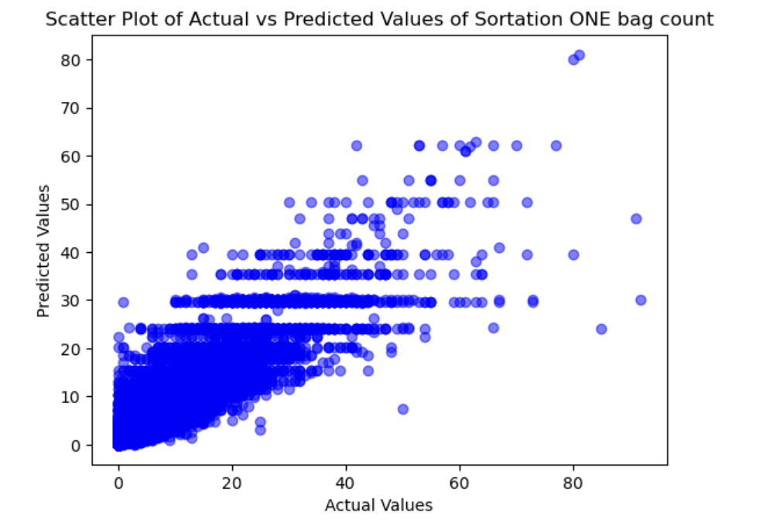
Visualizing Model Results: Actual vs Predicted Values
The above scatter plot shows predicted values against actual values, each point represents a single observation. The closer the points are to the diagonal line, the better the model's performance.

Slide 19
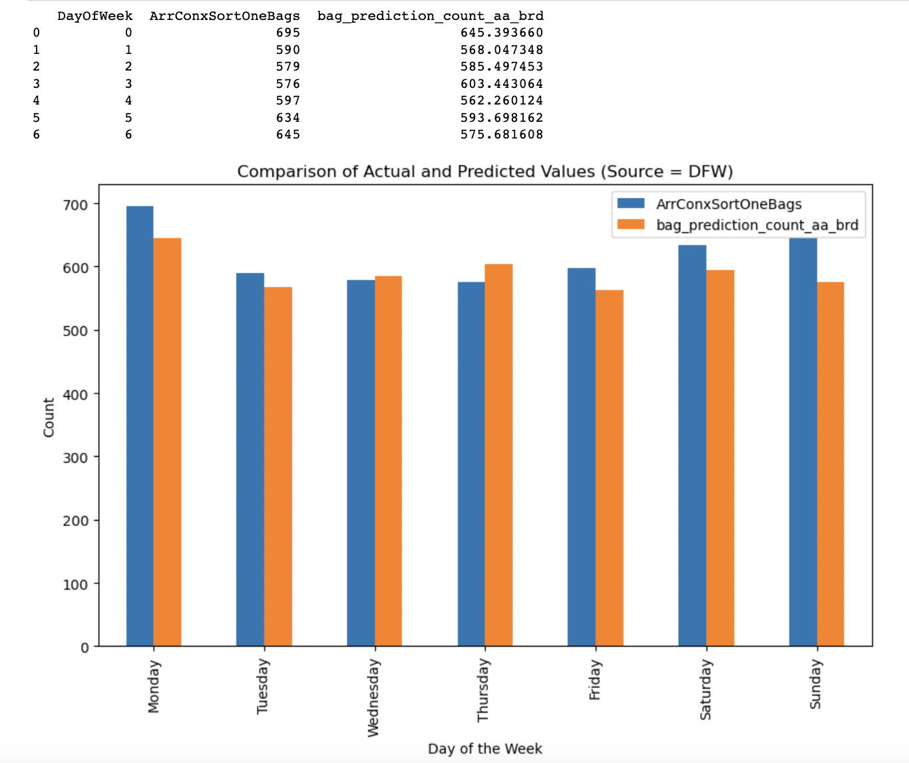

Slide 20
Summary
This EDA analysis is based on priority “One” Sortation of bags of ticketed passengers who are six hours before boarding an airplane.
Limitations in dataset, 14 days of ticketed passengers.
Wide Body flights were more prevalent by daily flights.
There were a decline in the number of checked bags on January 11th.
Seasonal patterns exist for both the day of the week and the time of day, with the seasonal fluctuations being more noticeable for the latter.

Slide 21


