Slide 1
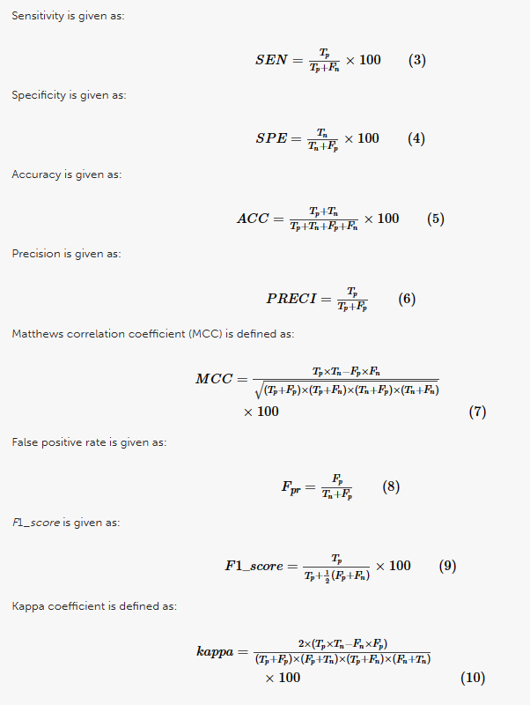

Slide 2
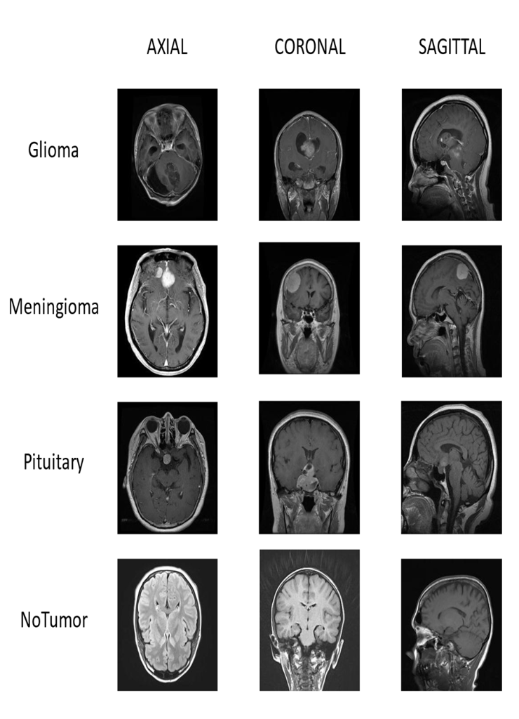
Classification of Brain Tumors using MRI images based on Convolutional Neural Network and Supervised Machine Learning Algorithms
Objective of the Research Paper:
Develop a method for classifying brain tumors using MRI images.
Improve the accuracy and efficiency of brain tumor classification.
Utilize AI techniques, including CNN and supervised machine learning algorithms.
Propose a hybrid method combining deep learning CNN models with supervised classifiers.
Focus on four brain tumor classes: glioma, meningioma, pituitary, and no tumor.
Extract features from MRI images using CNN models.
Achieve high performance in accuracy, precision, recall, and F1-Score.
Compare results with other state-of-the-art papers to demonstrate superiority.

Slide 3
Classification of Brain Tumors using MRI images based on Convolutional Neural Network and Supervised Machine Learning Algorithms
About the Research Paper Dataset:
Dataset includes 6,321 MRI images.
Categorized into four classes: glioma, meningioma, pituitary, and no tumor.
Obtained from Kaggle, FigShare, SARTAJ dataset, and Br35H.
Used for analysis and model training.
Data Preprocessing Insights:
Augmentation Techniques: Image rotation, sharing, scaling, and reflection.
Enhance dataset diversity and reduce overfitting.
Resizing Images: Uniform dimensions (224x224x3 pixels) for optimal deep learning model performance.
Grayscale Conversion: Simplify data and reduce computational complexity.
Standardize the dataset for deep learning and ML models.

Slide 4
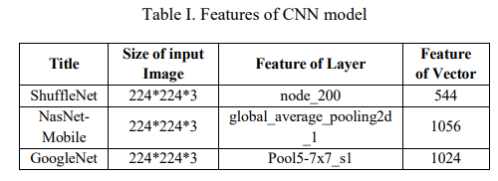
Classification of Brain Tumors using MRI images based on Convolutional Neural Network and Supervised Machine Learning Algorithms
Machine Learning/Deep Learning Models: Deep Learning Models:
GoogleNet: 22 learning layers, used for feature extraction from MRI images.
NasNet-Mobile: CNN model for feature extraction.
ShuffleNet: CNN model for feature extraction.
Machine Learning Classifiers:
k-Nearest Neighbor (KNN)
Support Vector Machines (SVM)
Linear Discriminant Analysis (LDA)
Hybrid approach combines deep learning and ML for classification.

Slide 5
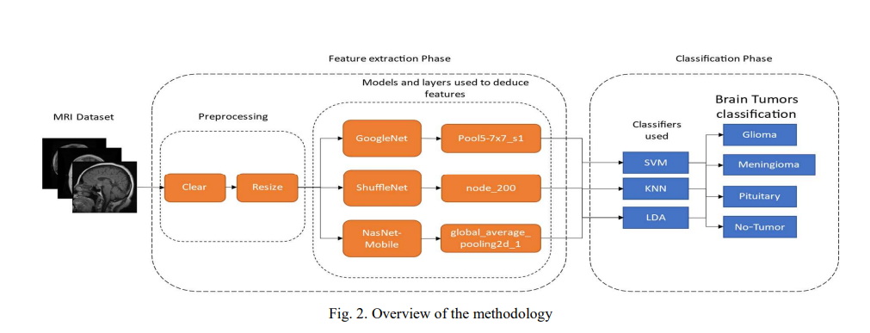
Classification of Brain Tumors using MRI images based on Convolutional Neural Network and Supervised Machine Learning Algorithms
Experimental Details:
Dataset includes 6,321 MRI scans with four brain tumor types.
Data augmentation techniques applied for model improvement.
MRI images resized to a uniform dimension of 224x224x3 pixels.
Deep learning models (GoogleNet, NasNet-Mobile, ShuffleNet) used for feature extraction.
Extracted features fed into machine learning classifiers (KNN, SVM, LDA).
Performance evaluated using accuracy, precision, recall, and F1-score.
Cross-validation with k=5 employed to mitigate overfitting.
ShuffleNet with SVM achieved the highest accuracy of 98.40%.

Slide 6
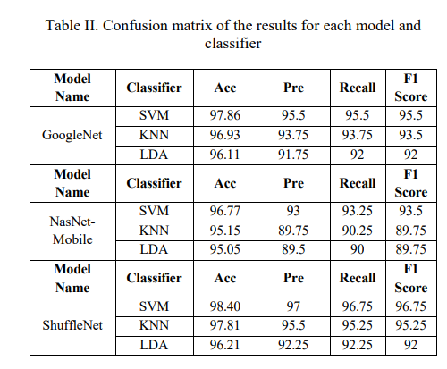
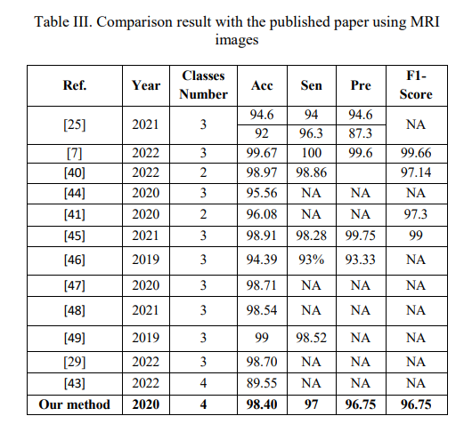
Classification of Brain Tumors using MRI images based on Convolutional Neural Network and Supervised Machine Learning Algorithms
Results:
ShuffleNet with SVM achieved the highest accuracy (98.40%).
Precision: 97%, Recall: 96.75%, F1-Score: 96.75%.
Outperformed other state-of-the-art papers in accuracy, precision, recall, and F1-score.
Compared favorably to different deep learning architectures and classic methods like SVM.
Presented results in confusion matrices, showing the effectiveness of combining deep learning and machine learning models.

Slide 7
Classification of Brain Tumors using MRI images based on Convolutional Neural Network and Supervised Machine Learning Algorithms
Conclusion:
This paper proposes a hybrid deep learning and machine learning approach for brain tumor classification from MRI images.
As preprocessing, techniques like augmentation, resizing and grayscale conversion are applied.
Three CNN models - GoogLeNet, ShuffleNet and NasNet Mobile - are used for feature extraction from the MRI images.
The extracted features are fed into 3 conventional ML classifiers - SVM, KNN and LDA.
ShuffleNet + SVM achieves the best performance with 98.4% accuracy, 97% precision, 96.75% recall and F1-score.
The lightweight ShuffleNet architecture extracts more discriminative features compared to GoogLeNet and NasNet Mobile.
The results are compared to recent papers, and the proposed hybrid approach provides superior tumor classification accuracy.
The authors of the research report "Classification of Brain Tumors using MRI images based on Convolutional Neural Network and Supervised Machine Learning Algorithms" are
Saif Al-jumaili: Affiliated with the Electrical and Computer Engineering department at Altinbas University in Istanbul, Turkey. Email: saif.aljumaili@ogr.altinbas.edu.tr, saifabdalrhman@gmail.com
Adil Deniz Duru: Affiliated with the Neuroscience and Psychology Research in Sports Lab at Marmara University in Istanbul, Turkey. Email: deniz.duru@marmara.edu.tr
Osman Nuri Ucan: Affiliated with the Electrical and Computer Engineering department at Altinbas University in Istanbul, Turkey. Email: osman.ucan@altinbas.edu.tr
Aytug Boyaci: Affiliated with the Department of Computer Engineering at Air Force Academy in Istanbul, Turkey. Email: aytugboyaci@firat.edu.tr
Dilek Goksel Duru: Affiliated with the Faculty of Science at Turkish-German University in Istanbul, Turkey. Email: dilek.goksel@tau.edu.tr

