Slide 1


WEALTHCLOCK
About|Solutions|Top Picks|Money Tools|Insights|Contact Us
SIGN IN
Y O U R T I M E

Slide 2
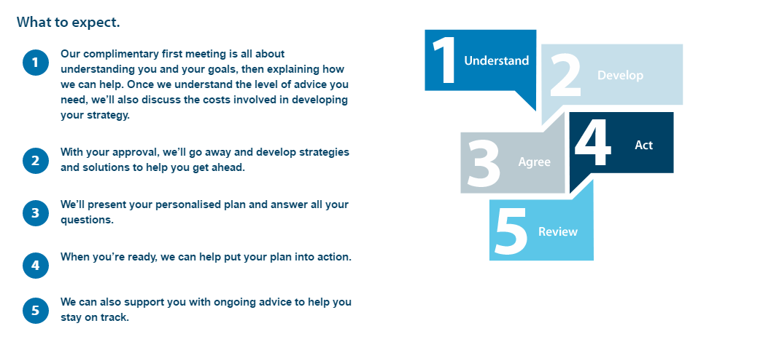
WEALTHCLOCK
About|Solutions|Top Picks|Money Tools|Insights|Contact Us
SIGN IN
How our investment process works
Y O U R T I M E
I S N O W
Notes:
How It Works
Understand
There is no ‘one size fits all’ solution for financial planning – our service is personal to you. Some people need one-off advice in a specific area such as passing on an inheritance. Others would like a comprehensive plan that covers all areas of their finances.
A specific area or a full plan - Our financial planners can help you to reach a specific goal. You may want to make sure you have saved enough money for the retirement you want, or pass on an inheritance without paying more tax than is necessary.
We can also create a full financial plan to meet all your goals and requirements. Our financial planners will look at every aspect of your finances, including your tax situation, to understand how advice in one area may affect or depend on others. Your plan will be tailored to your individual circumstances and priorities, taking into account your complete financial situation.
Reviewing your progress
Financial planning is a long-term process, not a one-off exercise. As your priorities change over time, your financial plans should too. We can work with you over the long term to make sure your plans continue to reflect your lifestyle, goals and overall tax situation.
http://www.wealthworks.co.nz/financial-planning-process
https://www.bosinvest.com/how-we-plan/

Slide 3

WEALTHCLOCK
About|Solutions|Top Picks|Money Tools|Insights|Contact Us
SIGN IN
Understand
There is no ‘one size fits all’ solution for financial planning – our service is personal to you. Some people need one-off advice in a specific area such as passing on an inheritance. Others would like a comprehensive plan that covers all areas of their finances.
A specific area or a full plan - Our financial planners can help you to reach a specific goal. You may want to make sure you have saved enough money for the retirement you want, or pass on an inheritance without paying more tax than is necessary.
We can also create a full financial plan to meet all your goals and requirements. Our financial planners will look at every aspect of your finances, including your tax situation, to understand how advice in one area may affect or depend on others. Your plan will be tailored to your individual circumstances and priorities, taking into account your complete financial situation.
Y O U R T I M E
I S N O W

Slide 4

WEALTHCLOCK
About|Solutions|Top Picks|Money Tools|Insights|Contact Us
SIGN IN
Develop
We use two pillars to ensure that you create wealth in the manner best suited to you. These two pillars are
The “right” asset allocation (mix) - By this we mean your money is invested in the right mix (ie equity, debt or short term) of funds that are best suited to your profile and goals. So, if you want less volatility, have a large portfolio, and are 45 years old, our recommended portfolio will be different than if you are 30 years old, have a smaller portfolio and are willing to take some volatility for higher returns. Many studies have shown that the “right” asset allocation is the most critical variable in creating sustained wealth over the long term, but is often the most overlooked aspect. We help you create and maintain the right balance of assets, over the life of your portfolio.
The “right” funds - There are no “best funds” in our view- only “right funds”. So we recommend the funds which suit your profile best. For instance, a fund might be the “best performing fund” in its category, but that simply means that its returns are the best over one time period- it doesn’t take into account that it has been very volatile in giving those returns. So if you are a conservative investor, it will give you stress, and will not be right for you. The same fund, however, will be right for a more aggressive investor looking for high returns.
Our proprietary algorithms will ensure that you invest in the right mix of funds and the right funds. Also, any additional investments, and redemptions are made so as to maintain the mix.
Right Allocation
Y O U R T I M E
I S N O W

Slide 5
WEALTHCLOCK
About|Solutions|Top Picks|Money Tools|Insights|Contact Us
SIGN IN
Agree
There are really three things everyone needs to keep in mind when thinking about their own financial planning:
The first is expectations: if you want to live like a king you need to come up with a plan to accumulate enough funds to do so. The accumulation to live like a pauper is much lower. So expectations are very important.
The second is accumulating. You need to accumulate commensurately with your expectations. A person desiring to live like a king needs to accumulate great wealth, a person satisfied to live like a pauper requires much less.
The third is spending. Each time you spend you need to keep the expectation in line. Spending now may make it harder to live like a king later while spending now may make it easier to live like a pauper.
All three require decisions to be made constantly, whether these decisions are made consciously or unconsciously are up to you.
Y O U R T I M E
I S N O W

Slide 6
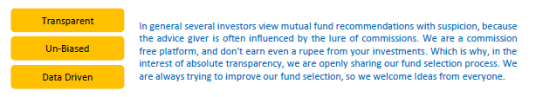
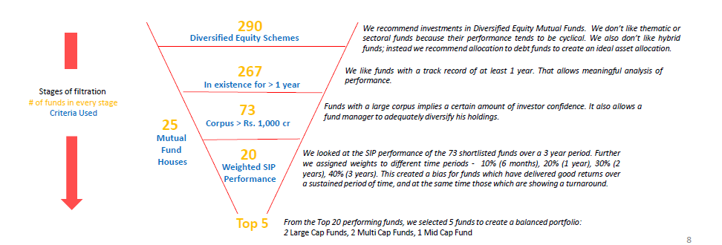
WEALTHCLOCK
About|Solutions|Top Picks|Money Tools|Insights|Contact Us
SIGN IN
Act
We recommends just 3 funds in each categories
Mutual Fund Shortlisting process
Y O U R T I M E
I S N O W

Slide 7
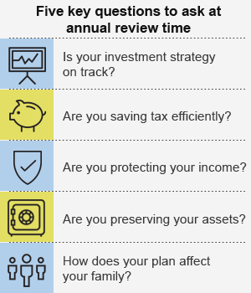
WEALTHCLOCK
About|Solutions|Top Picks|Money Tools|Insights|Contact Us
SIGN IN
Review
When are you most likely to do a reality check on your investments? Is it when they’re doing well? Or is it when the markets are down and you’re nervous? Chances are it is the latter, which may not be the optimal time to make investment decisions, particularly if emotions are high. That’s why taking the time to do an annual review of your investments and other financial matters makes sense. “Think of it as if you were driving on a dangerous road. That’s not when you check your brakes and tires. You do that before, so you know they are in good shape.”
An annual financial checkup can accomplish many things. You can stop and think about your family’s financial goals, such as saving for retirement, a house, or a child’s education. You can consider reducing taxes on your investments, protecting your income, or building a financial cushion. Once you are clear on your goals, you can then work on ensuring that you are investing appropriately for those goals.
Y O U R T I M E
I S N O W

Slide 8
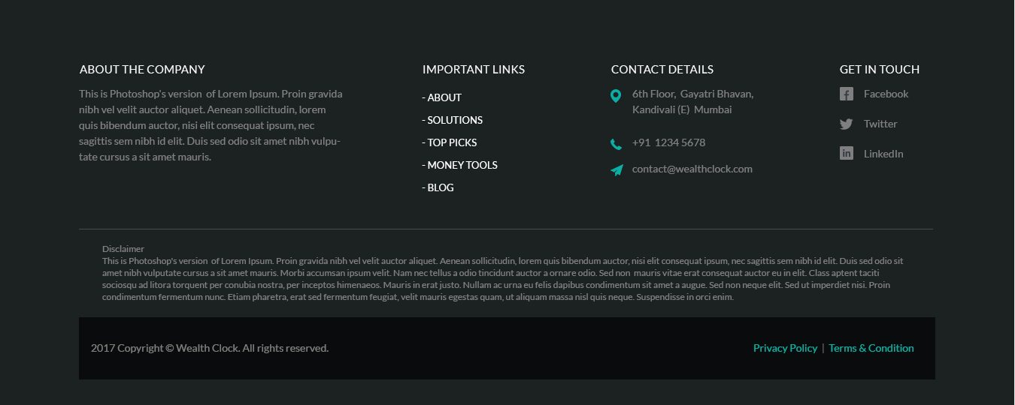
Notes:
How it works - https://www.finaskus.com/home

