Slide 1
Improving length of stay prediction using a hidden Markov model
Presenter : Mani Sotoodeh
Date: 10.03.18

Slide 2
Motivation
Length of stay significance
Intervention to prevent adverse outcomes in patients
Optimization of resource allocation ( equipments and beds)
Allocation of staff and care to high risk patients
Improving patients satisfaction and hospitals reputation
Most of the previous work is on classification rather than regression
Track multiple physiologic measurements and their interactions over time
States may be later be interpretable by physicians
Physician can predict short or long staying patients only half of the time

Slide 3
Problem Statement
Input : physiological measurements throughout time for 48 hours
Blood pressure, temperature, heart rate, Glasgow Coma Score, serum glucose, white blood cell count urine output.
Output : Length of stay in ICU in days ( Regression)

Slide 4
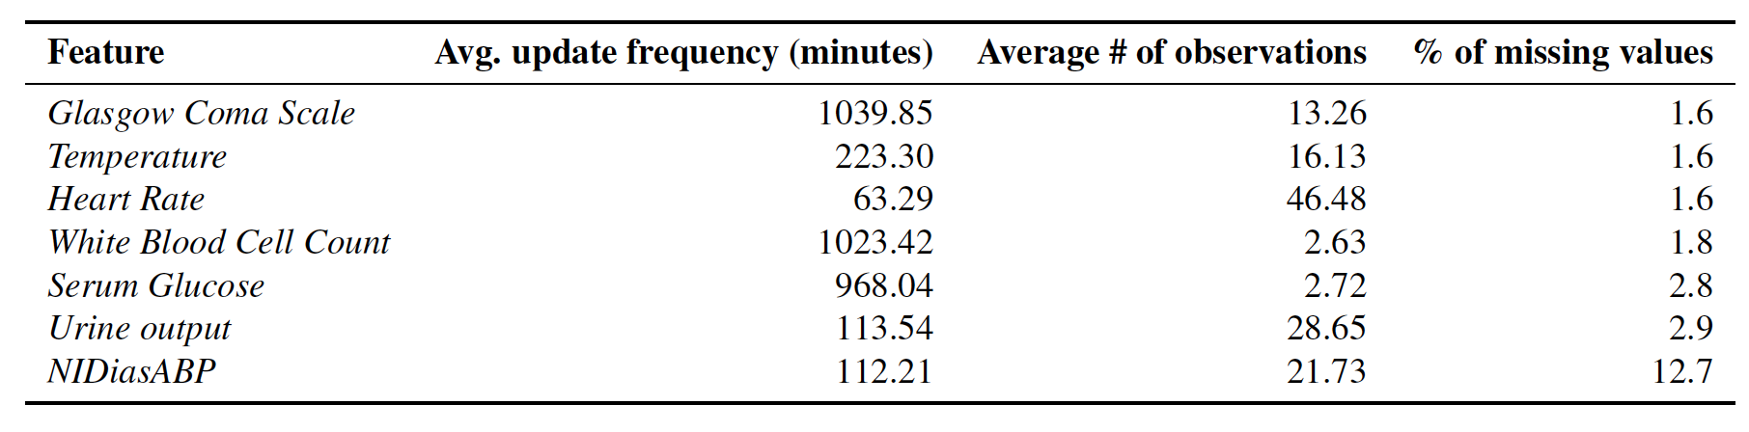
Properties of dataset
4000 patients
General descriptors including age and gender as well as 37 different physiological measurements

Slide 5
Baseline models
Min, Max, Mean, First and Last for each of the 7 variables
35 in total
five common regression models: LASSO regression, ridge regression, Poisson regression, binomial regression, and support vector regression (SVR)

Slide 6
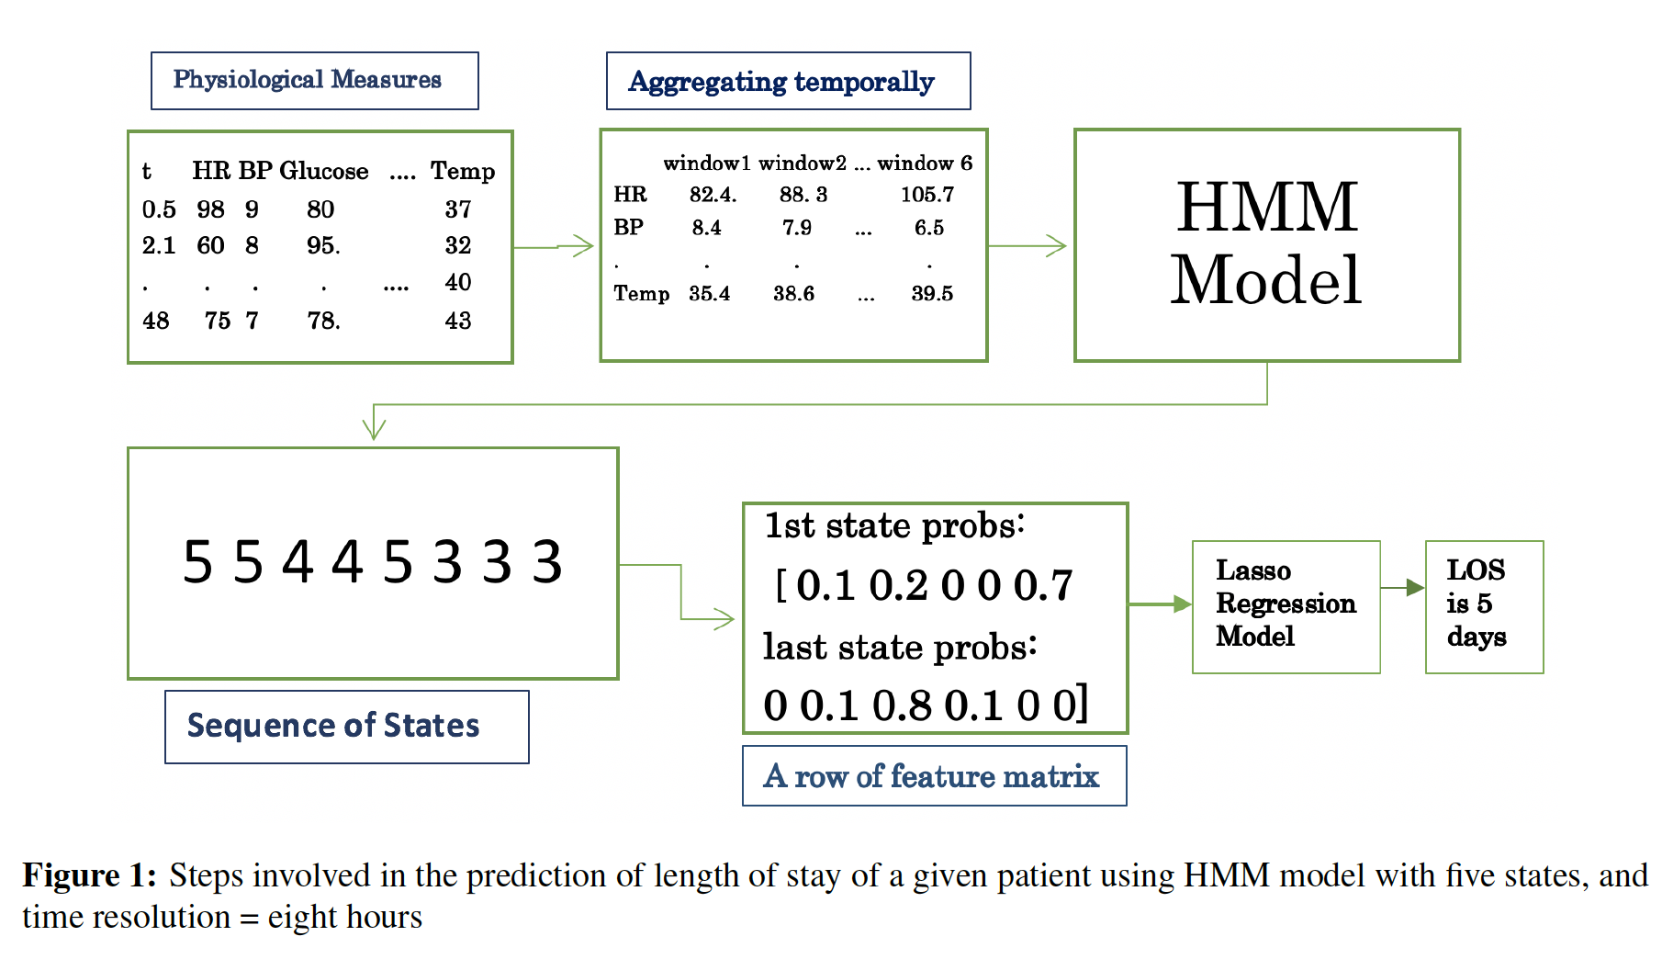
HMM model Overview

Slide 7
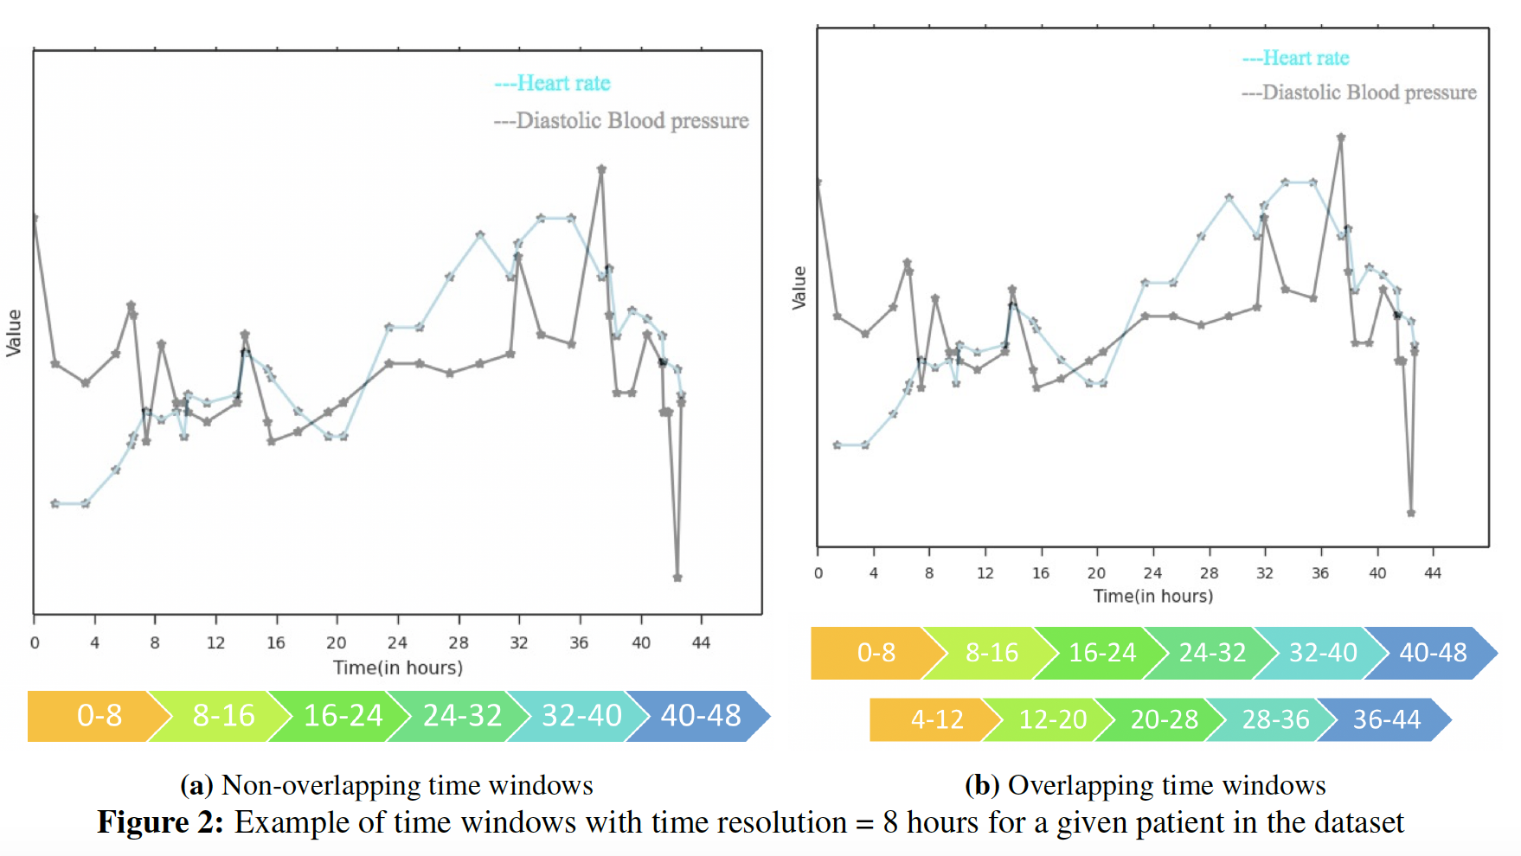
Visualization of Data for a single patient

Slide 8
Design choices
Number of states
Overlapping or non-overlapping time windows
Time Resolution
Stability of results

Slide 9
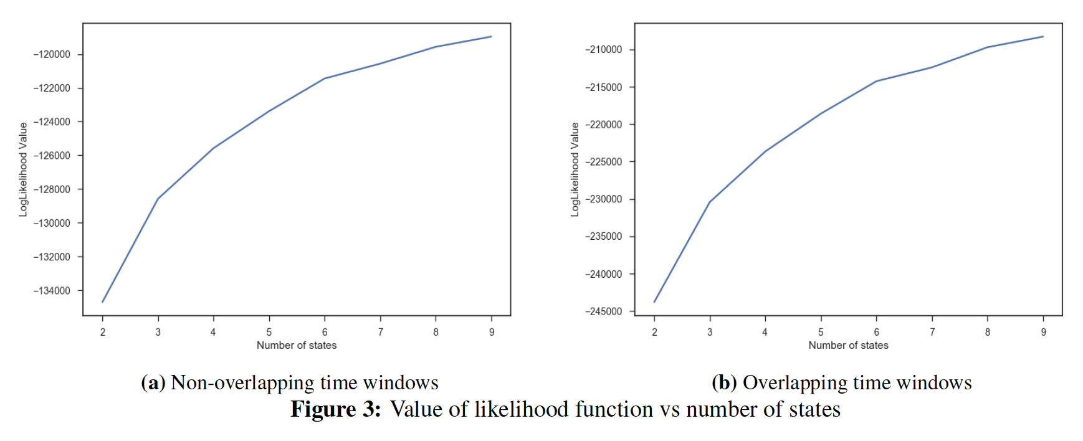
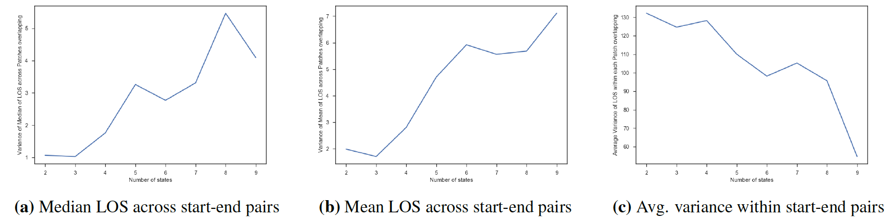
Optimum # of states

Slide 10
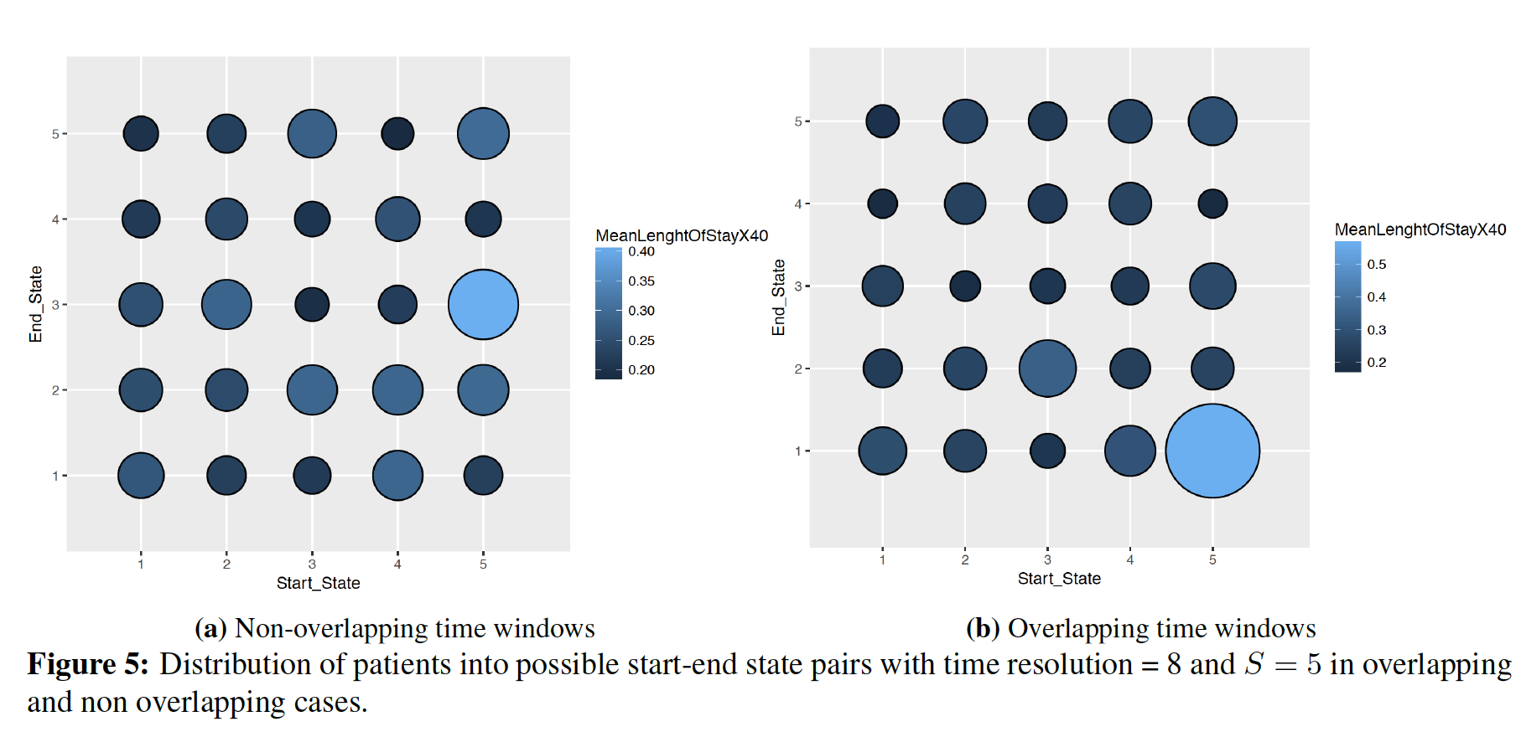
Overlapping or exclusive time windows

Slide 11
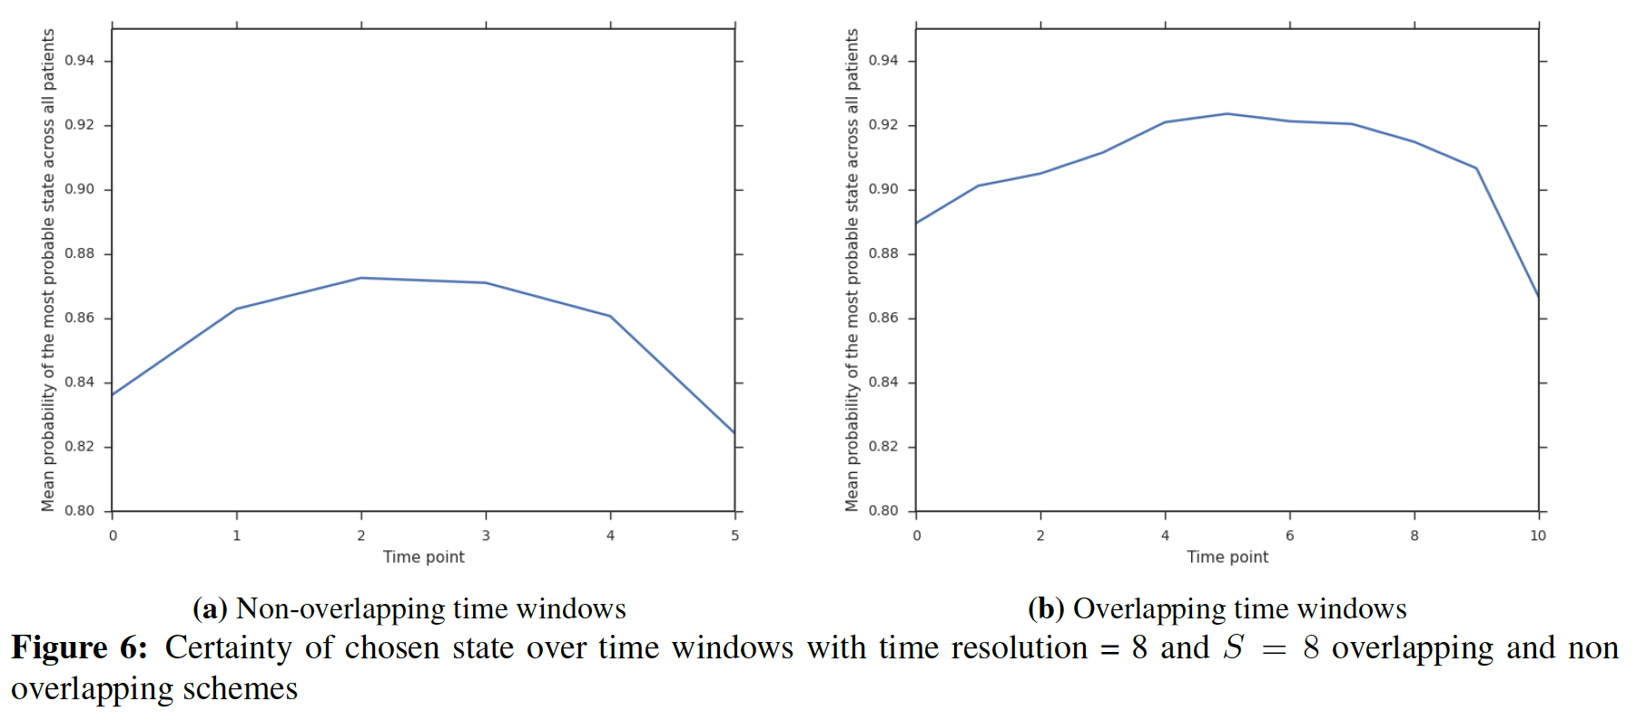
Overlapping edge - continued

Slide 12
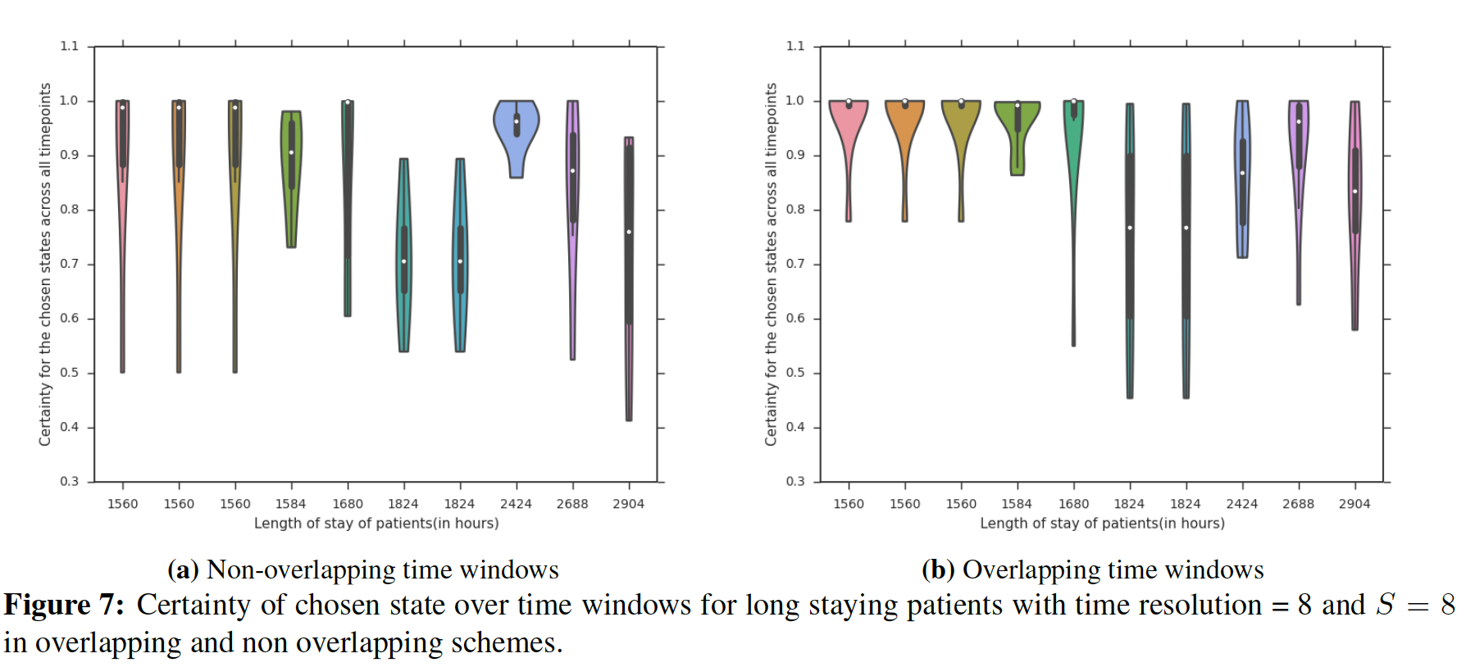
Overlapping edge-continued

Slide 13
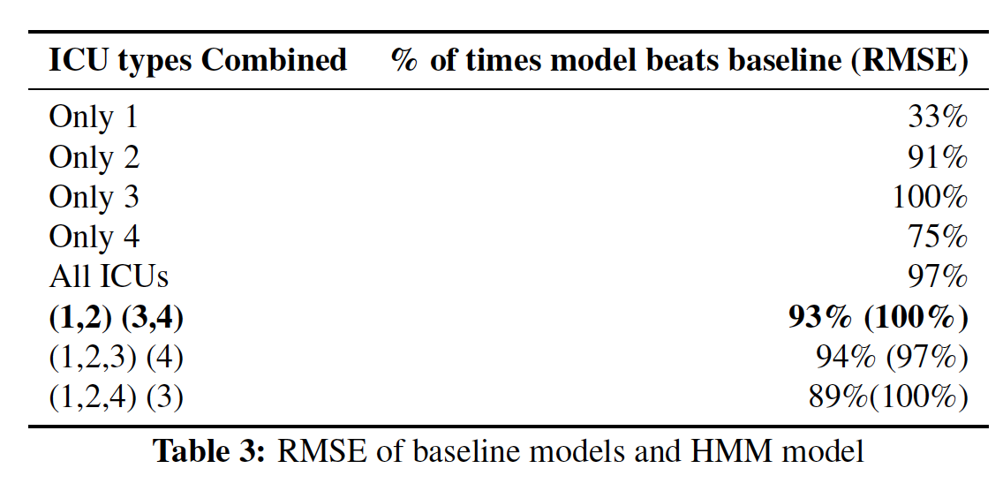
Combining ICU type

Slide 14
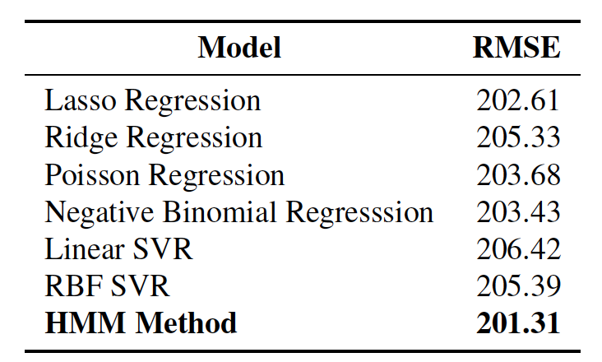
RMSE Comparison

Slide 15
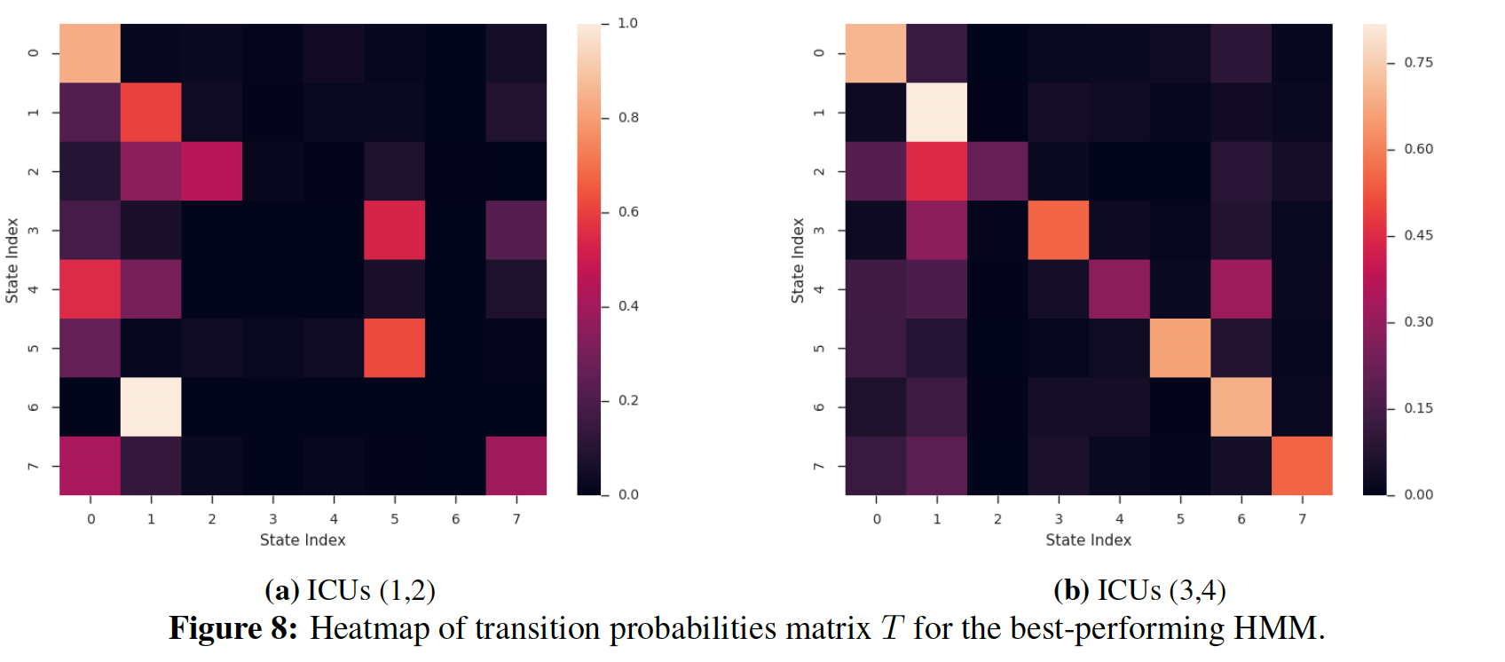
Interpretability

Slide 16
Future work
Checking patterns observed on the larger dataset MIMIC III.
Restraining the states to signify certain characteristics.
Comparison to Deep learning models.
Using multitasking with each task being a different ICU type

