Slide 1
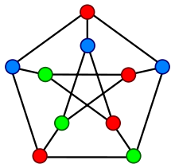
Distributed Graph Coloring
CS526 Spring 2017
Presenters: Mani Sotoodeh – Derek Onken – Reza Karimi

Slide 2
Modeling Distributed Processors as a Graph
Distributed Processors: Several processors working in parallel, typically on a joint problem.
Message-passing model of distributed computation
Nodes(vertices) are host processors , edges show connections.
Discrete rounds, running time is number of round to solve the joint problem.
Each round, a processor can send message to all its neighbors. No cap on number of messages.

Slide 3
Necessary Definition for formulating the problem
Girth: Minimum length of all simple cycles found in in graph G.
Chromatic number: minimum number of colors that can be used so that no two adjacent vertices have the same color.
Finding an optimal coloring that employs exactly chromatic number of colors is NP-hard.(even approximation with epsilon is as hard)
We restrict ourselves to ⍙ + 1 coloring where ⍙ is the maximum degree of a vertex in graph G.

Slide 4
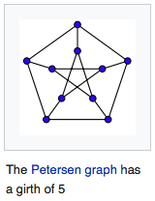
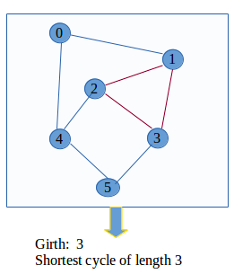
Examples for Girth

Slide 5
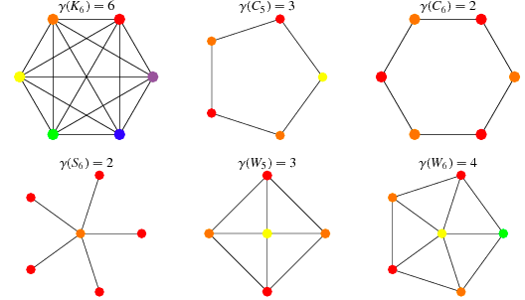
Chromatic Number Examples

Slide 6
Maximal independent set(MIS) and finding ⍙ + 1 coloring
Maximal not maximum. No new vertex in the remaining graph can be added to the set.
Greedy algorithms exist for both problems, but they are sequential in nature, and as a result cannot be used for to color a graph in a distributive manner.
Graphs with arbitrarily large girth and large chromatic number will come in handy.

Slide 7
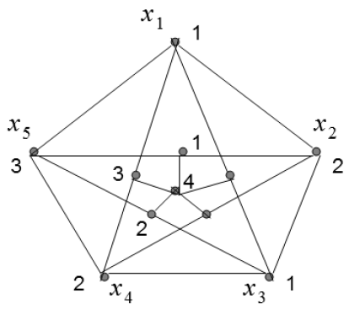
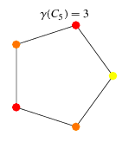
Some examples (triangle free(girth>=4) ) and chromatic number in the same order
Chromatic number = 4

Slide 8

Enhance the generalization for higher order(Mycielski’s construction)
Given a triangle free Graph G which is k colorable, generate a graph H which is K+1 colorable, and has 2n + 1 nodes. (find all paths of size 3 in which endpoints are not connected togethr through another vertex connect them, once no such a path exists, add another vertex connecting it to all newly created vertices)
5 cycle: 5 (3 colors)
Grotsch graph 4 colors : 5 + 5 + 1 = 11
Next one graph 5 colors : 11 + 11 + 1 = 23
More formally

Slide 9
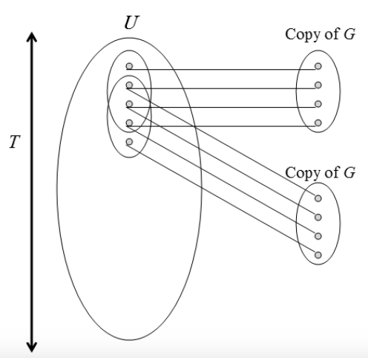

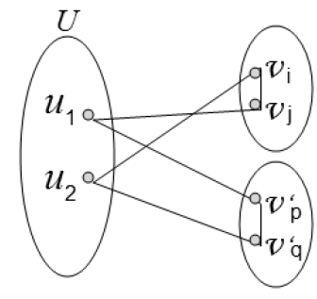
Descartes Construction(+ few details)
Given a graph G of girth at least 6 and chromatic number k, generate another graph H, with girth at least 6 and chromatic number k+1.

Slide 10
Important conclusions achieved so far…
2 explicit ways for generating graphs of arbitrarily large chromatic number. ( The intuition being that for a big graph with large girth locally looks like a tree and trees are easy to color)
Based on Ramanujan graphs and Erdos probabilistic proof of existence of such graphs, we can claim the following:
For every k, ℓ, there exists a graph G with girth(G) > k and χ(G) ≥ ℓ.
In simple English, one can generate graphs of arbitrarily large girth and chromatic number.

Slide 11
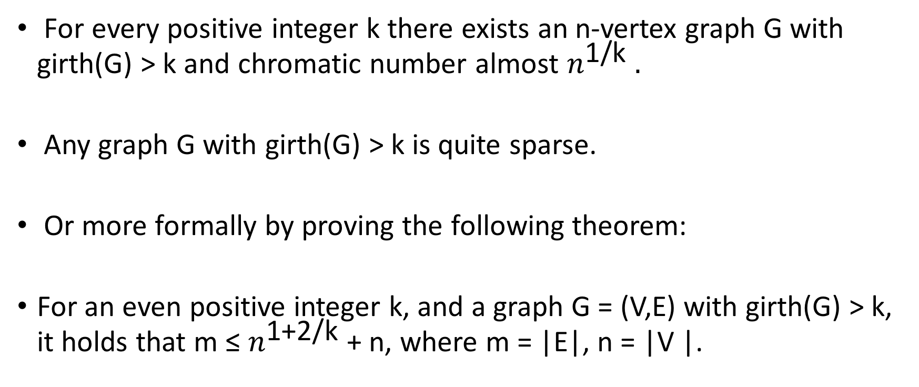
Further Lemmas concerning girth
For every positive integer k there exists an n-vertex graph G with girth(G) > k and chromatic number almost $n^{\text{1/}\text{k}} .$
Any graph G with girth(G) > k is quite sparse.
Or more formally by proving the following theorem:
For an even positive integer k, and a graph G = (V,E) with girth(G) > k, it holds that m ≤ $n^{\text{1+2/}\text{k}}$ + n, where m = |E|, n = |V |.

Slide 12
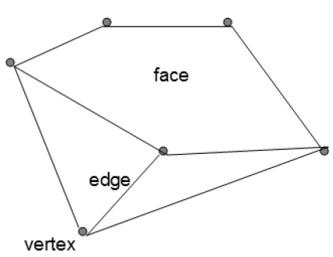
Planar Graphs
A graph with non touching edges
A plane graph is a specific drawing of a planar graph.
Face : a polygon whose boundary is a chordless cycle, no edge (vi, vj) between a pair of non-consecutive vi and vj within the cycle.

Slide 13
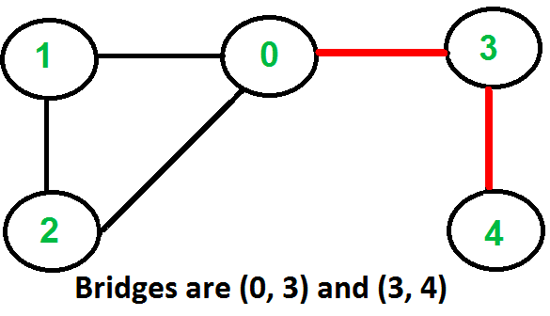

Bridge edge and some other preliminary results
(Euler’s formula) In a connected plane graph with n vertices, m edges, and f faces, it holds that n − m + f = 2
An edge e is a bridge edge in a graph G if G / {e} is not connected.
In a bridge free plane graph, every edge is adjacent to exactly two faces. On the other hand, a bridge edge is adjacent only to the outer face.
Suppose that G is bridgefree. Then:
Illustration on board about the above formula for the previous slide graph

Slide 14
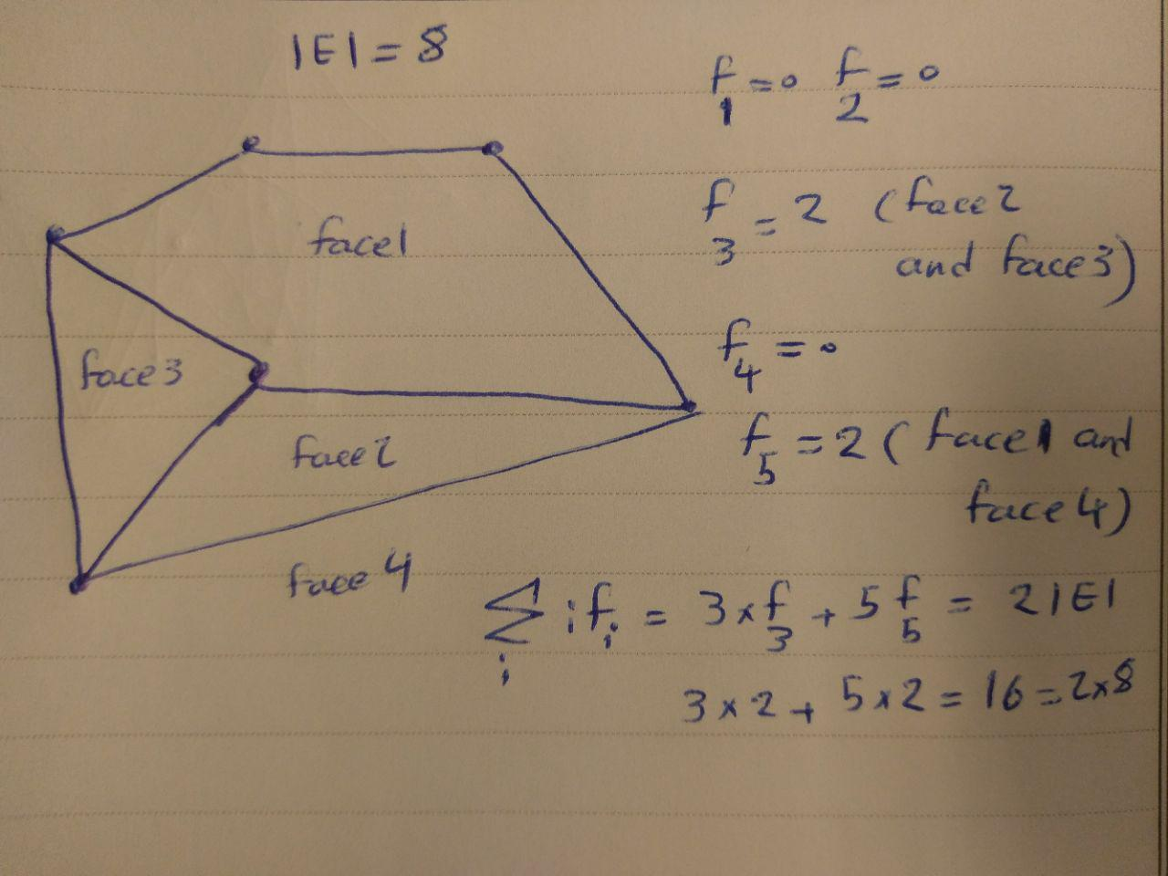
Illustration

Slide 15

More results on planar graphs and Arboricity
Two Approaches to define Arboricity (the two are equivalent Nash Williams Thorem)
1- Density of a Graph G(V,E)
2 - The arboricity a(G) is the minimum number a of edge-disjoint forests F1, F2, ..., Fa, whose union covers the entire edge set E of the graph G = (V,E). Such a decomposition is called an a-forest-decomposition of G.

Slide 16
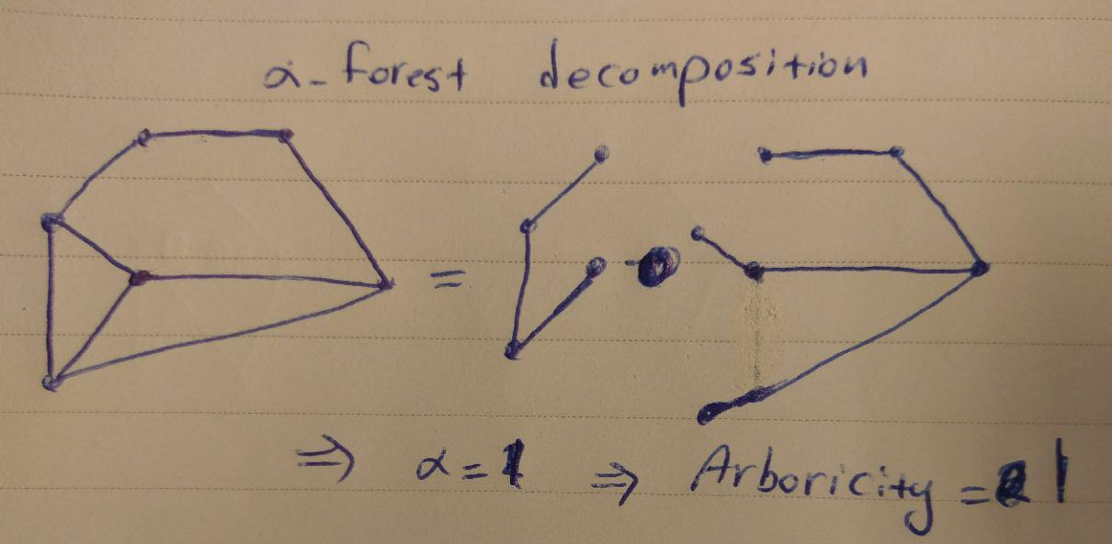
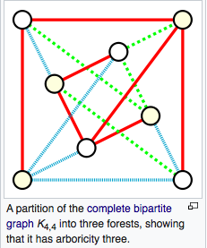
Two Examples of Arboricity

Slide 17
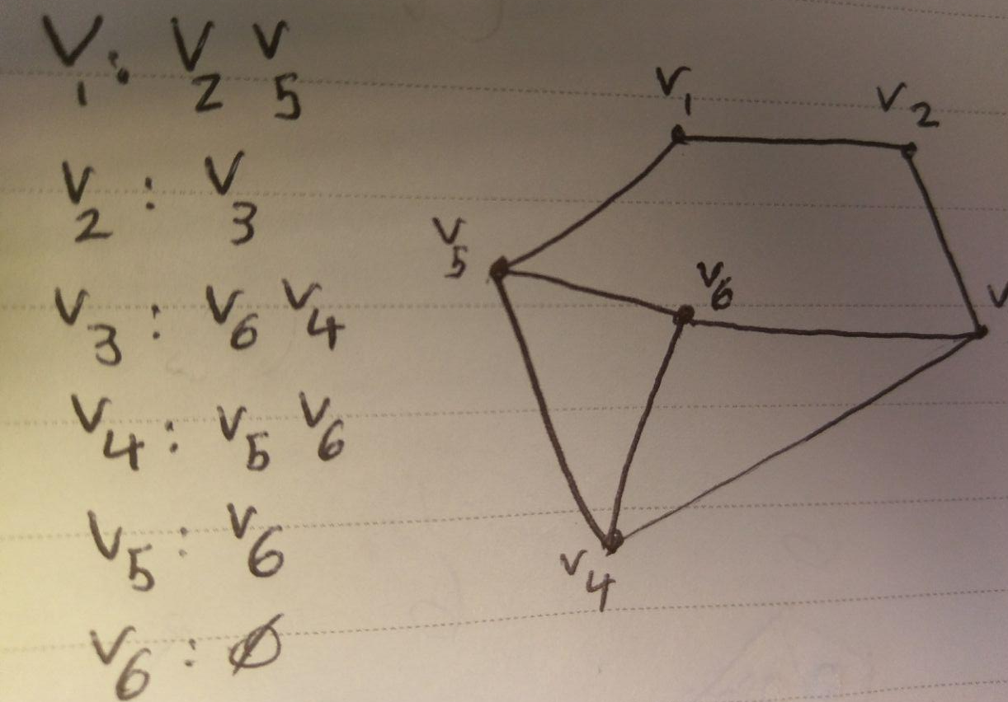

Degeneracy and coloring
For a graph G = (V,E), the degeneracy degen(G) is the minimum integer number d so that there exists an ordering of the vertex set of G, V = (v1, v2, ..., vn), such that for every index i ∈ [n − 1], vi has at most d neighbors with greater index.
Degen(G) = 2
Chromatic number = 3
3 <= 2+1

Slide 18
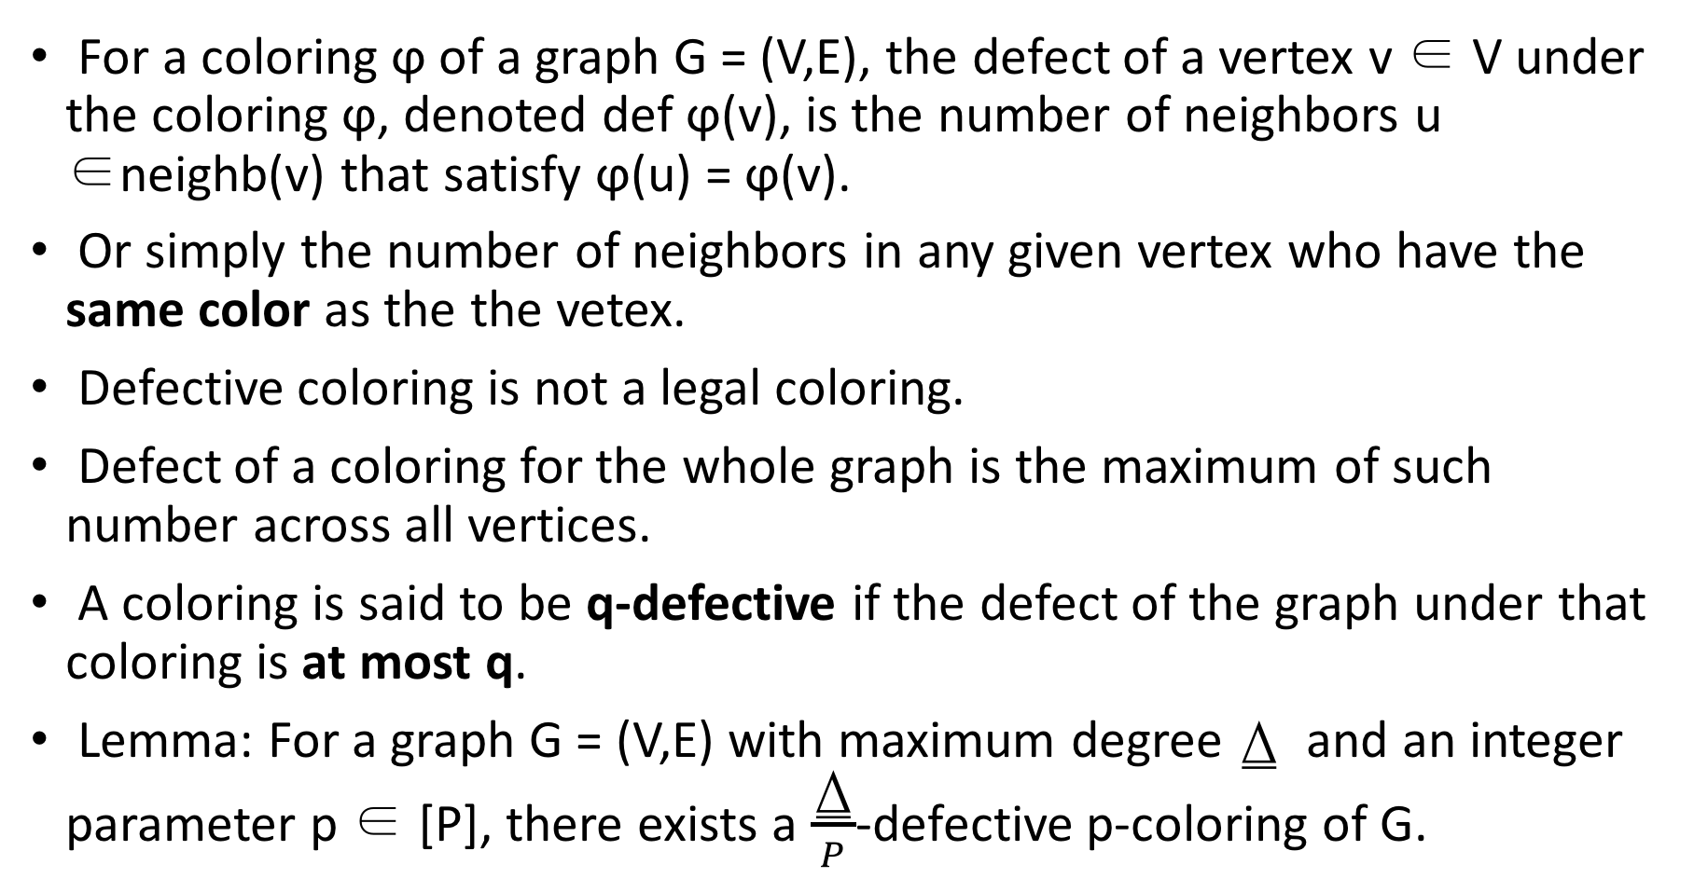
Defective Coloring, a relaxed notion of coloring
For a coloring ϕ of a graph G = (V,E), the defect of a vertex v ∈ V under the coloring ϕ, denoted def ϕ(v), is the number of neighbors u ∈neighb(v) that satisfy ϕ(u) = ϕ(v).
Or simply the number of neighbors in any given vertex who have the same color as the the vetex.
Defective coloring is not a legal coloring.
Defect of a coloring for the whole graph is the maximum of such number across all vertices.
A coloring is said to be q-defective if the defect of the graph under that coloring is at most q.
Lemma: For a graph G = (V,E) with maximum degree ⍙ and an integer parameter p ∈ [P], there exists a $\frac{\text{⍙}}{P}$-defective p-coloring of G.

Slide 19
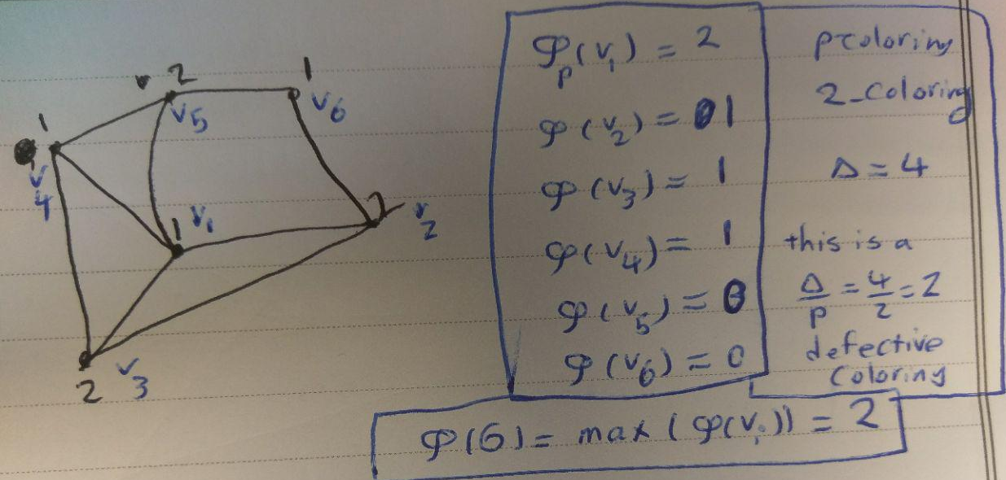
Illustration of defective coloring
2
1

Slide 20
The Distributed Message-Passing LOCAL Model
Message-passing model of distributed computation
Nodes(vertices) are host processors , edges show connections.
Static meaning its topology does not change during an execution of an algorithm
For each two vertices u, v ∈ V , there is an edge (u, v) ∈ E if and only if the two processors corresponding to u and v in the network are connected by a communication link.

Slide 21
LOOCAl model description continued
Each vertex has a unique identity number. These numbers are assumed to belong to the range {1, 2, ..., n}.
Initially, each vertex v knows only its identity number Id(v).
Specifically, a computation (or equivalently, an algorithm) starts simultaneously in all vertices, and proceeds in discrete rounds.
Computations that are performed locally are not taken into account in the running time analysis of distributed algorithms in this model.

Slide 22
Basic Color Reduction
Suppose we have a graph G = (V,E) with maximum degree , which is legally α-colored by a coloring ϕ, for some α ≥ +1.
reduces the number of colors to (⍙ + 1) within α − (⍙ + 1) rounds
In the first round each vertex v of color α recolors itself in parallel into an available color from the palette [⍙ + 1]. Specifically,
The set neighb(v) of neighbors of v is colored with at most ⍙ colors, i.e., |ϕ(􀀀(v))| ≤ ⍙ .
Using this prcedure we can reduce the number of colors to ⍙+1, reducing one color at each step.

Slide 23
Orientations
An orientation μ is an assignment of directions to the edges of G, where each edge (u, v) is directed either towards u or towards v.
If an orientation does not contain any oriented cycles,it is said to be an acyclic orientation.
Acyclic orientations turn out to be very useful for graph coloring.
A graph G with an acyclic orientation μ of length k can be colored using k + 1 colors in k + 1 rounds.

