Slide 1
SPOT 100.00 K 100.00 σ 20.00% r 5.00% T 1.00Y MODELS BSM · B76 · CRR · LR · MC · LSMC · PDE
> Internship Project
EUR CALL · K100 · 1Y
Derivative Pricing
Engine & Greeks
PRICE
10.4506
DELTA
0.6368
GAMMA
0.0188
VEGA /pt
0.3752
A Python platform that prices 7 option types on 7 engines, computes Greeks, runs scenarios and checks every number against an independent calculation.
THETA /d
−0.0176
RHO /1%
0.5323
Team 1 · Internship Project · October 2026
Manish Esuri, Arush Gupta, Nitish Singh, Alexander Zee, Shuarya Saxena, Vanditha Toleti, Naitik Patel
Notes:
Open with the one-line pitch: a pricing and risk engine, not a Black-Scholes script. The quote panel is real engine output for the running example used on every slide: S = K = 100, one year, r = 5%, vol = 20%, no dividend. Seven engines: Black-Scholes, Black-76, CRR, Leisen-Reimer, Monte Carlo, Longstaff-Schwartz and a finite-difference PDE.

Slide 2
00 / AGENDA
What we'll
cover.
01
Objective & scope
05
Scenario analysis
what was asked, what was delivered
full revaluation, and where Taylor fails
02
Architecture & data
06
Model validation
one interface, ten inputs
35 checks plus an independent audit
03
Pricing models
07
Live dashboard demo
closed form, trees, simulation, PDE
nine pages, one sidebar
04
Greeks engine
08
Findings & next steps
five Greeks for seven products
results, limits, roadmap
~15 min talk + 5 min demo + Q&A
DERIVATIVE PRICING ENGINE & GREEKS ·
02 / 34
Notes:
Keep this under 20 seconds. Flag that section 07 is a live demo. The story in one line: we built it, we proved the numbers, and we know where it is still wrong.

Slide 3
01 / OBJECTIVE
Build what a derivatives
quant desk actually uses.
PRICE
MEASURE
STRESS
PROVE
SHOW
7 option types
Δ Γ ν Θ ρ
46 shocks
35 checks
9-page app
for every product, in desk units, plus vanna, volga and charm
spot, vol, rate, time, barrier and correlation, all by full revaluation
automated harness across 11 model families, 365 unit tests passing
Next.js front end on a FastAPI layer; original Streamlit dashboard kept
European, American, futures, Asian, lookback, basket, barrier on 7 engines
Deliverables documented Python package · unit tests · web dashboard · validation harness · this deck
Who uses this: derivatives quants pricing a trade, model-validation teams checking it, and risk desks stressing it.
DERIVATIVE PRICING ENGINE & GREEKS ·
03 / 34
Notes:
Frame the problem: a single price is useless without sensitivities, stress tests and proof that it is right. Each card is one goal from the brief with what was delivered against it. The rest of the talk is the evidence.

Slide 4
02 / MODEL_MAP
One engine.
Seven products.
EUROPEAN
BSM
closed form · price + all 5 Greeks
AMERICAN
CRR / LR TREE + LSMC
early exercise · tree or fitted rule
FUTURES OPT
BLACK-76
F replaces S·e^((r−q)T) · no carry to model
ASIAN
MONTE CARLO
path average · geometric control variate
LOOKBACK
MONTE CARLO
path max / min · continuity correction
BASKET
MONTE CARLO
correlated assets · Cholesky
BARRIER
FD · PDE
knock-in / knock-out as a boundary
analytic
tree
Monte Carlo
PDE
DERIVATIVE PRICING ENGINE & GREEKS ·
04 / 34
Notes:
The key idea: each model exists because the previous one could not handle a contract feature. European has a closed form; early exercise needs a tree or a fitted exercise rule; futures use Black-76; path dependence needs Monte Carlo; a barrier is a boundary condition, which is what a PDE grid handles. The four colours follow through the deck.

Slide 5
02 / ARCHITECTURE
Instruments describe.
Engines price.
market_data/
→
calibration/
→
models/
→
scenario/
→
strategies/
→
validation/
→
api/
→
web/
BSM
BLACK-76
CRR
LR
MONTE CARLO
LSMC
FD · PDE
every engine implements →
price() delta() gamma() vega() theta() rho()
3,356
1,342
3,219
365
35
lines in the engine
lines of API, 14 endpoints
lines of front end, 9 pages
tests in 15 files, all passing
validation checks
Design rule: the dashboard and API contain no pricing maths. Units are fixed across engines: vega per vol point, theta per day, rho per 1%.
DERIVATIVE PRICING ENGINE & GREEKS ·
05 / 34
Notes:
Two input records describe the trade and the market; engines are interchangeable algorithms behind one six-method interface. That is what lets the same option be priced by several engines, which is the basis of validation. The web layer holds no pricing maths, so every layer is unit-testable on its own.

Slide 6
PHASE 1 / MARKET_DATA
Ten inputs.
Each one can
break a price.
Underlying price
332.89 Yahoo last price
Strike · expiry
335 · 13-Nov-2026 (38 d, nearest to a 36-day target)
Risk-free rate
4.02% 13-week T-bill (^IRX)
Dividend yield
0.32% vendor field cross-checked vs trailing 12 m (0.318%)
Implied volatility
solved per strike with Brent on the mid
Source Yahoo Finance (yfinance)
Snapshot AAPL · 06-Oct-2026 · 53 raw quotes
Realised volatility
24.8% from 251 daily closes
Market option price
mid of bid/ask; last trade only if no bid
INSIGHT
Bid-ask spread
kept if ≤ 15% of mid
Outside US hours Yahoo reported open interest of 0 on all 53 rows, so the liquidity filter kept none. A filter is only as good as the hour the data was pulled.
Volume · open interest
kept if volume ≥ 5 and OI ≥ 20
Sanity filters
moneyness 60–140%, inside no-arbitrage bounds
DERIVATIVE PRICING ENGINE & GREEKS ·
06 / 34
Notes:
Data is where these projects die. Three things the collector does that a naive script does not: it prices off the bid-ask mid, it cross-checks the vendor dividend yield against the trailing dividend history instead of guessing the unit, and it rejects quotes outside no-arbitrage bounds. Be honest about the overnight result: Yahoo reported zero open interest on every row outside US hours, so the liquidity filter removed the whole chain. The filter needs market-hours data.

Slide 7
PHASE 3 / CLOSED_FORM
Closed form: the benchmark
every other engine must match.
BLACK-SCHOLES-MERTON
CALL VALUE vs SPOT
C = S·e^(−qT)·N(d₁) − K·e^(−rT)·N(d₂)
d₁ = [ln(S/K)+(r−q+½σ²)T] / σ√T d₂ = d₁ − σ√T
CALL
PUT
PARITY
IV(11.00)
10.4506
5.5735
exact
21.46%
Vectorised precomputation: all six outputs share the same normal evaluations.
Zero volatility is handled explicitly instead of silently defaulting to 20%.
The implied-vol solver returns no value for a price outside no-arbitrage bounds.
Time value is widest at the strike and decays toward intrinsic.
DERIVATIVE PRICING ENGINE & GREEKS ·
07 / 34
Notes:
This is the engine everything else is tested against. Running example: call 10.4506, put 5.5735; put-call parity holds to machine precision. The implied-volatility solver uses Brent: a market price of 11 inverts to 21.46%. Chart: value is convex in spot and sits above intrinsic; the gap is time value, widest at the strike and shrinking as expiry approaches.

Slide 8
PHASE 3 / GREEK_PROFILES
Gamma concentrates at the
strike as expiry approaches.
DELTA vs SPOT
GAMMA vs SPOT
At-the-money gamma 0.0188 at 1 year → 0.0896 at 18 days: 4.8× the hedging sensitivity for the same contract.
Units on every engine: vega per 1 vol point · theta per calendar day · rho per 1% of rate
DERIVATIVE PRICING ENGINE & GREEKS ·
08 / 34
Notes:
Two views of the same engine at three maturities. Delta is a smooth S-curve at one year and sharpens toward a step near expiry. Gamma peaks at the money and the peak grows as time shrinks: that is the pin risk a desk hedges. Units are fixed across every engine in the project.

Slide 9
PHASE 5 / BLACK_76
One model. Two questions:
spot Greeks or futures Greeks.
BLACK-76 · FUTURES OPTIONS
DELTA vs UNDERLYING, K = 100
C = e^(−rT)·[F·N(d₁) − K·N(d₂)]
STOCK MODE
INDEX / COMMODITY
F = S·e^((r−q)T)
F quoted = 100
price
10.4506
price
7.5771
delta
0.6368
delta
0.5135
rho
0.5323
rho
−0.0758
Stock mode matches Black-Scholes to 1e-14; futures parity residual is 0e+00.
Futures rho = −T·V/100: a future has no carry to offset discounting.
Futures delta is capped at e^(−rT) = 0.951, not 1.
DERIVATIVE PRICING ENGINE & GREEKS ·
09 / 34
Notes:
Black-76 is Black-Scholes written on the forward, so carry never has to be estimated. The engine has two explicit modes. With no futures price, the forward is derived from spot and the model equals Black-Scholes exactly. With a quoted future, the Greeks are futures Greeks: delta is capped at the discount factor and rho is minus T times the value, negative for calls and puts alike. Mixing the two conventions was a defect in the draft; the mode is now explicit and selectable as Stock, Index or Commodity in the app.

Slide 10
PHASE 4 / AMERICAN_OPTIONS
51 Leisen-Reimer steps beat
1,001 CRR steps on accuracy.
> crr(n=1001) vs lr(n=51)
ABSOLUTE ERROR vs STEPS (log-log)
LR ERROR @ 51
CRR ERROR @ 1,001
0.00013
0.00175
European call vs BSM
13× larger, 20× the steps
At 201 steps LR is about 1,000× more accurate than CRR (error 0.000009 vs 0.0087).
American put 6.0903 vs European 5.5735: early-exercise premium 0.517.
American call 10.4506 = European 10.4506: with no dividend, early exercise is never optimal.
With early exercise LR loses its second-order rate, so the benchmark there is a 2,001-step tree.
Slope −1 for CRR, −2 for Leisen-Reimer.
DERIVATIVE PRICING ENGINE & GREEKS ·
10 / 34
Notes:
CRR oscillates between odd and even step counts with an error that falls like one over N. Leisen-Reimer chooses the up-probability so the tree matches the normal at d1 and d2, and converges at second order. LR at 51 steps has an error of 0.00013; CRR at 1,001 steps is still 0.00175. At 201 steps the gap is about a thousand times. The American put is worth 6.0903 against 5.5735 European, an early-exercise premium of 0.517. The American call equals the European call because there is no dividend: that is one of the validation tests.

Slide 11
PHASE 4+ / LONGSTAFF_SCHWARTZ
American options by simulation,
with an honest bias.
PAPER TEST · S36 K40
RUNNING PUT
EARLY-EXERCISE BOUNDARY, AMERICAN PUT
4.481
6.058
±0.006. Paper 4.472, 50 dates. American tree 4.486
±0.012. Tree 6.090: 0.5% low by design
Same paths 6.071 biased high · fresh paths 6.055 biased low
Rule fitted on one path set, priced on another: a lower bound that tightens as the rule improves.
European option on the same paths as a control variate.
Greeks reuse the fitted rule with common random numbers, so bumps are not refitted.
Fixes the notebook's double discounting, which read 5.92 on a 6.09 contract.
The fitted rule tracks the tree near expiry, where exercise happens.
DERIVATIVE PRICING ENGINE & GREEKS ·
11 / 34
Notes:
Simulating an American option needs an exercise rule. Longstaff-Schwartz fits one by regressing discounted future cash flows on Laguerre polynomials of the price, using in-the-money paths only. Fitting and pricing on the same paths lets the rule see each path's future and biases the price up, so the rule is fitted on one set of paths and priced on a fresh set, which gives a lower bound. On the original paper's test case the engine gives 4.481 against the paper's 4.472. On the running example it reads 6.058 against 6.090 from the tree, about half a percent low by design. This was listed as future work in the brief's guide; it is now delivered.

Slide 12
PHASE 6 / MONTE_CARLO
Variance reduction is where
the real work is.
EUROPEAN CALL: ESTIMATE AND 95% BAND vs PATHS
ANTITHETIC
CONTROL VARIATE
÷2.1
÷746
variance, Asian call
variance; error ÷27
Exact log-normal stepping: no discretisation error in the marginals.
Common random numbers for every bumped Greek, so the noise cancels.
Error bars measured on antithetic pairs; counting 2n paths overstated precision by 37%.
A 40-seed study confirmed no bias and correctly sized error bars.
The band narrows as 1/√N and always contains the closed form.
DERIVATIVE PRICING ENGINE & GREEKS ·
12 / 34
Notes:
Monte Carlo error falls like one over root N: four times the paths to halve the error. Antithetic paths roughly halve the variance. The geometric-average Asian has a closed form and tracks the arithmetic payoff almost perfectly, so as a control variate it cuts the variance about 746 times, a standard error 27 times smaller on the same paths. One correction mattered: with antithetic paths the standard error must be computed on pair averages, or the error bar is overstated by about 37%.

Slide 13
PHASE 6 / EXOTICS
Path-dependent products
need the whole path.
ASIAN
LOOKBACK
BASKET
BASKET CALL vs CORRELATION
5.7825
17.2168
9.1657
±0.0009 · 252 fixings. Vanilla 10.45: 45% cheaper
closed form. MC raw 16.61 → corrected 17.22
ρ = 0.5, 3 assets. Levy approx 9.13
Asian: an average swings less than a terminal price, so the option is cheaper and has 41% less vega.
Lookback: a discrete path misses extremes between dates, a one-sided bias that never averages out.
Basket: value is a direct bet on how together the assets move.
ρ 0 → 0.8 lifts the price 7.46 → 10.02.
DERIVATIVE PRICING ENGINE & GREEKS ·
13 / 34
Notes:
Each product depends on something the terminal price cannot give: the average, the extreme, or several correlated assets. Asian: 5.7825 with 252 daily fixings, 45% cheaper than the vanilla because an average moves less. Lookback: the closed form is 17.2168; the raw discrete simulation reads 16.61, 3.5% low, because it cannot see an extreme between observation dates; the continuity correction fixes it. Basket: the price rises from 7.46 to 10.02 as correlation goes from 0 to 0.8, so the holder is long correlation.

Slide 14
PHASE 7 / FINITE_DIFFERENCE
The barrier is
just a boundary.
UP-AND-OUT CALL vs BARRIER LEVEL
UP-AND-OUT, H=120
UP-AND-IN, H=120
1.1756
9.2750
closed form 1.1761
vanilla minus knock-out
IN + OUT
MC · BROWNIAN BRIDGE
10.4506 ✓
1.1750
vanilla 10.4506
±0.0092
Crank-Nicolson on a 240 × 300 grid ending at H, where V = 0.
576 barrier prices checked against Reiner-Rubinstein: all within 0.2% of the vanilla.
A barrier at 120 cuts the call from 10.45 to 1.18.
DERIVATIVE PRICING ENGINE & GREEKS ·
14 / 34
Notes:
A barrier is a boundary condition, which is what a grid handles naturally. The solver is Crank-Nicolson on a grid that ends at the barrier, where the value is zero; the grid is sized automatically from the distance to the barrier. In-out parity is the built-in test: knock-in plus knock-out equals the vanilla. The PDE gives 1.1756 against the closed form 1.1761; a Brownian-bridge simulation agrees within its error. Be honest: Rannacher start-up steps are not implemented yet, and barrier gamma very close to the barrier is not reliable.

Slide 15
PHASE 8 / GREEKS_ENGINE
Greeks across products.
PRODUCT
ENGINE
DELTA
GAMMA
VEGA /pt
THETA /d
RHO /1%
European call
BSM
0.6368
0.0188
0.3752
−0.0176
0.5323
American put
LR tree, 501
−0.4111
0.0230
0.3749
−0.0061
−0.3025
Futures call
Black-76
0.5135
0.0189
0.3776
−0.0093
−0.0758
Asian call
MC, 252 fixings
0.5879
0.0317
0.2197
−0.0094
0.2449
Lookback call
MC, floating
0.1726
0.0000
0.6801
−0.0250
0.4657
Barrier UO 120
PDE
−0.0237
−0.0055
−0.1328
0.0035
0.0076
Basket call
MC, 3 assets
0.6468
0.0215
0.3080
−0.0161
0.5548
The up-and-out call is short delta, gamma and vega: more volatility raises the chance of a knock-out.
The lookback has zero gamma because its value scales with spot; the Asian has 41% less vega than the vanilla.
DERIVATIVE PRICING ENGINE & GREEKS ·
15 / 34
Notes:
One row per product, same market inputs, same units. Analytic where a closed form exists; read off the lattice for trees; bump-and-revalue with common random numbers for simulation and the PDE. Three things to point at: the up-and-out call is short delta, gamma and vega, so more volatility hurts it; the lookback has zero gamma because its value scales with spot; and the Asian carries about 41% less vega than the vanilla.

Slide 16
PHASE 9 / SCENARIO_ANALYSIS
What breaks, and how badly.
−10%
−5%
−1%
0
+1%
+5%
+10%
VOL −10
−8.77
−6.72
−4.34
−3.65
−2.92
+0.28
+4.76
VOL 0
−5.36
−2.94
−0.63
0.00
+0.65
+3.41
+7.21
VOL +10
−1.79
+0.82
+3.16
+3.78
+4.41
+7.05
+10.61
RATES ±100bp
TIME 1d · 7d · 30d
BASKET ρ 0.5 → 0.2 / 0.8
BARRIER 120 ±5%
−0.53 / +0.54
−0.02 · −0.12 · −0.53
−0.97 / +0.85
−0.79 / +1.21
Worst cell: spot −10% with vol −10 points loses 8.77, which is 84% of the 10.45 premium.
P&L per unit of one long ATM call; basket and barrier tiles are for those products. Full revaluation throughout.
DERIVATIVE PRICING ENGINE & GREEKS ·
16 / 34
Notes:
Every cell is a full reprice of one long at-the-money call, not a Greek extrapolation. Point at the worst cell: spot down 10% with volatility down 10 points loses 8.77, which is 84% of the premium. The four tiles underneath are the other shocks the brief asks for, including the two product-specific ones: basket correlation and the barrier level.

Slide 17
PHASE 10 / DELTA_GAMMA
Near a barrier, the Taylor
approximation breaks.
UP-AND-OUT CALL (H=120): P&L vs SPOT MOVE (%)
ACTUAL @ +20%
DELTA-GAMMA @ +20%
−1.18
−1.58
knocked out: the full premium
135% of the premium
A long option cannot lose more than its premium; the approximation says it can.
On the vanilla call the same estimate is off by 0.77 at +20% and 0.39 at −20%.
The error grows with move size, near expiry and near a barrier, which is where risk matters most.
Past the barrier the option is gone; the quadratic keeps falling.
DERIVATIVE PRICING ENGINE & GREEKS ·
17 / 34
Notes:
A delta-gamma estimate is fine for small moves on a vanilla. For the up-and-out call it is not. At plus 20% the option is knocked out and loses its whole premium of 1.18; delta-gamma predicts a loss of 1.58, more than the option is worth. Even the vanilla is off by 0.77 at plus 20%. That gap is exactly why the scenario engine reprices in full instead of trusting the Greeks.

Slide 18
PHASE 13 / VALIDATION
Eight checks.
8 / 8 passing.
PUT–CALL PARITY
PASS
NO-ARBITRAGE BOUNDS
PASS
4.8771 = 4.8771
4.877 ≤ 10.4506 ≤ 100
AMERICAN ≥ EUROPEAN
PASS
CRR CONVERGENCE
PASS
35 harness checks, all passing
11 model families
365 unit tests passing
6.0903 ≥ 5.5735
err 0.0018 @ N=1001
LR CONVERGENCE
PASS
MONTE CARLO
PASS
err 0.0001 @ N=51
|MC − BSM| = 0.5 SE
18 invariants · 9 closed-form · 8 cross-model. The harness reruns live in the app on the contract in the sidebar.
STABLE GREEKS
PASS
BARRIER BEHAVIOUR
PASS
analytic vs bump < 0.01%
1.1756 + 9.2750 = vanilla
DERIVATIVE PRICING ENGINE & GREEKS ·
18 / 34
Notes:
A number is not a validated number. The eight checks are the ones the brief lists, each with the value the engine produced. Behind them is a harness of 35 checks across 11 model families, of three kinds: compared with an independent formula, compared between two methods that share no code, or a relationship that must hold under no-arbitrage alone. It reruns live in the app against whatever contract is in the sidebar. 365 unit tests pass.

Slide 19
PHASE 13+ / INDEPENDENT_AUDIT
We audited our own engine.
Prices hold; some Greeks do not.
1,472
closed-form, tree and PDE comparisons
160
simulation comparisons + 40-seed study
8
real tickers, incl. AAPL, TSLA, S&P 500
HOLDS
OPEN ISSUES FOUND
BSM and Black-76: price and Greeks exact on all 144 cases each.
Leisen-Reimer prices within 0.1%; CRR within 0.24%.
All 576 barrier PDE prices within 0.2% of the vanilla.
Monte Carlo: no bias over 40 seeds; error bars the right size.
Barrier gamma close to the barrier: +0.154 where the true value is −0.0035.
Lookback 0.3–0.4% high at 62 steps; gone at 252.
Very small knock-in prices inherit the knock-out grid error.
A fixed seed leaves the plain Asian estimate 2.5 standard errors low; the control variate is right.
Knowing where a model fails is part of validating it: each open issue has a reproducible case and a planned fix.
DERIVATIVE PRICING ENGINE & GREEKS ·
19 / 34
Notes:
Beyond the built-in harness, every model was re-run on eight real tickers against formulas and simulations written separately, including Reiner-Rubinstein for all barrier types. Prices hold across the board. The audit also found things the harness missed, and they are listed here rather than hidden: barrier gamma is wrong close to the barrier, lookbacks read slightly high at coarse steps, and very small knock-in values are unreliable. Knowing where a model fails is as important as knowing where it works.

Slide 20
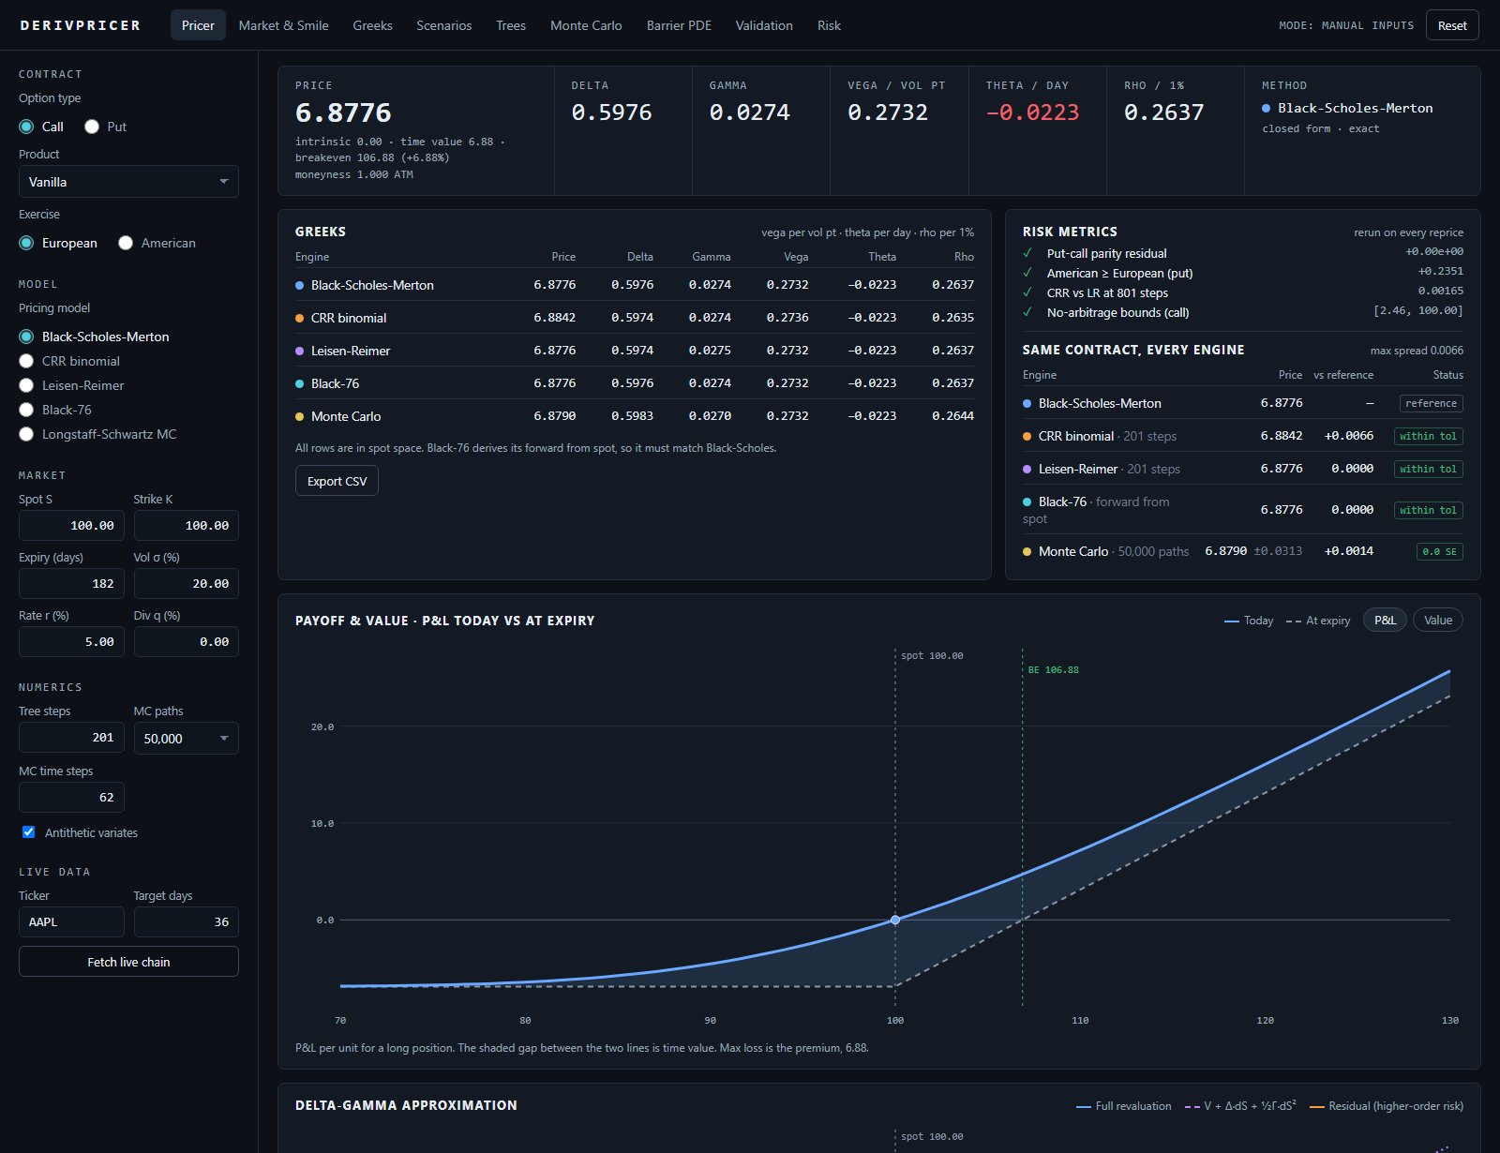
PHASE 12 / DASHBOARD
Live demo.
01
Pick option type, product and model
02
Enter market data, press Price
03
Price, Greeks and every engine side by side
04
Scenarios: spot × vol grid, shock ranking
05
Trees and Monte Carlo: convergence, American
06
Validation: the 35 checks, live
http://localhost:3000
Next.js + FastAPI · 9 pages · 14 endpoints
Pricer page: price and Greeks strip, Greeks by engine, risk metrics, P&L against payoff.
DERIVATIVE PRICING ENGINE & GREEKS ·
20 / 34
Notes:
Follow the six numbered steps in order; rehearse to about five minutes. Run on manual inputs so nothing depends on the network. Good live moment: switch Exercise to American and watch Black-Scholes and Black-76 switch off, the benchmark change to a tree, and the Monte Carlo page move to Longstaff-Schwartz. Keep this screenshot as the fallback.

Slide 21
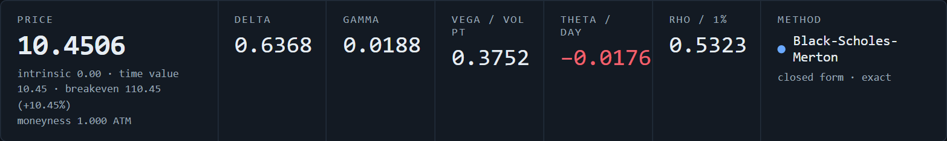
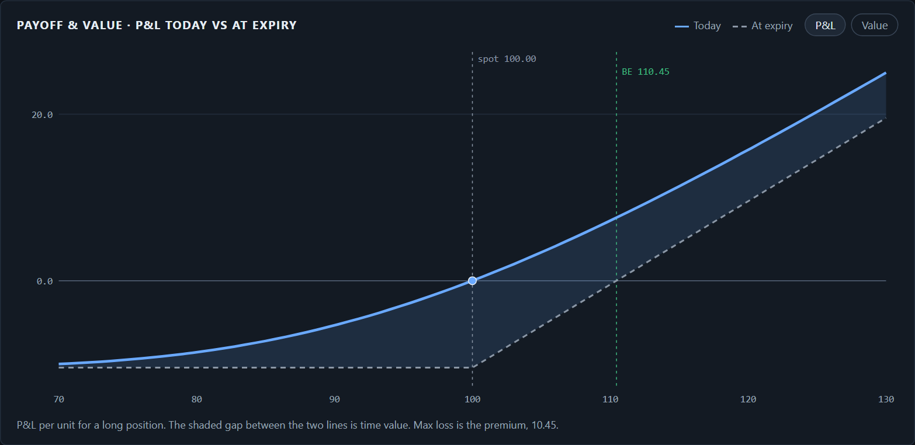
DASHBOARD 1 / BLACK_SCHOLES_MERTON
LIMIT one fixed volatility; no early exercise.
Black-Scholes: one formula, six numbers.
A closed-form price for a European option, which can be exercised only at expiry. It assumes a constant volatility and averages the discounted payoff. Use it for plain calls and puts, and as the yardstick for every other engine.
SET IN THE SIDEBAR, THEN PRESS PRICE
PRICER › price strip
Option type
Call
Product
Vanilla
Exercise
European
Pricing model
Black-Scholes-Merton
S 100 · K 100 · 365 d · σ 20% · r 5% · q 0%
PRICER › Payoff & value
WHERE TO LOOK, AND WHAT IT SHOWS
PRICER › price strip
Price 10.4506. Delta 0.6368, gamma 0.0188, vega 0.3752, theta −0.0176 per day, rho 0.5323.
PRICER › Payoff & value
Break-even 110.45; the most a buyer can lose is the 10.45 premium.
PRICER › Same contract, every engine
CRR 10.4593, Leisen-Reimer 10.4506, Monte Carlo 10.4549 ± 0.047.
SIDEBAR › Option type → Put
Price becomes 5.5735; put-call parity residual stays 0.
DERIVATIVE PRICING ENGINE & GREEKS ·
21 / 34
Notes:
Model: Black-Scholes-Merton is a formula, so there is no simulation or grid and the answer is exact under its assumptions. Dashboard: leave the sidebar on its defaults except Expiry 365 days and press Price. The strip across the top of the Pricer tab is the six outputs. Read them in words: the call costs 10.45; it moves 0.64 for a 1.00 move in the stock; it gains 0.38 per volatility point and loses 0.018 a day. The payoff chart underneath shows value today against payoff at expiry; the shaded gap is time value. The engine table on the right proves the trees and the simulation agree with the formula.

Slide 22
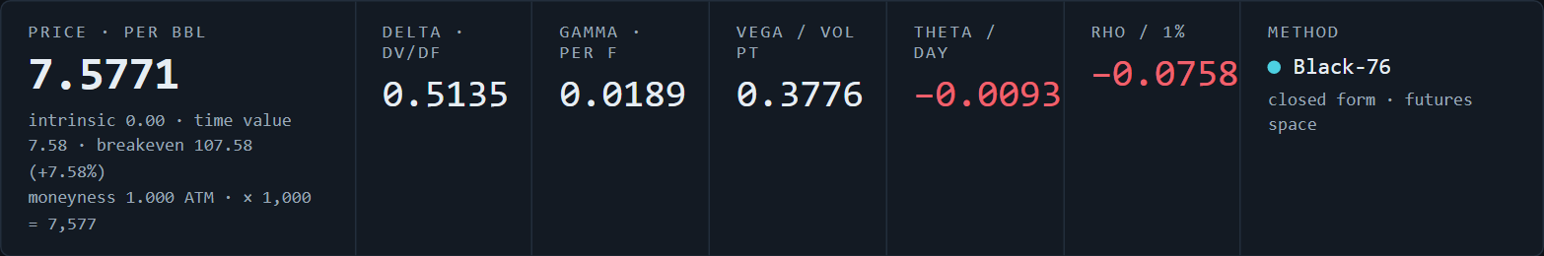
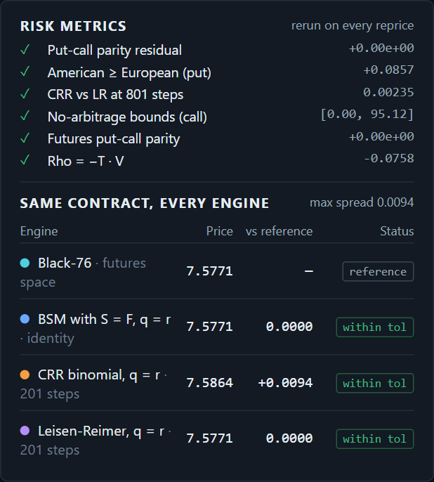
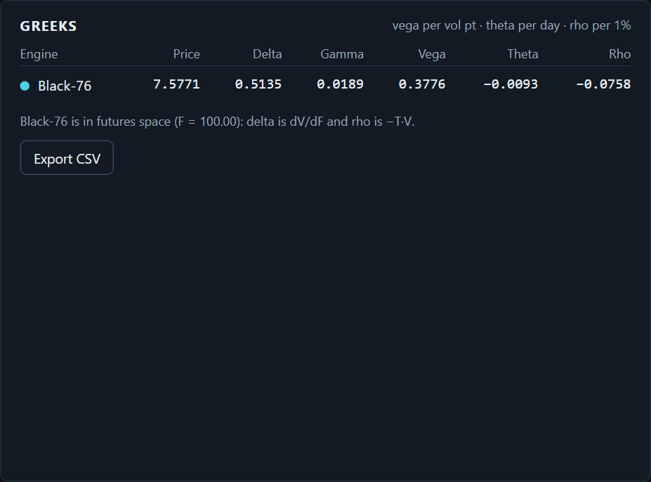
DASHBOARD 2 / BLACK_76
LIMIT European only; same fixed-volatility assumption.
Black-76: the same formula, written on a futures price.
A futures price already contains interest and dividends, so the model takes it as given and only discounts the payoff. Use it for options on index, commodity and rate futures. European exercise only.
SET IN THE SIDEBAR, THEN PRESS PRICE
PRICER › price strip
Pricing model
Black-76
Black-76 underlying
Commodity
Contract
WTI crude · CL
Futures F
100.00 (replaces Spot S)
Multiplier
1,000 (replaces Div q)
PRICER › Risk metrics
PRICER › Greeks
K 100 · 365 d · σ 20% · r 5%
WHERE TO LOOK, AND WHAT IT SHOWS
PRICER › price strip
7.5771 per barrel, × 1,000 = 7,577 per contract. Delta dV/dF 0.5135.
PRICER › price strip, Rho
−0.0758: negative, because a higher rate only discounts the payoff more.
PRICER › Risk metrics
Futures put-call parity 0; Rho = −T·V passes; BSM with S = F, q = r gives the same 7.5771.
SIDEBAR › Underlying → Stock
Forward is derived from spot and the price returns to 10.4506, equal to Black-Scholes.
DERIVATIVE PRICING ENGINE & GREEKS ·
22 / 34
Notes:
Model: Black-76 is Black-Scholes with the futures price in place of the stock price. Dashboard: choose Black-76 under Pricing model and a new block appears, Black-76 underlying, with three buttons: Stock, Index, Commodity. Pick Commodity and the Spot and Dividend fields are replaced by Futures F and Multiplier, and a Contract dropdown appears. With F = 100 the call is 7.58 against 10.45 for the stock, because a future has no upward drift from interest. Point at rho: it is negative, which never happens for a call on a stock. The Risk metrics card adds two futures-specific checks. Switching the underlying back to Stock returns exactly the Black-Scholes number.

Slide 23
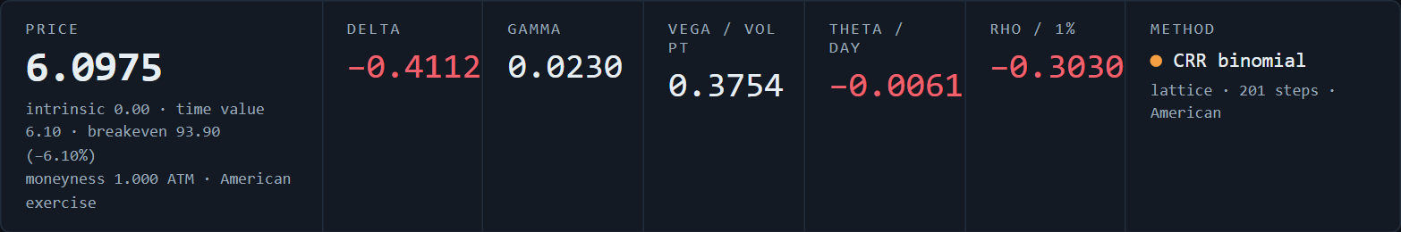
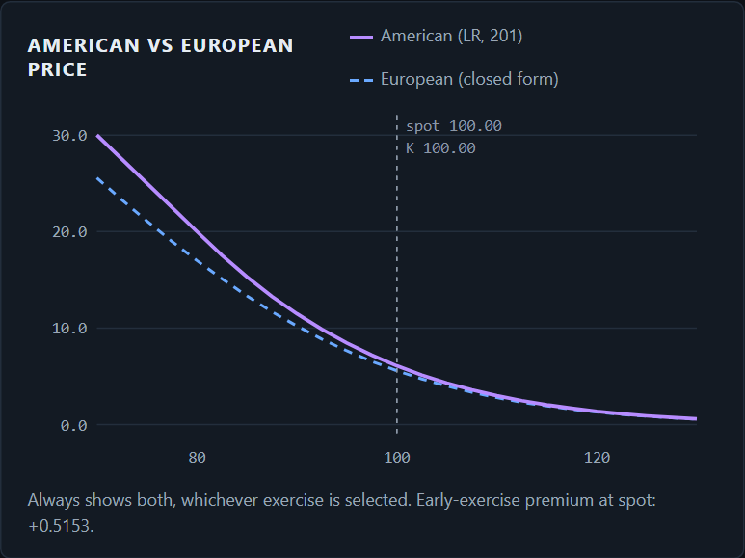
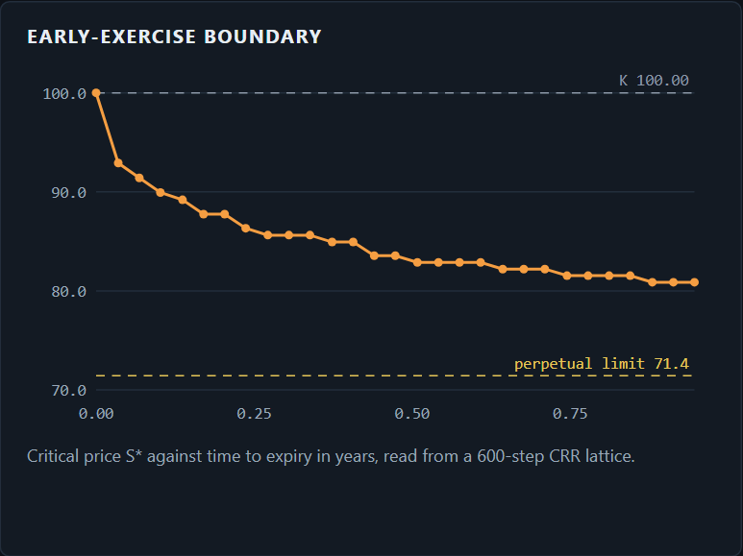
DASHBOARD 3 / CRR_BINOMIAL_TREE
LIMIT slow, uneven convergence: still 0.007 off at 201 steps.
CRR tree: the price of being allowed to exercise early.
At each step the stock moves up or down by a fixed proportion. The tree is solved backwards from expiry, and at every node it checks whether exercising now is worth more than waiting. Use it for American options.
SET IN THE SIDEBAR, THEN PRESS PRICE
PRICER › price strip
Option type
Put
Product
Vanilla
Exercise
American
Pricing model
CRR binomial
Tree steps
201
TREES › American vs European price
TREES › Early-exercise boundary
S 100 · K 100 · 365 d · σ 20% · r 5% · q 0%
WHERE TO LOOK, AND WHAT IT SHOWS
SIDEBAR › Pricing model
Black-Scholes and Black-76 switch off: a formula cannot decide when to exercise.
PRICER › price strip
6.0975, lattice · 201 steps · American. Delta −0.4112.
TREES › American vs European price
European put 5.5735. Early-exercise premium at spot +0.5153.
TREES › Early-exercise boundary
With a year left, exercise below about 80.9. Long-run floor 71.43.
DERIVATIVE PRICING ENGINE & GREEKS ·
23 / 34
Notes:
Model: the Cox-Ross-Rubinstein tree. Dashboard: select Put and American. The two closed-form models grey out with a note explaining why, which is a good live moment. The Pricer shows 6.0975 at 201 steps. Open the Trees tab: the page title changes to American exercise and every chart follows. American vs European price shows the two curves separating as the put goes in the money; the gap at spot is the early-exercise premium, about 0.52. The boundary chart shows the stock price below which exercising immediately is optimal. The convergence table at the bottom lists both trees against a 2,001-step reference.

Slide 24
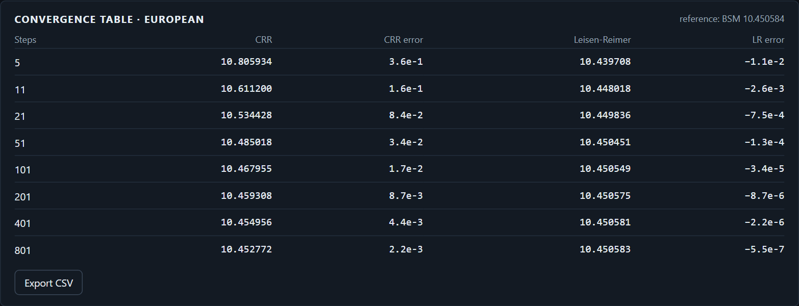
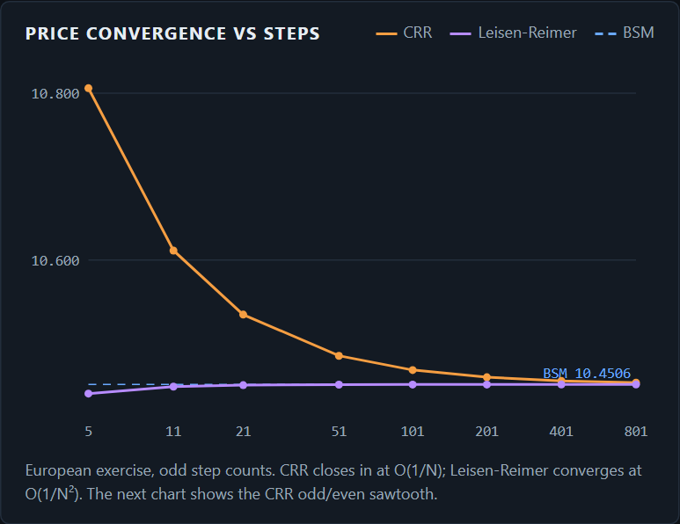
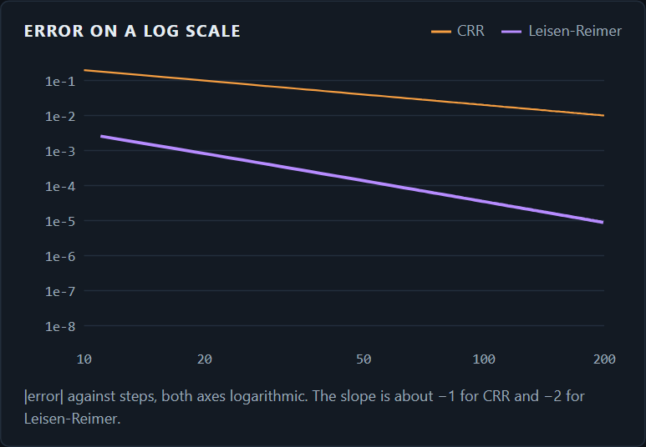
DASHBOARD 4 / LEISEN_REIMER_TREE
LIMIT with American exercise the gain drops to about 5× at 201 steps.
Leisen-Reimer: the same tree, far fewer steps.
A binomial tree whose up and down moves are chosen to centre it on the strike. That removes the odd-even jumps of the CRR tree. Use it wherever CRR is used, when accuracy matters more than simplicity.
SET IN THE SIDEBAR, THEN PRESS PRICE
TREES › Convergence table · European
Option type
Call
Exercise
European
Pricing model
Leisen-Reimer
Tree steps
201
S 100 · K 100 · 365 d · σ 20% · r 5% · q 0%
WHERE TO LOOK, AND WHAT IT SHOWS
PRICER › price strip
TREES › Price convergence vs steps
TREES › Error on a log scale
10.4506 at 201 steps: equal to Black-Scholes to four decimals.
TREES › Price convergence vs steps
CRR closes in slowly from above; Leisen-Reimer sits on the reference from 21 steps.
TREES › Error on a log scale
Slope about −1 for CRR and −2 for Leisen-Reimer.
TREES › Convergence table · European
Error at 51 steps: CRR 0.034, LR 0.00013. At 201 steps: CRR 0.0087, LR 0.000009.
DERIVATIVE PRICING ENGINE & GREEKS ·
24 / 34
Notes:
Model: Leisen and Reimer choose the up-probability so the tree reproduces the normal distribution terms at the strike, which gives second-order convergence. Dashboard: select Leisen-Reimer and open the Trees tab. The convergence chart shows CRR approaching slowly while Leisen-Reimer is flat. The log-scale chart is the evidence: two straight lines with slopes of about minus one and minus two. In the table, 11 Leisen-Reimer steps (error 0.0026) are already closer than 401 CRR steps (0.0044). Be honest about the limit: switch Exercise to American and the same table shows errors of 0.0014 against 0.0073 at 201 steps, a five-fold gain, not a thousand-fold one.

Slide 25
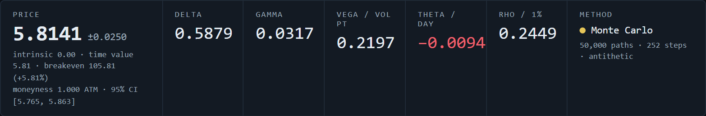
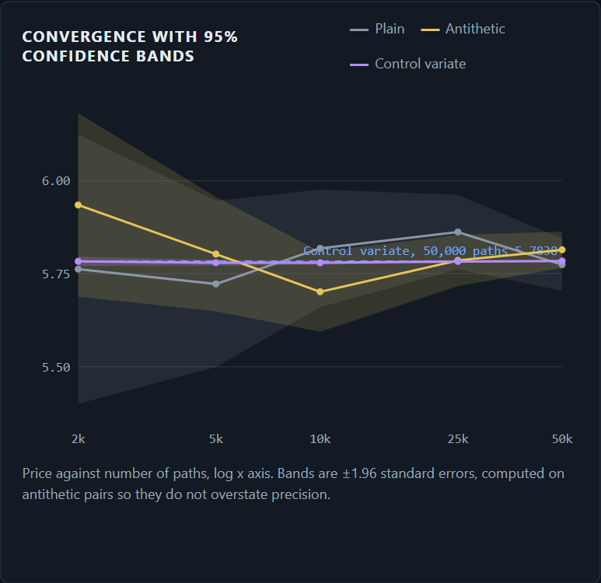
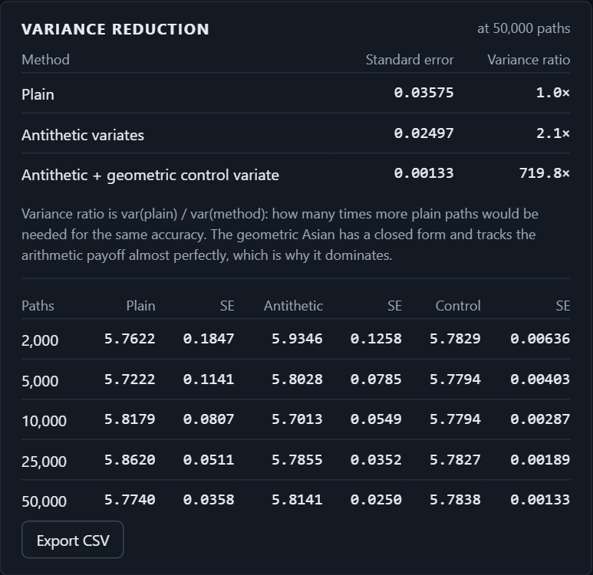
DASHBOARD 5 / MONTE_CARLO
LIMIT slow: seconds per price, where a formula takes a millisecond.
Monte Carlo: a price that comes with an error bar.
Simulate many possible paths of the stock, compute the payoff on each, average and discount. Use it when the payoff depends on the whole path. The example is an Asian call, which pays on the average price over the year.
SET IN THE SIDEBAR, THEN PRESS PRICE
PRICER › price strip
Product
Asian (average price)
Pricing model
Monte Carlo (only choice)
MC paths
50,000
Fixings
252
Antithetic variates
ticked
MONTE CARLO › Convergence with 95% bands
MONTE CARLO › Variance reduction
S 100 · K 100 · 365 d · σ 20% · r 5% · q 0%
WHERE TO LOOK, AND WHAT IT SHOWS
PRICER › price strip
5.8141 ± 0.0250, 95% interval 5.765 to 5.863. Vanilla call: 10.4506.
PRICER › Same contract, every engine
With the geometric control variate: 5.7838 ± 0.0013 on the same paths.
MONTE CARLO › Convergence, Variance reduction
Error bar ± 0.126 at 2,000 paths, ± 0.025 at 50,000. Variance ÷ 2.1 antithetic, ÷ 720 with the control variate.
SIDEBAR › Product → Lookback / Basket
Lookback 17.2628 ± 0.037 (closed form 17.2168). Basket, ρ 0.5: 9.1928 ± 0.037.
DERIVATIVE PRICING ENGINE & GREEKS ·
25 / 34
Notes:
Model: Monte Carlo prices by averaging simulated payoffs, and the error falls with the square root of the number of paths. Dashboard: choose Asian under Product. The model list shrinks to Monte Carlo and the numerics field is relabelled Fixings. The price strip now shows a plus-or-minus and a confidence interval. The Asian call is 5.81 against 10.45 for the vanilla, because an average moves less than a final price. Open the Monte Carlo tab: the first chart shows the band narrowing as paths are added; the second is the important one, where the control variate cuts the variance about 720 times on the same paths. Changing Product to Lookback hides the Strike field, because the payoff has no strike; Basket adds Assets and Correlation fields.

Slide 26
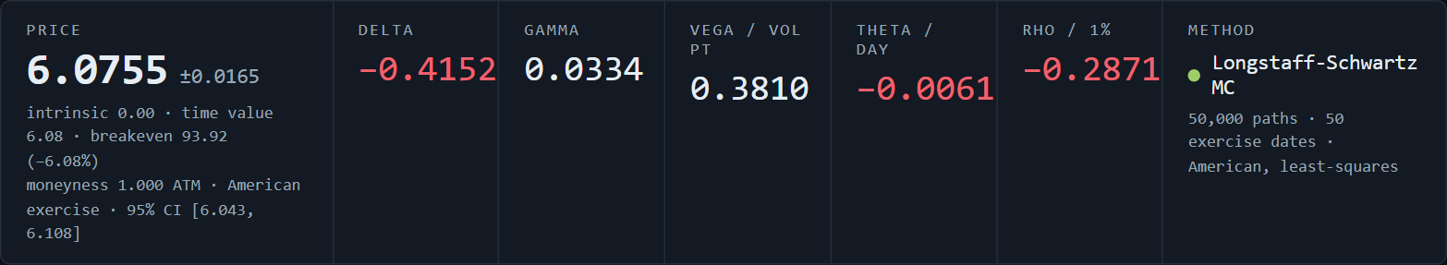
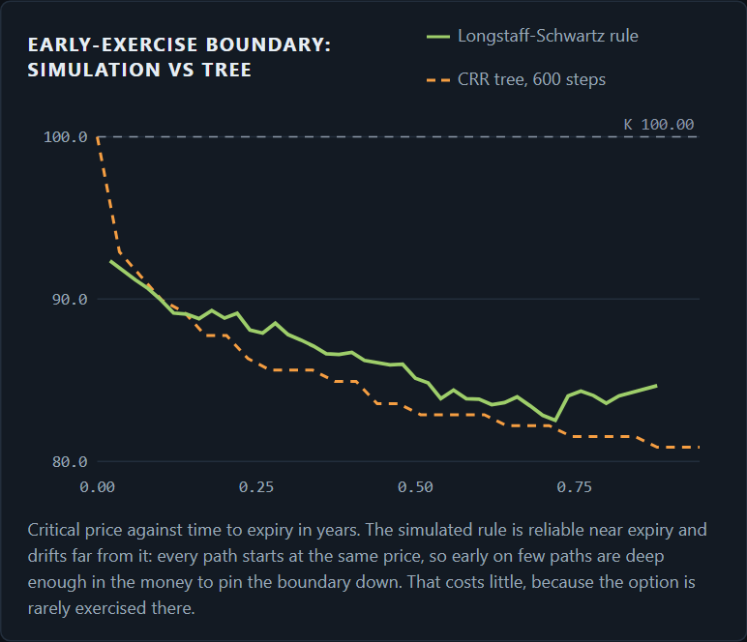
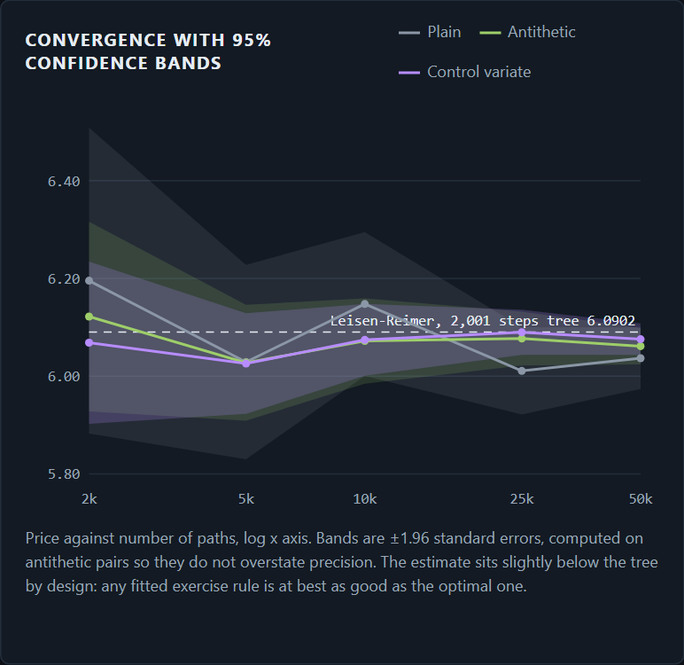
DASHBOARD 6 / LONGSTAFF_SCHWARTZ
LIMIT reads about 0.2 to 0.5% low; slower than a tree for one stock.
Longstaff-Schwartz: early exercise inside a simulation.
A plain simulation cannot decide when to exercise. This method estimates, at each date, whether exercising beats waiting by fitting a curve through the simulated outcomes. Use it for American options where a tree is impractical.
SET IN THE SIDEBAR, THEN PRESS PRICE
PRICER › price strip
Option type
Put
Exercise
American
Pricing model
Longstaff-Schwartz MC
MC paths
50,000
Exercise dates
50
MONTE CARLO › Early-exercise boundary
MONTE CARLO › Convergence with 95% bands
S 100 · K 100 · 365 d · σ 20% · r 5% · q 0%
WHERE TO LOOK, AND WHAT IT SHOWS
PRICER › price strip
6.0755 ± 0.0165, 95% interval 6.043 to 6.108.
PRICER › Same contract, every engine
Leisen-Reimer 6.0888 is the reference; the simulation is 0.0133 below it.
MONTE CARLO › Early-exercise boundary
The fitted rule plotted against the tree's boundary, date by date.
MONTE CARLO › In-sample vs out-of-sample
Same paths 6.0543, fresh paths 6.0612: the gap is inside the error bar. Tree 6.0902.
DERIVATIVE PRICING ENGINE & GREEKS ·
26 / 34
Notes:
Model: least-squares Monte Carlo from Longstaff and Schwartz, 2001. Dashboard: with Exercise on American, pick Longstaff-Schwartz MC. The numerics field is relabelled Exercise dates. The Pricer shows 6.08 with an error bar, and the tree in the engine table is inside that bar. Open the Monte Carlo tab: for an American option it shows two extra cards. The boundary chart compares the exercise rule the simulation learned with the one from the tree. The convergence chart shows the estimate and its band against the tree's dashed line as paths are added. The in-sample and out-of-sample card shows the price on the paths used to fit the rule and on fresh paths; at these settings the two differ by less than the error bar and both sit just below the tree, which is expected because an estimated rule can match the best rule or fall short of it, never beat it.

Slide 27
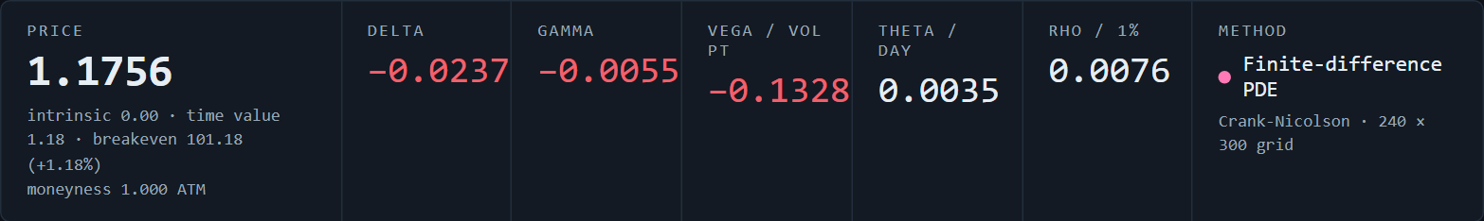
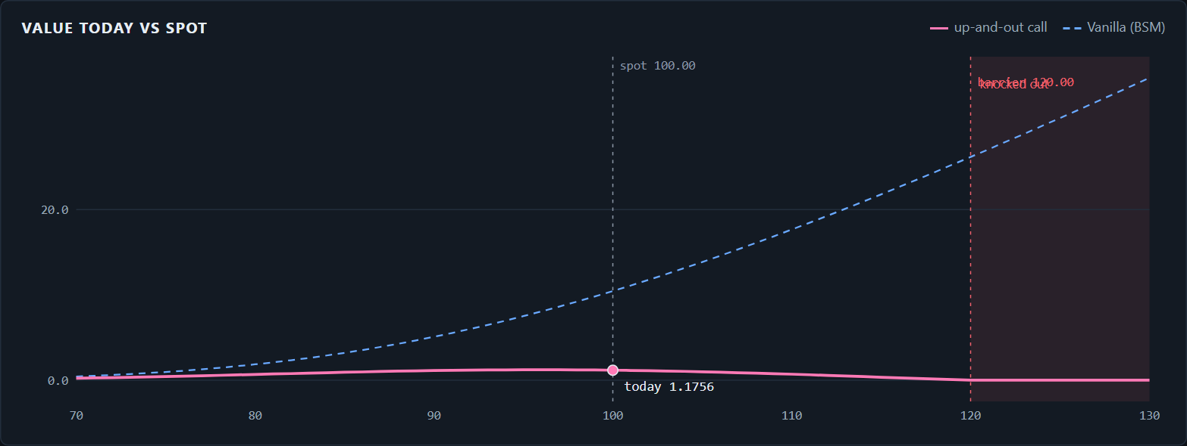
DASHBOARD 7 / FINITE_DIFFERENCE_PDE
LIMIT price is accurate; gamma very close to the barrier is not.
Barrier PDE: the barrier is a line on the grid.
The pricing equation is solved on a grid of stock prices and dates. A knock-out option is worth zero once the stock touches the barrier, so the grid simply ends there. The example is a call cancelled if the stock reaches 120.
SET IN THE SIDEBAR, THEN PRESS PRICE
PRICER › price strip
Product
Barrier
Pricing model
Finite-difference PDE
Barrier · Type
up-and-out
Barrier · Level H
120.00
Option type
Call
BARRIER PDE › Value today vs spot
S 100 · K 100 · 365 d · σ 20% · r 5% · q 0%
WHERE TO LOOK, AND WHAT IT SHOWS
PRICER › price strip
1.1756 on a 240 × 300 grid: 11% of the 10.4506 vanilla call.
PRICER › price strip, Greeks
Delta −0.0237, vega −0.1328, theta +0.0035: all opposite in sign to a plain call.
BARRIER PDE › Same contract, every engine
Brownian-bridge simulation 1.1683 ± 0.0128. Up-and-in twin 9.2750: the two sum to the 10.4506 vanilla.
BARRIER PDE › Value vs barrier level
Raising H to 160 lifts the price to 8.8962, close to the vanilla.
DERIVATIVE PRICING ENGINE & GREEKS ·
27 / 34
Notes:
Model: Crank-Nicolson finite differences on a grid that stops at the barrier. Dashboard: choose Barrier under Product and a Barrier block appears with a Type dropdown and a Level field. With an up-and-out barrier at 120 the call is worth 1.18, about a ninth of the plain call, because the large rises that make a call valuable are the ones that cancel it. Point at the Greeks: delta and vega are negative and theta is positive, so this option gains from calm markets. Open the Barrier PDE tab: the first chart is the value against spot, rising and then falling to zero at 120; the engine card shows the simulation and the knock-in twin; the surface shows the value over spot and time. The knock-in plus the knock-out equals the vanilla exactly, which is the built-in check.

Slide 28
DASHBOARD 8 / WHERE_EVERYTHING_IS
One sidebar, seven models: what to select and where to read it.
Same market on every row: S = K = 100, 365 days, σ 20%, r 5%, q 0%. Each price is what the Pricer tab shows.
MODEL
SIDEBAR SELECTION
PRICE
TAB AND SECTION TO SHOW
Black-Scholes
Call · Vanilla · European · Black-Scholes-Merton
10.4506
Pricer › price strip, Payoff & value
Black-76
Black-76 · Commodity · WTI crude · F 100
7.5771
Pricer › Risk metrics (Rho = −T·V)
CRR tree
Put · American · CRR binomial · 201 steps
6.0975
Trees › American vs European price
Leisen-Reimer
Call · European · Leisen-Reimer · 201 steps
10.4506
Trees › Error on a log scale
Monte Carlo
Asian (average price) · 50,000 paths · 252 fixings
5.8141 ± 0.025
Monte Carlo › Variance reduction
Lookback (floating strike) · 252 time steps
17.2628 ± 0.037
Pricer › Same contract, every engine
Basket · 3 assets · correlation 0.5
9.1928 ± 0.037
Monte Carlo › Basket price vs correlation
Longstaff-Schwartz
Put · American · Longstaff-Schwartz MC · 50 dates
6.0755 ± 0.016
Monte Carlo › Early-exercise boundary
Barrier PDE
Barrier · up-and-out · H 120 · Finite-difference PDE
1.1756
Barrier PDE › Value today vs spot
Rule use the simplest model that can handle the contract. Formula: about 1 ms, exact. Tree: about 10 ms. Simulation: seconds, with an error bar.
DERIVATIVE PRICING ENGINE & GREEKS ·
28 / 34
Notes:
Use this as the map for the live demo. Every row is the same market: stock and strike 100, one year, 20% volatility, 5% rate, no dividend. The rule to state out loud: use the simplest model that can handle the contract. A formula takes a millisecond and is exact; a tree takes about ten milliseconds; a simulation takes seconds and comes with an error bar.

Slide 29
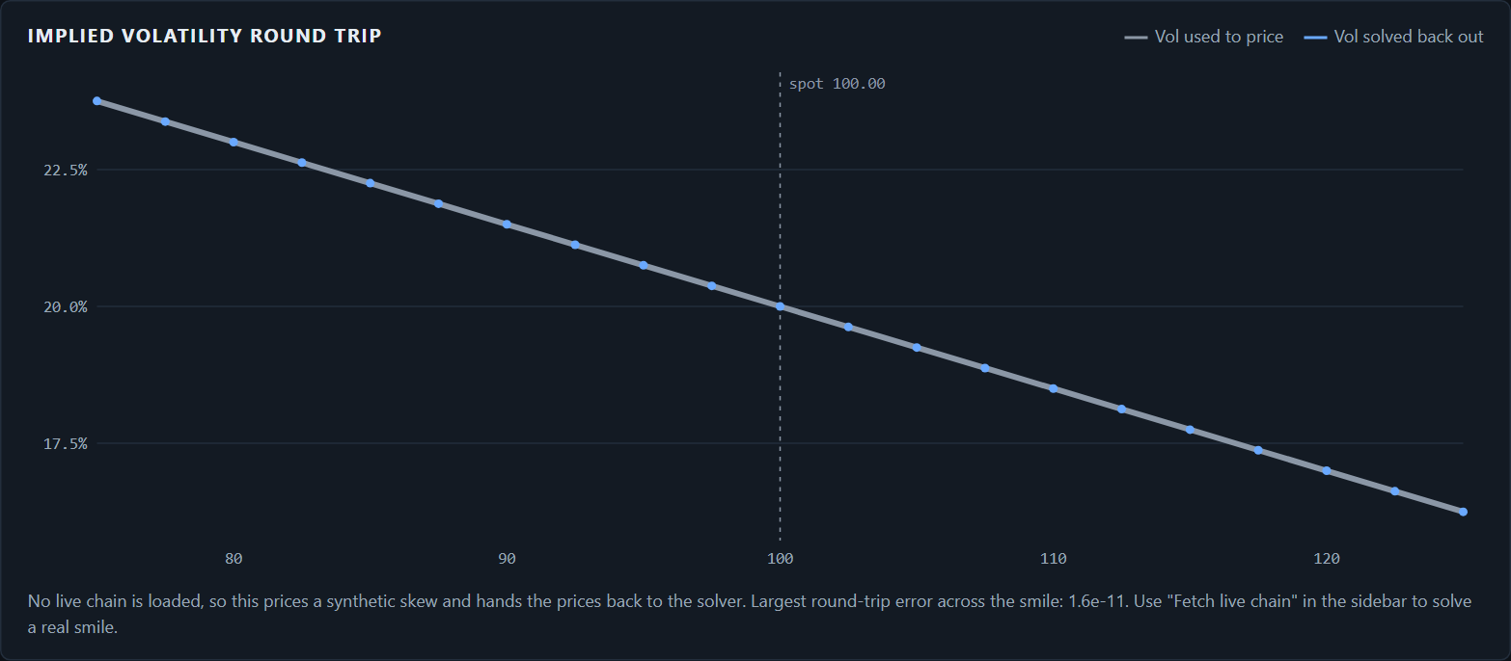
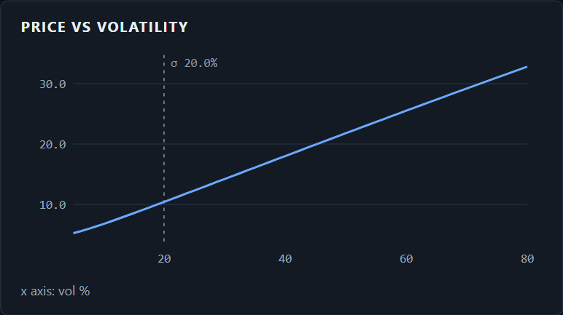
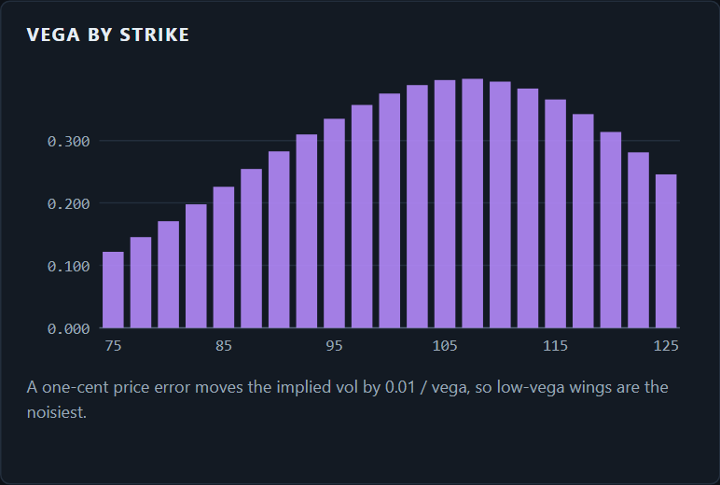
DASHBOARD 9 / VOLATILITY_INPUT
LIMIT one flat volatility per contract; the smile is not used to price.
Volatility: the one input you cannot look up.
Volatility is how much the stock is expected to swing, quoted per year. Realised volatility is measured from past prices. Implied volatility is the number that makes the model reproduce a market price. Every model here takes it as one input, Vol σ.
SET IN THE SIDEBAR, THEN PRESS PRICE
MARKET & SMILE › Implied volatility round trip
Product
Vanilla
Pricing model
Black-Scholes-Merton
Vol σ (%)
20.00
Call · S 100 · K 100 · 365 d · r 5% · q 0%
WHERE TO LOOK, AND WHAT IT SHOWS
PRICER › price strip, Vega
0.3752: the 10.4506 call gains or loses 0.38 for each 1-point change in volatility.
GREEKS › Price vs volatility
GREEKS › Price vs volatility
MARKET & SMILE › Vega by strike
Close to a straight line: 6.81 at 10% volatility, 10.45 at 20%, 14.23 at 30%.
MARKET & SMILE › Implied volatility round trip
21 strikes priced on a skew from 23.75% to 16.25%, then solved back. Largest error 1.6e-11.
MARKET & SMILE › Vega by strike
0.397 at strike 105, 0.122 at strike 75: far-from-the-money quotes pin volatility down least.
DERIVATIVE PRICING ENGINE & GREEKS ·
29 / 34
Notes:
Volatility is the only Black-Scholes input that is not observable: spot, strike, expiry and rate can be read off a screen, volatility has to be estimated or implied. Dashboard: the Vol field in the sidebar's Market block feeds every model. The Greeks tab has a Price vs volatility chart, which for an at-the-money option is nearly a straight line with slope equal to vega. The Market and Smile tab shows the reverse direction: it prices 21 strikes on a known skew, hands only the prices to the Brent solver and recovers the volatility at every strike to eleven decimal places. With a live chain fetched from the sidebar the same page solves a real smile. Useful single number: a market price of 11.00 on this call implies a volatility of 21.46%. Vega by strike explains why wing quotes are noisy: a one-cent price error moves the implied volatility by 0.01 divided by vega.

Slide 30
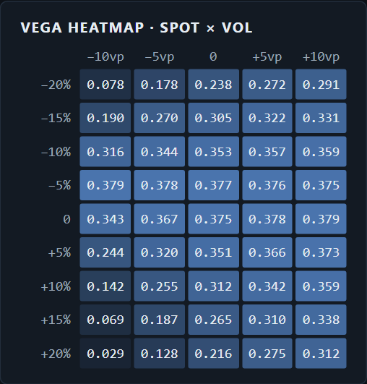
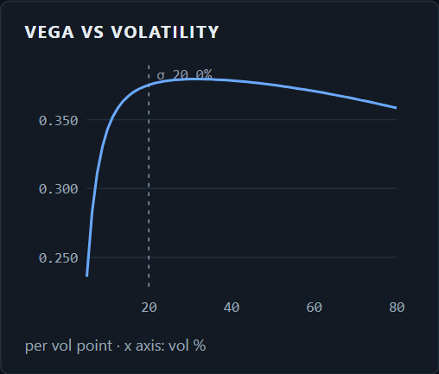
DASHBOARD 10 / VEGA_BY_PRODUCT
LIMIT bump of one flat volatility; simulation vegas carry sampling noise.
Vega: how much each product cares about volatility.
Vega is the change in price for a one-point change in volatility. It is largest at the money and with a long time to expiry, and it differs sharply by product: averaging dampens it, a look-back amplifies it, and a knock-out barrier reverses its sign.
SET IN THE SIDEBAR, THEN PRESS PRICE
GREEKS › Vega heatmap · spot × vol
GREEKS › Vega vs volatility
Product
each of the five in turn
Option type
Call
Barrier
up-and-out · H 120
S 100 · K 100 · 365 d · σ 20% · r 5% · q 0%
WHERE TO LOOK, AND WHAT IT SHOWS
PRICER › price strip, Vega
Vanilla 0.3752 · Asian 0.2197 · Basket 0.3081 · Lookback 0.6801 · Barrier −0.1328.
GREEKS › Vega heatmap · spot × vol
0.375 at the money. 0.238 with spot 20% lower, 0.216 with spot 20% higher.
GREEKS › Vega heatmap, corner
Spot +20% and volatility 10 points lower: 0.029. Deep in the money, volatility barely matters.
SIDEBAR › Exercise → American, Put
Vega 0.3754 on the tree against 0.3752 European: early exercise hardly changes it.
DERIVATIVE PRICING ENGINE & GREEKS ·
30 / 34
Notes:
Vega is per volatility point on every engine, so the numbers are directly comparable. Dashboard: change Product in the sidebar and read Vega on the Pricer's price strip. The Asian call has 41% less vega than the vanilla because an average swings less than a final price. The lookback has 81% more because a wider range means a better best price. The up-and-out barrier is negative: more volatility raises the chance of touching 120 and losing everything. The Greeks tab has a Vega heatmap across spot and volatility for the selected product; it is brightest at the money and fades in both directions. The same tab ends with a table comparing all Greeks across products on the same market inputs.

Slide 31
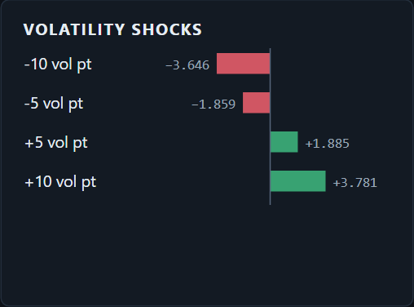
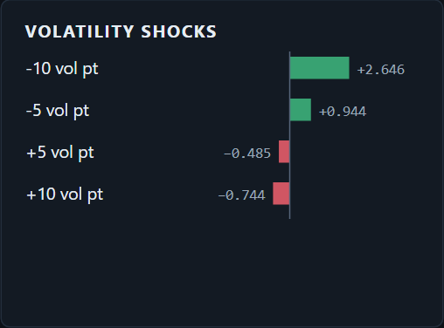
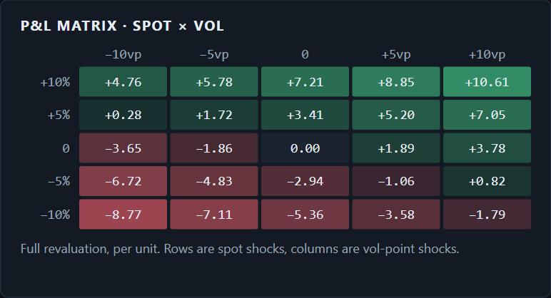
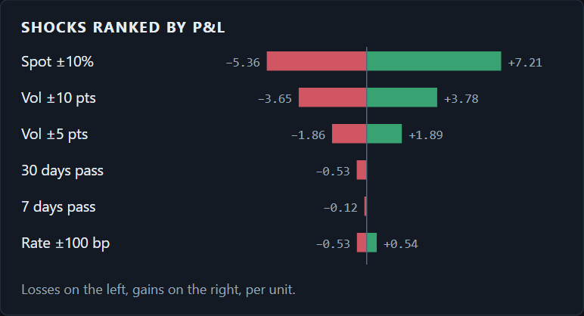
DASHBOARD 11 / VOLATILITY_SHOCK
LIMIT parallel shift of one flat volatility; no smile or term-structure shocks.
Volatility shock: reprice at ±5 and ±10 points.
A volatility shock moves the Vol σ input and reprices the contract in full, with everything else held fixed. The Scenarios tab runs ±5 and ±10 points and crosses them with spot moves. A long option gains when volatility rises; a knock-out barrier does the opposite.
SET IN THE SIDEBAR, THEN PRESS PRICE
SCENARIOS › Volatility shocks · vanilla call
SCENARIOS › Volatility shocks · barrier
Pricing model
Black-Scholes-Merton
Tab
Scenarios
Then Product
Barrier · up-and-out · H 120
S 100 · K 100 · 365 d · σ 20% · r 5% · q 0%
WHERE TO LOOK, AND WHAT IT SHOWS
SCENARIOS › Volatility shocks
On the 10.4506 call: −10 points −3.646 (−35%), −5 −1.859, +5 +1.885, +10 +3.781 (+36%).
SCENARIOS › against vega
Vega × 10 predicts ±3.752. The full reprice is +3.781 up and −3.646 down: not symmetric.
SCENARIOS › P&L matrix · spot × vol
SCENARIOS › Shocks ranked by P&L
SCENARIOS › P&L matrix · spot × vol
Worst cell, spot −10% with volatility −10: −8.77, or 84% of the premium. Best: +10.61.
SCENARIOS › Volatility shocks, Barrier
Signs reverse on the 1.1756 knock-out: −10 points +2.646 (+225%), +10 points −0.744 (−63%).
DERIVATIVE PRICING ENGINE & GREEKS ·
31 / 34
Notes:
Every scenario is a full reprice, not vega times the move. Dashboard: open the Scenarios tab with the vanilla call. The Volatility shocks card shows four bars. A 10-point rise adds 3.78 and a 10-point fall removes 3.65; vega alone would say 3.75 both ways, so even for a vanilla the estimate is slightly off and the error grows with the size of the shock. The P&L matrix crosses five spot moves with five volatility moves: the worst corner loses 84% of the premium, and a 5% fall in spot is more than paid for by a 10-point rise in volatility. Then switch Product to Barrier: the same card flips sign. The knock-out call more than triples when volatility falls 10 points, because the barrier becomes much harder to reach. Other products for reference, plus or minus 10 points: put plus 68% and minus 65%, Asian plus 38% and minus 37%, lookback plus 38% and minus 40%.

Slide 32
FINDINGS / NEXT_STEPS
What we found.
01
LR reaches 0.0001 accuracy in 51 steps; CRR is still at 0.0018 after 1,001.
LIMITATIONS
One flat volatility per contract; no smile in pricing
Continuous dividend yield, no discrete dividends or jumps
Barrier gamma unreliable near the barrier; no Rannacher steps yet
Live chain depends on Yahoo and market hours
02
The geometric control variate cuts Asian variance 746× on the same paths.
03
Delta-gamma predicts a loss of 135% of premium on a knocked-out barrier.
NEXT
04
A basket is long correlation: 7.46 → 10.02 as ρ goes 0 → 0.8.
Fit an SVI smile and price exotics off it
Rannacher start-up and grid Greeks for the barrier PDE
QuantLib as an independent oracle in the test suite
Sobol sampling; Heston or local volatility
PDF research report generated from the engine
05
A raw discrete lookback is 3.5% low; the continuity correction removes it.
DERIVATIVE PRICING ENGINE & GREEKS ·
32 / 34
Notes:
Close on the strongest finding, not the limitations. But state the limitations plainly: a panel reads their absence as not understanding the models. The honest headline limit is one flat volatility per contract.

Slide 33
CLOSE / REFERENCES
Questions.
We built a pricing engine, checked every number against an independent calculation, and know where it is still wrong.
PROJECT
engines
7
REFERENCES
products
7
Hull, Options, Futures and Other Derivatives
Glasserman, Monte Carlo Methods in Financial Engineering (2004)
Cox, Ross & Rubinstein (1979); Leisen & Reimer (1996)
Longstaff & Schwartz, Review of Financial Studies 14 (2001)
Broadie, Glasserman & Kou (1997), continuity correction
Reiner & Rubinstein (1991); Kemna & Vorst (1990)
tests
365
checks
35
app pages
9
DERIVATIVE PRICING ENGINE & GREEKS ·
33 / 34
Notes:
Thank the panel. The repository and dashboard are on this machine; offer to open any page. Backup slide follows with the answers to the questions a derivatives panel usually asks.

