Slide 1
Case Study
Implementing IaaS and PaaS in Azure
- Manish Choudhary
(Azure Operations Team)
Batch 1

Slide 2
Contents
Business Requirements
Implementation flow
Takeaway Learnings

Slide 3

Business Requirements
Nilavembu Herbs provides a safer alternative to modern medicine wherever possible and to offer simple, effective and safe remedies for common problems. spreads awareness about the medicinal uses of these natural and safe herbs all over the world and to make it easily available through their online store for all those who want to enjoy its benefits
Nilavembu Herbs requires
A low cost solution based on demand of dynamic business conditions.
As the business expands across EastUS and SEA, they would like to have their DataCenter virtualised using cloud computing.
Critical Data should be made available in case of disaster
As of now they want to have Proof Of Concept(POC) in Microsoft Azure
You have been deployed for POC
The following slides will provides required details.

Slide 4
SEA region
2 web servers with 99.95% high availability
These web services has to be utilised with proper balance with client affinity with Public IP
Selected web servers should be reachable via RDP from internet
A jump port should accessible from internet to upload contents to web servers.
Protect web server traffic restricted to allowed based on ip addresses which will be updated as warranted
Enable backup for WebServers
Have alert generated in case of 80% above cpu usage

Slide 5
EastUS
EastUS server (Server11) should be accessible from internet via public IP
Establish secure Connection to SEA-EUS Azure sites
All servers should be reachable with internal ip addresses

Slide 6
Storage Requirements
EUS based resources should provide data resiliency in case of azure datacentre failure.
The storage should be accessible by applications with secure access. provide access urls and keys.
Sales manager should access his resource from windows explorer.
SEA data resources must provide high resiliency in case of even multiple azure data center failures

Slide 7
Azure Resource management
Create Vmadmin user who can manage all VM in the subscription
Create Backup_admin user who can manage backup only in EUS servers in EURG

Slide 8
Implementation Flow
South East Asia region (SEA)
Southeast Asia Region setup
Creating and configuring Virtual network
Creating and configuring availability set
Creating and configuring network security group
Creating 3 virtual machine
Creating and setting load balancer
Installing IIS service in Southeast Asia VMs to make it webserver
Enabling and configuring backup
Creating alert rule

Slide 9
Implementation Flow
East US region EUS
Creating virtual network in East US
Creating virtual machine
Establishing secure connection to SEA-EUS acquire sites through peering
Servers are reachable with internal IP addresses

Slide 10
Implementation Flow
Storage Requirement
Creating storage account for EUS region with zone-redundant storage.
Creating secured access for Storage account in EUS region.
Creating Files share.
Creating storage account in SEA region with Geo-redundant storage to be used in multiple azure data centre failure.

Slide 11
Implementation Flow
Azure Resource Management.
Creating VM admin user to monitor all VM in subscription.
Creating Backup admin user, to manage backup only in EUS servers.
Adding roles to the users created.

Slide 12





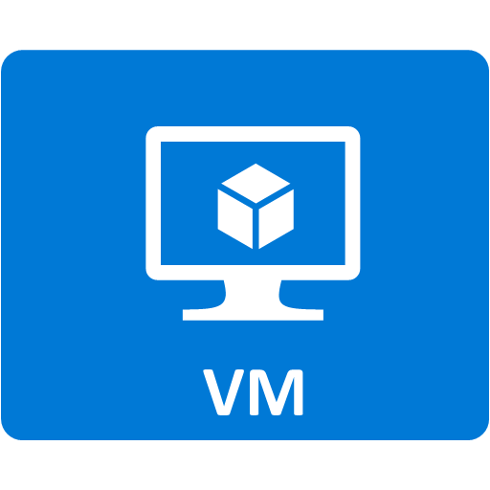

Architecture
Vnet SEA
Subnet WebServers
Load Balancer
Availability
set
Vnet EUS
VM webservers
VNet
Peering
(Bidirectional)
Subnet server
Subnet Jump port
VM server
VM jumpport

Slide 13
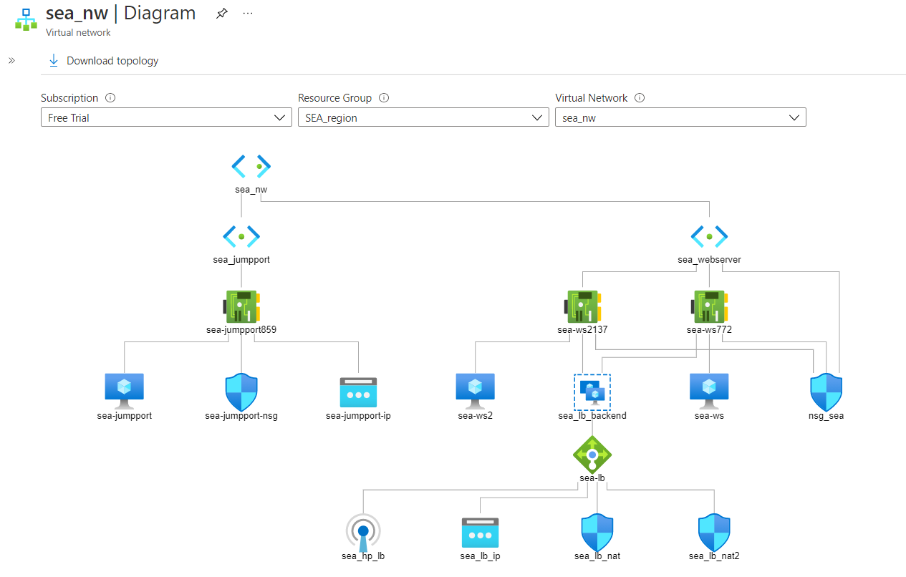
SEA Region virtual network Diagram

Slide 14
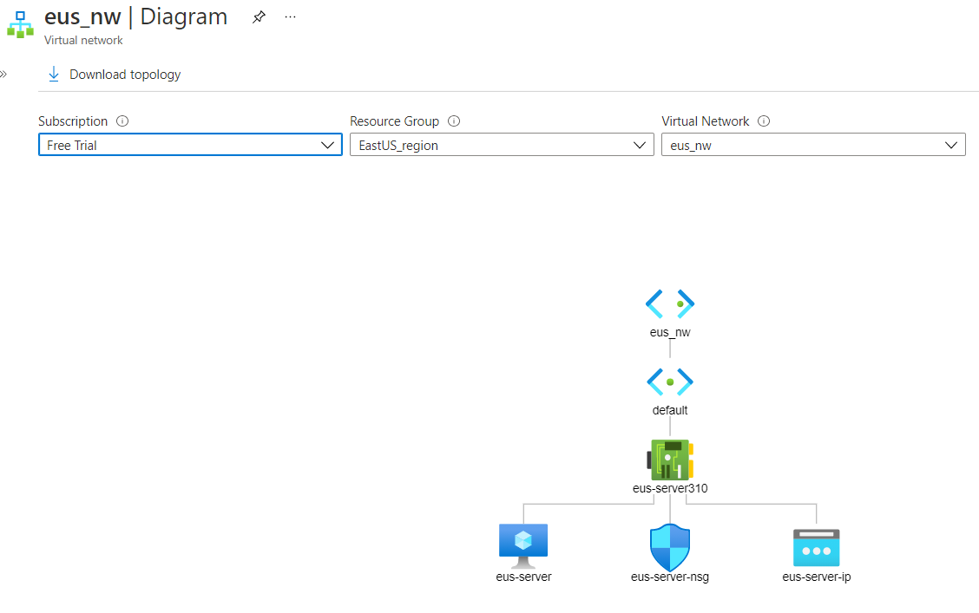
EastUS region virtual network Diagram

