Slide 1
Seminar
On
Free Space Optics / Laser Communication
PRESENTED BY ANN RIYA DEVASSY

Slide 2
CONTENTS
INTRODUCTION
HISTORY OF FSO
HOW FSO WORKS
ARCHITECTURE
FSO SECURITY
APPLICATIONS
MERIT
DEMERIT
CONCLUSION

Slide 3
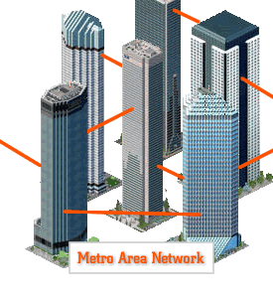
introduction
Free Space Optics (FSO) communications, also called Free Space Photonics (FSP) or Optical Wireless, refers to the transmission of modulated visible or infrared (IR) beams through the atmosphere to obtain optical communications.

Slide 4
History of Free Space Optics (FSO)
The engineering maturity of Free Space Optics (FSO) is often underestimated, due to a misunderstanding of how long Free Space Optics (FSO) systems have been under development.
Historically, Free Space Optics (FSO) or optical wireless communications was first demonstrated by Alexander Graham Bell in the late nineteenth century (prior to his demonstration of the telephone!).

Slide 5
How Free Space Optics Works
Free Space Optics (FSO) transmits invisible, eye-safe light beams from one "telescope" to another using low power infrared laser in the teraHertz spectrum.
The beams of light in Free Space Optics (FSO) systems are transmitted by laser light focused on highly sensitive photon detector receivers.
These receivers are telescopic lenses able to collect the photon stream and transmit digital data containing a mix of Internet messages, video images, radio signals or computer files.

Slide 6
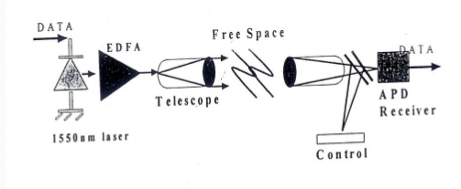
Architecture
The safety standard recommends that these systems should be located where the beam cannot be interrupted or viewed inadvertently by a person or receiver.

Slide 7
Free Space Optics (FSO) security
FSO is far more secure than RF or other wireless-based transmission technologies for several reasons:
Laser beams cannot be detected with spectrum analyzers or RF meters.
The laser beams are narrow and invisible, making them harder to find and even harder to intercept and crack.
Data can be transmitted over an encrypted connection adding to the degree of security available in FSO network transmissions.

Slide 8
Applications
Metro Area Networks (MAN)
Last Mile Access
Enterprise connectivity
Fiber backup
Backhaul
Service acceleration

Slide 9
Merits
• Flexible network solution over conventional broadband services.
• Straight forward deployment- no licenses required
• Low initial investment
• Ease of installation
• Re-deployability
• High bit rates and low error rates

Slide 10
Demerits
Fog
Physical obstructions
Scintillation
Solar interference
Scattering
Absorption
Building sway / Seismic activity

Slide 11
CONCLUSION
Free space optics (FSO) provides a low cost, rapidly deployable method of gaining access to the fiber optic backbone.
FSO technology not only delivers fiber-quality connections, it provides the lowest cost transmission capacity in the broadband industry.
As a truly protocol-independent broadband conduit, FSO systems complement legacy network investments and work in harmony with any protocol, saving substantial up-front capital investments.

Slide 12
REFERENCES
www.google.com
www.wikipedia.com
www.studymafia.org

Slide 13
Thanks

