Slide 1
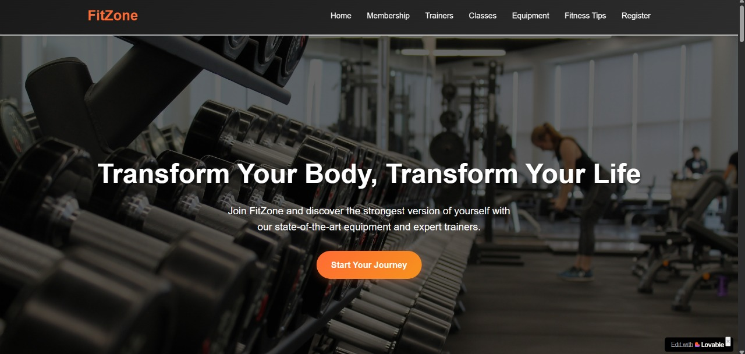
FITZONE
Submitted by – Yash 2510977067
Manish 2510987026
Raghav 2510987057

Slide 2
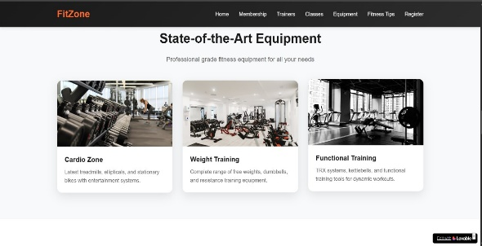
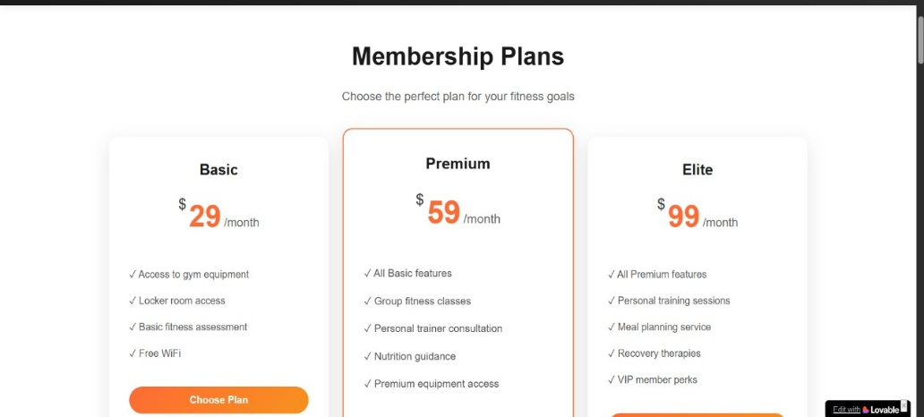
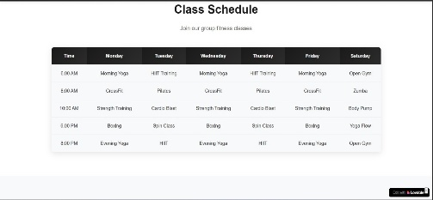
Introduction
FitZone is an innovative online platform that aims to change the way you look.
FitZone bridges the gap between the laziness and the gym. With an easy-to-use interface , you can choose and buy the membership plan that suites you the best to start your journey.
Welcome to FitZone, and Break, Build & Live.

Slide 3
Problems Faced
Alignment issues – Difficulty in arranging elements properly on the page.
Not responsive – Website doesn’t adjust well on mobile or tablet screens.
Limited features – No interactivity like forms or animations.
Broken links – Pages may not connect correctly due to wrong file paths.

Slide 4
Solutions to the problems
Alignment issues – Use <div>s and CSS margin/padding to adjust elements.
Not responsive – Use % widths and simple media queries to fit mobile screens.
Limited features – Keep content simple; links, images, and text only.
Broken links – Make sure file names and paths are correct.
.

Slide 5

Interface
The interface of our fitness website FitZone is designed with simplicity and functionality in mind. Upon visiting the homepage, users are greeted with a clean and intuitive layout, featuring easy-to-navigate menus and prominently displayed search options.
The homepage showcases the different variety of options available for the user.
Each service listing is presented with clear images, detailed descriptions, and pricing information, enabling users to make informed decisions. Users can also view membership fees, trainers, and recommendations to further enhance their browsing experience.

Slide 6
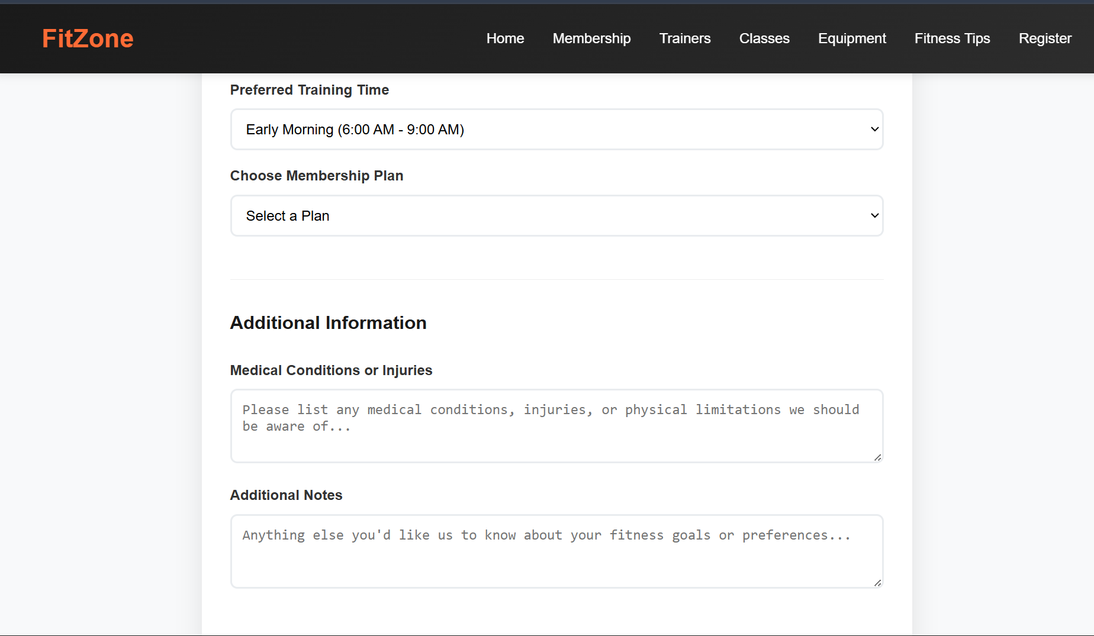
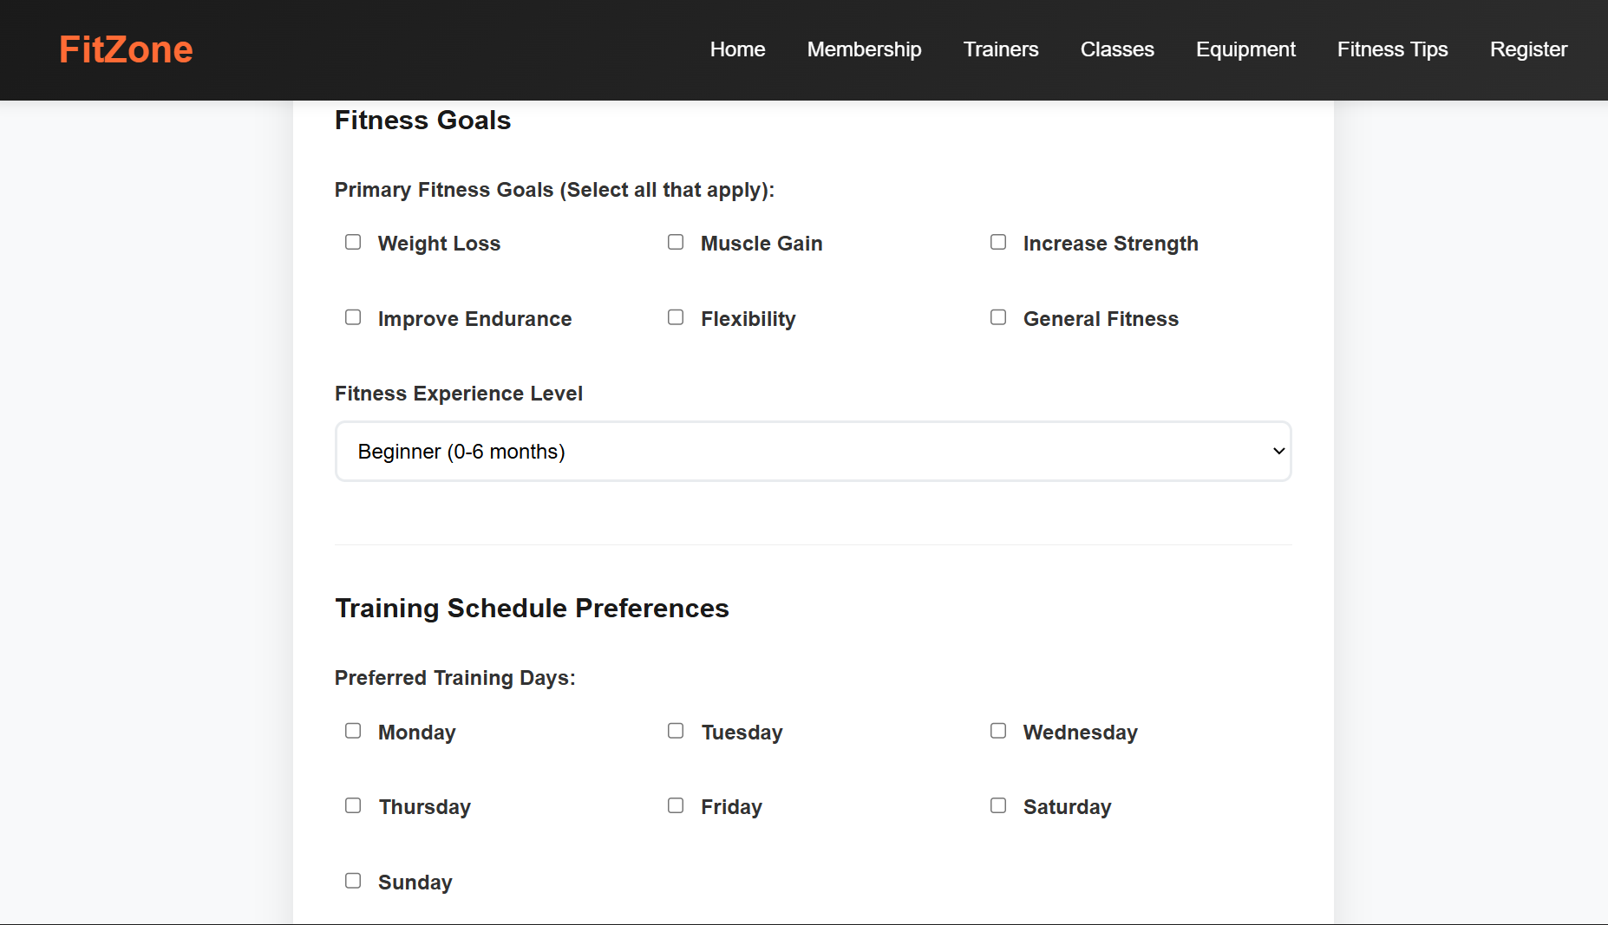
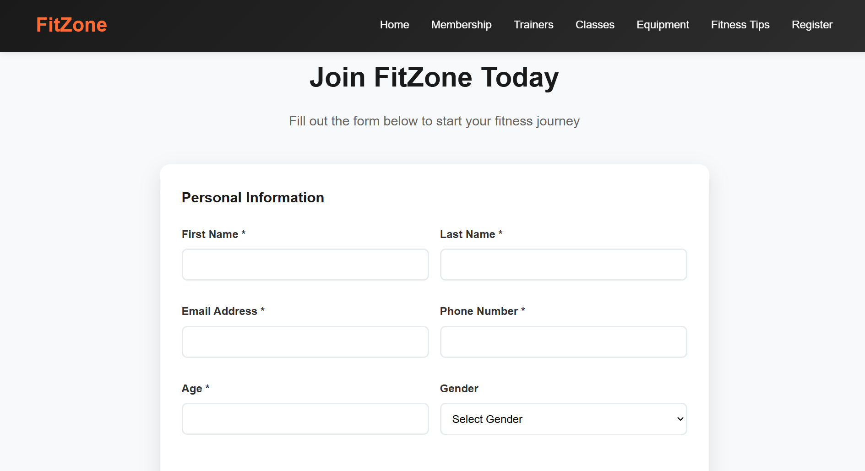
Registration Form
FitZone also have a registration form at last which has to be filled by the user. Some of the basic personal details and about the training member ship plans , training schedules and training timings to have a hasslefree appointment with the trainers.

Slide 7
Key features
User friendly interface
Interactive
FIT ZONE
Easy navigation
Attractive
Engaging

Slide 8
Thank You

