Slide 1

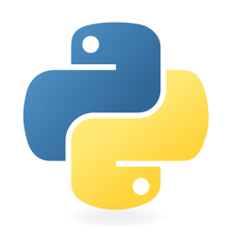

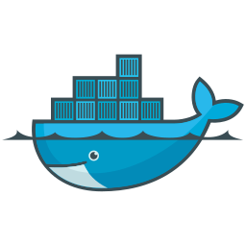

Distributed CI/CD
Orchestration Platform
Mid-Term Project Defense

Slide 2
# REVISION
What is the project?
A self-hosted platform that runs build, test and deploy jobs across many machines, each job isolated in a container.
Unlike a single centralized server, if one worker fails its job is re-assigned automatically.
Developer
Coordinator
Workers
Dashboard
pushes code
schedules
run in containers
live status

Slide 3
# REVISION
System architecture
Webhook -> coordinator -> Redis queue -> workers; PostgreSQL stores everything
enqueue
dispatch
Forgejo (git)
Coordinator
Redis
Worker nodes x N
webhook source
Rust -scheduler, health
job queue
run jobs in containers
persist
heartbeat / report
Pipeline Parser
PostgreSQL
YAML -> plan
main database
Dashboard (hosted)
reads live status
Solid = working now · Dashed = planned / in progress

Slide 4
Deployment & infrastructure
Where the platform runs
Oracle Cloud VM · Mumbai
worker calls
1 OCPU · 6 GB RAM · 100 GB
5 test laptops
Forgejo - self-hosted git
webhook
Coordinator
Redis
worker nodes
git.manishacharya.name.np
PostgreSQL
Dashboard
Coordinator, Redis, PostgreSQL and the dashboard are hosted together on the Mumbai VM.
Five physical laptops act as distributed worker nodes; Forgejo triggers pipelines via webhook.

Slide 5
Four modules, one system
Separate programs that talk over HTTP + JSON
Coordinator Rust
Pipeline Parser Python
Schedules, tracks health, dispatches jobs.
Reads pipeline.yml, validates, orders jobs.
Command Executor FastAPI
Dashboard HTML / JS
Runs a command in a container, reports result.
Shows pipelines, jobs and logs, live.

Slide 6
Done - Coordinator (the core)
The distributed engine works
REST API: register, heartbeat, trigger, claim, report
Job queue + worker registry in memory
Heartbeat failure detection - a dead worker is caught automatically
Coordinator
queue + registry
claim
heartbeat
Worker A
Worker B
Reaper
no heartbeat 5s -> offline

Slide 7
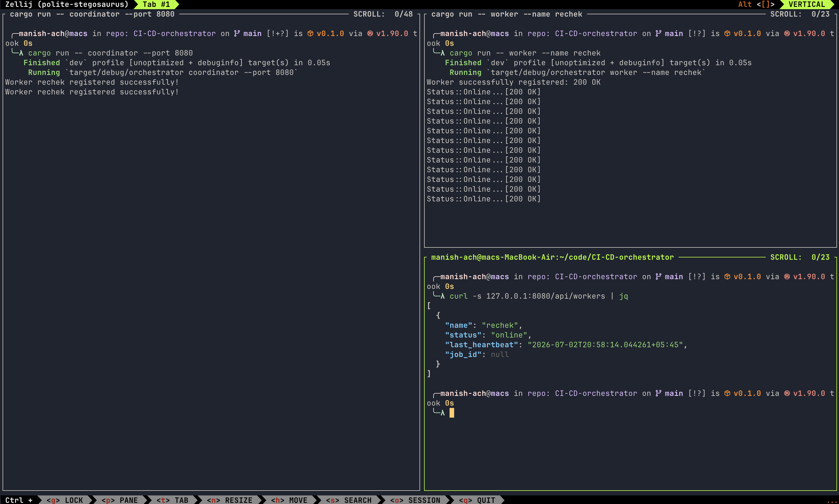

Slide 8
Module - Pipeline Parser
Turns a YAML file into an ordered job plan
Reads pipeline.yml into typed objects
Validates: unknown stages, bad references, cycles
Topological sort -> execution order
CLI: validate and plan commands
YAML
read
Validate
models.py
checks
schema
Done
Plan
Next: emit full job details (command, image) to the coordinator
order

Slide 9
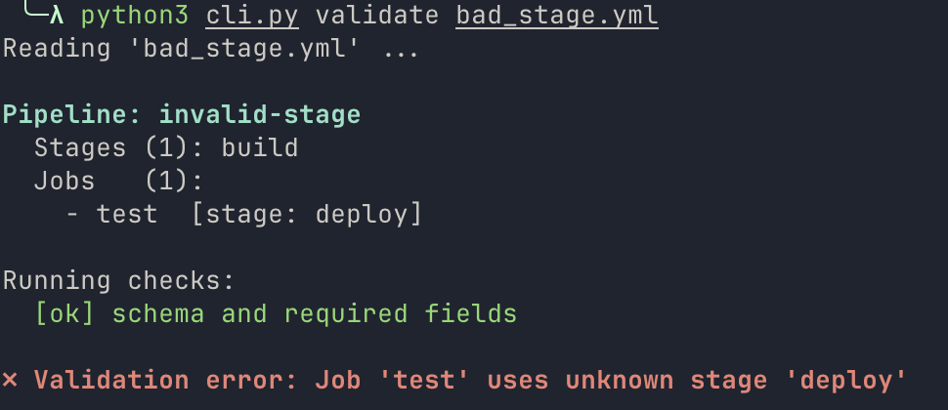
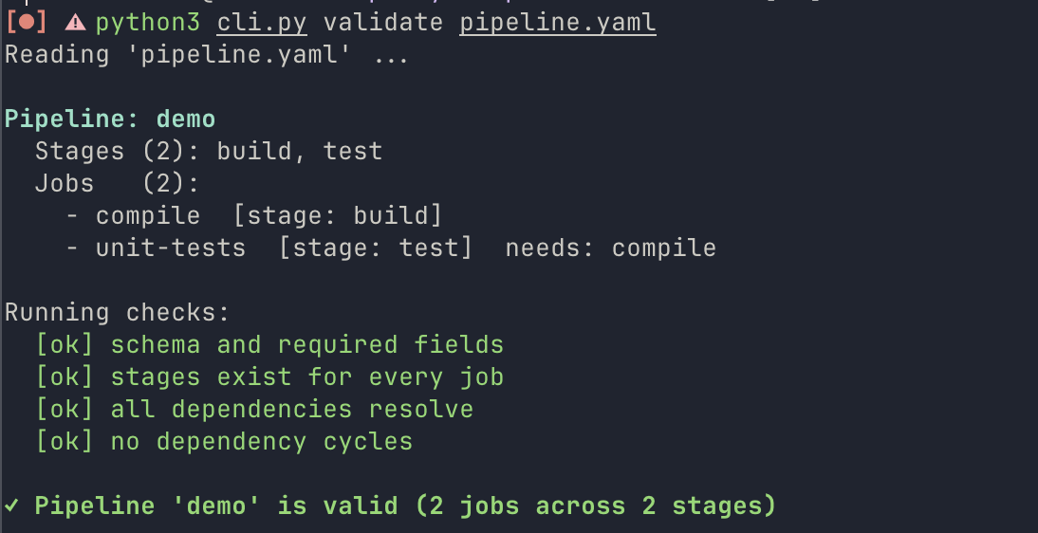
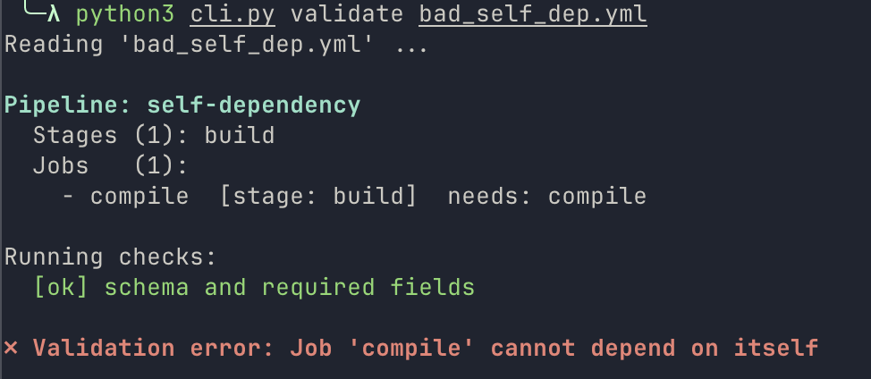

Slide 10
Module - Command Executor
Runs a job in a container and reports the result
FastAPI service; the worker calls it over HTTP
Runs the command as a subprocess (Docker next)
Captures logs, exit code, timeout, cancel
Stores every job in SQLite (survives restart)
POST /run
command
SQLite
status + logs
subprocess
execute
In progress
Foundation (config, DB schema, API) built; executor is the current work

Slide 11
Module - Dashboard
Live view of pipelines, jobs and logs
Three pages: run list, run detail, job logs
Colour-coded status (green / red / yellow / grey)
Auto-refresh every 3 seconds (plain fetch)
Pure HTML / CSS / JS : no framework needed
List
Detail
Logs
runs
jobs
output
In progress
UI shell built; data layer (fetch + render) is next

Slide 12
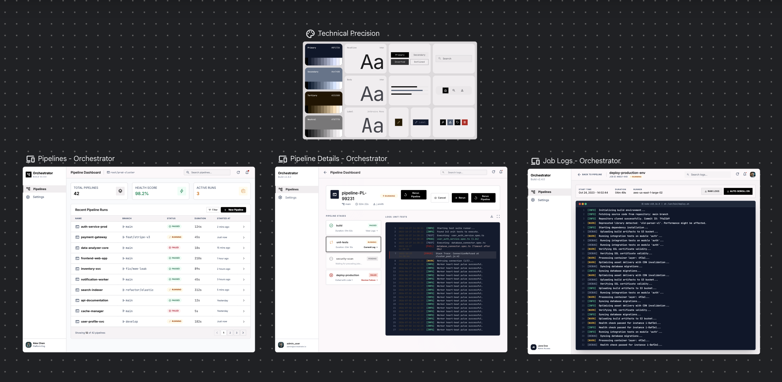

Slide 13
Progress across modules
API, heartbeats, failure detection, claim/report
Coordinator (Rust)
Done
Parser, validator, planner, CLI, tests
Pipeline Parser (Python)
Done
Config + DB + app skeleton; executor next
Command Executor (FastAPI)
In progress
UI shell for 3 pages; data layer next
Dashboard (HTML/JS)
In progress

Slide 14
What works end-to-end today
One pipeline run, step by step
1. Trigger
2. Queue
3. Claim
4. Run
5. Report
6. Status
requested
pending
worker takes
execute
pass / fail
updated
Kill a worker mid-job and the coordinator detects the failure within seconds.
Next step: run each job inside a Docker container instead of a bare subprocess.

Slide 15
What's to be done
Coordinator
Command Executor
Dashboard
Integration
Redis queue + PostgreSQL
Requeue dead job + stage order
Run jobs in Docker
Subprocess executor + logs
Timeout & cancel
Finish endpoints
Fetch + 3s refresh
Render live data
Cross-origin (CORS)
Wire modules over HTTP
docker-compose stack
End-to-end tests

Slide 16
Roadmap to final
1
Complete execution
Executor + coordinator job requeue & ordering
2
Connect & display
Dashboard data layer; wire the modules together
3
Containerize
Run jobs in Docker; docker-compose the stack
4
Harden
End-to-end tests, evaluation, documentation

Slide 17
Summary
A distributed, containerized CI/CD platform - four independent modules.
Done: the Rust coordinator and the pipeline parser.
In progress: the command executor and the dashboard data layer.
To do: Docker execution, integration, end-to-end testing.
The distributed core works today; remaining work is execution, integration and containerization.
Thank you · Questions?

