Slide 1
CVIC PARSER
Project Overview
Project Objective
Project Details
Live demo
Way Ahead/ Furthur Improvements

Slide 2
OVERVIEW
CV/RESUME
CVIC PARSER
RESUME PARSER

Slide 3
RESUME
User can enter his/her details
User can choose different templates.
User can view his/her resume output in different templates.
User can download his/her resume.

Slide 4
Resume Parser
Input Resumes can be Parsed (Image Format).
Key information from resume can be fetched.
Input fields are selected to compare analyze resume
Score generated based on input fields ( Relavancy of resume).

Slide 5
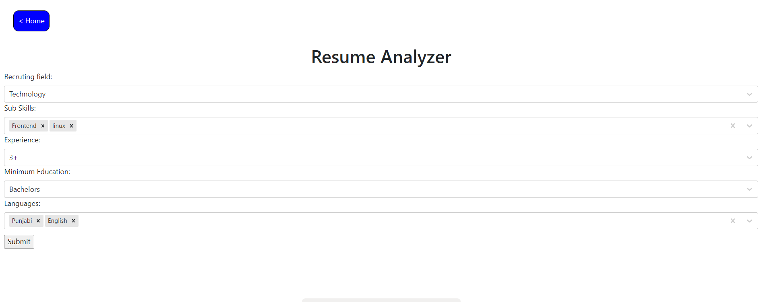
Project Detail

Slide 6
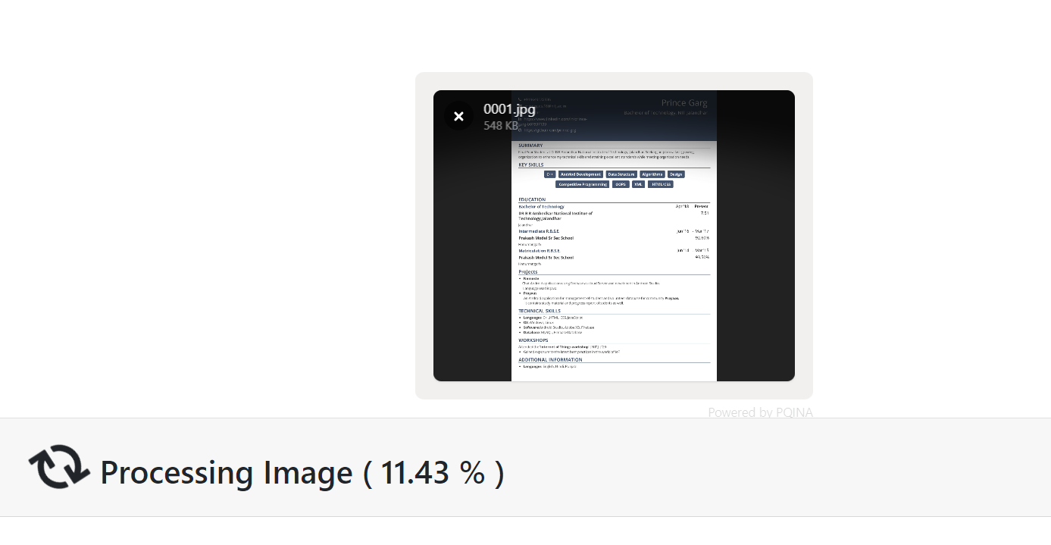
Project Detail

Slide 7
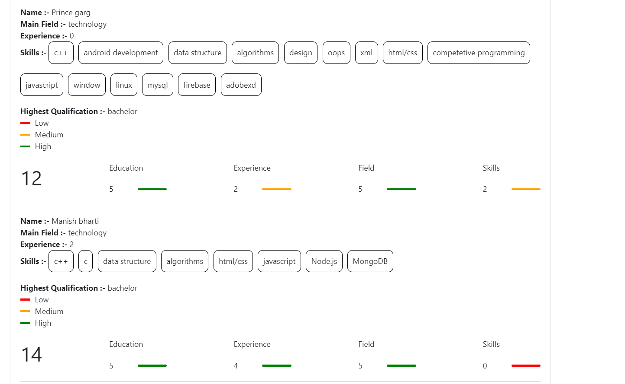
Project Detail

Slide 8
Now The Question is How Parsing Works.

Slide 9
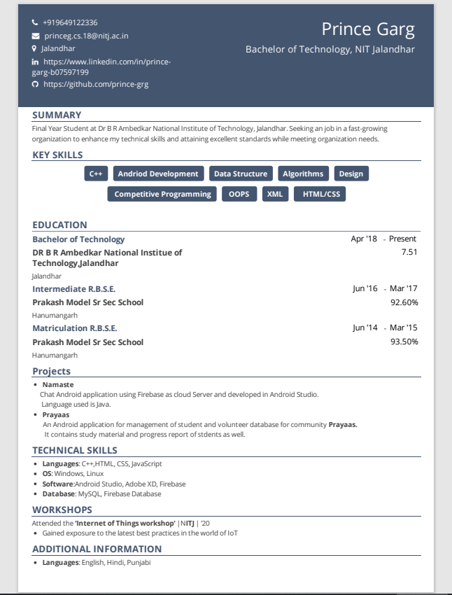
Create block from page layout (heading,subheading part).
We can detect all words in a block through tesseract.js
Now NAME must be a word block of highest size.
Heading of a block can be fetched with second maximum size of all words.
Now field , education and skills category can easily be detected by comparing with pre configured words.

Slide 10
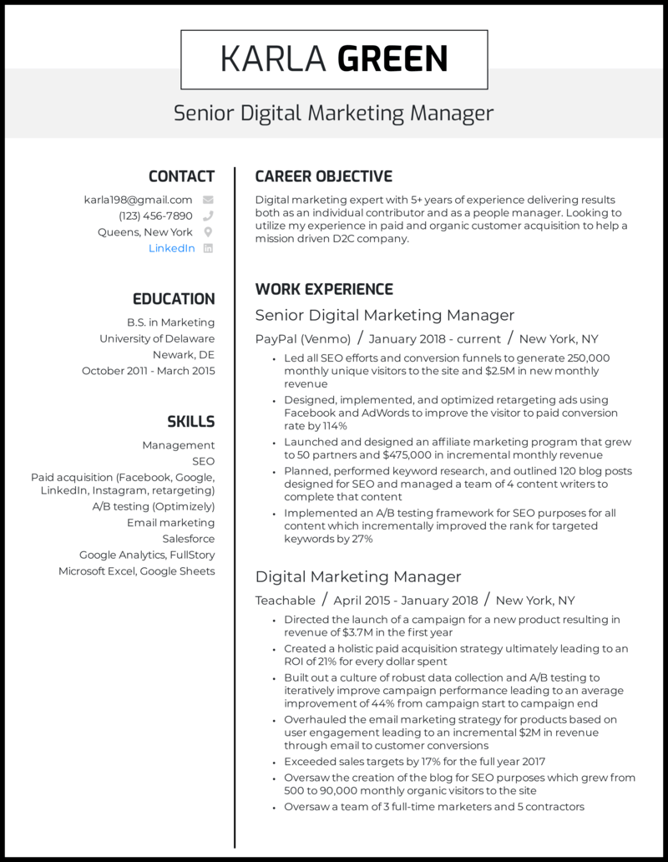
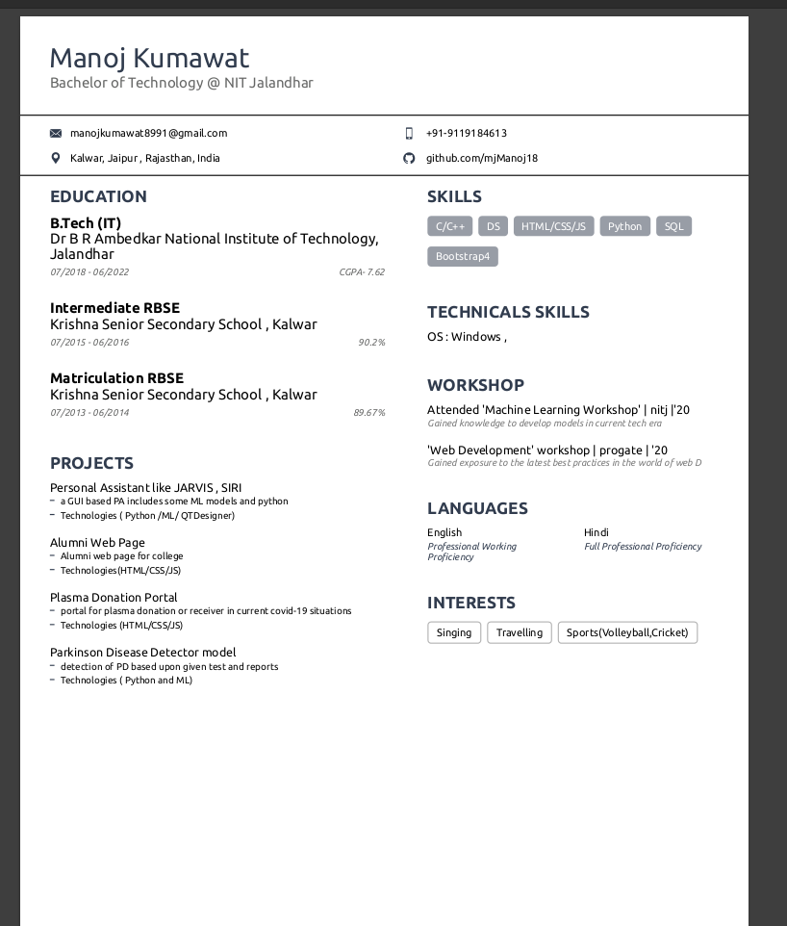

Slide 11
Live Demo

Slide 12
Improvements
It only work with single column page resume.
Solution -> (can be solved by words analysis).
2. Resume must be in image format (PDF)(require more power).
Solution -> Require more computing power.
Calculating experience. In work section. Dates must be present just after company’s name(it ignores all other dates)(no solution).
Solution -> No.
Speed improvement. One resume takes 15 20 to parse and then analyze(getting words, getting blocks, calculating score, words equal comparision.
Solution -> technology change python because of scientific and high end calculation.
colors. internal algorithm convert image in black and white.
Solution -> tesseract.js limitation.

Slide 13
Question
And
Answers

