Slide 1
CVIC PARSER
Project Overview
Project Objective
Project Details
Live demo
Way Ahead/ Furthur Improvements

Slide 2
OVERVIEW
CV/RESUME
CVIC PARSER
RESUME PARSER

Slide 3
RESUME
User can enter his/her details
User can choose different templates.
User can view his/her resume output in different templates.
User can download his/her resume.

Slide 4
Resume Parser
Input Resumes can be Parsed (Image Format).
Key information from resume can be fetched.
Input fields are selected to compare analyze resume
Score generated based on input fields ( Relavancy of resume).

Slide 5
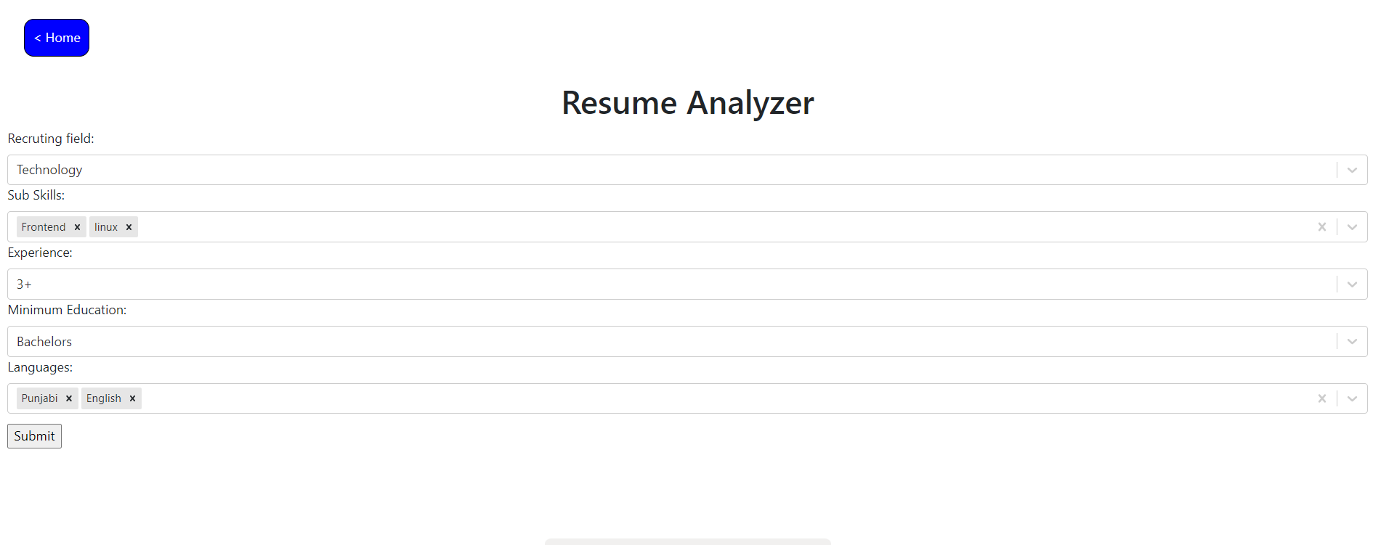
Project Detail

Slide 6
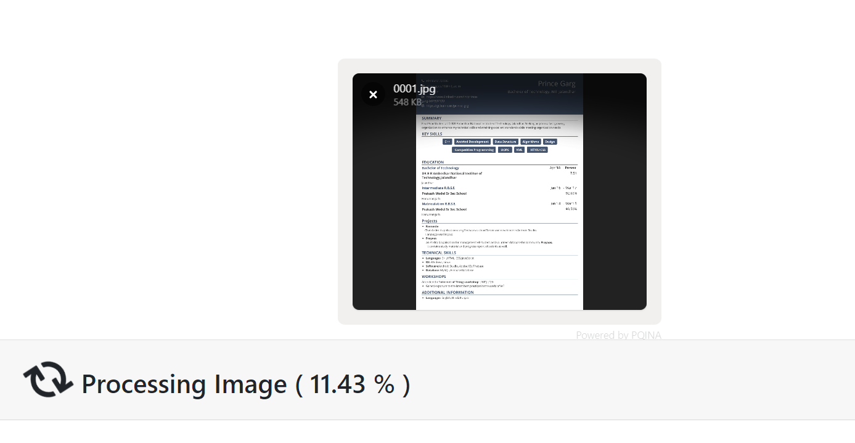
Project Detail

Slide 7
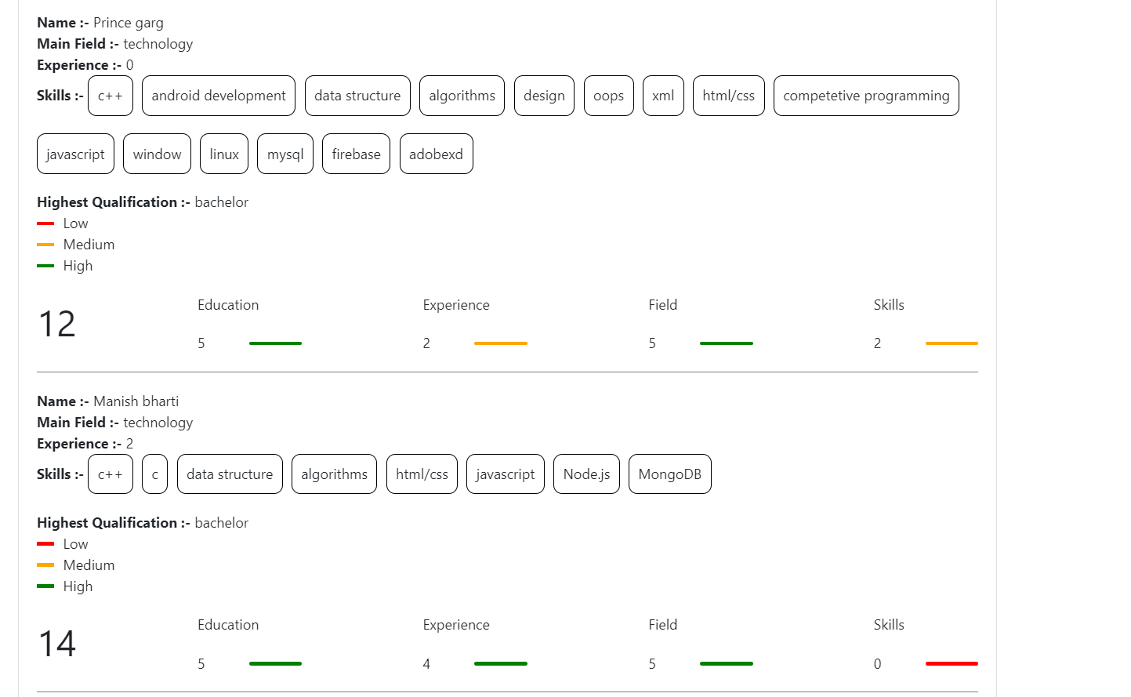
Project Detail

Slide 8
Now The Question is How Parsing Works.

Slide 9
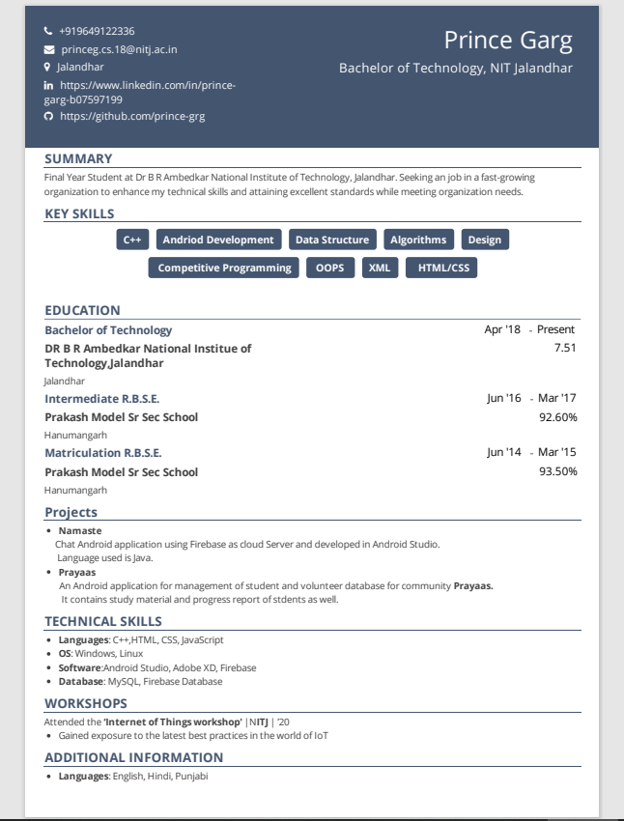
Create block from page layout (heading,subheading part).
We can detect all words in a block through tesseract.js
Now NAME must be a word block of highest size.
Heading of a block can be fetched with second maximum size of all words.
Now field , education and skills category can easily be detected by comparing with pre configured words.

Slide 10
Live Demo

Slide 11
Improvements
It only work with single column page resume.
Solution -> (can be solved by words analysis).
2. Resume must be in image format (PDF)(require more power).
Solution -> Require more computing power.
Calculating experience. In work section. Dates must be present just after company’s name(it ignores all other dates)(no solution).
Solution -> No.
Speed improvement. One resume takes 15 20 to parse and then analyze(getting words, getting blocks, calculating score, words equal comparision.
Solution -> technology change python because of scientific and high end calculation.
colors. internal algorithm convert image in black and white.
Solution -> tesseract.js limitation.

Slide 12
Question
And
Answers

