Slide 1
N
Optimal Ship Routing
Using Pathfinding Algorithms, Geospatial Constraints & Machine Learning
Project Code 43 · Nautilus
Student | USN
K. Aravind Kamath | NNM23IS082
Manisha G. P. | NNM23IS093
Drupad | NNM23IS064
Dhanvee | NNM23IS055
Guide
Mr. Prashanth Kumar
Department of Information Science & Engineering
Free · Offline · Laptop-safe · 100% open-source
Notes:
Introduce the project title and team. One line: a free, offline system that finds safer, calmer, more efficient ship routes around India.

Slide 2
1
The Problem & Why This Project
Traditional ship routing uses static charts and fixed historical routes. It ignores today's real sea conditions.
Wasted fuel Pushing through heavy head seas burns far more fuel.
1
Our goal
A fast, adaptive routing system for Indian ports
Reacts to real weather - waves, direction, period
Keeps ships in deep water and 22 km off the coast
Explainable, not a black box
Completely free and runs offline on a laptop
Higher cost Longer, harder passages raise operating cost.
2
More emissions Extra fuel means more CO2 - against sustainability goals.
3
Safety risk Fixed routes can pass too close to shoals and coastlines.
4
Notes:
Lead with the problem: static routing ignores weather, wasting fuel and risking safety. Our goal is a fast, adaptive, explainable, free system.

Slide 3
2
What Nautilus Does
An intelligent, weather-aware router shown through an interactive web app.
Grid ocean model
Real GEBCO depth turns the sea into safe/unsafe cells.
Two algorithms
Dijkstra (shortest) vs weather-aware A* (proposed).
A
B
ML speed model
Predicts how waves slow the chosen vessel.
3 weather modes
Typical, Rough (storm) and Live real-time waves.
C
D
Google Maps UI
Animated route, ship & anchor icons, wave overlay, tooltips.
Proof built in
Evaluation vs traditional on 4 metrics.
E
F
Notes:
Overview of everything Nautilus offers. Mention the Nautilus web app features here: Google Maps, ship/anchor icons, wave overlay, weather tooltips, and a free Streamlit fallback.

Slide 4
3
End-to-End Architecture
1
Preprocess Slice 11.6 GB raw data to the region, shrink to ~1 MB.
Tech stack
Grid model Safe/unsafe cells; 22 km coast buffer; KD-tree snapping.
Python 3
xarray + dask (big data)
scipy (KD-tree, geometry)
scikit-learn (Random Forest)
Flask + Google Maps
Streamlit (fallback)
Open-Meteo (live waves)
2
3
ML model Random Forest learns wave-to-speed relationship.
4
Weather Map waves to grid: typical / rough / live.
5
Routing Dijkstra baseline + weather-aware A*.
6
Evaluate Compare proposed vs traditional on 4 metrics.
7
Nautilus UI Interactive Google-Maps web dashboard.
Notes:
Walk the 7-stage pipeline left to right. Emphasise each stage caches a small output so the next is fast and the laptop never hangs.

Slide 5
4
The Datasets - Why These, Not Others
GEBCO 2024
ERA5 waves
Open-Meteo
Sea-floor depth
Wave height / direction / period
Live real-time waves
Global depth at 15 arc-sec. Tells us deep water, land and shoals.
The 3 inputs that decide how hard a passage is.
Current waves for any point - powers the Live mode.
Why not others: Charts are paid/licensed; ETOPO is too coarse.
Why not others: Wind-only is indirect; currents add little at this scale.
Why not others: Commercial marine APIs need a paid key / card.
All three datasets are completely free.
Notes:
For each dataset say what it is, why we chose it, and why not the alternative. Key point: all free.

Slide 6
5
Grid Model & Safety Constraints
The ocean becomes a grid at 0.05 deg (~5.5 km) cells.
A cell is navigable only if water is deep enough (below -10 m)...
...and at least 22 km from the coast - a safety buffer.
A KD-tree snaps any port to the nearest safe sea cell.
Only the main connected ocean body is used, so every port is reachable.
When shrinking depth data we keep the shallowest point per block - never average away a shoal.
540 x 1000
grid cells
337,196
navigable cells (62%)
22 km
coastline safety buffer
~1 MB
working data (from 11.6 GB)
Notes:
Explain how safety is guaranteed: depth + 22 km buffer + KD-tree snapping to the main ocean body. Note the keep-shallowest trick.

Slide 7
6
Weather, Cost Function & Vessels
Three weather scenarios
Typical
Average sea state
Rough
Simulated storm (95th pct)
Live
Real-time from Open-Meteo
The cost function (why the route bends)
Vessel matters
Higher waves -> the move costs more.
Sailing INTO the waves (head seas) -> costs more still.
Short, choppy periods -> slightly more.
A simple, explainable formula - not a black box.
5 vessel types (Container, VLCC, Bulk, Cargo, LNG).
Each has speed, draft & wave-sensitivity.
A big ship powers through; a small one detours.
So the SAME sea gives DIFFERENT best routes.
Notes:
Cover the three scenarios, the explainable cost function, and why vessel parameters change the optimal route.

Slide 8
7
Machine-Learning Speed Model
A scikit-learn Random Forest predicts the vessel's attainable speed from the sea state.
Inputs: wave height, relative wave angle, wave period, vessel speed & sensitivity.
The A* uses cost = distance / predicted speed = real travel time.
So the ML directly drives the routing decision (the 'ML decision technique').
0.998
test R-squared (near-perfect fit)
~2 s
0.17
Why Random Forest, not deep learning?
Trains in ~2 seconds on a CPU - no GPU, no cost.
Very accurate & stable here; fully explainable.
Trained on physics-based data; can retrain on real AIS logs later.
to train
(CPU only)
knots
speed error
Notes:
Explain the ML clearly: it predicts attainable speed and feeds the A* cost. Defend Random Forest over deep learning: fast, accurate, explainable, free.

Slide 9
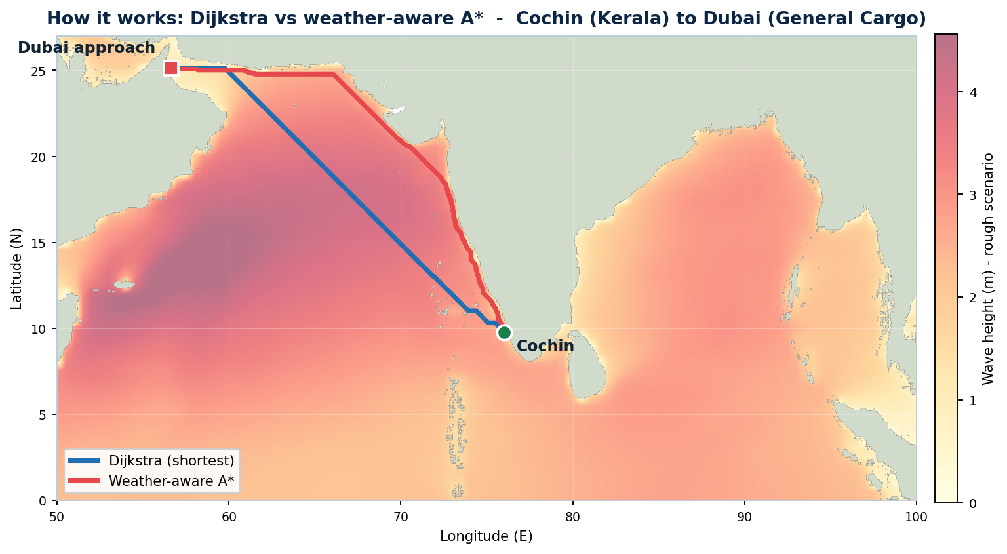
8
How It Works: Dijkstra vs Weather-Aware A*
Blue - Dijkstra
Shortest safe distance. Ignores weather.
Red - Weather-aware A*
Detours around the roughest water for a calmer, safer passage.
74%
fewer cells explored than Dijkstra
(A* heuristic = still optimal)
Real output: Cochin to Dubai, rough seas, General Cargo
Notes:
This is the money slide. Point at the map: blue cuts straight, red bends around the orange/red rough-wave zone. A* is both safer and far more efficient (74% fewer cells).

Slide 10
9
Results, Live Demo & Conclusion
Live demo (30 seconds)
Run python server.py -> open localhost:8000
Vessel: General Cargo · Cochin -> Dubai · Rough
Click Find route - blue vs red appear
Click a dot for a wave tooltip; switch to Live
Conclusion
A free, offline, explainable system that makes ship routes safer, calmer and more efficient - proven against a traditional baseline.
Key results
A* explores ~74% fewer cells than Dijkstra.
Cochin->Dubai: +298 km to cut peak wave 4.13 -> 3.31 m.
Every route stays >= 22 km from the coast.
Notes:
Demo script: start server before the session. General Cargo, Cochin to Dubai, Rough, Find route. Read the verdict. Click a wave dot. Switch to Live if internet is available. Close with the conclusion line. If no internet, stay on Typical/Rough.

