Slide 1

Presented by:
Manish Rachakonda (2023EBCS668)
TalkToJesus
BSc Computer Science (2025-2026)
A Bilingual Voice-First AI Spiritual Companion
Under the guidance of
Swapnil Saurav
Notes:
[0:00-0:20] Name, roll number, supervisor, one sentence on what it is:
"A user speaks a question in English or Telugu and hears a scripture-grounded reply
in a pastoral voice." Then move on - do not linger on the title slide.

Slide 2
Problem Statement
Telugu Bible apps have millions of downloads - and zero conversation.
One-way communication - they present content; none answer a question
Access is gated on a person - a pastor must be available, scheduled, approachable
Guidance is not situation-aware - a reading plan does not know what you are facing
Language and culture - general AI assistants are not scripture-grounded, and their
Telugu is not idiomatic - addressing a believer as "naa bidda" (నా బిడ్డ) is not
a translation problem
The gap: a believer with a question at 2 a.m., in Telugu, has nowhere to ask it.
Notes:
[0:20-1:30] Lead with the one-liner - millions of downloads, zero conversation.
Then the four gaps, one sentence each. Land on the 2 a.m. line: that is the whole
motivation. Do not read the bullets verbatim.

Slide 3
Objectives & Scope
Objectives (PO1-PO7):
PO1-PO2 Cross-platform app + secure backend with auth, conversation, subscriptions
PO3-PO4 LLM for scripture-grounded replies; voice in and voice out
PO5 Bilingual English/Telugu with culturally correct address
PO6-PO7 Subscription monetisation; containerised deployment on GCP
Scope:
In - conversation, Bible reader, hymn library, subscriptions, admin console
Out - app store publication, video avatar, community features, RAG over scripture
Notes:
[1:30-2:20] Do NOT read seven objectives. Group them as shown: app + backend,
AI + voice, bilingual, money + deployment. Spend the saved time on the "Out" line -
being explicit that there is no RAG is a credibility point, and an examiner may ask.

Slide 4
Existing System / Literature Review
Conversational? Scripture-grounded? Telugu? Voice-first?
YouVersion Bible App - strong content, no dialogue
Telugu Bible apps - Telugu and scripture, but static content only
Pray.com - guided prayer and audio, no conversation, no Telugu
General AI assistants - conversational, but not scripture-grounded, weak Telugu
Glorify / Abide - devotional, no conversational AI, no Telugu
Each covers some. None covers all four. That intersection is the contribution.
Notes:
[2:20-3:10] The point is the empty column, not the competitor list. Say the four
criteria once, then: "every one of these covers some of the four; none covers all
four at once." That sentence is the UVP - deliver it deliberately.

Slide 5
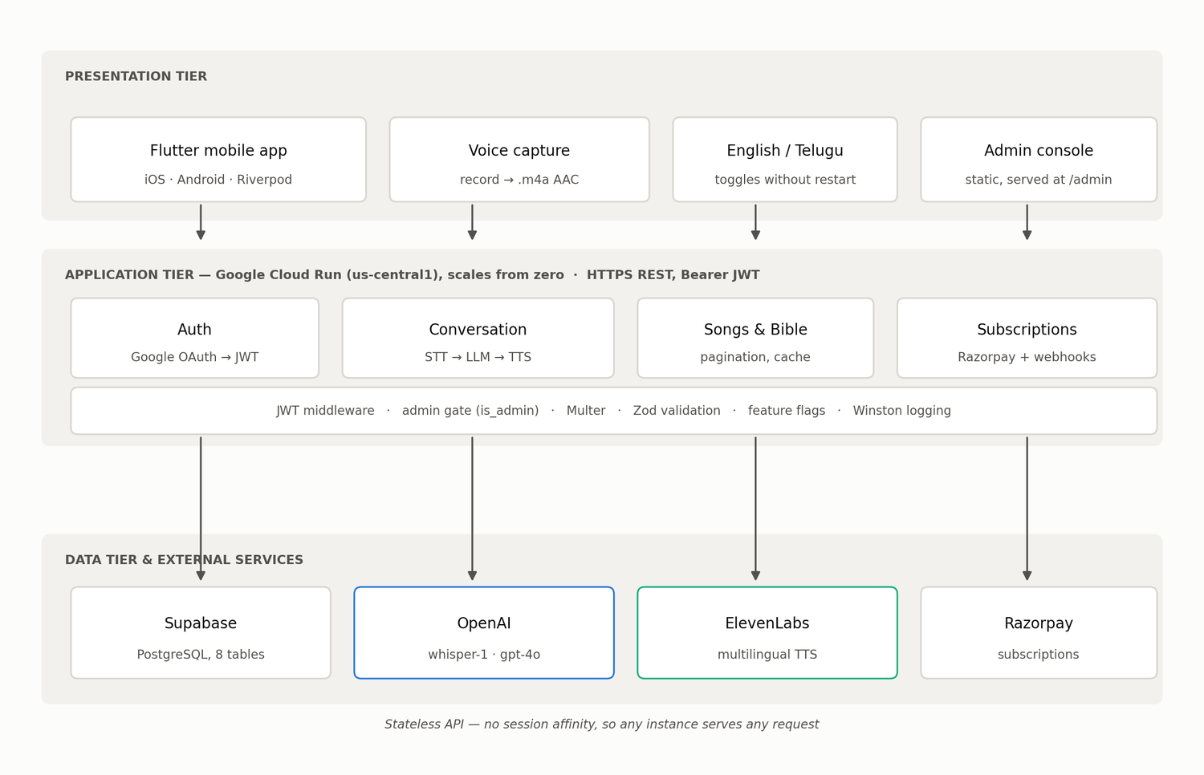
Proposed System Architecture
Three tiers, one stateless API:
Presentation - Flutter (iOS/Android, Riverpod) + the admin console
Application - Express 5 / TypeScript, 28 endpoints, Cloud Run, scales from zero
Data - Supabase PostgreSQL (8 tables) + OpenAI, ElevenLabs, Razorpay
One decision drives the rest: the API holds a service-tier key that
bypasses row-level security - so authorization lives in application code.
Notes:
[3:10-4:30] The most technical slide - slow down. Walk the diagram top to bottom.
Then land the service-key point: RLS is on but unpolicied and bypassed, so every
user-scoped query must filter in code. That is an honest architectural weakness and
naming it before the examiner does is worth more than hiding it.

Slide 6
Tools & Technologies
Language / Framework: Dart + Flutter 3.38.6 | TypeScript 5.9 + Express 5 on Node 20
State / Validation: Riverpod 2.5 | Zod 4.1
Database: Supabase (PostgreSQL), 8 tables, no ORM
AI services: OpenAI whisper-1 (STT) + gpt-4o (LLM) | ElevenLabs (TTS)
Payments / Identity: Razorpay subscriptions | Google OAuth 2.0 -> HS256 JWT
Infrastructure: Docker, Cloud Build, Cloud Run (us-central1), Artifact Registry
Observability: Winston, Sentry, PostHog, per-stage latency instrumentation
Quality: Jest (66 tests) + flutter_test (75 tests) = 141, gated in CI
Notes:
[4:30-5:00] Read the categories, not every item. Finish on the last line - 141 tests,
all passing, gated in CI. Then >>> CHECK THE CLOCK. You need seven clear minutes for
the demo. If you are past 5:15, skip straight to slide 7.

Slide 7
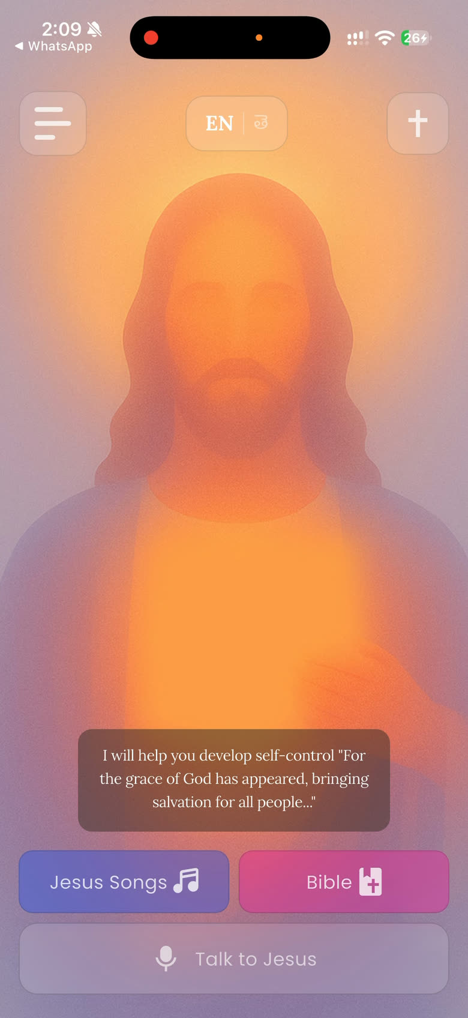
Implementation / Demo
LIVE DEMO
1. Sign in with Google
2. Home screen - switch EN -> TE (తెలుగు), every label changes, no restart
3. Bible reader in Telugu - Genesis 1, then change translation
4. Hymn library - 12 bundled hymns, plays with no network
5. Speak a question - record, send, hear the reply
6. Free tier exhausted -> paywall -> Razorpay UPI -> badge turns active
7. Conversation history - the full turn with scripture citations
8. Admin console - live metrics, then the latency breakdown
Fallback: the recorded demo, and the console's offline demo mode.
Notes:
[5:00-12:00] SEVEN MINUTES. This is the slide that decides the viva.
Order matters: bilingual switch first (it is instant and visual), then Bible, then
hymns, then the voice turn. START THE VOICE TURN EARLY - it takes ~28 seconds to
come back. Fill that silence deliberately: "while that runs, note that every stage
is being timed - I will show you the numbers in two minutes." Do not apologise for
the wait; frame it as the thing you measured.
Then paywall -> UPI -> badge. Then history. Then the console.
FALLBACKS, in order: (1) if the network is slow, play the recorded demo from
10-Demo-Video-Links.txt; (2) if the backend is down, the console has an offline
demo mode - but SAY it is demo data; (3) if all else fails, walk the figures in
the report.

Slide 8
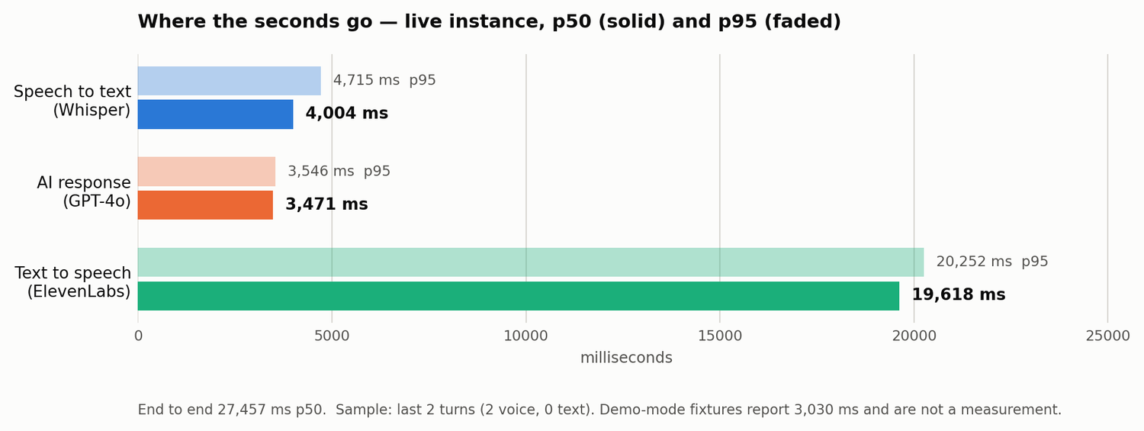
Results & Analysis
20/20 functional requirements implemented | 141 automated tests, 0 failing
Full subscription flow verified end to end on device, real UPI payment
MEASURED pipeline latency (live instance, p50):
Speech to text (Whisper) 4,004 ms 15%
AI response (GPT-4o) 3,471 ms 13%
Text to speech (ElevenLabs) 19,618 ms 71%
End to end 27,457 ms
NFR1 required 5 seconds. Not met - and the instrumentation is what found it.
Notes:
[12:00-13:15] The most important slide after the demo. Do not soften it.
Say plainly: "The requirement was five seconds. We measure 27.5. It is not met."
Then the useful part: 71% is speech synthesis, so this is a TTS problem, not a
model problem. And the probable cause is our own prompt - it specifies 2-4
sentences and the model returns three paragraphs, so we are asking the synthesiser
to render five times more text than designed.
If asked about the "3-6 seconds" in the Phase 3 document: that number came from
the admin console's DEMO FIXTURES, not a measurement. We found that while writing
this report and corrected it. Own it - the correction is the result.
Caveat honestly: sample is 2 turns. Enough for an order of magnitude, not a
distribution.

Slide 9
Challenges & Limitations
Latency fails NFR1 by ~5x - dominated by speech synthesis
Authorization rests on application code - RLS is enabled but unpolicied and bypassed,
and no automated test asserts isolation between users
Secrets committed - a long-lived token, PostHog key and Sentry DSN must be rotated
No rate limiting; CORS is unrestricted
Transcripts are personal data with no retention or deletion policy
Coverage stops at the service layer - no widget, integration or end-to-end tests
Three bundled hymns are CC BY-SA and need a credits screen the app does not have
Notes:
[13:15-14:00] Deliver these flatly and quickly - no hedging, no "but". A limitations
slide read confidently reads as competence; one read apologetically reads as doubt.
Do not soften the secrets line. If asked "why is a token in source control?" the
honest answer is that it was a demo convenience that should have been removed, it
is in the report's pre-submission checklist, and it will be rotated.

Slide 10
Conclusion & Future Work
Conclusion:
All 7 primary objectives met; 20/20 functional requirements implemented
141 automated tests passing across both tiers, gated in CI
Bilingual voice conversation working in Telugu with culturally correct address
Future Work:
1. Tighten the persona prompt and re-measure - likely the bulk of the 19.6 s
2. Stream synthesised audio so playback starts before synthesis finishes
3. Add authorization-isolation tests - the most valuable missing test
4. Rotate the committed secrets; add rate limiting; restrict CORS
5. Data retention policy; about/credits screen for CC BY-SA compliance
The system measures itself - and that is how it caught its own claim.
Notes:
[14:00-14:45] Conclusion in three lines, future work in five, then the closing line.
The closer is the thesis of the whole project: "Most projects can tell you their app
works. This one can tell you where its seconds go - and that is how it caught a claim
it had been repeating about itself in three documents."
>>> STOP AT 14:45. Leave the closing line on screen for questions.

