Slide 1

PUG TECH TALK · AUGUST 22, 2026
Building AI Agents with
Microsoft Foundry Local & Agent Framework
Manish Lad
AI Product Manager
Notes:
Welcome the room. Frame it up front: this is a field report, not a product tour. A third of this talk is what broke.

Slide 2
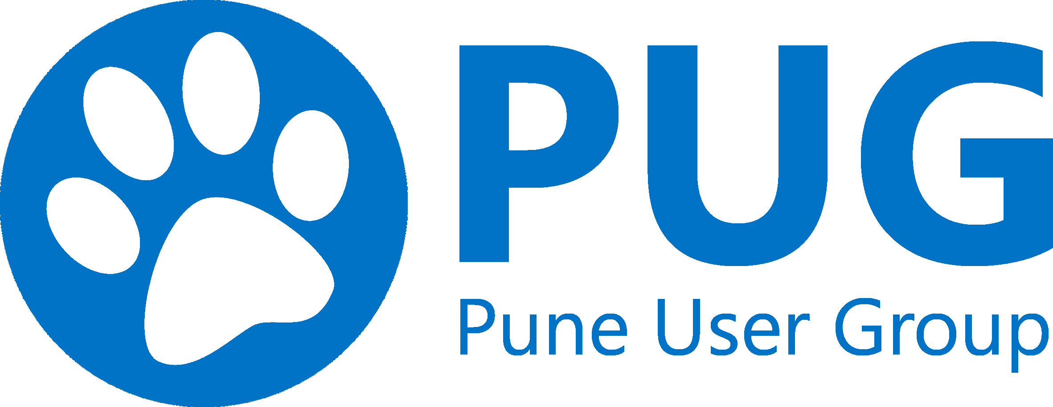
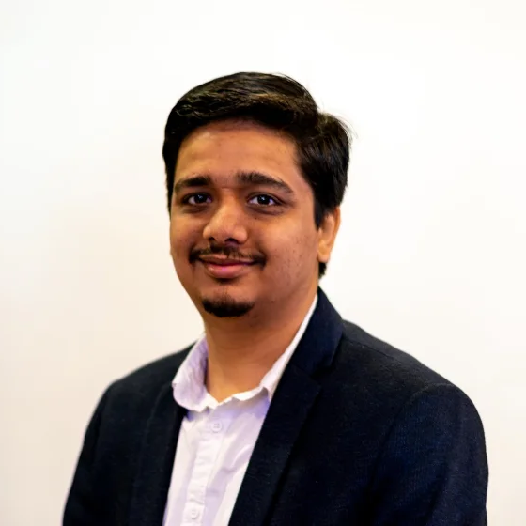
HELLO — I'M
Manish Lad
AI Product Manager
·
12+ years of experience, 6+ working with AI
·
15+ years volunteering with Pune User Group
·
I write about AI × product strategy — for builders and leaders.
substack manishlad.substack.com
in /manish-lad
PUG Tech Talk · August 22, 2026
Notes:
Quick intro — keep it to 60 seconds. Who you are, what you build, and why this topic. Drag your photo onto the slot before the talk.

Slide 3
Why build local-first?
PUG Tech Talk · August 22, 2026
Notes:
Pause here. Ask the room before answering — most people reach for cost first, and cost is the less interesting half.

Slide 4
Why build local-first?
01
02
Data privacy & compliance
Zero latency & predictable cost
Process sensitive enterprise documents, healthcare data, or PII completely on-device. Zero network transmissions mean guaranteed compliance with air-gapped security requirements.
Eliminate cloud network round-trips and API rate limits. Achieve sub-10ms local token execution with standard zero recurring cloud API token costs.
PUG Tech Talk · August 22, 2026
Notes:
Two reasons that decide it before any benchmark: the data legally cannot leave the machine, and the economics of local execution are flat. Everything after this is downstream of these two.

Slide 5
Microsoft Foundry Local
Microsoft Foundry Local provides lightweight, high-performance local AI runtime for running open models (like Phi-4 and Mistral) directly on developer machines and edge hardware.
It exposes standard OpenAI-compatible endpoints seamlessly, enabling drop-in local replacements for cloud LLMs without altering agent code structure.
PUG Tech Talk · August 22, 2026
Notes:
Introduce the runtime plainly before the diagram. The second paragraph is the whole pitch: drop-in replacement, no code restructuring.

Slide 6
Microsoft Agent Framework
The Microsoft Agent Framework provides structured primitives for building reliable, task-oriented LLM workflows and multi-agent systems.
KEY CAPABILITIES
Deterministic state management and conversation routing.
Modular tool calling and structured output extraction.
Seamless binding to local inference runtimes.
PUG Tech Talk · August 22, 2026
Notes:
Plain introduction before the division-of-labour slide. The third capability is the one that matters here — it binds straight to Foundry Local.

Slide 7
Foundry Local runs the model. Agent Framework orchestrates what you do with it .
Agents, tool calling, conversation, workflows. Provider-agnostic — so local-first is a deployment decision, not an architectural commitment.
PUG Tech Talk · August 22, 2026
Notes:
Division of labour: Foundry Local runs the model, Agent Framework orchestrates. Provider-agnostic — local-first is a deployment decision, not an architectural commitment.

Slide 8
Demo
PUG Tech Talk · August 22, 2026
Notes:
Switch to the machine.

Slide 9
When to combine framework & local
01
Privacy-sensitive workflows
02
Offline / edge deployment
Triage, summarize, or extract structured metadata from confidential legal or medical documents locally.
Build intelligent agents that run on field equipment, vessels, or air-gapped industrial networks.
03
Cost reduction at scale
04
Fast local prototyping
Replace repetitive bulk cloud LLM tasks with high-throughput local Small Language Models (SLMs).
Iterate rapidly on agent tool definitions and prompt templates with zero latency and no cloud bill.
PUG Tech Talk · August 22, 2026
Notes:
Four situations where the pairing earns its keep. The first two are constraint-driven, the last two are economics — most teams arrive via one and stay for the other.

Slide 10
Q&A
Over to you.
PUG Tech Talk · August 22, 2026
Notes:
Open the floor. Repeat each question for the room before answering.

Slide 11
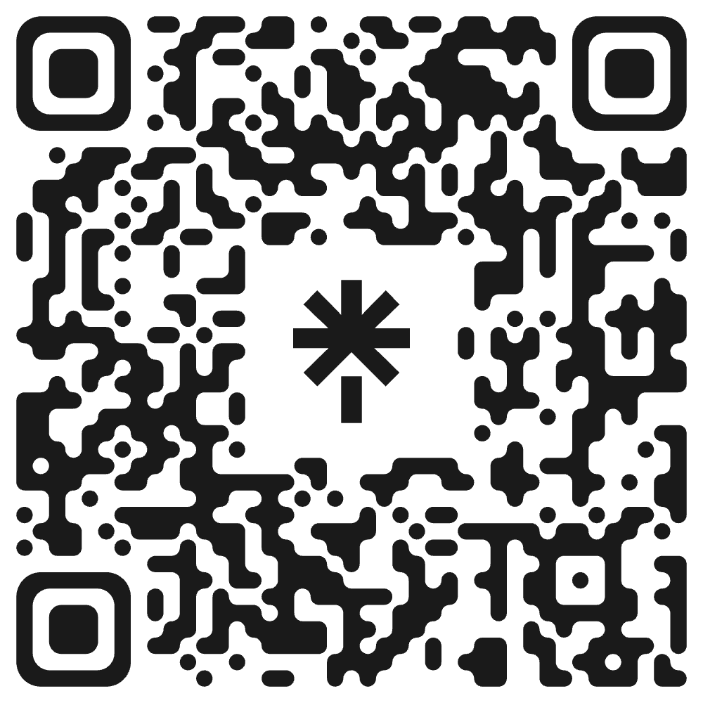
THANK YOU
Let's connect.
Manish Lad
AI Product Manager
substack
manishlad.substack.com
linkedin
linkedin.com/in/manish-lad
Writing about AI × product strategy — for builders and leaders.
SCAN TO CONNECT
linktr.ee/manishlad
PUG Tech Talk · August 22, 2026
Notes:
Thank the room. Point to the Substack and LinkedIn, and the QR to get started tonight. Open for questions.

