Slide 1
Crimes and Household in Austin, Texas (CS 6830)
- Manish Meshram (MS CS)

Slide 2
Contents
Introduction
Dataset
Analysis and Results

Slide 3
Introduction
Dataset – Crime and Household in Austin, Texas in 2015
Aim – To find the most occurred crime and identify the reason behind it or find out relation between crimes and household data

Slide 4
Dataset
Crime and Household in Austin, Texas in 2015
Data Cleaning
Ignored null values
Cleaned special characters
Selected important attributes

Slide 5
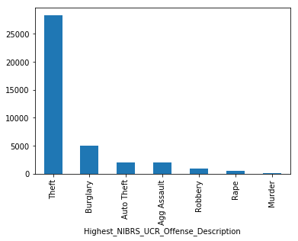
Analysis and Results
Most occurred crime

Slide 6
Analysis and Results
Mean and Standard deviation for selected attributes
Attribue | Mean | Standard Deviation
Populationbelowpovertylevel | 22.828399828399828 | 13.436202985687384
Populationwithdisability | 9.000663000663002 | 2.280427717436714
Unemployment | 8.148122148122148 | 6.020988100356848
Largehouseholds(5+members) | 8.166296166296167 | 6.020988100356848
Homesaffordabletopeopleearninglessthan$50000 | 37.5982215982216 | 28.83318859210238
Rentalsaffordabletopeopleearninglessthan$25000 | 11.481806481806482 | 8.575010319427765

Slide 7
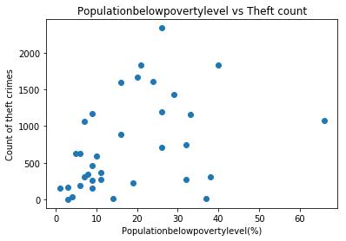
Analysis and Results
Correlation – Percentage of population below poverty level and Theft count for zip codes
Pearson correlation coefficient: 0.399363685513 p value: 0.0174679610264

Slide 8
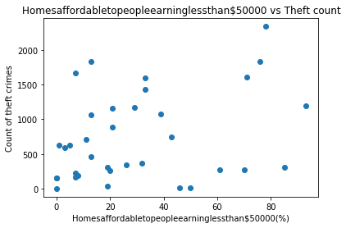
Analysis and Results
Correlation – Percentage of homes available to people earning less than $50000 and Theft count for zip codes
Pearson correlation coefficient: 0.327312033345 p value: 0.0549435006369

Slide 9
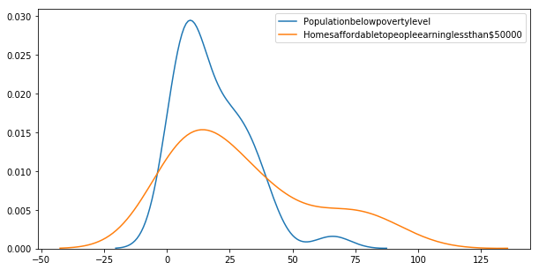
Analysis and Results
Distributions Populationbelowpovertylevel vs Homesaffordabletopeopleearninglessthan$50000
T value: 2.31150686279 p value: 0.023841935982

