Slide 1

IITB_RISC-32
Six Stage Pipelined Processor
Manish Prajapati 213070074 | Ajay Verma 213070059
Amit Kumar Singh 213070069 | Subham Singh 213070076
Reset
Department of Electrical Engineering
IIT Bombay
CLock

Slide 2
IITB-RISC is six stage pipelined processor. It is a 16-bit computer system with 8 registers (R0 to R7).
It includes hazard mitigation techniques, such as data forwarding and branch prediction.
Each address corresponds to two bytes of main memory.
This architecture uses two conditional code registers carry flag (C) and zero flag (Z).
There are three machine-code instruction formats (R, I, and J type) and a total of 14 instructions.
Opcode (4-bit) | RA (3-bit) | RB (3-bit) | RC (3-bit) | Unused (1-bit) | Condition (2-bit)
R-Type
Opcode (4-bit) | RA (3-bit) | RC (3-bit) | Immediate (6-bits)
I-Type
Opcode (4-bit) | RA (3-bit) | Immediate (9-bits)
J-Type

Slide 3
Instruction Encoding
ADD | 00_01 | RA | RB | RC | 0 | 00
ADC | 00_01 | RA | RB | RC | 0 | 10
ADZ | 00_01 | RA | RB | RC | 0 | 01
ADL | 00_01 | RA | RB | RC | 0 | 11
ADI | 00_00 | RA | RB | 6 Bit Immediate
NDU | 00_10 | RA | RB | RC | 0 | 00
NDC | 00_10 | RA | RB | RC | 0 | 10
NDZ | 00_10 | RA | RB | RC | 0 | 01

Slide 4
Instruction Encoding
LW | 01_00 | RA | RB | 6 Bit Immediate
SW | 01_01 | RA | RB | 6 Bit Immediate
BEQ | 10_00 | RA | RB | 6 Bit Immediate
JAL | 10_01 | RA | 9 Bit Immediate
JLR | 10_10 | RA | RB | 000_000
JRI | 10_11 | RA | 9 Bit Immediate
NOPE | 11_11 | XXXX
Source
Destination

Slide 5
Instruction Description
Mnemonic | Name & Format | Assembly | Action
ADD | ADD (R) | add rc, ra, rb | Add content of regB to regA and store result in regC. It modifies C and Z flags.
ADC | Add if carry set (R) | adc rc, ra, rb | Add content of regB to regA and store result in regC, if carry flag is set. It modifies C and Z flags.
ADZ | Add if zero set (R) | adz rc, ra, rb | Add content of regB to regA and store result in regC, if zero flag is set. It modifies C and Z flags.
ADL | Add with one bit left shift of RB (R) | adl rc, ra, rb | Add content of regB (after one bit left shift) to regA and store result in regC It modifies C and Z flags.
ADI | Add immediate (I) | adi rb, ra, imm6 | Add content of regA with Imm (sign extended) and store result in regB. It modifies C and Z flags.

Slide 6
Instruction Description
Mnemonic | Name & Format | Assembly | Action
NDU | Nand (R) | ndu rc, ra, rb | NAND the content of regB to regA and store result in regC. It modifies Z flags.
NDC | Nand if carry set (R) | ndc rc, ra, rb | NAND the content of regB to regA and store result in regC if carry flag is set. It modifies Z flags.
NDZ | Nand if zero se (R)t | ndz rc, ra, rb | NAND the content of regB to regA and store result in regC if zero flag is set. It modifies Z flags.
LW | Load (I) | lw ra, rb, imm6 | Load value from memory into reg A. Memory address is formed by adding immediate 6 bits with content of red B. It modifies Z flags.
SW | Store (I) | sw ra, rb, imm6 | Store value from reg A into memory. Memory address is formed by adding immediate 6 bits with content of red B.

Slide 7
Instruction Description
Mnemonic | Name & Format | Assembly | Action
BEQ | Branch on equality (I) | jeq ra, rb, imm6 | If content of reg A and reg B are the same, branch to PC+Imm, where PC is the address of beq instruction.
JAL | Jump and link (I) | jalr ra, imm9 | Branch to the address PC+ Imm. Store PC+1 into regA, where PC is the address of the jalr instruction.
JLR | Jump and link to register (I) | jalr ra, rb | Branch to the address in regB. Store PC+1 into regA, where PC is the address of the jalr instruction.
JRI | Jump to register (J) | jri ra, imm9 | Branch to memory location given by the RA + Imm.

Slide 8
Instruction Fetch
S_BPU
IF_ID
S
IS_IF1
PC
1
PC
PC+1
00
PC_IF
01
BTA
Instruction
Memory
10
IS_IF2
Instruction
ALU_R_EX_MEM
11
PC_IF_ID_Write_HZ
PC_1_EX_MEM
PC_Src_BPU1
// BA: Branch address
// BTA: Branch target address
PC_IF_ID_Write_HZ

Slide 9
Instruction Decode
S_NS_BPU2
ID_RR
S_IF_ID
S_NS
S
HDU_B
B
Branch Predictor Controller
PC
PC
PC+1
PC+1
Instruction
Controller
EX
MEM
Hazard Detection Unit
Instruction_IF_ID
WB
Instruction
Instruction
Instruction[15:12]_ID_RR

Slide 10
Register Read
S_NS_BPU2
RR_EX
S_ID_RR
S_NS
S
B
PC
PC+1
EX
S_B_MEM_WB
RA
MEM
RB
WB_RF_W_C7
Write_Control
Register
File
WB
Data_RA
Data_RA
Add_RD
Data_RB
Data_RB
Data_RD
Instruction
Instruction

Slide 11

Instruction Execute
S_NS_BPU2
EX_MEM
Data Forwarding Unit
S_NS
S
S_RR_EX
B
00
Data_RA
Data_RA
PC+1 | PC
IS_EX1
01
00
Data_RB
Data_RB
MEM
10
10
ALU_R_EX_MEM
PC
IS_EX3
WB
01
11
ALU_R_MEM_WB
C
Z
Zero
IF_Br
EX_ALU_DF1
10
EX_ALU_C1
00
ALU_R_EX_MEM
ALU_R
Data_RB
01
IS_EX4
R << 1
01
ALU_R_MEM_WB
Data_RA
Data_RB
Data_RB <<1
00
IS_EX2
EX_ADD_NAND_C3
S_E_6
10
Data_RB
Imm6
SE_Imm6
EX_ALU_DF2
S_E_9
11
Instruction [15:3]
Imm9
SE_Imm9
Instruction [15:3]
ALU_R_EX_MEM
EX_ALU_C2

Slide 12
Memory Access
and
Write Back
MEM_WB
S
00
B
01
PC+1
PC+1
Data_RD
10
WB
WB_Sel_C6
Data_RA
ALU_R
0
Data
Memory
Data_MA
10
1
ALU_R
RA
RA
01
RB
RB
Add_RD
MEM_DM_WR_C4
Write_Control
WB_Sel_DF3
00
RC
RC
S_B_EX_MEM
WB_Sel_R_C5
Instruction [15:3]
ALU_R_MEM_WB

Slide 13
Data Forwarding Unit
Hazard Detection Unit
IF_ID_Instruction [15:9]
PC_IF_ID_Write_HZ
EX_ALU_DF1
ID_RR_Instruction [15:6]
B = Bubble
RR_EX_Instruction [15:3]
EX_MEM_Instruction [15:3]
EX_ALU_DF2
MEM_WB_Instruction [15:3]
RR_EX_Instruction [15:12]
CZ_Write_C0
WB_Sel_DF3
C
Z

Slide 14
Branch Prediction Unit
ALU_R_EX_MEM
PC_EX_MEM
IF_BR
History bit
Write_Signal
BIA Field
BTA Field
BIA
BTA
HB

Slide 15
Branch Prediction Unit
S_NS_BPU
I_15_14_PR1
S_XX_XX
S_NS
I_15_12_PR4
PC_Src_BPU1[0]
IF_BR
PC_Src_BPU1[1]
PC_IF_ID
PC_EX_MEM
S_BPU
1
S_XX_XX
PC_1_EX_MEM
0
S_NS_BPU2
Zero
PC_RR_EX
ALU_R_EX_MEM
BTA
S_NS_BPU
Data_RB_EX_MEM

Slide 16
Instruction Decode | Controller
 |  |  | ADD | ADC | ADZ | ADL | ADI | NDU | NDC | NDZ | LW | SW | BEQ | JAL | JLR | JRI
EX_ALU_C1 |  |  | 00 | 00 | 00 | 00 | 00 | 00 | 00 | 00 | 01 | 01 | 10 | 10 | 11 | 00
EX_ALU_C2 |  |  | 00 | 00 | 00 | 01 | 10 | 00 | 00 | 00 | 10 | 10 | 10 | 11 | 00 | 11
EX_ADD_NAND_C3 |  |  | 1 | 1 | 1 | 1 | 1 | 0 | 0 | 0 | 1 | 1 | 1 | 1 | 1 | 1
MEM_DM_WR_C4 |  |  | 0 | 0 | 0 | 0 | 0 | 0 | 0 | 0 | 0 | 1 | 0 | 0 | 0 | 0
WB_Sel_R_C5 |  |  | 00 | 00 | 00 | 00 | 01 | 00 | 00 | 00 | 10 | 00 | 00 | 10 | 10 | 00
WB_Sel_C6 |  |  | 00 | 00 | 00 | 00 | 00 | 00 | 00 | 00 | 10 | 00 | 00 | 01 | 01 | 00
WB_RF_W_C7 |  |  | 1 | 1 | 1 | 1 | 1 | 1 | 1 | 1 | 1 | 0 | 0 | 1 | 1 | 0

Slide 17
Condition for Bubble: Load is followed by an instruction whose source is the destination for the load instruction.
Condition for Data-Forwarding: Instruction I1 is followed by instruction I2 whose source is destination of I1.
Use SW, BEQ, JAL, and JLR after 3 NOPE. (Data forwarding is not implemented for data stored from register file)

Slide 18
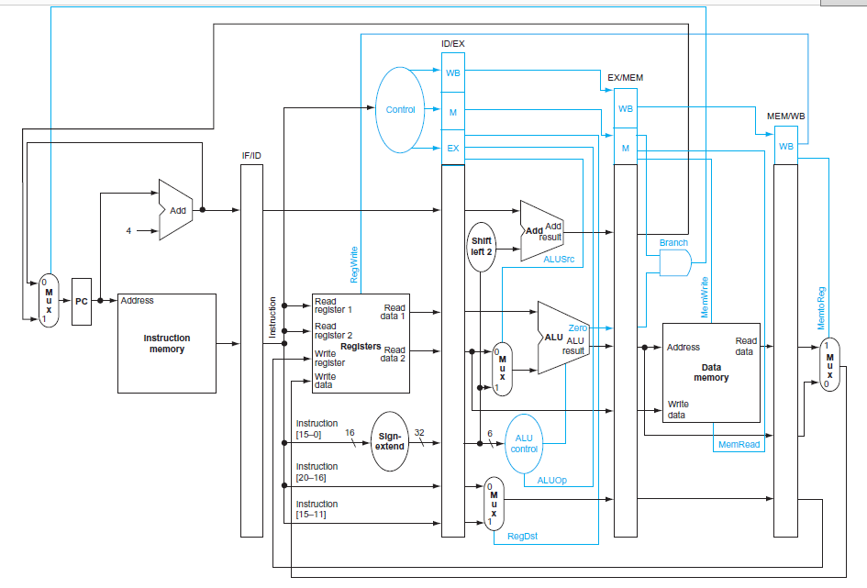
Source: Computer Organization and Design,
Patterson & Hennessy

Slide 19
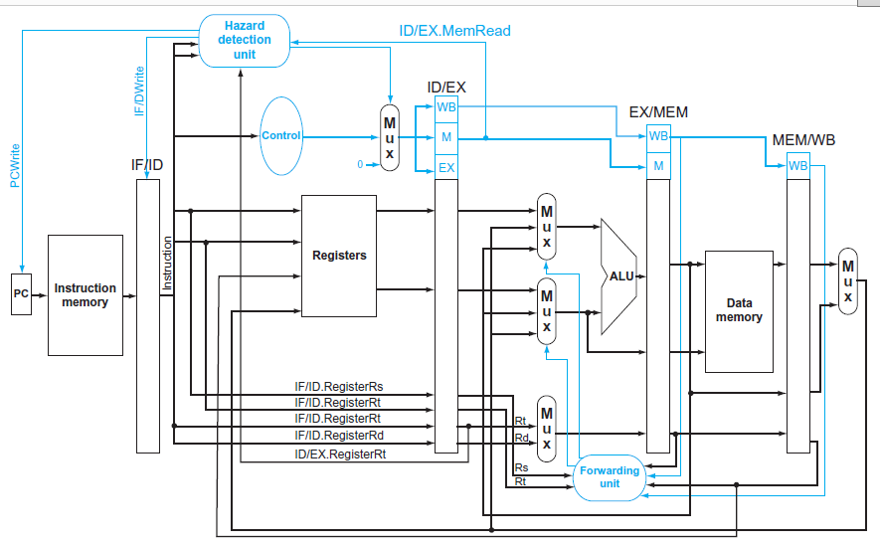
Source: Computer Organization and Design,
Patterson & Hennessy

