Slide 1
Markov Transition Field
for Time Series Analysis
Encoding electricity load data as 2D images
with Bayesian-optimized parameters
Exploratory Analysis
Markov Chains
Image Encoding
Bayesian Optimization
ML-Ready
Dataset: ETTh1 — Electricity Transformer Temperature | 17,420 hourly readings | 7 features

Slide 2
What We Cover
A structured walkthrough from raw data to ML-ready image encoding
01
The Problem
04
Bayesian Optimization
Why raw time series is hard to work with at scale
Intelligently tuning the most critical parameter
02
Dataset & EDA
05
Results & Insights
Understanding the electricity load data before processing
MTF images, transition patterns, and regime analysis
03
What is MTF?
06
Applications
How a time series becomes a 2D image, step by step
Real-world uses across industries

Slide 3
01
The Problem
Why raw sensor data is not enough

Slide 4
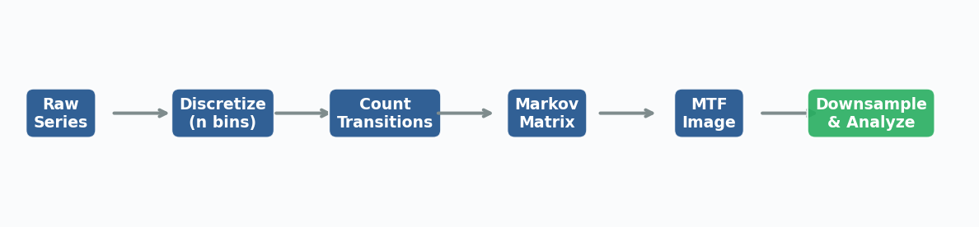
The Challenge with Raw Time Series Data
Three core pain points in electricity load analysis
🔢
Thousands of Numbers
📉
Hidden Dynamics
⚙️
AI Incompatibility
17,420 hourly readings per sensor. No human can inspect this raw stream — patterns are invisible to the naked eye.
Simple line plots show what the values are, not how they tend to change. The statistical transition structure is lost.
State-of-the-art image recognition AI (CNNs, Vision Transformers) cannot directly process a 1D sequence of numbers.
Our Answer
Convert the time series into a 2D image that captures BOTH the temporal order AND the probabilistic transition structure of the data. This image can then be fed directly into any image-based AI model.
Raw series → Discretize → Transition Matrix → MTF Image → AI-ready

Slide 5
02
Dataset & EDA
Understanding the electricity transformer data

Slide 6
ETTh1 — Electricity Transformer Temperature Dataset
Hourly sensor readings from a Chinese power grid
17,420
7
~2 yrs
1,000
Hourly readings
Sensor features
Time span
Rows analysed
Column | Description | Role
HUFL | High Useful Load | ★ Our Focus
HULL | High Useless Load | Supporting
MUFL | Medium Useful Load | Supporting
MULL | Medium Useless Load | Supporting
LUFL / LULL | Low Useful / Useless Load | Supporting
OT | Oil Temperature | Distinct behaviour

Slide 7
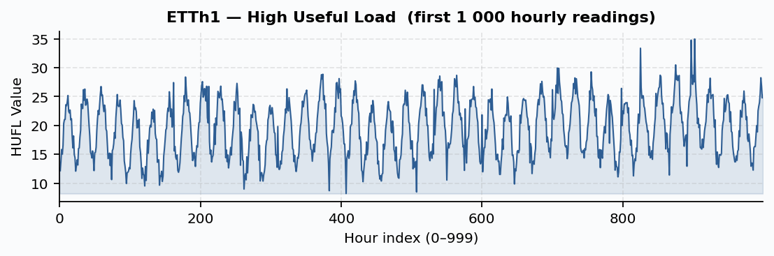
The Raw HUFL Signal
High Useful Load — first 1,000 hourly readings
💡 The signal shows clear repeating cycles (daily load peaks during working hours) and occasional sharp spikes. These patterns need to be captured quantitatively — not just observed visually.

Slide 8
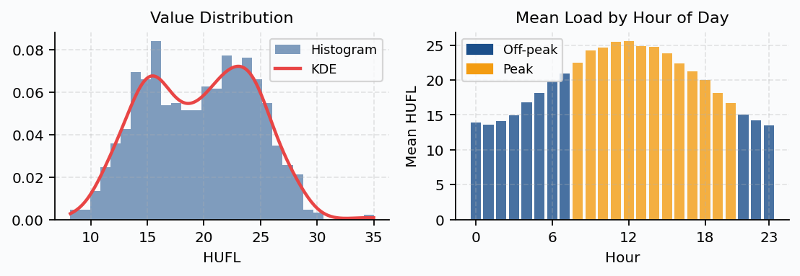
Value Distribution & Daily Load Patterns
Is the data normally distributed? When is load highest?
Left chart: The distribution is right-skewed and non-normal. This is why we use quantile binning — it doesn't assume a bell curve shape, giving each bin an equal number of data points.
Right chart: Load peaks clearly in business hours (8am–8pm, shown in gold). Night-time load (blue) is consistently lower. The MTF will capture this daily rhythm as transition patterns.

Slide 9
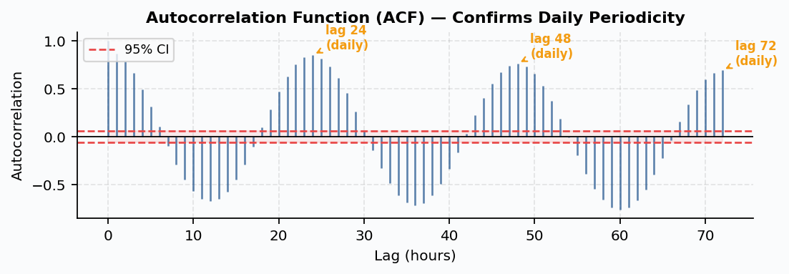
Autocorrelation Analysis (ACF)
Measuring how much the present predicts the future
What is ACF?
Key Finding: lag 24 & 48
Why it matters for MTF
It measures how well the current value predicts a value 'lag' hours in the future. Values outside the red band are statistically significant.
Strong peaks at lag 24 and 48 hours confirm a precise daily (24-hour) cycle in electricity load — the same pattern repeats every day.
The MTF encodes this memory explicitly — the transition probabilities between hour-pairs 24 steps apart will be systematically higher than random.

Slide 10
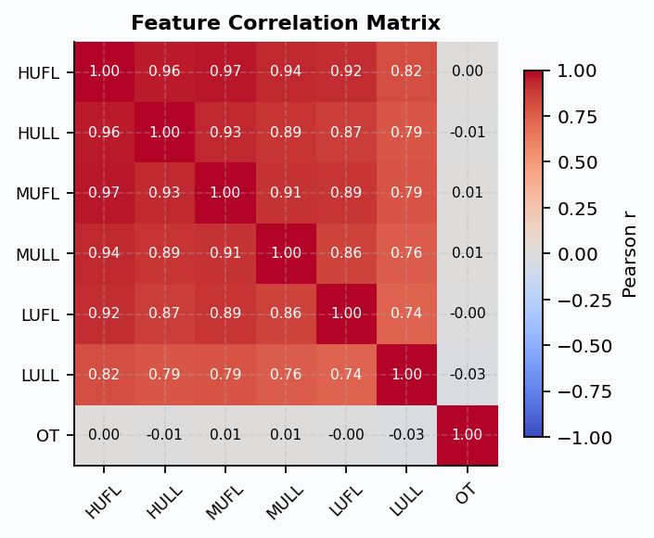
Feature Correlation — All 7 Sensors
How do the different load measurements relate to each other?
🔗
High load correlation
HUFL, HULL, MUFL, MULL are all strongly correlated (r > 0.8). They all respond to the same demand events.
🌡️
Oil Temperature (OT) differs
OT has weaker correlation with load features — it reflects thermal lag and equipment physics, not just demand.
🎯
Focus on HUFL
Since features are redundant, we analyse HUFL as the most representative signal for MTF encoding.

Slide 11
03
What is a Markov Transition Field?
From numbers to images in three steps

Slide 12
The Core Idea — A New Way to See Time Series
We photograph the data's behaviour, not its shape
What MTF captures:
An intuitive analogy:
Not the values themselves,
Think of a weather forecaster.
They don't just record today's temperature — they track how often 'cold' days are followed by 'warm' days.
MTF does the same for electricity load: it records the full map of 'if the load is at level A now, how likely is it to be at level B at any future moment?'
The result is a visual fingerprint of the signal's statistical behaviour.
→ but how they CHANGE
Not just consecutive steps,
→ but transitions between ANY two time points
Not just whether change happened,
→ but HOW LIKELY each change is
Temporal ordering is preserved —
→ position in the image = position in time

Slide 13
Building the MTF — Three Steps
A plain-English walkthrough of the pipeline
1
DISCRETIZE
2
TRANSITION MATRIX
3
BUILD THE IMAGE
Group continuous readings into numbered buckets (bins). E.g., bins 0–11 from 'very low load' to 'very high load'. Each hour now has a bin label instead of a raw number.
Scan every consecutive pair of hours. Count: 'how often did bin A lead to bin B?' Divide by totals to get probabilities. Result: a Q×Q grid of transition probabilities.
For every pair of hours (i, j), look up the transition probability between their bins in the matrix. That value becomes a pixel in the N×N image.
📌 Method: Quantile binning — equal data in each bin, no normality assumption needed.
📌 Key property: each column sums to 1 — it's a proper Markov model.
📌 Result: a square image where position = time and brightness = transition probability.
💡 MTF preserves BOTH temporal ordering (position in the grid = position in time) AND Markovian dynamics (value in the grid = transition probability). No other standard encoding achieves both simultaneously.

Slide 14
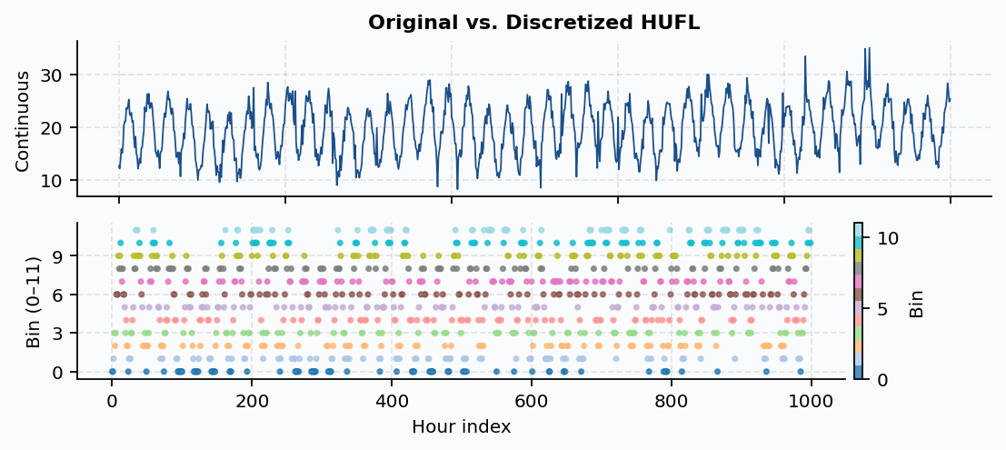
Step 1 — Discretizing the HUFL Signal
Grouping continuous values into labelled bins
Top chart — Original signal: The continuous HUFL readings, ranging from ~6 to ~33. These raw numbers cannot be directly used in a Markov model.
Bottom chart — Discretized: Each hour now has a bin number (0–11). Colours show which bin. Equal-frequency (quantile) binning ensures each state appears roughly the same number of times.

Slide 15
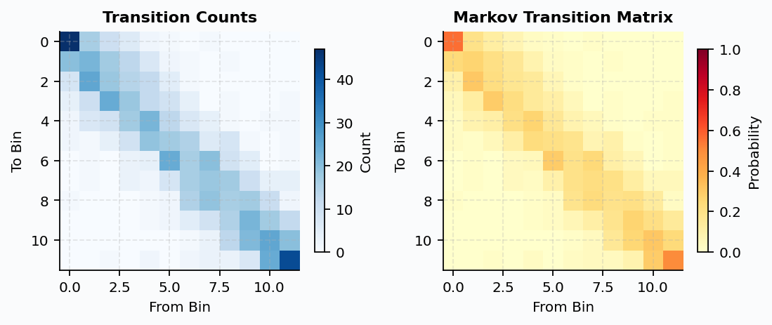
Step 2 — Building the Transition Matrix
Counting and normalising state transitions
Left — Transition Counts: Each cell [row, col] shows how many times the signal moved FROM bin 'col' TO bin 'row' in consecutive hours. Darker = more frequent.
Right — Transition Probabilities: Dividing by column totals gives probabilities (0–1). Notice the strong diagonal — the load most often stays in its current bin (gradual changes). Off-diagonal = jumps.

Slide 16
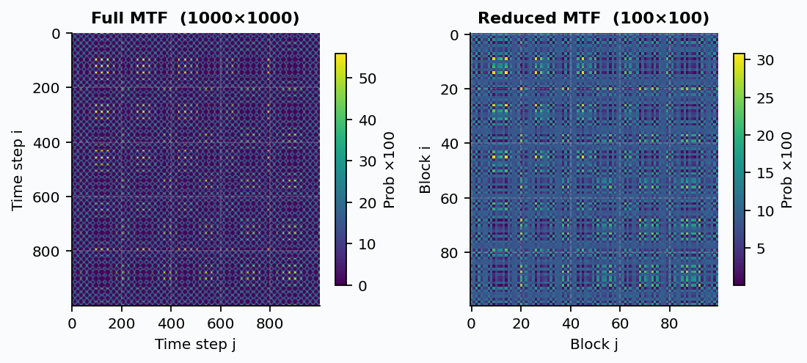
Step 3 — The Markov Transition Field Images
Full resolution and downsampled versions
Left — Full MTF (1000×1000): Every pixel [i,j] = transition probability between the states at hour i and hour j. Bright = high probability, dark = low. Diagonal blocks reveal stable periods.
Right — Reduced MTF (100×100): Block-averaged to 10×10 regions. 100× smaller — easy to store and process by ML models — while preserving all major structural patterns.

Slide 17
04
Bayesian Optimization
Finding the best number of bins intelligently

Slide 18
Why Does the Number of Bins Matter So Much?
Too few or too many both hurt the quality of the MTF
Too Few Bins (e.g. 3)
Optimal Bins (BO finds this)
Too Many Bins (e.g. 30)
✗ Coarse grouping — fine differences lost
✓ Each bin well-populated
✗ Most transitions never observed (zeros)
✗ Many distinct hours treated as identical
✓ Transition matrix reliable and stable
✗ Probabilities estimated from 1–2 examples
✗ MTF loses detail, low information content
✓ MTF encodes rich temporal dynamics
✗ MTF becomes sparse and noisy
✗ Poor model performance
✓ Maximum information content (entropy)
✗ Overfits to specific sample
← Bayesian Optimization
finds this automatically

Slide 19
How Bayesian Optimization Works
Smart search that learns from every evaluation
Grid Search (naive)
Bayesian Optimization
Test n_bins = 4, 5, 6, 7, 8, 9 ... 20
(17 evaluations, all treated equally)
①
Sample:
Test 3 random bin counts to start.
Problems:
②
Model:
• Wastes time on obviously bad regions
Fit a Gaussian Process — predicts entropy for any untested bin count, with uncertainty estimates.
③
Select:
• Treats all values as equally likely to be optimal
Pick the bin count with highest Expected Improvement: the most likely to beat the current best.
• Does not use previous results to guide next guess
④
Update:
Evaluate it, add to observations, re-fit the model. Repeat.
Result: finds the optimal n_bins in ~13 total evaluations (vs 17 for grid search)

Slide 20
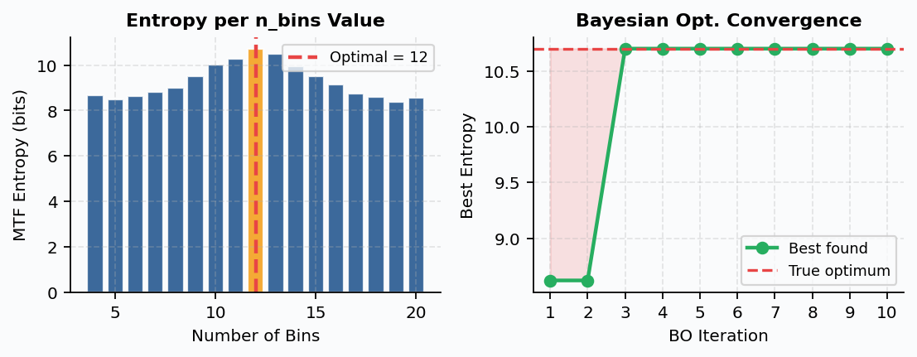
Bayesian Optimization Results
Finding the optimal number of bins using MTF entropy
Left — Entropy Landscape: Bar height = information richness of the MTF at that bin count. The gold bar is the identified optimum. Higher entropy = more diverse, informative transition image.
Right — Convergence: The green line shows the best entropy found so far at each BO iteration. It climbs quickly and reaches near-optimal within just a few steps — far more efficient than grid search.

Slide 21
05
Results & Insights
Reading the MTF and what it reveals about load behaviour

Slide 22
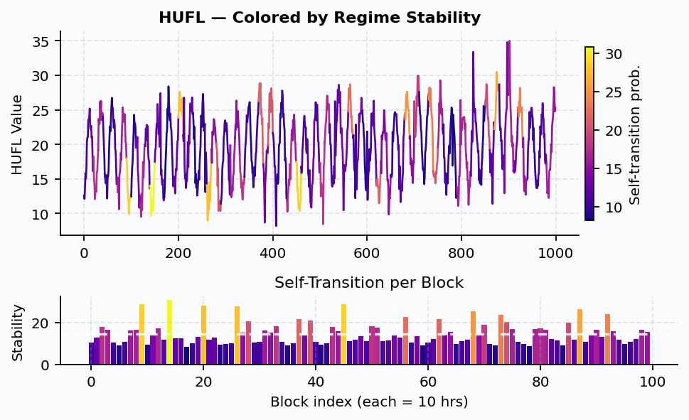
Regime Analysis — Stable vs. Volatile Periods
The MTF diagonal reveals when load behaviour changes character
Top chart — each 10-hour segment of HUFL is coloured by its self-transition probability. Yellow/bright = stable (load holds its level). Purple/dark = volatile (load is rapidly changing states).
Bottom chart — the bar chart shows self-transition probability per block. High bars = plateau/steady-state periods. Low bars = rapid regime switches (morning ramp-up, unexpected demand spikes).

Slide 23
What Regime Analysis Tells Grid Operators
Actionable intelligence from the MTF diagonal
🌙
Stable Night Periods
⚡
Morning Ramp-Up
☀️
Daytime Plateau
Consistent low load from ~10pm–5am. High self-transition means the system holds steady. Safe window for maintenance work.
Volatile transition between ~6–9am as load rapidly increases. Low self-transition probability flags this as a high-risk period.
Business-hours load is relatively stable (moderate-high self-transition). Demand response programs can be planned here.
🔔
Anomaly Flagging
📅
Weekly Patterns
🤖
ML Feature
Any unexpected dark (low self-transition) segment outside normal patterns is a candidate anomaly — automatic alert trigger.
Weekend blocks show systematically different stability profiles vs. weekdays — a useful input for demand forecasting.
The regime map itself becomes a rich feature vector for supervised learning — training models to predict future instability.

Slide 24
06
Applications & Use Cases
Where else can Markov Transition Fields be applied?

Slide 25
MTF Across Industries
Any time series signal can be encoded as an MTF image
⚡ Energy
🏥 Healthcare
💹 Finance
Fault & Anomaly Detection
ECG / EEG Classification
Market Regime Detection
Encode transformer readings as MTF images. Train a CNN to classify normal vs. fault conditions.
Cardiac arrhythmia or brain state classification from wearable sensor time series.
Encode price or volatility series to identify structural shifts between bull/bear markets.
🏭 Industry
🌤️ Weather
📱 IoT / Human
Predictive Maintenance
Climate State Classification
Activity Recognition
Detect when machine vibration patterns shift away from normal operating dynamics.
Encode temperature or pressure series to identify recurring atmospheric regimes.
Accelerometer data encoded as MTF for step detection, fall detection, gesture classification.

Slide 26
MTF vs. Other Time Series Encodings
How does it compare with alternative image-encoding methods?
Method | What it captures | Preserves time order? | Captures transitions? | Best for
MTF ★ | Probabilistic state transitions | ✓ Yes | ✓ Yes | Dynamics, regime detection, forecasting
GAF (Gramian Angular Field) | Geometric shape, amplitude correlation | ✓ Yes | ✗ No | Shape-based classification
RP (Recurrence Plot) | Recurring patterns, periodicity | ✓ Yes | ✗ No | Chaos, periodicity detection
STFT Spectrogram | Frequency content over time | ✓ Yes | ✗ No | Audio, vibration frequency analysis
Wavelet Transform | Multi-scale frequency features | Partial | ✗ No | Non-stationary signals, denoising

Slide 27
Key Takeaways
What we learned from this analysis
1
4
The Problem
Bayesian Opt.
Raw 1D sensor data is hard to analyse at scale and incompatible with image-based AI.
Intelligently finds the optimal bin count by learning from each evaluation — far more efficient than grid search.
2
5
MTF Solution
Regime Map
Converts time series into a 2D image encoding BOTH temporal order AND transition probabilities.
The MTF diagonal reveals stable vs. volatile periods — directly actionable for maintenance scheduling and anomaly alerts.
3
6
Data Insights
Next Steps
HUFL has a clear 24-hour daily cycle (ACF lag 24, 48). Load features are highly correlated. Distribution is non-normal.
Train a CNN on MTF images to classify operating conditions, predict faults, and detect anomalies automatically.

Slide 28
Thank You
Questions & Discussion
ETTh1 dataset → EDA → Discretization → Markov Transition Field
Bayesian Optimization of n_bins → Regime Analysis → ML-Ready Image
References
Wang, Z. & Oates, T. (2015). Encoding Time Series as Images for Visual Inspection and Classification. AAAI.
ETTh1 Dataset: github.com/zhouhaoyi/ETDataset
Brochu, E. et al. (2010). A Tutorial on Bayesian Optimization. arXiv:1012.2599

