Slide 1
MOTION CAPTURE HAND POSTURE
Group 4
Submitted By:
Akshay Rautkar | Anmol Singh | Ayush Mahendra
Manish Khapre | Mayur | Sneha Pandey
Batch: DSE_PUNE_SEPT: 2019-2020
Mentored By: Mr. Shashank Prakash Shirude

Slide 2
Content
Introduction
Background
Problem Statement
Data Set Information
Exploratory Data Analysis
Summary of Applied Models
Future Work
Conclusion

Slide 3
Introduction
What is Motion Capture?
Motion Capture of an object involves sensing, digitizing, and recording that object in motion.
Whole body
Hands
Face
Purpose of Motion Capture
Originally used for military tracking purposes.
In sports, motion capture acts as a tool for bio-mechanic research that is focused on the mechanical functioning of the body, like how the heart and muscles work and move.

Slide 4
Introduction
Hand gesture recognition system received great attention in the recent few years because of its manifoldness applications and the ability to interact with machine efficiently through human computer interaction.
In this project we are developing hand gesture recognition system .
Key issues of hand gesture recognition system are presented with challenges of gesture system. Review methods of recent postures and gestures recognition system presented as well.
Summary of research results of hand gesture methods, databases, and comparison between main gesture recognition phases are also given.

Slide 5
Background
The signs language are used from ages to interact with person to person so as to convey message or to assign task related to the sign.
The hearing and speaking disabled persons are the ones who uses this type of communication.
The disabled person who can’t speak don’t have way to communicate through systems.
The aged persons and the ones who are not compatible with the typing input interfaces has difficulty to interact with systems.

Slide 6
Problem Statement
In the recent years there have been much development and research in the field of hand gesture recognition system. This has been a major topic in the field of machine learning so as to convey message to the system or have interaction with the systems through the hand gesture.
The system detects the hand postures and then take necessary actions or the task is triggered accordingly with specified classes to the gesture.
In this project we are classifying the hand gesture classes accordingly with the coordinates data which we obtained by markers attached to the glove.
This classification will lead to the accurate model with reduction in the errors of the recognition system. This model will also lead to the systems where the disabled persons can be precise to use such systems.

Slide 7
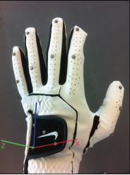
Dataset Information:
Marker Placement
Reflective markers are used on the back of the hand glove as shown in the picture.
A motion capture camera is used to capture the position of markers and are converted to the coordinates.

Slide 8
Dataset Information
The dataset is Multivariate and has missing values
The data presented here is already partially pre-processed.
All reflecting markers were transformed into the local coordinate system of the record containing them.
Each transformed marker with a norm greater than 200 millimeters was pruned.
Finally, any record that contained fewer than 3 markers was removed.

Slide 9
Dataset Information
Class: The Class of the given record is ranges from 1 to 5 as
1=Fist (with thumb out)
2=Stop (hand flat)
3=Point1 (point with pointer finger)
4=Point2 (point with pointer and middle fingers)
5=Grab (fingers curled as if to grab)
User :- (Integer). The ID of the user that contributed the record. No meaning other than as an identifier.
'Xi' - (Real). The x-coordinate of the i-th unlabeled marker position. 'i' ranges from 0 to 11.
'Yi' - (Real). The y-coordinate of the i-th unlabeled marker position. 'i' ranges from 0 to 11.
'Zi' - (Real). The z-coordinate of the i-th unlabeled marker position. 'i' ranges from 0 to 11.

Slide 10
Dataset Information
The starting 2 attributes are categorical and have no missing values. Rest all are continuous numerical.
Features X3,Y3,Z3 has 0.88% missing values.
Features X4,Y4,Z4 has 3.99% missing values.
Features X5,Y5,Z5 has 16.67% missing values.
Features X6,Y6,Z6 has 33.09% missing values.
Features X7,Y7,Z7 has 50.13% missing values.
Features X8,Y8,Z8 has 60.86% missing values.
Features X9,Y9,Z9 has 69.30% missing values.
Features X10,Y10,Z10 has 81.10% missing values.
Features X11,Y11,Z11 has 99.95% missing values.

Slide 11
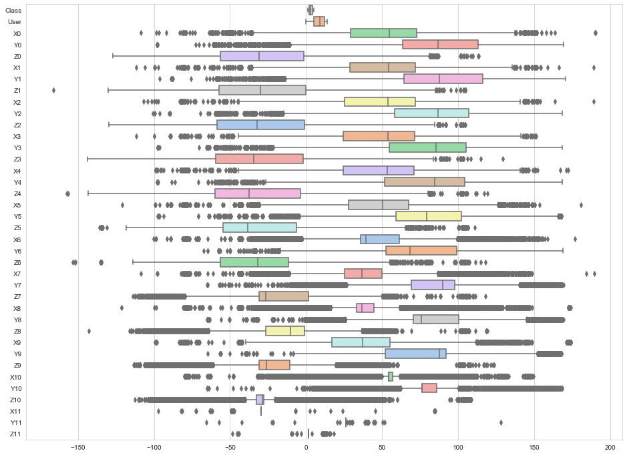
Outliers Detection

Slide 12
Imputing Missing Values
We replace missing values i.e. ‘?’ by the mean of the respective coordinates according to their classes.
After that we came to know that there are some features which doesn’t have any values for their respective classes. So we decided to drop that features.

Slide 13
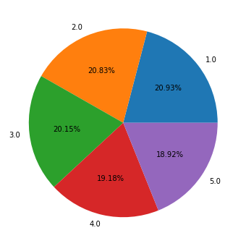
Exploratory Data Analysis
Class wise distribution of dataset

Slide 14
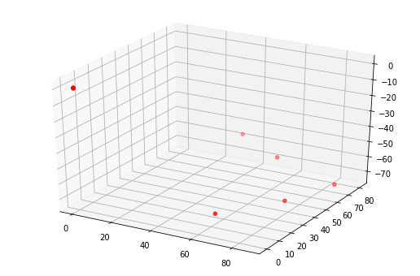
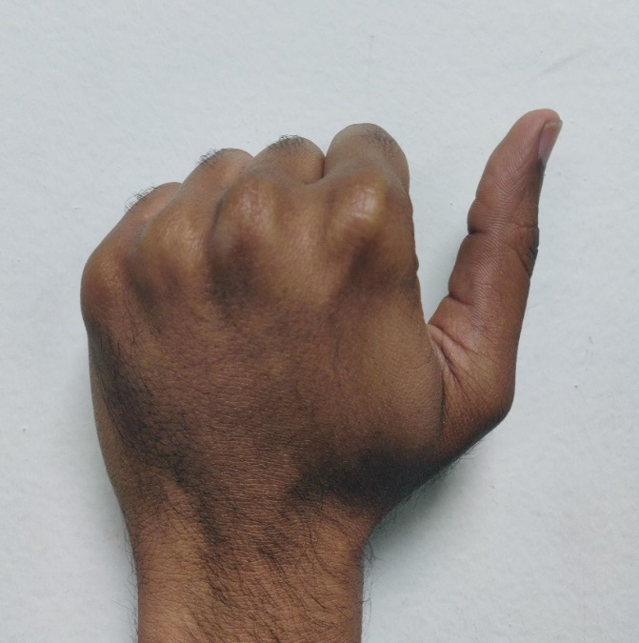
Exploratory Data Analysis
Class 1 Fist (with thumb out)

Slide 15
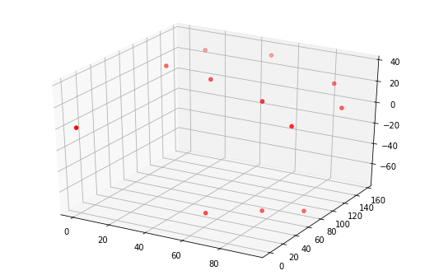
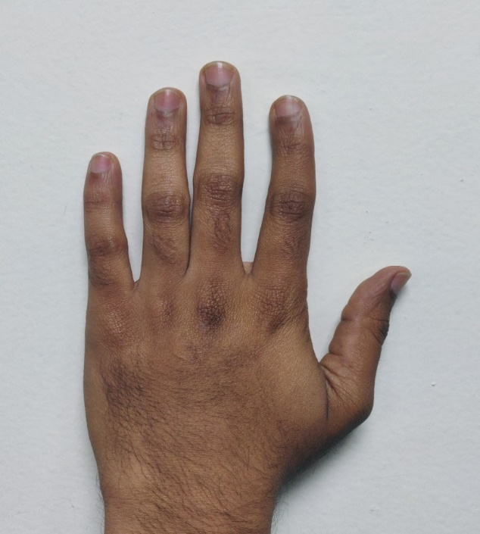
Exploratory Data Analysis
Class 2 Stop (flat hand)

Slide 16
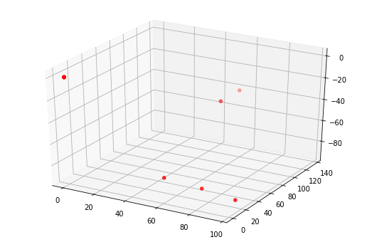
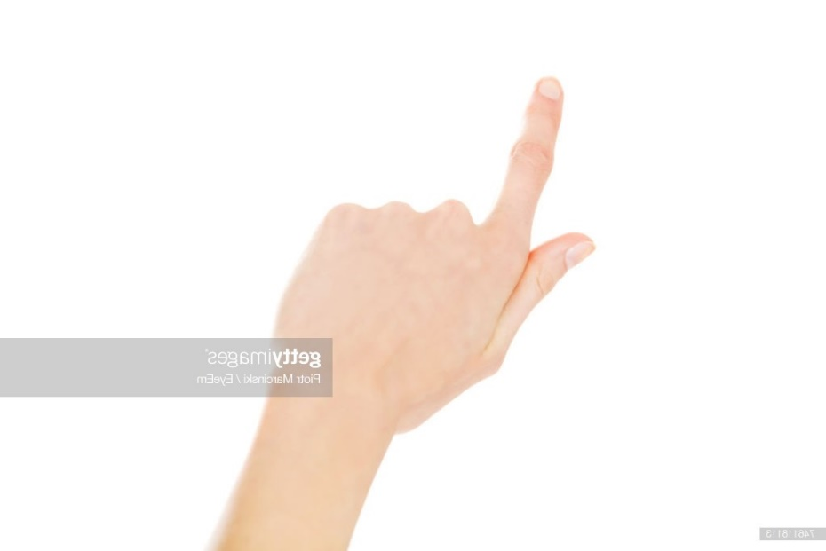
Exploratory Data Analysis
Class 3 Point 1 (point with pointer finger)

Slide 17
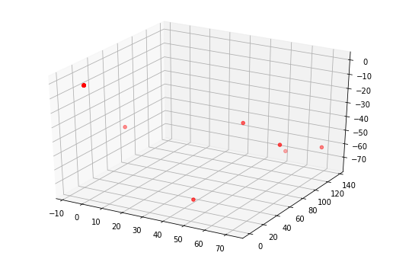
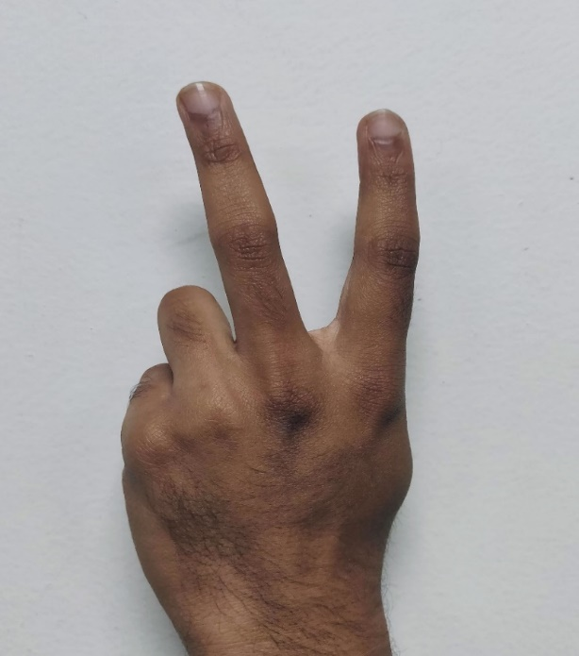
Exploratory Data Analysis
Class 4 Point 2 (point with pointer and middle finger)

Slide 18
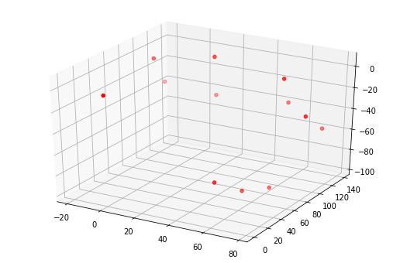
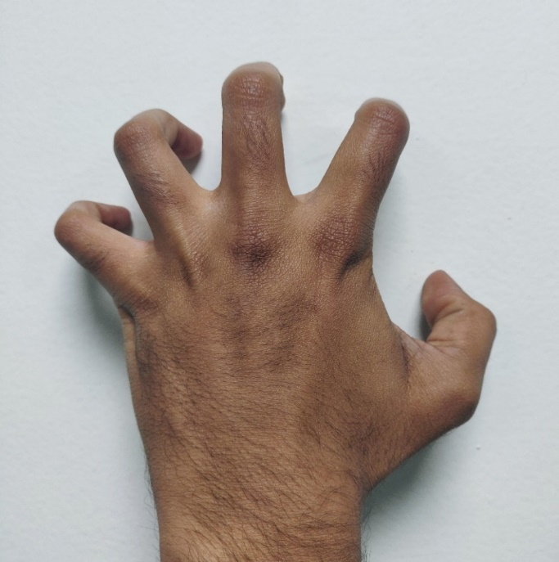
Exploratory Data Analysis
Class 5 Grab (fingers curled as if to grab)

Slide 19
Applied Models and Findings
Sr no | Applied Models | Training Accuracy | Testing Accuracy | Bais Error | Variance Error
1 | Decision Tree | 95.13% | 94.59% | 0.06 | 0.001
2 | KNN | 100% | 97.54% | 0.032 | 0.0003
3 | Random Forest | 89.70% | 89.63% | 0.108 | 0.002
4 | XG Boost | 99.08% | 98.55% | 0.014 | 0.001

Slide 20
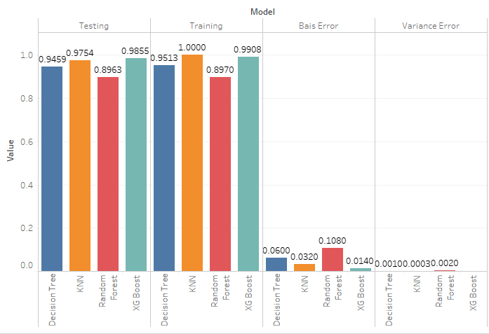
Applied Models and Findings EDA

Slide 21
CONCLUSION
As per our dataset, we used various classification models in order to find the best result in terms of accuracy and prediction
XGBOOST is providing the better result in comparison to other models such as Decision Tree, Random Forest and KNN.
Confusion Matrix
Hyper-parameter Tuning.
All of these techniques gave us the inference that XGBOOST in performing better than above mentioned models.

Slide 22
Future Scope
Gaming
Accessible gaming for people with physical and cognitive disabilities.
A framework for mobile games for children with a motor disability using simple hand postures.
Designing and training hand gestures for robot.
A framework for disabled or paralyzed human fist or fingers.

Slide 23
References
1.A. Gardner, J. Kanno, C. A. Duncan, and R. Selmic. 'Measuring distance between unordered sets of different sizes,' in 2014 IEEE Conference on Computer Vision and Pattern Recognition(CVPR), June 2014, pp. 137-143.
2.A. Gardner, C. A. Duncan, J. Kanno, and R. Selmic. '3D hand posture recognition from small unlabeled point sets,' in 2014 IEEE International Conference on Systems, Man and Cybernetics (SMC), Oct 2014, pp. 164-169

Slide 24
THANK YOU!!

