Slide 1
Fresh Grads – Group Project
Bug Tracking application

Slide 2
Problem Statement
To Create an Application for bug tracking
Employees should be able to view the list of bugs which are open, closed and in progress.
Users should be able to create the bugs.
Admin should be able to perform below operations:
1. Employee Management Module
2. Bug management Module
3. Admin Module
4. Project Module
5. Login Module

Slide 3

Road Map
Application will be developed in following Sprints –
Core Java +JPA with Hibernate
Spring Boot + Rest Controller + JPA with Hibernate
Angular for UI design (Front End) + Integration with previous Sprint

Slide 4
Plan
Design
Generate the skeleton as per class design provided
TDD approach
Identify test cases for each module
Write Failing Test cases
Convert the Test Cases in GREEN
Implement the case study in incremental manner

Slide 5
Modules
Employee Module
Bug
Management Module
Project Module
Login Module

Slide 6
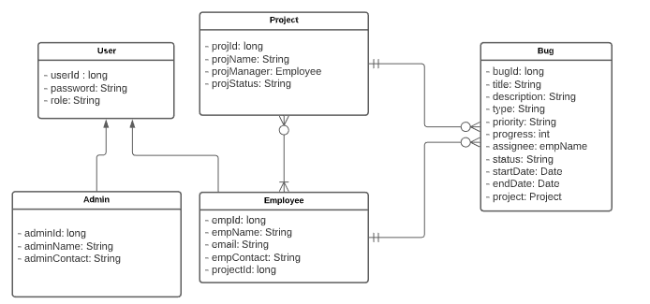
Class Design

Slide 7
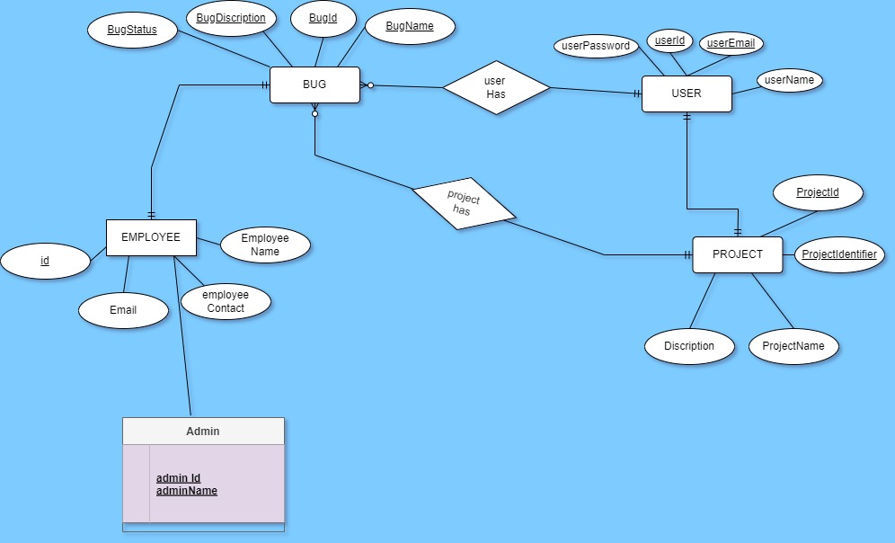

Slide 8
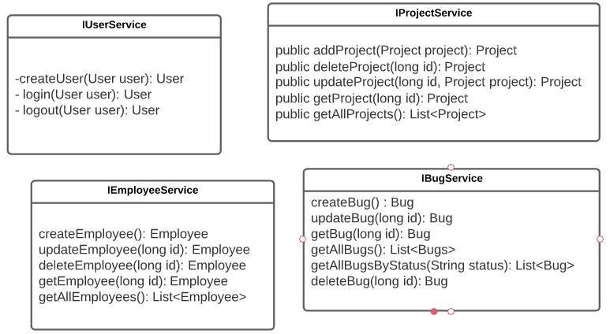
Class Design
Service Interface

Slide 9
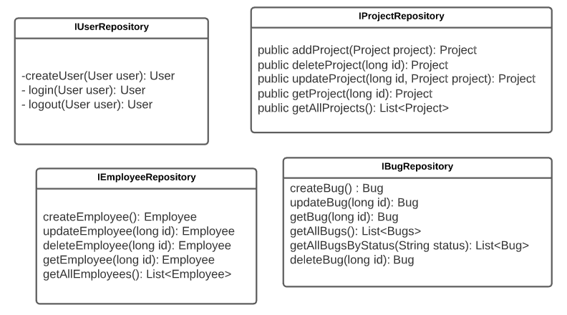
Class Design
Repository:

Slide 10




Questions

