Slide 1

Prepared by:- Manish parmar

Slide 2
What is Grunt?
Grunt is a JavaScript task runner tool
Grunt is a tool used to automatically perform frequent tasks such as minification, compilation, unit testing, and linting
It uses a command line interface to run custom tasks defined in a file (known as a Gruntfile)
After you've configured it through a Gruntfile, a task runner can do most of that mundane work for you
Grunt was created by Ben Alman and is written in Node.js

Slide 3
Why use Grunt?
Open Source
Large Community
Easy to use
Hundreds of plugins
Build your own plugin

Slide 4
Who have been using it?
Twitter
jQuery
Mozila
Bootstrap
Adobe
WordPress
Opera

Slide 5
How do I start Grunt?
NPM
NPM(Node Package Manager) manages dependencies for an application through the command line
Node.js
Node.js is an open source command line tool built for the server side Javascript

Slide 6
How do I install grunt cli?
To install grunt on your system you need to install Grunt's command line interface (CLI) globally as shown below −
npm install -g grunt-cli
This will put the grunt command in your system path, which makes it to run from any directory
Installing the grunt-cli does not install Grunt task runner. The role of the grunt-cli is to run the version of Grunt which has been installed next to a Gruntfile. It allows a machine to install multiple versions of Grunt simultaneously.

Slide 7
Getting started with Grunt project
A typical setup will involve adding two files to your project: package.json and the Gruntfile.
package.json: This file is used by npm to store metadata for projects published as npm modules. You will list grunt and the Grunt plugins your project needs as devDependencies in this file.
Gruntfile: This file is named Gruntfile.js and is used to configure or define tasks and load Grunt plugins.

Slide 8
Package.json file
package.json has the following
attributes :
Name
Version
devDependencies
You can use npm init or the grunt –init package to generate package.json file
{
"name": "my-project-name", "version": “1.0.0", "devDependencies": {
"grunt": "^1.2.1",
"grunt-contrib-sass": "^1.0.0",
"grunt-contrib-watch": "^1.1.0"
}
}

Slide 9
Installing Grunt and gruntplugins
In the folder with package.json, run npm install command
This will install the correct version of each dependency listed therein
The easiest way to add Grunt and gruntplugins to an existing package.json is with the command npm install <module> --save-dev. Not only will this install <module> locally, but it will automatically be added to the devDependencies section
For instance, the following command will install latest the latest version of Grunt and adds it to your devDependencies −
npm install grunt --save-dev
npm install grunt-contrib-sass --save-dev

Slide 10
The Gruntfile
The gruntfile.js file is a valid JavaScript that belongs in the root directory of your project
A gruntfile is comprised of the following parts:
The "wrapper" function
Project and task configuration
Loading Grunt plugins and tasks
Custom tasks

Slide 11
The Gruntfile(Continued)
//Wrapper function
module.exports = function(grunt){
// Project configuration.
grunt.initConfig({
sass: {
app: {
files: {
'src/main.css': 'src/main.scss'
}
}
},
watch: {
css: {
files: ['src/*.scss'],
tasks: ['sass']
}
}
});
// Load the plugin that provides the “sass" task.
grunt.loadNpmTasks('grunt-contrib-sass');
grunt.loadNpmTasks('grunt-contrib-watch');
// Default task
grunt.registerTask('default', ['watch']);
};

Slide 12
The Gruntfile(Continued)
The "wrapper" function
Every gruntfile (and gruntplugin) uses this basic format, and all of your Grunt code must be specified inside this function:
module.exports = function(grunt) {
//Do grunt related things in here
}

Slide 13
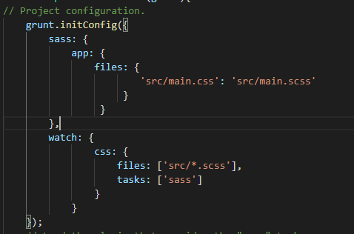
The Gruntfile(Continued)
Project and task configuration
Most Grunt tasks rely on configuration data defined in an object passed to the grunt.initConfig method
Each plugin defines a task
Tasks are named for the action they take( sass, jasmine, concat, etc.)
Each task have multiple targets
Targets are names however you like
In the example sass is task

Slide 14
The Gruntfile(Continued)
‘src/main.css' : ‘src/main.scss’ is the path to the css file where all the changes will be compiled
files: ['src/*.scss'] - specify which files to track;
tasks: ['sass'] - when file is added, deleted, or modified, run the specified task;

Slide 15

The Gruntfile(Continued)
Loading Grunt plugins and tasks
As long as a plugin is specified in package.json
as a dependencies, add in grunfile using
grunt.loadNpmTasks('grunt-contrib-sass');
grunt.loadNpmTasks('grunt-contrib-watch');

Slide 16

The Gruntfile(Continued)
Register custom task
You can configure Grunt to run one or more tasks by default by defining a default tasks

Slide 17
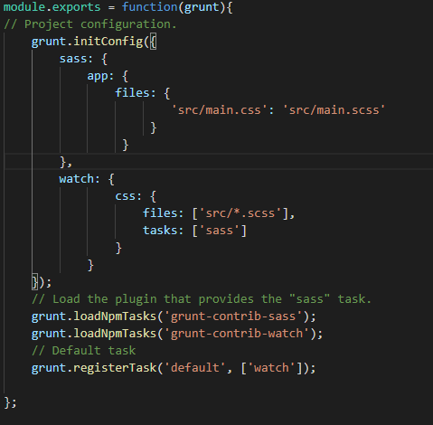
The final Gruntfile

Slide 18
Demo link
https://github.com/manish1906/GruntJS

Slide 19
Thank You

