Slide 1
Prototypes in Javascript
Prepared By:- Parmar Manish

Slide 2
Prototypes
JavaScript is a prototype based language, so, whenever we create a function using JavaScript, JavaScript engine adds a prototype property inside a function, Prototype property is basically an object (also known as Prototype object), where we can attach methods and properties in a prototype object, which enables all the other objects to inherit these methods and properties
This Prototype property has a constructor property by default
The constructor property points back to the on which prototype object is a property. We can access the function’s prototype property using functionName.prototype
Let’s see an example in next slide

Slide 3

Prototype
<script>
function Person(firstName, lastName){
this.firstName= firstName;
this.lastName=lastName;
}
console.log(Person.prototype);
</script>
Output:

Slide 4
Prototypes
As shown in previous slide, Person constructor function has a prototype property that points to the prototype object. The prototype object a has constructor property that points back to the Person constructor function
When object is created in javascript, javascript engine adds a __proto__ property to the newly created object which is called dunder proto
__proto__ points to the prototype object of the constructor function
Let’s see example in next slide

Slide 5
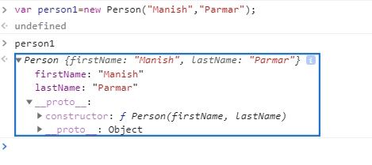
Prototypes
As shown in above image, the person1 object which is created using Person constructor function has dunder proto or __proto__ property Which Points to the prototype object of the constructor function

Slide 6
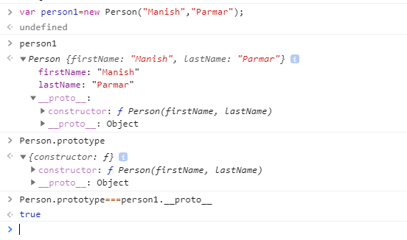
Prototypes
As can be seen from the above image, both person1 __proto__ property and Person.prototype is equal
Person.prototype===person1.__proto__
Above statement return true means person1’s __proto__ property and Person.prototype are pointing to same object

Slide 7
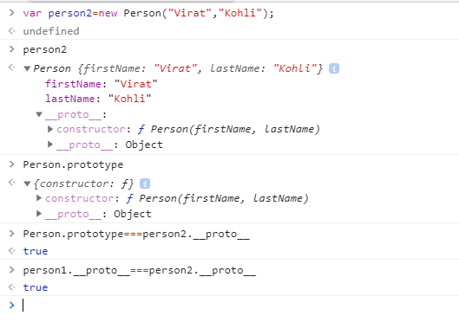
Prototype
Let’s create another object person2 using the Person constructor function
Above output shows that even person2 __proto__ property is equal to the Person.prototype property and they point to the same object and person1 and person2 __proto__ property points to Person constructor function’s prototype object

Slide 8
Prototypes
Previous seen that a prototype object is an object, we can attach properties and methods to the prototype object. Thus, enabling all the objects created using the constructor function to share those properties and methods
The new property can be added to the constructor function’s prototype property using either the dot notation or square bracket notation as shown below:
Person.prototype.age = 21;
//or
Person.prototype["age"] = 21;

Slide 9
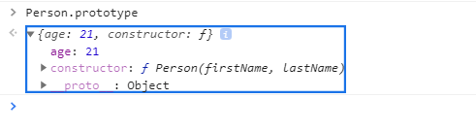
Prototypes
age property have been added to the Person prototype

Slide 10
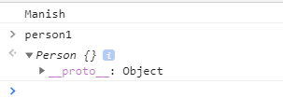
Prototypes
<script>
function Person(){
}
Person.prototype.name = “Manish" ;
Person.prototype.age = 21;
var person1 = new Person();
Console.log(person1.name);
</script>
Output:

Slide 11
Prototype
As we can see that in pervious slide person1 object is empty and it does not have any property except its dunder proto property. So how does the output of person1.name was Manish?
When we try to access a property of an object, the JavaScript engine first tries to find the property on the object, if the property is present on the object it outputs its value. But, if the property is not present on the object then it tries to find the property on the prototype object or dunder proto of the object. If the property is found the value is returned else JavaScript engine tries to find the property on the dunder proto of the object. This chain continues until the dunder proto property is null In these cases, the output will be undefined

Slide 12
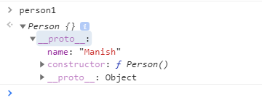
Prototype
So, when person1.name is called, JavaScript engine checks if the property exists on the person1 object. In this case, name property was not on the person1’s object. So, now JavaScript engine checks if the name property exists on the dunder proto property or the prototype of the person1’s object. In this case, name property was there on the dunder proto property or the prototype of person1’s object. Hence, the output was returned Manish.

Slide 13
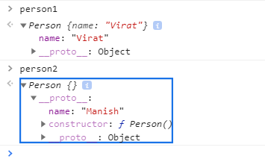
Prototype
Let’s create another object person2 using Person constructor function
var person2=new Person();
console.log(person2.name); //Output: Manish
Person1.name=“Virat”;
console.log(person1.name);//Output: Virat
Console.log(person2.name);//Output: Manish

Slide 14
Prototype
Here person1.name outputs “Virat”. As mentioned earlier, the JavaScript engine first tries to find the property on the object itself. In this case, name property is present on the object person1 itself, hence JavaScript engines outputs the value of name property of person1
In the case of person2, the name property is not present on the object. Hence, it outputs person2’s prototype object’s property name

Slide 15
Problems with Prototype
As prototype object is shared among all the objects created using the constructor function, its properties and methods are also shared among all the objects. If an object A modifies a property of the prototype having primitive value, other objects will not get affected by, as object A will create a property on its objects
Another example to display the issue with prototypes when the prototype object contains a property of reference type
Person.prototype.language = [“Gujrati”, “Hindi”];
//Arrays are of reference type in JavaScript
person1.language.push("English");

Slide 16
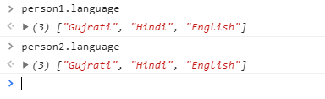
Problems with Prototype
In the above example, person1 and person2 point to the same language array of the prototype object. person1 languages friends property by adding another string in the array
As language array exists on Person.prototype, not on person1, the changes made in the language property by person1 object is reflected on person2.languages also (which points to the same array)
If the intention is to have an array shared by all instances, then this outcome is okay. But here this was not the case

Slide 17
Problems with Prototype
Combine Constructor/Prototype
To solve the problems with the prototype and the problems with the constructor, we can combine both the constructor and function.
Problem with the constructor function: Every object has its own instance of the function
Problem with the prototype: Modifying a property using one object reflects the other object also
To solve both problems, we can define all the object-specific properties inside the constructor and all shared properties and methods inside the prototype as shown next slide

Slide 18

Solve the problems with Prototype
<script>
function Person(firstName, lastName){
this.firstName = firstName,
this.lastName = lastName,
this.languages = ["Gujrati", "Hindi"]
}
Person.prototype.getFullName = function(){
console.log(this.firstName+" "+this.lastName);
}
var person1 = new Person("Manish", "Parmar");
var person2 = new Person("Virat", "Kohli");
person1.languages.push("English");
console.log(person1.languages)
console.log(person2.languages)
</script>

Slide 19
Problems with Prototype
In previous example we have wanted each object to have their own firstName, lastName, and languages property. Hence, we have defined these properties inside the constructor using this. However, as getFullName is defined on the prototype object, it will be shared among all the objects.
In the previous slide example, the languages property of person2 did not change on changing the languages property of person1.

Slide 20
Inheritance in Javascript
JavaScript does not have classes like other languages. It uses the concept of prototypes and prototype chaining for inheritance
We have already seen Prototypes topic
Prototype Chaining
Prototype chaining means an object’s dunder proto or proto property will point to another object instead of pointing to the constructor function prototype. If the other object’s dunder proto or proto property points to another object it will result in the chain. This is called Prototype Chaining

Slide 21
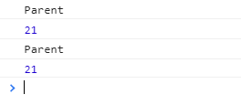
Inheritance in Javascript
<script>
function Parent(){
this.name = "Parent"
}
Parent.prototype.getParentName = function()
{
return this.name
}
function Child(){
this.age = 21;
}
Child.prototype = new Parent();
Child.prototype.getChildAge = function(){
return this.age;
}
var child1 = new Child();
console.log(child1.name);
console.log(child1.age); console.log(child1.getParentName()); console.log(child1.getChildAge());
</script>
Output:-

Slide 22
Inheritance in Javascript
In pervious example
Child.prototype = new Parent();
Above line rewrites the default prototype or the dunder proto property of the Child constructor function and makes Child.prototype to point to an object of Parent constructor function
This means that all the properties and methods that exist on an instance of Parent will now exist on Child.prototype also. This means that now, Child function has access to all the Parent properties and methods

Slide 23
Inheritance in Javascript
Child.prototype.getSubAge = function(){ return this.age; }
After the default prototype of Child constructor function has been overwritten, by using the above line of code we add a new method getChildAge() on top of what was inherited from Parent, to the prototype object of Child constructor function
Note: New methods must be added to the Child after the inheritance because inheritance overwrites the existing prototype of Child

Slide 24
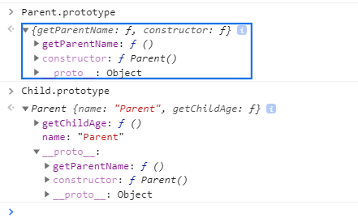
Inheritance in Javascript
getParentName() method remains on the Parent.prototype object, but name property ends up on Child.prototype. That’s because getParentName() is a prototype method, and the property is an instance property. Child.prototype is now an instance of Parent, so the property is stored there

Slide 25
Problems with prototype chaining
As all the properties of the Parent prototype are shared among the child objects, if one child modifies the property of the parent prototype, other children also get affected
To fix this issue, we use the constructor to inherit the instance properties and prototype chaining to inherit methods and share properties

Slide 26
Solve problems with prototype chaining
<script>
function Parent(firstName, lastName){
this.firstName = firstName,
this.lastName = lastName,
this.languages = ["Gujrati", "Hindi"]
}
Parent.prototype.getFullName = function(){
return this.firstName + " " + this.lastName;
}
function Child(firstName, lastName, age){
//Inherit instance properties
Parent.call(this, firstName, lastName);
this.age = age;
}
Child.prototype = new Parent();
Child.prototype.getChildAge = function(){
return this.age;
}
var child1= new Child("Manish", "Parmar", 21);
var child2 = new Child("Sachin", "Tendulkar", 39);
child1.languages.push("English");
console.log(child1.languages);
console.log(child2.languages);
console.log(child1.firstName);
console.log(child1.age);
console.log(child1.getFullName());
console.log(child1.getChildAge());
console.log(child2.firstName);
console.log(child2.age);
console.log(child2.getFullName());
console.log(child2.getChildAge());
</script>

Slide 27
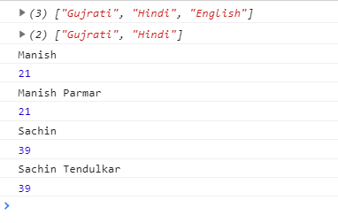
Solve problems with prototype chaining
Output:
we have defined a Parent constructor function with firstName, lastName, and languages as instance properties, then we have defined a getFullname method on the prototype of Parent.

Slide 28
Solve problems with prototype chaining
function Child(firstName, lastName, age){
Parent.call(this, firstName, lastName);
this.age = age;
}
Here, we define a Child constructor function. Inside the Child constructor function, we call the Parent constructor function with call. Call executes the Parent constructor function in the context of the object being created using the Child constructor function. After inheriting the instance properties of the Parent, we add one age property to the Child constructor function
So far we have just inherited all the instance properties of the Parent constructor function, but the shared properties and methods of the Parent constructor function is still not inherited. We inherit them using the below lines of code
Child.prototype = new Parent();

Slide 29
Solve problems with prototype chaining
var child1= new Child("Manish", "Parmar", 21);
When we execute the above line of code, all the three parameters ("Manish", "Parmar", 21) are passed to the Child constructor function. Child constructor function then calls Parent constructor function using call Parent.call(this, firstName, lastName) this here represent the child1
Parent constructor function is executed in the context of child1 and add properties firstName, lastName, languages to the child1 object After the return of Parent.call(this, firstName, lastName), Child constructor function adds a age property to child1 object.
Thus as of now, there are properties with the child1 object (firstName, lastName, and age). Currently, Child constructor function has the following methods and shared properties in its prototype property:
getFullName()
getChildAge()
child1 inherits all these properties from Child constructor function.

Slide 30
Thank You

