Slide 1



Telangana Growth Analysis
Presented by :- Manish Kumar

Slide 2


About Telangana
Agenda
About Data
Objective
Primary Insight

Slide 3
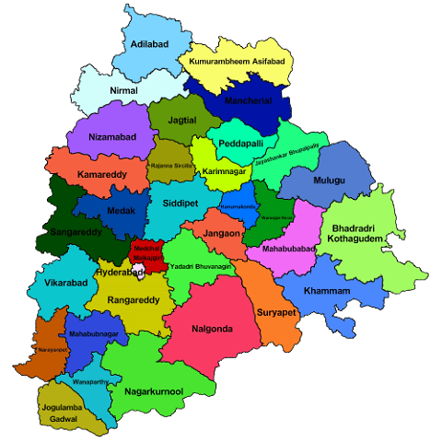
About Telangana
Telangana is a state located in southern India. It was officially formed as the 29th state of India on June 2, 2014, when it was carved out from the larger state of Andhra Pradesh.
Hyderabad is the capital city of Telangana and also serves as a major technological and economic hub.
Telugu and Urdu are the official languages of Telangana, with Telugu being the most widely spoken.
The economy of Telangana is diverse and includes sectors such as information technology (IT), manufacturing, agriculture, and services. Hyderabad is known as "Cyberabad" due to its booming IT industry.
Telangana has a parliamentary system of government, with a Chief Minister as the head of the state and a Governor appointed by the President of India.

Slide 4
About Data
In this data we provided by the 5 table :-
1. dim_districts
2. dim_date
3. fact_stamps
4. fact_transport
5. fact_TS_iPASS
1. dim_districts
The table contains information about districts.
- dist_code
-district
4. fact_transport
The table provides information about the individual vehicle sales data from the RTA(Regional Transport Authority) of the state of Telangana categorized by fuel type, vehicle class, seating capacity, and other general categories aggregated at the district and monthly level.
- dist_code
- Month
- Vehicle sales categorized by different fuel types
- Vehicle sales categorized by different vehicle class
- Vehicle sales categorized by seating capacity
- Sales of vehicles by other categories
2. dim_date
This table contains the dates at the monthly level. Please be aware that the fiscal year of Telangana spans from April to March.
- month
- Mmm
- quarter
- fiscal_year
5. fact_TS_iPASS
The TS-iPASS dataset in Telangana comprises data concerning units or businesses established within the state under the "Industrial Project Approval and Self-Certification System" (iPASS). This government initiative aims to foster industrial growth and investment by streamlining project approvals and enabling self-certification for businesses.
- dist_code
- month
- sector
- investment in cr
- number_of_employes
3. fact_stamps
The table provides data on the revenue generated from document registrations and estamp challan payments aggregated at the district and monthly level.
- dist_code
- month
- documents_registered_cnt
- documents_registered_rev
- estamps_challans_cnt
- estamps_challans_rev

Slide 5
Objective
• Explore Stamp Registration, Transportation and Ts-Ipass Datasets. Understand their attributes, categories and time period.
• Analyze trends and patterns within each department.
• Identify growth opportunities and areas needing attention.
• Find correlation among these departments and report the overall growth of the state through insights and relevant visuals such as shape maps.

Slide 6
Let Start the Primary Question with SQL Query, Output and Data Visual

Slide 7
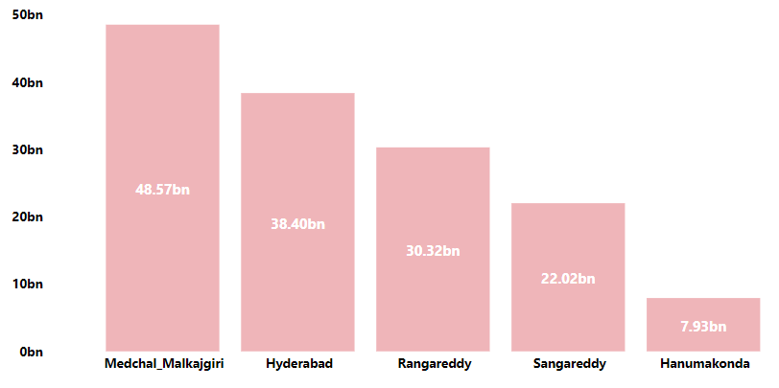
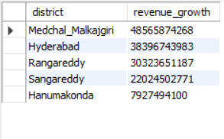
Stamp Registration
1. How does the revenue generated from document registration vary across districts in Telangana? List down the top 5 districts that showed the highest document registration revenue growth between FY 2019 and 2022.
Medchal Malkajgiri generated the highest revenue growth approx. 48.57bn between fy 2019 and 2022.

Slide 8
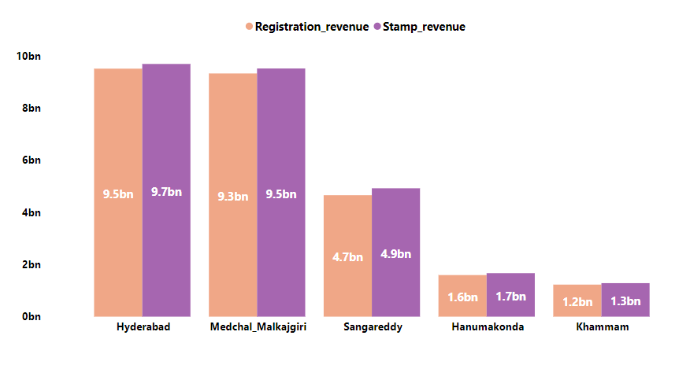
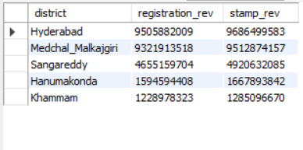
Stamp Registration
2. How does the revenue generated from document registration compare to the revenue generated from e-stamp challans across districts? List down the top 5 districts where e-stamps revenue contributes significantly more to the revenue than the documents in FY 2022?
This are the top 5 district who generated e-stamp revenue more than the registration revenue.

Slide 9
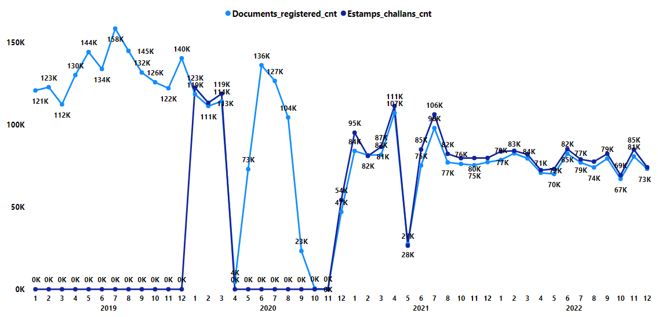
Stamp Registration
3. Is there any alteration of e-Stamp challan count and document registration count pattern since the implementation of e-Stamp challan? If so, what suggestions would you propose to the government?

Slide 10
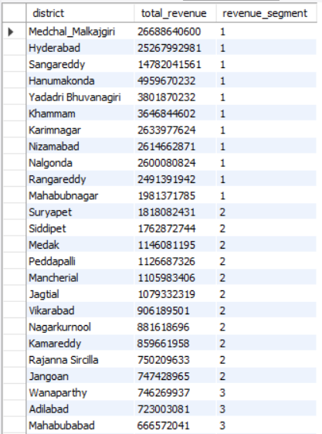
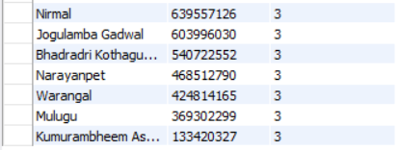
Stamp Registration
4. Categorize districts into three segments based on their stamp registration revenue generation during the fiscal year 2021 to 2022.

Slide 11
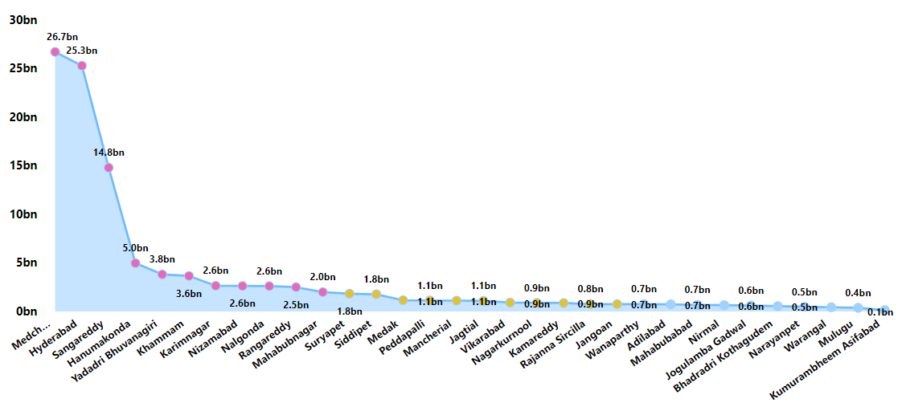
Stamp Registration
1 Segments
2 Segments
3 Segments

Slide 12
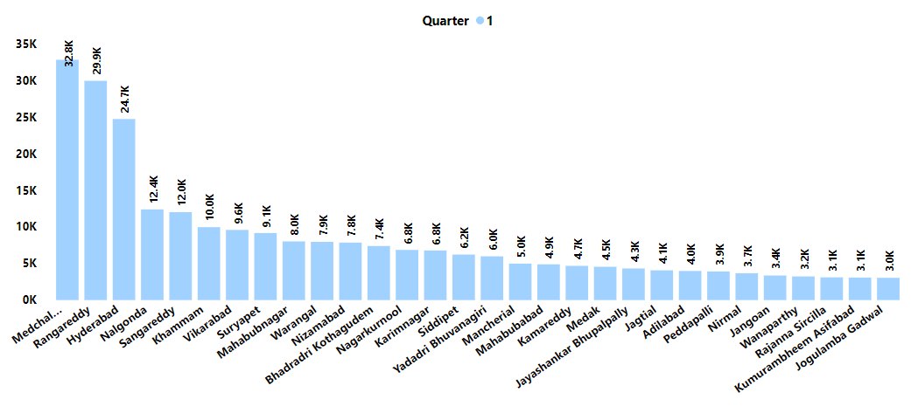
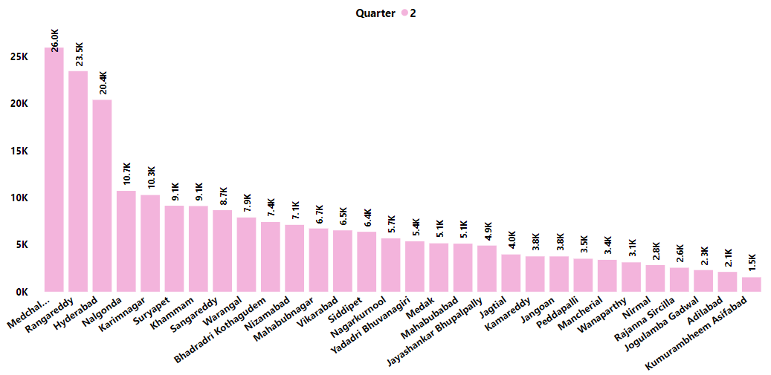
Transportation
5. Investigate whether there is any correlation between vehicle sales and specific months or seasons in different districts. Are there any months or seasons that consistently show higher or lower sales rate, and if yes, what could be the driving factors? (Consider Fuel-Type category only)
The Higher sale rate in all 4 quarter
This district Medchal, Rangareddy, Hyderabad and Nalgonda remain higher in all 4 quarter.

Slide 13
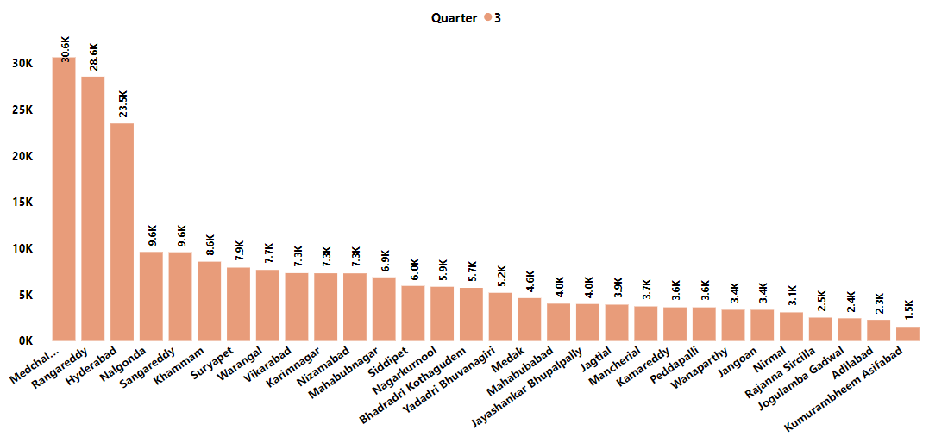
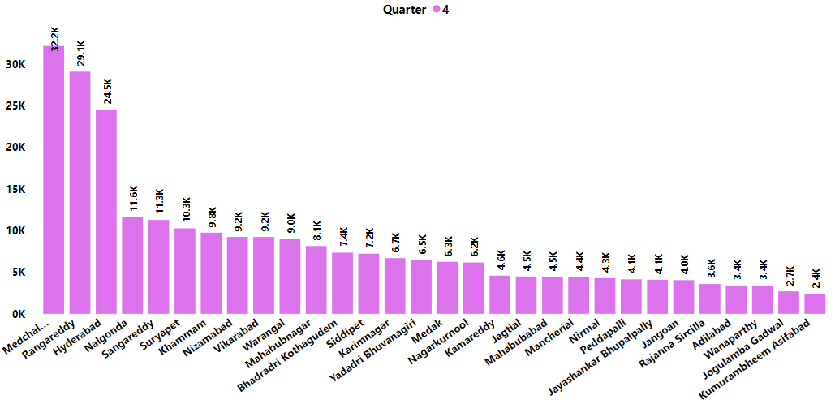
Transportation
The lower sale rate in all 4 quarter
This district kumurambheem remain lower in all 4 quarter.

Slide 14
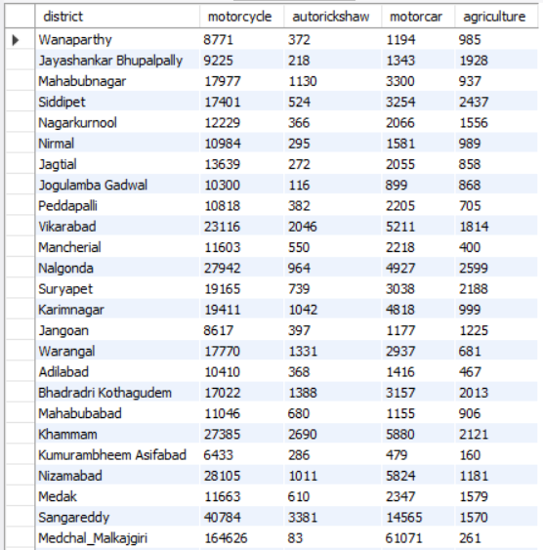
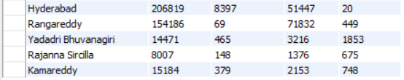
Transportation
6. How does the distribution of vehicles vary by vehicle class (MotorCycle, MotorCar, AutoRickshaw, Agriculture) across different districts? Are there any districts with a predominant preference for a specific vehicle class? Consider FY 2022 for analysis.

Slide 15
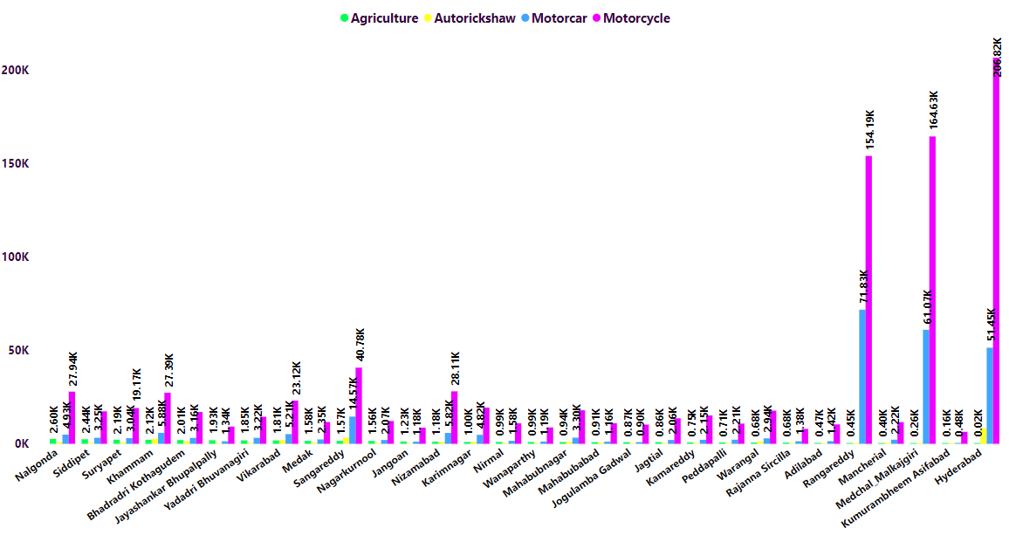
Transportation
As we see Motorcycle sales remain high in all the district compare to other vehicle. Hyderabad district have the highest sales of motorcycle, motorcar, autorickshaw and agriculture.

Slide 16
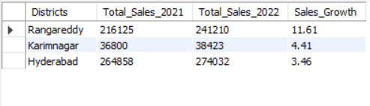
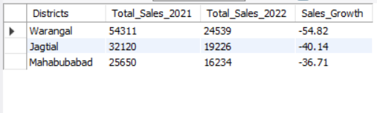
Transportation
7. List down the top 3 and bottom 3 districts that have shown the highest and lowest vehicle sales growth during FY 2022 compared to FY 2021? (Consider and compare categories: Petrol, Diesel and Electric)

Slide 17
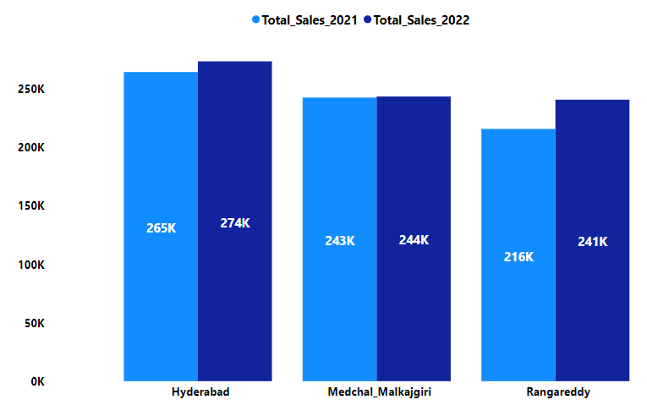
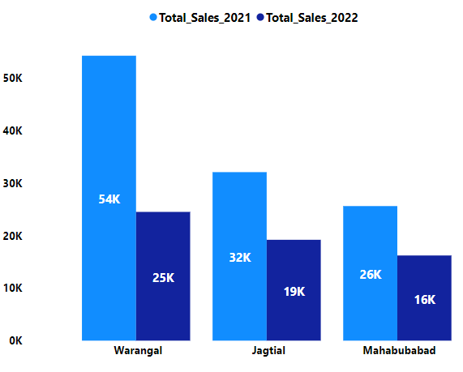
Transportation
Top 3 Highest Vehicle sales growth district
Top 3 Bottom Vehicle sales growth district

Slide 18
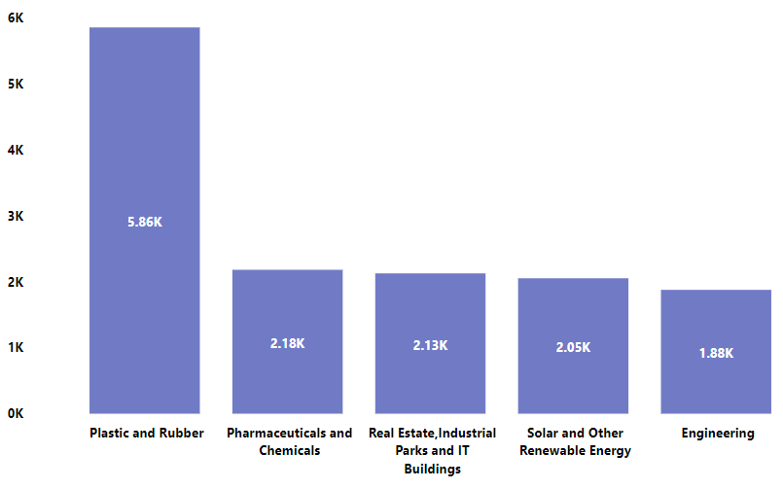
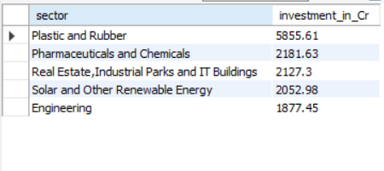
Ts-Ipass
8. List down the top 5 sectors that have witnessed the most significant investments in FY 2022.
Top 5 Sector who get the most investments in fy 2022.
All the value show in the graph in crore.

Slide 19
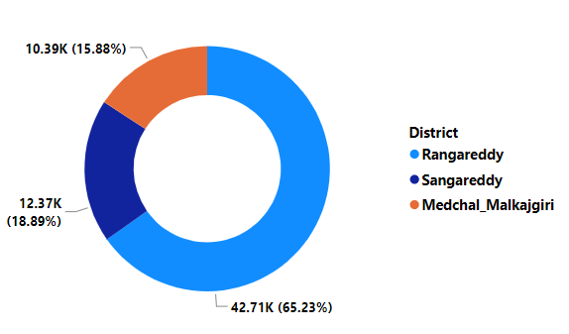
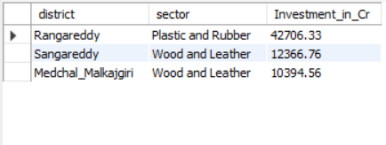
Ts-Ipass
9. List down the top 3 districts that have attracted the most significant sector investments during FY 2019 to 2022? What factors could have led to the substantial investments in these particular districts?
Top 3 District that have attracted the most significant sector investments during FY 2019 to 2022.
All the value show in the graph in crore.

Slide 20
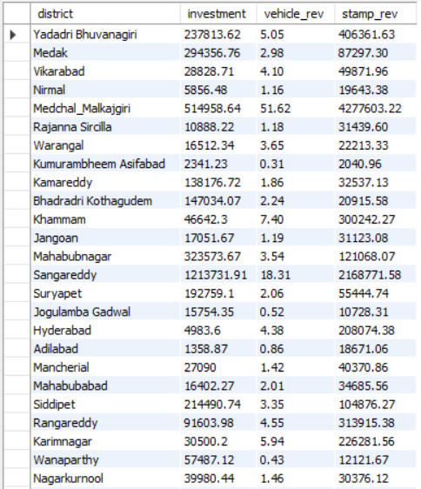

Ts-Ipass
10. Is there any relationship between district investments, vehicles sales and stamps revenue within the same district between FY 2021 and 2022?

Slide 21
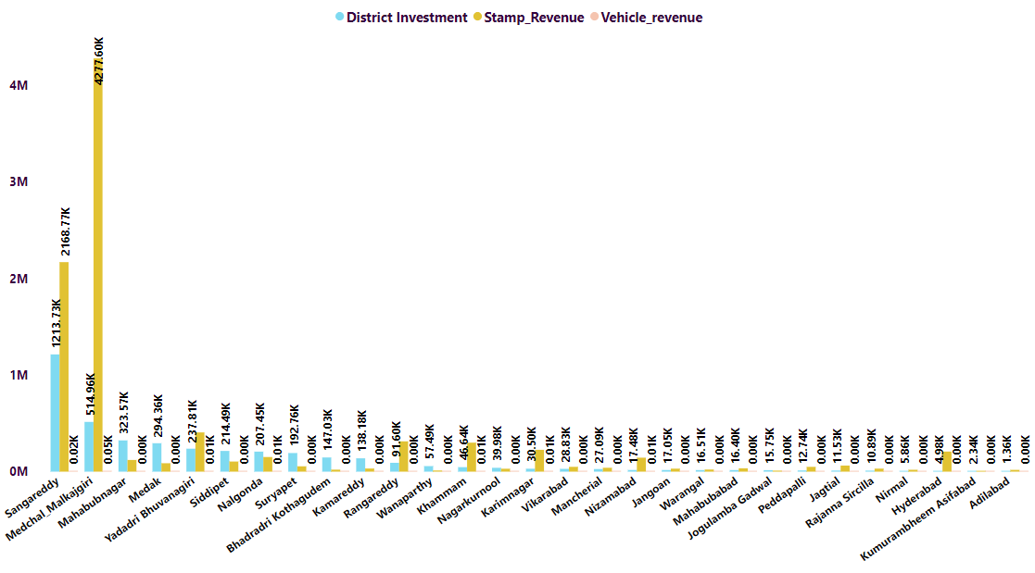
Ts-Ipass
Medchal District have highest stamp revenue and Vehicle revenue
Sangareddy district have highest district Inventment
All the value show in the graph in crore.

Slide 22
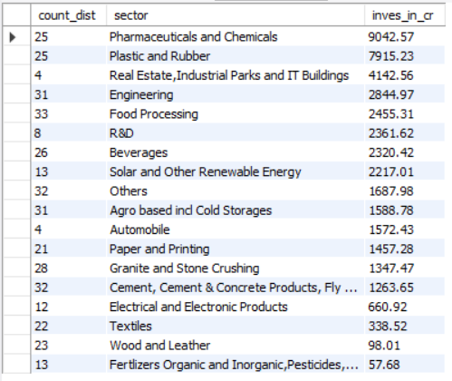
Ts-Ipass
11. Are there any particular sectors that have shown substantial investment in multiple districts between FY 2021 and 2022?

Slide 23
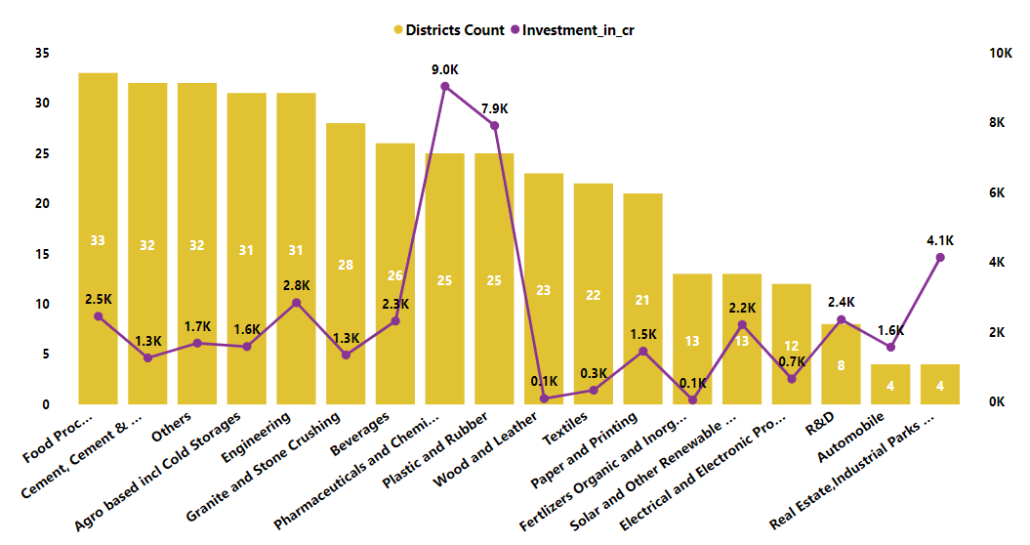
Ts-Ipass
Pharmaceuticals and plastic Sector have highest Investment approx. 9k crore and 7.9k crore in 25 district.
Food sector invest in 33 district which is the highest but the investment is less approx. 2.5k crore.

Slide 24
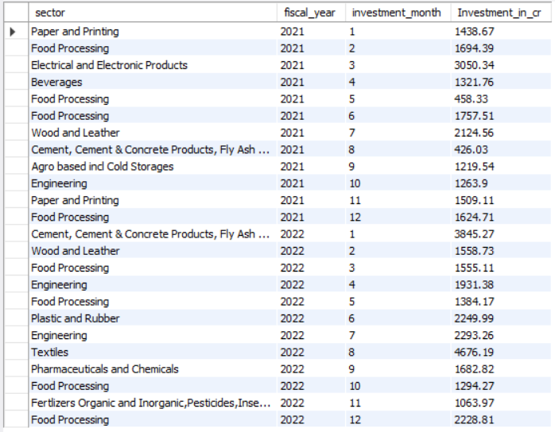
Ts-Ipass
12. Can we identify any seasonal patterns or cyclicality in the investment trends for specific sectors? Do certain sectors experience higher investments during particular months?

Slide 25
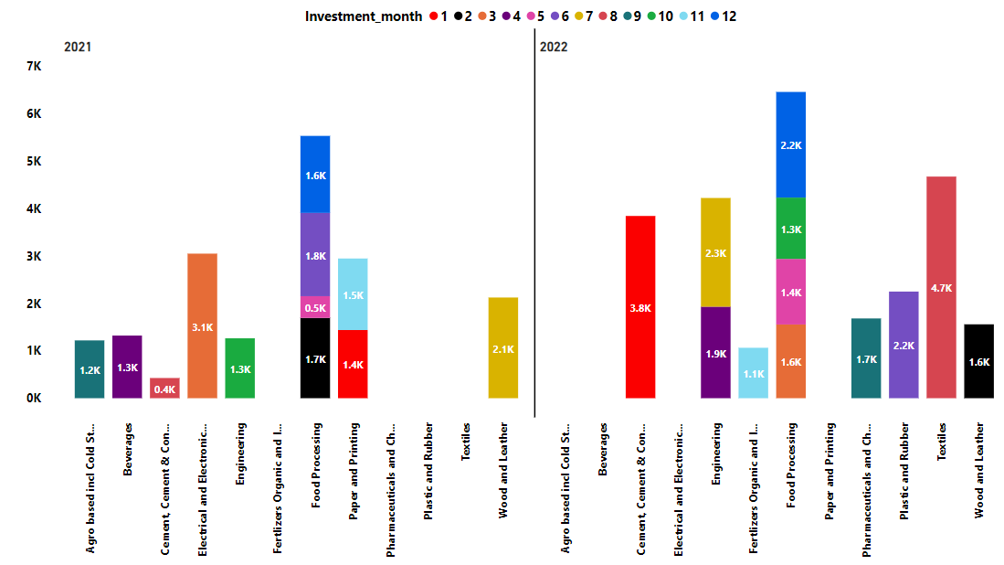
Ts-Ipass
Food Processing get the highest investment in both year 2021 and 2022

Slide 26




Thank you
very much!
Dhaval Patel
Founder of Codebasics
Hemanand Vadivel
Co-Founder - Codebasics

