Slide 1
Track Management
A Web Application using JAVA J2EE Framework
Submitted by-
Manish Shaw
Roll No.- 15/C.A./601 Registration No.- 20158378

Slide 2
Introduction
This presentation discusses the result of the work done in development of “Track Management - A Web Application using JAVA J2EE Framework" on Java Platform. It is an application based on J2EE framework for providing a common platform for facilitating the use of methodological approach during the execution of the
project.

Slide 3
Background and Motivation
The volume of data transacted by devices grows exponentially. In several vertical markets there are more and more devices that communicate with each other to accomplish tasks.
The present work aims to contribute to the
development of a platform for data communications.

Slide 4
Objective
1. A Web Service was required for interaction with the various services (like request, respond, manipulate, etc.) with the platform specification being done in the application itself.
2. Based on the final platform configuration and bindings, visualization of the analysis results and the target platform.

Slide 5
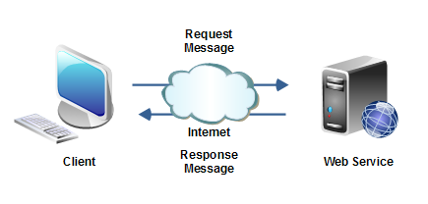
Visualization
Client-server is a standard method for designing applications
where data is kept in central locations (server computers) and efficiently shared with any number of other computers (the clients) on request. All web browsers function as clients that request information from websites (servers).

Slide 6
Project Requisites
1. Tomcat v7.0 Server
2. XAMPP for MySQL
3. Google Chrome
4. Eclipse IDE

Slide 7
Implementation

Slide 8
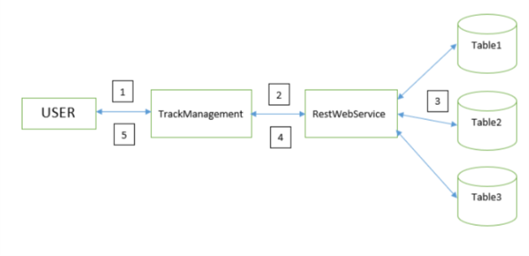
Inserting Track
1 – User gives Singer and Title.
2 – TrackManagement sends Singer and Title values to RestWebService.
3 – RestWebService stores the values in respective database.
4 – Sends the success message to TrackManagement.
5 – TrackManagement shows success message to user.

Slide 9
Searching Tracks
1 – User gives Singer/Title.
2 – TrackManagement sends Singer/Title value to RestWebService to search in the tables.
3 – RestWebService searches the value in all the tables.
4 – On getting the result, it is stored in a list and sent to TrackManagement.
5 – TrackManagement displays the result to user.

Slide 10
View All Tracks
1 – User request to show all the entries.
2 – TrackManagement sends the request to RestWebService to give entries of all the tables.
3 – RestWebService collects the values from all the tables.
4 – On getting the result, it is stored in a list and sent to TrackManagement.
5 – TrackManagement displays the result to user.

Slide 11
Screenshots

Slide 12
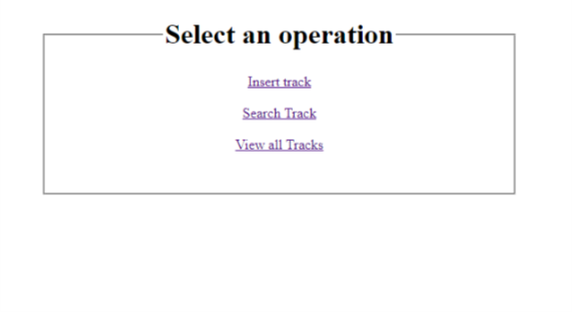
Home Page – index.jsp

Slide 13
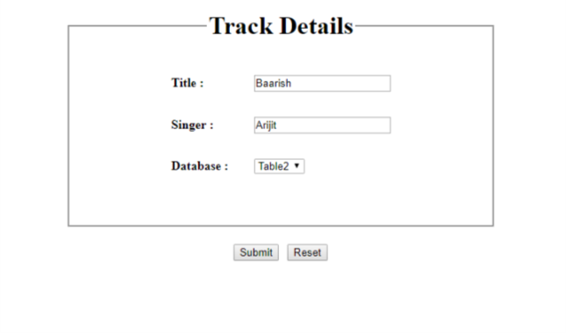
Insert Track – CreateTrack.jsp

Slide 14
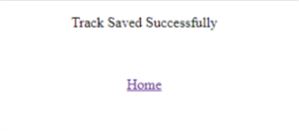
Successful Page – Success.jsp

Slide 15
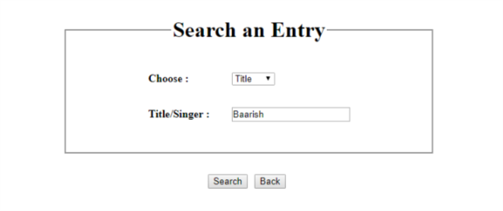
Search an Entry – FindTrack.jsp

Slide 16
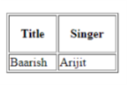
Result – FindTrack.jsp

Slide 17
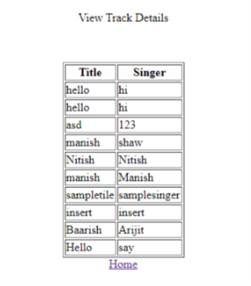
View All Tracks – ViewTracks.jsp

Slide 18
Future Work
Introducing Security measures.
Making the project based on real time.
Working on increased overhead.
Introducing Distributed Database.

Slide 19
Bibliography
http://www.mkyong.com/webservices/jax-rs/restful-java-client-with-jersey-client/
http://www.tutorialspoint.com/listtutorials/java/j2ee/1
https://stackoverflow.com/

Slide 20
Thank You

