Slide 1
Classification of Chest X-Ray Images using deep learning Architectures
Swanith Ambadas (swanitha)
Manish Bikumalla (manishbi)
Hariharan Sriram (hsriram)

Slide 2
Project Description
Short Summary:
Pneumonia is a life altering respiratory disease, which if not treated properly can lead to death. This project aims to enhance the accuracy and reliability of pneumonia diagnosis using chest x-rays using deep learning techniques. We aim to build a robust model with high precision and recall in identifying pneumonia using Convolutional Neural Networks (CNNs) and Generative Adversarial Networks (GANs).
Objectives:
Develop a deep leaning model to classify chest X-ray images into +ve and -ve categories accurately.
The model’s performance can be improved through GAN-based data augmentation to address the issue with limited labeled data.
Evaluate the model's performance against existing benchmarks and ensure it meets clinical standards for diagnostic accuracy.
Some x-rays can be of very large sizes (more pixels) which takes more computational power. Using Autoencoder to reduce image sizes and reduce training time.

Slide 3
Background
Major issues in Medical imaging and disease diagnosis:
Lack of sufficient, largely diverse and class wise seggregated data.
Even if the data is available, there is a class wise imbalance which effects the training as well as validation of various machine learning models
Especially in the current dataset where we have 1583 Normal Chest Xray images and 4273 Pneumonia Chest Xray images.
Lack of medical personnel or proper diagnosis of diseases which was palpable in 2020 and 2021 when covid struck the world.
Because of the above problems there is a rising need for technological intervention which will further aid medical practitioners for better disease diagnosis and better health outcomes of patients

Slide 4
Background - contd..
How is your approach similar or different from others?
A lot of research is already being done in this area and has been ramped up in the post covid era during which period various deep learning methodogies were explored to classify chest xray images as well as ct scans.
In this project, our main goal is to classify chest xray images based on the available data into normal or pneumonia essentially making it a binary classification problem. For this we started with a base CNN and experimented with various complex architectures.
Further realizing the paucity of data and data imbalance, we generated synthetic images using Generative adversarial Networks (GANs) to make the model more robust, similar to this paper.
Another approach in using Autoencoders - for feature extraction, enhanced efficiency, discarding irrelevant artifacts, reduction of complexity and memory usage.
By applying these complex and intuitive preprocessing steps, the results were further evaluated and compared with the previous models.

Slide 5
Dataset
Describe the data you are working with for your project
The dataset comprises chest X-ray images categorized into two main classes: Pneumonia and Normal. It is organized into three primary folders: train, test, and validation, each containing subfolders for the respective image categories. In total, the dataset includes 5,856 X-ray images in JPEG format. Each image is of size 224*224 pixels with only 1 channel (gray-scale).
Where did it come from?
The images were sourced from retrospective cohorts of pediatric patients aged one to five years from Guangzhou Women and Children’s Medical Center, Guangzhou

Slide 6
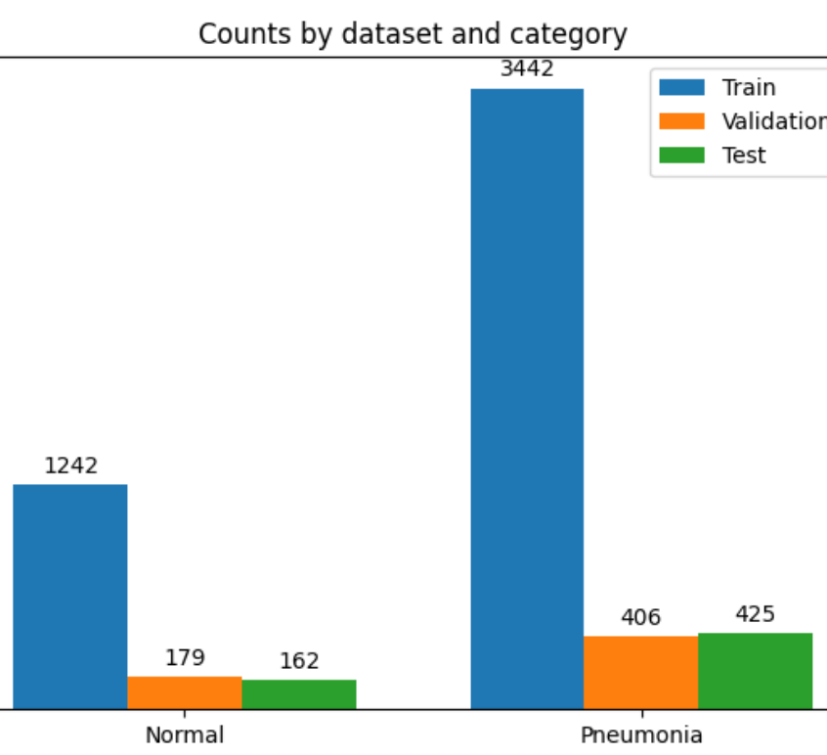
Dataset - contd..
Did you have to do any preprocessing, filtering, or other special treatment to use this data in your project?
One of the major filtering process we did was that initially the images were not divided as 80-10-10 (train, test, validation), so we had to combine the images from all the folders separately for each class (normal and pneumonia) and then again split them into 80-10-10 size sets.
We also used few transformation steps for data augmentation, so that the model can trained robustly, such randomly rotating the images by 15 degrees, randomly flipping the images horizontally, centre cropping the images so that every image is of size 224*224 pixels.
In addition to this in the later parts of the project we used GAN and autoencoder as our pre-processing steps to generate the images for our model tarining.

Slide 7
Methods
Built a Convolutional Neural Network to detect pneumonia based on chest X-rays.
Tune the hyperparameters for the said model to optimize the performance.
Applying Deep Learning methods like VGG19, ResNet34 etc. and other different architectures along with model performance evaluation.
Generation of synthetic X ray images using GANs thereby enhancing the robustness of the model.
Using autoencoders to reduce the dimensionality of the images to achieve faster training times with no compromise in accuracy.
Using Tensor board to visualize the model's performance in real time for better understanding of the model.
Fine-tuned all the above models to prevent over fitting, better accuracy etc. and based on the results of each model, best model based on the requirements can be picked.

Slide 8
Methods - contd..
The images were generated using GAN where in each epoch 64 images were generated and the output was a 64x64 gray scale image. Further the images were generated separately for Normal and Pneumonia data and the number of epochs for each set were 20, thereby generating 1280 images for normal images and 1280 images for pneumonia images. Post generation of these images, ResNet and DenseNet were run once again.
Autoencoders initially take our input images encode them into lower dimensions based on the underlying features of the images. Later these encoded images are decoded using decoder into new images while reducing the noise and imperfections. So, the encoded low dimensional images from autoencoder have been applied on Adv_CNN to reduce computational times which happens because of the smaller size of the images. Initially 224*224*1 images are now reduced to 14*14*256 images.
Using Tensorboard to monitor the performance of the model during training and validation. Through plotting the metrics, model's live performance is observed to make necessary changes to improve the model.

Slide 9
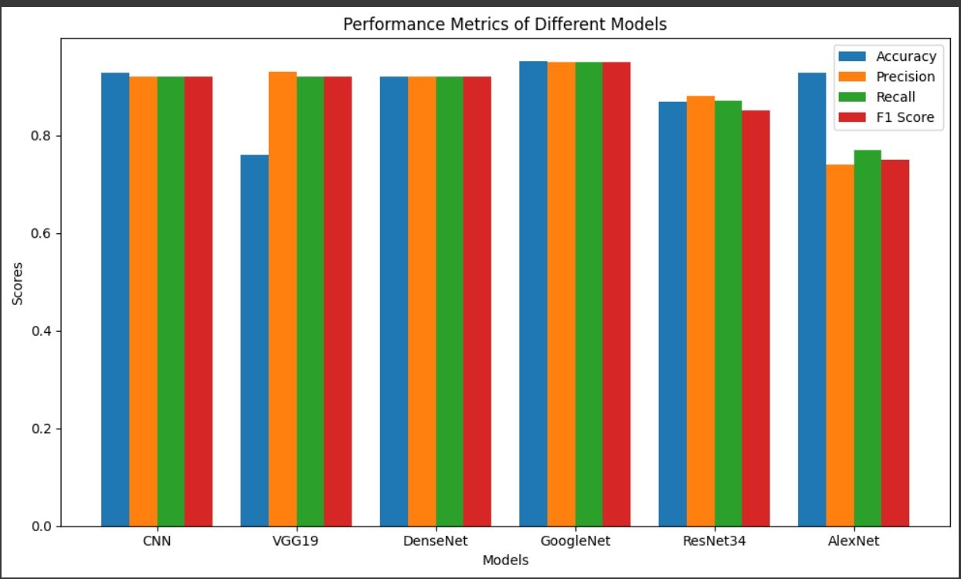
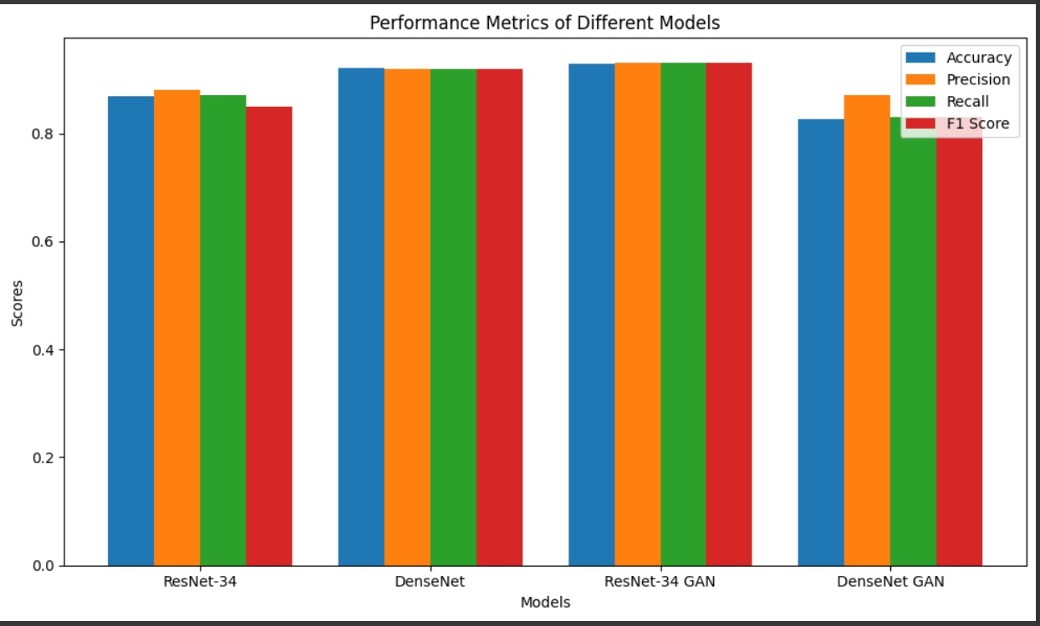
Results
Complex models like ResNet, DenseNet, GoogleNet has a better performance when compared to simple CNN models like Base CNN, VGG-19, AlexNet.
On applying ResNet, DenseNet to GAN generated images, it's observed that DenseNet performed well without GAN images.
Whereas ResNet has a better results with GAN due to its ability to skip connections.
On applying CNN to Autoencoded images, the training time has significantly reduced to 17.52 sec with high accuracy of 89.95% as the image dimensions were reduced.

Slide 10
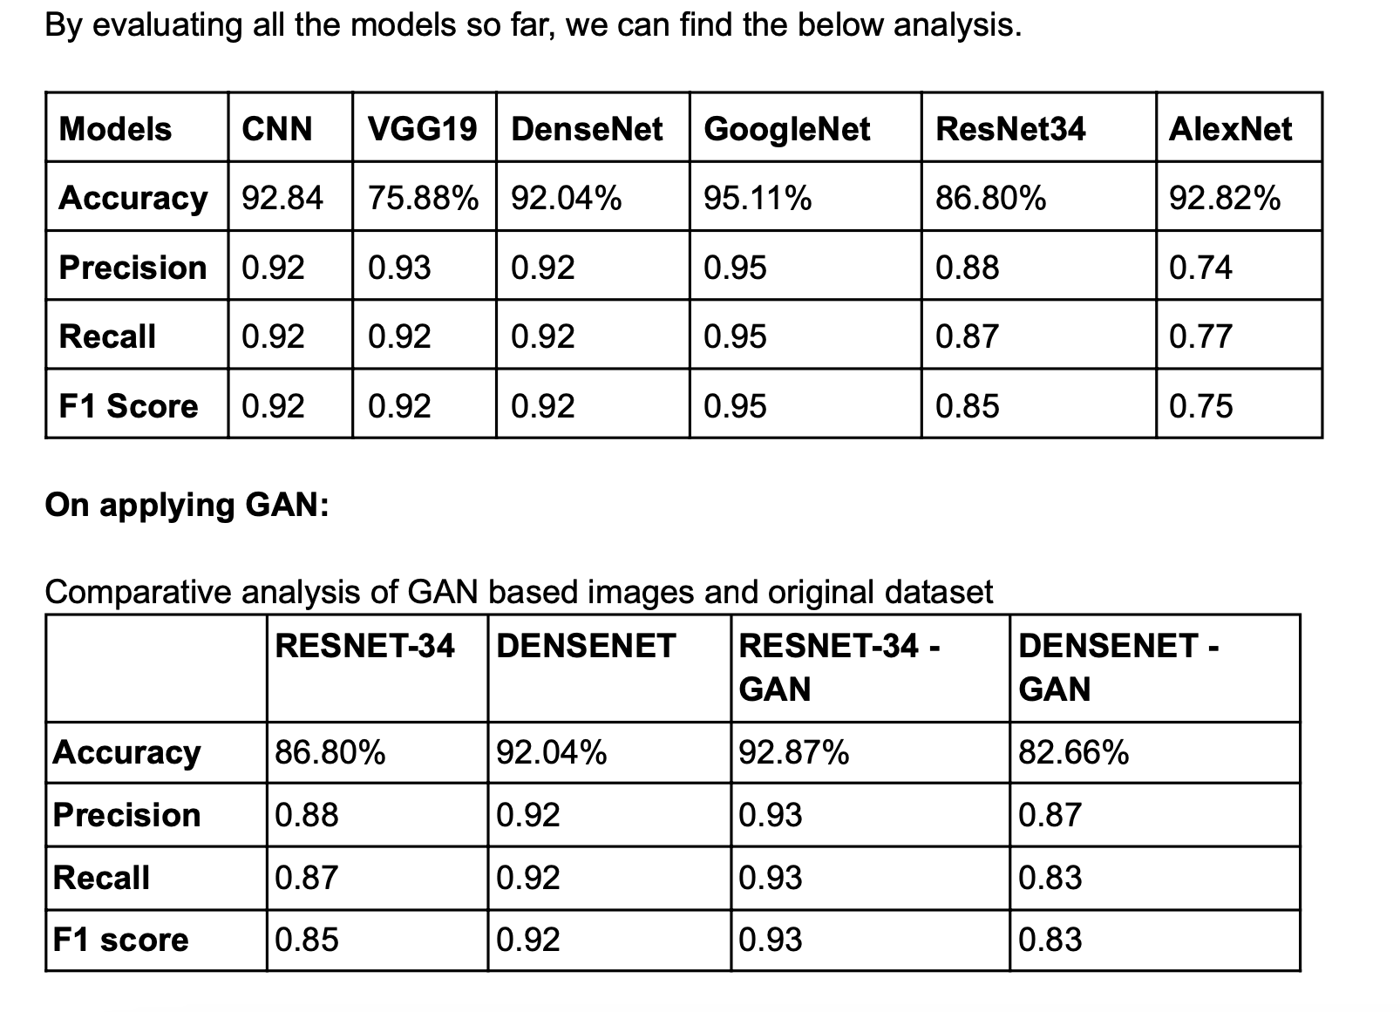
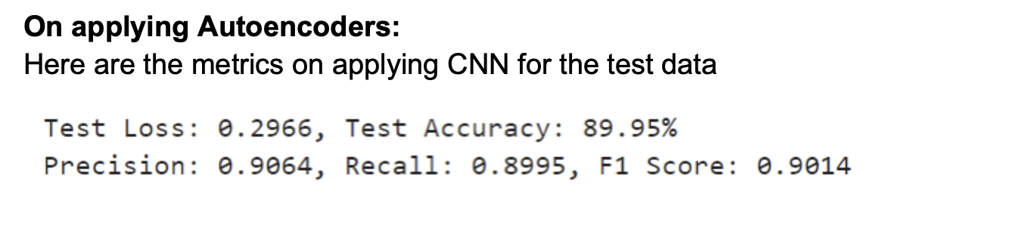
Results - contd..
The tables adjacent represent the standard evaluation metrics llike accuracy, precision, recall and F1 score.
As can be seen from the data GoogleNet which is a pretrained model performed the best. While post application of preprocessing steps in GANs and autoencoders, Resnet performed better

Slide 11
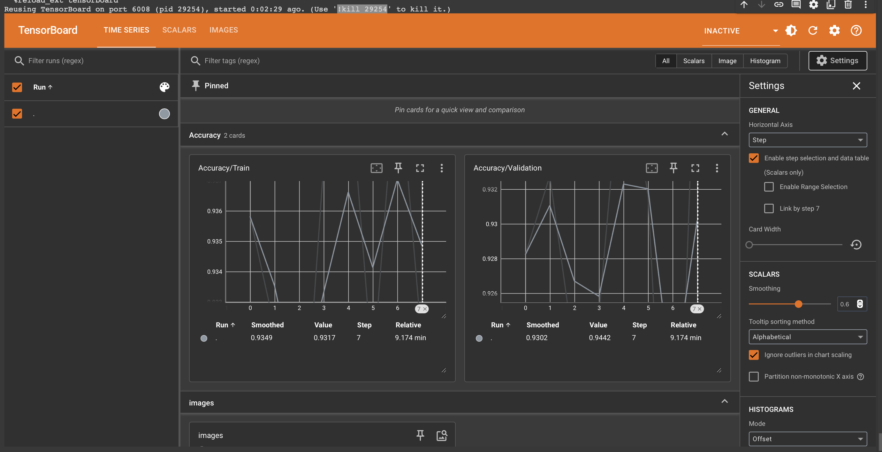
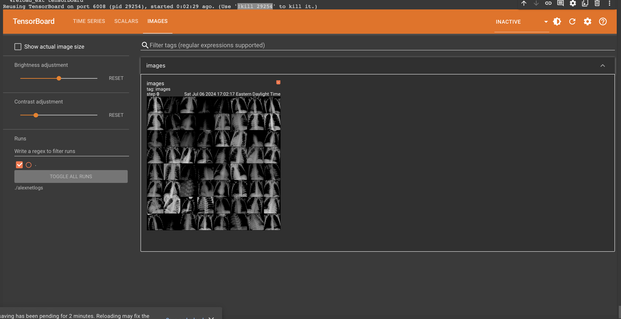
Results - contd..
Model Visualisation using Tensor Board for AlexNet model is deployed where key features like Images, Time Series, Scalars, Histograms are visualized for better understanding of the model.
The time series provide real time view of metrics like accuracy, loss for the model.
Images show the images in the dataset, histograms provide how tensor values evolve across different layers in the model.

Slide 12
Key Observations / Summary
To summarise our observations of the project-
Our base CNN model performed well compared to complex model architectures like VGG19 and AlexNet. Upon application of Autoencoders to this model, the computational time required was reduced immensely and this was achieved by only sacrificing 3% accuracy which can be considered a great trade off.
Upon generating synthetic images using GAN, the performance of ResNet improved while the performance of DenseNet dropped probably because of reliance on subtle features.
Pretrained model GoogleNet performed the best of the lot, however it requires a lot of computational power which necessitates the need for better optimised and faster models.
These applications open the pathway for integration of deep learning and medical diagnosis for example, if these models are integrated with Xray machines, it aids medical practitioners across the world providing better health outcomes.

Slide 13
Team Contribution
Name | UBIT | Work done | Contribution
Swanith Ambadas | swanitha | Data pre-processing, CNNs, VGG19, Autoencoders and Final Report | 33.33%
Manish Bikumalla | manishbi | ResNet34, DenseNet, GoogleNet, GANs and Final Report | 33.33%
Hariharan Sriram | hsriram | AlexNet, Tensor Board, Report 1 Report 2, Final Report | 33.33%

Slide 14
THANK YOU!

