Slide 1
OSGi and Integration Server
Kalpesh Shah
November 7, 2026

Slide 2
Agenda
December 9, 2011
Introduction to OSGi
Integration Server under OSGi
SAG OSGi Platform basics
Understanding Integration Server Profile
Q&A

Slide 3
Introduction to OSGi

Slide 4
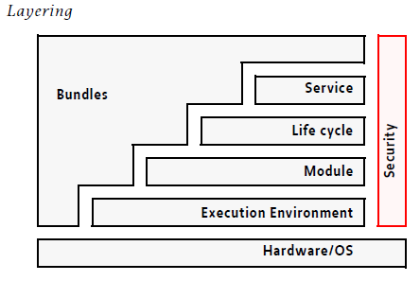
OSGi Framework Layers
December 9, 2011

Slide 5
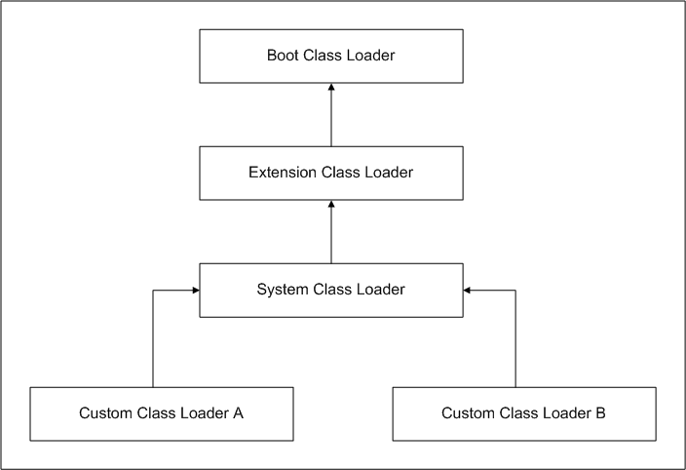
Java Classloader
December 9, 2011
Core Java Library
<JAVA_HOME>/lib
<JAVA_HOME>/lib/ext
java.class.path /
CLASSPATH

Slide 6
Problems faced with Java Classloader and Jars
December 9, 2011
No information hiding across jars
    Public classes are visible to every other jar running inside JVM
Lack of version information
    Multiple applications within JVM need to access different versions of jars
Lack of explicit dependencies (jar hell)
Jars are not modules
Notes:
No Information Hiding across Jars – Example of a Public class A, can be accessed freely by anyone within that Jar as well as anyone outside that Jar running inside the same JVM.
Lack of version information – if multiple applications are sharing common/lib, one can not promote without another one promoting it
Lack of explicit dependencies – could lead to broken systems i.e. a.jar requires classes from b.jar and if b.jar is not available would cause ClassNotFoundException during execution.

Slide 7
OSGi – Module Layer
December 9, 2011
OSGi is the module system for Java. It defines a way to create true modules and a way for those modules to interact at runtime
Modules are known as Bundles
Bundle is a jar with some additional metadata information in MANIFEST.MF
Application can be comprised of set of bundles
Each bundle has its own classloader
There are different implementers of OSGi framework – SpringDM, Knopflerfish, Apache Felix, Equinox
SAG platform uses EQUINOX as OSGi framework
Notes:
No Information Hiding across Jars – Example of a Public class A, can be accessed freely by anyone within that Jar as well as anyone outside that Jar running inside the same JVM.
Lack of version information – if multiple applications are sharing common/lib, one can not promote without another one promoting it
Lack of explicit dependencies – could lead to broken systems i.e. a.jar requires classes from b.jar and if b.jar is not available would cause ClassNotFoundException during execution.

Slide 8
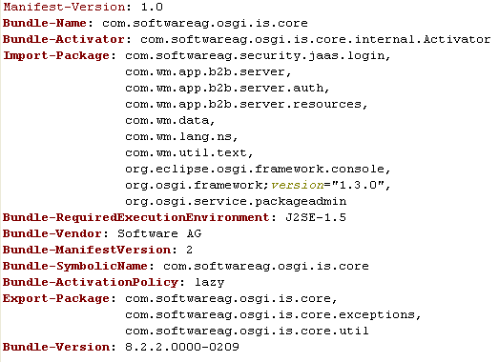
Bundle MANIFEST.MF file
December 9, 2011
Bundle-Name:
Bundle-SymbolicName:
Bundle-ManifestVersion:
Bundle-Version:
Bundle-Activator:
Export-Package:
Import-Package:
Require-Bundle: (Not recommended)
Notes:
Bundle-Name: Defines a human-readable name for this bundle, Simply assigns a short name to the bundle.
Bundle-SymbolicName: The only required header, this entry specifies a unique identifier for a bundle, based on the reverse domain name convention (used also by the java packages).
Bundle-Description: A description of the bundle's functionality.
Bundle-ManifestVersion: This little known header indicates the OSGi specification to use for reading this bundle.
Bundle-Version: Designates a version number to the bundle.
Bundle-Activator: Indicates the class name to be invoked once a bundle is activated.
Export-Package: Expresses what Java packages contained in a bundle will be made available to the outside world.
Import-Package: Indicates what Java packages will be required from the outside world, in order to fulfill the dependencies needed in a bundle.

Slide 9
Bundle Activator
December 9, 2011
Most important interface in OSGi framework
Specified from Bundle’s Manifest file
Implementers should have no-arg constructor
Invoked when starting or stopping a bundle within the framework
Must implement start and stop methods
Start and Stop methods gets BundleContext
BundleContext allows Activator to interact with the framework

Slide 10
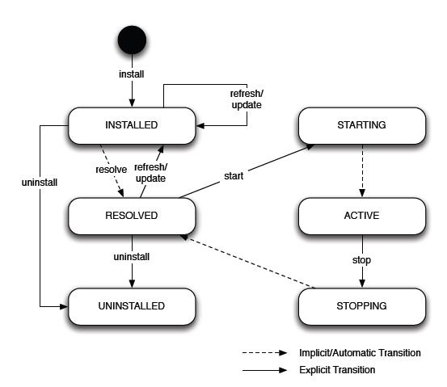
OSGi – Lifecycle Layer
Bundle Lifecycle
December 9, 2011
Notes:
http://eclipsecon.org/2008/sub/attachments/Equinox_Framework_How_to_get_Hooked.pdf

Slide 11
Bundle Lifecycle
December 9, 2011
INSTALLED – Bundle is installed in the framework
RESOLVED – Once all constraint for the bundle has been satisfied
STARTING – Start bundle is invoked. Invokes BundleActivator.start
ACTIVE – start of BundleActivator is successful and bundle is active
STOPPING – Stop bundle is invoked. Invokes BundleActivator.stop
UNINSTALLED – Removes it from the framework
Notes:
http://eclipsecon.org/2008/sub/attachments/Equinox_Framework_How_to_get_Hooked.pdf

Slide 12
Demo!
Notes:
Install test bundle.
Uninstall test bundle.

Slide 13
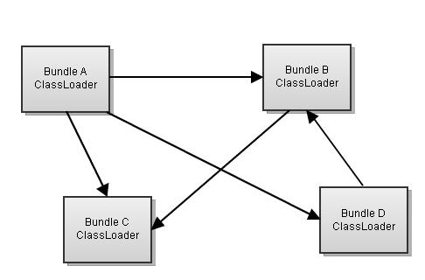
OSGi Classloader
December 9, 2011
From Tree to Graph
Classloader per Bundle
Class loading Sequence
  Try the parent for java.packages
  Try the parent for boot delegation packages
  Try to find it from imported packages
  Try to find it from required bundles
  Try to find from its own classpath
  Try from extensions (buddy class loading, proxy - hook)
Notes:
Explain what is Boot Delegation

Slide 14
Boot Delegation
December 9, 2011
By default when we try to access java.* packages, parent class loader is used to find the classes. What do we do for other packages provided in JVM? ➔Boot Delegation
Can be used to access com.sun.* or javax.* packages
Controlled with a property - org.osgi.framework.bootdelegation in configuration file – config.ini

Slide 15
Buddy Classloading
December 9, 2011
What happens if Library bundle needs to load classes from its clients
    e.g. WS-Stack factories need to load classes from IS bundle or Hibernate Bundle needs to load classes from its clients
Equinox specific
Manifest-Version: 1.0
Bundle-ManifestVersion: 2
Bundle-Name: com.softwareag.osgi.is
Bundle-SymbolicName: com.softwareag.osgi.is
Bundle-Version: 1.0.0
Bundle-Activator: com.softwareag.osgi.is.Activator
Bundle-Vendor: SOFTWAREAG
Import-Package: org.osgi.framework;version="1.3.0"
Bundle-ActivationPolicy: lazy
Bundle-RequiredExecutionEnvironment: JavaSE-1.6
Export-Package: com.softwareag.osgi.is.launcher
Eclipse-BuddyPolicy: registered
Manifest-Version: 1.0
Bundle-ManifestVersion: 2
Bundle-Name: Sample Plug-in
Bundle-SymbolicName: test.softwareag.osgi.sample
Bundle-Version: 1.0.0
Bundle-Activator: test.softwareag.osgi.sample.Activator
Import-Package: org.osgi.framework;version="1.3.0",
org.osgi.util.tracker;version="1.3.1"
Bundle-RequiredExecutionEnvironment: JavaSE-1.6
Export-Package: test.softwareag.osgi.sample
Eclipse-RegisterBuddy: com.softwareag.osgi.is
Require-Bundle: com.softwareag.osgi.is
Notes:
http://wiki.eclipse.org/index.php/Context_Class_Loader_Enhancements#Buddy_Policy_2
https://iwiki.eur.ad.sag/download/attachments/113410326/JAX+classloading_and_type_visibility_in_osgi.pdf?version=1&modificationDate=1320653754970

Slide 16
Classloader Hook, Proxy Bundle
December 9, 2011
Equinox specific
Add classpath entries to the bundle classloader
Provided by the SAG OSGi platform
Used by IS to access classes present in Integration Server’s class space
Notes:
http://eclipsecon.org/2008/sub/attachments/Equinox_Framework_How_to_get_Hooked.pdf

Slide 17
OSGi Services – Service Layer
December 9, 2011
Service can provide late binding
Service is a plain Java Object.
Published in the OSGi Service Registry under the name of one or more Java interfaces
Consumers who wish to use it may look it up using any of those interfaces names.
Used inside the same JVM (not distributed)
Notes:
http://eclipsecon.org/2008/sub/attachments/Equinox_Framework_How_to_get_Hooked.pdf

Slide 18
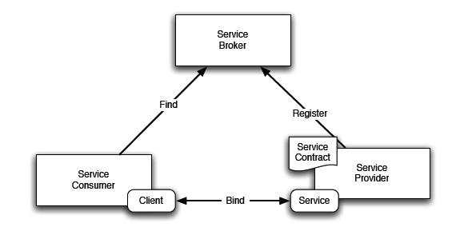
OSGi Services
December 9, 2011
Notes:
http://eclipsecon.org/2008/sub/attachments/Equinox_Framework_How_to_get_Hooked.pdf

Slide 19
Registering and Unregistering a service
December 9, 2011
Bundle can register or unregister a service by calling one of the methods on BundleContext
registerService(java.lang.String clazz, java.lang.Object service, java.util.Dictionary properties)
registerService(java.lang.String[] clazzes, java.lang.Object service, java.util.Dictionary properties)
ServiceReference.unregister()
Notes:
http://eclipsecon.org/2008/sub/attachments/Equinox_Framework_How_to_get_Hooked.pdf

Slide 20
Locating a Service
December 9, 2011
Bundle can lookup a service by calling one of the methods on BundleContext
getServiceReference(java.lang.String clazz)
Returns a ServiceReference object for a service that implements and was registered under the specified class.
getService(ServiceReference reference)
Returns the specified service object for a service.
Using ServiceTracker
  Simplifies using Services from OSGi framework
  Tracks the service add, update, delete
  Utility methods to get Service
Notes:
http://eclipsecon.org/2008/sub/attachments/Equinox_Framework_How_to_get_Hooked.pdf

Slide 21
Demo and Code for Services!

Slide 22
Integration Server under OSGi

Slide 23
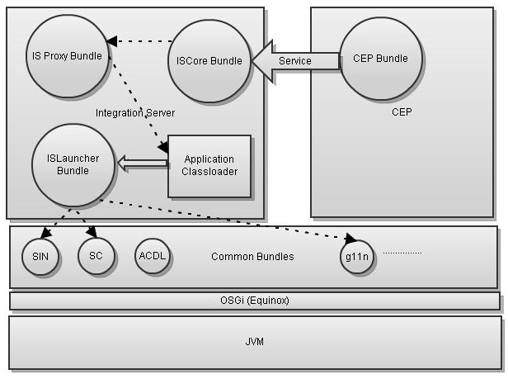
Integration Server under OSGi
December 9, 2011
Instead of breaking entire Integration Server into bundles, used the Hybrid approach - ISLauncher

Slide 24
Integration Server bundles
December 9, 2011
com.softwareag.is.launcher
  Used to launch the actual Integration Server instance
com.sofwareag.is.core
  Provides capability to run Integration Server flow / java services through internal Integration Server API (avoids transport layer)
  Used by CEP for services for management of triggers and different java services
com.softwareag.is.proxy
  Used by Platform Hook classloader to load classes from Integration Server class space

Slide 25
Integration Server bundles
December 9, 2011
MANIFEST.MF file for Integration Server Proxy bundle
Manifest-Version: 1.0
Bundle-ManifestVersion: 2
Bundle-Name: Integration Server Proxy Bundle
Bundle-Description: A bundle that exposes Integration Server's client packages
Bundle-SymbolicName: com.softwareag.osgi.is.proxy
Bundle-Version: 8.2.2.qualifier
Bundle-Vendor: Software AG
Bundle-ActivationPolicy: lazy
Bundle-RequiredExecutionEnvironment: J2SE-1.5
Export-Package: com.wm.app.b2b.client, com.wm.lang.ns, com.wm.data, com.wm.util, com.wm.util.text, com.wm.app.b2b.server;resolution:=optional, com.wm.app.b2b.server.auth;resolution:=optional, com.wm.app.b2b.server.resources;resolution:=optional, com.wm.app.b2b.server.wss;resolution:=optional, com.softwareag.cst.util.security;resolution:=optional
Require-Bundle: com.softwareag.osgi.is.launcher
Proxy-For: com.softwareag.osgi.is.launcher
Indicates what packages
to load from
Integration Server classloader

Slide 26
Bundles used by Integration Server from the Platform
December 9, 2011
Instead of using jars from common/lib, as a first step we utilized few of the bundles from the platform
Various bundles for SIN
Bundles provided for g11n
Shared Component bundle

Slide 27
SAG OSGi Platform Basics

Slide 28
SAG OSGi Platform Basics
December 9, 2011
What is a platform?
What is a template in platform?
Profile
p2

Slide 29
SAG OSGi Platform
December 9, 2011
Equinox distribution
Support of creating separate “profile” or “instances” of the platform (from installer API)
Contains base bundles such as SIN, Log4j, g11n
Provides base infrastructure - common startup, shutdown scripts
Purpose is to provide shared pool of bundles that can be used by multiple products
Installed under <SAG_DIR>/common/runtime directory

Slide 30
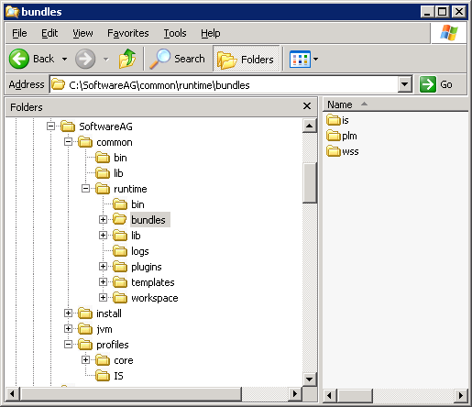
Directory Structure
December 9, 2011
platform runtime
Contains IS bundle
Folder for all products
to contribute bundles
Template profiles
IS profile directory
Notes:
Taken from OSGi Training.
bin/ - contains startup/shutdown and helper scripts
logs/ - contains Platform log files
bundles/ - contains Software AG OSGi products
templates/ - contains base templates that can be used to create instances of Platform

Slide 31
Template
December 9, 2011
Platform provided set of pre-configured profile for binaries (bundles) and configuration
Can be replicated for individual products and customized based on its requirement
A profile for a product can be created from a template
Three flavors of the template
    core – Contains Tomcat Web Container
    jetty – Contains Jetty Web Container
    minimal – No Web Container
Product installation uses installer API to create its instance from one of the above template

Slide 32
Profile
December 9, 2011
Created from the template provided by the platform
Instance of the platform for a product
Created under <SAG_DIR>/profiles/<product_code> e.g. <SAG_DIR>/profiles/IS
During installation, product installer will include product specific set of bundles and configurations in a profile
Each instance / profile runs in a separate JVM

Slide 33
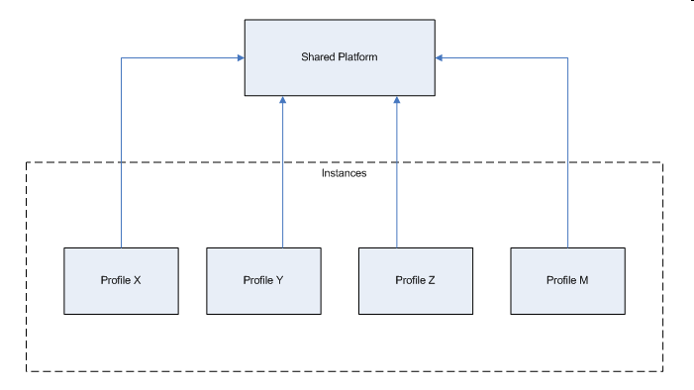
Profile
December 9, 2011
Notes:
From iWiki

Slide 34
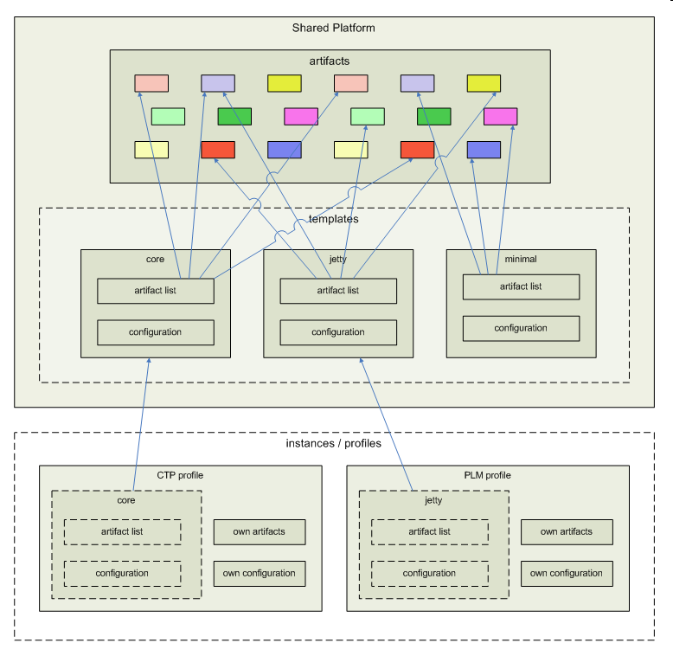
Profile
December 9, 2011
Notes:
From iWiki

Slide 35
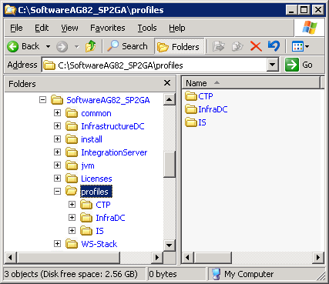
Directory Structure of a Profile
December 9, 2011
Product profiles
Notes:
Contains Product specific profiles

Slide 36
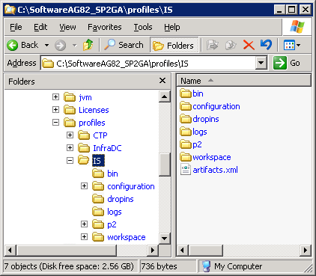
Directory Structure of a Product Profile
December 9, 2011
Startup/shutdown scripts
Used by Equinox for loading bundles
Logs from the platform
Notes:
Contains Product specific profiles

Slide 37
p2
December 9, 2011
Replaced Update Manager of Eclipse
Provisioning solution for OSGi Systems – Allows initial installation, update, rollback, un-installation of the products
Describes metadata about the application and their dependencies
Product builds generates p2 repository using Eclipse PDE build for a product and provides it as a build module to the installer
p2 repository used during the installation of the product
Notes:
http://wiki.eclipse.org/Equinox_p2_Getting_Started

Slide 38
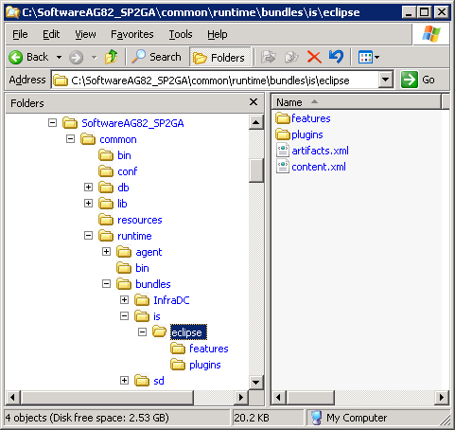
p2 Repository
December 9, 2011
Notes:
http://wiki.eclipse.org/Equinox_p2_Getting_Started
http://wiki.eclipse.org/Equinox_p2_Repository_Mirroring
Features have a manifest that provides basic information about the feature and its content. Content may include plug-ins, fragments and any other files that are important for the feature. A feature can also include other features. The delivery format for a feature is a JAR, but each included plug-in will be provided as a separate JAR.

Slide 39
p2 Repositories
December 9, 2011
A Feature is used to package a group of plug-ins together into a single installable and updatable unit.
View IS p2 repository under <SAG_DIR>/common/runtime/bundles/is/eclipse
Metadata Repository (content.xml)
    Holds information about the installable unit and their interdependencies
    Examine content
Artifact Repository (artifacts.xml)
    Stores information about the artifacts
    Examine content
Notes:
http://wiki.eclipse.org/Equinox_p2_Getting_Started
http://wiki.eclipse.org/Equinox_p2_Repository_Mirroring
Features have a manifest that provides basic information about the feature and its content. Content may include plug-ins, fragments and any other files that are important for the feature. A feature can also include other features. The delivery format for a feature is a JAR, but each included plug-in will be provided as a separate JAR.

Slide 40
Understanding Integration Server Profile

Slide 41
Understanding Integration Server profile
December 9, 2011
View IS Profile and other products profile and various folders under it
  bin Platform scripts for start / shutdown
  configuration (config.ini)
  Simple configurator (bundles.info) provides the OSGi framework the list of bundles to run.
  dropins Allows to install features and plugins during development time without going through the install process. Not recommended for production systems.
Scripts for start / shutdown of Integration Server under <IS_DIR>/bin for backward compatibility and customization
Notes:
http://wiki.eclipse.org/Equinox_p2_Getting_Started#Dropins

Slide 42
Q&A

Slide 43
Thank you and Have fun with OSGi…

