Slide 1
Lending Club Case Study
Group Members:
Manish Sharma

Slide 2
Abstract
Lending club is the largest online loan marketplace, facilitating personal loans,
business loans, and financing of medical procedures.
Borrowers can easily access lower interest rate loans through a fast online interface.
The objective of analysis is to use the information about past loan applicants and find whether they ‘defaulted’ or not.

Slide 3
Problem solving methodology
Data Analysis
Data Analysis
Data Analysis
Data Cleaning
Data Understanding
Univariate Analysis
Segmented Univariate Analysis
Analysing the continuous data columns with respect to the categorical column
Bivariate Analysis
Recommendations
Removing the null valued columns, unnecessary variables and checking the null value percentage and removing the respective rows.
Working with the Data Dictionary and getting knowledge of all the columns and their domain speciﬁc uses
Analysing each column, plotting the distributions of each column.
Analysing the two variable behaviour like term and loan status with respect to loan amount.
Analysing all plots and recommendations for reducing the loss of business by detecting columns best which contribute to loan defaulters.

Slide 4
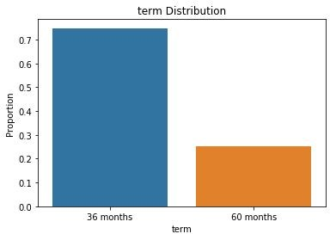
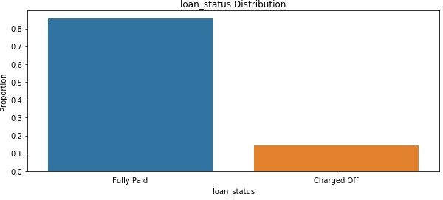
Analysis
There are just two loan lengths available: 36 months and 60 months. Approximately 75% of borrowers took out loans with a period of 36 months.
In the given data set, charged-off borrowers account for around 15% of the total, while fully paid borrowers account for approximately 85%.

Slide 5
When the loan interest rate is high, the loan is more likely to default.

Slide 6
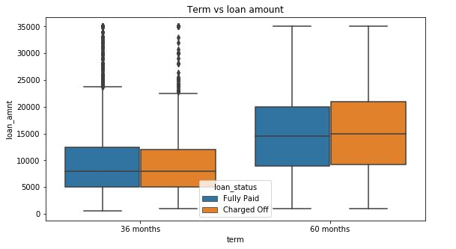
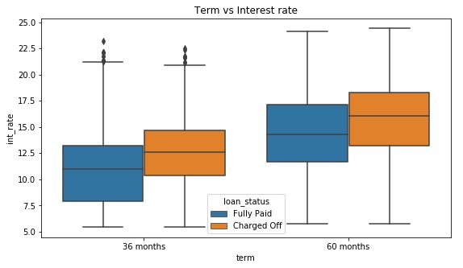
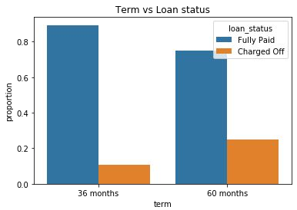
Analysis
The default rate is high in the 60-month term because most customers took out large loans with hefty interest rates and had difficulty repaying the money to the bank.

Slide 7
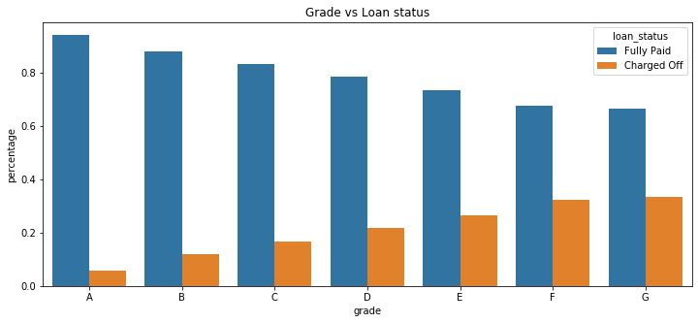
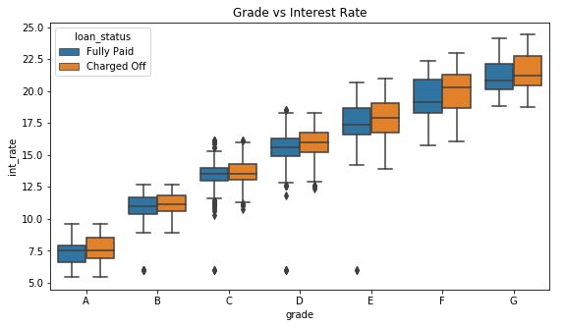
Analysis
Grades are an excellent category for predicting a borrower's likelihood of defaulting on a loan.
Lower grades (E,F,G) are more likely to default on a debt than better grades (A,B).
Furthermore, lower grades are receiving loans with higher interest rates, which may be the cause of loan default.

Slide 8
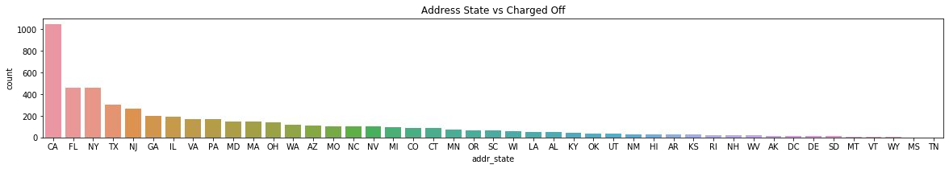
Analysis
Borrowers in California, Florida, and Texas default on their loans at a higher rate than those in other states.

Slide 9
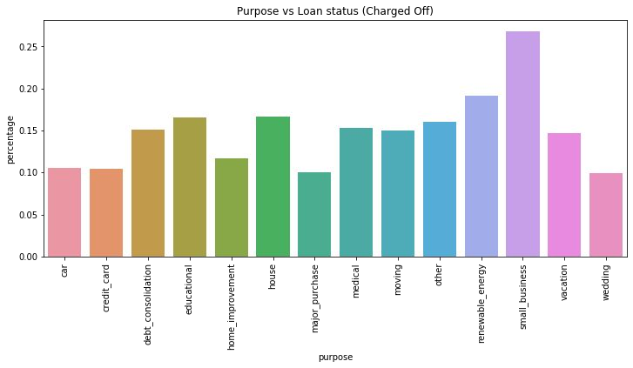
Analysis
Lenders who took out loans for small businesses have defaulted at a higher rate.

Slide 10
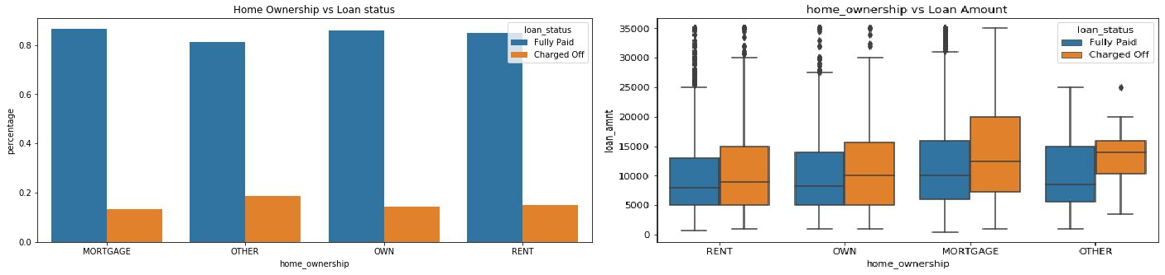
Analysis
Each home ownership group has an about 20% likelihood of loan default.
According to the second plot, those with greater loan amounts in mortgage house ownership have a higher default rate than others.

Slide 11
The sanctioned loan (Funded Amount by Investor) is less than the sought loan amount by borrowers in the Other Home Ownership category.

Slide 12
Conclusions
Lending Club should limit high-interest loans with a term of 60 months since they are prone to loan default.
Grades are an effective indicator for identifying defaulters. Before making loans to low-credit customers, Lending Club should get additional information from them (G to A).
To maximize earnings, Lending Club should limit the quantity of loans it makes to borrowers in California, Florida, and New York.
Small business loans are more likely to default. Lending Club should suspend or limit the amount of loans it makes to them.
Borrowers who own a home with a mortgage take out larger loans and fail on the authorised loans. When the loan amount sought exceeds $12,000, Lending Club should cease making loans to this group.
People who have a greater number of public negative records are more likely to file for bankruptcy. The lending club should ensure that the borrower has no public unfavourable records.

