Slide 1


Slide 2
Chinese Food Supermarket Business Sales Analysis
Time Period(in dataset) : 2020-2023
Prepared by: Manish Sharma

Slide 3
About Chinese Food Supermarket
Chinese Food Supermarket is a leading retail chain specializing in Chinese groceries and fresh produce.
Offers a wide range of vegetables, packaged food, and specialty Chinese ingredients.
Focuses on quality, variety, and customer experience.
Dataset reflects sales transactions and operational performance from 2020 to 2023.

Slide 4
Business Problem
Identify sales trends and profitability drivers.
Reduce return rates and optimize inventory.
Improve category and item-level profitability.
Leverage data to inform strategic business decisions.

Slide 5
Research Objective
To perform a comprehensive sales analysis of the supermarket.
To identify key patterns and trends in sales, profit, and returns.
To derive actionable insights to drive business growth.
To support data-driven decision-making.

Slide 6
Objectives
Analyze overall sales and profit trends by year.
Evaluate performance across categories and items.
Understand temporal patterns (hourly, weekly, monthly).
Investigate factors contributing to returns.
Provide actionable business recommendations.

Slide 7
Hypothesis
Sales exhibit strong seasonality with peak months.
Specific categories contribute disproportionately to profits.
Returns are higher for certain items/categories.
Optimal sales hours can be leveraged to boost revenue.
There are untapped opportunities to improve margins.

Slide 8
Data Overview
Data Source: Supermarket Sales Dataset (Kaggle)
Time Period: 2020 to 2023
Only first 6 months of data is there in 2020 and last months of data is there in 2023 year, rest years have all months of data.
Sample Size: approx. 878,000 records
Key Fields:-
Date, Time, Item Code, Item Name, Category Name, Quantity Sold (kilo), etc.

Slide 9
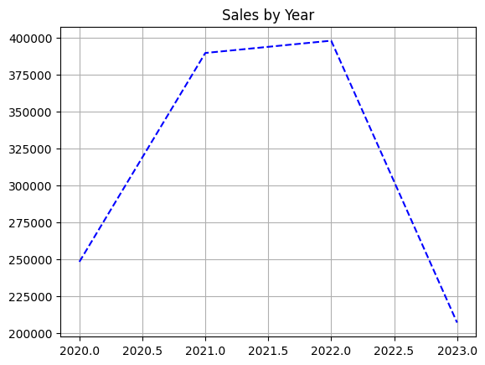
Sales by Year
Consistent growth in total sales observed from 2020 to 2022.
2021 recorded the highest overall sales volume.
Sales dip in 2022 likely reflects pandemic impact.
Strong recovery trend indicates market resilience.

Slide 10
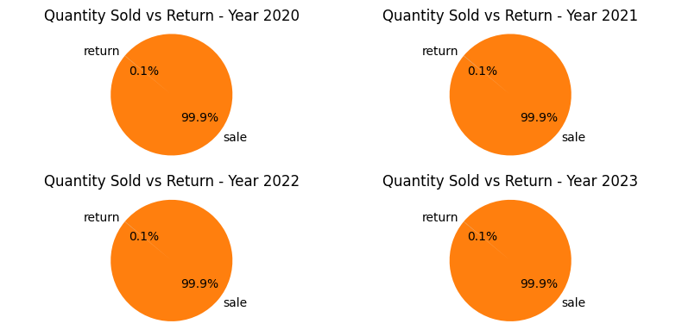
Quantity Sold vs Returns by Year
Return volumes have declined steadily year-on-year.
Majority of sales transactions result in successful sales.
All Years shows both high sales and controlled return levels.
Effective inventory and quality management may be contributing.

Slide 11
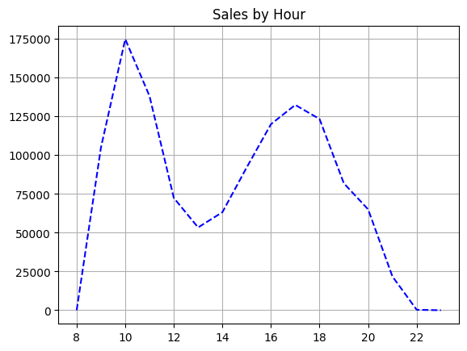
Sales by Hour
Peak sales hours occur around midday (11AM - 2PM).
Sales volume drops sharply during early morning and late night.
Clear opportunity to optimize staffing and promotions during peak hours.
Late evening hours could be explored for additional sales.

Slide 12
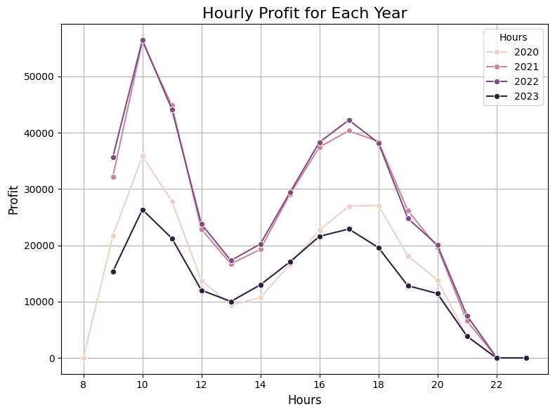
Hourly Profit for Each Year
Hourly profit trends closely mirror sales volume patterns.
High profitability maintained during peak sales hours.
Profit variability across different years suggests changes in pricing or product mix.
Sustained margins during mid-day hours is a key strength.

Slide 13
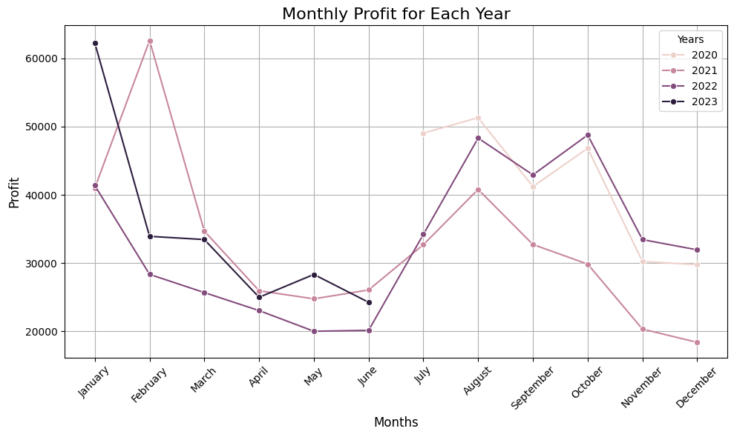
Monthly Profit for Each Year
Significant seasonality in monthly profits observed.
Profit peaks in late-year months (Nov-Dec), likely due to festive demand.
Steady profits in mid-year months suggest strong baseline demand.
Opportunity to plan targeted campaigns during low-profit months.

Slide 14
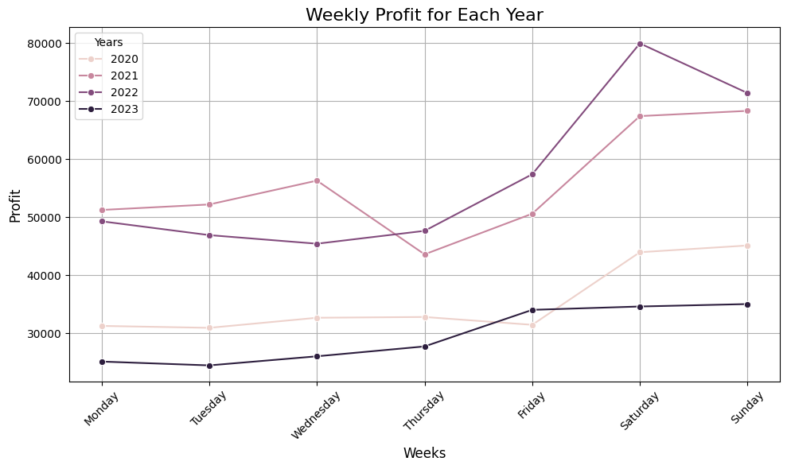
Weekly Profit for Each Year
Weekly profit trends show clear cyclical patterns.
Certain weeks consistently outperform others across all years.
Operational and promotional strategies can be fine-tuned based on weekly patterns.
Monitoring week-over-week trends enables agile business planning.

Slide 15
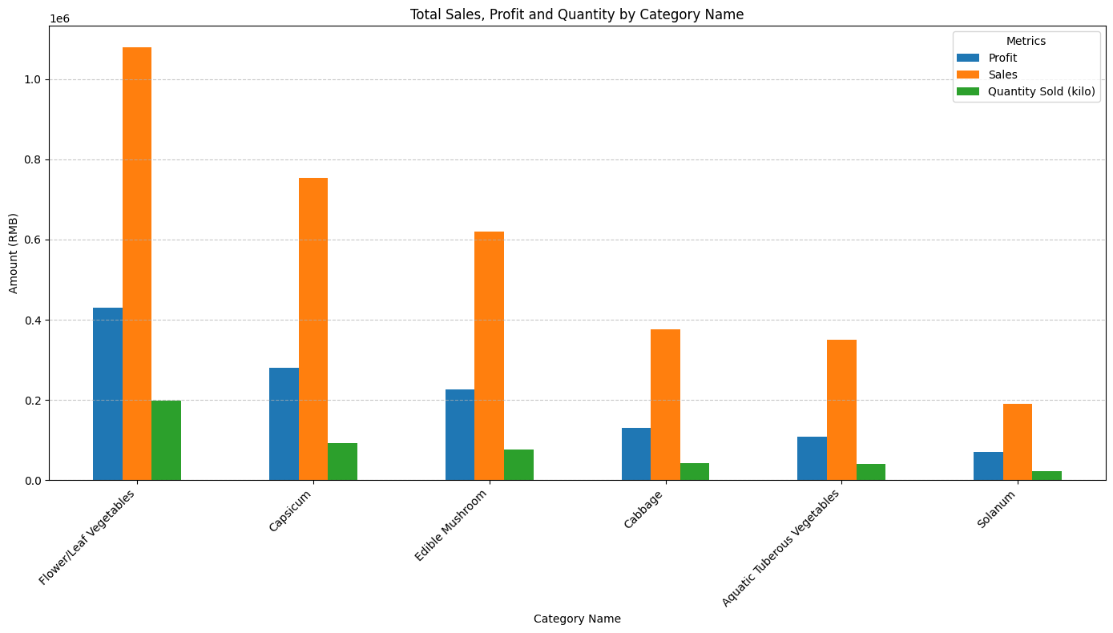
Total Sales, Profit and Quantity by Category
Top 2-3 categories contribute majority of sales and profits.
High-quantity categories are not always the most profitable.
Balancing sales volume with profitability is essential.
Opportunities exist to improve performance of lower-profit categories.

Slide 16
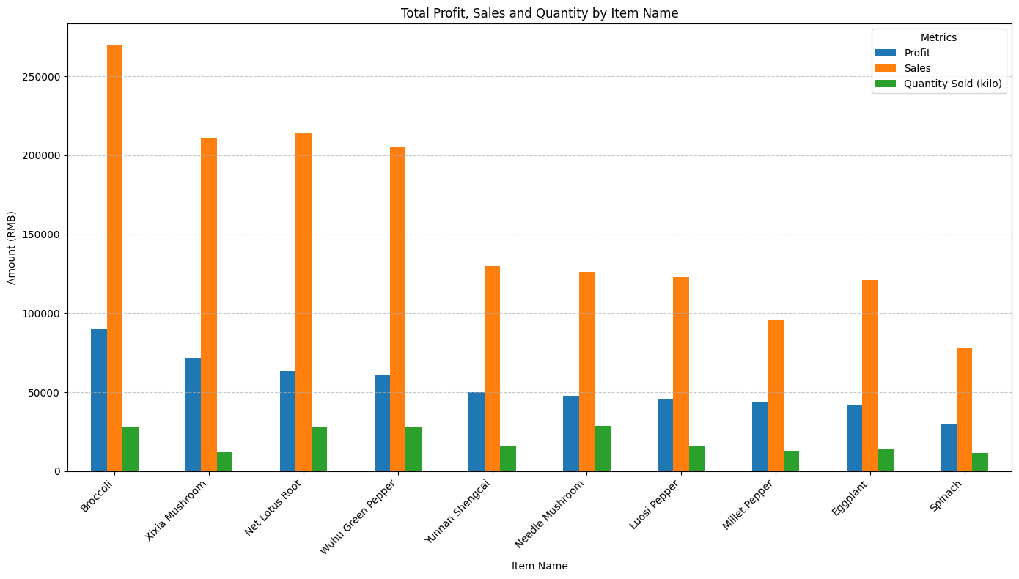
Total Profit, Sales and Quantity by Item Name
Certain items demonstrate very high profitability relative to sales volume.
Popular items drive both sales and brand loyalty.
Tail opportunities exist in niche items with high margins.
Dynamic pricing could enhance overall profitability.

Slide 17
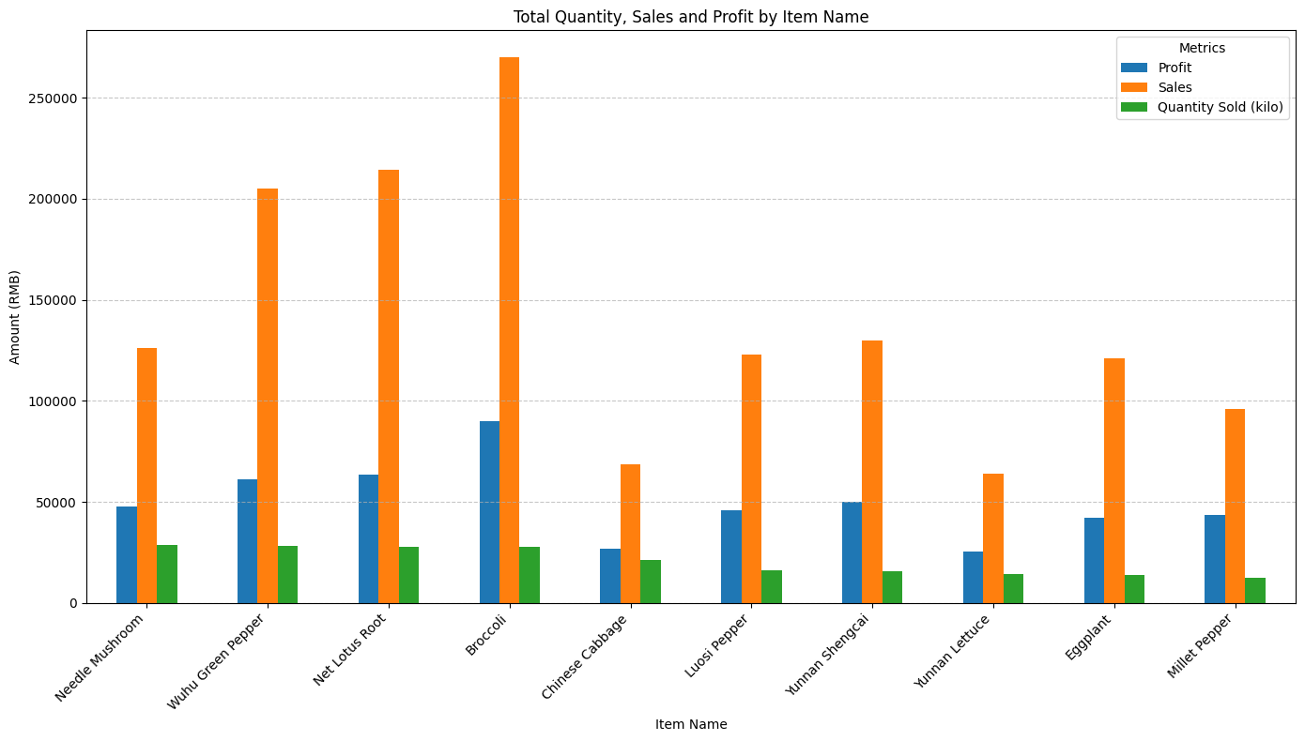
Total Quantity, Sales and Profit by Item Name
Items with highest quantities are not necessarily the most profitable.
Volume drivers must be analyzed alongside profit contributions.
Insights inform inventory optimization and pricing strategy.
Aligning marketing efforts with both volume and profit leaders is critical.

Slide 18
Recommendations
Leverage seasonal demand peaks through targeted promotions.
Optimize staffing during identified peak sales hours.
Focus on improving profit margins of high-volume categories.
Implement strategies to further reduce return rates.
Continuously monitor trends for agile business adjustments.

Slide 19
Thank You!
Questions & Discussion
Prepared by: Manish Sharma

