Slide 1
Big Data Analytics: Analyzing ACM Citation Network
Created by:
Manish PATIL
Rohit TATAR

Slide 2
Overview:
Processing and analyzing the ACM Citation Network.
4 major components in analysis:
Process ACM Citations dataset to generate citation links between each paper.
Visualize the in-degree distribution.
Implement Weighted page rank algorithm to produce top 10 ranked papers.
Calculation of clustering coefficient and shortest path for graph.

Slide 3
Initial Setup:
Configure MapReduce Driver class to a customizable record delimiter
Configuration conf = getConf();
conf.set(“textinputformat.record.delimeter”,”#*”);
Job job = new Job(getConf());

Slide 4
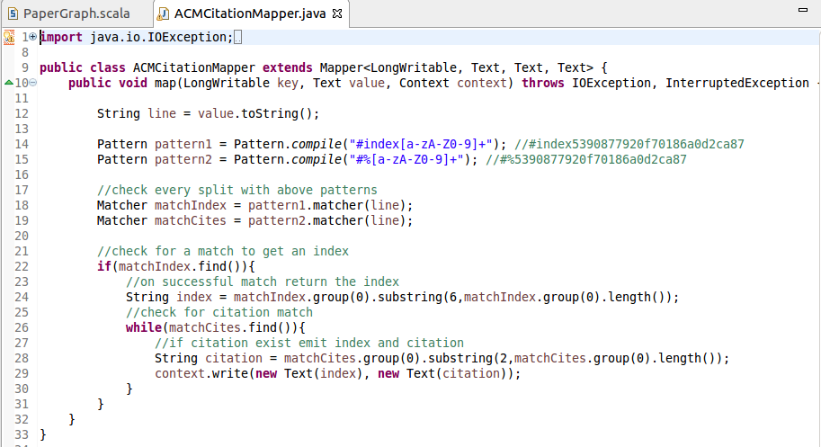
Building the Citation network using MapReduce:
Create two regular expressions to filter indexes and citations.
After successful match emit key=index , value=citation.

Slide 5
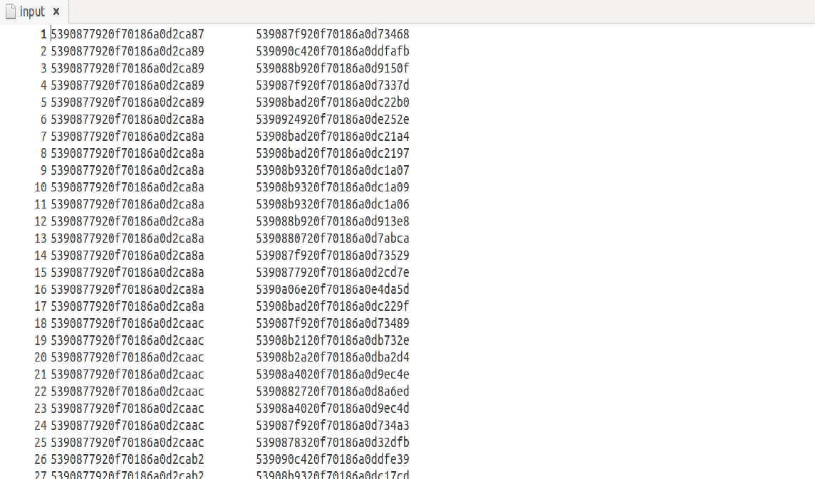
Output:
Paper Index and Citations generated after filtering .

Slide 6
Visualizing In-Degree Distribution:
Create in-degree distribution graph using the Spark GraphX API.
In-degree represents number of paper it has been referenced.
The in-degree distribution p(k) of a network is the fraction of nodes in the network with degree k.
P(k)=nk/n
P(k)=In-degree distribution for a paper
n(k)=number of papers with the same in-degree
n=total number of papers.

Slide 7
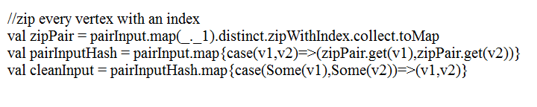
In-Degree Distribution:
Graphx API only support Integer type to be used as nodes.
Converting them into indexes using zipWithIndex.

Slide 8
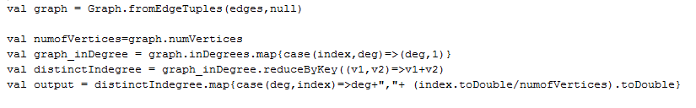
Calculating In-Degree Distribution in Spark:
Calculating degree for each vertex.
Using reduceByKey, to combine the indegrees for each key.

Slide 9
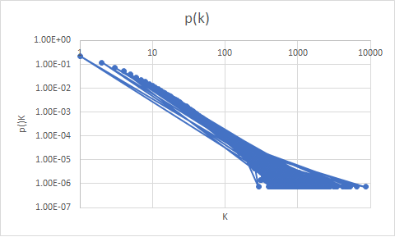
Visualizing In-Degree Distribution:

Slide 10
Weighted Page Rank Algorithm:
Algorithm assigns weight to each paper which implies that the higher the weight of the node, the more important it is.
Implemented this algorithm to identify most influential papers.
Objective is to find the top 10 papers with the highest weighted page rank in ACM citation network.

Slide 11
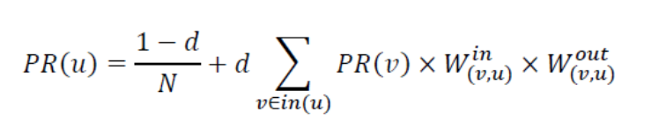


Implementing the Weighted Page Rank Algorithm:
The Weighted Page Rank is calculated using iterative calculations.
d = 0.85
N =Total number of papers.
in(u) =in-degree of u.
Win(v,u) =
Wout(v,u)=

Slide 12

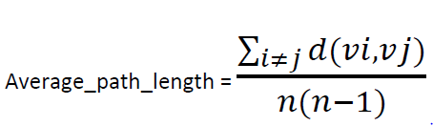
The local clustering coefficient of a node v in a graph is defined as follows:
The average path length of a graph is the average length of the shortest path between every two nodes in the graph and is computed as follows :

Slide 13
References:
Scala Cookbook
GraphX programming Guide

Slide 14
Conclusion:
MapReduce used to filter index and citations.
Using GraphX API, plotted the graph for indegree distribution.
The Weighted Page Rank algorithm provides with the top ten most influential papers.

Slide 15
Thank You

