Slide 1

How to Design Printed Circuits Boards
... and live to tell about it.
Manish kumar, IoT Embedded Engineer
Department of Electronics and Communication Engineering

Slide 2
Overview
What is a Printed Circuit Board?
How do you design a PCB?
How do you order a custom PCB?

Slide 3
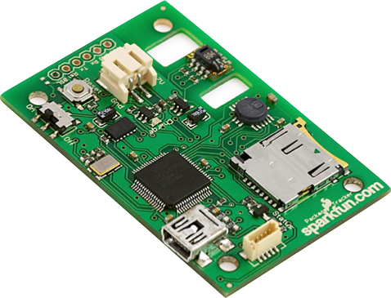
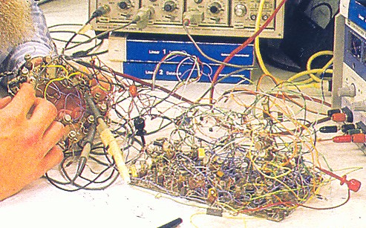
What is a PCB?
A Mechanical Solution to an Electrical Problem
Photo from hephaestusaudio.com
Photo from www.sparkfun.com

Slide 4
What are PCBs?
PCBs are the backbone of electrical
devices.
They are non-conductive board that
holds all electronic components
through a circuit embossed over it.
PCBs are built to last for a wide range
of industrial, commercial, and
domestic applications.
They can be customized to any
specifications to users’ requirements.

Slide 5

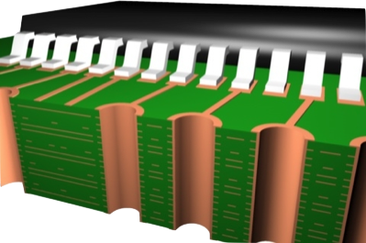
What is a PCB?
Layers, Traces, Planes, and Vias ... oh my!
Image from www.elkosoft.com

Slide 6
History of PCBs
PCBs were first developed during the Second World War.
The revolutionary invention was made by an Austrian Engineer, Paul Eisler.
Since 1929, PCBs have been mass produced for commercial applications.
They were first used in transformers and capacitors.

Slide 7
Terminology
track/trace: Copper “wires” on the board connecting components.
pad: Exposed copper on which you can solder things. Thru-hole pads often act like vias.
via: A hole in the board that is plated on the inside. Used to connect tracks on different layers of a board.
silkscreen: Print legend on PCB
soldermask: insulating coating that protects covered parts from solder. Mandatory for fine-pitch wave/reflow soldering

Slide 8
Terminology
Thru-hole components: components with leads that go through the circuit board and get soldered on the other side.
Surface-mount (SMD/SMT) components: Components that are meant to be soldered on the same surface on which it is mounted (these are usually smaller and harder to solder).

Slide 9

What is a PCB?
Essentially, you’re job is this ...
Image from www.gettyimages.com

Slide 10
PCB Types
Single Sided – Base material (rigid laminate with a woven glass epoxy base material) clad with copper on one side.
Double Sided - The assembly encompasses a base material with copper on its both sides.
Multi Layered – Encompasses several layers of substrates. Each layer is separated by an insulation.

Slide 11



Component Suppliers
Where do we get the goods?
For the “weird & wonderful” -
For the “inexpensive everyday” -
For the board itself -
www.sparkfun.com
www.mouser.com
www.4pcb.com

Slide 12
Parts of a PCB
The assembly consists the following parts.
Components – Actual devices in the board.
PCB components can be categorized as active and passive.

Slide 13
Active components include:
Diode – Allows current to flow in one direction.
Transistor – Amplifies and switches electrical
power and electronic signals.
Integrated Circuits (ICs) – Responsible for
several signal processing functions.
Passive components include:
Capacitor – Stores and discharge electricity.
Resistor – Limits the power of electrical current.
Inductor – Responsible for creating magnetic Field.

Slide 14
PCB software :
Vendors :
Orcad (Cadence)
Allegro (Cadence)
Eagle (Cadsoft)
P-CAD (Altium)
ExpressPCB
Kicad

Slide 15
EAGLE
• Stands for Easily Applicable Graphic Layout
Editor
• flexible, expandable and scriptable EDA application with schematic capture editor, PCB layout editor, auto-router.
• Latest version is 6.1 and minimum requirements are MAC OS X 10.6, Linux 2.6 and Windows XP.

Slide 16

The PCB Design Process
From Vision To Reality
Schematic Capture
Place Components
Iteration
Route Traces
Eagle PCB
www.cadsoft.de
Generate Gerbers
Fab!

Slide 17

Eagle PCB
A CAD Tool For Designing a Board
Control Panel
Project
Schematic Capture
Layout
Symbol
Footprint
Library

Slide 18
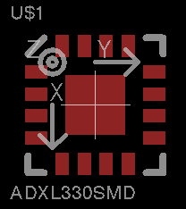
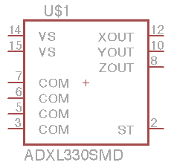
Eagle PCB
Symbol + Footprint + Device = Component
Symbol
Sym
Device
Dev
Footprint
Pac

Slide 19
Eagle PCB
Stuff I Need To Get Started
A Plan
  Block Diagram / Napkin Sketch
  Component Selection
  Connections and Testing Considerations
  Power and Performance Considerations
A New Project
Access to Libraries

Slide 20
Eagle PCB
It’s all about the planning.
Components
Connections
Power & Performance
Passives: 0805, 0603, etc.
Mechanical Connections
Power Ratings
IC Packages: QFN, TQFP, etc.
Bus Connections
Battery Performance
Libraries
PC Connections
High-Speed / High-Sensitivity

Slide 21
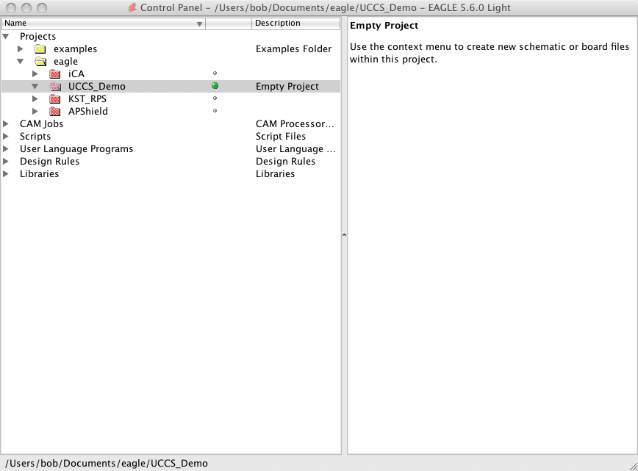
Eagle PCB
Creating a New Project
Launch Eagle
File -> New -> Project
Enter Project Name
Directory structure taken care of automagically.
Active project is shown with a green light.

Slide 22
Eagle PCB
Accessing Libraries
Full view of libraries available via Control Panel
Download more from the web and place in the Eagle installation directory in /lbr
Sparkfun has an incredible library of more advanced parts (accelerometers, etc.)
Caution! Just because you see the library in Control Panel doesn’t mean you can access it in your schematic.

Slide 23
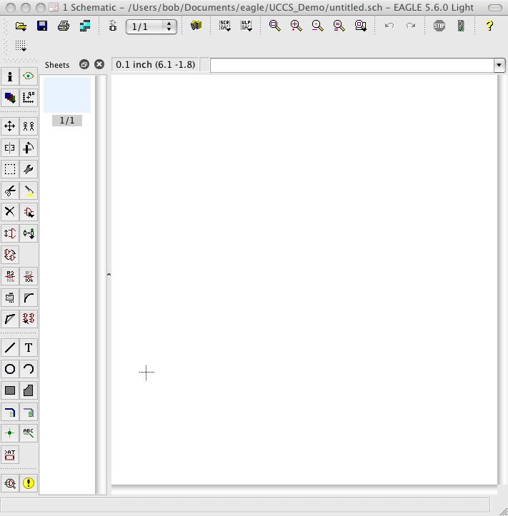
Schematic Capture
Schematic Capture
Creating a New Schematic
File -> New -> Schematic
Save it right away.
Don’t worry about creating a Board just yet.
Keep the 100-mil grid.

Slide 24
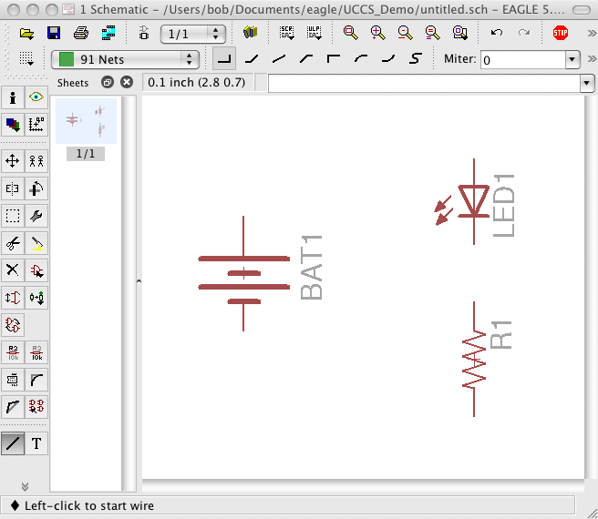
Schematic Capture
Schematic Capture
Adding Components
Click the Add icon
Find the component in the library
Set values
Don’t see the library? Try Use -> Library

Slide 25
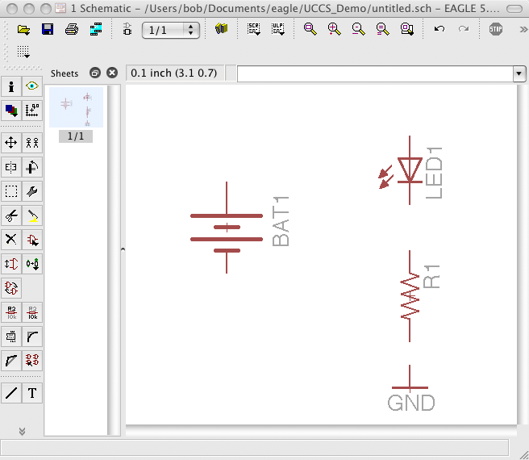
Schematic Capture
Schematic Capture
Adding Global Symbols
Click the Add icon
Find the global symbol in the library (supply1)
Place as if it were a component

Slide 26
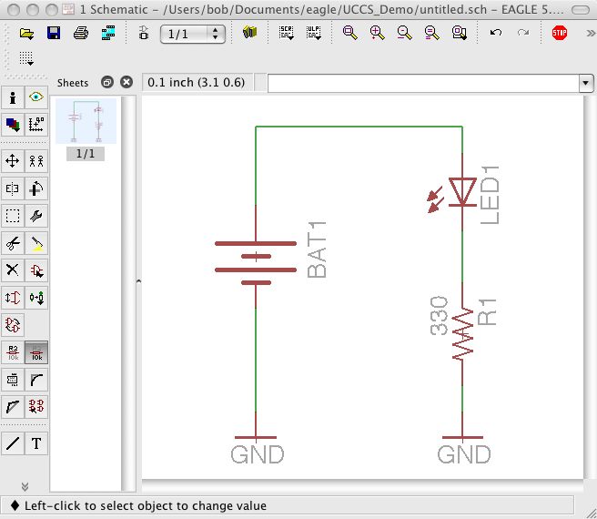
Schematic Capture
Schematic Capture
Adding Traces (aka Wires)
Click the Wire icon
Have at it!

Slide 27
Schematic Capture
Schematic Capture
Some General Tips
Avoid changing the grid unless absolutely necessary.
Free Eagle version does not allow “sheets”.
Free Eagle version requires that schematic drives the layout ... not vice-versa.
Groups, Info, and Layers icons are useful.
Pan, zoom, niceties easy to use.
Really care about that “net”? Label it.
Keep it clean - don’t be lazy.
Document!

Slide 28




Place Components
Schematic Capture
Place Components
But before you do ...
Passives - 0805 means 0.08” by 0.05”
Connectors - beware of physical fit
Actives - lots of packaging alternatives
Give thought to testability and troubleshooting
Thru-Hole (TH)
Surface Mount (SMT)
DIP
LQFP, QFP, TQFP
QFN
BGA

Slide 29
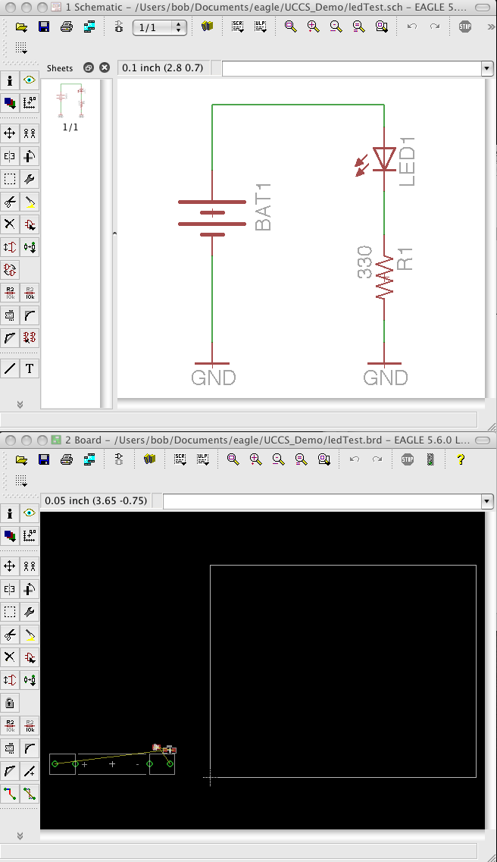
Place Components
Schematic Capture
Place Components
Creating a new board design
From the schematic, choose File -> Switch to Board.
“Create From Schematic”? You bet!
Board window automatically opens.

Slide 30
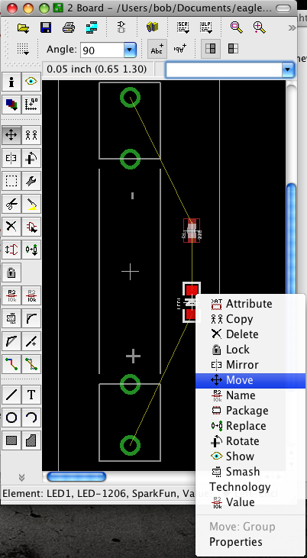
Place Components
Schematic Capture
Place Components
Some Common Tasks
Right-click on top of component, select Move to reposition.
While moving, right-click to Rotate.
Use “Group” wisely.
Right-click to Mirror (change to other side of board)
Use Move to change outline

Slide 31
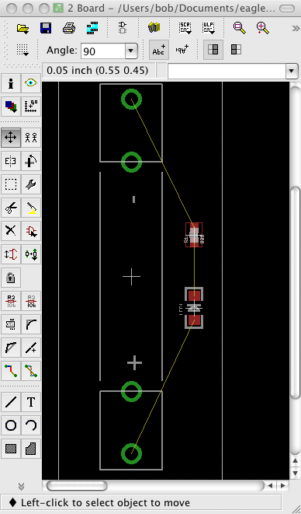
Place Components
Schematic Capture
Place Components
Thinking ahead
Take your time.
Untangle flight lines.
Think about planes.
Consider testability.
Mechanical Fit?
Hard stuff first.
Keep silkscreen.
Think hard about components on 2-sides.

Slide 32
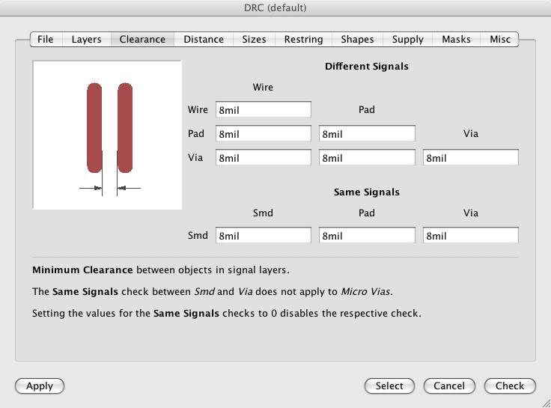
Place Components
Schematic Capture
Place Components
Some General Tips
Are your Design Rules setup correctly?
Run the Design Rule Check (DRC) often.
Run the Electrical Rule Check (ERC) often.
Save a snapshot of your placement file.

Slide 33
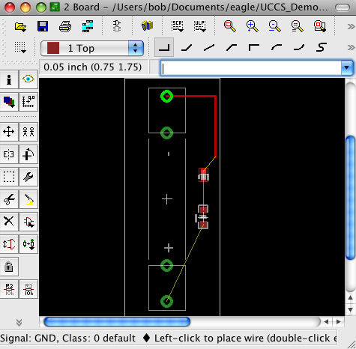
Route Traces
Schematic Capture
Place Components
Route Traces
Adding “Waaaahrs” To Your Layout
You want to route, not wire.
You want to ripup, not delete nets.
Are you on the top or the bottom?
Vias are on top and bottom. Easy to add.
DRC often!
Iterate like mad.

Slide 34
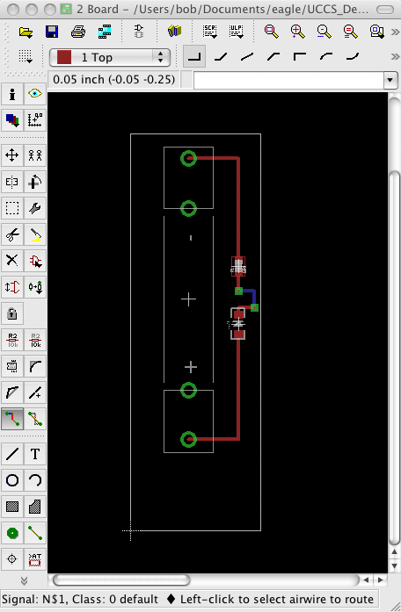
Route Traces
Schematic Capture
Place Components
Route Traces
Some General Tips
Two layers? Have an x-layer and a y-layer.
Don’t forget mounting holes, other nice things.
Add testability features.
Do the “what if?” dance.
Do the cardboard mockup.
Pour Copper.

Slide 35
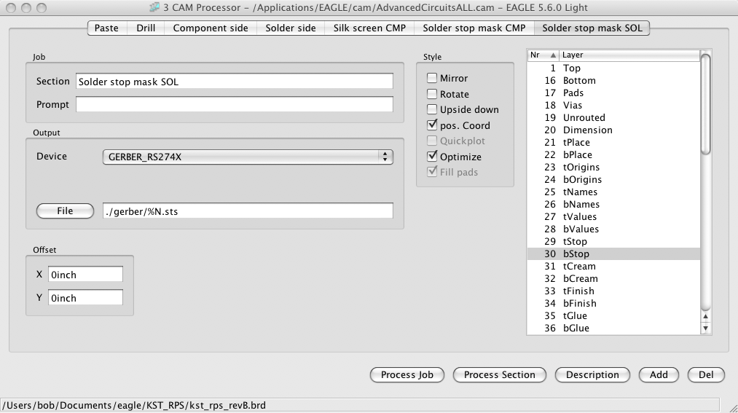


Generating Gerbers
Schematic Capture
Place Components
Route Traces
Some General Tips
Gen Gerbers
Easier than spit!
Using Advanced Circuits? Have I got a script for you ...
This involves the “CAM Processor” ...
Generate critical layers.

Slide 36
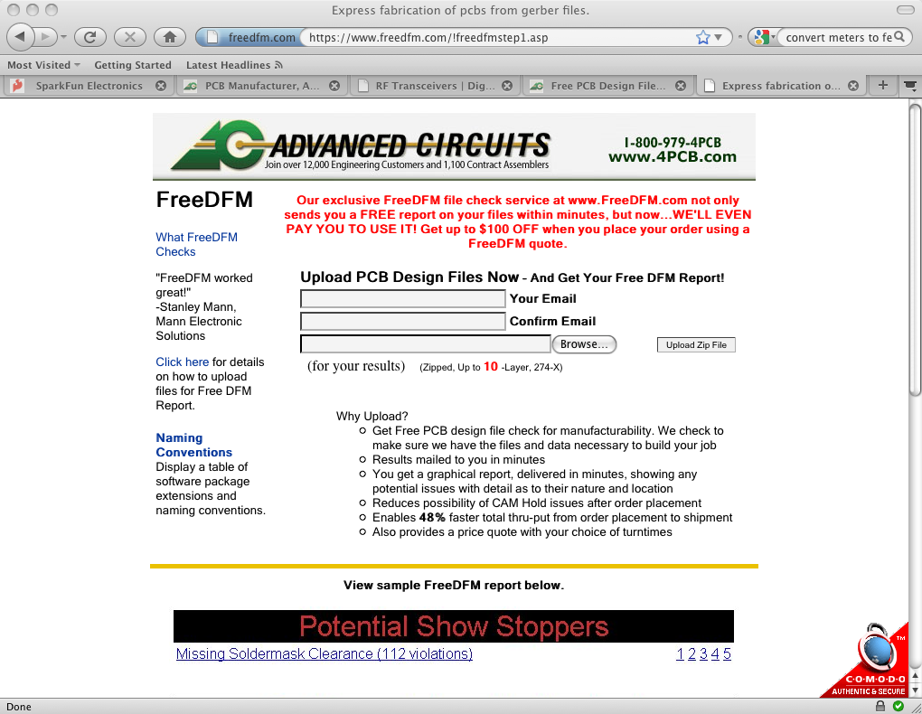
Generating Gerbers
Schematic Capture
Place Components
Route Traces
Sanity Checking The Result
Gen Gerbers
freedfm.com
You’ll need an account with Advanced Circuits.
Email will be sent confirming design rule checking.
Advanced Circuits even gives you a discount.
Squash any errors, review all warnings. Look for open vias, closed vias, etc.

Slide 37
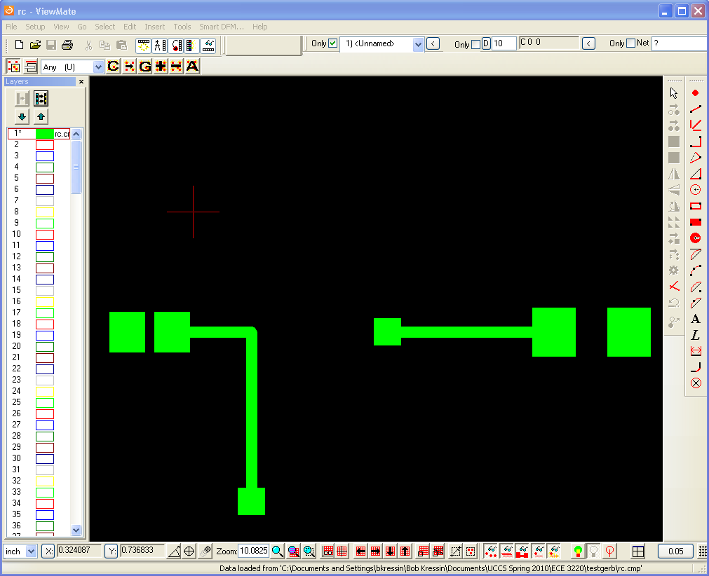
Generating Gerbers
Schematic Capture
Place Components
Route Traces
Reviewing The Result
Gen Gerbers
ViewMate - Free Gerber Viewer for Microsoft Windows (link on Dr. Wickert’s site).
Review planes, drill holes, and “obvious” defects. Not usually any surprises here.
Biggest error - not exporting the proper layers.

Slide 38
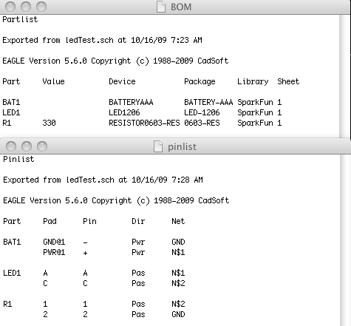
Fab
Schematic Capture
Place Components
Route Traces
Before you hit “the button” ...
Gen Gerbers
Fab!
Generate a Parts List (aka “The BOM”) using Export -> Partlist.
Generate a Pin List (aka “The Netlist”) using Export -> Netlist.
Sanity check both.

Slide 39

Fab
Schematic Capture
Place Components
Route Traces
Some General Tips
Gen Gerbers
Fab!
Do you have all of your components? Lead time?
Find out what file format your PCB Vendor wants.
Advanced Circuits - GERBER_RS_274X (no, really)
Consider routing it yourself at UCCS.
Consider barebonespcb.com. Really cheap.
Sleep on it. Follow my tradition -

Slide 40
The PCB Design Process
A Summary of a Lot of Information
Schematic Capture
Place Components
Iteration
Route Traces
Eagle PCB
www.cadsoft.de
Generate Gerbers
Fab!

Slide 41
Applications
Medical - Pacemakers, imaging equipment, drug delivery systems, wireless controllers.
Military - Weapons guidance systems, communication systems, GPS, aircraft missile-launch detectors.
Aerospace - Radar equipment, GPS, radio communication systems, control tower systems, sensors.
Telecommunication - Base stations, handheld units, communication satellites, wireless communication systems, signal processing systems.

Slide 42
Applications
Automotive - Electronic control module, transmission controls, LCD displays, comfort control units, air conditioning systems, music systems.
Manufacturing - Test equipment, electrical switches, industrial automation systems, control panels, industrial air conditioners, and CCTV surveillance systems.
Consumer Appliances - Oven, TV remote controllers, washing systems, lighting systems, solar power systems, UV water purifiers.

Slide 43
Power supply board
• A power supply is a device that
supplies electric power to an electrical load.
• Power converters that convert one form of
electrical energy to another.
• Power supplies for electronic devices can be
broadly divided into line-frequency (or
"conventional") and switching power supplies.

Slide 44
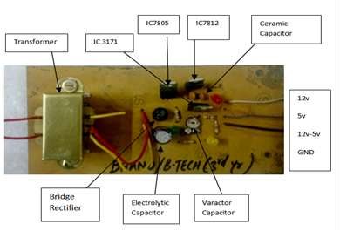
POWER SUPPLY PCB

Slide 45
THANK YOU

