Slide 1
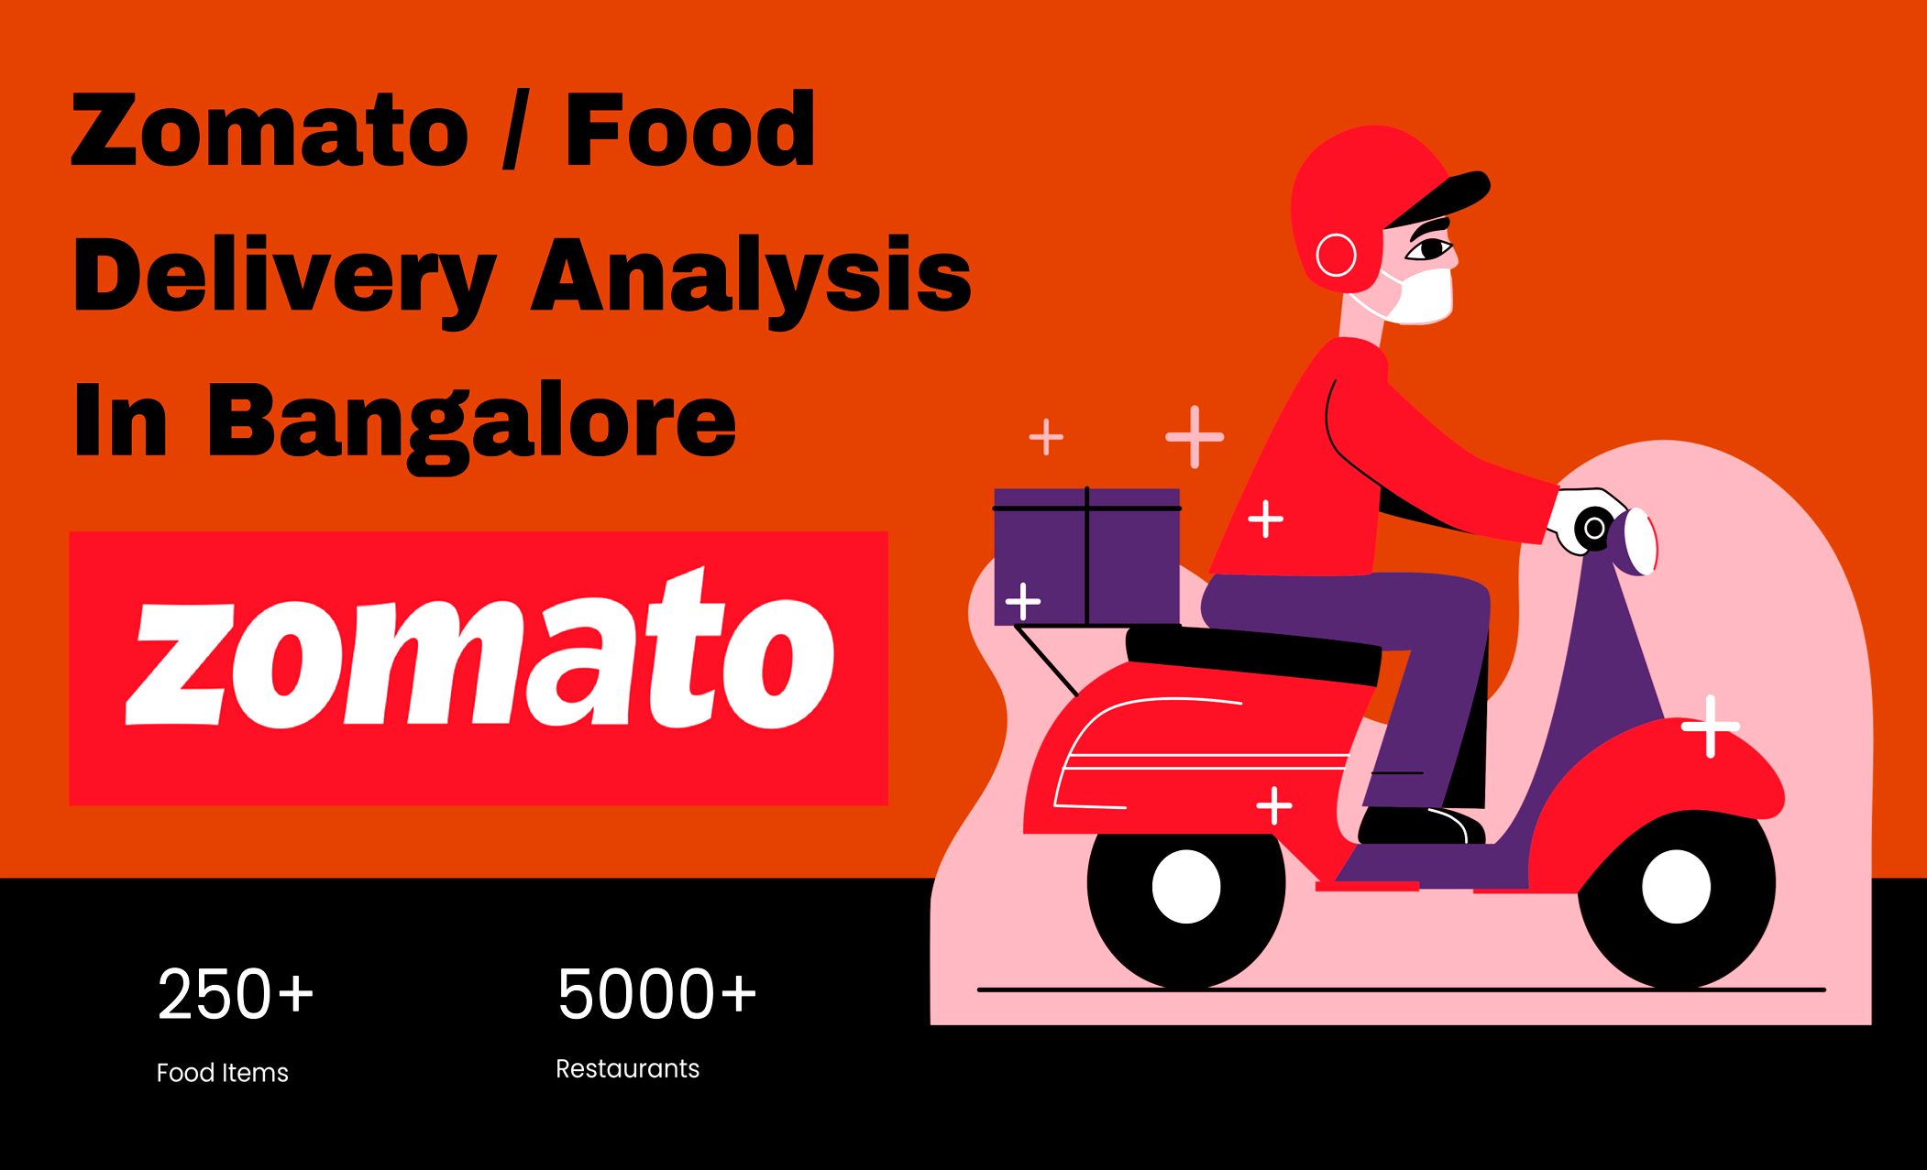
INTRODUCTION
DAKSH KAYAT
SURAJ SATPATHY
SOUMESWAR BANDOPADHYAY
RITIK AGARWAL
MANISH SINGH RAWAT

Slide 2
OBJECTIVES
SCRAPING THE DATA FROM THE ZOMATO WEBSITE AND PRESENTIG THEM IN TWO TABLES WITH SPECIFIED COLUMNS.
FINDING THE MENTIONED INSIGHTS FROM THE SCRAPPED DATA AND REPRESENTING THEM USING DIFFERENT VISUALISATIONS.
TRAINING THE DATASET USING THE BEST FIT MACHINE LEARNING MODEL FOR RECOMMENDATION.
WORKED WITH HTML AND FLASK TO DEPLOY THE ML MODEL.

Slide 3
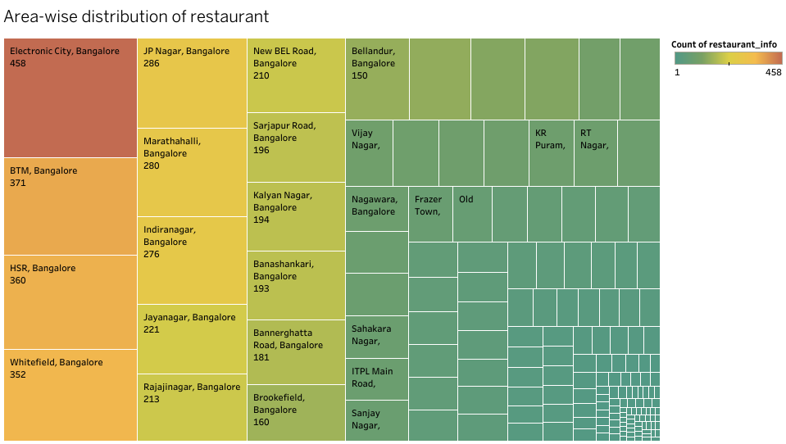
AREA-WISE DISTRIBUTION OF RESTAURANT

Slide 4
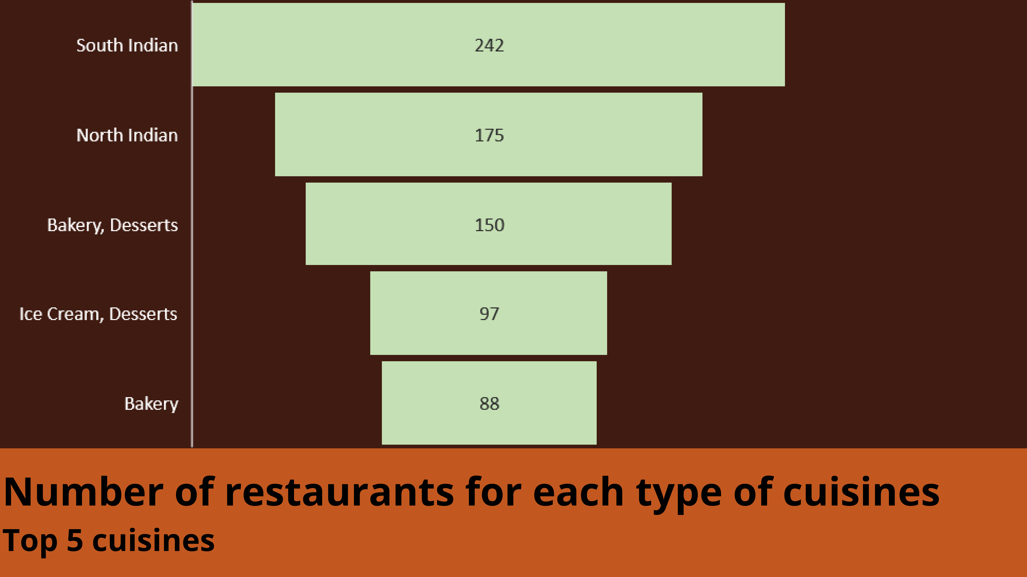

Slide 5
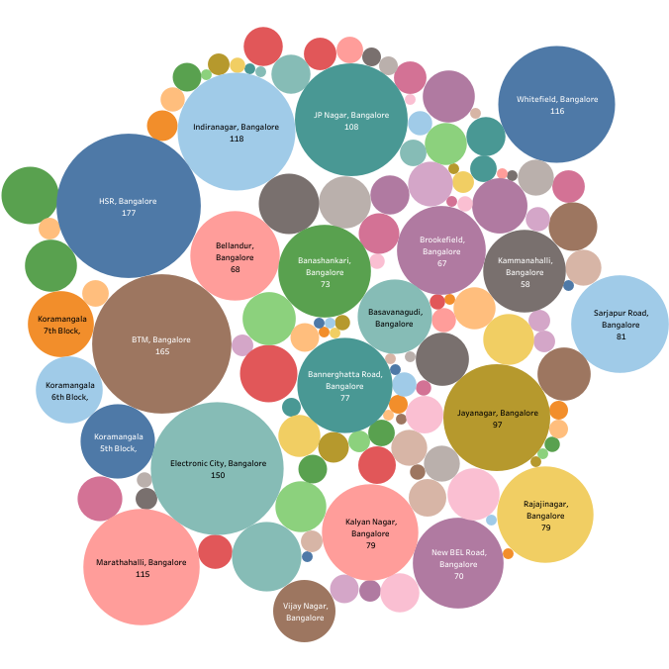
Location of maximum number of restaurant where the delivery review number is greater than 1000.

Slide 6
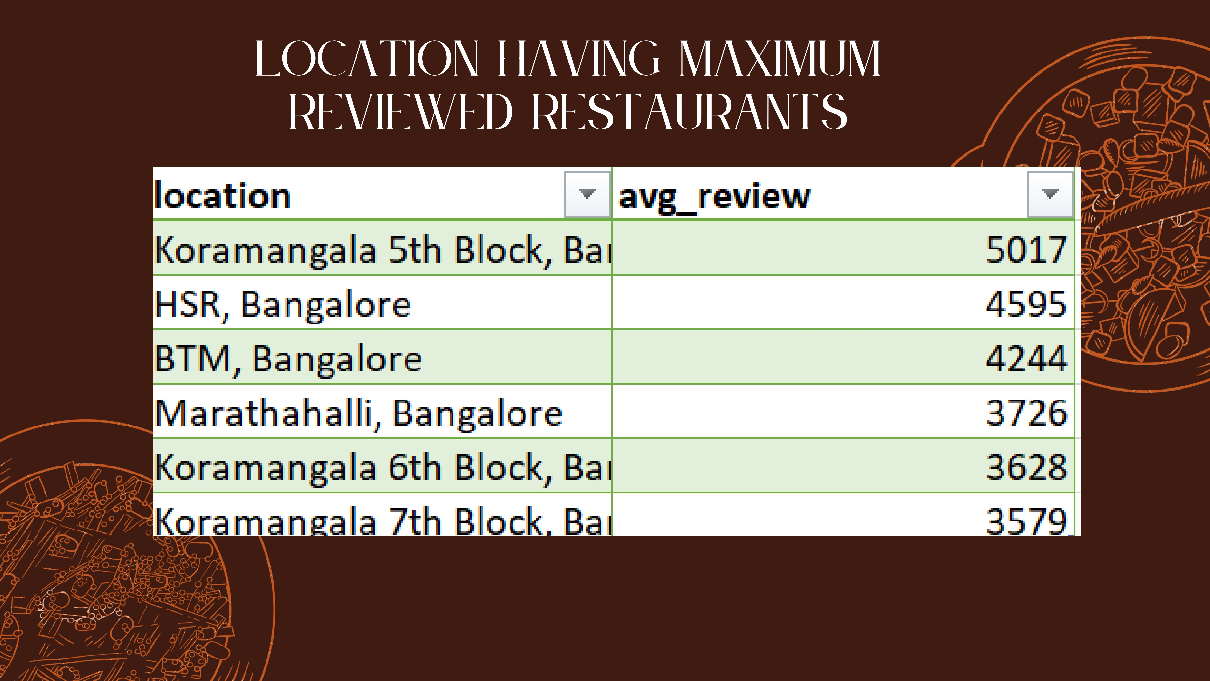

Slide 7
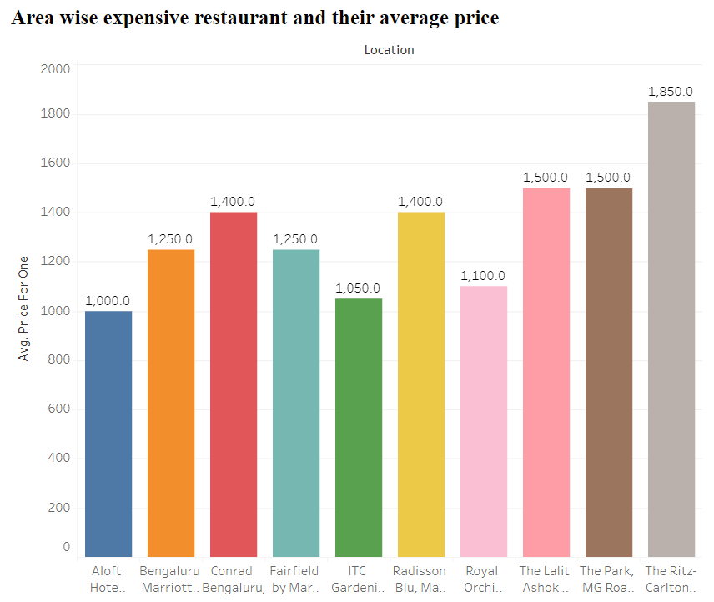
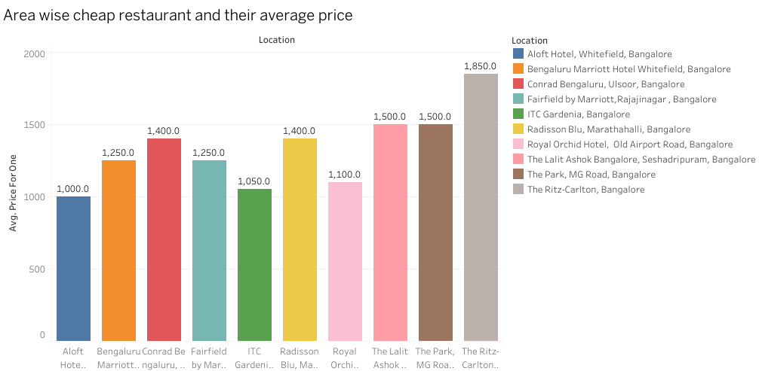

Slide 8
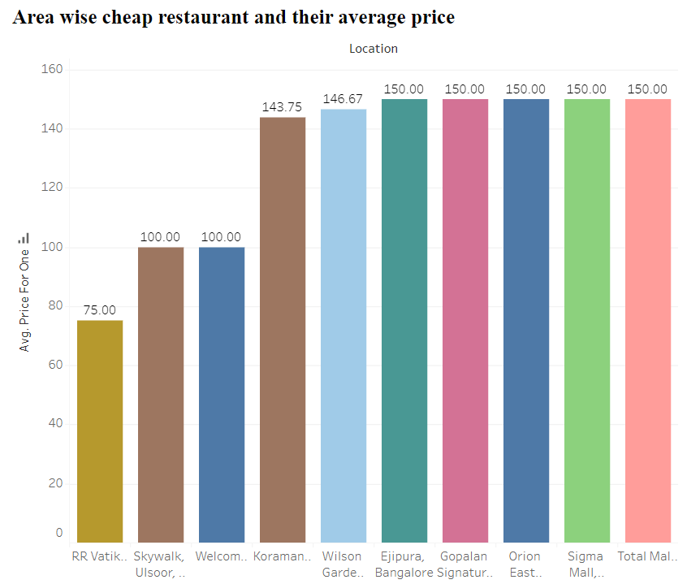
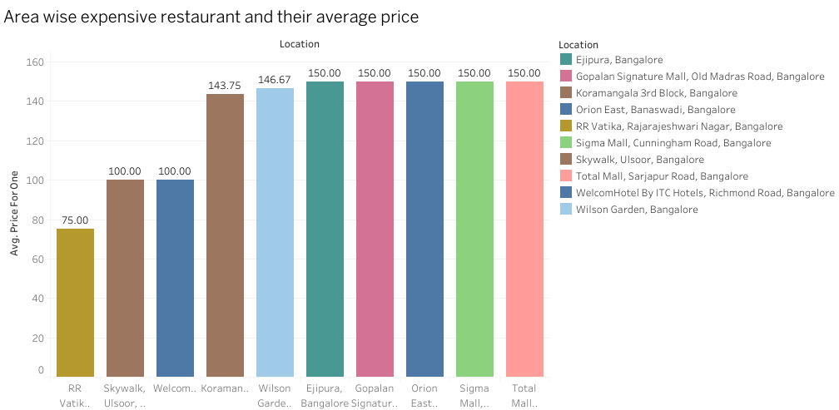

Slide 9
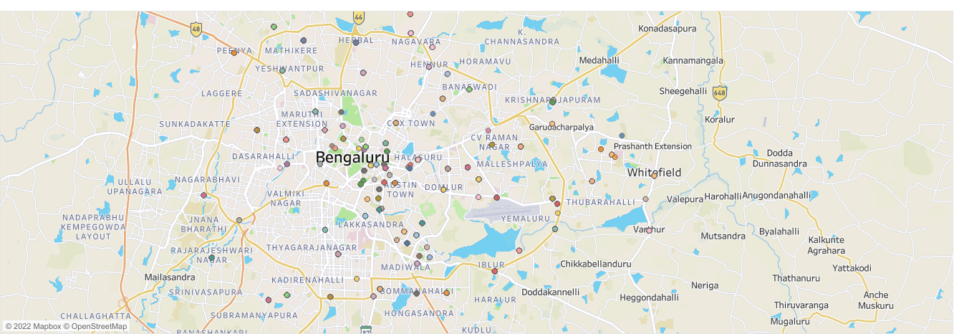
AREA WISE DISTRIBUTION OF RESTAURANT

Slide 10
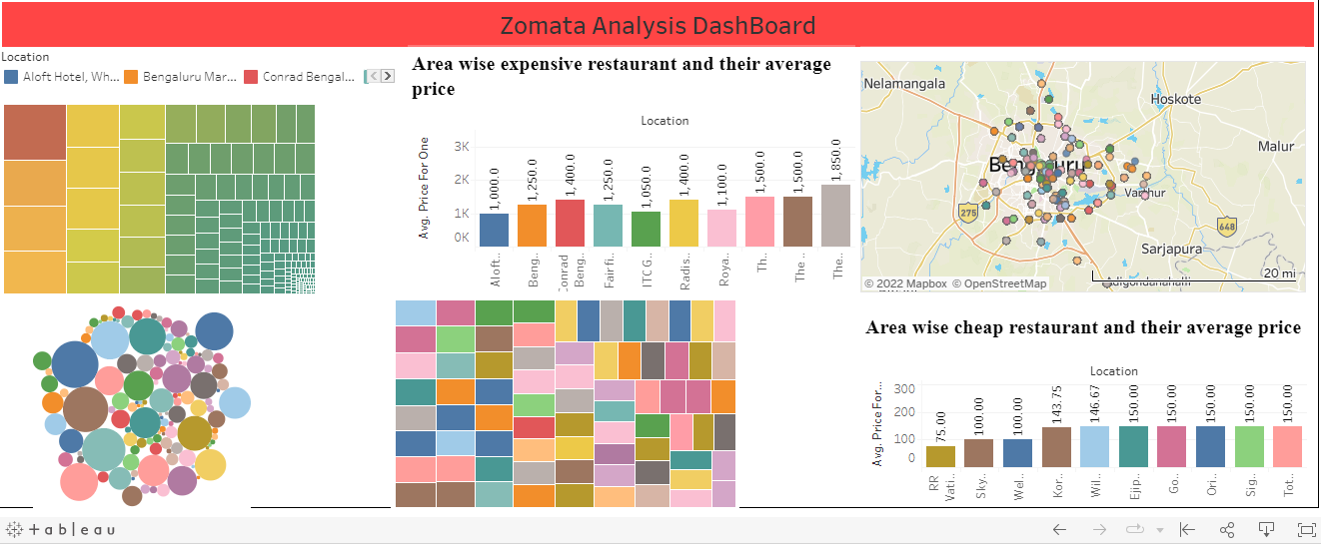
Tablue Public Dash Board
://public.tableau.com/views/Zomato_Insights_Dashboard/Dashboard1?:language=en-US&:display_count=n&:origin=viz_share_link

Slide 11
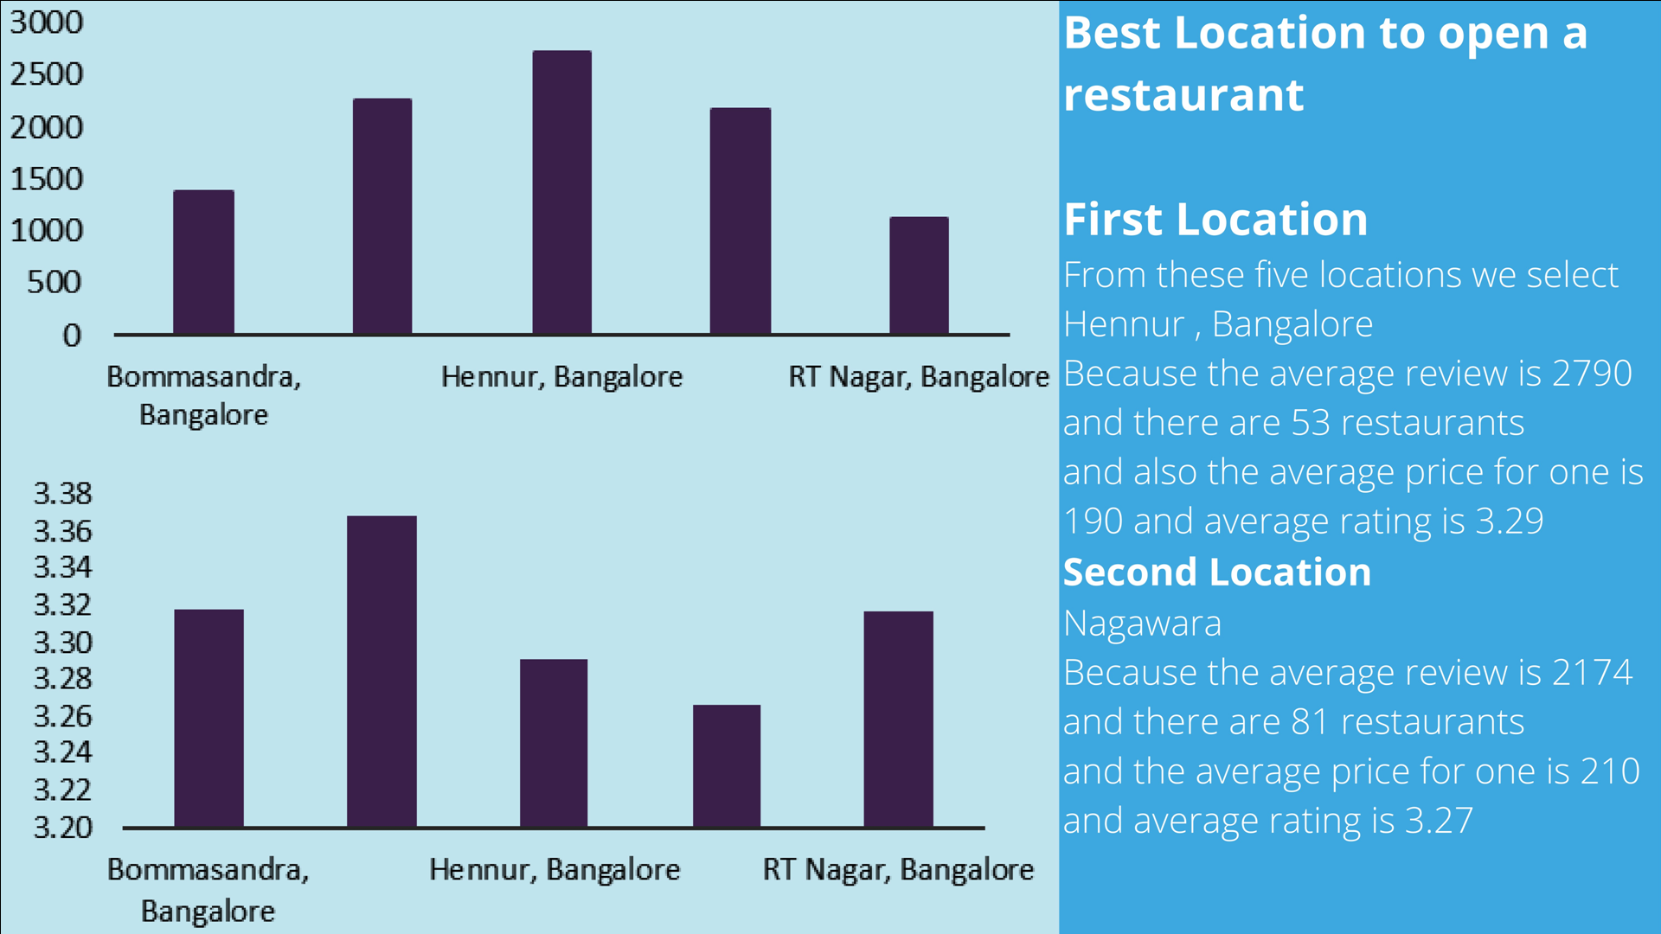

Slide 12
CHALLENGES FACED
SCRAPING THE DATA FROM THE ZOMATO WEBSITE AS THE SITE WAS DYNAMIC.
ENCODING THE CUSINE CATEGORY TO MAKE A MODEL.
DEPLOYING THE MODEL USING FLASK IN FRONT END PART
TIME MANAGEMENT BETWEEN TEAM MEMBERS.

Slide 13
OUR LEARNING
A. Web Scraping
B. We have learned about deploying the model on a web page using pickle.
C. We have learned about the basic structure of HTML.
D. We have learned the basic functionality of the Flask framework.
E. Team collaboration and management.

Slide 14
THANK YOU

Slide 15


