Slide 1
Evaluating Branch Prediction Schemes with an Out-of-Order Core in gem5
-Manish and Adithya

Slide 2
Background & Hypothesis
Deep OOO pipelines → control hazards; predictor quality matters
Designs: Local/Bimodal, Perceptron, Tournament (local+global), TAGE/LTAGE (tagged geometric histories)
Expectation: TAGE/LTAGE ≥ Tournament > Local/Bimodal/Perceptron on branch/loop-sensitive code
Compute-bound mm → minimal IPC sensitivity to predictor choice

Slide 3
Experimental Methodology
Mode: gem5 SE; CPU: X86 O3CPU; 1 core; DDR3_1600_8x8
Caches: L1I/L1D + unified L2; fixed across runs
Workloads: branchy_test (branch-heavy), fft.1 (loop-regular), mm (compute-heavy)
Predictors: BiModeBP, LocalBP, PerceptronBP, TournamentBP, TAGE, LTAGE
ROI: first 100M committed instructions; one variant per run
Metrics: IPC; committed branches; mispredictions; mispred rate (committed); MPKI
Baseline: O3CPU + LocalBP

Slide 4
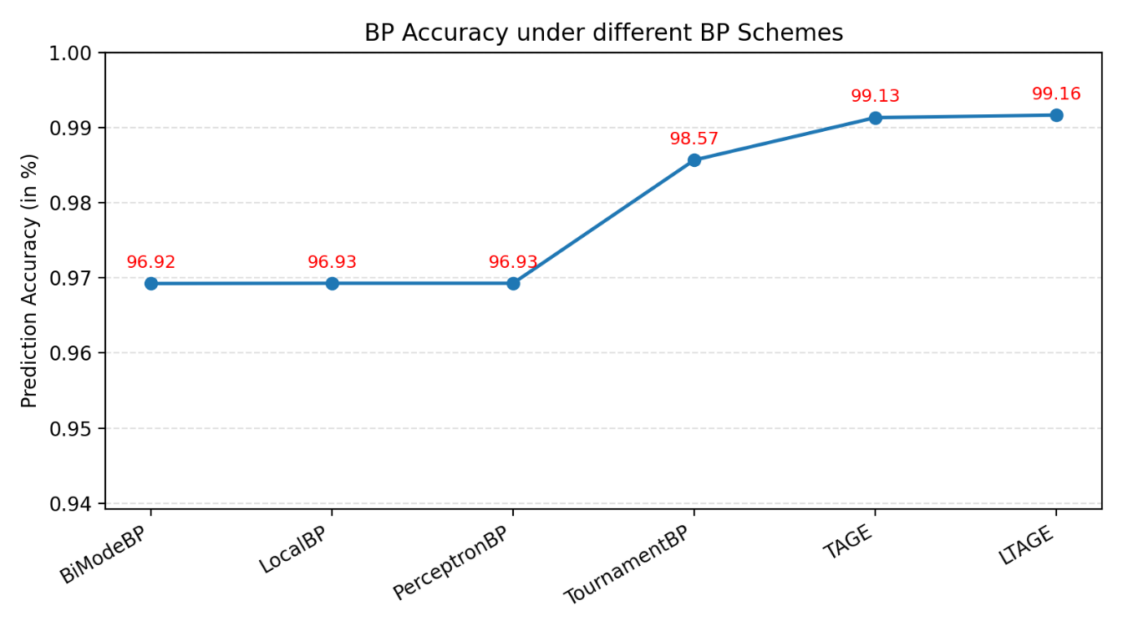
Global accuracy overview

Slide 5
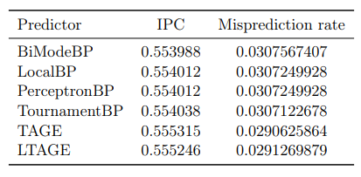
Results
branchy_test:
Best IPC: TAGE ≈ 0.5553; LTAGE ≈ 0.5552
Lowest mispred rate: TAGE ≈ 2.906%; LTAGE ≈ 2.913%
Local/BiMode/Perceptron cluster: ≈ 3.07% mispred; IPC ≈ 0.5540

Slide 6
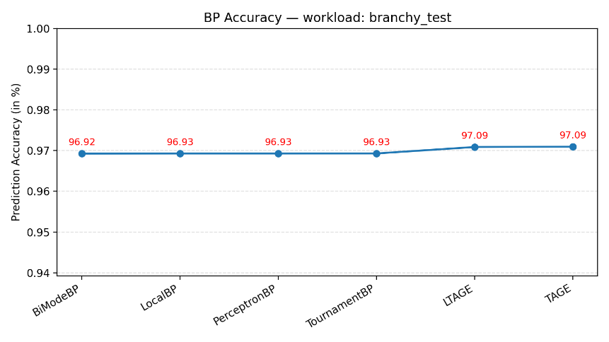
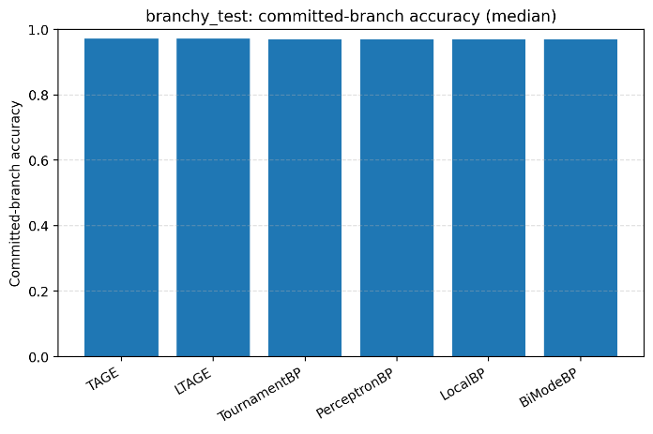
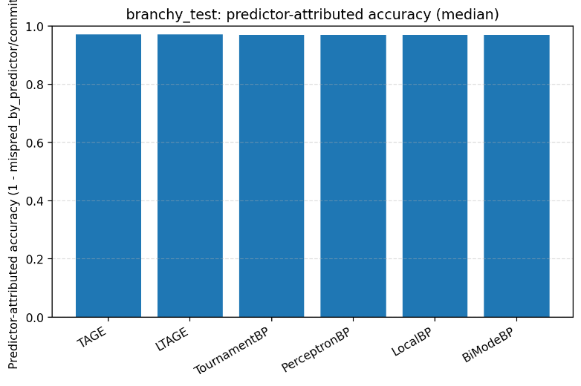
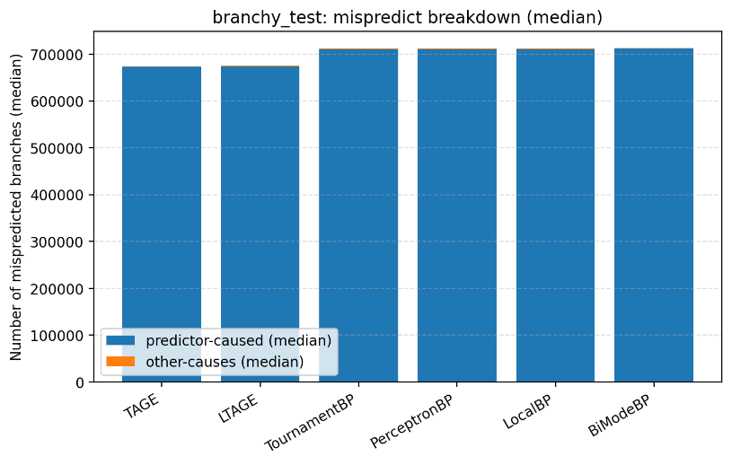

Slide 7
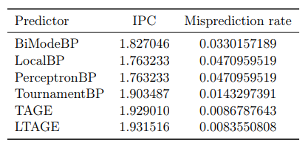
fft.1:
Step change in accuracy: Local/Perceptron (~95.3%) → LTAGE (~99.16%)
Tournament/TAGE-class leverage long/global history in loops
Lower predictor-caused mispreds map to higher IPC

Slide 8
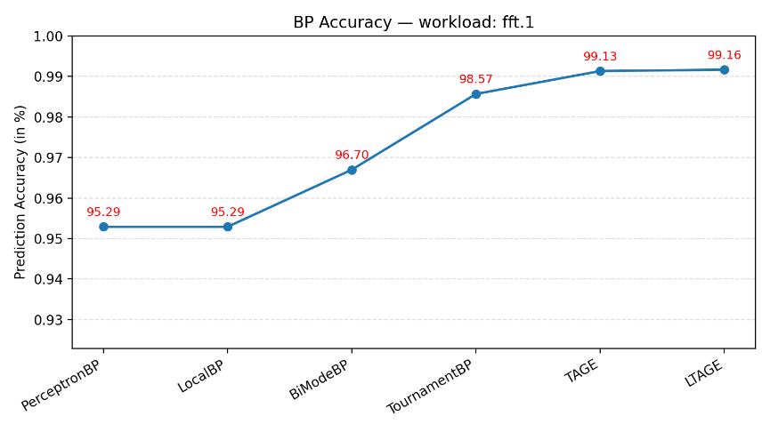
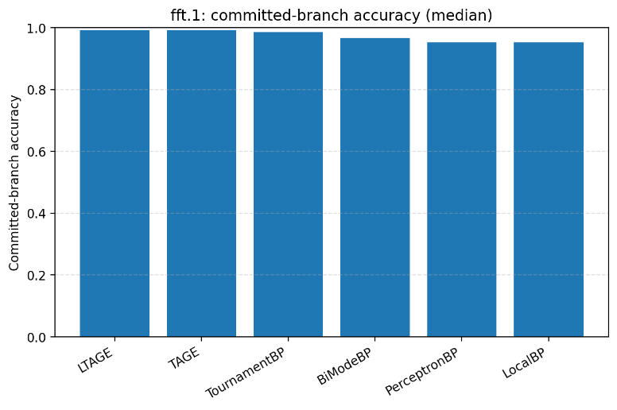
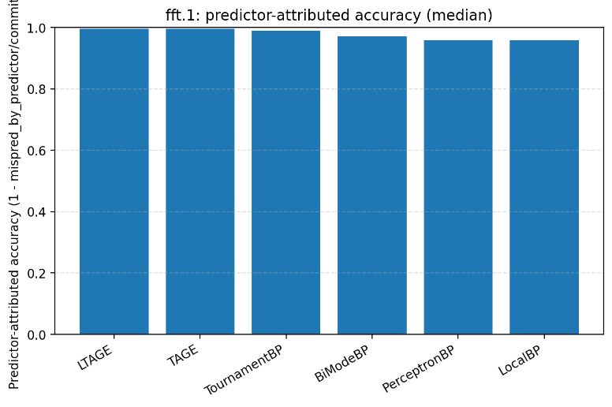
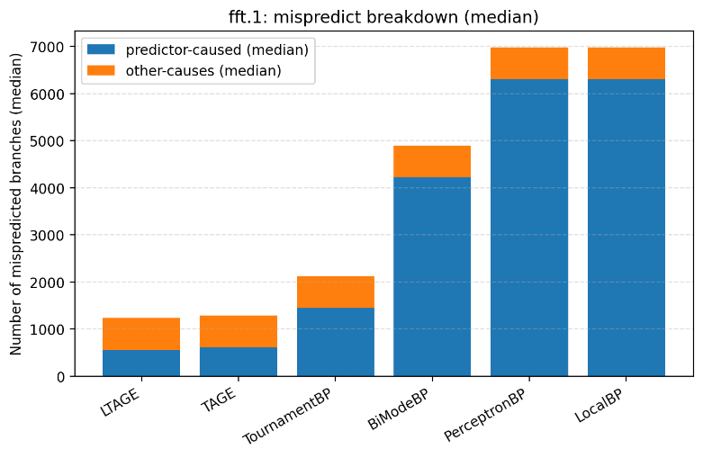

Slide 9
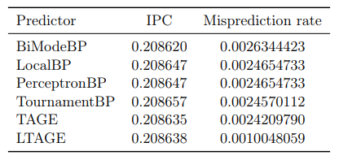
mm:
Accuracy saturated (~99.75–99.90%) across all predictors
Predictor choice irrelevant for IPC; back-end/memory bound behavior

Slide 10
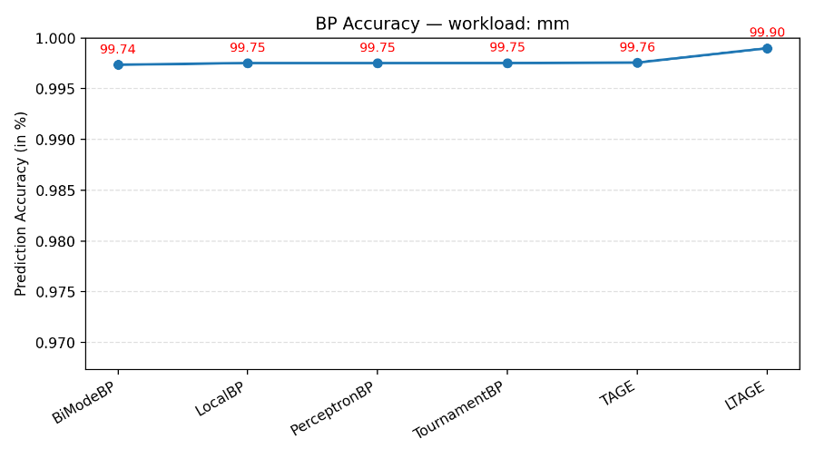
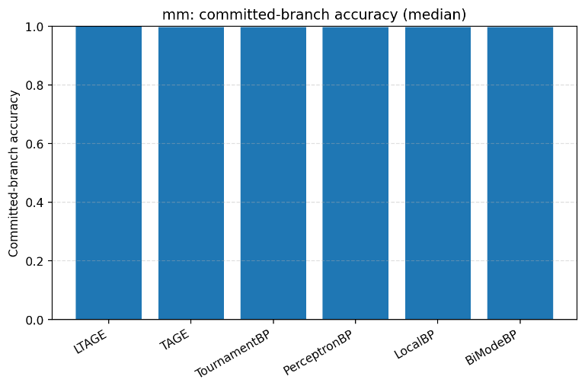
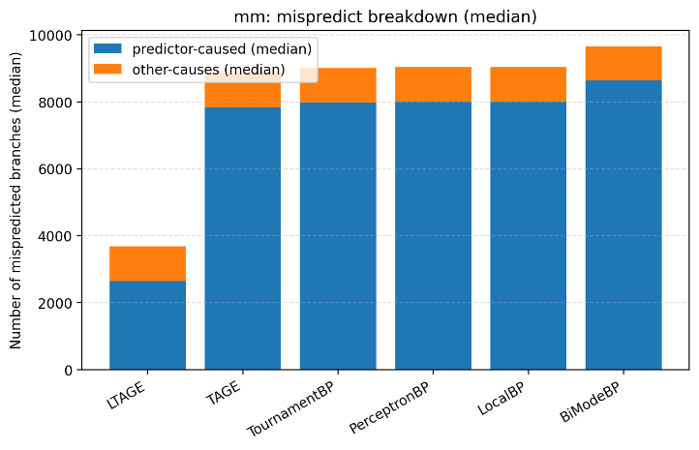
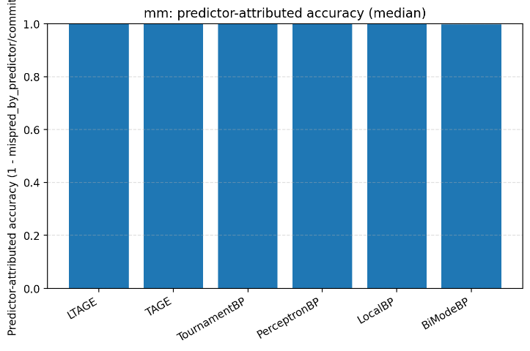

Slide 11
Discussion
Mechanism–outcome alignment: tagged geometric history ⇒ fewer aliases, better correlation capture
Branch/loop-sensitive codes: accuracy → IPC uplift (fewer squashes, steadier fetch)
Compute-bound kernel (mm): front-end improvements masked by back-end limits
Tournament competitive via chooser; Local/Bimodal/Perceptron adequate when branch entropy is low

Slide 12
Conclusion and Limitations
Best overall: TAGE/LTAGE; Tournament close
branchy_test/fft.1: noticeable IPC gains with higher accuracy predictors
mm: negligible IPC differences; predictor choice non-critical
Fixed-instruction ROI; uniform microarchitecture → clean attribution to predictor design

