Slide 1


Instance Strategy

Slide 2
Contents
Objectives
Approach
Timeline & Key Dates
Roles and Responsibilities
Tools and Templates
Assumptions
Appendix

Slide 3

Objectives

Slide 4
Objectives
The Oracle Cloud Implementation Environment Strategy outlines the approach the project team will take in determining what Oracle Cloud Environments will be made available to support the various implementation activities throughout the project.
The availability of necessary Oracle Cloud Environments is a critical success factor in realizing the overall Cloud Implementation Project goals.
This document also provides details on the Environment strategy for steady state support for < Client Name >.

Slide 5
Approach

Slide 6
Oracle Cloud - Terminology
Below are a list of Oracle Cloud Environment terminology for reference -
POD: Instance or environment
MOS: My Oracle Support
ER: Enhancement Request
SR: Service Request
ISM: Implementation success manager
Release Upgrades: update the PODs with the latest fixes, enhancements, and new features. Oracle delivers 4 quarterly updates every year.
Patching:
Quarterly Vs Monthly: Issue fixes and new features for current release (US Payroll customers are always patched Monthly)
Concurrent Vs Non-concurrent: All non-prod and prod PODs patched at the same time.
Environment Cloning: Possible cloning options are as below - .
Test to Test (T2T): Migrates data from one non-production environment to another (Dev, Conv, Test, etc.).
Production to Test (P2T): Environment refresh copies data from Production to Non-production typically after Go-Live or to prepare for testing phase.
Test to Production (T2P): This is not supported by Oracle. It is possible only using these tools – Manual Configuration, Functional Setup Manager, FBDI Load, HCM Data Loader, ADFdi Spreadsheet Loader, Payroll Batch Loader, and Customization set Manager (CSM). These activities should be taken care during the Production cutover activities.

Slide 7
POD Provisioning
Below is the process of how Oracle provisions POD.
Oracle provisions initial PODs once a contract is signed.
At this time, a CSI (customer service identifier) is generated.
An administrator from the client will receive confirmation emails from Oracle POD provisioning team.
Upon receipt of these emails, administrator needs to log in and change all PODs’ passwords and create implementation accounts for each POD.
Reference:
Service Administrator Action List
Oracle Enterprise Resource Planning Cloud: Get Started with your Implementation (Doc ID 2046113.1)

Slide 8

















Working with Cloud
Cloud Policies & Guidelines
Understand hosting and delivery policies for your Cloud
Review security guidelines
My Cloud Community
Customer Connect
Customer Forums
Getting Started
Environment access email – You will receive an email with details on how to access your cloud service
Welcome Videos
Service Administrator Action List - critical tasks to perform after receiving your environment access email
Get started with your Implementation
HCM / ERP / Sales Cloud / Risk Cloud
Oracle Communities
Oracle University – For instructor lead or live virtual classes
Online Documentation
New to Cloud?
Click here to access the Cloud Information Center
Working with Support
My Oracle Support Home Page
Logging a Service Request (SR)
Working effectively with Support
Contact Support
Manage your Cloud Service
Oracle Cloud My Services
Cloud Portal Notifications
Service Entitlements
Service Entitlements List – Review services that support & optimize your Cloud
Release Upgrades
Release Upgrade Planning
Performing Your Upgrade
Release Readiness Content
Updates
Oracle Applications Cloud - Update Policy – Understand updates to your Cloud environment
Note: The latest references can also be obtain from Oracle Applications Cloud – Information Center for Administrators (Doc ID 110.2)

Slide 9
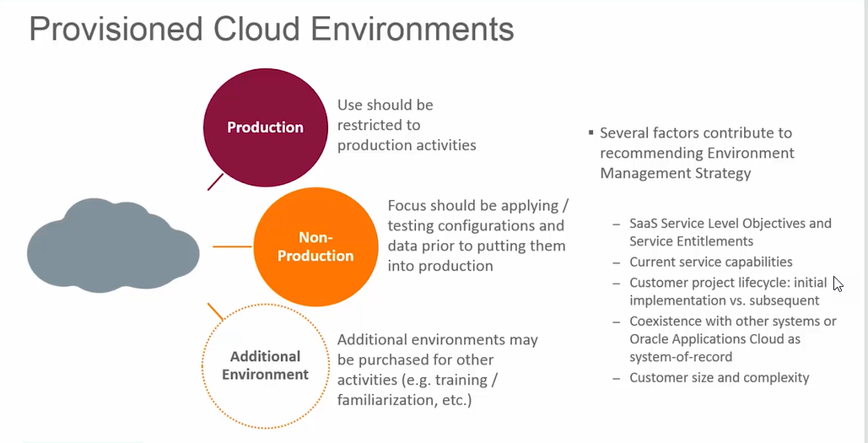
Provisioned Environments

Slide 10
Environment Naming Convention
Acronym/Instance | Description
POD | Oracle refers to an instance/environment as a POD (Portable on Demand)
DEV | Custom RICE development and Unit testing of components prior to promoting to other testing instance.
CONV | Environment to conduct Conversion
SPRINTS | Environment to conduct Sprint Test Cycles
SIT1 | Environment for System Integration Testing cycle - 1
SIT2 | Environment for System Integration Testing cycle – 2
UAT | Environment for User Acceptance Testing cycle
GOLD | Functional configuration reference for all environments
PROD | Production environment

Slide 11
Executive Summary
In order to support implementation of Cloud Applications solution, the following environments are proposed
The standard practice dictates a dedicated environment each for development and integration testing, UAT and Production. It is also a good practice to keep environment allocated for Production to be used only for Production (i.e. not use for any non-Production activity prior to “Go-live”).
Deloitte recommends there should be at least 5 Software-as-a-Service (SaaS) to be provisioned, and 4 Platform-as-a-Service (PaaS) environments to be provisioned.

Slide 12
< Client Name > Oracle Cloud PODs
Below are the < Client Name > owned Oracle Cloud environments -
Environment | Implementation Phase | Steady State Phase (Post go-live) / Talent Management Implementation
env1 Gold | Gold Environment Final functional setup environment as per latest BR100 No Development and transactions to be done Oracle to refresh all the environment using this as reference
env2 Sprints / Development | Development POD Technical and Functional build & unit test We need to synch this with Test POD (test) for each phase. | Talent Management Development POD Technical and Functional build & unit test We need to synch this with Test POD(ekaw-test) all the time based on the need/project plan.
env3 Conversion | Conversion POD Conversion unit test We need to synch this with Test POD (test) for each phase. | Talent Management Data Conversion POD To support data conversion activities – design, build, unit test, trouble shooting, etc. Steady state mass upload support/testing
env4 Prototype / Payroll Reconciliation | For Prototype and Payroll Reconciliation 1 & 2 | Production support POD to address and fix production issues post go-live. This needs to be synch with Production all the time. This needs be on same patching schedule as production post go-live.

Slide 13
< Client Name > Oracle Cloud PODs contd..
Environment | Implementation Phase | Steady State Phase (Post go-live) / Talent Management Implementation
env5 Recruiting Cloud Conversion | Data Conversion POD for Recruiting Cloud Candidates, Resumes, Applicants | Sandbox and Training POD for Recruiting Cloud Sandbox to support user training, user experience.
env6 Test | Test POD To support SIT1, and UAT, Performance Testing | Talent Management Test POD To execute Talent Management Testing Cycles This will be used to test technical objects and functional processes/ configurations before migrating to Production POD. Need to sync this all the time with Production POD
env7 Training | Training POD Preparing & executing training, <Client Name > IT Sandbox | Sandbox and Training POD Sandbox to support user training, user experience.
env8 Release Testing | Preparing and executing the new release testing, SIT2 and QA testing before patching to test | New Release Testing POD (R13 Testing – Opt-in Features) For future Oracle Cloud releases. Support QA testing of bug fixes before patching to env6
prod Production | Production POD (Cutover) | Production POD

Slide 14
< Client Name > Oracle Cloud PODs
PODs
Implementation | Functional Setup | Development | Conversion | Prototype | Conversion for Recruiting | Training | SIT2 | SIT1 | Production
 | Gold Environment for Setup | Development of Integration | Mock Conversion Issue Fix | Payroll Reconciliation 1 |  | <Client Name> IT Sandbox | QA Testing
 | Setup as per BR100 |  | Payroll Reconciliation Preparation |  |  |  | New Release Testing | UAT
 | Functional configuration for all environment |  | Cutover Rehearsal (Dry Run)
Steady State | Development | Development | Data Conversion / Mass Upload Testing | Production Support POD | Training for Recruiting Cloud | Training | New Release Testing | Test | Production
Talent Management Implementation | Setup | Development | Conversion |  |  | Training | New Release Testing | Test | Production
Prototype / Payroll Reconciliation
Recruiting Conversion
TestReleaseing
Test
Production
Gold
Development
Conversion
Training

Slide 15
< Client Name > Infor WFM & Cloud PODs Mapping
Infor Instances
Implementation | Functional Setup | Gold Environment for Setup | Sprint Demo | Training Development | SIT1 | Release testing | Production
 | Functional configuration for production environment | Functional configuration for all environment | SIT2 |  | QA
 | POC environment |  | QA |  | UAT
 | Development of Integration |  | Conversions |  | PAR
Steady State | On-going development/Prod Fixes | Gold copy of Configuration | Functional Testing/QA | Training | PAR | PROD Support | Production
Oracle Environment | Development | Gold | Conversion/TEST | Training | PAR/Test Releasing | PROD Support | Production
Development
Gold
Testing
Training
Stage
Prod Support
Production
Gold

Slide 16
SaaS Environment Usage with PaaS
SaaS Environment | Environment Status | Usage | Usage Date | Paired PaaS Environment
dev1 |  | CONFIG/GOLD |  | NA
dev2 |  | DEV/SPRINTS |  | DEV PaaS
dev3 |  | CONVERSION |  | NA
test |  | SIT1/UAT |  | INT1 PaaS
dev7 |  | TRAINING |  | NA
dev8 |  | SIT2/PROD SUPPORT |  | INT2 PaaS
prod |  | PRODUCTION |  | PROD PaaS
* We currently have 1 PaaS environment as of now

Slide 17
PaaS Environment Usage
PaaS Environments | Usage | DBCS |  | JCS-SX | Middleware
 |  | Instance | Schema | Instance
Dev PAAS | Dev/Sprints | 1 | Schema1 | 1 | 1
INT1 PAAS | SIT1 | 1 | Schema1 | 1 | 1
 | UAT |  | Schema2
INT2 PAAS | SIT2 | 1 | Schema1 | 1 | 1
 | PROD SUPPORT |  | Schema2
PROD PAAS | PROD | 1 | Schema1 | 1 | 1

Slide 18
Environment Refresh
An environment refresh migrates data from a source environment, usually production, to a target environment, usually nonproduction, making a copy of the source environment. Environment refreshes ensure a predictable experience during testing activities by providing a comparable nonproduction environment for testing and validation, before applying changes to your production environment.
Types of Environment Refresh: Environment Refresh is the service entitlement that you should request to migrate data from a source environment to a target environment. Currently there are two different types of environment refresh services available for customers:
Production-To-Test (P2T): From a production environment to a non-production environment
Test-To-Test (T2T): From a non-production environment to another non-production environment, for those customers with multiple non-production environments.
NOTE: Environment refreshes don’t support migrating data from a nonproduction environment to a designated production environment.

Slide 19
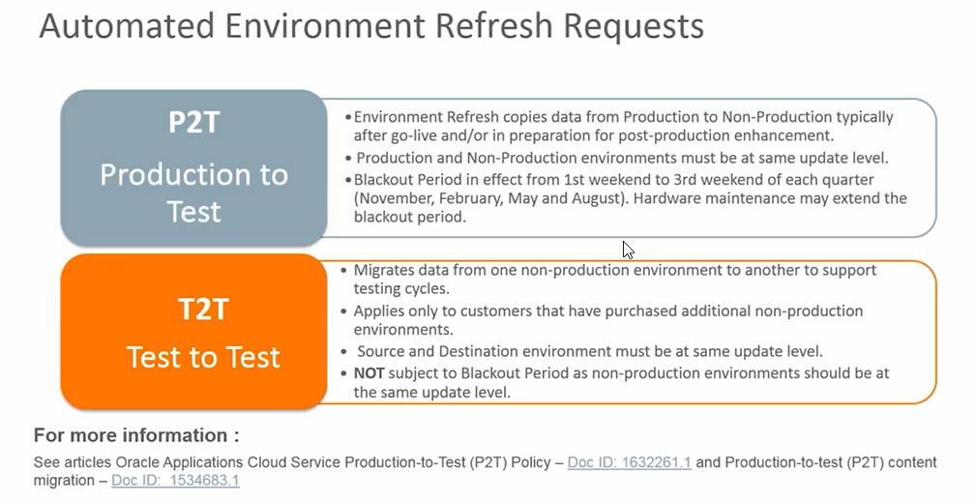
Automated Environment Refresh

Slide 20
About the Environment Refresh Service
Request an environment refresh using either the online self-service scheduling feature or the Service Request (SR) user interface in My Oracle Support (MOS)
Cloud Service Type | ERP, HCM, Risk, Sales and Engagement, SCM Cloud Services
Typical Frequency | Based on business need
Fulfillment Method | Log an SR using the Self-service Scheduling Tool or MOS.
When to Submit SR | Submit your SR 3-12 weeks before the date you need changes applied. Submitting an SR before or after this submittal window will result in your environment refresh request being canceled and rescheduled.
Maximum Downtime for Target Nonproduction Environment | 48 hours – 96 hrs. (with data masking)

Slide 21
What Is Copied During Environment Refresh
Application Object | Example
All data in the Fusion schema | Transactional data and functional setup
Webcenter content | File attachments and inbound and outbound Integration files
Key artifacts managed through Fusion Middleware Metadata Services (MDS) | User interface extensions managed as Application Development Framework (ADF) sandboxes, such as flexfields and workflow/approval extensions managed by the Service-Oriented Architecture (SOA) Suite
Business Intelligence Web Catalog and Repository Definitions (RPDs)
Pre-compiled Fast Formula used by the HCM Cloud Service

Slide 22
What Is NOT Copied During Environment Refresh
Application Object | Example
Compiled objects | Fusion Applications binaries, Fusion Middleware binaries, and for HCM Cloud Services customers, compiled FastFormula
Home page notifications | Approval requests
Data maintained in the Functional Setup Manager’s (FSM) Topology Manager | Endpoint URLs to other environments
Enterprise Scheduler Service (ESS) process parameters

Slide 23
Environment Refresh Scheduling – Key Points To Consider:
3-weeks advanced notice: Submit your Environment Refresh Service Request (SR) at least 3 weeks before the requested date.
Update levels: Source and target environments must be on the same update level for environment refresh to be performed (including language packs and TDE)
P2T blackout period: Stay away from blackout period for P2T requests! 2-week P2T blackout period exists every month between Stage (1st weekend) and Production (3rd weekend) monthly updates.
Environment refresh and upgrades: P2T needs to be completed at least 72 hours prior to a scheduled release upgrade start date and time. Since P2T could take up to 48 hrs. downtime, this means, the P2T should start 5 days (6 days if data masking is needed) prior to the start of your scheduled non-production environment upgrade. Furthermore avoiding the P2T blackout period is still needed.
Exception updates: When a customer requests and gets approved for an exception update due to business critical issue without a workaround, their previously scheduled P2T request may be cancelled. Please be aware of potential impact to your P2T requests before you request an exception update.
Concurrent updates: This option is available for implementing customers that are not live, and allows customers to have their non-production and production environments to be updated on the same schedule during their implementation. These customers can request their P2T to be scheduled anytime during the month.

Slide 24
Request Environment Refresh
For detailed steps on how to file a service request (SR), see Instructions on Submitting a Cloud Service Request (SR) in My Oracle Support Doc ID 2120276.1.
Other Reference:
For Details on Environment Refresh please refer to the below Notes:
Oracle Applications Cloud Service Définition - Environnent Refresh (Doc ID 2015788.1)
Oracle Cloud Applications Service Entitlements, Doc ID 2004494.1
Oracle Cloud Applications Concurrent Maintenance Option, Doc ID 1646394.1
Oracle Cloud Applications – Fusion Applications Update Policy, Doc ID 1966109.1
Cloud Service Requests and Fulfillment for Oracle HCM Cloud Service (Taleo Zone Refresh with Fusion HCM Environment Refresh), Doc ID 2108681.1
Oracle Cloud Applications - Data Masking Standalone Service Entitlement, Doc ID 2092389.1

Slide 25
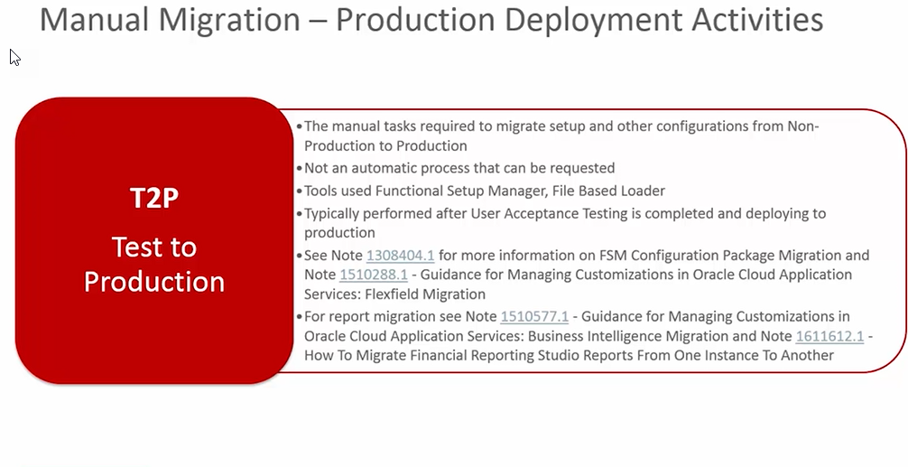
Manual Migration

Slide 26
Patching, Cloning & Release Upgrade
Overview of patching, cloning and release upgrade of each POD -
Patching:
Oracle releases patches to fix issues identified by diff. clients or to add new features to the current release of Oracle Cloud.
Cloning:
The Environment cloning or POD refresh is a client requirement to support diff. testing cycles during implementation phase and post go-live to support the steady state operations.
Release Updates:
Oracle releases four updates per year. These release updates are based on the enhancement requests to support or introduce new features/functionality in the Oracle Cloud.
Any issues/questions related to Oracle Cloud are addressed through the SRs (Service Requests) to Oracle Support Team (MOS Portal)
SRs are addressed by Oracle Support Team based on the SLA between <Client Name> and Oracle.
For environment refresh/release upgrade SR need to be raised using My Oracle Service portal (this is new from April 2017 onwards).
For T2T/P2T, both Source and Target PODs must be at same patch level and Release level.
Blackout dates for T2T/P2T
To schedule a T2T/P2T, raise an SR at-least 21 days before (3 to 12 weeks range).
SR Cancellation request must be 7 days before the T2T/P2T
Release upgrade starts normally on Tuesday of the week.
It is recommended to confirm the release upgrade date early by raising an SR to have better planning around the down time.
Send SR details to ISM to get the cloning/release upgrade schedule finalized/approved.

Slide 27
Quarterly Vs. Monthly Patching
Monthly Patching
Oracle will apply the mandatory patches on every month. All payroll customers are by default on Monthly patch schedule.
Client can not defer or skip these patches.
PODs are down and not available for use during the patching window. The normal patching window is 24-48 hours and patching starts at 10pm EST on Friday. For non-production, it is on 1st week of the month and for Production it is 3rd week of the month.
Need to plan for POD downtime on monthly basis; might impact the overall implementation time line.
Don’t have to wait for 90 days to have new functionality of fixes as in the case of Quarterly patches.
<Client Name> will be on monthly patch schedule during implementation of Oracle Cloud and after go-live.
Quarterly Patching / Release Updates
Oracle has rolled out this option for Non-payroll customers from November, 2016 onwards. Oracle applies the mandatory patches on first month of the quarter.
<Client Name> is a payroll customer and can not have this option.
Note: The vertex patches are applied on every month regardless of the option client has opted for – monthly Vs. quarterly. This will be applied each month on 18th for Non-prod PODs and on 25th for production POD. There is no downtime associated with vertex patch.

Slide 28
Concurrent Vs. Non-concurrent Patching
Concurrent Patching
When on concurrent patching, production and non-production PODs are patched on the first weekend of the month.
The patching window is from 24-48 hours and it starts at 10:00pm EST on Friday.
This provides more flexibility when scheduling P2Ts because it nullify the blackout dates due to POD patch levels are out of sync.
This is recommended for the duration of implementation time frame (till go-live).
Non-Concurrent Patching
When on a non-concurrent patching schedule, non-production PODs are patched the first weekend of the month and production PODs are patched on the 3rd weekend of the month. During the time in between the patches (black out period), no P2Ts can be scheduled.
The patching window is from 24-48 hours and it starts at 10:00pm EST on Friday.
This is recommended post Go-Live approach.

Slide 29
POD Cloning
Below is an overview of POD Cloning and considerations regarding Service Request.
Two types of clones may be requested from My Services
P2T – Production to Test clone
T2T – Test to Test clone
Service Requests (SRs) & Planning Time
Oracle requires a 3 to 12 weeks lead time for scheduling a clone.
Clones may not be scheduled during any blackout period. Blackout periods occur when source and target PODs are not on the same release/patch level.
Test PODs/non-prod PODs are patched on the 1st weekend of the month and production PODs are on the 3rd weekend. It is recommended that concurrent patching be requested during the implementation period to avoid this blackout period.
There is no downtime during a clone for the source POD and there is up to 48 hours of downtime for the target POD (up to 72 hours with data masking), depending on the amount of data.
Cancelling a scheduled P2T or T2T requires 7 days lead time.
What information is included in a clone?
Transactional and functional setup data
Web center content (file attachments, integration files)
BI Web catalog and repository definitions
Data Masking Option
Requires a paid subscription to the data masking service.
May be requested during a P2T, T2T or standalone.
Additional data masking information may be found on Oracle Support, Doc ID 2015788.1
SSO configured POD Cloning
Both PODs (T2T/P2T) have SSO configured then no additional action required after the refresh.
Source has SSO and Target doesn’t then additional steps required to reset the user passwords in Target POD after the refresh.
Target has SSO and Source doesn’t then no additional action required after refresh.

Slide 30
POD Sizing
POD Sizing Considerations
The implementation time-line is aggressive and the testing cycles are back to back. We have total 6 testing cycles to be performed on available 10 PODs including production. All PODs must be sized to achieve data conversion and integration/user acceptance/parallel testing as per the project plan.
The employee LDAP Synch, HR Synch, Payroll processes, Absence processes, eligibility processes, etc. must be taken into consideration for resizing of the PODs.
Ekaw-dev3, ekaw-dev4, ekaw-dev5 and ekaw-test must be resized to support all testing cycles effectively.
SR to be raised in well advance to provide user/population details and module functionality to be tested on diff. cycles to Oracle to properly size all test PODs.
Oracle to support all the testing cycles by observing the performance from back end and provide input to optimize the performance to achieve cutover in a week time frame for go-live.

Slide 31
POD Sizing
POD Sizing Recommendation
Recommended POD resizing : Based on other Oracle Cloud implementations where the employee population, scope and conversion requirements are comparable to <Client Name> scope and requirements.
POD | Purpose | Cycle | Resizing Required | Min. threads recommended |  |  |  |  | Comments
 |  |  |  | HDL | PBL | ESS (Enterprise Scheduler Service) | BI (Heap Size/ RAM) | Resize Request Date
prod | Production | Prod | Y | 96 - 120 | 96 - 120 | 280 - 360 | 24 - 40GB |  | Production POD
DEV2 | Development | P1 | N | 96 | 96 | 160 - 280 | 24 - 40GB | TBD | Development POD for technical and functional build and unit test.
DEV3 | Conversion | Mock Conv. Fix, M5 | Y | 96 - 120 | 96 - 120 | 160 – 280 | 24 - 40GB | TBD | Data conversion POD and might not be running heavy ESS processes
DEV4 | Prototype 2 / Payroll Reconciliations | P2 - (M1), PR1 & 2 | Y | 96 - 120 | 96 - 120 | 280 – 360 | 24 - 40GB | TBD | Mainly for payroll reconciliation.
TEST | SIT | SIT1-(M2), SIT3-(M4) | Y | 96 - 120 | 96 - 120 | 280 - 360 | 24 - 40GB | TBD | For system integration testing. We will be doing data conversion and running ESS processes.
DEV7 | Training | Training | N |  |  |  |  |  | For training purpose only (Need to revisit after the training strategy in place)
DEV8 | Release Testing / UAT / SIT | SIT2-(M3), R13, UAT | Y | 96 - 120 | 96 - 120 | 280 - 360 | 24 - 40GB | TBD | For new release regression testing, Data conversion and for ESS
The above recommended threads are not from Oracle but based on Deloitte’s experience from similar size clients.
EKAW-DEV6 is a training environment and will be resized based on the Training strategy requirements.
All other PODs are requested to be resized and team is working with Oracle on the same.

Slide 32
Single Sign-On (SSO)
Oracle Cloud supports the full and hybrid SSO.
SR to be raised to work with Oracle to enable SSO in Oracle Cloud.
<Client Name> will have SSO enabled in all the PODs they owned.

Slide 33
Data Scrambling
Data Scrambling recommendations
Data Scrambling (Masking) is a paid service from Oracle (Masking Service)
Data Scrambling for data conversion will be addressed in detail in the data conversion strategy.
Data scrambling for data conversion will be done by data extract team as part of data extraction.
For Prototype 2, SIT1 & SIT2 : The PII data will be scrambled during data extraction and converted in the Oracle Cloud.
For UAT, Payroll Reconciliation and go-live cutover: The production unscrambled data will be converted. If T2Ts are scheduled form UAT/Payroll Reconciliation PODs to other non-production PODs then data will be scrambled using Oracle masking service / data conversion extensions (mainly for SSN, Salary details and Address Line 1,2,3, etc. details).

Slide 34
Training
There will be dedicated environment for end user training – Functional admin, Line managers, Supervisors and Employees
Training environment preparation will start from TBD(Date). The environment will have all the setup/configuration for all modules.
There will be no data conversion for training POD. All required transaction data will be manually entered or created based on the training scenarios.
The training users will be created manually to support the training requirements.
The detailed training approach will be as per the training strategy

Slide 35
Release Update
The below are the task and owners for each task -
Task | Primary | Support
Receive the New Release documentation from Oracle | < Client Name > | Deloitte
Review the documentation | Deloitte | < Client Name >
Identify pros and cons for taking the New Release and discuss with Oracle | Both
Impact analysis of New Release on current implementation phase and project time line | Both
Request for Release Update and share Plan for rolling out new release with Oracle | < Client Name > | Deloitte
Finalize the key business processes to be validated/tested for new release upgrade | Deloitte | < Client Name >
Make sure the New Release update POD has latest and greatest data by requesting T2T | < Client Name > | Deloitte
Unit test the New Release features/changes | Deloitte | < Client Name >
Prepare for workshop/ Regression testing and execute the test | Deloitte | < Client Name >
Analyze the regression test results and its impact | Both
Identify the changes/efforts to make changes and update the configuration workbooks, project plan, testing cycle timeline/scope, technical solution changes, FSPEC/TSPEC updates, etc. | Both
Roll out the release upgrades to all the other PODs by requesting/updating the requested dates | < Client Name > | Deloitte

Slide 36
Timeline & Key Dates

Slide 37
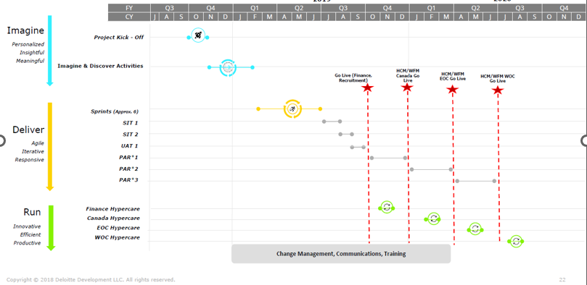
< Client Name > Freedom Project Timeline

Slide 38
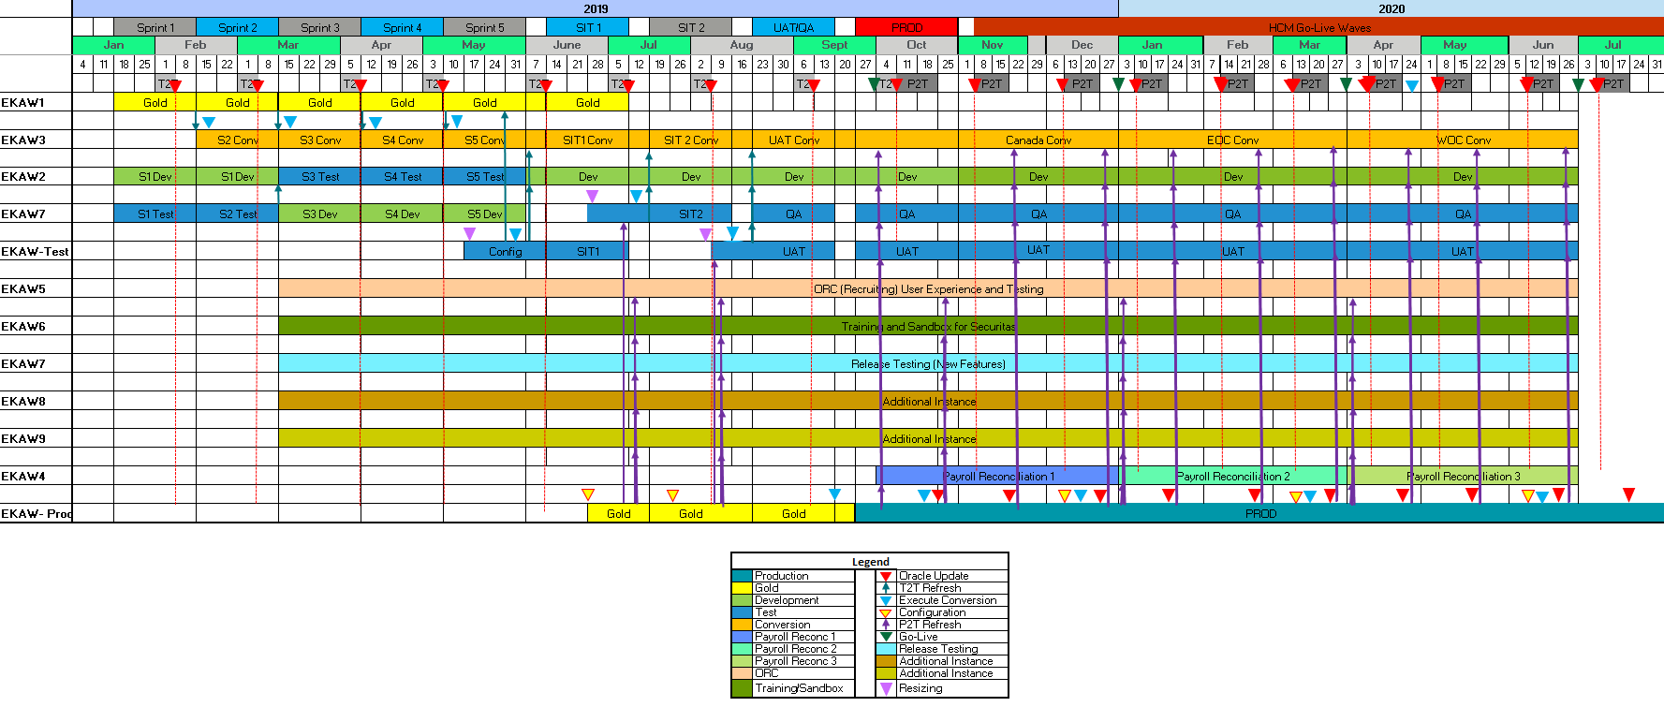
< Client Name > Oracle Cloud Refresh Strategy

Slide 39
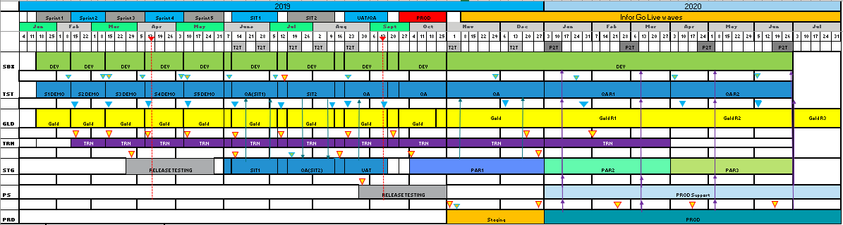
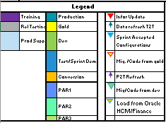
< Client Name > Infor Cloud Refresh Strategy

Slide 40
Roles & Responsibilities

Slide 41
Roles and Responsibilities
Responsibility | Primary | Support | Comments
Oracle Cloud (SaaS) Provisioned | < Client Name > | Deloitte | <Client Name> has total 11 environment provisioned by Oracle as per the contract (9 development, 1 test and 1 production).
Implementation User Setup in each Oracle POD | < Client Name > | Deloitte | As soon as Oracle PODs are provisioned, the implementation users – (i.e. Functional Super User, Technical Developer, Data Conversion User, Testing Administrator, etc.) to be setup.
Make sure Oracle ISM is assigned to support the Oracle Cloud issues/questions | < Client Name > | Deloitte | Oracle implementation success manager is dedicated to support any issues/questions related to Oracle Cloud for <Client Name>
Gather and distribute Monthly PB documentation to the project team | < Client Name > | Deloitte | Oracle provides the Patch Bundle documentation to the system administrator
Communicate upcoming POD down time with project team | < Client Name > | Deloitte | Mandatory monthly patch are scheduled on 1st Friday of every month for all PODs till go-live. After go-live the non-prod PODs on 1st Friday and production POD on 3rd Friday of the month.
Raise SRs to have POD refresh as per the schedule | < Client Name > | Deloitte | SRs to be raised at least 3 weeks (21 days) before as mentioned in the excel spreadsheet in the Appendix.
SR Management with Oracle | < Client Name > | Deloitte | Weekly meeting to go through the diff. SRs with Oracle Product Support team to prioritize the SRs

Slide 42
Tools and Template

Slide 43
Tools and Templates
Following tools will be used during the course of implementation and to support the steady state <Client Name> Oracle Cloud -
My Oracle Support (MOS) and My Cloud Services: for raising SR’s
Microsoft Office
< Client Name > current IT infrastructure, source systems tools & techniques
PeopleSoft (Database, SQRs, People Tool)
Kronos
Pinkerton
Oracle Cloud application/tools & techniques (HDL, PBL, Spreadsheet Loader, BI Publisher, OTBI, HCM Extracts, Web services, etc.)
Deloitte SWIFT data conversion tool

Slide 44
Assumptions

Slide 45
Assumptions
Below are a list of assumptions made for this Environment Strategy -
There will be total 11 PODs during Oracle Cloud implementation phase.
Oracle will provision all PODs on Release 13 of Oracle Cloud to start with.
As a Payroll customer, <Client Name> will take monthly patch. Concurrent patching till go-live and non-concurrent patching after go-live.
No RICEW effort required for Prototype 1 – P1. All configuration for P1 will be done manually including transaction records.
The testing, conversion, integration, reporting and security strategies are not part of this strategy.
Release Upgrades will be incorporated once the dates are confirmed from Oracle and updated project plan.
New release regression testing will be performed by dedicated testing team.
Assumptions are based on the current project Gantt chart & available prototype dates. Actual dates may change based on detailed project plan.
If additional SIT/Payroll Reconciliation cycles are included, then environment strategy will be updated accordingly to repurpose or strategize the POD management.
The foundation workshops will be conducted using Oracle’s Vision POD.

Slide 46
Assumptions (continued..)
During P2T/ T2T, source POD is available for normal activity but target POD is not available.
Scrambled data will be used for all prototypes and SITs while UAT and Payroll Reconciliation will be on unscrambled data from legacy systems.
New release (i.e. R13, R14, etc.) testing will be done in dedicated POD – DEV8 and then will be rolled out to other PODs including Production POD (prod).
The details of T2Ts, P2Ts, monthly update and release upgrade will be managed as per environment management strategy spreadsheet attached in the Appendix.
<Client Name> IT / DBAs / Security team will support the data conversion activities using SWIFT tool to resolve any database/IT access or performance related issues.
<Client Name> - all the Oracle Cloud PODs will have SSO enabled.
This strategy document is a living document and needs to be revised based on the project status and any other issues.
For development , SIT1, SIT2 , UAT and Production , <Client Name> will be responsible for provisioning and providing boundary system details. (e.g. PSFT, HarborLease , SAFES , etc. )

Slide 47
Appendix

Slide 48
Appendix
Bellow are the reference documents from My Oracle Support (MOS) and from Oracle:
Oracle Applications Cloud – Fusion Applications Update Policy (Doc ID 1966109.1)
Oracle Applications Cloud – Understanding Your Environments (Doc ID 2181568.1)
Oracle Applications Cloud Service Entitlements (Doc ID 2004494.1)
Oracle Application Cloud – Environment Refresh

Slide 49
Source System Environments
For Prototypes - P1 & P2
For Prototype 1 (P1) – No data conversion required. All data will be manually entered.
For prototype 2 (P2) data will be extracted from respective Production PeopleSoft/Kronos systems.
Sensitive data will be scrambled at source during data extraction
For SIT, UAT and Payroll Reconciliation
Prior to SIT & UAT cycles, source Test environment will be refreshed with latest data from Production environments before being extracted & loaded into Oracle SIT & UAT PODs. Alternately, data may be extracted from legacy Production environments.
For SIT the sensitive data will be scrambled at source during data extraction
UAT and Payroll Reconciliation the unscrambled production data will be extracted and converted
The data will be converted as per the approved data Conversion strategy approach.
Source Environments
For PeopleSoft, local On-premise environments will be available to support the data conversion into Oracle Cloud.
These environments will be refreshed from PeopleSoft production environment to have latest and greatest data to convert into Oracle Cloud.
Data extraction team will make sure the local On-premise environments are refreshed frequently based on the Oracle Cloud implementation project plan and data conversion cycles
For Kronos, the production data will be extracted to support the Recruiting data conversion in Oracle Recruiting Cloud.

Slide 50
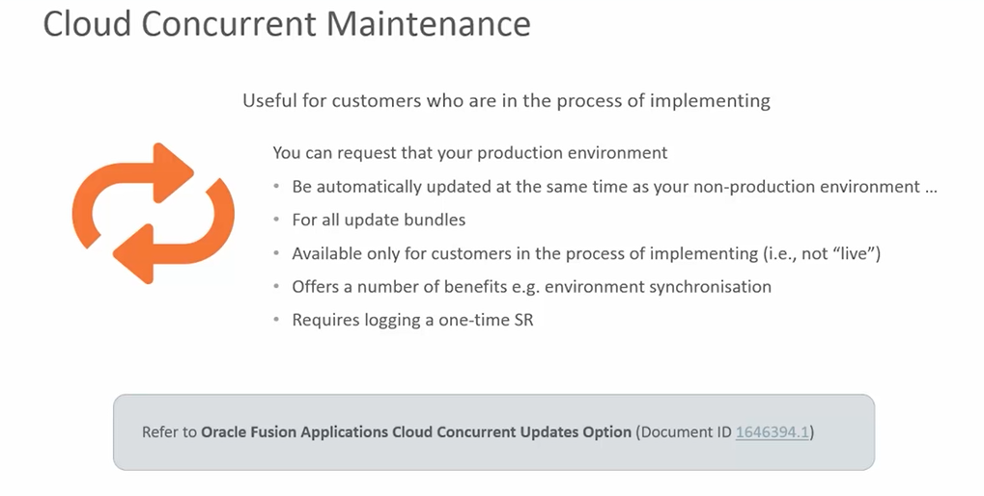
Concurrent Patching

Slide 51
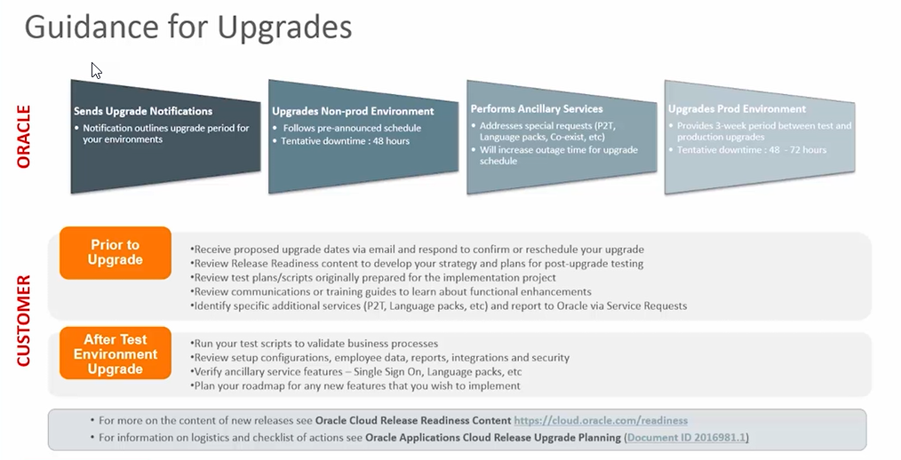
Guidance for Upgrades

Slide 52
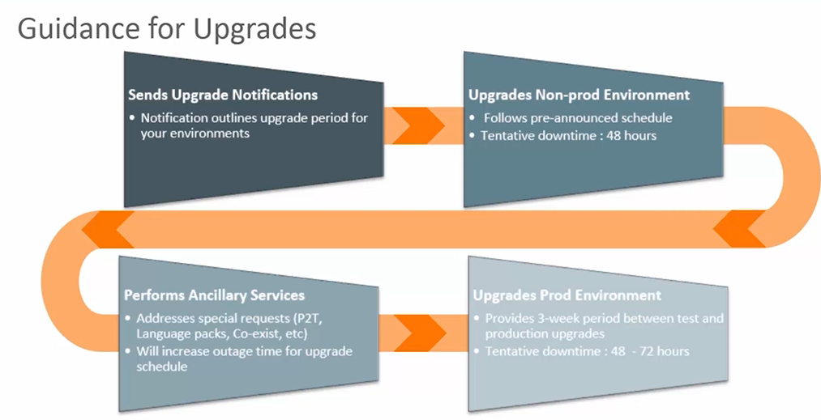
Guidance for Upgrades

Slide 53
< Client Name > Oracle Cloud POD Usage
POD | Purpose | Cycle | Oracle Cloud Project
 |  |  | Feb 2019 |  | Mar 2019 |  | Apr 2019 | May 2019 | Jun 2019 | Jul 2019 |  | Aug 2019 |  | Sep 2019 |  | Oct 2019 | Nov 2019 |  | Dec 2019 | Jan 2020 |  | Feb 2020 |  | Mar 2020 |  | Apr 2020 | May 2020 | Jun 2020
prod | Production - Recruiting/ERP | Prod - Recruiting/ERP |  |  |  |  |  |  |  |  |  | Recruiting Go-live Prep |  | Recruiting Go-live Cutover |  | Fin/Recruiting Go Live
Prod | Production - HCM | Prod - HCM |  |  |  |  |  |  |  |  |  |  |  |  | Canada Go-live Prep |  | Canada Go-live Cutover |  | Canada Go Live | EOC Go-live Prep |  | EOC Go-live Cutover |  | EOC Go Live |  | WOC Go-live Prep | WOC Go-live Cutover | WOC Go Live
DEV2 | Development | P1 | Prototype 1 |  |  | T2T |  |  |  | T2T |  |  | T2T |  |  | T2T |  |  |  | T2T
DEV3 | Conversion | Mock Conv. Fix, M5 | Resize |  |  | T2T |  |  |  | T2T |  |  | T2T | ¤ ◊ Cutover Dry Run |  | T2T | ¤ Mock 5 | ¤ ◊ Cutover Dry Run |  | T2T |  | ¤ ◊ Cutover Dry Run |  |  |  |  | ¤ ◊ Cutover Dry Run
DEV4 | P2/Payroll Rec. | P2 - (M1), PR1 & 2 | Resize | Mock 1 |  | ◊ Prototype 2 |  | ◊ Prototype 3 |  |  |  |  |  |  |  | Payroll Reconciliation 1 |  |  |  | Payroll Reconciliation 2 |  |  |  |  |  | Payroll Reconciliation 3
DEV5 | Recruiting Conversion | Mock Conv. Fix |  |  |  | ◊ Prototype 2 |  | ◊ Prototype 3 |  | T2T |  |  | T2T |  |  |  |  |  |  | * UAT (SIT 3)
EKAW-TEST | SIT/UAT | SIT1-(M2), UAT |  | Resize |  |  | Mock 2 |  |  | ◊ SIT 1 |  |  |  | ¤ Mock 4 |  | ◊ UAT
EDEV7 | Training | Training | Technical Sandbox
DEV8 | Release Testing | SIT2-(M3), R13 |  | Resize |  |  |  |  |  |  | Mock 3 |  | ◊ SIT 2 |  |  | Release Testing (R13)
 |  |  |  |  |  |  | ◊ - Source POD for T2Ts
Legend |  |  |  |  |  |  | ¤ - P2T to prepare for Mock, testing and training cycle configuration
Prototype 1 | P1
Prototype 2 | P2 | Note:
Mock 1 | M1 | 1. After each Mocks the conversion POD and Development POD will be refreshed through T2T request
Mock 2 | M2 | 2. Assuming there will be three cycles for Payroll Reconciliations. One is using the same data as SIT3 (Mock 4) data conversion and other using Mock5 data conversion.
Mock 3 | M3 | 3. All PODs to be resized except the EKAW-DEV2 and training POD - EKAW-DEV6 to support data conversion, payroll processing and other module processes included ESS.
Mock 4 | M4 | 4. Release testing will be planned in EKAW-DEV7
Mock 5 | M5 | 5. There will be no configuration and data conversion in Technical Sandbox. This is for <Client Name> IT practice and learning.
User Acceptance Testing | UAT | 6. This is a living document and needs regular cadence to analyze and update based on the project issues and progress
Note: The excel file is as attached in the Appendix, please refer spreadsheet tab – PODUsage

Slide 54
Key Dates
Below are the Critical Milestones for Environment Strategy -
Release 1
Activity | Date | Activity | Date
SR for T2T from dev3 to dev2 is raised for TBD | TBD | T2T from dev3 to dev2 is Complete | TBD
SR for T2T from test to dev1 is raised for TBD | TBD | T2T from test to dev1 is Complete | TBD
SR for P2T from efet to test is raised for TBD | TBD | P2T from efet to test is Complete | TBD

Slide 55
Key Dates (continue..)
Below are the Critical Milestones for Environment Strategy -
Release 1
Activity | Date | Activity | Date
Monthly Update for all PODS | TBD |  | TBD
Monthly Update for all PODs | TBD |  | TBD
Monthly Update for all non-prod PODs | TBD |  | TBD
Monthly Update for Production (efet) POD | TBD |  | TBD

Slide 56


