Slide 1

Oracle Cloud Implementation Technology Strategy

Slide 2

Finance Technology Scope - SUSA
Technology Components
Conversions | Ledger Balances Journal detail – current year Vendor Paid (12 months) Customer conversion Open contracts Open Invoices Assets Conversion Up to 3 TBD (moderate complexity)
Integration | Inbound interfaces from legacy systems Vertex, Certify, Entellitrack, Hyperion, Paragon/Valiant,smarts,Apex,Infor,Payroll,Fleet,NCC,NAB. Outbound interfaces from ERP cloud to Cypress, Ariba,SFDC, Citibank, RBC Total identified interfaces are 65
Reports | Placeholder Reports - 30
Extensions | Up to of 5 (moderate complexity)
Technology Scope* | Total
Conversions (maximum) | 10
Interfaces | 65
Reports (maximum) | 30
Extensions (maximum) | 5
* At the end of global design, the RICEF list will be rationalized based on the business priorities.
1 | Copyright © 2018 Deloitte Development LLC. All rights reserved.

Slide 3
Conversion Strategy Objectives
Conversion Approach
Define conversion process
Identify Tools to be used if any.
Data Conversion
Tools
Cleanse, Extract,
Transform
Identify data redundancy and perform deduplication
Identify source systems data formats and volumes
Develop data extraction programs
Map Data from source systems to Oracle Cloud Application formats
Reconcile
Import
Upload data to Oracle ERP Cloud and execute standard import programs
Validate and reconcile data
Analyze and resolve errors
Sign off converted data
2 | Copyright © 2018 Deloitte Development LLC. All rights reserved.

Slide 4
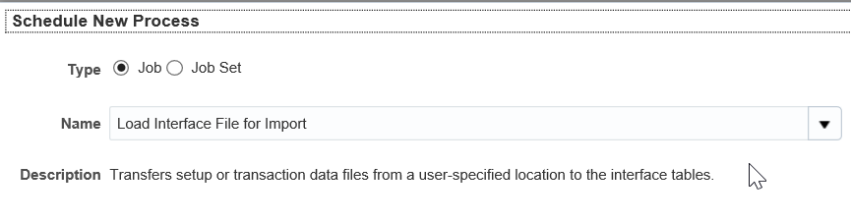
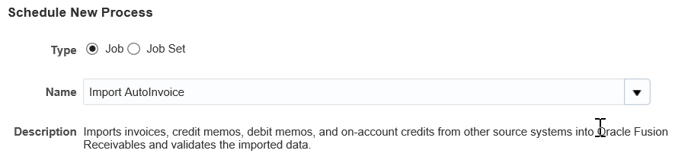
FBDI Conversion Process
Process flow to import data into Oracle Cloud using FBDI.
Standard Load ESS Job
Target System
Standard Import ESS Job
Target System
1. Generated source files data using pre-defined templates
2. UCM Server
3. Interface Tables
4. Application Tables
Data Conversion
Tools
Cleanse, Extract,
Transform
Oracle Cloud
The ‘Load Interface File for Import’ Enterprise Scheduler Services (ESS) job which will load the source data into interface tables.
Once the data load into interface tables successfully, run the product specific import jobs to load data into application tables.
Reconcile
Import
Key Takeaways
Understand data import process in Oracle Cloud.
There are specific programs for import of each data entity. Some of these program can support execution of imports in parallel (multiple threads).
3 | Copyright © 2018 Deloitte Development LLC. All rights reserved.

Slide 5

ERP Cloud Reports Approach
Reports Methodology
Reporting
Balances
Management Reporting, Board Room Quality, Distribution, Snapshot or Live Reporting, Graphs and Charts, and Multiple Output Options
START
1
2
3
4
Financial Reporting Center
Perform fit gap analysis comparing with Oracle ERP Cloud out of box reports
Access User Stories to best fit the oracle reporting tool
Gather Legacy application reports and new reporting requirements
Prepare Reports Inventory
Ad Hoc Analysis, Pivot Tables, Graph and Charts, and MS Office
Smart View
8
7
6
5
Schedule reports Using FRC/BI Administrator
Validate the reports based on test cases
Develop the reports based on the User Stories
Perform required setups for folder structure, KFF segments and DFF attribute
Transactional Data
Ad Hoc, Dashboards, Charts/Graphs, and Flexible Output
Transactional BI (OTBI)
9
10
11
FINISH
High-Volume
Specific Format`
BI Publisher
Configure folder level security using custom roles to provide read access to users
Assign General ledger Roles to user to run custom reports developed in FRS
Install Smart View, an Excel add-in, to each client computer (*option)
Mapping and Configurations
Data Extraction and Formatting
Scheduling and Delivery
Report and Data Model migration between two different environments can be done using the ‘Archive’ and ‘Unarchive’ options of Oracle ERP Cloud
4 | Copyright © 2018 Deloitte Development LLC. All rights reserved.

Slide 6


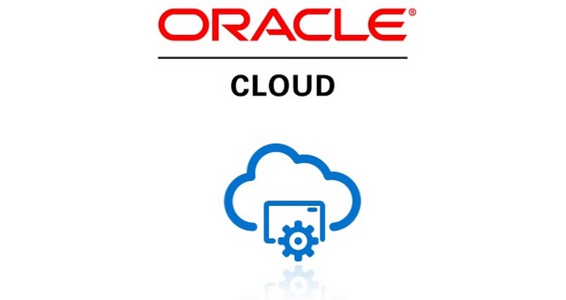




ERP Cloud Integration Approach
Boundary Systems(Cloud/On Premise)
Middleware
ERP Cloud
File Based
Secure Encrypted SSL
Secure Encrypted SSL
Middleware
Outbound
Public Report Web Service(BI Publisher)
Data Files
Data in csv/xml/json
Request/Response
Standard Web Service
Web Service Based
Inbound
Web Service(SOAP/REST)
ORDS/Web Service
Transformation
Paas
Middleware(OAIC)
Oracle ERP Cloud
Outbound
Invoke Public Report Web Service using OAIC SOAP Adapter to receive data in csv/xml/json format
Stage and transform data in OAIC
Transfer data to Boundary system using FTP Adapter(File Based) or SOAP/REST Adapter for Web Service based
Enable port for external SFTP server
Create BI publisher reports and ESS jobs
Provide Public Report Web Service details
Configure security for ESS job, Web Services and service account
Inbound
Receive data from boundary system using FTP file Adapter/Invoke exposed REST or SOAP WSDL
Transform and validate data. (If DBaaS is used ORDS can be used for validation and transformation)
Invoke Standard Web Service to Import Data into ERP Cloud Tables
Configure security for ESS job, Web Services and service account
View ESS Job details for Errors and Logs
Run Standard/Custom Report for reconciliation.
5 | Copyright © 2018 Deloitte Development LLC. All rights reserved.

Slide 7
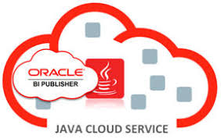
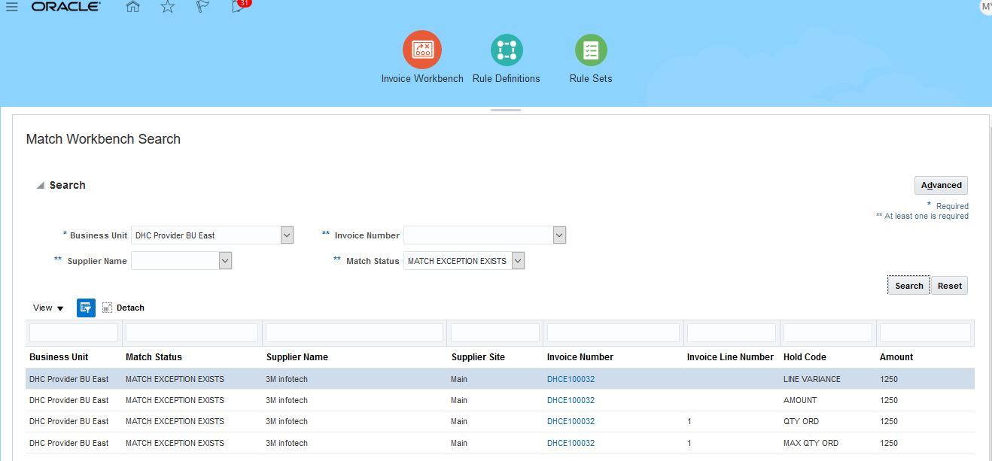
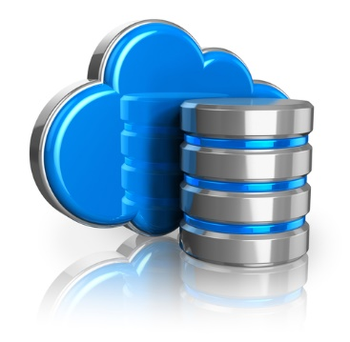

ERP Cloud Extension Approach
PaaS Server which hosts the ADF-BC application
JAVA Cloud SaaS Extension(JCSX)
ERP Cloud
Secure Encrypted SSL
PaaS
Standard Web Service
ORDS/SOAP/Java Web Service
Standard Web Service
ADF-BC Components
SOAP/REST
Database Schema as Service where custom DB objects can be created
ERP Cloud DB
Custom Java Web Service
Process Flow
SaaS Extensions can be leveraged by subscribing to the Oracle JCS-SX (WebLogic based PaaS Server) and DBaaS(DB Schema as Service)
ADF-BC components can be used to build Java Applications/Pages which can integrate and be directly accessed from Oracle ERP Cloud.
Subscribing to the DBaaS(Schema as Service) enables to create custom tables which ADF-BC components can refer.
ADF-BC component can be used to create custom Java Web Service which can perform DML operations/PLSQL validations on DBaaS tables as required by the extension.
The modified data can be imported in ERP Cloud by invoking Standard Web Services from ADF Application.
6 | Copyright © 2018 Deloitte Development LLC. All rights reserved.

