Slide 1
XX Integration Strategy
November 22, 2021

Slide 2
Integrated ERP Planning | Detailed Timelines
Stakeholder Interviews
Workshop
Milestone
Note: Week of Nov 22, Dec 20 and Dec 27 are marked as collective shutdown
Tasks | Week 1 Oct 11-Oct 15 | Week 2 Oct 18-Oct 22 | Week 3 Oct 25-Oct 29 | Week 4 Nov 1-Nov 5 | Week 5 Nov 8-Nov 12 | Week 6 Nov 15-Nov 19 | Week 7 Nov 29-Dec 3 | Week 8 Dec 6-Dec 10 | Week 9 Dec 13-Dec 17 | Week 10 Jan 3-Jan 7 | Week 11 Jan 10-Jan 14 | Week 12 Jan 17-Jan 21
Concept Overview
Legal Entity, Ledger, Business Unit
Inventory Organizations
Socialize and Signoff
Concept Overview
Develop COA Structure
Initiate COA Segment Definition
Current State IT Walk-throughs
Current State Application Architecture
Future State Application Architecture
Current State IT Walk-throughs
Future State Application & Landscape
Reporting, Integration Strategy & Platforms
RICEW Dev Assessment
Socialize and Signoff
Current State Security and Controls Walkthroughs
Future State Security and Controls Discussions
Security and Controls Approach Deliverable
Socialize and Signoff
Activities
Enterprise Structure
[ES]
Finalized Design
Preliminary Design
Finalized Design
Approved ES
Chart of Accounts
[COA]
Preliminary Design
Finalized Design
Approved COA
O2C, P2P, D2D, M2O, PLM
Application Architecture
[AA]
R2R
Preliminary Future State AA
Approved Future State AA
Preliminary Design
Finalized Design
Technology
Preliminary Design
Finalized Design
Preliminary Design
Finalized Design
Security & Controls
We are here

Slide 3
Executive Summary
To Be Architecture
Integration Patterns
Platforms Strategy
Security Considerations
Error Management
Overview

Slide 4
Executive Summary

Slide 5
The objective of this document is to provide a strategy to integrate Oracle Cloud Solutions with third party/boundary applications at Global foundries.
This document proposes different integrations patterns/approaches to be used and ensures that all the Integrations use a standard approach and are easy to maintain.
The document also details integration scope along with the various considerations of security, performance ,and exception handling.
Dell Boomi and/or Oracle OIC (one of the PaaS offerings in the Oracle Public Cloud) would be leveraged to integrate Oracle Cloud with third party/boundary applications.

Slide 6
To Be Architecture

Slide 7
Consolidated Structure
*Kindly zoom in for better view

Slide 8
Common Terminologies
Boundary Systems: Third party applications interfacing with Oracle Cloud ERP.
E.g., SAP PM ,MES,XXCS
Middleware: An integration platform that helps connect Oracle cloud ERP to boundary systems. Oracle OIC will be referenced as Middleware for the context of this project.
Terminologies
ESS Jobs: Oracle Enterprise Scheduler Service, provides the ability to manage the complete life cycle of a scheduled process including development, distribution, scheduling and monitoring
DFF: Descriptive Flex Fields - It is a flexible data field that can be customized to meet business needs without programming
UCM Server: Oracle Universal Content Management- it is WebCenter content server and is a preferred method for file-based loads.
Web Services (SOAP / Rest): API that can be remotely invoked using HTTP/HTTPS requests. It also allows for exposing the business functionality to the calling environment.
FBDI: FBDI (File Based Data Import) It is an excel based utility used to import large volumes of data into Oracle Cloud ERP from external applications.

Slide 9
Integration Mechanisms and Common Patterns
Most Common Integration Patterns to integrate external systems with Oracle Cloud
Inbound integrations : File based data import (FBDI) and Web services,MFT
Outbound Integrations: BI Publisher Reports, Web Services and BICC
File Based Data Load (FBDI)
Webservices
/APIs
Inbound Integration
Outbound Integration
BI Publisher
Report / BICC
Webservices

Slide 10
Inbound (Data into Oracle) : Integration Design Patterns
Business Case | Integration Pattern | Description | Data Volume | Response time
External Systems produce Events/Data and OIC pushes it to Oracle or any other system. | Inbound - Real Time Integration (OIC Specific) | OIC acts as a listener with inbuilt adapters (ex: workday, salesforce) for events, and can transform the event payload and push the transformed event payload to Oracle Cloud ERP. | Record/Record Set /Batch | Real Time Event
External Systems uses B2B to send EDI/RosettaNet docs to Oracle | B2B Inbound Integration Pattern (Dell Boomi Specific) | B2B for Oracle Integration represents a collective set of features inside Oracle Integration to support EDI document/RosettaNet document processing. | Batch | Near Real time B2B EDI/RosettaNet
External Systems use this webservice based pattern to send files to Oracle | Poll/Subscribe : FBDI: Inbound Integration | Middleware and ERP Cloud Import Bulk Data using services with File-based Data Integration (FBDI) compliant files. The goal is to import ERP data such as GL Journals supporting high data volumes. | Batch | Near Real Time File Based Import with Web Services
External System issues web services to oracle | Web Services: Inbound Integration (Common) Fire & Forget | The Inbound Web Service allows an external system to call Oracle Cloud published Web Service | Batch | Bulk Load Synchronous Transactions

Slide 11
Outbound (Data out of Oracle) : Integration Design Patterns
Business Case | Integration Pattern | Description | Data Volume | Response time
Oracle Sends Event/Data to External Systems | Business Event : Outbound Integration (OIC Specific) | Uses Business event to extract required data from SaaS, OIC Middleware formats it as per the requirements of external system, then expose it to Boundary Application | Record | Real Time Event
Oracle Sends Event/Data through Boomi to External Systems | Outbound hybrid Integration pattern with multiple middleware (OIC & Boomi) | OIC captures the ERP cloud generated event and enriches the data to pass it on to Boomi which is sent to MQs or in case of B2B , Boomi transforms the data to EDI/RosettaNet formats for trading partners. This pattern is particularly useful when OIC cannot directly interact with corporate MQs or when RosettaNet message exchange is required. | Record/Batch | Real time Event
Oracle uses B2B to send files to external systems | B2B Outbound Integration | Oracle cloud to outbound B2B File transport standard transmissions between trading partners | Bulk Data | Near Real Time File Based
Oracle Sends files (With or Without Transformations) to external Systems | Outbound MFT (Common) | Outbound MFT (File Transfer) with data orchestration/data-File transformation while enhancing security with industry-standard network & encryption protocols | Bulk Data | Near Real Time File Based with Transformation

Slide 12
Outbound (Data out of Oracle) : Integration Design Patterns (cont.)
Business Case | Integration Pattern | Description | Data Volume | Response time
Oracle Sends BI reports to External Systems | BI Report: Outbound Integration (No Middleware - Point to Point) | BI Report is created in ERP Cloud application to extract required details and file is placed directly at the boundary application SFTP; no middleware required. | Batch | Bulk Data BI Report
Oracle Sends BI reports (With Data Transformation if required) to External Systems | Near Real time Outbound Integration | Scheduled BI Reports to be exported and placed at SFTP, picked for data transformation and flows from OIC to down streams systems | Record/Record Set | Near Real Time BI Report with Transformation
External Systems Issue web services to Oracle (fetch data from Oracle, post data to Oracle) | Web Services: Outbound integration (Common) | Oracle Integration services enable outbound integration with web services so that processes can retrieve and update data that is stored in Oracle Cloud | Record / Record Set | Real Time Synchronous Transaction
Scheduled Integrations can pull data from Object storage/UCM Server in Oracle. | CDW Integrations Using Oracle BICC | BICC reports developed and extracted using UCM/Object Storage in OCI in scheduled manner as per the requirement from CDW and exported using APIs | Batch | Bulk Data

Slide 13
Inbound Integration Patterns

Slide 14







Inbound - Real Time Integration (OIC Specific)
Inbound Real Time Data from Target systems like Workday , Sales Force can be directed to Oracle Cloud ERP.
Workday/Salesforce
Oracle Cloud Infrastructure
Oracle ERP Cloud
OIC Event Process
API
Universal Content
Management
Status
Update
Base Tables
2
B
1
4
Interface Tables
Base Table
5
Standard Business Event
Subscribe Business Event
Retrieve Additional Details
Transform to
Required format/FBDI
Call Cloud Adapter
Enterprise Scheduler Service
3
6
Monitoring
Orchestration, Error handling and Reporting
Call Back Service
Database
Email
Notification
# | Exception Category | Failure Point | Reprocessing Mode | Reprocessing Strategy
 | System | ERP | Manual | If OIC orchestration doesn’t get initiated, manually check the OIC history in OIC and re-initiate the event in Oracle.
 | System | OIC | Automatic | For any connector related, auto retry up to 3 times with specified time interval enabled. If error persist, then reinitiate the transaction from OIC post fix of connection error
 | Data | OIC | Manual | Correct the data source and reprocess from source
 | System | Cloud ERP | Manual | If Call back service fails to initiate, manually check the scheduled job status on cloud ERP.
 | Business | ERP | Manual | Identify the root cause and business users needs to be notified. Post correction of data, reprocess the integration
1
4
2
3
6
B
5

Slide 15
Inbound - Real Time Integration ..(Contd)
Steps
Real time events are captured
Data Orchestration / Transformation within OIC
Formatted Output file is generated
Data Pushed to Oracle cloud via ERP Cloud Adapter
Call Back event triggered from Oracle Cloud to OIC after the Job is processed
Pros
Real time event can be captured and transferred to boundary systems
Suitable for post extraction data transformation and validation requirements
Easy configuration and compatibility with Non – Oracle Systems
Cons
Middleware orchestration is required
Applicability
Workday/Salesforce

Slide 16



B2B for Oracle Integration represents a collective set of features inside Oracle Integration to support EDI document processing.
B2B Inbound Integration Pattern
B2B/EDI
Dell Boomi
Oracle ERP Cloud
Dell Boomi
API
Universal Content
Management
945 - HUB Pull SO
1
B
4
Interface Tables
Base Table
850 – SO
Transform To XML for readability
Format to
FBDI
Cloud Connector
5
EDI File Read
Enterprise Scheduler Service
2
3
860 - EDI Change Order
Orchestration, Error handling and Reporting
6
Database
Email
Notification
Call Back Service
# | Exception Category | Failure Point | Reprocessing Mode | Reprocessing Strategy
 | System | Middleware | Automated | For any connector related, retry for specific interval enabled. If error persist, then source system must reinitiate the transaction
 | Data | ERP | Manual | Correct the data source and reprocess from source
 | Business | ERP | Manual | Identify the root cause and business users needs to be notified. Post correction of data, reprocess the integration
 | System | Middleware | Manual | If callback doesn’t get automated, manually check the ESS Status in ERP
4
1
3
2
5
B
6

Slide 17
B2B Inbound Integration Pattern (Common)
Steps
The boundary system triggers the B2B source file on the File server(Landing Zone).
OIC reads the file, does file validations and data transformations into xml
Data is orchestrated and uploaded in FBDI format on the UCM Server. Errors captured during these steps are notified to the support team via emails.
Once the file is placed in UCM server, OIC will trigger the ERP Cloud data import processes.
Pros
No additional B2B tool required.
Out of the box adapted available to cater EDI files
Cons
B2B adapter doesn’t support Rosetta net by OIC.
Applicability
850 – SO / 862 - HUB Pull SO / 945 - HUB Pull SO /
855 – OA/ INVRPT945 Hub Pull SO/ ORDERS /
860 - EDI Change Order / ORDCHG - EDI Change Order

Slide 18

Poll/Subscribe : FBDI: Inbound Integration (Common)
Middleware and ERP Cloud Import Bulk Data services with File-based Data Integration (FBDI) compliant files. The goal is to import ERP data such as account payable invoices using processes in ERP Cloud.
Boundary Systems
Oracle Cloud Infrastructure/Dell Boomi
Oracle ERP Cloud
OIC/Dell Boomi
API
Universal Content
Management
MFT /SFTP
Source
B
4
Interface Tables
Base Table
1
5
Receive file and Validate
Process , transform and generate Output format
Bulk Import
Enterprise Scheduler Service
MQ
(Corp)
2
3
Monitoring
Orchestration, Error handling and Reporting
Database
Email
Notification
6
Call Back Service
# | Exception Category | Failure Point | Reprocessing Mode | Reprocessing Strategy
 | System | OIC/Boomi | Automatic | For any connector related, auto retry up to 3 times with specified time interval enabled. If error persist, then reinitiate the transaction from OIC post fix of connection error
 | Data | OIC/Boomi | Manual | Correct the data source and reprocess from source
 | System | Boomi/OIC | Manual | If callback doesn’t get automated, manually check the ESS Status in ERP
 | SyStem | ERP | Manual
1
4
2
3
6
B
5
Identify the root cause and business users needs to be notified. Post correction of data, reprocess the integration

Slide 19
Poll/Subscribe : FBDI: Inbound Integration (Common)
Steps
The boundary system places source file on the File server(Landing Zone).
OIC reads the file, does file validations and data transformations and uploads data in FBDI format on the UCM Server. Errors captured during these steps are notified to the support team via emails.
Once the file is placed in UCM server, OIC will trigger the ERP Cloud data import processes.
Pros
Bulk Data can be captured and transferred to Cloud ERP
Adapter available to import data to cloud
Suitable for complex extraction requirements such as computed columns
Suitable for post extraction data transformation and validation requirements
Can be scheduled based on the frequency.
MFT can be one of the sources of data apart from an FTP/SFTP source/Message Queue
Cons
Middleware orchestration is required
GL Journals/LockBox/ Customer Master Inbound Integration
Cash Management Integrations for Banks
Applicability

Slide 20
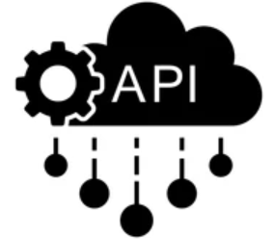



Web Services: Inbound Integration (Common) Fire & Forget
(Common)
The Inbound Web Service allows an external system to call Oracle Cloud published Web Service .
Source System
OIC/Boomi
Oracle ERP Cloud
MFT /SFTP
Process and transform
Source
3
1
Invoke
ERP Webservices
Receive and Validate
2
Monitoring
Orchestration, Error handling and Reporting
Base Table
MQ
(Corp)
Email
Notification
Database
Email
Notification
real time integration
 | Exception Category | Failure Point | Reprocessing Mode | Reprocessing Strategy
 | System | Boundary | Automatic | For any connector related, auto retry up to 3 times with specified time interval enabled. If error persist, then reinitiate the transaction from middleware post fix of connection error
 | System | Middleware | Automatic | If external system is not available at once, OIC can retry hitting the service a couple of times based on requirement
 | System | Middleware | Manual | Correct the data and reprocess.
1
3
2

Slide 21
Web Services: Inbound Integration (Common) Fire & Forget
(Common)
Steps
Boundary System pushes data to middleware system
Middleware orchestrates and transform the data
Invoke Cloud ERP exposed service to send data
Pros
Real time data transfer
Suitable for complex transformation and mapping
Cons
Not recommended for bulk data load
Applicability
ASMView/SAP PM Data to Cloud ERP (Parts PR).

Slide 22
Outbound Integration Patterns

Slide 23

Business Event : Outbound Integration (OIC Specific)
Uses Business event to extract required data from SaaS, OIC format it as per the requirement of external system, then expose it to Boundary Application
Oracle ERP Cloud
Oracle Cloud Infrastructure
Boundary 1
EX.MES
OIC
Transaction
2
4
BIP Report
1
MQ
(Corp)
Subscribe Business Event
Retrieve Additional Details
Transform
Standard Business Event
3
Monitoring
Orchestration, Error handling and Reporting
Database
Email
Notification
Boundary N
# | Exception Category | Failure Point | Reprocessing Mode | Reprocessing Strategy
 | System | ERP | Manual | If OIC orchestration doesn’t get initiated, manually check the OIC history in OIC and re-initiate the event in Oracle.
 | System | OIC | Automatic | For any connector related, auto retry up to 3 times with specified time interval enabled. If error persist, then reinitiate the transaction from OIC post fix of connection error
 | Data | OIC | Manual | Correct the data source and reprocess from source
1
4
2
3

Slide 24
Business Event : Outbound Integration …(Contd)
Steps
Event is triggered and captured in OIC
OIC invokes the BI Report is created in ERP Cloud application to extract additional details and fetches data.
OIC transforms the data as per data model and publish it as API or the queue.
Manufacturing Queue/API and import in the target system.
Pros
Real time event can be captured and transferred to boundary systems
Suitable for complex extraction requirements such as computed columns
Suitable for post extraction data transformation and validation requirements
Cons
Middleware orchestration is required
One event process at a time.
Finance/MES Outbound Integration
Applicability

Slide 25

Outbound Hybrid Integration pattern with multiple middleware
(OIC & Boomi)
When OIC captures the cloud generated event and enrich the data from cloud to pass it on the other middleware tool which can interact with boundary systems
Oracle ERP Cloud
Oracle Cloud Infrastructure
Boomi
Boundary 1
EX.MES
OIC
2
MQ
(Corp)
Transaction
Transform
Message
Received
From
OIC
Message Published to MQ
Boundary N
BIP Report
1
4
Standard Business Event
Subscribe Business Event
Retrieve Additional Details
3
Send Message
B2B- EDI/RosettaNet
Monitor
Trading Partners
Orchestration, Error handling and Reporting
Database
Email
Notification
Convert to EDI/RosettaNet Format
810 – Invoice 3C3 – AP Invoice
# | Exception Category | Failure Point | Reprocessing Mode | Reprocessing Strategy
 | System | ERP | Manual | If OIC orchestration doesn’t get initiated, manually check the OIC history in OIC and re-initiate the event in Oracle.
 | Data | OIC | Manual | Correct the data source and reprocess from source
 | System | OIC | Automatic | For any connector related, auto retry up to 3 times with specified time interval enabled. If error persist, then reinitiate the transaction from OIC post fix of connection error
1
2
3
4

Slide 26
Outbound Hybrid Integration pattern with multiple middleware
(OIC & Boomi)
Steps
OIC Subscribe to the event in ERP Cloud with tight coupled adapter
Call Cloud ERP Webservice for Orchestration
Send transformed message to Boomi
Boomi publishes the message to corporate MQ
In case of MQ based message exchange ,Boundary system subscribe from Corporate MQ and processes it further.
In case of B2B Integrations Boomi converts the file into RosettaNet/EDI format and transfers it to the trading partner domain.
Pros
Suitable for integrations where real time data flow is required and OIC cannot communicate with Corporate MQ directly
Cons
OIC and Dell Boomi Middleware orchestration is required
Applicability
Outbound SAP PM Integrations.
Event based B2B Integrations where RosettaNet support is required

Slide 27
B2B Outbound Integration Pattern
Oracle cloud to outbound B2B File transport standard transmissions between trading partners
Oracle ERP Cloud
Dell Boomi
B2B/EDI
Trading Partners
File Server /SFTP
BI Reports
1
4
810 – Invoice
Transformation
B2B Adapter
Receive file and validate
3
ORDRSP
3C3 – AP Invoice
Base Table
2
Orchestration, Error handling and Reporting
Database
Email
Notification
# | Exception Category | Failure Point | Reprocessing Mode | Reprocessing Strategy
 | System | OIC | Manual | If middleware Service doesn’t get initiated, then retry the once middleware service is up
 | Data | Middleware | Manual | Majorly, the transformation to CDM going to be straightforward mapping and negligible chances of error while transformation. Correct the record in source system and reinitiate the transaction
 | System | ERP | Automatic | If external system is not available at once, middleware can retry hitting the service a couple of times based on requirement.
1
2
3
4

Slide 28
B2B Outbound Integration Pattern (Common) …(Contd)
Steps
Scheduled Job to run BI Reports and export data at configured location
Middleware application read through the file and transform data to B2B Standard Format
Pushing data to the trading partners .
Pros
Near Real time jobs to capture data
Suitable for extraction requirements such as computed columns
Suitable for B2B transformation and validation requirements
Leveraging Dell Boomi will be useful as already interacting with existing B2B integration
Cons
No Rollback mode available. Once process is run, data cannot be rolled back
Error capturing and handling could be tedious
No Rollback mode available. Once process is run, data cannot be rolled back
Error capturing and handling could be tedious
OIC: B2B adapter doesn’t support Rosetta net.
Applicability
810 – Invoice
856 – ASN ACK, etc.
RosettaNet – 3C3

Slide 29
Outbound MFT (Common)
Outbound MFT (File Transfer) with data orchestration/data-File transformation while enhancing security with industry-standard network & encryption protocols
Oracle ERP Cloud
Oracle Cloud Infrastructure/Dell Boomi
MFT Server
Target Systems
File Server /SFTP
BIP Reports
Boundary 1
1
4
Receive file and validate
Transform
Place File To SFTP
Boundary 1
2
3
Base Table
Monitoring
Orchestration, Error handling and Reporting
Database
# | Exception Category | Failure Point | Reprocessing Mode | Reprocessing Strategy
 | System | ERP | Manual | If middleware isn’t picking file as scheduled, check the scheduler service
 | System | Middleware | Manual | For any connector related, retry for specific interval enabled. If error persist, then source system must reinitiate the transaction
 | Data | OIC | Manual | Correct the data source and reprocess from source
1
4
2
3

Slide 30
Outbound MFT (Common)…(Contd)
Steps
Scheduled Job to run BI Reports and export data at configured location
Middleware read through the file and transform data as per the requirement by boundary systems
Push data to SFTP location.
MFT picks data from target SFTP and Place the file to Boundary System SFTP
Pros
Suitable for huge file transfers where security with industry-standard network & encryption protocols required
Cons
Middleware orchestration is required.
External MFT system is required.
Applicability
AP Invoices to C2FO
Payment Instructions to Citibank, etc..

Slide 31
BI Report: Outbound Integration (No Middleware - Point to Point)
BI Report is created in ERP Cloud application to extract required details and file is placed directly at the boundary application SFTP, no middleware required
Oracle ERP Cloud
Boundary Systems
Scheduled BI Publisher Report Extract
File Server /SFTP
Target
1
2
Base Table
# | Exception Category | Failure Point | Reprocessing Mode | Reprocessing Strategy
 | System | ERP | Automatic | If SFTP is not available , retry the BI publisher job again.
 | System | ERP | Manual | If SFTP is not available , retry polling another time .
1
2

Slide 32
BI Report: Outbound Integration …(Contd)
Steps
BI Report is created in ERP Cloud application to extract required details and BI bursting functionality configured to SFTP the files to required locations. The report is scheduled to run at specific intervals.
When the report executes, the output in necessary file format as per the report design is sent to SFTP server provided by Boundary.
Boundary system picks up the file and imports data into their system.
Pros
Scheduled interface to transfer data to boundary systems
Suitable for cases where less orchestration is required.
No Intermediate Middleware required.
Cons
Only Base64 format files shall be transferred.
SFTP transfer only
Not Suitable for post extraction data transformation and validation requirements.
such as computed columns
Not suitable for post extraction data transformation and validation requirements
Applicability
Bank Integrations

Slide 33
Near Real time Outbound Integration (Common)
Scheduled BI Reports to be exported and placed at SFTP, picked for data transformation and flows from OIC to down streams systems
Oracle ERP Cloud
Oracle Cloud Infrastructure/Dell Boomi
Target System
SFTP
OIC /Dell Boomi
BI Reports
Boundary 1
MQ
(Corp)
1
4
Boundary 2
Receive file and Validate
Transform
Push data to SFTP /WebService/Queue
2
SFTP
Base Table
3
Boundary N
Monitoring
Orchestration, Error handling and Reporting
Database
Email
Notification
# | Exception Category | Failure Point | Reprocessing Mode | Reprocessing Strategy
 | System | Middleware | Manual | If middleware Service doesn’t get initiated, then retry the once middleware service is up
 | Data | Middleware | Manual | Majorly, the transformation to CDM going to be straightforward mapping and negligible chances of error while transformation. Correct the record in source system and reinitiate the transaction
 | System | ERP | Automatic | If external system is not available at once, middleware can retry hitting the service a couple of times based on requirement.
1
3
2
4

Slide 34
Near Real time Outbound Integration …(Contd)
Steps
Scheduled Job to run BI Reports and export data at configured location
Middleware read through the file and transform data as per the requirement by boundary systems
Pushing data to the boundary system through the adapter capabilities.
Pros
Near Real time jobs to capture data
Suitable for extraction requirements such as computed columns
Suitable for post extraction data transformation and validation requirements
Can be automated using PaaS, middleware and on-premise boundary applications
Good approach for extraction of volume data
Cons
Middleware orchestration is required
Real time data flow is not possible.
Applicability
Oracle to ASMView (Inv Ship, Mfg plan Master), Oracle to SAP PM , Xsite, PMC (Parts On Hand Qty) etc.

Slide 35
Web Services: Outbound Integration (Common)
Oracle Integration services enable outbound integration with web services so that processes can retrieve and update data that is stored in Oracle Cloud
Source System
Oracle Integration Cloud/Dell Boomi
Oracle ERP Cloud
OIC /Dell Boomi
API
Boundary System n
WebService
1
Request
2
Response
Push data through ERP Cloud
WebServices/APIs
Base Table
Receive and Validate
Process and transform
Monitoring
Orchestration, Error handling and Reporting
Database
Email
Notification
real time integration
# | Exception Category | Failure Point | Reprocessing Mode | Reprocessing Strategy
 | System | OIC | Manual | If middleware Service doesn’t get initiated, then retry the once middleware service is up
 | System | ERP | Automatic | If external system is not available at once, middleware can retry hitting the service a couple of times based on requirement.
1
2

Slide 36
Web Services: Outbound Integration (Common) …(Contd)
Steps
Boundary system will call a webservice hosted by middleware to query for data on Cloud.
Middleware calls Oracle cloud exposed webservice/Rest API to fetch data
Send back the data to boundary system
Pros
Suitable for complex extraction requirements such as computed columns
Suitable for post extraction data transformation and validation requirements
Best suitedSupported by most platforms and technologies
for real-time integrations
Cons
Middleware orchestration is required
Not suitable to export high volume
Applicability
Handheld Scanner-WMS, Capital Request System -Projects

Slide 37
CDW Integrations Using Oracle BICC.
BICC reports developed and extracted using UCM in scheduled manner as per the requirement from CDW and exported using APIS
Oracle ERP Cloud
OCI/ Dell Boomi
Cloud CDW
OIC / Boomi
File Server /SFTP
Stream Set
Aggregated Zone
Snowflake
Base Tables
BI Cloud Connector is inbuilt tool within Oracle ERP Cloud
Transform
UCM
Raw Zone
1
2
BICC Connector
# | Exception Category | Failure Point | Reprocessing Mode | Reprocessing Strategy
 | System | ERP | Manual | If BICC Scheduler failed , manually check the BICC history and re-initiate the job in Scheduler.
 | System | CDW | Manual | If streamset was failed to fetch data due to connection issue ,retry the process after connection is up.
1
2

Slide 38
CDW Integrations Using Oracle BICC..(contd)
Steps
Data extraction runs can be scheduled in ESS with a frequency of running annually to running daily.
File is placed at the universal content Management (UCM)
OIC fetches file with the webservices and places it at FTP location
CDW picks the file from SFTP and processes it.
Pros
Run extracts on-demand or schedule them to run at specified intervals during the day, in a week, or throughout the month
Extract complete or partial data. You can select offerings or specific objects.
Run incremental extracts if you need only the data that changed since your last extract.
Schedule multiple independent extracts at convenient intervals.
Cons
Minimum frequency could be hourly
Applicability
High Volume Data

Slide 39
Integration Mechanisms Selection Matrix
Drivers and Evaluation criteria to identify the correct integration mechanism
 | Inbound Interfaces
 | FBDI | Web Services
 | Integration Pattern | Integration Pattern
Data Volume | Medium to High | Low
Recommended volume ranges | Less than 100K records Use Multiple threads | Less than 100 records
Real Time | No | Yes
Batch | Yes | No
Complex Parent-Child structure | Yes | No
Performance | High (for larger volume) | High (for smaller volume)
Multithreaded processing within Oracle | Yes | No
DFF Support | Yes | Partial
Business Objects Supported | Financials, SCM | Limited
Middleware needed | Yes | Yes
Outbound Interfaces
Business Intelligence Report | Web Services
Integration Pattern | Integration Pattern
High | Low
Less than 100K records Data file cannot exceed 4GB | Less than 100 records
No | Yes
Yes | No
Yes | No
High (for larger volume) | High (for smaller volume)
Yes | No
NA | NA
All | Limited
Yes | Yes

Slide 40
Platforms Strategy

Slide 41


Our perspective on potential integration platforms
Given our initial understanding of the integration requirements for XX, we believe these options are the most viable for the API & Microservices platform.
Supports cloud and on-premise integration use cases. Enables data, application, process, API-based and B2B integration options.
Strong API management capabilities (includes full life cycle API management through API manager).
Strong security support, support multi-protocol , message styles
Many ready to use connectors and templates available to use
User friendly development tools which support Cloud based drag and drop development environment
Supports cloud and on-premise integration use cases. Enables data, application, process, API-based and B2B integration options.
Strong API management capabilities (includes full life cycle API management along with Apiary).
Strong security support , multi-cloud deployment
Model driven design , allows reusable templates and has very user-friendly development tool
Periodic release to support latest updates

Slide 42
Comparison of Integration platform options
Criteria | OIC |  |  | Dell Boomi | Comments
Elasticity & Scaling |  |  |  |  | OIC is automatically scaled up by Oracle
Parallel processing
On-Premise vs. Cloud connectivity among ERP systems |  |  |  |  | OIC has connectivity agent
Support for asynchronous long running transactions
Data splitting and aggregation
Batch data integration
API Management |  |  |  |  | Available as separate product offering
Code-free Development |  |  |  |  | No code development in OIC
Drag and drop development
Mapping Suggestion |  |  |  |  | OIC provides ML based suggestions
Pre-packaged integration flows |  |  |  |  | Oracle marketplace has many pre-packaged integration flows
Reusable Templates
LOB friendly development tools |  |  |  |  | Browser based development in OIC
Model-driven design
Metadata discovery
Performance and Scalability
Low-code development
42
Notes:
Sagar

Slide 43
Comparison of Integration platform options
Criteria | OIC |  |  | Dell Boomi | Comments
Adapters/Connectors
Platform/data security
Marketplace (Prebuilt integrations)
Multiprotocol support
Multiple data/message styles
Data Transformation
Support for EDI transactions |  |  |  |  | B2B support is newly introduced in OIC
Rules Engine based integration
Monitoring
Instance level Audit Tracing
Component Migration |  |  |  |  | OIC offers simple Export and Import features.
Automated Deployment
Integration Insight |  |  |  |  | Browser based development in OIC
Self Service Integration
Asserter Recordings |  |  |  |  | New feature in OIC
Third party integrations and security
Interface Monitoring and Deployment
43
Notes:
Sagar

Slide 44
Comparison of Integration platform options
Criteria | OIC |  |  | Dell Boomi | Comments
Cloud ERP Business Event Integration |  |  |  |  | Only OIC supports Cloud SaaS business events
EPM Adapter |  |  |  |  | Only available with OIC
Automation with RPA (UiPath, Automation Anywhere) |  |  |  |  | Support for invoking RPA bots through integrations.
Human-in-the-Loop integration |  |  |  |  | RPA to quickly remediate transaction issues
Inbuilt SFTP server
Process Automation |  |  |  |  | Process Cloud Service comes bundled with OIC
Case Management
Bulk data load (ETL type loads)
Key Features
Others
44
Notes:
Sagar

Slide 45
Security Considerations

Slide 46
Security Considerations
Security plays a big role in any SaaS integration as there is exchange of data between two systems.
1
Application security
Why is security important?
Integrations with banks require encryption of the files being exchanged.
PII data, such as SSN and salary, need to be masked so that intermediate systems cannot read them.
To mitigate unauthorized access, the file servers and WebServices need to be secured using credential store.
Role-based access control (RBAC) is an approach to restricting system access to authorized users. Access to SaaS functionality and data is secured using the industry standard framework for authorization, RBAC. In an RBAC model, users are assigned roles, and roles are assigned access privileges to protected system resources.
2
Data security
Data masking and encryption of process flows, and audit/data files can be used to secure PII data. Encryption policies may be used to encrypt and decrypt message/specific fields in a payload or audit file.
3
Data file security
Cloud apps support encryption of files at rest and in transit. Secured file locations with authentication are used for storage of files. Password or public key authentication is also supported by cloud applications.

Slide 47
Data Security in Integrations
Data in rest and motion during the integration is secured
Data Security
Program Security
Data Masking
XX PII/CI data will be masked in development and test instances during refreshes.
File Security
Data files would be stored in a secured location on XX assets only accessible to authorized resources from Deloitte and Global Foundry .
Encryption
Wherever applicable PGP encryption will be used to encrypt the data files
Cloud Universal Content Management Security
Oracle UCM for XX is secured through user roles and privileges which will restrict access to unauthorized users.
Secured Web Service
XX PaaS instance will have connections which are secured with credentials. Web Services exposed from XX network will have security policies attached to them.
Secured Integrations
Web services exposed by Oracle Cloud Applications are secured by roles and privileges resulting in secured integrations with XX on premise and third party systems.
Security during Transmission
All Oracle Cloud Web Services are secured by a global server-side security policy in addition to X509 certificate for encryption of transmitted data.

Slide 48
Error Management

Slide 49
Error Handling Standards
Two types of errors are monitored by Integration Middleware
System errors – network, firewall, database connectivity, invalid credentials, etc.
Data errors – errors that require remediation at the source system.
Integration error logging
Documents/Messages can be stored in the error log
Documents/Messages stored in the log can be encrypted for highly confidential and confidential data
Integration error handling standards
Retry – automated and configurable for number of attempts and duration
Rerun – subsequent attempt to retry a failed message AFTER the original failure
Reprocess – reacquire the data from the source system once data issue has been remediated
Stop Service – automated process that elegantly stops a service once the number of configured Retry attempts has been exhausted (applies to System Errors only)
Error handling automated notification
Platform Wide - specified user or group notified via email for all processes and errors
Functional Domain – specified functional user or group notified via email (e.g., HR)
Interface Process – specified functional user or group notified via email down to a specific process area
Interface Process Exception Category – specified functional user or group notified via email down to the exception type within a specific process and functional domain

Slide 50
Logging and Error Handling Strategy
Error handling and correction mechanisms - Various stages of the integrations
Error Category | Error Location | Error Handling | Correction Mechanism
Data file errors/failures during interface table load E.g., missing column, data type, and field length mismatch | Middleware | This error happens mainly because of invalid/corrupted data files. Configure error notification on Middleware to notify Apps support team | Manual; Contact source application owner to confirm if the data provided is adhering to an agreed format. Re-submit the corrected file
Business errors in Inbound interfaces | Cloud/Middleware | All errors along with the description should be listed in the log file against each record as a part of callback integration in case of FBDI Imports Notify Apps Support team on Business validation error received in response from Cloud | Identify the cause of validation error Perform the required setups or missing configurations Resubmit the interface program Use the standard user interface/ADFdi template to correct the errors
Business errors in outbound interfaces | Middleware | Notify Apps Support team on Business validation error received in response from Boundary applications | Identify the cause of validation error Perform the required setups or missing configurations Resend full or partial file
Connection to SFTP server/infrastructure related | Middleware & Boundary Application | Errors due to infrastructure and system failure | All scheduled interface programs should automatically run once system errors are fixed and failed transactions are reprocessed. Program errors due to system failure will be manually restarted once the system restores
Web service invocation fails | Cloud & Boundary applications | Error when invoking Web services OIC/DellBoomi should be able to store the messages for the cases where the source application cannot resend them | Verify if all the applications involved are up and running Verify service access and user access Reprocess the messages manually once the issue is fixed

Slide 51
Dashboard for Error Management
Identify the Error
Debug the Root Cause
Reprocess the message
Filters
Filter errors by various criteria such as time period, Integration, Error Recovery Jobs etc..
Business Identifier
Integrations can be designed to include a business identifier such as Invoice Number etc.. Based on which integration executions can be searched
Audit Trail
Audit trail of the failed execution can be traced to each activity to help troubleshooting
Payload Tracking
With necessary configurations, Payload can be tracked at each activity in the Integration
Reprocess
Resubmit the failed messages to re-run the integration once the root cause is fixed
Bulk Mode
The resubmission can be done at a single message level or in Bulk mode

Slide 52
Appendix

Slide 53
Dell Boomi Licenses – Current Snapshot
Cost Factor (Inclusive of all Environments) | In $ (Projected for 2022)
Annual Subscription Fee | 214.4 K
Enterprise Connectors + Standard Connectors + TP Connectors (Variable Fee) | 30 K
PostGre SQL db (Open-Source S/W) | 0 K
Total Cost | 244.4 K

Slide 54
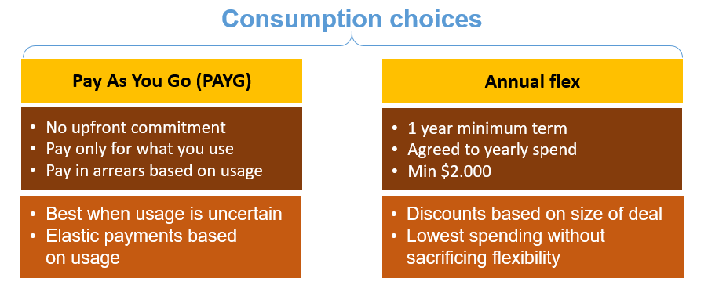
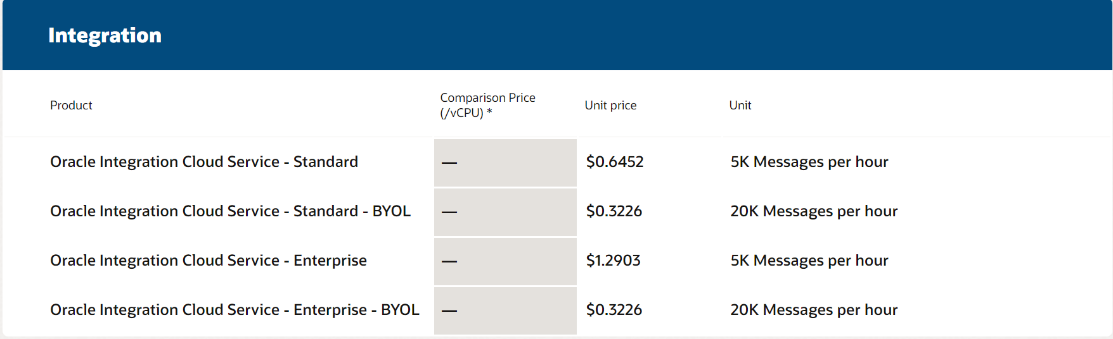
Oracle Integration Cloud Licensing
Oracle Integration cloud – Enterprise – 5k messages per hour – $ 1.2903
Technology Cloud
Use case description details | Environment | Metric | # | Monthly Commit | Number of hours per day per msg bundle | Number of days per month usage | Calculated total hours per month needed | Monthly credits needed
Oracle Integration Cloud -Enterprise | Prod | 5k msg per hour | 1 | $1.2903 | 24 | 31 | 744 | $959.98
 |  |  |  |  | Total Monthly Credits Needed for OIC Usage |  |  | $959.98
Note :- This table is the sample representation and needs to be evaluated in actual negotiation |  |  |  |  | Total Yearly Credits Needed for OIC Usage |  |  | $11520
Integration – 5k Message Pack per hour Integration – 1msg =< 50kb

Slide 55
Recommendations
Dell boomi +Mendix | Database as a Cloud Service | OIC(Integration + VBCS)
Considerations | Yearly Cost | Considerations | Yearly Cost
Dell boomi (All current environments) | $214K | 2 Prod Instance 20K msg per hour | $207K
 |  | 5 non prod Instance 10K Msg per hour
Short Term Strategy | Long Term Strategy
Build the future applications in VBCS as it is tightly coupled with Oracle Cloud and Integration. | Over the time move the existing Mendix applications/All home-grown ERP applications to VBCS and save on Mendix cloud license.
Existing B2B integrations (RosettaNet),Non-Real Time integrations to continue with Dell-Boomi | Get commitment from OIC Product development for RosettaNet Support and move all B2B workloads to OIC.
All Real-time integrations in the target state to be reworked with OIC when transformation to ERP Cloud begins.

Slide 56











Oracle Integration Cloud (OIC)
OIC Integrations focus on simplicity and time-to-market. It increases agility by reducing integration development cycle time with more out-of-the-box functionality , configuration approach and wide array of adapters.
Digital assistant
Blockchain
IoT
Augmented analytics
Deployment flexibility
API management
Capability
Prebuilt
Application Integration
Adapters
Cloud
CX
HCM
ERP
Process Automation
Business Accelerators
OCI API Gateway
Design
Develop
Deploy
+
Cloud + Ground
Visual App Builder
ML Recommendations
Ground
Security
Simplified Application Integration
Performance

Slide 57








































Enterprise Connectivity
Prebuilt adapters for cloud, on-premise, Oracle, non-Oracle and custom apps
ERP Connectivity
HCM Connectivity
Productivity and Social Connectivity
ERP Cloud
EPM Cloud
Commerce Cloud
Utilities Cloud
Logistics Cloud
HCM Cloud
Talent Acquisition Cloud
Talent Cloud for Midsize
Shopify
CX Connectivity
Database Connectivity
Engagement Cloud
CPQ Cloud
Eloqua
Responsys
Marketo
Database Cloud
ATP Cloud
ADW Cloud
Database
Field Service Cloud
Service Cloud
Policy Automation
Google Tasks
Enterprise Messaging
Technology Connectivity
RPA Connectivity
Future Proof
MS Contacts
Apache Kafka
AQ
REST
FTP
MS Email
SOAP
Limit maintenance and upgrade costs
Oracle supported
JMS
IBM MQ Series
SOA
Suite
FILE
MS Calendar
For more detailed information see here
57

Slide 58

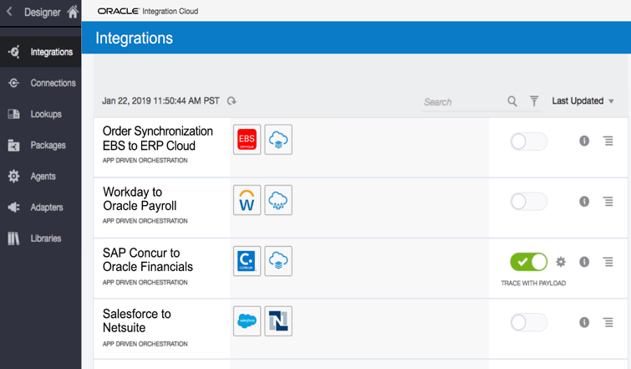
SaaS to On-Prem Connectivity
Connectivity Agents are required for OIC to communicate with on-premise applications like Database, E-Business Suite, etc.
Provides multithreading support, which allows for multiple executors to perform downstream message processing.
Message payloads of up to 10 MB are supported through the use of compression.
Features :
Embedded recommendations
Connect SaaS with on-premise apps
Extensive support for non-Oracle apps
Automatic discovery of business objects, services, events

Slide 59
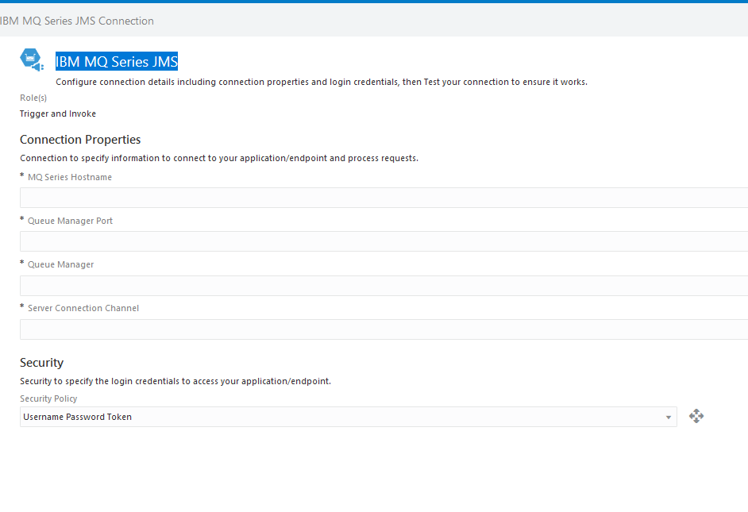
IBM MQ Series Adapter in OIC

Slide 60
Integrations Listing – Current State
Integration's listing is placed at the SharePoint location --> | LINK

Slide 61
OIC Licensing & Billing - References
https://technology.amis.nl/oracle-cloud/oracle-integration-cloud-pricing-explained-oci-vs-classic/
https://www.rubiconred.com/blog/understanding-oracle-integration-cloud-licensing

