Slide 1
XX Reporting Strategy
December 16, 2021

Slide 2
Integrated ERP Planning | Detailed Timelines
Stakeholder Interviews
Workshop
Milestone
Note: Week of Nov 22, Dec 20 and Dec 27 are marked as collective shutdown
Tasks | Week 1 Oct 11-Oct 15 | Week 2 Oct 18-Oct 22 | Week 3 Oct 25-Oct 29 | Week 4 Nov 1-Nov 5 | Week 5 Nov 8-Nov 12 | Week 6 Nov 15-Nov 19 | Week 7 Nov 29-Dec 3 | Week 8 Dec 6-Dec 10 | Week 9 Dec 13-Dec 17 | Week 10 Jan 3-Jan 7 | Week 11 Jan 10-Jan 14 | Week 12 Jan 17-Jan 21
Concept Overview
Legal Entity, Ledger, Business Unit
Inventory Organizations
Socialize and Signoff
Concept Overview
Develop COA Structure
Initiate COA Segment Definition
Current State IT Walk-throughs
Current State Application Architecture
Future State Application Architecture
Current State IT Walk-throughs
Future State Application & Landscape
Reporting, Integration Strategy & Platforms
RICEW Dev Assessment
Socialize and Signoff
Current State Security and Controls Walkthroughs
Future State Security and Controls Discussions
Security and Controls Approach Deliverable
Socialize and Signoff
Activities
Enterprise Structure
[ES]
Finalized Design
Preliminary Design
Finalized Design
Approved ES
Chart of Accounts
[COA]
Preliminary Design
Finalized Design
Approved COA
O2C, P2P, D2D, M2O, PLM
Application Architecture
[AA]
R2R
Preliminary Future State AA
Approved Future State AA
Preliminary Design
Finalized Design
Technology
Preliminary Design
Finalized Design
Preliminary Design
Finalized Design
Security & Controls
We are here

Slide 3
Table of Contents
Overview
Reporting Tools
ERP Reporting Tool Details
EPM Reporting Tool Details
Reporting Scope
Appendix

Slide 4
Executive Summary
Reporting Landscape
Development Life Cycle
Guiding Principles
Reporting Categorization
Overview

Slide 5
Executive Summary
This document details XX’s Reports Strategy -
The purpose of this document is to define the standard reporting approach and strategy for Cloud ERP/ EPM Reports
The document lists various enterprise reporting solutions offered by Oracle for transactional, analytical and management reporting and defines the use-case for each option for an optimal reporting solutions
The document covers different tools that can be used for report development
This document will be referenced by the Development team and Functional Leads during the execution of project
The document lists down best practices to be followed by Development team during report development

Slide 6
Reporting Landscape
** Needs separate License
Management reporting (Directs and manages the business) - Present aggregated snapshots of data and KPIs to executive leadership in a manner that quickly provides them with a view of the overall business and areas that require attention
“How do we maximize shareholder value?”
“How do we prioritize strategic actions?”
Examples: Board retreat materials, Strategic asset management review, Portfolio risk ranking, etc.
Executive
management
Strategic
Analytics
Fusion Analytics Warehouse – Oracle Analytics Cloud (OAC) **
Corporate
management
Division
strategic
Operational reporting (Plans the business) - Leverage month-end reporting to paint a picture of the present, what will occur in the immediate future, and identify immediate business needs. Regulatory/Statutory Reports are a sub-type.
“How did actuals perform against plan?”
“How does recent actuals impact future forecasting?”
“Are we in compliance with required regulatory and tax provisions?
Consolidated
External
EPM – Reporting
Narrative Reporting, Smart View
Operational
month-to-month
Transactional reporting (Daily operation & control) – Contains the lowest common denominator/level of information used by colleagues to make decisions on the most frequent basis (e.g., daily, intra-week, etc.)
“What did we do yesterday?”
“Are we on track? What levers can I pull?”
Examples: List all Open Purchase Orders, All closed invoices in the period, etc.
ERP – Reporting Oracle Transactional
Business Intelligence
(OTBI)/
Business Intelligence Publisher (BIP)
Department/ Field
management
Tactical
day-to-day

Slide 7
Reporting Methodology
The reporting methodology for Oracle Cloud is based on the approach for collating and rationalizing the reporting requirements, mapping these to the best suited Cloud reporting tools and enabling user access to support daily business operations.
Gather as-is and future state reporting requirements
Prepare Reports Inventory across process areas
Map reporting requirements to Oracle Cloud reporting tools
Update Reports Inventory across process areas
Perform dry runs of BIP schedules, OTBI analyses and FRS data slice-and-dice
Validate the reports based on user stories and end-to-end test cases
Develop pixel perfect or analytical reports as per requirements
Validate pre-requisite setups for the report development
Configure folder level security using custom roles to enable access
Assign Roles to users to run existing reports or newly created reports
Run high volume reports and resolve potential performance issues
Mapping and Configurations
Data Extraction & Formatting
Scheduling & Delivery

Slide 8
Reporting Principles
Data Privacy
Report Category
Report Access
Data Volume
Report Format
Level of Reporting
Data Classification
The reporting solution is driven by a set of guiding principles that help align the factors involved in the reporting implementation methodology
Customer data
Internal data
Public/ External data
High Volume
Low Volume
Batch extracts
HTML
Excel
PDF
Dashboard
PPT/ Word
Management
Transactional
Period Close
External
Analytical
Business Group
Legal Entity
Business Unit
Business Functions
Power Users
Business Users
Private data to be restricted
Public data to be classified
Principle | Benefits
Single source of truth | Enables true performance measurement and metrics usage across the organization Provides factual understanding and confidence in reporting
Information consistency | Drives commonality and consistency in decision-making across disparate functions and levels of the organization
Rationalized toolsets | Enforces standards to enable reliability and rapid development Limited toolsets reduce training effort and promotes transferability
Clearly defined access | Provides users with appropriate view of enterprise information
Minimal custom reports | Reduces maintenance efforts and eases impact on upgrade initiatives

Slide 9
Reporting Categorization
At a high level, reports can be classified as statutory, monitoring, operational and analytical to assess the right fit for Cloud reporting tool
Purpose
Statutory Reporting
Business Process Monitoring Reporting
Operational Reporting
Analytical Reporting
Usage
Audit Reports
GAAP/ IFRS reports
Tax Reports
Country specific reports for regulatory purpose
Key Process Matrix and check point reports
Exceptions and error reports
Process based dashboards
Transactional Reports
Real time availability
Pre-formatted documents
Ad-hoc queries
Role based dashboards
Forecast or variance analysis
Forward looking scenarios
Financial and Operational Key-performing Indicators
Ad-hoc analysis

Slide 10

ERP + EPM: Integrated Reporting Model
Deloitte’s seamlessly integrated Financial Enterprise Performance model enables digital transformation, process improvement, and workflow efficiency
EPM
Financial Budgeting & Planning
CAPEX Planning
Project Planning
Long Range Planning
Consolidations & Close
Account Reconciliations
Tax Reporting
Reporting & Analytics
Slice/Dice/Pivot
Strategic
ANALYTICAL
ERP
Tactical
General Ledger
Accounts Payable
Accounts Receivable
Fixed Assets
Order-to-Cash
Sub-Ledger
Transactional BI & Reporting
Operational
TRANSACTIONAL

Slide 11
ERP Reporting Tools
EPM Reporting Tools
Reporting Tools

Slide 12

Cloud ERP Reporting Tools
Financial Reporting Studio
BI Publisher
Browser-based financial reporting with real-time drill down capabilities and data visualization.
Examples (Typical)
Income Statement
Balance Sheet
Limitations
Suitable for low/medium data volumes.
Report needs to be updated if there are changes in COA hierarchy levels and their members
Highly formatted operational reports with advanced features supporting high volume, scheduling and bursting.
Examples (Typical)
Check printing
Payment formats
Shipping labels
Limitations
No drill-down and drill-through capabilities.
Users cannot make changes to report on the go.
Report development requires basic to advanced knowledge of SQL and Cloud tables.
Reporting
Smart View
Oracle Transactional BI (OTBI)
Excel-based slice-and-dice of data for easy and quick ad-hoc financial reporting.
Examples (Typical)
GL balances across COA hierarchies
Net revenue for a period and location
Limitations
Suitable for low/medium data volumes.
Report needs to be updated if there are changes in COA hierarchy levels and their members.
On reopening the spreadsheet, user will need to refresh it to view the latest data.
Provides self-service reporting capabilities to business users for real-time operational and transactional data.
Examples (Typical)
Sales across periods
Late receipts analysis
Limitations
Suitable for low/medium data volumes.
Not all ERP tables and columns are exposed for reporting.
Limited cross-subject area reporting functionality.
Difficult to create reports in a specific format.
Minimal data visualizations capabilities.

Slide 13
EPM Reporting Tools
* Financial Reporting Studio enables browser-based financials reports for management reporting with real-time drill down capabilities
Narrative Reporting (Formerly EPRCS) enables organizations to streamline internal and external reporting processes, and to combine data and narrative content in a single, secure and collaborative environment with workflow management
Narrative Reporting (Formerly EPRCS)
Financial Reporting Studio
Reporting EPM Tools
SmartView
EPM Dashboards
* SmartView
enables excel-based slice-and-dice of data for easy and quick ad-hoc financial reporting
EPM Dashboards enables business users to use highly summarized version of data from EPBCS/FCCS home screen without the need to connect to a different tool
* Applies to ERP as well

Slide 14
BI Publisher
OTBI
FRS
Smart View
ERP Reporting Tools Details

Slide 15
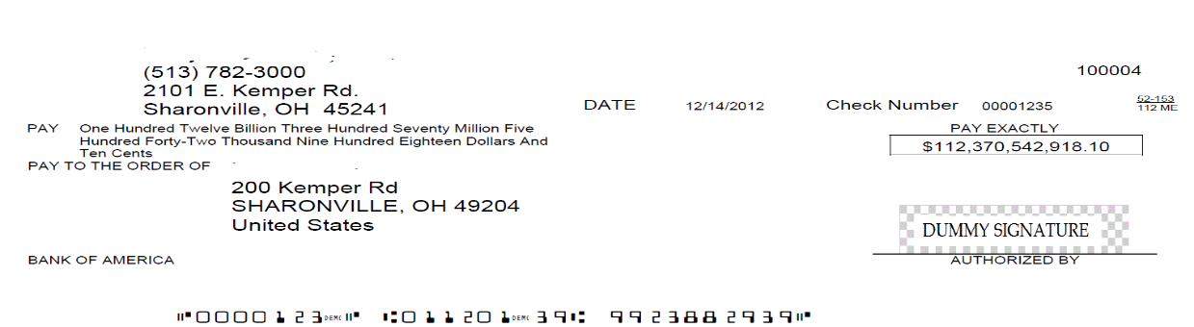
BI Publisher
Why This Tool?
How Does It Work?
Limitations
Flexibility to write SQL queries or tune performance; remove dependencies with Oracle for delivering OTBI attributes
Picture Perfect Reporting
Allow multiple output formats like pdf, html, rtf, excel
Support for Bursting options to multiple destinations
High volume data reports can be developed
Supports calculations though SQL queries
Dataset(s) generate runtime XML from a single or multiple data sources
Generated XML is parsed though a static template for a single or multiple output(s) in different formats
Report output can be delivered using delivery options (ex – Email, SFTP)
Developer Centric Tool and Users should have some basic to advanced knowledge of SQL
Complex BI reports can take significant development time
No drill-down and drill-through capabilities
Users cannot make changes to report based on their needs
Third Party Application
XX Applicability Examples - Label Print Report, AP Invoice Aging Report, Shipping Label Print Report, Customer Invoices Report
Sample Report Output

Slide 16
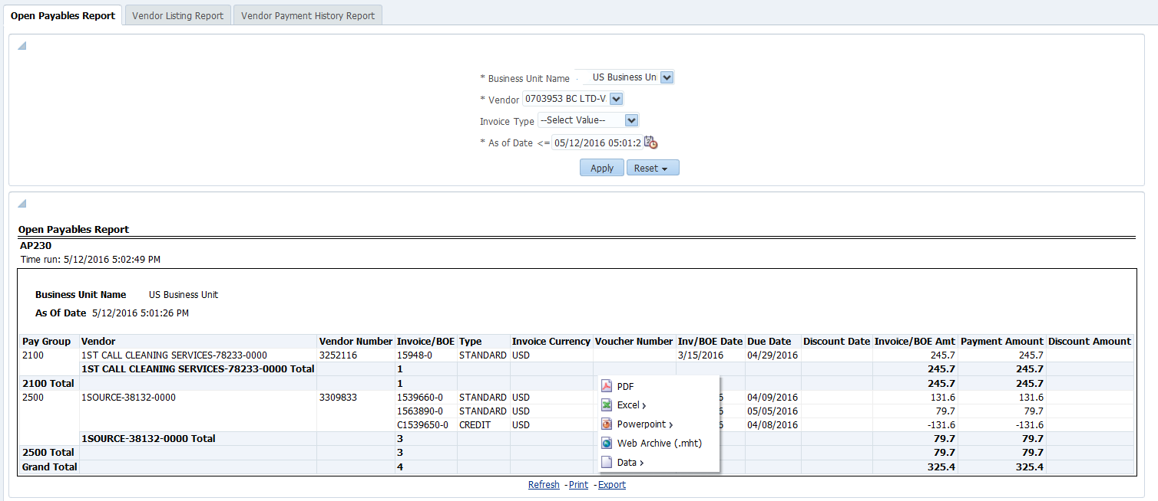
OTBI
Why This Tool?
How Does It Work?
Limitations
Designed for end user and Adhoc reporting - users of this tool do not require knowledge of SQL or the underlying database schemas supporting Oracle Cloud
Pre-packaged content - delivered subject areas provided for drag and drop interface
Data access and security integrated with Oracle Cloud requiring no further setup
Primarily meant for operational users who want to create their own custom reports and dashboards
OTBI is fully integrated with Oracle Cloud(roles, flex fields, lookups)
There is no need for additional implementation steps to map security or provide configuration inputs
OTBI needs minimum setup and is ready for use once Oracle Cloud is installed and configured
Customizations of the subject area are not supported; also, limited capabilities to combine subject area
All data attributes are not included in subject areas and dependencies with Oracle if the attribute is not available to select in the output
Performance issues noticed when running complex reports and dependencies with Oracle on performance tuning
Minimal data visualizations, up to 25000 rows
Third Party Application
XX Applicability Examples - AR Revenue Details Report, Asset Balance Report
Sample Report Output

Slide 17
FRS *
Why This Tool?
How Does It Work?
Limitations
Based on real-time general ledger
account balances
Supports multi-dimensional analysis
Supports multiple output formats, such as HTML, PDF, Excel
Graphical tool makes it easy for users to create reports by dragging and dropping data elements from the accounting hierarchy onto a grid layout
Financial Reporting Center uses an object-oriented graphical report layout
FRS utilizes Oracle Fusion General Ledger balances cube as data source
Installation file is available within the oracle cloud instance – Financial reporting center
Reports can be accessed from Financial Reporting Center
Report need to be updated with new member details if there are changes in COA hierarchy levels and their members
XX Applicability Examples – Balance Sheet Report, Profit and Loss Report, Cash Flow Reports
Sample Report Output
* Applies to EPM as well

Slide 18
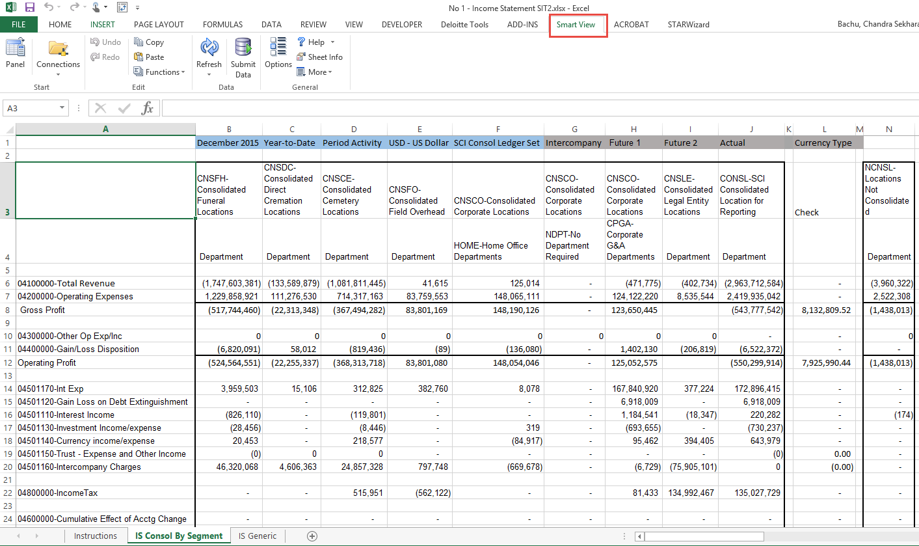
Smart View *
Why This Tool?
How Does It Work?
Limitations
Excel-based analysis tool that allows quick ad hoc reporting on Oracle tools like Essbase
Allows drag and drop, drill down, and pivoting to manipulate data and perform ad hoc analysis
Smart View reports can be saved off-line and refreshed with latest GL data
Easy Installation – Excel Add in available under Financial Reports Workspace
Fetches data from Oracle Fusion General Ledger Balances cubes by configuring Essbase connection setup
It’s not a structured reporting tool. User can use free flow mode by pivoting dimensions between rows and columns
Report need to be updated with new member details if there are changes in COA hierarchy levels and their members
On Reopening the spreadsheet user will need to Refresh the spreadsheet to view the latest data
Third Party Application
XX Applicability Examples – any Financial report that needs slicing and dicing and drilling down to transaction level
Sample Report Output
* Applies to EPM as well

Slide 19
In addition to Smart & FRS
Narrative Reporting
EPM Dashboards
EPM Reporting Tools Details

Slide 20
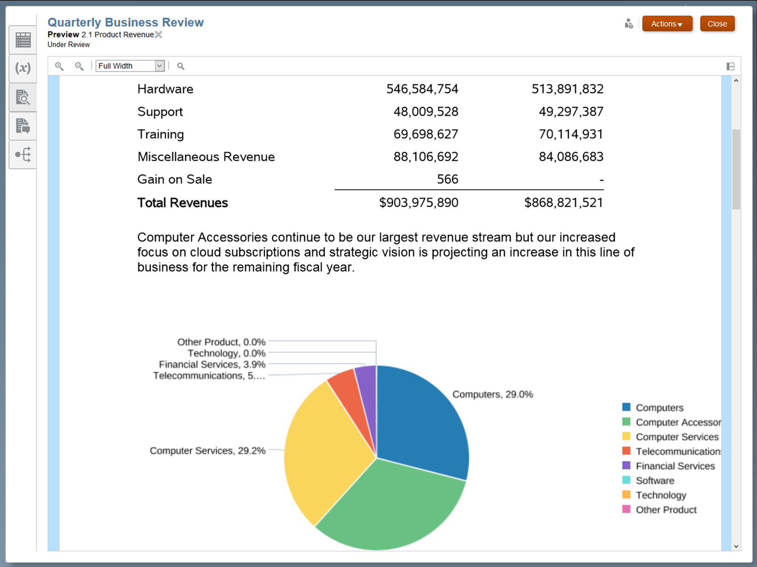
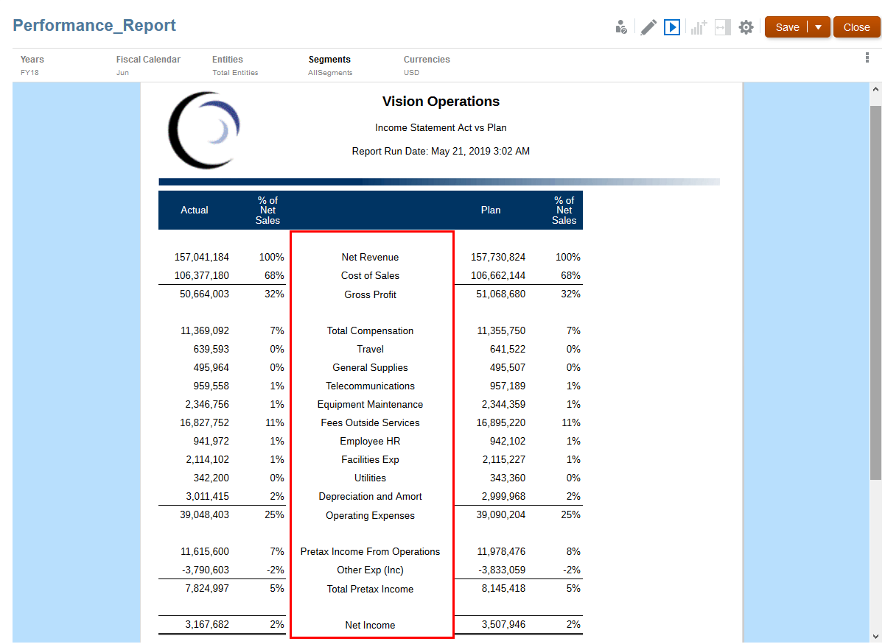
Narrative Reporting
Why This Tool?
How Does It Work?
Limitations
Enables organizations to streamline internal and external reporting processes by combining data and narrative reporting into a single, secure, collaborative environment
Comes as part of the Enterprise EPM license
Notifies authors and reviewers when a document is ready for input
Comments and review responses are embedded within the document
Gain visibility into the progress and status of a reporting lifecycle
Synchronize management, narrative, and statutory reporting into a singular solution
Use the direct integration of Oracle EPM, business intelligence, and ERP data sources to leverage existing systems and investments
Use the mobile, self-service, and collaboration capabilities to review reports from anywhere
Tool is relatively new in the market v/s Workiva and Donnelly. Some of the key features like XBRL & regulatory reporting are still being worked on to make it more robust (with Workiva, Donnelly currently offer better XBRL reporting capabilities)
Third Party Application
XX Applicability Examples – Internal/external reporting for detailed textual commentary (external releases, variance analysis)

Slide 21
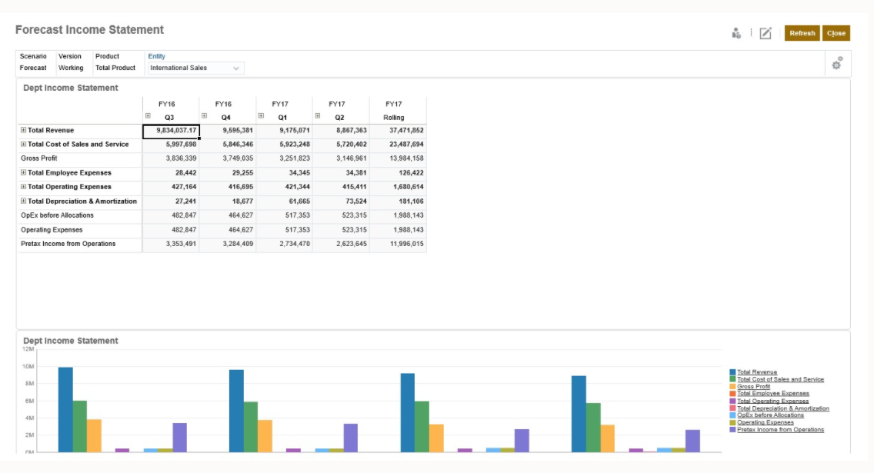
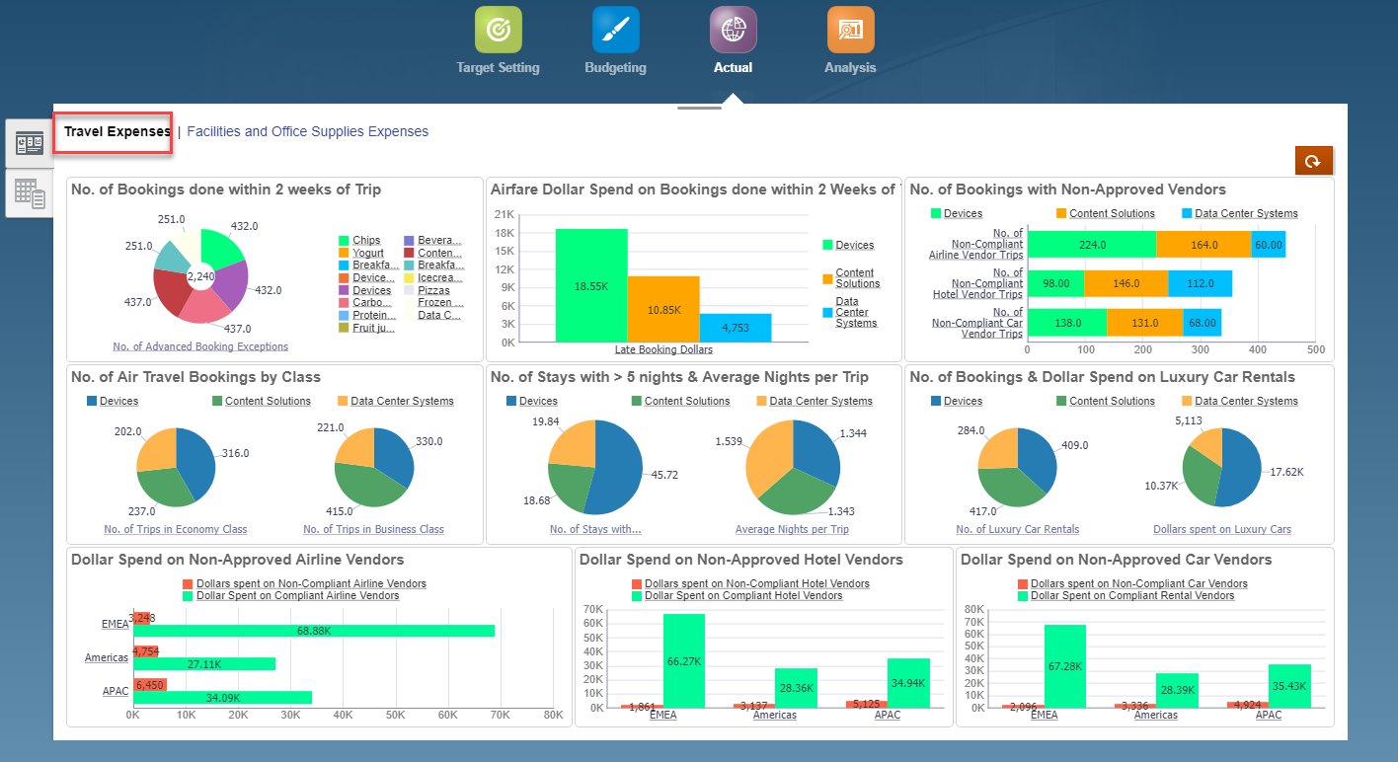
EPM Dashboards
Why This Tool?
How Does It Work?
Limitations
The versatility of EPM dashboards enables users to chart, evaluate, highlight, comment on, and even change key business data
Dashboards can be created by simply dragging and dropping a variety of objects from the library panel on the left to the dashboard workspace, in any of the EPM applications
Depict data interactively with a wide variety of chart types such as area, bar, bubble, column, combination bar and line, doughnut, funnel, gauge, scatter, radar, and so on
Depending on the form design, enable users to drill down into underlying detail and select which members to work with
Include user variables in the global POV bar and the local POV
Tiles display a specific value from the cube. To provide the value for each tile, you can specify a form or a cell intersection as a data source. One can include up to nine charts or tiles on a given dashboard to keep the performance and visual appearance intact.
Third Party Application
XX Applicability Examples – Storyboard choreographed drill-down to offer transparency for end user analysis

Slide 22
Reporting Scope

Slide 23
Proposed Reporting Scope - Draft
Proposed listing is based out of our Current state understanding. Scope and categorization will undergo review based on the outcome of Future state workshops (Functional and Technical)
By Workstream
By Module
Workstream | Total
Demand To Deliver (DTD) | 17
Order to Cash (OTC) | 39
Procure to Pay (PTP) | 63
Report to Retire (RTR) | 55
Grand Total | 174
Module | Total
Accounts Payable (AP) | 58
Accounts Receivable (AR) | 32
Cash Management (CM) | 2
Fixed Assets (FA) | 26
General Ledger (GL) | 22
Inventory (INV) | 17
Order Management (OM) | 5
Purchasing (PO) | 5
Projects (PPM) | 4
Tax (TAX) | 3
Grand Total | 174
By Report Categorization
Report Category | Total
Analytical Reporting | 6
Business Process Monitoring Reporting | 28
Operational Reporting | 134
Statutory Reporting | 6
Grand Total | 174
Attached is the Proposed Report Listing – Draft version as per current state understanding

Slide 24
Appendix

Slide 25
Reporting Tools Summary
A quick comparison of the tools that will be used as part of the Fusion ERP journey
ERP Reporting Tools
Financial Reporting Studio
SmartView
OTBI
BI Publisher
Business Area
GL Balances only
Several predefined OTBI Subject Areas
All Business Areas
Data Source
Essbase Cubes in ERP Cloud
Essbase Cubes in ERP Cloud
ERP View Objects
ERP Cloud Tables
Output Capabilities
Presentation Quality Reports in Formats like Excel, PDF, HTML
Excel Pivoting, drag-and-drop and drilldown
Graphical and tabular Reports in HTML, PDF, Excel, csv etc.
HTML, PDF, Excel, CSV etc.
Data Freshness
Not Real Time
Not Real Time
Real Time
Real Time
Use Cases
Management Reports
Adhoc Analysis
Operational Real Time reports
Highly formatted operational reports
Scheduling
EPM Workspace
None
OTBI Agents
BI Scheduling/ESS Jobs
Mobile Access
Yes
No
Yes
No

Slide 26
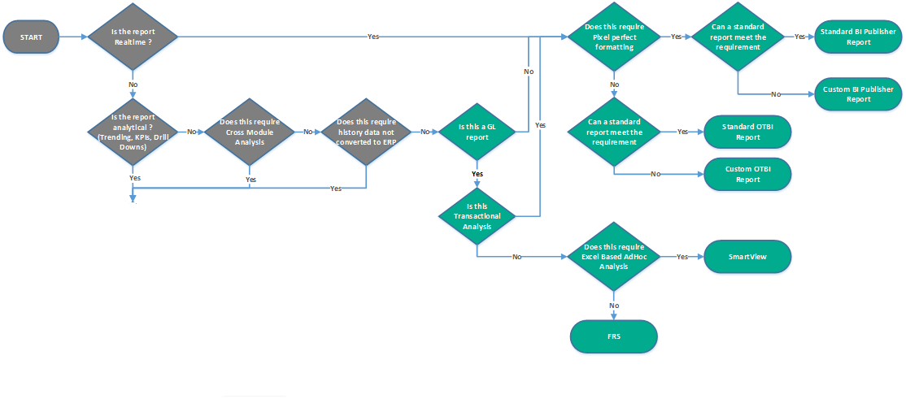
Tools Rationalization
The flowchart below illustrates the typical rationalization steps that will be followed to identify the best-fit Reporting Tool for the requirements. Fit-Gap analysis will be performed to leverage standard (Out of the Box) Reports, where available, to meet the requirements.
Third Party Application
ERP

Slide 27
Reporting Tools Selection
Attached is the Reporting Tool Selection Macro, which could help select the Reporting to be used to develop the report based on parameters.
Once the parameters are answered, Macro would provide proposed Reporting tool to be used to for development.
However, User can override the proposed tool and select tool of choice for development

