Slide 1
Agenda
Topic | Duration
Introductions | 10 min
Terminology | 5 min
Data Conversion Objective and Principles | 10 min
Data Conversion Approach | 20 min
Data Conversion Tools | 20 min
Reconciliation and Validation Process | 10 min
Testing Cycles | 20 min
Roles and Responsibilities | 10 min
List of In-Scope Conversions | 10 min
Objectives & Outputs
Conversion Capabilities
Understand Conversion Approach
Align on Roles and Responsibilities
Draft Conversion Entities in Scope
Parking Lot items

Slide 2

Global Design Workshop - Rules of the Road
Workshop Materials
1
Clear Objectives and Outcome
All Global Design Decks will be uploaded to Teams 24hrs prior to the workshop for the attendees.
After workshops have concluded the recordings and meeting minutes will be uploaded to correct session folder.
2
Deloitte Leads will include a slide that outlines a clear and concise objective for the session.
Additionally, a section on the actual outcomes of the session will be provided.
Clearly lay out to attendees what we are asking from you.
Scribes
4
Scribes will be ready and available to take notes for the workshop.
Will monitor the chat for any questions/comments.
Present captured items at the end of every session.
Invitations for Audience
3
Deloitte Leads will provide more detailed Agendas for the audience on the invites.
Deloitte Leads will indicate whether the session is a deep dive.
Based off agenda Technology Leads will identify the required personnel for the meeting.
Notes:
Tags: customer, journey, person, circle, arrow

Slide 3
Terminology
Acronym | Description
POD | Oracle refers to an instance/environment as a Pod (Portable on Demand)
FBDI | File Based Data Import – Standard Template files provided by Oracle to import Finance and SCM data entities
ADFdi | Application Development Framework (ADF) Desktop Integration - Used for uploading data for specific complex entities like Employees
DR | Dress Rehearsal (or Dry Run) – Conversion run in an environment like test environment on a different pod
PII | Personal identifiable information
Legacy Applications | Applications that will be replaced as part of this transformation project
ESS | Oracle Enterprise Scheduler Service - ESS Job is a feature using which one can schedule a Job in Oracle Cloud to run at specific intervals
DFF | Descriptive Flexfield in Oracle Cloud – It's a field of fixed number of segments that are used to capture additional information in describing an object.
UCM | Oracle’s Universal Content Management application used for secured file transfer of inbound and outbound files to/from Oracle Cloud

Slide 4
Data Conversion Objective
The key objective of data conversion strategy is to ensure that best practices are followed to convert existing legacy data to Oracle ERP Cloud. Following are the key activities involved in data conversion lifecycle.
Identify conversion scope
Legacy data extraction and cleanse. This may involve some transformation on the source
Transformation of extracted data to Oracle supported format
Load the transformed data into Oracle Cloud
Reconciliation and Validation of converted data

Slide 5
Conversion Principles
Every conversion entity must have a data owner associated. Data owner will have below responsibilities
Provide sign-off on data validation approach
Provide sign-off post business data validation of their assigned conversion entity in a conversion cycle
Data Files emerging from the boundary system should have versioning and control to avoid ungoverned changes from being converted in future conversion execution runs
Data extracted should always be from the production environments at the source
Personal Information (PII) conversion must be clearly agreed upon and documented, and any required mitigation should be in place in the source data prior to the conversion of such data in any environment
All conversion data files will be staged in secured folders and would not be shared over emails
Execution time on each run must be captured and provided as an input to the production cutover
Execution order and dependencies need to be pre-defined to ensure a smooth execution
Reconciliation Reports must be available for each conversion load to validate the quality and quantity of the run data
Conversions for all entities should be tested through Mock cycles and post validation and approval from business should proceed to load into Integration and User Acceptance environment
Team members with production access needed to perform conversions, must have their access revoked post the final conversion run and reconciliation

Slide 6
Conversion vs Integrations
 | Conversions | Integrations
Frequency | Conversions are a one-time event | Interfaces are ongoing activity
Occurrence in the project timeline | Once prior to go-live in production to bring in legacy data into the current system | Regular cycle scheduled to run daily/weekly/monthly etc. to bring in live transactions post go-live
Manner of execution | Batch mode | Batch or real time
Maintenance | Focus is on bringing complete legacy data with minimal fall outs. No regular maintenance needed since it is one-time activity | Needs regular monitoring through out the project life cycle
Examples | GL Balances from legacy Open transactions Master data like suppliers, customers etc. | Day to day purchase orders Receipts Payments

Slide 7
Conversion Approach
Conversion Tools
Reconciliation & Validation
Testing Cycles
Responsibility Matrix
Entities in Scope
Oracle ERP Cloud Conversion Approach
ERP Conversion processes consists of data extract, cleansing, transformation and enrichment, Load and Reconciliation.
START
1
2
3
Data extraction
Master and transactional data is extracted from legacy system based on a preapproved extraction criteria.
Define data requirements
Perform initial
data analysis
Define business rules, configure ERP cloud
Activities enhanced by the ERP Conversion Process
8
7
6
5
4
Data cleansing
Extracted data is cleansed, merged and basic source transformations at legacy system are applied
Load data to ERP cloud modules
Create data in predefined templates for load
Transform data for conversions
Enrich data
Extract and perform legacy to ERP cloud mapping
FINISH
Data validation
Cleansed data is confirmed for accuracy and business approval.
9
10
11
Generate Reconciliation Metrics/Reports
Generate reconciliation metrics/reports
Analyze Exceptions and Resolve Errors
Analyze exceptions and resolve errors
Perform Final Reconciliations
Perform final reconciliations
Data Transform & load
Cleansed and approved data is transformed and loaded to Cloud instance.
Data planning, analysis, and configurations
Extraction, transformation, and load
Reconciliation
Leading practices on what should be migrated:
Data reconciliation
Post-load, generate reconciliation report to reconcile data between legacy and target systems and to promote accuracy in data quality across parameters like accounting, counts, etc.
XYZ owns the validation of converted data and providing sign offs.
Master data – Suppliers, Customers etc.
Transactional data – Open transactions (open PO, open invoices, etc.) at the time of transition
Historical data - Opening balances and Incremental monthly trial balance for the current & prior year e.g. ( Open GL Balances )

Slide 8
Data Conversion Tools
Conversion Approach
Conversion Tools
Reconciliation & Validation
Testing Cycles
Responsibility Matrix
Entities in Scope
File Based Data Import
ADF Desktop Integrator
Standard Import Process
Source data will be extracted and formatted into a specific file format FBDI
Transferred into Oracle interface tables and imported into Oracle Cloud application
Used for batch loading and high-volume conversions
ADFdi enables business users to search for valid values, perform validation during data entry
Submit transactions directly from Oracle provided Excel templates from the user’s desktop
Used for lower volume conversions
Standard Import Process is the advanced version of FBDI process with ease of use, Improved Performance and usage of REST and command line APIs for job definition, Invocation and Monitoring.
Used for conversions that do not have a FBDI support.

Slide 9
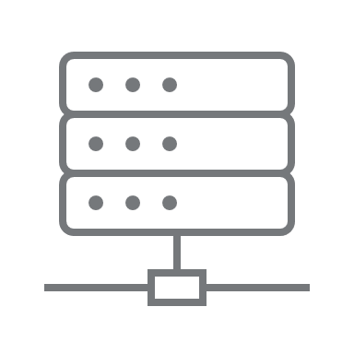


FBDI Approach – Data Flow
Conversion Approach
Conversion Tools
Reconciliation & Validation
Testing Cycles
Responsibility Matrix
Entities in Scope
** OIC and ATP is leveraged when there are complex transformations that would be handled in Oracle ERP cloud
Load Process
Oracle ERP Cloud
2
3
Upload Data File
Download the data file
Upload file to UCM
EBS
SFTP Server
Load Data Files
Universal Content Management Server (UCM)
SFTP - Download File
1
Perform Transformation/
validations
Load Interface File
Submit ESS Job
Informatica
Data Files
Interface Table
Import Process
Non-EBS Systems
Create Oracle
file (s)/zip
Submit ESS Job
Base Table
Automated Load Process
1
3
Generate data file based on extraction logic, handle source transformation
and place in landing zone.
GoAnywhere SFTP Location is secured with access limited to required personnel
from boundary system and Deloitte
UCM is secured through user roles and
privileges which will restrict access to
unauthorized roles
Reconciliation reports are generated here
OIC
ATP
2
Download the data file, transform if applicable and then generate FBDI format, Load to UCM and trigger ESS job
Notes:
1) Pull the files from sftp server, load to UCM server and load to Oracle application.
2) Reconciliation should be case by case basis to holistically close this task since source systems can be different and how target takes the data.
3) Documented for failures: RCA and how to mitigate in next run.

Slide 10
SFDC to Oracle Data Flow
Conversion Approach
Conversion Tools
Reconciliation & Validation
Testing Cycles
Responsibility Matrix
Entities in Scope
OIC Middleware
Oracle ERP Cloud
2
3
Upload Data File
Extract the
data
Upload file to UCM
1
Universal Content Management Server (UCM)
Invoke Bulk API
Perform Transformation/
validations
Load Interface File
Submit ESS Job
SFDC
SalesForce Adapter
Interface Table
Import Process
Create Oracle
file (s)/zip
Submit ESS Job
1
SFDC exposes bulk APIs to be triggered by the middleware to extract relevant data.
OIC has inbuilt SalesForce adapters to connect to SFDC and extract the source data.
Base Table
2
3
OIC Middleware invokes the bulk API, extracts the data, applies transformation and validation rules and pushes into Oracle ERP cloud
UCM is secured through user roles and
privileges which will restrict access to
unauthorized roles
Reconciliation reports are generated here
Notes:
1) Pull the files from sftp server, load to UCM server and load to Oracle application.
2) Reconciliation should be case by case basis to holistically close this task since source systems can be different and how target takes the data.
3) Documented for failures: RCA and how to mitigate in next run.

Slide 11
Conversion Approach
Conversion Tools
Reconciliation & Validation
Testing Cycles
Responsibility Matrix
Entities in Scope
FBDI Approach - Activities
Functional Lead
Adhere to business rules signed off as part of design
Create User Stories and Acceptance Criteria pertaining to XYZ
After conversion validate the data in cloud, perform reconciliation and provide sign off
Middleware Team
Extract and transform(as needed) the data
Create data files in predefined templates and place in SFTP server
Deloitte Team
Download files from SFTP server
Upload to UCM server and load to Oracle Cloud ERP application
Generate Reconciliation reports

Slide 12
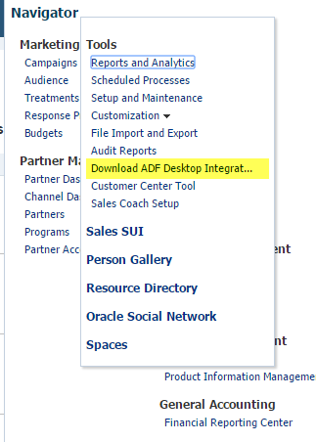
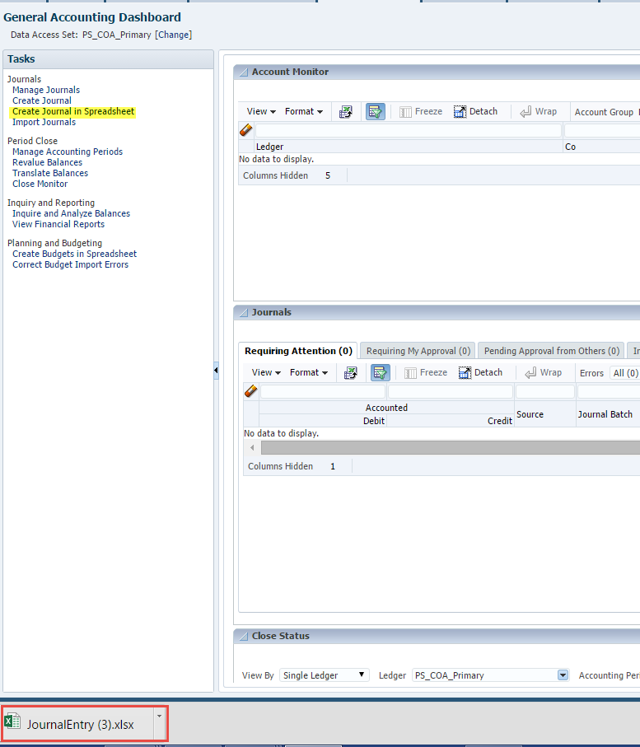
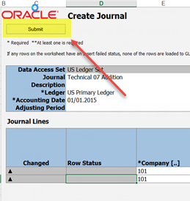
Conversion Approach
Conversion Tools
Reconciliation & Validation
Testing Cycles
Responsibility Matrix
Migration – Using ADFDI
In cloud, Oracle provides ADF based templates to migrate/integrate small volumes of data, which has been plugged into the template, directly into the application.
Install ADFDI Installer
Download Template
Populate Data
Upload the Data
Download Template
Populate Data
Upload the Data
Download ADFdi Installer software from application and install on local desktops.
Templates can be downloaded from application.These are used to upload / download data and correct the errors.
Template performs data validations during data entry and displays error messages.
Spreadsheet provides different options to choose and submit the processes to upload the data into applications.

Slide 13
Conversion Approach
Conversion Tools
Reconciliation & Validation
Testing Cycles
Responsibility Matrix
Entities in Scope
Migration – Using Standard Import Method
The following flow diagram outlines the manual steps involved in the process:
Evaluate Your Import Object Data
Login to Cloud Application
Identify the relevant Import Objects
Map Your Data to the Import Objects
Create and Submit an Import Activity
Verify the Import Results
Download and Review the Log files

Slide 14
Reconciliation and Validation Process
Conversion Approach
Conversion Tools
Reconciliation & Validation
Testing Cycles
Responsibility Matrix
Entities in Scope
Reconciliation provides comparison between the total number/value of records received from source system and the total number/value of records successfully imported in the Oracle Cloud
Validation provides comparison between the data in Oracle Cloud and source system to ensure that the data is accurate
Reconciliation
Validation
Reconciliation
Validation
Record counts on converted data
Summary of converted data
Count of rows in data file
Count of rows having validation error/s
Count of rows successfully converted
List of different errors encountered with counts
Control totals on converted data
Post conversion Oracle recon report to have control totals that is to be used for reconciliation against source values such as amounts, balances and complete validation.
Key Values Checking
Steps involved in this validation are:
Identify a sample data set to be used for this testing
Verify all the fields values for correctness
Create downstream transactions using the sample data.
Business Data Validation
Steps involved in this validation are:
All data fields identified for conversion are correctly loaded into the Cloud
Meeting all business requirements which are outlined in design documents
All associated business processes should be tested and validated using converted data.

Slide 15
Reconciliation
Conversion Approach
Conversion Tools
Reconciliation & Validation
Testing Cycles
Responsibility Matrix
Entities in Scope
Source file Reconciliation
Summary report on control totals of records present in source file
Control total of records loaded
Percentage of data loaded.
Reconciliation Reports
Report on imported data
Report output will be compared against source file
Data Validation
Random check on Oracle Cloud for converted data elements
Execute reports to check the data converted
1
2
3
Metric | Description | Example
Quantitative Analysis | Describes verification of data in a quantifiable numeric | Total value of invoices in data extract is equal to total value of migrated invoices to Oracle Cloud Row counts between the cleansed data file provided and the rows migrated to Oracle Cloud
Qualitative Analysis | Describes verification of data in qualitative terms w.r.t accuracy and data integrity | All the fields on the Invoice, including the Descriptive Flex Fields, are populated correctly in Oracle Cloud. Data migrated as per the business rules listed in individual functional specification.

Slide 16
Reconciliation – Detailed Approach
Conversion Approach
Conversion Tools
Reconciliation & Validation
Testing Cycles
Responsibility Matrix
Entities in Scope
Recon Approach | Approach Type | Description | Example
Count and Amount Match | Quantitative | Counts and Amounts for the data loaded against the counts and amounts for the data available in the base tables | Customer numbers, Supplier number, GL Balances etc.
Summarized Data | Quantitative | Summarize data by logical groups and perform count and amount matches at these groups. Mostly applicable where data volume is huge and Excel operations like Pivot etc. are not possible | Fixed Asset data grouped by Asset Category
Random Checks | Qualitative | Perform random checks on different sets of data to ensure everything looks fine as expected | Customers, Suppliers etc.
Manual Excel Reconciliation | Quantitative | Perform manual Excel reconciliation by taking both the source data and the data from Oracle base tables into an excel and reconcile manually. This is possible when the data set is low in volume | Payables invoices, Receivables Invoices, Banks etc.
Shakedown Testing | Qualitative | Perform shakedown testing by entering transactions in the system which uses converted data | AP invoice to use Supplier Data, AR invoice to use Customer Data
Accounting Reconciliation | Qualitative | Perform the accounting reconciliation to ensure that the balances match between the subledger and GL for both EBS and Cloud | Payables invoices – Drill Down from GL to AP
*Note: More than one approach can be applied to one conversion. e.g., AP Invoice conversion can use Count and Amount match, Random Checks, Manual excel reconciliation and Qualitative Reconciliation approaches

Slide 17
Data Conversion Testing Cycles
Conversion Approach
Conversion Tools
Reconciliation & Validation
Testing Cycles
Responsibility Matrix
Entities in Scope
Cycle | Conversion Test Cycle | Purpose
MC1 | Conversion Cycle 1 | This first mock conversion cycle validates the data mapping, sequence of extracts and execution of conversion routines.
MC2 | Conversion Cycle 2 | To validate configurations correctness in converted data which can be used for running the business processes including any interfaces with boundary applications. Familiarize Data Owners with the reconciliation process
MC3 | Conversion Cycle 3 | Like MC2 with remediation of issues identified in previous cycles. Validation of functional scenarios operate successfully with converted master data and transactional data. Validation of reporting scenarios operates with a combination of new and converted transactional data.
MC4 | Conversion Cycle 4 | A full, 100% end-to-end conversion will be carried out and fully reconciled and final sign off by identified Data Owners.

Slide 18
Data Conversion Cycles Timeline (Proposed)
Conversion Approach
Conversion Tools
Reconciliation & Validation
Testing Cycles
Responsibility Matrix
Entities in Scope
Phase | Data Conversion Cycles | Cycle Start Dates | Proposed End Dates
1A | MC 1 | 13-Feb-2023 | 17-Feb-2023
1A | MC 2 | 27-Feb-2023 | 03-Mar-2023
1A | MC 3 / INT | 13-Mar-2023 | 17-Mar-2023
1A | MC 4 / UAT | 17-Apr-2023 | 21-Apr-2023
1A | Dress Rehearsal | 12-Jun-2023 | 16-Jun-2023
1B | MC 1 | 29-May-2023 | 16-Jun-2023
1B | MC 2 / INT1 | 17-Jul-2023 | 28-Jul-2023
1B | MC 3 / INT3 | 25-Sep-2023 | 6-Oct-2023
1B | UAT MDM | 11-Sep-2023 | 15-Sep-2023
1B | MC 4 / UAT | 06-Nov-2023 | 17-Nov-2023
2 | MC 1 | 19-Feb-2024 | 01-Mar-2024
2 | MC 2 / INT1 | 22-Apr-2024 | 03-May-2024
2 | MC 3 / INT2 | 03-Jun-2024 | 14-Jun-2024
2 | MC 4 / UAT | 08-Jul-2024 | 19-Jul-2024
** The proposed cycles dates are planned based on the instance/Pod's availability driven by the instance strategy. Subjective to change may or may not post workshop discussion.

Slide 19
Conversion Approach
Conversion Tools
Reconciliation & Validation
Testing Cycles
Responsibility Matrix
Entities in Scope
Mock Entry/ Exit Criteria
Entry Criteria
All conversion Scenarios are documented, and Conversion Approach is approved.
Required Oracle SaaS Instance is available for data conversion
All Mock configurations are complete in respective environment, as documented
Quality check to be performed on the data extracts and required data transfer folders/tools are in place to stage/load the data.
Sanity check needs to be performed to ensure all connectivity and readiness for conversion.
Validation of Data file needs to be performed before loading into the instance
Transformed data files needs to be approved before load initiation.
Exit Criteria
Final data load extracts, data validation results and reconciliation reports needs to be recorded and placed on secured directory.
Agreed upon percentage of conversion throughput defined must be met
All execution parameters(e.g., record count, execution time etc.,) needs to be recorded in a playbook.
Business team review the data reconciliation workbook and confirm both quantitative and qualitative analysis are performed. All Recon reports have been verified for format, usability and accuracy by Business and IT team
All issues/defects should be marked with root cause, assigned to the correct team and responsible individual should be logged in conversion log.
Any critical issue that can block succeeding test cycle should be resolved or have a workaround identified. Remediation plan documented for all conversion issues.
Business Sign off needs to be provided for all entities to exit the cycle.
**Mock is an iterative process to refine the data conversion process (extract, transformation, load, remediation, reconciliation) and Mock 1 is the first time Manual / extracts will be loaded in an configured pod.

Slide 20
Conversion Approach
Conversion Tools
Reconciliation & Validation
Testing Cycles
Responsibility Matrix
Entities in Scope
Exit Criteria – Target Load Percentage
Phase | Conversion Cycles | Mapping % | Extraction % | Cleansing % | Transformation % | Load % | Target Load %
1A | Mock 1 | 100 | 30 | 30 | 30 | 30 | 30
1A | Mock 2 | 100 | 50 | 50 | 50 | 50 | 50
1A | Mock 3 / INT | 100 | 80 | 80 | 80 | 80 | 80
1A | Mock 4 + UAT | 100 | 100 | 100 | 100 | 100 | 100
1A | Prod Cutover | 100 | 100 | 100 | 100 | 100 | 100
1B | Mock 1 | 100 | 50 | 50 | 50 | 50 | 50
1B | Mock 2 / INT 1 | 100 | 60 | 60 | 60 | 60 | 60
1B | Mock 3 / INT 3 | 100 | 80 | 80 | 80 | 80 | 80
1B | Mock 4 / UAT | 100 | 100 | 100 | 100 | 100 | 100
1B | Prod Cutover | 100 | 100 | 100 | 100 | 100 | 100
2 | Mock 1 | 100 | 50 | 50 | 50 | 50 | 50
2 | Mock 2 / INT 1 | 100 | 60 | 60 | 60 | 60 | 60
2 | Mock 3 / INT 2 | 100 | 80 | 80 | 80 | 80 | 80
2 | Mock 4 / UAT | 100 | 100 | 100 | 100 | 100 | 100
2 | Prod Cutover | 100 | 100 | 100 | 100 | 100 | 100
* The throughput numbers highlighted above are only indicative and there might be run time fallouts which needs to corrected and reloaded after discussing with Deloitte/ teams
* Any incorrect/missed configuration that restricts valid data to be uploaded should be resolved before exiting the conversion cycle for a specific entity
e.g., 1) Payment term setup missing for Invoice entity
2) Incorrect value in specific column of a template
e.g., Assignment Status Type Code in Employee entity should be 'INACTIVE_PROCESS' and not 'INACTIVE PROCESS'

Slide 21
Activities and Roles​
Conversion Approach
Conversion Tools
Reconciliation & Validation
Testing Cycles
Responsibility Matrix
Entities in Scope
This Responsible, Approver, Consulted, and Informed (RACI) matrix is built specific to the steps involved in building the Integrations identified as part of implementation project.
Tasks | Description | Deloitte IT Team | Deloitte Functional Team | IT Team | Business
Provide FBDI templates | Provide Predefined template from Oracle Enterprise Repository | C | R | I | I
Develop lean specs | Provide extraction criteria for each Conversion entities in scope. | I | R | I | A
Legacy to Target Data Mapping | Data mapping between legacy and Oracle Cloud to be performed | I | R | C | A
Data extracts from source | Define business rules for data extraction | I | I | R | A
Data cleansing at source | Define criteria for pre-extract clean up, post extract clean up, pre conversion cleanup and post conversion acceptance. Transform the data where applicable at Source(Legacy) System | I | I | R | A
Data transformation | Transform the data based on requirements called out in the design | R | C,A | I | I
Data validation before load (Only for Mock cycles) | Based on the conversion object different load validations will occur in Oracle which have to be handled before the load. For e.g., GL Journal amount balancing of credit and debit amounts. | C | R | I | I
Data import into ERP Cloud | Import data extract available in predefined templates into Oracle Cloud | R | C,A | I | I
Build reports for data reconciliation | Generate reconciliation metrics reports | R | A | I | I
Analyze fall outs and reconciliation | Analyze exceptions, resolve system/data errors and perform reconciliation | I | R | R | R
Perform Delta load | Post error correction re-load the data | R | C,A | I | I
Provide Sign-offs for Data Conversion | Provide sign-off for conversion data extracts and reconciliation reports | I | I | C | A

Slide 22
Data Conversion Scope
Conversion Approach
Conversion Tools
Reconciliation & Validation
Testing Cycles
Responsibility Matrix
Entities in Scope
S.No | Phase | Track | Entity | Source | Type | Target | Volume*
1 | 1A | General Ledger | Oracle GL Balances Conversion | EBS GL | Transactional | Oracle Cloud | 37,199
2 | 1A | HCM | Location | Trident, Workday | Master | Oracle Cloud | 44
3 | 1A | HCM | Employee & Contractors | Workday, Fieldglass | Master | Oracle Cloud | 7,055
4 | 1B | Oracle Receivables | Customers | EBS Customers | Master | Oracle Cloud | Bill to customer - 660 & ship to customer - approx. 6,000
5 | 1B | Product Data Hub | Products | EBS (Items), SFDC (SKUs) | Master | Oracle Cloud
6 | 1B | Product Data Hub | Bill of Material | EBS (Items), SFDC (SKUs) | Master | Oracle Cloud
7 | 1B | Oracle Order Management | Open Orders | WOT (SW), EBS OM | Transactional | Oracle Cloud | 2000
8 | 1B | Oracle Cash Management | Banks, Branches and Bank Accounts | EBS Cash Management | Master | Oracle Cloud | 36 banks & 78 branches
9 | 1B | Oracle Receivables | Open Receivables Transactions | EBS AR | Transactional | Oracle Cloud | 3,083
10 | 1B | Oracle Receivables | Unapplied Receipts | EBS AR | Transactional | Oracle Cloud | N/A
11 | 1B | Oracle Install Base | Install Base | EBS IB, SNOW, SFDC | Transactional | Oracle Cloud | No of active item instance in EBS
12 | 1B | Subscription Management | Subscription Details | EBS Service Contracts, SFDC | Transactional | Oracle Cloud | No of active service contacts in EBS
13 | 1B | Revenue Management (RMCS) | Revenue Contract Conversion | Workday | Transactional | Oracle Cloud
14 | 2 | Procurement | Suppliers | EBS AP, Lock path | Master | Oracle Cloud | 7,533 suppliers (Each Supplier has 2sites and 2 contacts )
15 | 2 | Expense | Credit Card Conversion | Workday | Transactional | Oracle Cloud
Volume: Numbers are based on what was provided by XYZ team in Oct 2022. Actuals will be weighed again during the design discussions
Oracle brings about enhancements on conversion tools. This is the current proposal and will be re-evaluated during the deliver phase
This is interim list of conversions and final list will be refined as an outcome of the workshop and deep dive sessions

Slide 23
Data Conversion Scope(Contd..)
Conversion Approach
Conversion Tools
Reconciliation & Validation
Testing Cycles
Responsibility Matrix
Entities in Scope
S.No | Phase | Track | Entity | Source | Type | Target | Volume
16 | 2 | Fixed Assets | Fixed Assets | EBS FA | Transactional | Oracle Cloud | 29,076
17 | 2 | Procurement | Contracts | EBS PO | Transactional | Oracle Cloud
18 | 2 | Procurement | Open PO’s | EBS PO | Transactional | Oracle Cloud | Year 2021 - 14,919 & Year 2022 to date - 4,899
19 | 2 | Oracle Accounts Payables | Open Invoices | EBS AP | Transactional | Oracle Cloud | Approx. 79K
20 | 2 | Oracle Account Payables | AP Invoice Attachments | EBS AP | Transactional | Oracle Cloud
21 | 2 | Oracle Account Payables | AP prepayments | EBS AP | Transactional | Oracle Cloud
22 | 2 | Projects | Project | Financial Force | Transactional | Oracle Cloud | Total - 6,433 & Open - 3,497
23 | 2 | Projects | Project Tasks | Financial Force | Transactional | Oracle Cloud | Total - 6,433 & Open - 3,497
24 | 2 | Projects | Bill & Cost Rate Schedules | Financial Force | Master/ Transactional | Oracle Cloud
25 | 2 | Project Revenue and Billing | Contracts | Financial Force | Transactional | Oracle Cloud | Year 2021 - 2,579 & Year 2021 - 788 to date May 2022
Volume: Numbers are based on what was provided by XYZ team in Oct 2022. Actuals will be weighed again during the design discussions
Oracle brings about enhancements on conversion tools. This is the current proposal and will be re-evaluated during the deliver phase
This is interim list of conversions and final list will be refined as an outcome of the workshop and deep dive sessions
* Volume: As shared by TD team

Slide 24
Wrap Up
Topic | Duration
Introduction | 10 min
Terminology | 5 min
Data Conversion Objective and Principles | 10 min
Data Conversion Approach | 20 min
Data Conversion Tools | 20 min
Reconciliation and Validation Process | 10 min
Testing Cycles | 20 min
Roles and Responsibilities | 10 min
List of In-Scope Conversions | 10 min
Objectives & Outputs
Conversion Capabilities
Finalize Conversion Approach
Finalize Roles and Responsibilities
Key Design Decisions & Change Impacts
Parking Lot items

Slide 25
Parking Lot / Follow Up Discussion Items
Date Identified: |  | Global Design Session Title: |  | Conversion Strategy
Parking Lot Item Description |  | Owner | Teradata POC |  | Estimated Date for Follow Up | Workstreams Impacted
 |  | Name Of XYZ To Follow Up With | Name of Deloitte Assignee

Slide 26
List of Reference Documents
Appendix Items | Reference Documents
FBDI Template Sample | JournalImportTemplate.xlsm
Detailed Information on Standard Import Approach | Standard Import Process.pdf

Slide 27
Reconciliation Report – Business Validation
Summary:
Each conversion entity to include custom/seeded reconciliation reports to support business validation
This file must be shared with the XYZ team and to be mutually agreed upon on the formats between XYZ and Deloitte team.
Supplier Reconciliation Report
Supplier Details
No of records that failed Import | No of records that was successfully imported | Total No Of Records
2 | 1 | 1
Supplier Sites Details
No of records that failed Import | No of records that was successfully imported | Total No Of Records
2 | 1 | 1
ILLUSTRATIVE ONLY
Supplier:
Supplier Details
Vendor | Vendor Type | ORG Type | Import Action | Status | Error
XXXX |  | XX_ORG_TYPE | CREATE | PROCESSED
YYYY |  | YY_ORG_TYPE | CREATE | REJECTED | Reason for failure to come here
Supplier Site:
Supplier Site Details
Supplier Name | Procurement BU | Supplier Site | Import Action | Status | Error
XXXX |  |  | CREATE | PROCESSED
YYYY |  |  | CREATE | REJECTED | Reason for failure to come here

Slide 28
PII Data and Data Masking
All conversion data will be secured to ensure that there is no personal (PII) information is exposed
Following fields will undergo data masking at source (legacy system) during extraction. Exceptions will be discussed with XYZ before starting a conversion cycle: For e.g., TIN, SSN, Salary, Date of Birth, Address Line 1, Bank Account numbers, Email Address etc.
Which
Notes on PII data: (1) Person Number alone does not define PII data. It needs to be accompanied with Person Name to be PII data (2) Person Name is PII data as a stand-alone value (3) SSN as a standalone field is PII data (4) Salary alone does not define PII data. It must be accompanied with person number or name to be PII data
Important
Note
Following is the data exchange mechanism to be followed in order to maintain confidentiality of PII data: (1) All conversion data files to be exchanged via SFTP server (2) Deloitte to access data files within Virtual Machines (3) No files to be transferred or moved to Deloitte laptops (4) Error Reports and data validation reports to be password protected and exchanged via MS Teams or SFTP server
Guidelines
Data masking to be applied at source during data extraction for all testing cycles except UAT. Exceptions will be discussed with XYZ.
Expect to have security roles in place during UAT to ensure data confidentiality is maintained.

Slide 29
Data Scrambling – Employee Details
Data Entity | Recommended Scrambling Rule
First Name, Last Name | N/A
Date of Birth | First day of the year of birth (E.g., If DOB is 07/05/1980, scrambled value will be 01/01/1980)
Place of Birth, Date of Death | N/A
Gender, Marital Status, Ethnicity | N/A
Social Security Number | Auto-number generation to match country specific format
Driving License Number | N/A
Passport Number | N/A
Visa and Work Permit | N/A
Bank Account Number | Random Digits
Salary | Fixed Number (E.g., All Records 50,000)
Address Line 1, Address Line 2 | Fixed String for Addresses Lines 1 & 2
County, City, Zip Code | N/A
Phone Number | Auto-number generation to match country specific format
Email Address | Suffix with _X in all cycles except Cutover

