Slide 1
Agenda
Topic | Duration
Workshop Objective – Workshop Expectations Rules of the Road Terminology | 5 min
Integration Approach – Integration Patterns Inbound Integrations Deep Dive Outbound Integrations Deep Dive Technology Common Framework Reprocessing Mechanism Integration Best Practices | 30 min
Integration Security | 10 min
Responsibility Matrix | 10 min
Objectives & Outputs
Understanding Integration Patterns
Understanding Integration Approach
Understanding Integration Best Practices
Understanding integration security and responsibilities
Parking Lot items

Slide 2
Workshop Expectations
Discuss Integration Approaches
Review Best Practices
Review Integration Security & Error Handling
Key Activities:
Review Integration Patterns
Deep dive in Integration approaches available for Inbound and Outbound Integration
Key Activities:
Review Best Practices for Integrations
Understand boundary system dependencies
Key Activities:
Cover security considerations
Review Error Handling & Notification capabilities
Notes:
Overall, the objective here is to list the integration options that are available to fit the scope of Inbound and Outbound interfaces involving Oracle Cloud and the boundary applications, as part of the Optimus Prime Implementation.

Slide 3

Global Design Workshop - Rules of the Road
Workshop Materials
1
Clear Objectives and Outcome
All Global Design Decks will be uploaded to Teams 24hrs prior to the workshop for the attendees.
After workshops have concluded, the recordings and meeting minutes will be uploaded to correct session folder.
2
Deloitte Leads will include a slide that outlines a clear and concise objective for the session.
Additionally, a section on the actual outcomes of the session will be provided.
Clearly lay out to attendees what we are asking from you.
Scribes
4
Scribes will be ready and available to take notes for the workshop.
Will monitor the chat for any questions/comments.
Present captured items at the end of every session.
Invitations for Audience
3
Deloitte Leads will provide more detailed Agendas for the audience on the invites.
Deloitte Leads will indicate whether the session is a deep dive.
Based off agenda, Technology Leads will identify the required personnel for the meeting.
Notes:
Tags: customer, journey, person, circle, arrow

Slide 4
Terminology
Term | Meaning
Boundary Systems | Third party applications interfacing with Oracle Cloud ERP. E.g., Salesforce
Middleware | An integration platform that helps connect Oracle cloud ERP to boundary systems. OIC/IICS will be referenced as Middleware for the context of this project.
ESS Jobs | Oracle Enterprise Scheduler Service, provides the ability to manage the complete life cycle of a scheduled process including development, distribution, scheduling and monitoring
DFF | Descriptive Flex Fields - It is a flexible data field that can be customized to meet business needs without programming
UCM Server | Oracle Universal Content Management- it is WebCenter content server and is a preferred method for file-based loads.
Webservices (REST / SOAP) | API that can be remotely invoked using HTTP/HTTPS requests. It also allows for exposing the business functionality to the calling environment.
FBDI | FBDI (File Based Data Import) It is an excel based utility used to import large volumes of data into Oracle Cloud ERP from external applications.
Inbound Integrations | These interfaces are used to transfer data from third party or boundary applications into Oracle Cloud.
Outbound Integrations | These interfaces are used to transfer data from Oracle Cloud to third party or boundary applications.
Batch Processing | Batch data processing is an efficient way of processing high volumes of data where a group of transactions is imported or exported at one time
PGP Encryption | Pretty Good Privacy (PGP) is an encryption system used for encrypting sensitive files.
ATP Database | Autonomous Transaction Processing Database is a fully autonomous database and requires no database administration. It comes at additional cost. Can be scaled as per usage.

Slide 5
Integration Patterns
Integration Approach
Integration Security
Responsibility Matrix
Inbound integrations : Batch Processing (File Based) and Web services/APIs
Outbound Integrations: File Based, Web Services/APIs
File Based Data Load (FBDI)
Webservices
/APIs
Inbound Integration
Outbound Integration
BI Publisher
Report
Webservices
/APIs
Notes:
Integration is a key aspect in any Cloud implementation. The integration use cases can be presented in many forms such as integrating Cloud applications and on-premise applications in real-time or getting a data into an application from a file generated by a data-source or it can expose APIs to an application which does not expose web-services natively.
Inbound to Oracle Cloud will contain all the patterns where in Oracle Cloud will be the target system and will be accepting data from the source systems.
Outbound from Oracle Cloud will contain all the patterns where in Oracle Cloud will be the source system and will be sending the data to the target systems.
All Web services are APIs, but all APIs are not web services. Web service is a collection of open source protocols and standards used for exchanging data between systems or applications, whereas API is a software interface that allows two applications to interact with each other without any user involvement.
Web service is used for REST, SOAP, and XML-RPC for communication, while API is used for any style of communication.
FBDI:
- FBDI is faster because it's executed from inside the Oracle Cloud Server and can-do Bulk Updates/Inserts. Use FBDI when updating data in bulk
Drawback - CSVs can ruin number and date formatting.
Drawback - numerous Fields and Worksheets in the Spreadsheet need to be populated and need to make sure that data Preparation is accurate
Webservices:
- Consider using Web Services when you have small amounts of data to Update as WebServices
Would entail less data preparation compared to FBDI as you would only need to provide the mandatory tags, unlike in FBDI wherein you have to populate multiple worksheets
Note on Multithreaded Processing:
When optimizing the data import, you identify the number of records to be included in your input data file as well as
the number of concurrent import activities that can be activated. Running import activities serially or running too many import
activities concurrently can lower your throughput. Finding the right values for these two parameters is a key aspect
of designing your import process. There's no right answer for every situation. Every data set is different; you need to
repeat this process for any new data import operations that you plan to perform.
Don't import more than 100,000 records in a single import operation or perform more than five concurrent
import activities.

Slide 6
Selection Matrix (OIC) - Inbound Integrations
Integration Approach
Integration Security
Responsibility Matrix
Approach | Batch Processing | Web Services
Data Volume | Medium to High | Low
Recommended volume ranges | Less than 100K records Use Multiple threads | Less than 100 records
Real Time | No | Yes
Batch | Yes | No
Performance | High (for larger volume) | High (for smaller volume)
Multithreaded processing | Yes | No
DFF Support | Yes | Partial
Implementation Complexity | Simple | High
Examples | General Ledger | PO Creation
Complex Parent-Child structure | Yes | No
Technical Expertise Required | Moderate | High
Notes:
FBDI:
- FBDI is faster because it's executed from inside the Oracle Cloud Server and can-do Bulk Updates/Inserts. Use FBDI when updating data in bulk
Drawback - CSVs can ruin number and date formatting.
Drawback - numerous Fields and Worksheets in the Spreadsheet need to be populated and need to make sure that data Preparation is accurate
Webservices:
- Consider using Web Services when you have small amounts of data to Update as WebServices
Would entail less data preparation compared to FBDI as you would only need to provide the mandatory tags, unlike in FBDI wherein you have to populate multiple worksheets
Note on Multithreaded Processing:
When optimizing the data import, you identify the number of records to be included in your input data file as well as
the number of concurrent import activities that can be activated. Running import activities serially or running too many import
activities concurrently can lower your throughput. Finding the right values for these two parameters is a key aspect
of designing your import process. There's no right answer for every situation. Every data set is different; you need to
repeat this process for any new data import operations that you plan to perform.
Don't import more than 100,000 records in a single import operation or perform more than five concurrent
import activities.

Slide 7
Selection Matrix (OIC) - Outbound Integrations
Integration Approach
Integration Security
Responsibility Matrix
Approach | Business Intelligence Report | Web Services
Data Volume | High | Low
Recommended volume ranges | Less than 100K records Data file cannot exceed 4GB | Less than 100 records
Real Time | No | Yes
Batch | Yes | No
Performance | High (for larger volume) | High (for smaller volume)
Multithreaded processing | Yes | No
DFF Support | Yes | Partial
Implementation Complexity | Simple | High
Middleware needed | No | Yes
Examples | General Ledger, Employee, AR etc. | Employee, Employee Assignment etc.
Complex Parent-Child structure | Yes | No
Additional Effort at Boundary system | No | Yes

Slide 8
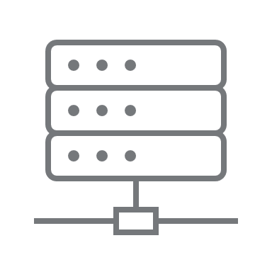
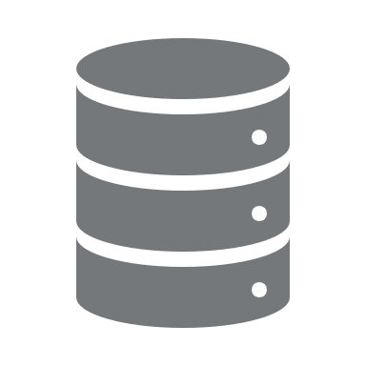
Inbound File Based Integration – FBDI With OIC
Integration Approach
Integration Security
Responsibility Matrix
Oracle Integration Cloud and ATP Database form the primary building blocks for building integrations into and out of Oracle Cloud
GoAnywhere SFTP
Oracle Integration Cloud
Oracle ERP Cloud
Orchestration
2
Oracle ERP
Cloud Adapter – Import Bulk Data
Trigger Scheduled Integration
Upload Data File
Universal Content Management Server (UCM)
Informatica
Source System
SFTP - Download File
Data Files
ERP Service - uploadFileToUCM
ERP Integration Service
Download the data file
Load Interface File for Import
1
ERP Service - submitESSJob
3
ERP Integration Service
ATP Database
Perform Chunking
Interface Table
Database -
Stored Procedure
ERP Service - submitESSJob
ERP Integration Service
Import Process
Informatica will
pull the file and placed in GoAnywhere SFTP
Perform mapping/
validations
Bulk transformations/ validations
Base Table
Callback Service triggered
Create Oracle
file (s)/zip
1
Generate data file based on extraction logic
and place in landing zone
Send Notification
3
Generate reconciliation reports
and define security rules
2
Poll for data file, transform to FBDI format,
Load to UCM and trigger ESS job
Notes:
Chunking - Integration Cloud does not allow loading files larger than 10MB for performance reasons. There may be cases where the source generated file may be too large, for example, 500 MB. Reading a large file in-memory is not a good approach, because it's possible to run out of memory. Oracle Integration has the ability to read the large source file in a series of chunks. This feature is called Stage Read. Prior to making use of Stage Read in the Oracle Integration flow, you should download the file locally to Oracle Integration where Oracle Integration can read the file in chunks, because chunk reading from an FTP Server is process and bandwidth expensive.

Slide 9

Inbound Integration Using Web Service - File Input With OIC
Integration Approach
Integration Security
Responsibility Matrix
Oracle Integration Cloud and ATP Database form the primary building blocks for building integrations into and out of Oracle Cloud
GoAnywhere SFTP
Oracle Integration Cloud
Oracle ERP Cloud
Orchestration
Informatica
2
3
Trigger Scheduled Integration
Webservice Call
Source System
Data Files
SFTP - Download File
Request
Response
ERP Service Catalog
Cloud Database
Download the data file
1
ATP Database
Perform Chunking
Informatica will
pull the file and placed in GoAnywhere SFTP
Send Notification
Database -
Stored Procedure
Perform mapping/
validations
Bulk transformations/ validations
3
Provide SOAP / REST webservice details,
Generate reconciliation reports
and define security rules
1
Generate data file based on extraction logic
and place in landing zone
2
Poll for data file, transform to webservice request,
And invoke oracle webservice
Notes:
Example - for File input Webservice - Creating AP Invoices - Oracle provides REST API

Slide 10
Inbound Integration Using SOAP/REST Web Service
Integration Approach
Integration Security
Responsibility Matrix
Source System
Oracle ERP Cloud
Various Authentication types supported for REST calls:
Basic Authentication (username and password)
OA Auth 2.0 (The API will grant access only when it receives a valid access token from the application)
1
Request
2
Response
ERP Service Catalog
Cloud Database
In-transit data secured by TLS 1.2
2
1
Source system invokes the SOAP/REST
Webservices with relevant parameters
Cloud ERP responds to the webservice call with appropriate data
Source System
Oracle ERP Cloud
Process
Create extraction logic and invoke web service
Pass authorization details (username & password) while invoking web service
Process response from Cloud to update the status of data extracted
Provide Web Service details to source system
Configure security for ESS job, Web Services and service account
Notes:
REST Webservices is majorly used but for modules where Rest service is not provided by Oracle, SOAP services are used.
Example of SOAP service: Fixed Assets, GL Journal, AP Invoice, Credit/Debit Memo

Slide 11
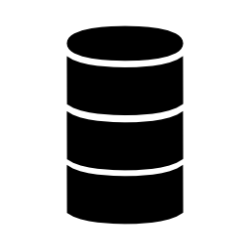
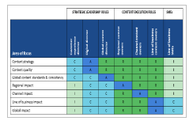
Integration Approach
Integration Security
Responsibility Matrix
Outbound File Based Integration – BI Publisher Extracts (Without Transformation)
Oracle ERP Cloud
UCM Cloud
1
2
Cloud Database
Bursting
Load Data
Process the Data File
Informatica
Data Files
Target System
BI Publisher Extracts
1
2
Enable port for SFTP server
Generate BI reports and ESS jobs
Define security rules
Target System to create import programs to load Data File from Target SFTP
Error handling

Slide 12
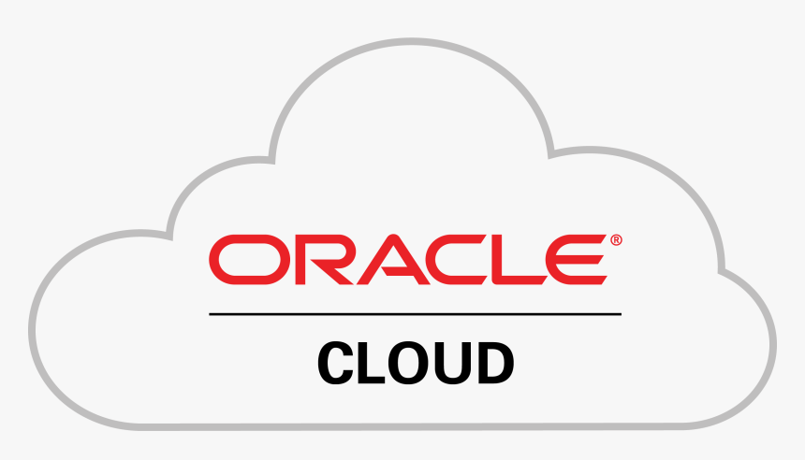

Integration Approach
Integration Security
Responsibility Matrix
Pub-Sub Integrations
ATP Database
PaaS
PLSQL APIs
OIC
Oracle ERP Cloud
Kafka Queue
Message received in OIC
Publish Message
Publish
Event
Publish Message to
kafka queue
Send the notification emails
Error Handling and Reporting
Note: Transactions from kafka queue will be picked up by Informatica and sent to other systems

Slide 13

Integration Using Salesforce Connector – Salesforce to Oracle ERP Cloud
Integration Approach
Integration Security
Responsibility Matrix
Salesforce
Oracle Integration Cloud
Oracle ERP Cloud
Orchestration
Request
Trigger Scheduled Integration
ERP Cloud Adapter
Response
Request
Salesforce Adapter
Response
ERP Service Catalog
Cloud Database
ATP Database
Database -
Stored Procedure
Send Notification
Perform mapping/
validations
Bulk transformations/ validations
Notes:
Example - for File input Webservice - Creating AP Invoices - Oracle provides REST API

Slide 14

Integration Using Informatica as Middleware – EBS to Oracle ERP
Integration Approach
Integration Security
Responsibility Matrix
Oracle EBS
GoAnywhere SFTP
Informatica
Oracle ERP Cloud
Orchestration
Load Data
Trigger Scheduled Integration
REST CALL - importBulkData
Data Files
Request
REST CALL
Response
ERP Service Catalog
Cloud Database
Read File from SFTP
ATP Database
Database -
Stored Procedure
Send Notification
Perform mapping/
validations
Bulk transformations/ validations
Notes:
Example - for File input Webservice - Creating AP Invoices - Oracle provides REST API

Slide 15
Technology Common Framework - Process Flow
Integration Approach
Integration Security
Responsibility Matrix
The framework ensures that an exception is gracefully addressed, and primary owners are notified about the issue in a non-intrusive manner. Logging, reporting and notification are the pillars of exception handling as they establish a consistent tracking paradigm to audit, troubleshoot and monitor
Common Notification Framework
Key Features
Common Notification Framework
Common Error Framework
Configurable- Configure interface design, monitor interface runs
Scalability - Scalable to send interface emails to different groups using simple configuration changes
SaaS Validation Failure - Notification sent when the entire interface file fails standard Oracle validations
Reconciliation - Error reports are generated for source data errors, custom validation errors and Cloud validation errors
Notifications- User friendly notifications in rich HTML format with all details related to interface run
Start
Interface Run
Error?
Capture Errors, Generate Recon Report with errors
Start
Yes
No
Notify User with Success Email
Notify User with Failure Email with Error Reports
Generate Cloud UCM Hyperlinks for error reports and logs
Error Type
Business/Data errors
PaaS technical error
PaaS/SaaS validation errors
Business users take corrective action and send correct data
Technical team to check exact PaaS Error
Process owners to take the corrective action and reprocess the required data
End
Interface Error Scenarios
Interface Error Scenarios
Success
Notification sent when the interface execution has completed successfully
Partial Success
Notification sent when a subset of interface data is imported successfully to Cloud while the rest fails in PaaS/SaaS
PaaS Validation Failure
Notification sent when the data in the interface fails PaaS validation logic
SaaS Validation Failure
Notification sent when the entire interface file fails standard Oracle validations
PaaS Server Error
Unexpected PaaS error due to server issues or inaccessible seeded web services
Notes:
Overall flow and introduction
Section-1
-- Notifications (Types of notifications PaaS Error, Success, Error, Partial Success)
-- Outbound notifications
-- Recon Report
Section-2 (Reprocessing)
-- PO
-- AP
-- PPR (No reprocessing)
-- GL
IT Controls
-- TO be decided

Slide 16
Sample Email Notification – Inbound Batch Error Reporting
Integration Approach
Integration Security
Responsibility Matrix
The interface with batch Id <Interface_MMDDYYYYHHMMSS> failed in execution.
Execution Details:
List of the ESS jobs submitted is follows:
Note: The base load import jobs spawn multiple child jobs. Status of these individual jobs can be checked by logging in to the Cloud ERP
Detailed Error Details:
Integration Stage | Status
Download data file from the file system | Success
Data file transformation and validation | Error
Generation of Zip file | Not applicable
Interface to Cloud ERP | Not applicable
Batch Report | Not applicable
Integration Stage | Status
Download data file from the file system | Success
Data file transformation and validation | Error
Error | Data file containing 0 valid records
Description | The input data file has 0 valid records. Log file may contain invalid records (if any). Source file path:<> File name:<> Integration instance can be viewed using the below URL. Instance ID <>
Disclaimer: This is just an illustration and will change as per actual design.

Slide 17
Sample Email Notification – Outbound Error Reporting
Integration Approach
Integration Security
Responsibility Matrix
The outbound interface file failed during SFTP transfer.
Possible Reason(s):
No file present in the staging location /stage/prod/…
SFTP transfer failed due to remote server timeout

Slide 18
Reprocessing mechanisms
Integration Approach
Integration Security
Responsibility Matrix
Retrigger the integration from OIC using same data file (in case of connectivity error)
Create a new data file with error records and retrigger the integration
Request source system to send the error records again in the next run
Import data from the user screen if applicable
Additional development and procurement of ATP DB will be required for:
Ability to reprocess previous runs error records in the next integration run automatically.
Ability to reprocess selective error records (With manual update to ATP DB tables)

Slide 19
Integration Best Practices
Integration Approach
Integration Security
Responsibility Matrix
Minimize point-to-point integrations and reduce solution complexity
Standardize exception handling, notification and reprocessing mechanism
Promote reusability by defining common services and subprocesses
Increase business agility by accommodating changes in boundary systems with minimal impact to the solution
Minimize points of failure
Standardize data models for master and transactional data entities
Provide end-to-end monitoring view of Integrations
Only provide third parties with access to data they require

Slide 20
Boundary System Dependencies
Integration Approach
Integration Security
Responsibility Matrix
It is recommended that each of the interconnected applications like Finance/SCM, EPM, Salesforce, EBS & other boundary systems always connect to a single instance of the boundary application and avoid connecting with more than one instance as it may lead to data integrity issues like duplicate transaction numbers etc. impacting testing
Refreshes between the instances of a particular application should also be in sync with the refreshes of the applications it connects. If refreshes are out of sync it may lead to data integrity issues like duplicate transaction numbers etc. impacting testing
All applications should be ready with the release specific changes before the INT/UAT test cycles begin. Unit testing should be completed to reduce the number of fallouts in INT/UAT testing. Any risks / challenges pertaining to build, or integration testing completion should be called out ahead of time.
Application downtimes should be communicated in advance to avoid a backlog of transactions upon the system being up

Slide 21
User Security
Integration Approach
Integration Security
Responsibility Matrix
User Security For Object Development
Individual user accounts will be created for developers to develop the interface
Required developer access will be provided to each user account
User Security For Object Execution/Scheduling
Integrations will be orchestrated securely as the connections will be created using Service Accounts and they will be created with minimal number of roles that are needed to execute integrations
Individual Users Accounts will have appropriate role access to monitor the integrations. Admin Team will have access to Service Accounts for additional debugging (if required)

Slide 22
Data Security in Integrations
Integration Approach
Integration Security
Responsibility Matrix
Data Security | Program Security
Data Masking PII/CI data will be masked in development and test instances during refreshes. File Security Data files would be stored in a secured location on system only accessible to authorized resources from Deloitte and XYZ. Encryption Wherever applicable PGP encryption will be used to encrypt the data files. Cloud Universal Content Management Security Oracle UCM for XYZ is secured through user roles and privileges which will restrict access to unauthorized users. | Secured Web Services and Integrations The Oracle Integration Cloud instance will have connections which are secured with credentials. Web Services exposed from network will have security policies attached to them and are secured by roles and privileges resulting in secured integrations with on premise and third-party systems. Security during Transmission In-transit data is kept secure using Transport Layer Security (TLS) 1.2 or later

Slide 23
Integration Security in Inbound Flow
Integration Approach
Integration Security
Responsibility Matrix
GoAnywhere SFTP
Oracle Integration Cloud
Oracle ERP Cloud
2
Orchestration
4
1
3
Oracle ERP
Cloud Adapter – Import Bulk Data
Trigger Scheduled Integration
Upload Data File
Universal Content Management Server (UCM)
Load Data
SFTP - Download File
Source System
Data Files
ERP Service - uploadFileToUCM
ERP Integration Service
Download the data file
Load Interface File for Import
ERP Service - submitESSJob
ERP Integration Service
ATP Database
Perform Chunking
Interface Table
Database -
Stored Procedure
ERP Service - submitESSJob
ERP Integration Service
Import Process
Perform mapping/
validations
Bulk transformations/ validations
Base Table
Callback Service triggered
Create Oracle
file (s)/zip
1
Secured SFTP Location with access limited to required personnel
from boundary system and Deloitte
Send Notification
4
UCM is secured through user roles and
privileges which will restrict access to
unauthorized roles
2
Sensitive files such Bank Statements can be encrypted using
PGP encryption at source. PGP encrypted file can be shared with Oracle Cloud.
In OIC, file will be decrypted with the private key
3
Accessing ERP Cloud Adapter / any other adapter /
REST services would require credentials. There are various
authentication methods for REST APIs, ranging from basic credentials
and token encryption to complex, multilayered access control and
permissions validation
Notes:
Chunking - Integration Cloud does not allow loading files larger than 10MB for performance reasons. There may be cases where the source generated file may be too large, for example, 500 MB. Reading a large file in-memory is not a good approach, because it's possible to run out of memory. Oracle Integration has the ability to read the large source file in a series of chunks. This feature is called Stage Read. Prior to making use of Stage Read in the Oracle Integration flow, you should download the file locally to Oracle Integration where Oracle Integration can read the file in chunks, because chunk reading from an FTP Server is process and bandwidth expensive.

Slide 24
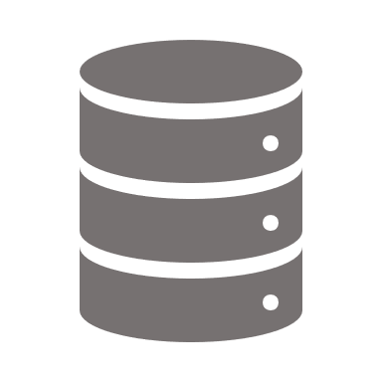




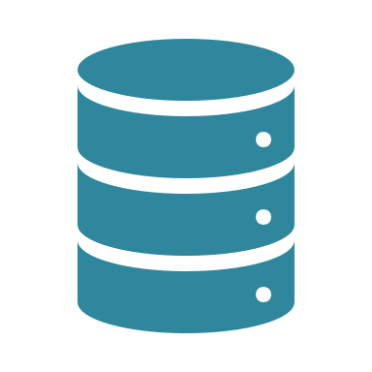
Data Security – File based Inbound Integration
Integration Approach
Integration Security
Responsibility Matrix
Source System
GoAnywhere SFTP
Oracle Integration Cloud
Oracle Cloud Applications
OIC Stage
Trigger import jobs
SFTP
Encrypted File
SaaS Adaptor
Public Key
Encrypted Data Files
Decrypt with
Private Key
PGP Encrypt files with public key
Encrypted Data Files
Transforms
ATP Database
XYZ Infra team will generate PGP Public and Private key pair using PGP encryption tool (Multiple options are available for tool or existing licensed tool can be used)

Slide 25
Integration – Roles and Responsibilities
Integration Approach
Integration Security
Responsibility Matrix
This Responsible, Approver, Consulted, and Informed (RACI) matrix is built specific to the steps involved in building the Integrations identified as part of implementation project.
Tasks | Deloitte Integration Lead | Deloitte Functional Lead | Integration Lead | IT Lead | GBPO
Lean Spec (Functional) | I | R | A | C | A
Lean Spec (Technical) | R | I | A | C | A
Develop Interfaces for Oracle Cloud | R | I | C,A | C | I
Execute Functional Unit Test cases for Cloud | C | R | I | I | I
Code Migrations for Cloud | R | I | A | I | I
Sign-Off for Deployment | C | C | A | I | A
Disclaimer:
Deloitte Functional Team activities are limited to Integrations applicable to Oracle ERP Cloud.
Tasks are limited to Integrations built with OIC as middleware.
Preparation and execution of test cycles are covered as part of test strategy document.

Slide 26
Wrap Up
Topic | Duration
Workshop Objective – Workshop Expectations Rules of the Road Terminology | 5 min
Integration Approach – Integration Patterns Inbound Integrations Deep Dive Outbound Integrations Deep Dive Technology Common Framework Reprocessing Mechanism Integration Best Practices | 30 min
Integration Security | 10 min
Responsibility Matrix | 10 min
Objectives & Outputs
Understanding Integration Patterns
Understanding Integration Approach
Understanding Integration Best Practices
Understanding integration security and responsibilities
Parking Lot items

Slide 27
Parking Lot/Follow Up Discussion Items
Date Identified: | 11/21/2022 | Global Design Session Title: |  | Integration Strategy
Parking Lot Item Description |  | Owner | Teradata POC |  | Estimated Date for Follow Up | Workstreams Impacted
 |  | Name Of XYZ To Follow Up With | Name of Deloitte Assignee

Slide 28
Next Steps
Notes from this session would be circulated
Follow up sessions would be scheduled for the parking lot items identified in the workshop
Please reach out to Lead and Deloitte Lead for any questions or clarifications

Slide 29
Key Call Outs
Deloitte will be responsible for the integrations between Oracle ERP Cloud and Salesforce and will use Oracle Integration Cloud for these interfaces.
Deloitte will be responsible for integrations between Oracle ERP Cloud and EPM Cloud.
XYZ will develop middleware integrations with boundary applications (non-Oracle ERP Cloud, EPM Cloud, Salesforce), for example Service Hub, Docusign
For any enhancements on Integrations at boundary application, Informatica middleware, legacy application - design/build/deployment will be taken care by XYZ team.

Slide 30
Key Considerations when Integrating with Oracle Cloud (OIC)
# | Issues or Limitations | Description | Approaches for Remediation
1 | BI Publisher Extract size limitations for Offline/Scheduled reports | The Maximum report data size for offline (scheduled) reports property sets the XML data size limit for the scheduled jobs. (Default limit = 500 MB for offline reports) If the data size exceeds the limit, BI Publisher cancels the report request and displays error message. | Make sure your data models generate only the data required to run specific report and optimize query for performance
2 | BI Publisher Online SQL Query Timeout | The Online Query Timeout limit is set at 600 seconds for the SQL queries of online reports and run Report Web Service calls. BI Publisher cancels report execution in this case | You cannot change the online SQL query timeout limit hence optimize queries or parameterize queries to limit query execution time
3 | OIC DB Adapter Timeout | OIC has a DB Adapter timeout of 240 secs which when exceeded results in connectivity timeout and processing issues | Data Chunking can be used within the Integration logic to limit the number of records processed at a given time
4 | OIC File Adapter size limitations (Structured data) | OIC File adapter limits reading structured datafiles to a limit of 50 MB | Use the SFTP adapter to download operation to stage the file as opaque for up to 1 GB data. Then use the File adapter stage and read operations to read data in chunked segments of reduced size of < 50 mb
Notes:
For Point 2: For reports that take longer than 600 seconds to generate, please use a scheduled job to generate the report as the timeout for scheduled jobs is 1800 seconds (30 minutes). The 600 second online report limit can not be overridden. If a large report needs to be run on demand, the user should create a report job for the report.

Slide 31
Key Considerations when Integrating with Oracle Cloud (OIC) (continued)
# | Issues or Limitations | Description | Approaches for Remediation
5 | OIC REST/SOAP Adapter Payload size limitations | OIC REST & SOAP adapter limits message size to a maximum limit of 50 MB | Use REST/SOAP adapter for low volume data integrations (Single records or very low batch size ( ~ 500 records)
6 | Oracle Cloud Failures with Callback Integration responses | Oracle Cloud ERP sometimes does not return the response expected via a Callback Integration from Middleware causing issues with Reconciliation or status reporting of Integrations | No direct solution available Utilize standard reports to tie back data or review status.

Slide 32
Integration Best Practices & Scenarios to Avoid
Scenario | Use Case Example | Best Practice
Calling external API within a looping construct for every record | Synchronize records in a file or large data set with an external system | Drawback: Downstream applications receiving a large number of atomic requests. This puts the entire system under duress. A usage-based pricing model translates to high costs. Best Practice: Accept multiple records in a single request Leverage adapter capabilities to send a large data set as attachments/files. Wherever possible, append data to file and send to the destination at the end instead of sending file segments
Scheduled job that never stops trying to process | Scheduled integration that looks for all files to process and loops over all to sequentially process until no files remain. | Limit the number of files to process in a single scheduled run. Process records within a set of files with a tight service level agreement (SLA) Use schedule parameters to remember the last processed file for the next run. Invoke the run now command from the same integration to trigger processing of the next file if waiting for the next scheduled run is not feasible.
Too many connections in an integration | Multiple connections pointing to the same application (duplicate connections). | Drawback: Complicates impact analysis when there is an application upgrade or metadata/coordinate change, makes manageability painful. Best Practice: Have a custodian create needed connections and ensure duplicate connections of the same types are not created. Build a best practice for naming conventions and maintaining a set of configurations.

Slide 33
Integration Best Practices & Scenarios to Avoid
Scenario | Use Case Example | Best Practice
Read files with many records | Read an entire file in memory with large number of records and process individual records. | Drawback: Consumes large amounts of memory and impacts other system processing Best Practice: Download the file to the stage location using the download file option Wherever possible, read the file in chunks/small segments instead of reading whole file at once
Long-Running or Time-Consuming Integrations | Synchronous integration running for more than 2 minutes and resulting in time-out | Do not expose long-running or time-consuming integrations as synchronous flows. This action can lead to client applications (including other integrations) timing out. Synchronous integrations also have a server-side time out. Instead, model any synchronous integration taking more than two minutes as an asynchronous flow.
Too many scheduled integrations | Too many scheduled integrations are configured, resulting in instances getting backlogged waiting for resources to become available or previous integration runs to complete. | Avoid too many scheduled integrations. Where possible: Use an asynchronous REST Adapter trigger instead of a scheduled trigger when an active schedule is not absolutely required. Do not create any long-running scheduled integrations Spread schedules out over time to avoid schedule clusters
Integrations running unchanged despite changing business needs | Integrations/schedules created during the initial implementation continue to run even though your business requirements have changed over time. | Periodically analyze existing integrations/schedules against current business needs. Consolidate integrations that are very similar. Deactivate integrations that are no longer relevant. Adjust the schedules for integrations that need lesser frequency and delete schedules no longer required.

Slide 34
Integration Best Practices & Scenarios to Avoid
Scenario | Use Case Example | Best Practice
Parallel Processing in Outbound Integrations | An outbound integration to send data to different third-party systems in parallel | Separate the integration into multiple integrations Create a main parent integration that only receives/processes the data Create separate child integrations to perform the individual outbound REST invocations The interface between the main and separate child integrations can follow these approaches Consist of dummy REST calls, but it must be asynchronous Follow a publish/subscribe design approach (for e.g., putting the data events in a queue, having each child flow subscribe from the queue, and so on).
Synchronous integration doing too much work | A request triggers complex processing involving enrichment and updates across multiple systems. | Explore moving completely to an asynchronous integration - fire and forget, asynchronous response Split into a synchronous integration containing mandatory processing before sending out a response and triggering separate asynchronous fire and forget integrations for other processing logic.
Generic best practices |  | Minimize point-to-point integrations and reduce solution complexity Standardize exception handling, notification and reprocessing mechanism Promote reusability by defining common services and subprocesses Increase business agility by accommodating changes in boundary systems with minimal impact to the solution Minimize points of failure Standardize data models for master and transactional data entities Provide end-to-end monitoring view of Integrations Leverage application integration patterns that best suit the business requirements Only provide third parties with access to data they require
Notes:
Minimize point-to-point integrations – Example – System A is calling System B, System B is calling System C. Rather than this, Orchestration should be created for it. System A calling the integration and Integration internally calling system B and system C. OIC error handling will handle in case system B or C is down and display proper error message. This reduces dependency and complexity.
Reusability – Any piece of code that we can combine and generalize, we can pull it and make an integration of it and re-use it everywhere. Example – File based inbound integrations – portion of calling import process and callback service can be generalized and invoked from different scheduled services. Another example is common notification framework which is parameterized and can handle different client requirements of JSON/XML/File Output
Increase business agility by accommodating changes in boundary systems with minimal impact to the solution – This totally depends on business deliverables. If integration needs to be delivered in less time and there is a complex file format change, which is easier done at boundary application, then this point is justified
Standardize data models for master and transactional data entities – For example – there are multiple end systems consuming supplier data – create standard report for suppliers that can be used by multiple end systems and can be used for multiple purposes, e.g, reporting, auditing

Slide 35
Error Handling Architecture
The sequence of error handling and high-level details for Inbound and Outbound interfaces via OIC as Middleware, is as follows
Error Handling
Understand the failure points and the associated error categories for any given integration
Errors will be handled at important stages of integration life cycle
Leverage ATP DB as a centralized place to log integration errors as per the requirements
Notification
Notification will be sent out to IT support team with processing and error details
Custom OIC lookups will be created to derive the data entity, email addresses and interface specific details dynamically
Reprocessing
Understand the reprocessing options for different types of integration error categories
Notes:
We try to avoid hardcoding in OIC as much as possible, that’s where lookups come into picture. Lookups can be used to store mappings between two systems or can also be used to store common details which if changed can be directly updated in lookup without touching the integration.

Slide 36
Error handling and correction mechanisms
Following table captures error handling and corrections mechanisms at various stages of an integration
Error Category | Error Location | Error Handler | Correction Mechanism
Data file errors/failures during interface table load E.g., missing column, data type, and field length mismatch | Oracle Integration Cloud & SaaS | This error happens mainly because of invalid/corrupted data files Configure error notification on Oracle Integration Cloud jobs and SaaS ESS jobs to notify IT support team | Manual; Contact source application owner to confirm if the data provided is adhering to an agreed format Re-submit the corrected file
Custom validation errors from Inbound interfaces | Oracle Integration Cloud | All errors along with the description should be listed in the log file against each record Validation and error report should be generated and shared | Identify the cause of validation error Perform the required setups or missing configurations Resubmit the interface program
Custom validation errors from outbound interfaces | Oracle Integration Cloud | All validation errors reported for outbound integrations should be sent for manual correction | Identify the cause of validation error Perform the required setups or missing configurations Resend full or partial file using parameters
Import process errors | Oracle Integration Cloud & SaaS | Errors originating from SaaS ESS jobs can be viewed and verified using delivered user interface from Oracle Create a BI report that lists errors | Use the standard user interface/ADFdi template to correct the errors Resubmit the standard Import after correcting the data file
Notes:
ADFdi - ADFDI is an excel based tool which is used to manage a large volume of data from cloud applications by using an Excel Spreadsheet. In Oracle Cloud generally, data is uploaded through two excel tools i.e. FBDI and ADFDI. FBDI is more useful when the volume of data is very large but when the volume of data is not very large then ADFDI will be the best option as it is directly connected to the application.
As ADFDI Excel sheet is connected with the application it will not allow us to upload the invalid values. Just like any other excel we can copy and paste the values. The user can also search the values just by double-clicking the cell.
ADFDI file can also be used for deleting the lines which are stuck in the interface.
(https://www.trinamix.com/blog/oracle-products/adf-desktop-integration-adfdi-in-oracle-cloud-applications/)

Slide 37

Errors handled for Inbound Integrations - OIC
1
Oracle Integration Cloud
SFTP Server
2
Oracle ERP Cloud
3
Upload File into Interface/Base Table
Read File
Universal Content Management Server (UCM)
Source System
Transformations
Cloud Upload
Load
Data
Data Files
Cloud Database
4
Send error files via email and notify
BI Publisher
Step 1: Integration will first check for the file in the landing area
Step 2: Extract the file from landing area transform it to FBDI format as expected by Oracle Cloud
Step 3: Zip the transformed .csv files and invoke web service for uploading file to UCM and trigger ESS job
Step 4: Send Success/ Failure Email notification with Error Summary
Scenarios covered:
Connection to SFTP server failed
Source file not found
Invalid/corrupted source file format
Scenarios covered:
Transformation checks on mandatory field like Invoice Number, Supplier ID. etc. fails
Incorrect Datatype between source and target
Scenarios covered:
Call to web service fails
Scenarios covered:
Interface data load program fails
Interface Import program fails
In above scenarios Interface will fail and send failure email
In above scenarios Interface will fail and send failure email
In above scenarios Interface will fail and send failure email
In above scenarios Oracle will send notification email

Slide 38
Errors handled for Outbound Integrations - OIC
Oracle ERP Cloud
XYZ SFTP Server
Oracle Integrated Cloud
Target SFTP Server
Orchestration
1
2
3
4
Write File
Bursting
Read File
Transformations
Transfer File
Load Data
Cloud Database
BI Publisher/ Extracts
Load Data
Data Files
Transfer error files and notify
Data Files
Step 1: BI Report job runs as per schedule
Step 2: Burst the BI Report job generated output file onto SFTP server location
Step 3: Integration will first check for the file in the landing area. Extract the file from landing area transform it to desired format as expected by target system.
Step 4: Transfer outbound file onto Target system SFTP server
Scenarios covered:
BI Report Job completes with error status
Scenarios covered:
Connection to SFTP server failed
Scenarios covered:
Connection to SFTP server failed
Source file not found
Invalid/corrupted source file format
Transformation checks on mandatory field like Invoice Number, Supplier ID. etc. fails
Scenarios covered:
Connection to Target system failed
Failure during file archival to SFTP server
In above scenario, an email notification is sent notifying failure status
In above scenario, an email notification is sent notifying the failure status
In above scenarios Interface will fail and send failure email
In above scenarios Interface will fail and send failure email

Slide 39
Sample Email Notification – Outbound Error Reporting
The outbound interface file failed during SFTP transfer.
Possible Reason(s):
No file present in the staging location /stage/prod/…
SFTP transfer failed due to remote server timeout

Slide 40
Oracle Documentation Links for REST APIs, SOAP Services, FBDI
Module | REST API | SOAP Webservices | File Based Data Import
Financials | https://docs.oracle.com/en/cloud/saas/financials/22d/farfa/index.html | https://docs.oracle.com/en/cloud/saas/financials/22d/oeswf/index.html | https://docs.oracle.com/en/cloud/saas/financials/22d/oefbf/index.html
Supply Chain Management | https://docs.oracle.com/en/cloud/saas/supply-chain-management/22d/fasrp/index.html | https://docs.oracle.com/en/cloud/saas/supply-chain-management/22d/oessc/index.html | https://docs.oracle.com/en/cloud/saas/supply-chain-management/22d/oefsc/index.html
Procurement | https://docs.oracle.com/en/cloud/saas/procurement/22d/fapra/index.html | https://docs.oracle.com/en/cloud/saas/procurement/22d/oeswp/index.html | https://docs.oracle.com/en/cloud/saas/procurement/22d/oefbp/index.html
Projects | https://docs.oracle.com/en/cloud/saas/project-management/22d/fapap/index.html | https://docs.oracle.com/en/cloud/saas/project-management/22d/oespp/index.html | https://docs.oracle.com/en/cloud/saas/project-management/22d/oefpp/index.html

Slide 41
SFDC Integration Mechanisms
Inbound integrations : Platform Events, Web services/APIs
Outbound Integrations: Platform Events, Web Services/APIs
Webservices
/APIs
Platform Events
Inbound Integration
Outbound Integration
Platform Events
Webservices
/APIs
Notes:
All Web services are APIs, but all APIs are not web services. Web service is a collection of open source protocols and standards used for exchanging data between systems or applications, whereas API is a software interface that allows two applications to interact with each other without any user involvement.
Web service is used for REST, SOAP, and XML-RPC for communication, while API is used for any style of communication.

Slide 42
High Level Inbound Integration Architecture SFDC
Oracle Cloud (SaaS)
Salesforce
Oracle PaaS Platform
1
OIC (Middleware)
Error Handling and Reporting
Business validation and custom data transformation happens in OIC
Business validation and custom data transformation
Web Services/APIs, Platform Events
Web Services/ APIs/ Platform Events
2
3
4
Extract data from PDH
Transform data
Invoke Web service to send data
Inbound integration process flow
1
Data Integration
2
Extract data from Oracle
3
Transform Data
4
Send to Salesforce system
Records created in Oracle Cloud is pushed to Salesforce through Oracle Paas Platform through Webservices, APIs and Platform events E.g. Product is created in Oracle Cloud and published to OIC
Extract Product Data from Oracle Cloud
Perform any data transformation required
Exposed web service is invoked to send data transformed data in the previous step to Salesforce system

Slide 43
High Level Outbound Integration Architecture SFDC
Salesforce
Oracle PaaS Platform
Oracle Cloud (SaaS)
1
OIC (Middleware)
Business validation and custom data transformation
Web Services/APIs, Outbound Messages, Platform Events
Error Handling and Reporting
2
3
4
Near real-time requirements
Extract data from Salesforce
Trigger data load
Web Services/APIs
Transform data
Reprocessing mechanism is handled by OIC
Error Logging
Leverage existing error handling
Outbound Interface process flow steps
1
Data integration
2
Extract/ Receive Data
3
Transform data
4
Load to Oracle Cloud
Web service – Data is pushed to Oracle PaaS platform via Web Services/APIs or Outbound Messages or Platform Events Case by Case basis
E.g. Customer Data Sync and Order Orchestration Integration can be through Platform Events
Extract data for the Subscribed records from Salesforce
Any data issues are reported to the relevant stakeholders via common Error notification framework
Successfully validated data is transformed into Oracle required format by OIC
Standard Oracle Import job is triggered to load interface data to Oracle Cloud
A detailed SaaS- PaaS reconciliation report is published to the user via an email notification. In case of any failures, the user can reprocess the data

Slide 44
Common Error Logging Framework SFDC - Process Flow
The framework ensures that an exception is gracefully addressed, and primary owners are notified about the issue in a non-intrusive manner. Logging and notification are the pillars of exception handling as they establish a consistent tracking paradigm to troubleshoot and monitor
Common Notification Framework
Key Features
Common Error Log Framework
Common Error Framework
Common Error Log Framework
Custom - Custom implement Error logging framework and capture errors and log though framework
Scalability - Scalable to send interface emails to different groups using simple configuration changes and custom email messaging services in salesforce
Reports – Reports can be built on Error Log records
Notifications- User
friendly notifications in HTML format with details related to interface run
Start
Interface Run
Error?
Start
Yes
No
Notify User with Success Email
Notify User with Failure Email with Error Reports
Create Error Logs records in Salesforce
Build Reports
Error Type
Business Validation Errors
Technical error
Business users take corrective action and send correct data
Technical team to check exact Error, fix and retrigger failure records
End
Interface Error Scenarios
Interface Error Scenarios
Success
Notification sent when the interface execution has completed successfully
Partial Success
Notification sent when a subset of interface data is integrated successfully to Cloud while the rest fails
Business Validation Failure
Notification sent when the data in the interface fails Business validation logic
Technical Error
Unexpected error due to server issues or inaccessible seeded web services
Notes:
Overall flow and introduction
Section-1
-- Notifications (Types of notifications PaaS Error, Success, Error, Partial Success)
-- Outbound notifications
-- Recon Report
Section-2 (Reprocessing)
-- PO
-- AP
-- PPR (No reprocessing)
-- GL
IT Controls
-- TO be decided

Slide 45
SFDC Data Security in Integrations
Authentication Protocol
OAuth: OAuth (Open Authorization) is an open protocol that provides secure API authorization from applications in a simple and standardized way.

Slide 46
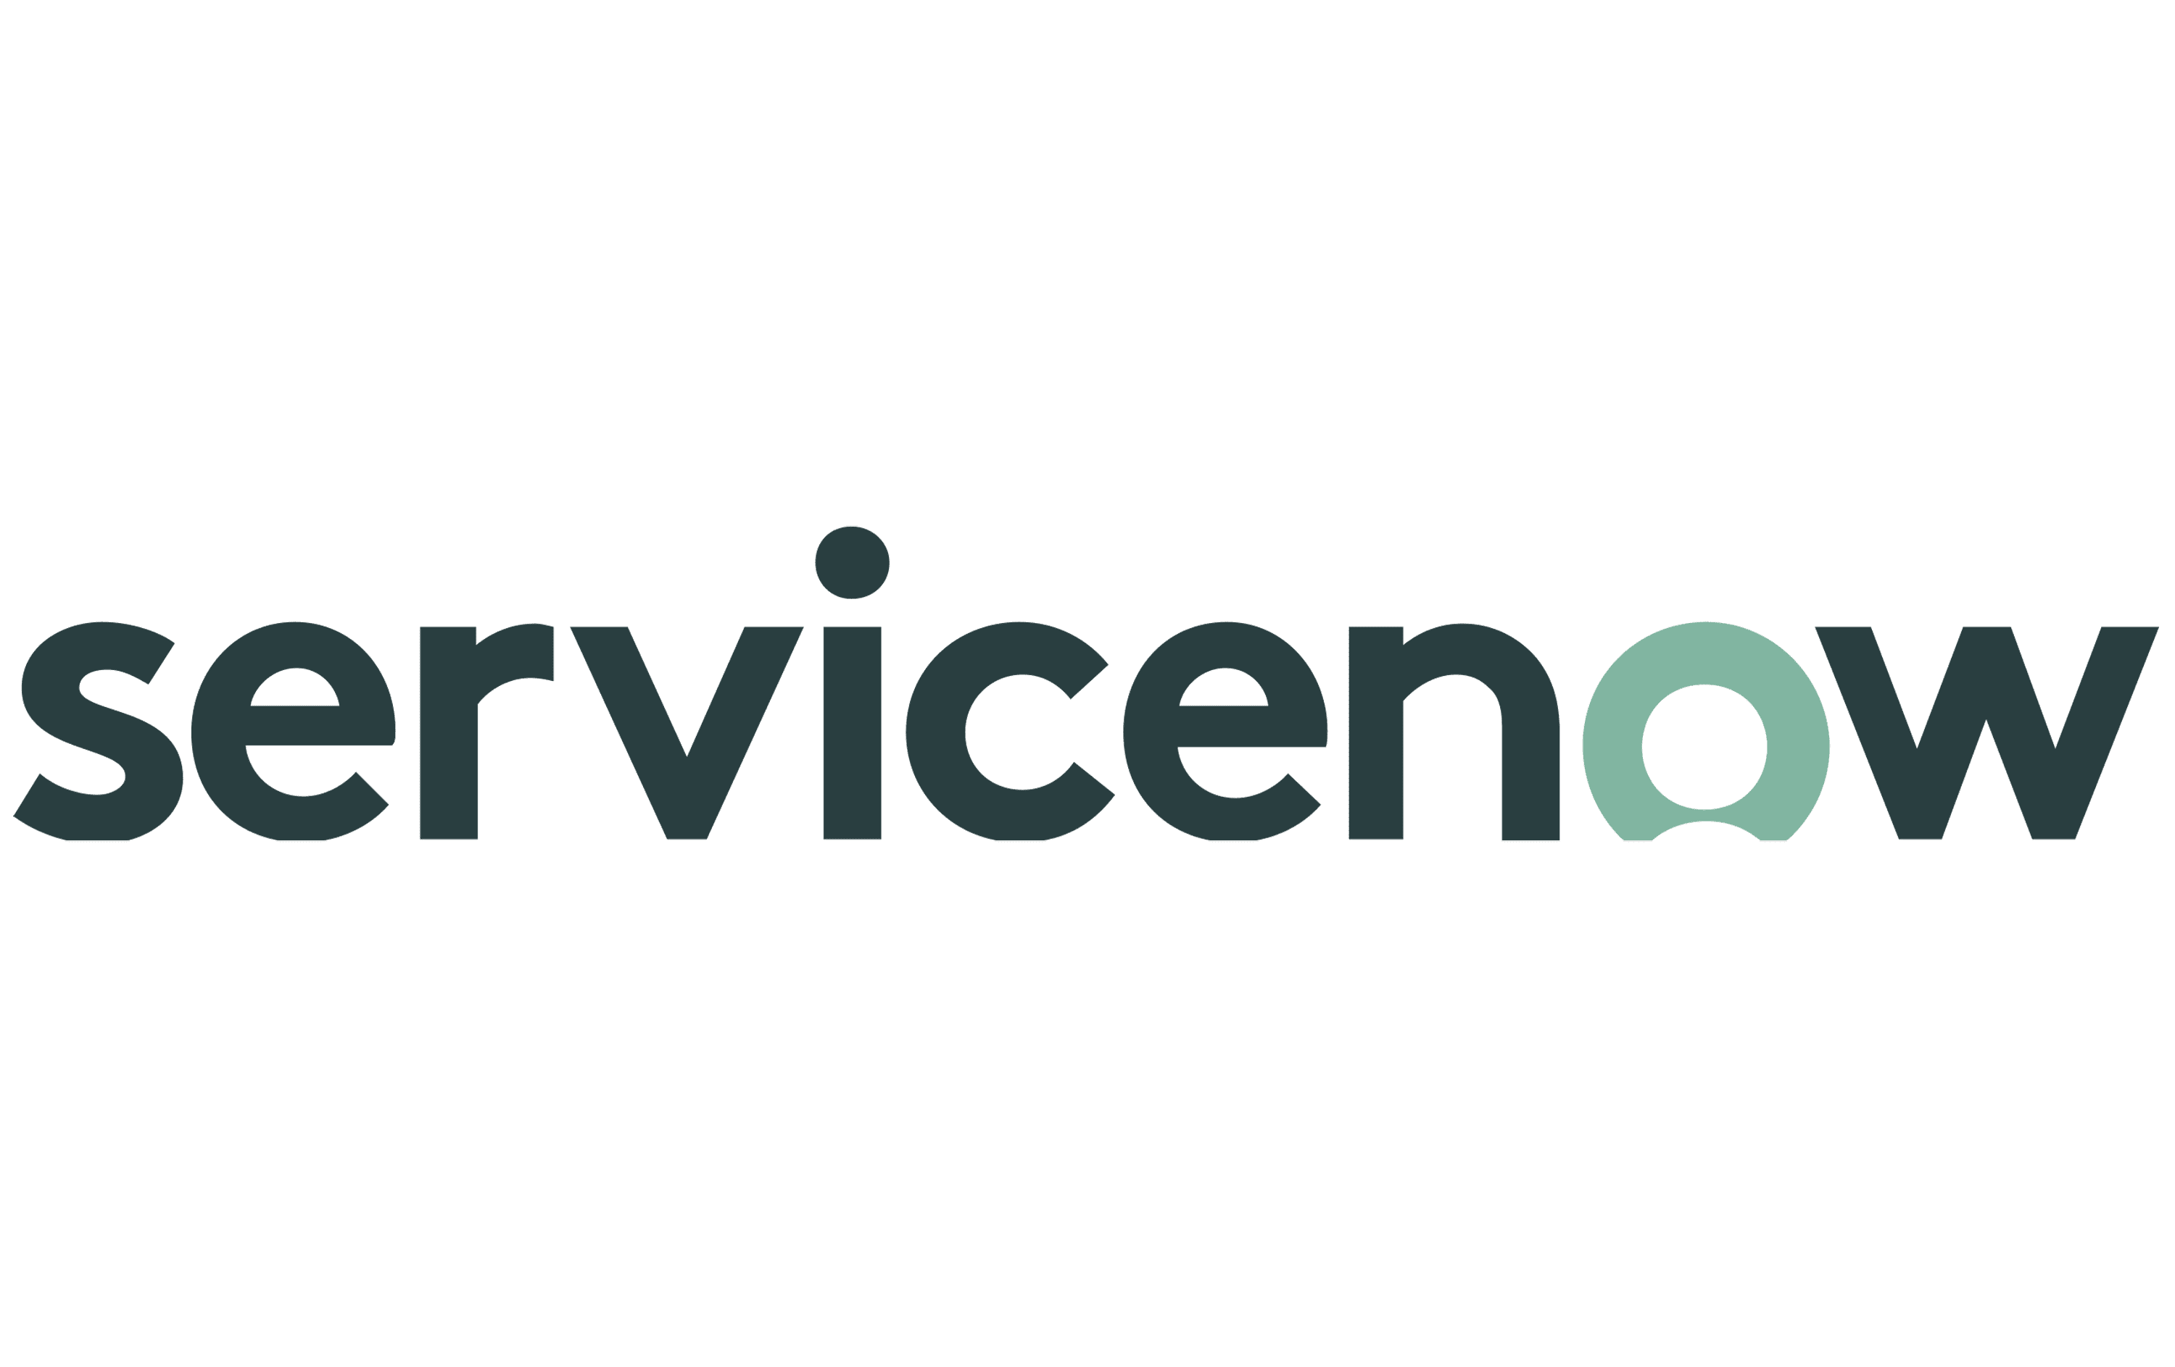

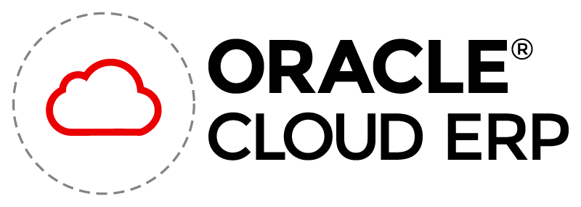








Pre-installed Adapters
Application adapters simplify integration by eliminating the complexity associated with web services and other connectivity methods
File / FTP Adapter
Oracle E-Business Suite
REST Adapter
ATP Adapter
SOAP Adapter
https://www.oracle.com/in/integration/application-adapters/

Slide 47
Oracle Cloud ERP Integrations with IICS as Middleware
Guidelines for roles and responsibilities of IICS and Oracle Cloud ERP Team
IICS Middleware
Oracle ERP Cloud - Deloitte
Development of Integration using the inputs from boundary application and Oracle Cloud
Unit testing by developer
Integration testing with Deloitte team to see if Interface table is populated.
If acknowledgement is expected, then validate if Oracle has sent an ack and it is received in IICS.
Work with Deloitte team to validate if data is correct and transformations have worked as expected
Debug issues reported in Middleware build
Deployment and documentation for middleware components
Provide payload for REST / SOAP call & clarify any mapping asks of fields between source and target
Name of ESS job that will execute at Oracle, parameters required to execute ESS Job
Provide Webservice / FBDI details using Oracle documentation
Provide server details (Dev / Test / Prod)
Integration testing along with IICS developer to ensure data is interfaced as expected.

Slide 48
Middleware Selection Matrix
Approach | IICS | OIC
Bulk Transformations | Strong ETL in for IICS – Data Integration Module | Yes
Inbuilt DB | No | Yes. Comes with inbuilt ATP DB for temporary staging and transformations.
ERP Cloud Connector for FBDI Process | Limited entities of Financials (Workaround – Use REST / SOAP API for Bulk Data Import) | Yes (Selecting bulk import process will automatically pick UCM account, Import job name and package details)
ERP Cloud Connector for UCM File Upload | No (Workaround – Use SOAP Service to place file to UCM) | Yes
Global Fault Handler | No | Yes
Transformations and Connection with Applications happen in one layer | No (Combination of Application Integration (AI) and Data Integration (DI)) | Yes
FBDI Process Callback efficient? | No | Yes (In rare scenarios issues are observed with Callback but resolved using Oracle Support)
Notes:
Reprocessing is another issue reported in IICS. In OIC, since there is an inbuilt DB we can update flags to U/V. IICS doesn’t support bulk updates for reprocessing, you have to go one by one which slows down the process. But if are not planning on having an automated process of reprocessing and instead using the manual route, then this point should not be mentioned.

Slide 49
Integration Pre-Workshop Questions and Responses
Question | Response
Does they have pre-established code standards or best practices with respect to current ERP . If so, can you share relevant documents | Boopathi(10/4): We use IICS for application integration – we follow IICS coding standards (not specific to only ERP, but general standards)
Is there any archival/Purging of data being done today? If so, can you share the eligibility criteria and duration for purging | Boopathi(10/4): We don’t purge data in ERP – our load strategy is Insert / Update
Do any of the current integrations expects response either real time or have definite response time/SLA? If so, can you share the SLAs for those integrations from current system | Boopathi (10/04): We don't have SLAs but have support team which monitors all integrations and react to issues quickly.
What are the current error handling and reprocessing strategies | Boopathi(10/04): Error Handling: Email notifications to technical team and business stakeholders as required Recovery: Rerun
What middleware currently landscape supports and between which source/target systems | Boopathi(10/04): IICS, GoAnywhere Raj: Kafka for staging data for etl
Any time zone specific transformation or process currently in place | Boopathi (10/04): Yes. We have control table with time zone specific dates to handle incremental loads
Any existing integration framework available
Notes:
For Point 2: Archival – for file-based import, callback service can take care of archival. For Rest / SOAP services, main process itself will take care of archival.
Shell script can be written for archival and purging in a regular interval

