Slide 1
XXXX - Future State Application Architecture

Slide 2
XXXX – Future State Application Architecture (Procure To Pay)
Boundary Applications
MuleSoft
Oracle ERP Cloud
Galaxy³
Outbound: Employee
Payables
Fixed Assets
Amber Road⁴
Outbound: Supplier Holds
Inbound : Suppliers
Receivables
Cash Management
General Ledger
Revenue Management
AMEX⁴
Inbound: Expenses
Subscription Management
Procurement
Expenses
Oracle Tax
JPM
Inbound: Payments and Positive Pay
HSBC
Inbound: Payments
To be decided
Boundary Applications
Oracle Applications
Mulesoft
Oracle Direct Integration
MuleSoft Integration
Indicates the module in scope for this workstream

Slide 3
PTP – Discussion points
Boundary Application | Open Question | Follow up Comments | Status | Due Date
Coupa¹ | Decision on single Coupa platform for XXXX and Saba.​ (DD: PTP-001). | Confirmed that Coupa is out of scope | Closed | 9/16
Banks² | Bank Integration for payments of EdCast and SumTotal (DD: PTP-004) | There will only be two banks in future state – JPM (For North America) and HSBC (Global Payments) | Closed | 9/23
HRMS(Galaxy)³ | Finalization of source system for inbound Employee Integration to Oracle. Plan to upgrade Galaxy which is current source system for Employees.​​ (PTP003) | Galaxy has been identified system for Employee integration. | Closed | 9/16 12/9
AmberRoad⁴ | In current state, there is an integration from ERP(NetSuite) to Amber Road. Does Amber road need to receive any data from ERP ? | Confirmed that we need outbound integration. Follow up needed whether this is needed on OTC as well. | Closed
iExpense⁵ | How are expenses sent from iExpense to ADP/ActivPay for re-imbursement? | 11/10 Business confirmed that they will not need this integration and will use Payables to pay Expense reports Will be addressed in PTP Design Sessions, PTP Team doing a KDD to finalize the approach. | Closed | 11/18

Slide 4
PTP – Discussion points
Boundary Application | Open Question | Follow up Comments | Status | Due Date
iExpense⁶ | With Coupa being replaced by iExpense for expense re-imbursement, do we need to have an interface from iexpense to ActivPay/ADP? | To be discussed in PTP Design sessions, The PTP team working on KDD and the captured as item in the next slide. | Closed
Oracle ERP Cloud⁷ | This P2P architecture - Expenses and Procurement are missing on Oracle ERP CLoud Box | Updated | Closed
Banks⁸ | Is the JPM and HSBC payments integrations outbound from Oracle or outbound from Banks ? arrow and description doesn't match. | These direction is w.r.t Oracle Cloud. As those are outbound from ERP, the direction is towards boundary system. | Closed
Activ Payroll⁹ | Expenses sent to Payroll (ADP, Active Payroll) from ERP is missing ?? Check with P2P team | This one already captured in the previous slide | Closed
Egencia | What is the data that will be manually integrated b/w Mavenlink and Egencia ? | PTP team to update on this by 12/2 | Closed

Slide 5
XXXX – Future State Application Architecture (Record To Report)
Boundary Applications
Oracle ERP Cloud
FxLoader with Oanda
Outbound: Exchange Rates
Payables
Fixed Assets
MuleSoft
Activ Payroll
Outbound: Journals
Receivables
Cash Management
Balances
ADP^{1 (US/CA)}
Outbound: Journals
General Ledger
Revenue Managment
Kyriba
Outbound: Banks Statements
Inbound : Exchange Rates
Subscription Management
Procurement
DWH
Inbound : Exchange Rates
Expenses
Oracle Tax
Visual Lease
Outbound:
Journal
Oracle EPM
Budgets, Forecasts
SFDC
Outbound:
Item ID, Opportunity ID
Payroll
Inbound:
Payroll
FX Rate
Actuals
Anaplan – FP&A
Outbound: Budgets to EPM
Inbound : Actuals from EPM
Floqast
Inbound: Account Balances
Workiva
Inbound: Journals
Northstar Salesforce
Inbound: Exchange Rates
Mavenlink
Outbound : Journals
Anaplan-Commissions
Outbound: Commission JE to ERP
To be decided
Boundary Applications
Oracle Applications
Mulesoft
Oracle Direct Integration
MuleSoft Integration
Indicates the module in scope for this workstream
Manual

Slide 6
RTR – Discussion points
Boundary Application | Open Question | Follow up Comments | Status | Due Date
ADP¹ | Confirm that the multiple ADP Environments will follow a common format to share the Journal file | All NA Payrolls will be merged into one instance by 1/1/2023. | Closed
Anaplan² | Need confirmation on what all integrations are required with Cloud ERP. Anaplan to ERP : Commissions, Item IDs ERP to Anaplan : Opportunity IDs, Exchange Rates, FX Rates | Confirmed that Journals and COA will be Manual and Anaplan needs Exchange Rates will be considered post go-live. Item IDs, Opportunity IDs come from SFDC. Commissions data will flow from Anaplan to ERP | Closed | 9/23 10/14 11/3
Mavenlink³ | In current state, the integrations are manual. Confirm whether Mavenlink will be ready to automate these integrations | Confirmed that Mavenlink integrations will be manual | Closed | 9/16
Coupa⁴ | In current state, there is an integration for exchange rates. Confirm whether we need it. | Confirmed that Coupa is out of scope | Closed | 9/16

Slide 7
RTR – Discussion points
Boundary Application | Open Question | Follow up Comments | Status | Due Date
Floqast & Workiva⁵ | 11/1: As per the understanding, Floqast & Workiva will integrate with EPM and not ERP? 11/7: The lines should show what data is exchanged between the systems . for some it is mentioned , most it is not | 11/1: Workiva - We got confirmation only in week of 10/24 that it'll be EPM. Floqast- We are tracking this as an ERP Integration and there is a meeting b/w Bri and Floqast on future state account reconciliation 11/7: The data that is exchanges, is mentioned within the boxes | Close
Floqast⁶ | The integration with FloQast is from ERP or EPM? | Floqast is from ERP. Requirement discussions are happening with Floqast on how the future state account reconciliations happen b/w ERP and Floqast | Closed
Avalara⁸ | Should we have integration between ERP & Avalara as bi-directional? as we send data to Avalara to get correct Tax Code. | Updated Avalara Integration in version 1.51. Please review that version going forward | Closed
Kyriba, DWH & SFDC⁹ | FX rates needs to go to Kyriba , DWH and SFDC from ERP | RICE objects added to the tracker for Kyriba and DHW | Closed

Slide 8
RTR – Discussion points
Boundary Application | Open Question | Follow up Comments | Status | Due Date
Anaplan¹⁰ | Anaplan - Commissions i assume would flow from Anaplan to GL not other way around. Has anyone had a discussion with Anaplan team??? | Commision is going from Anaplan to Oracle ERP this has been confirmed by RTR team with Business | Closed

Slide 9
Future State Application Architecture (OTC,CRM) – Release 2 (Jun)
MavenLink
Professional Service Contracts
Galaxy
Inbound: Employees
JPM
Inbound: Lockbox
Market Place
Manual : Inbound
Support Site
Manual : Usage
Northstar Salesforce
Oracle ERP Cloud
Accounts, Contacts, Products, Pricebook, New Orders, Order Updates
Payables
Fixed Assets
Master Data² : Accounts, Contacts, Pricebooks, Products
Transactional Data : Orders
Receivables
Cash Management
Invoice Details⁴, Subscription Details,
Master data updates³
General Ledger
Revenue Managment
Subscription Management
Procurement
Expenses
Oracle Tax
Avalara
(out-of-box Tax Integration)
Boundary Applications
ERP, CRM
Retire by R2 (Jun)
Retire by R3
(Sep)
Manual Entry
Oracle Direct Integration
MuleSoft Integration
Indicates the module in scope for this workstream

Slide 10
OTC – Discussion points
Boundary Application | Open Question | Follow up Comments | Status | Due Date
License Provisioning System¹ | Before Order Confirmation, should Salesforce be integrated with License provisioning system ? (Or) Is it Oracle ERP that should connect ? | 11/8: Ravi – Confirmed with OTC Team (Anup and Parag) that these systems will be integrated with SFDC | Closed | 9/30 10/14
Oracle ERP (Master Data)² | Can Master data (Customers, Products, Pricebook) be updated in ERP ? Can we maintain SFDC as a single source of truth for the Master data | OTC team to discuss with CRM. There is a KDD Logged (OTC-001.1). Current ETA is 9/30 and we requested to close this by 9/23 considering the build time lines. OTC team have detailed approached Captured in the KDD | Closed | 9/23 10/14
Master Data Updates³ | Is there a scenario where Master data is updated in ERP and that needs to synch back to SFDC ? | OTC team to discuss with CRM. There is a KDD Logged (OTC-001.1). Current ETA is 9/30. The KDD has details, on the approach | Closed | 9/30 10/14
Financial Information⁴ | Does SFDC need any financial information such as Invoice details and Revenue details ? | Invoice Details are needed in SFDC for credit management and also to provide comprehensive view of Orders/Customers. Revenue plans are not needed. | Closed
Lockbox Integrations⁵ | Will Oracle receive lockbox files directly from Bank (Or) Kyriba will send these files ? | Lockbox will be received only from JPM Bank. | Closed

Slide 11
OTC – Discussion points
Boundary Application | Open Question | Follow up Comments | Status | Due Date
Oracle ERP⁶ | Any impact on the ERP Implementation due to the interim integration from Mar to May? (eg:- Conversions, Integrations etc) | No Impact to us as this is only between CRM Systems. | Closed
Saba⁷ | Saba is part of R2. We don't have R3 anymore. | Corrected this | Closed
NS SFDC⁸ | What's the difference between NS Salesforce and XXXX Salesforce? (As per understanding, Sumtotal will be part of Release 2 CRM which will get clubbed into NS CRM) | XXXX SFDC is legacy. NS SFDC is future state. Yes, SumTotal is part of Release 2 for Northstar CRM. | Closed
Oracle ERP⁹ | We should be thinking around all the cut-over steps from interim integration of NSuite to Oracle Cloud if not done already | That'll be addressed via Cutover Plan activity. | Closed
ServiceNow¹⁰ | Why is ServiceNow here ? | Discussed with OTC Tram and Service now is not needed to support the OTC functionality | Close
Marketplace⁷ | The integration from Marketplace to ERP would be bi-directional? | Marketplace integrations are in discussion right now. Once we get rationalized list, we will add them. | Open | 12/2

Slide 12
XXXX – Future State Application Architecture (Consolidation & Close)
Oracle ERP – Pulling data from all ledgers
Oracle
ERP/GL
Oracle Financial & Close Cloud
Actuals
Journals
Consolidation
Intercompany
Cash Flow
Anaplan
Translation
Budget, Forecast
Workiva
COA, Journals
FloQast
TB Data
Anaplan
Actual consolidated data
SmartView
Excel Reporting
Monthly Reporting Package
Internal Reporting
Boundary Applications
Oracle Applications
Oracle Direct Integration

Slide 13
FCCS – Discussion points
Boundary Application | Open Question | Follow up Comments | Status | Due Date
Net Suite | Decision on monthly data for 2020 is going to pulled from Net Suite directly into FCCS. | New ERP/GL application will only have year data seeded for FY2020. | Closed
Anaplan | Decision on which Budget to load into FCCS. Either FY22 or FY23 or both. | FCCS can handle both Budgets. | Closed
Anaplan | Decision on to setup Actual feedback from FCCS to Anaplan with the eliminations included. | Generally, this would be used for reporting, But I’m guessing going forward, FCCS will be used to build the standard monthly packages. | Closed
Oracle ERP | Is the flow from Oracle ERP to EPM bi-directional? If so, what coming in ERP from EPM? | As of right now, nothing is flowing back to ERP from EPM. Updated slide with correct direction of arrow. ERP to EPM. | Closed

Slide 14
Appendix

Slide 15
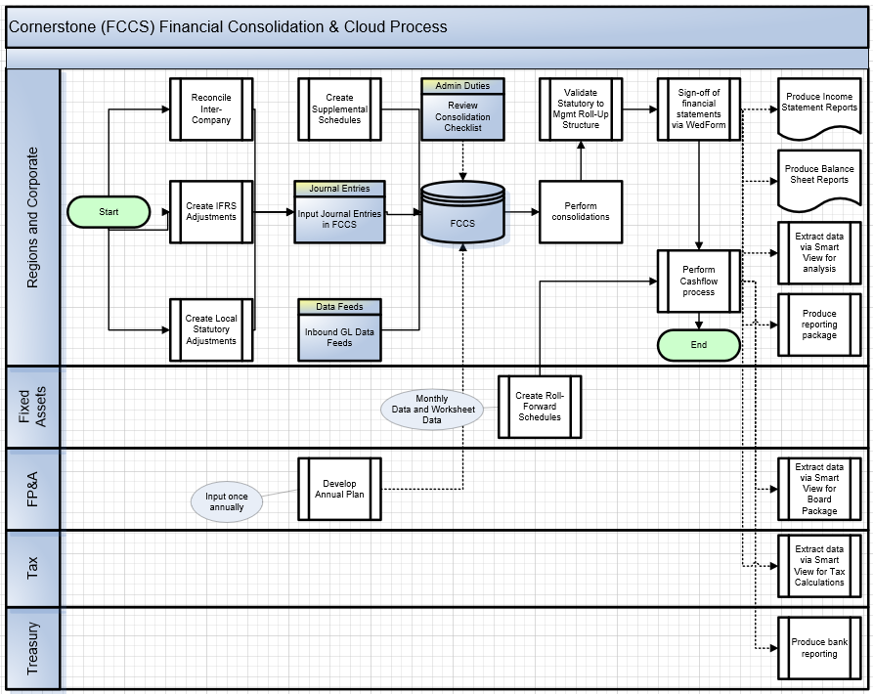
XXXX – Future State Application Architecture (FCCS)

Slide 16
XXXX – Future State Application Architecture (OTC,CRM) – Release 1 (Feb)
All Integrations represented here are connected through MuleSoft Middleware
Mavenlink
Inbound: Professional Service contracts
Galaxy
Inbound: Employees
Northstar Salesforce
Master Data² : Accounts, Contacts, Pricebooks, Products
Transactional Data : Orders
R1 Scope : New Order Capture for XXXX, EdCast
Order Completion to continue in NetSuite
Accounts
Accounts, Products, Orders
XXXX SFDC
XXXX NetSuite
R1 Temporary Integrations from NS-SFDC : Accounts
R1 Temporary Integrations from NS-SFDC : Accounts, products, Orders
R1 Temporary Integrations to NS-SFDC:
Invoice Details
To retire by Release 2 (June)
Boundary Applications
ERP, CRM
Retire by R2 (Jun)
Retire by R3
(Sep)
Oracle Direct Integration
MuleSoft Integration
Indicates the module in scope for this workstream

Slide 17
Future State Application Architecture (OTC,CRM) – All Releases
MavenLink
Inbound: Professional Service Contracts
Galaxy
Inbound: Employees
JPM
Inbound: Lockbox
Northstar Salesforce
Oracle ERP Cloud
To Oracle ERP: Accounts,Contacts, Products, Pricebook, Order creation and Modification
To Northstar SFDC: Invoice Details, Subscription details, Master data updates (Account, Contact, Product)
XXXX SFDC
XXXX NetSuite
R1 Temporary Integrations from NS-SFDC : Accounts
R1 Temporary Integrations from NS-SFDC : Accounts, products, Order Items
R1 Temporary Integrations to NS-SFDC:
Invoice Details
To retire by Release 2 (June)
To be decided
Boundary Applications
ERP, CRM
Retire by R2 (Jun)
Retire by R3
(Sep)
Oracle Direct Integration
MuleSoft Integration

