Slide 1
XXXX-Reporting Strategy

Slide 2
Reports Overview
Cloud ERP and EPM Reporting Tools
XXXX Reporting Tool
Reports Methodology
Identifying the Best-fit reporting platform
Oracle Out of Box Report v/s Report customization
Reports Scope
Object List
Roles and Responsibilities
Reporting Tools
Financial Reporting Studio
Smart View
Oracle Transactional Business Intelligence
BI Publisher

Slide 3
Reports Overview

Slide 4

Cloud ERP and EPM Reporting Tools
Financial Reporting Studio(FRS) – ERP and EPM
BI Publisher (BI)
Browser-based financial reporting with real-time drill down capabilities and data visualization.
Reporting Scenarios
Income Statement
Balance Sheet
Limitations
Suitable for low/medium data volumes.
Report needs to be updated if there are changes in COA hierarchy levels and their members
Highly formatted operational reports with advanced features supporting high volume, scheduling and bursting.
Reporting Scenarios
Check printing
Payment formats
Shipping labels
Limitations
No drill-down and drill-through capabilities.
Users cannot make changes to report on the go.
Report development requires basic to advanced knowledge of SQL and Cloud tables
Reporting
Smart View – ERP and EPM
Oracle Transactional BI (OTBI)
Excel-based slice-and-dice of data for easy and quick ad-hoc financial reporting.
Reporting Scenarios
GL balances across COA hierarchies
Net revenue for a period and location
Limitations
Suitable for low/medium data volumes.
Report needs to be updated if there are changes in COA hierarchy levels and their members.
On reopening the spreadsheet, user will need to refresh it to view the latest data.
Provides self-service reporting capabilities to business users for real-time operational and transactional data.
Reporting Scenarios
Sales across periods
Late receipts analysis
Limitations
Suitable for low/medium data volumes.
Not all ERP tables and columns are exposed for reporting.
Limited cross-subject area reporting functionality.
Difficult to create reports in a specific format.
Minimal data visualizations capabilities.

Slide 5




XXXX BI Reporting
Snowflake Datawarehouse
Data Visualization
Rich Visualization Based Reporting
Historic Data
Analysis
Applications & Databases
Cross Application Reporting

Slide 6

Report Methodology
Our approach to ERP Cloud based report methodology using FRS, OTBI, Smart View, BI Publisher
Mapping and Configurations Steps
Gather Report requirements
Perform fit gap analysis
Access reports to identify the best reporting tool.
Prepare Inventory
START
1
2
3
4
Gather Report requirements and rationalize reports
Perform fit gap analysis comparing with Oracle ERP Cloud out of box reports
Access User Stories to best fit the oracle reporting tool
Prepare Reports Inventory
Data Extraction and Formatting Steps
Configure flex fields for OTBI reports.
Create FRS reports for GL Balance for scheduling.
Create Smart View Analysis for GL Balances Reports and ad hoc reporting.
Create Data Models for BI Reports.
8
7
6
8
7
5
Schedule reports Using FRS/BI Administrator
Validate the reports based on test cases
Develop the reports based on the User Stories
Perform required setups for folder structure, KFF segments and DFF attribute
9
10
11
FINISH
Scheduling and Delivery Steps
Configure folder level security using custom role.
Create Schedules as per the user stories.
Provide access to users to run reports
Configure Smart view for all the financial users for ad hoc reporting requirements
Configure folder level security using custom roles to provide read access to users
Assign General ledger Roles to user to run custom reports developed in FRS
Install Smart View, an Excel add-in, to each client computer (*option)
Responsibility
Functional
Tech
Joint: Tech & Functional
S&C
XXXX IT

Slide 7
XXXX Report Methodology : Stakeholders at various stages
Identify report requirements
Prioritize report requirements
Perform integration testing & deploy reports
Perform fit-gap analysis
Operational reporting
Statutory reporting
Analytical modeling
Business process monitoring
Build & unit test reports
Disposition reports by tools
Develop lean specifications for reports
Functional Team
Build reports inventory
Tech Team
Joint – Functional and Technical

Slide 8
Report Classification
Below matrix represent various parameters taken into consideration for report classification
Audience
Internal / audit
External Party
Regulatory agency
Formatting
HTML
Excel
PDF
Dashboard
Scope
Operational data
Consolidated financial data
Aggregation / KPI calculations
Timeliness
Real-time
Near real time
Batch processing schedule
Interactivity
Dashboard needs
Dependency on data inputs
Varying attributes / dimensions
Security
Data level security restrictions.
Role based access to the report
Globalization
Global requirements
Local statutory considerations
Translation such as currencies
Metadata
Master data from source systems
Standard data hierarchies from the source system
Functionality
Any downstream business process that this report should serve

Slide 9
Identifying the best-fit Reporting Platform
Yes
Start
Is the report
Real Time?
Is the report
Analytical?
Yes
Analytics
Tool
No
No
Does this
require cross application
analysis?
Yes
Yes
No
Is
this transactional
Analysis?
Is this a
GL report
No
Does
this require history data
Not converted to
ERP?
Yes
Yes
No
No
Does
this require Pixel perfect
Formatting/High Volume
/Complex Calculation?
No
Yes
Does this require
Excel based AdHoc
Analysis?
Can a standard
Report meet the
requirement
Can a standard
Report meet the
requirement
Yes
No
Yes
No
Yes
No
SmartView
FRS
Custom
OTBI report
Standard
OTBI report
Custom
BI Publisher
report
Standard
BI Publisher
report

Slide 10
ERP Reports : Standard v/s Customized Reports
Below flow chart illustrates how to distinguish between an oracle outbox report and a report customization requirement
START
Document Process
Identify Reporting
Analyze existing report
Design
requirements
(By Track)
for format and content
Review standard Oracle
Reports
Custom Report
& Data?
No
No
No
Meets
Requirements?
Data Changes
Only ?
Format Changes
Only ?
Yes
Yes
Yes
Yes
Develop Custom Report using right reporting tool
Customize Standard Report
Modify Existing Templates
User Standard Oracle
Report
Report Development
END

Slide 11
Sample Reports

Slide 12
Reporting Requirements
RICE Object | Track
General Ledger and Subledger Analysis Report | RTR
General Ledger Trial Balance Report | RTR
Trial Balance Report | RTR
Trial Balance Extract | RTR
General Ledger Journal Entry Report | RTR
Account Analysis Report | RTR
Journal Entries Report | RTR
Asset Addition Report | RTR
Asset Cost Adjustment Report | RTR
Asset Retirements Report | RTR
Asset Transfers Report | RTR
Asset Cost Summary Report | RTR
Reserve Summary Report | RTR
Subledger Period Close Exceptions Report | RTR
What-if Depreciation Analysis Report | RTR

Slide 13
Reporting Requirements
RICE Object | Track
Remittance Advice | PTP
HSBC Check Format | PTP
JPM Check Format | PTP
Month End P&L Report | EPM
Month End Balance Sheet Report | EPM
Intercompany Matching Reports | EPM
Check Companies TB balances | EPM
Cash Flow Report | EPM
Monthly Trend Report P&L | EPM
Monthly Trend Report BS | EPM

Slide 14
Roles and Responsibilities
Activity | Primary | Secondary
Identify report requirements (Reports Inventory) | Client | XXXXX
Prioritize & Categorize report requirements | Client | XXXXX
Perform fit-gap analysis for High Priority, Customer-Facing and External Reporting requirements | XXXXX | Client
Rationalize other Reporting requirements | Client | XXXXX
Disposition reports by tools | XXXXX | Client
Finalize reports inventory | XXXXX | Client
Develop lean specifications for reports | XXXXX | Client
Build & unit test reports | XXXXX | Client
Perform Report validation & deploy reports | XXXXX/Client | XXXXX/Client
Rationalization
Development and Testing
Delivery

Slide 15
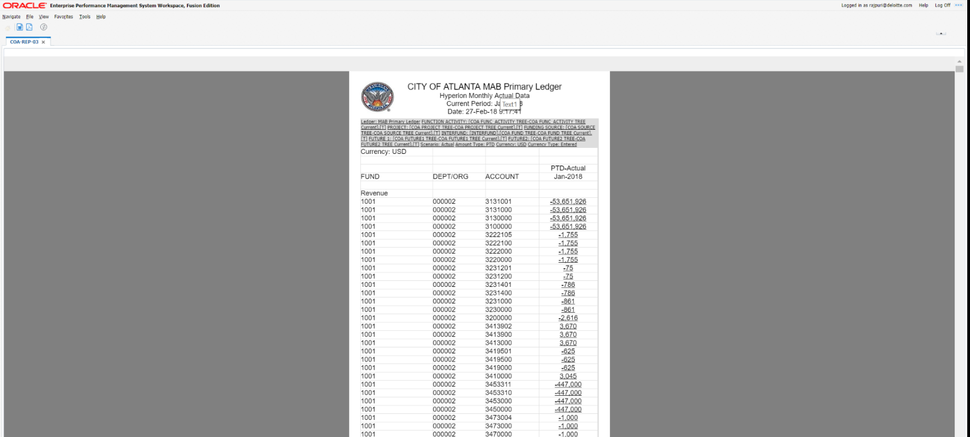
Financial Reporting Studio (FRS)
Financial Reporting Studio allows users to create production quality, highly formatted reports for management reporting using data from various Oracle data sources like Essbase, Planning
FR Studio supports powerful formulas and calculations, advanced formatting, embedded charts, pictures, PDFs, multidimensional analysis, summary/detail expansions, drilldown, and run-time points of view (reporting filters) to create reports

Slide 16
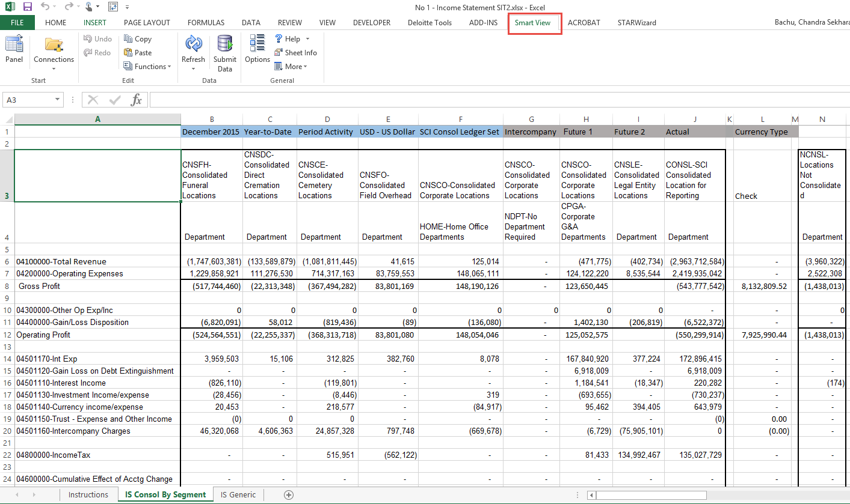
Smart View
Excel-based analysis tool that allows quick, ad hoc reporting on Oracle data sources like Essbase.
Enabled by drag and drop, drill-down, and pivoting features to manipulate data and perform ad hoc analysis. Smart View reports can be saved offline and refreshed with latest GL data. Can be run directly from Excel

Slide 17
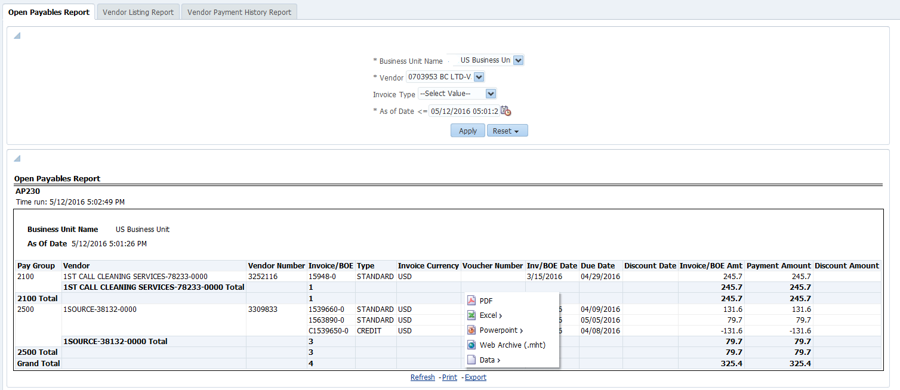
Oracle Transactional Business Intelligence (OTBI)
Ad hoc query and self-service reporting application with access to real-time transaction data
OTBI reduces reliance on IT for the creation and maintenance of reports
Seamless integration with Oracle ERP Cloud applications, any changes to applications data security are immediately available in OTBI
Reports can include powerful analysis features, such as drill-downs, calculations, and charts
Reports have advanced formatting features and output can be downloadable to pdf, excel, csv, and ppt.

Slide 18
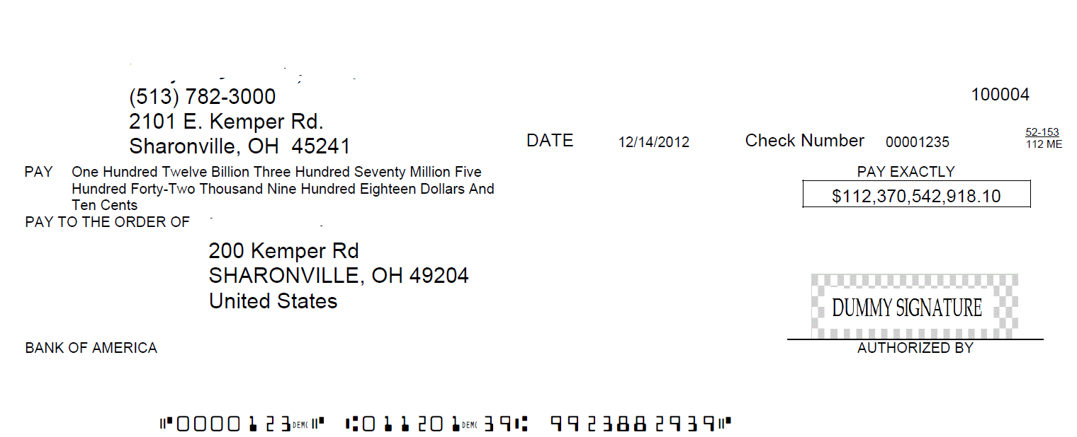
BI Publisher
Preferred for High Volume Data
Used to produce reports, such as invoices, shipping labels, government forms, EFT and EDI files.
Standard reports are provided by Oracle and can be customized
Easy to create layout as per the User Stories
A single report can be burst with personalized content to multiple output formats and destinations

Slide 19
Open Items
ID | Open/Follow up Question | Follow Up Comments | Due Date | Status
1 | Slide 4 - Do we have all the reporting tools listed (and plan to use them, setup all the data etc.)? | Yes, all the ERP Tools were listed. Plan to use them is documented in slide : 9 |  | Close
2 | Slide 5 - Similar question as above(1), is this just showing what is possible? Or what is our strategy in how we are going to use the DH? | This is documented in Slide:9 based on discussion with XXXX- BI Team (Chetna). However any reporting from DH is not in XXXXX’s Scope. |  | Close
3 | Slide 7 - Who is on the functional team vs the tech team? | Functional team and Technical Teams refer to XXXXX team only. |  | Close
4 | Slide 9 – any custom report I’d like to approve | Per process, we take BPO approval. We need to remind all our workstream leads, if there is any addition to this approvers at object level .once we have determined the fit/gap and before we proceed to add that in RICE tracker, we will seek both Alex’s and Leena’sapproval since this may go beyond what we have in current SOW. |  | Close
5 | We have our current report inventory – this should be used as an aid in change mgmt., and also for the teams if they need it as a guide to help with requirements. It does not and should not represent our reporting requirements | aligned with XXXXX. |  | Close
6 | Reporting requirements should be captured in user stories by the workstreams | aligned with XXXXX. |  | Close
7 | XXXXX will take the reporting requirements, and do a fit gap against standard reporting from Oracle | aligned with XXXXX. |  | Close
8 | Anything that is a gap, we would have further discussions (using the thought of slide 9), to determine how to best solution it. | aligned with XXXXX. |  | Close
9 | The final list of future state reporting will be completed – we will use our current state inventory to compare to that as a supporting document for change mgmt. | aligned with XXXXX. |  | Close
10 | Shouldn't fit gap analysis be done by XXXXX functional team ? just want to understand if it is XXXXX or XXXX? | XXXX team provide the rationalized list containing list of all the report, XXXXX team perform FIT Gap while working with XXXX Business Team |  | Close
11 | What is the Analytics Tool ? | This will be Tableau. The tool selection criteria are captured after discussing with XXXX-BI Team (Chetna). The scope of building Analytics reporting is not in XXXXX Scope. |  | Close
12 | No OTC report requirements? | These were sample reports that we received from workstream when we prepared the deck. Actual reports will be added to the RICE List once report rationalization completes. |  | Close

Slide 20
Thank You

