Slide 1
PRESENTATION ON-
“PAPERLESS BILLING”

Slide 2
Introduction
This application is designed by keeping both shopkeepers and customers in mind so
as to ease in their work and shred the time consumed in all the billing process. It will
be a windows based application.
Its GUI will basically comprise of a bill receipt-like structure in the computer screen
where basic details of the customer, the product being purchased, its amount, quantity
and total amount will be entered by the user.
Once the customer has billed out his purchase a text message, an email (pdf in the
form of bill receipt image) and a whatsapp text in the form of an image will be sent
to the respective customer.

Slide 3
Customers will also be provided with an option for how they want to receive their bill receipt (which
will be selected out of 3 available options).one copy of the bill receipt will be available in the database
of the shopkeeper.
All the work of a bill receipt which is done on paper will be done digitally i.e. a digital bill is going
to be generated by our application and it will be transferred to the following customer via
email/whatsapp/text message. Email will contain a pdf file which will actually be an image of
the bill receipt, whatsapp message will also contain an image of the bill and the text message will
be a few details regarding the bill.
Initially, this application is being created for a garment Shoppe but in future we will be making this durable as for the use of other shops and organizations.

Slide 4
PROPOSED FLOWCHARTS:
Start
This flowchart basically comprises of a bill receipt-like structure in the computer screen where basic details of the customer, the product being purchased, its amount, quantity and total amount will be entered by the user. Once the customer has billed out his purchase a text message, an email (pdf in the form of bill receipt image) and a whatsapp text in the form of an image will be sent to the respective customer.
Is customer
buying
anything?
no
End
yes
Enter Customer’s
details
Generate bill
Send bill
end

Slide 5
Start
Our second module introduces the stock section handling for the local scale businesses. Our basic motto is to provide this facility of digitization in the hands of medium scale businesses, by using this software the owner of the business can manage his/her business and keep track of all the activities and also go through the whole billing procedure without using a single dime of paper.
Modify/
check
content?
no
Return to
home
yes
women
Which
category
to modify?
children
Check/alter
content
Check/alter
content
no
Work
done?
yes
End

Slide 6
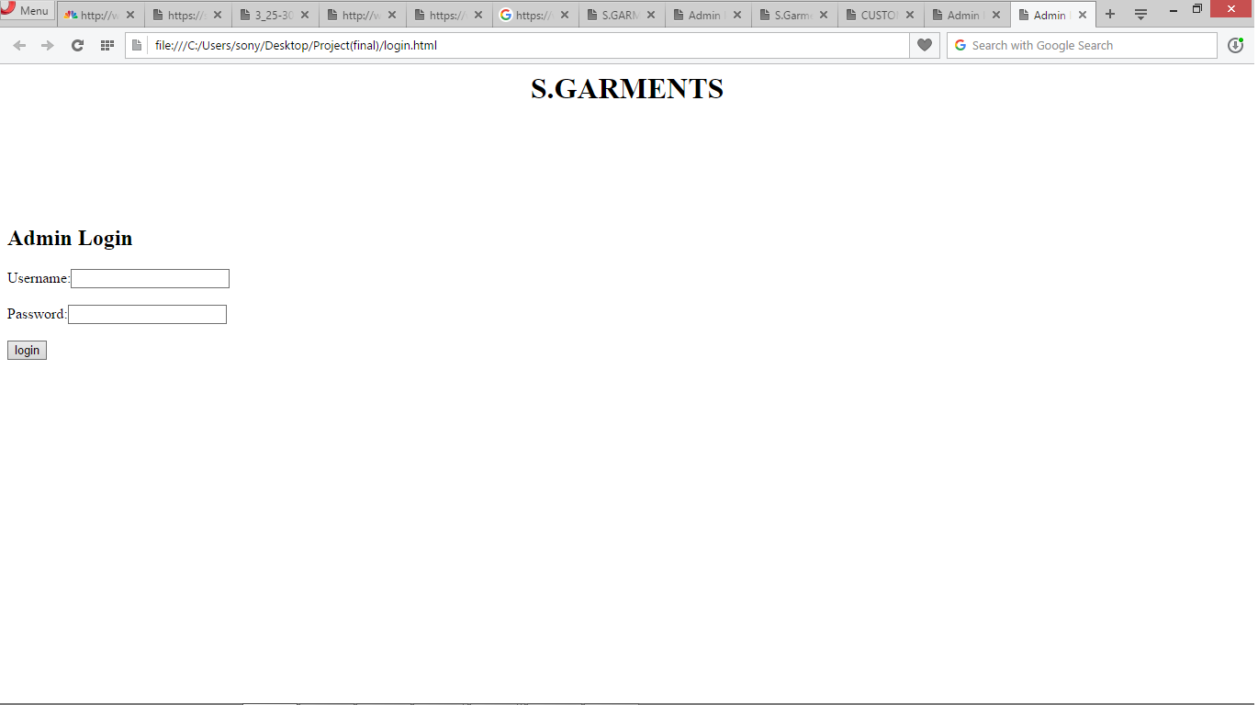

Slide 7
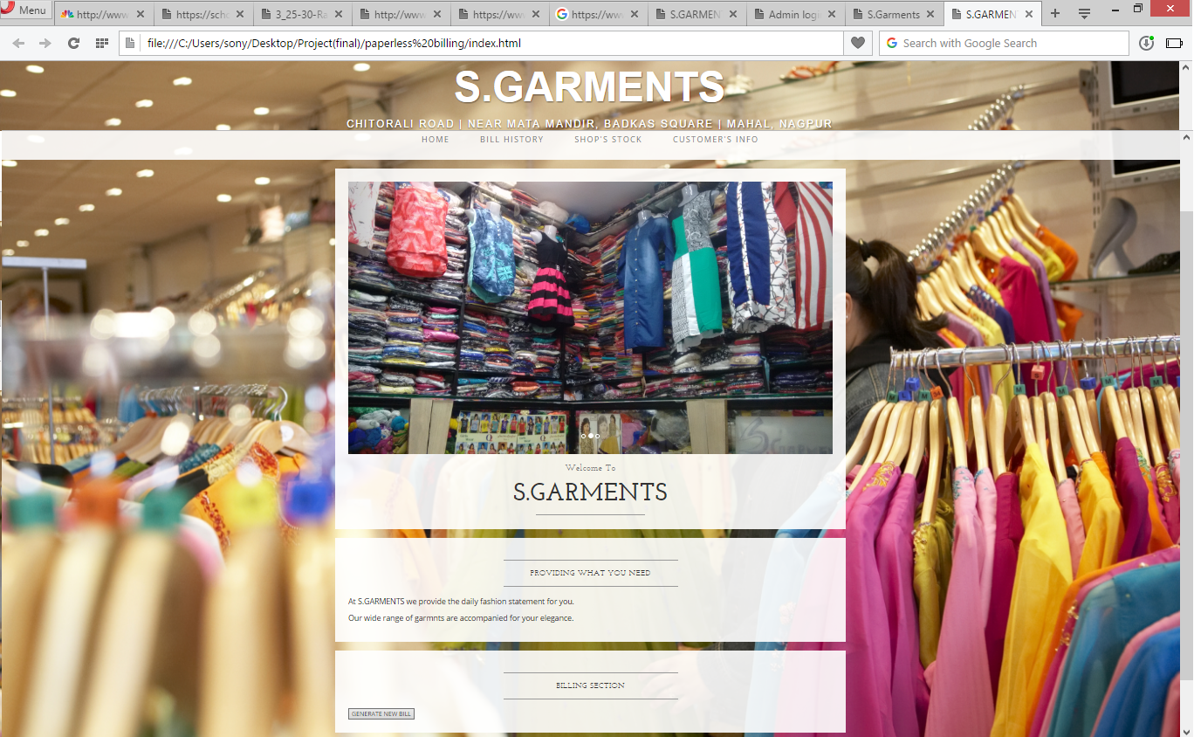

Slide 8
RELATED WORK:
Advancement in the digital era had made us dependent on computers. Everything is automated
with the help of computers now-a-days. Maintaining and handling stores with the help of
computers is a common thing now.
Billing sector has developed a several applications/
software which are easy to handle and use. They save time, efforts and energy.
This kind of software are used in places where there is a constant need of generating
invoice for every purchase.
Most of the shops which are used to using a atomized system
for their handling of goods and keeping track of their activities and sales are the
main target of these software.

Slide 9
APPLICATIONS:
In stores with maximum sales record (all categories of stores included)
Distributors
Enterprises
Private businesses
Institutions
Wholesale distributors

Slide 10
Thank you!
Any queries?

