Slide 1

Manish Prajapati (200241220095)
Anchal Dubey (20241220014)
Mr. Prashant Karhale
Center Coordinator
Mr. Chetan Pardeshi
Project Guide

Slide 2

Group members
◆ Anchal Dubey (200241220014)
◆ Manish Prajapati (20024122095)

Slide 3

Presentation on
E-Commerce (online shopping)

Slide 4
Introduction
E-commerce definition
About our system

Slide 5
What is E-Commerce
Commonly known as Electronic Marketing.
“It consist of buying ,selling and renting goods and services over an electronic systems Such as the internet and other computer networks.”

Slide 6
Our System
◆ Our System is an e-commerce website from where people can buy,rent products online.
◆ Admin monitors the activity of the users and checks the transactions.

Slide 7
Features:
Catalog Browsing
Category List Product List
Menu
Catalog Management
Product Browsing
Product Reviews Related Products
Shopping Cart
Checkout

Slide 8
Languages:
HTML 5
CSS 3
Bootstrap
Angular
MySQL
J2EE
Tools:
Adobe Photoshop
Vs code
Wamp

Slide 9
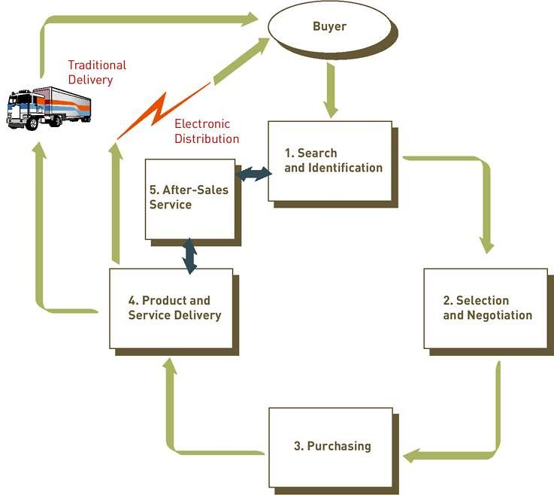
THE PROCESS OF E-COMMERCE

Slide 10
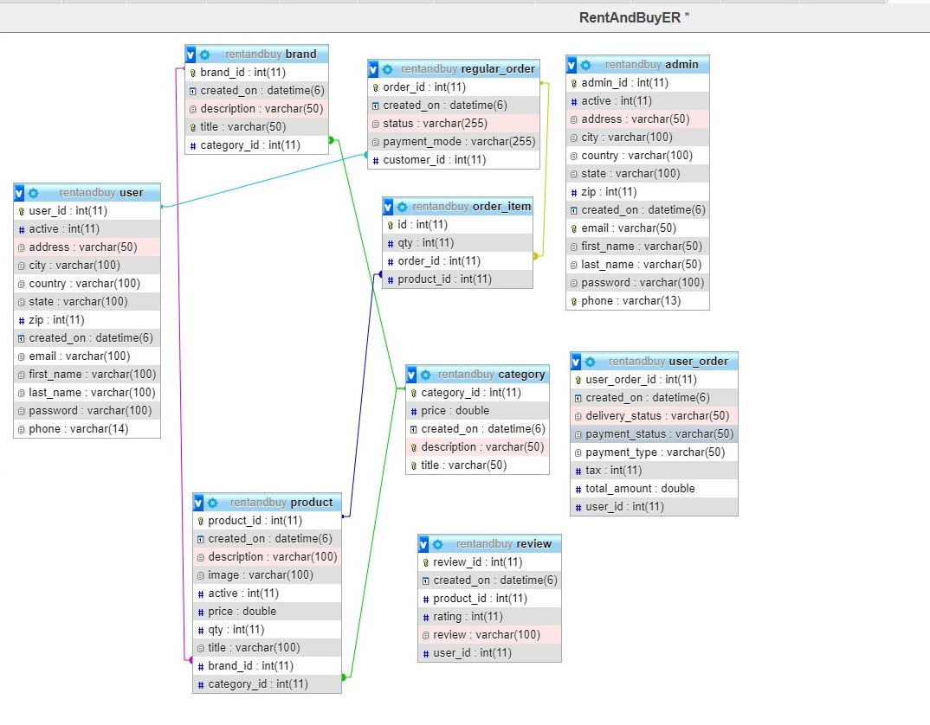
ER Diagram

Slide 11
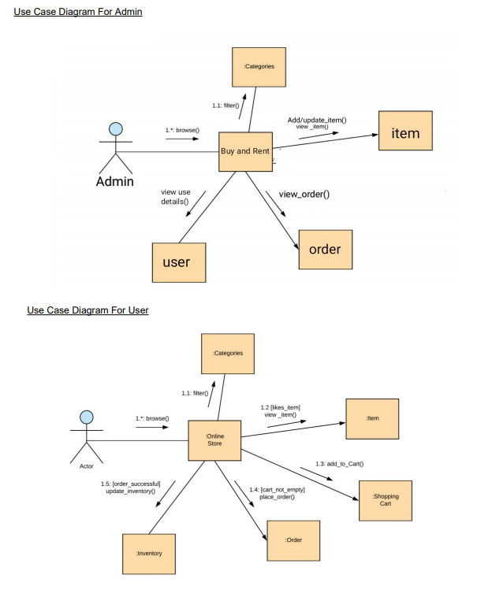
Use Case Diagram

Slide 12
Business process model
Start
Customer
Product List
Buy Product
Payment Type
End
Admin
Check Transaction

Slide 13
ADVANTAGES OF E-COMMERCE
Faster buying/selling procedure, as well as easy to find products.
Buying/selling 24/7.
More reach to customers, there is no theoretical geographic limitations.
Low operational costs and better quality of services.
No need of physical company set-ups.
Easy to start and manage a business.

Slide 14
DISADVANTAGES OF E-COMMERCE
Unable to examine products personally
Not everyone is connected to the Internet
There is the possibility of credit card number theft
Mechanical failures can cause unpredictable effects on the total processes.

Slide 15
Future plan
◆ We are thinking of some modifications and adding some advanced new features in out system. Some of them are –
# GUI modification (more user friendly) #Payment Interface
# Users can signup / login using their social media account such as facebook , google+ etc.

Slide 16
GUI(Graphical User Interface)

Slide 17
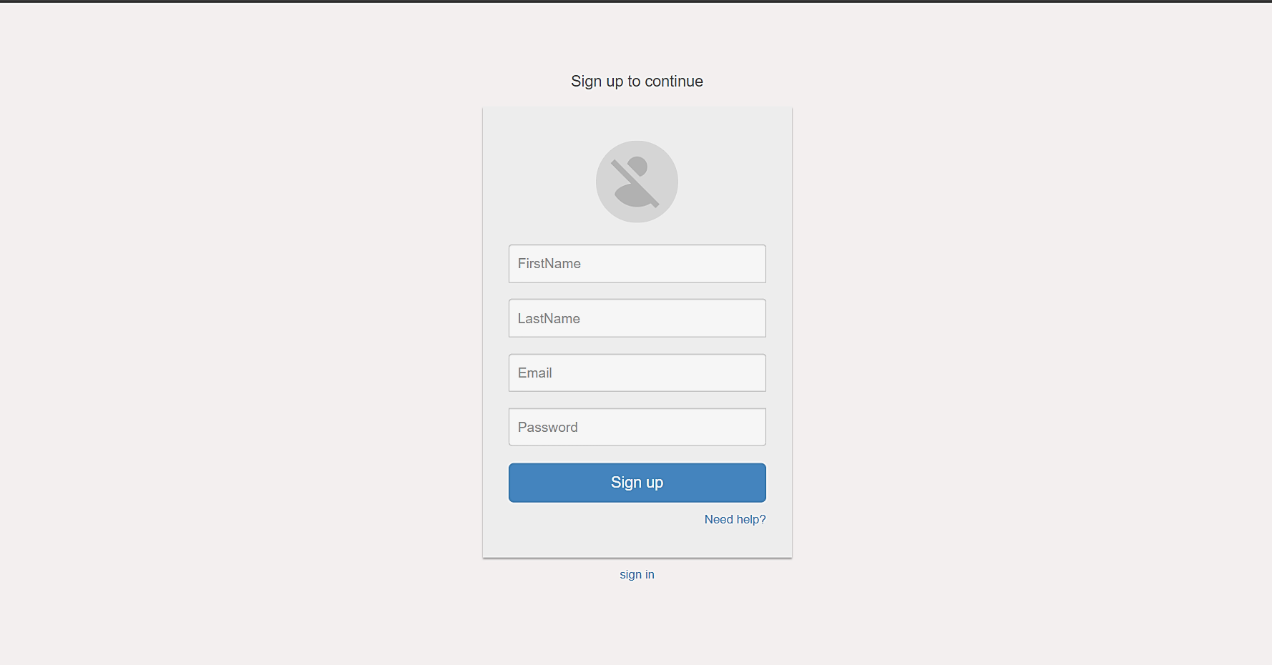
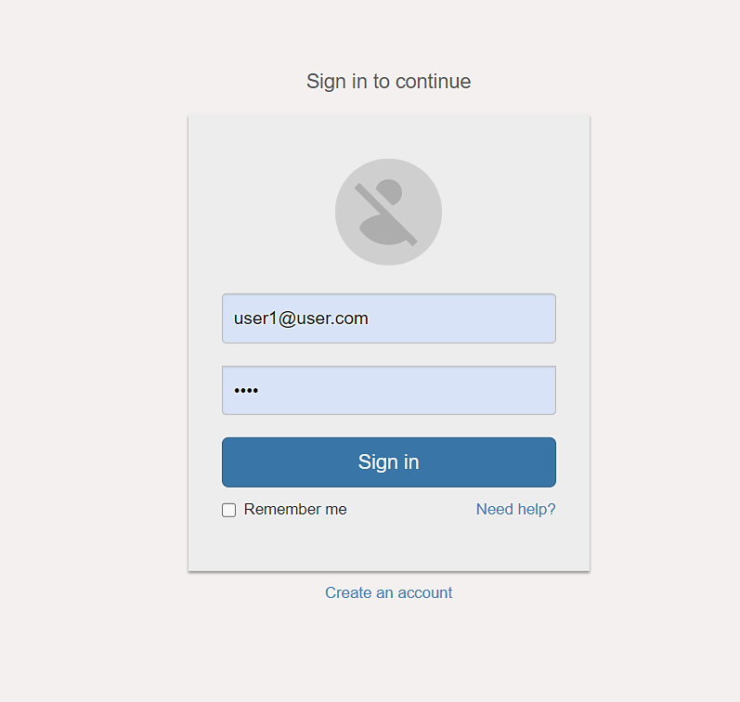
User Login & Signup

Slide 18
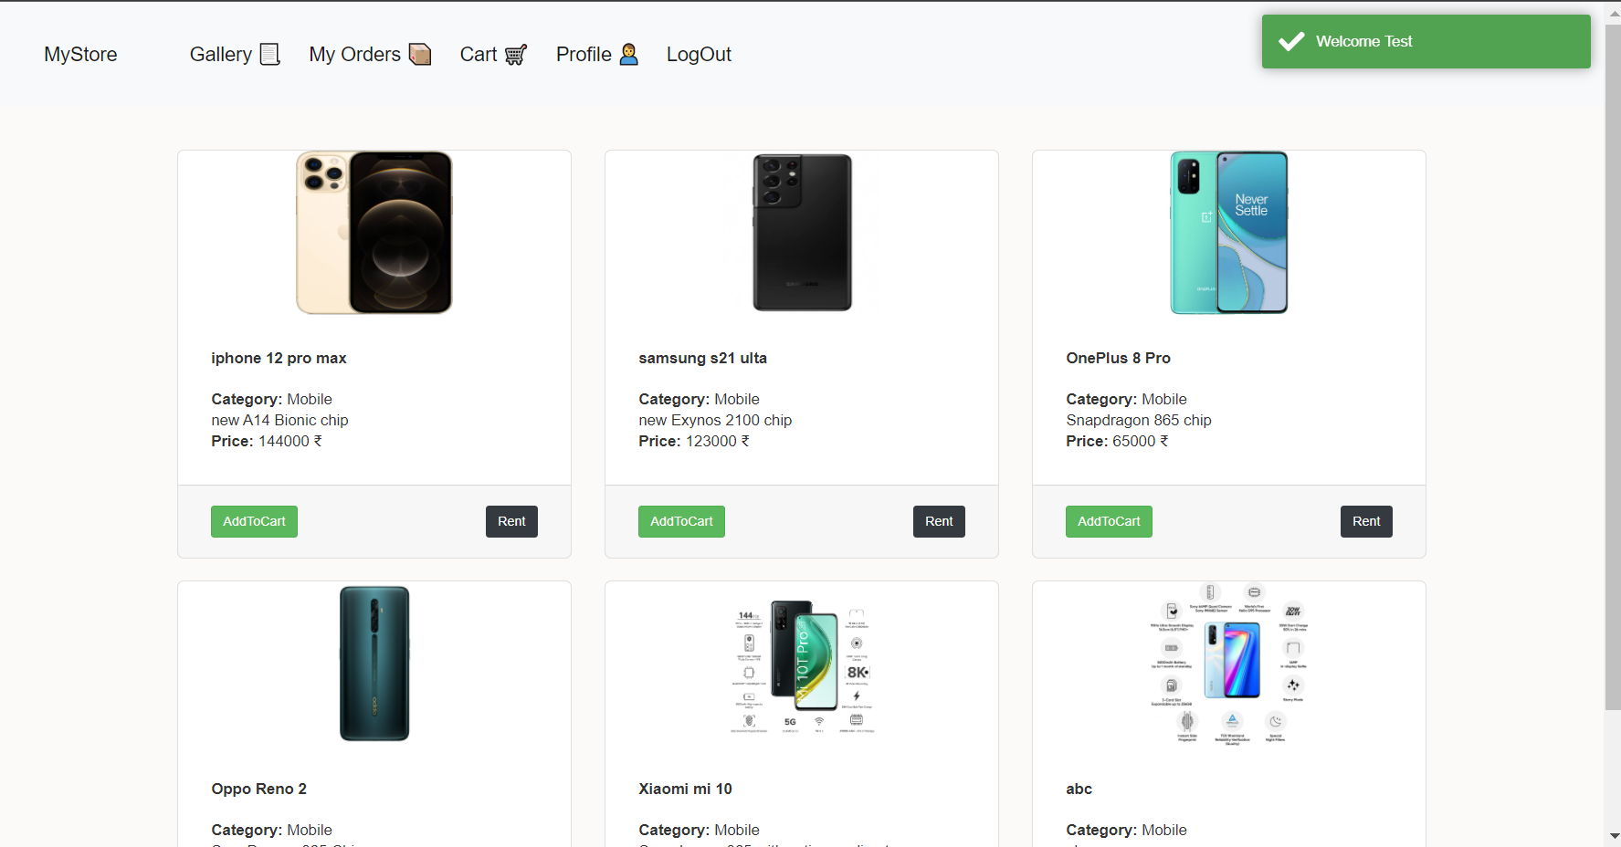
Home Page

Slide 19
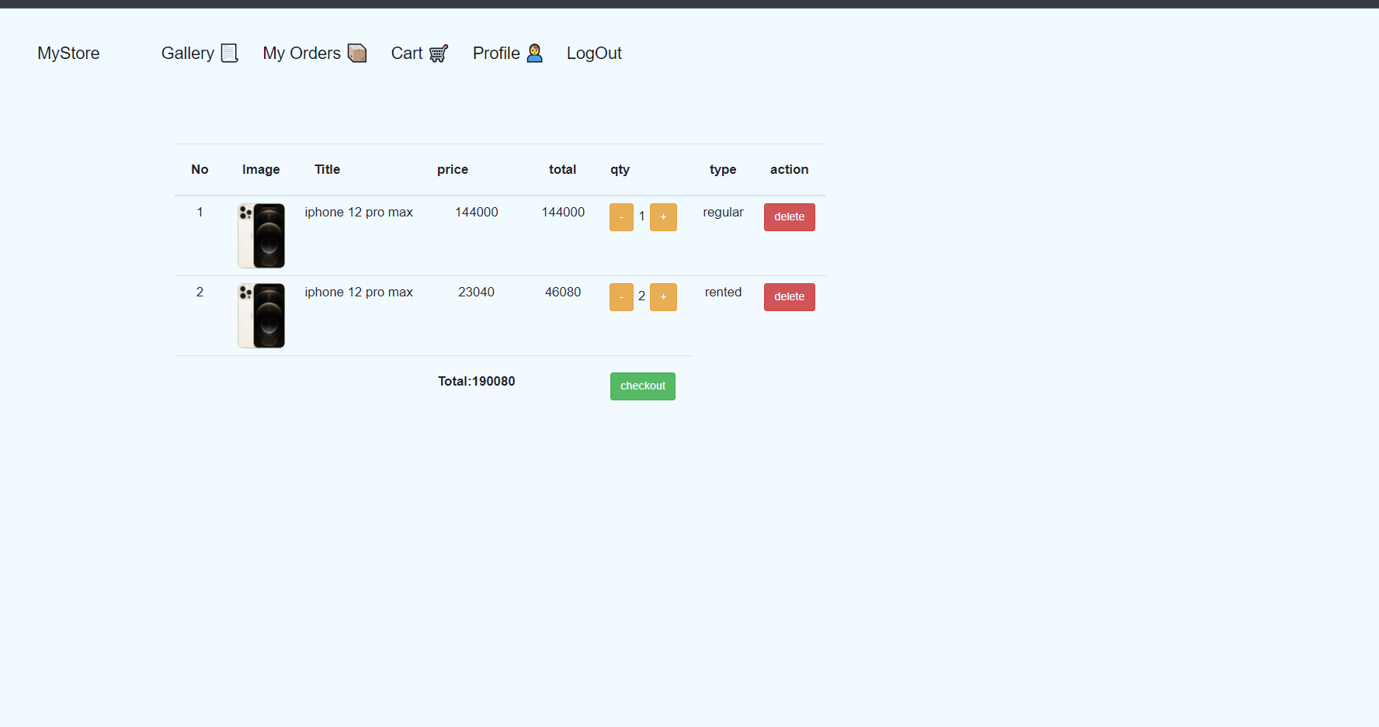
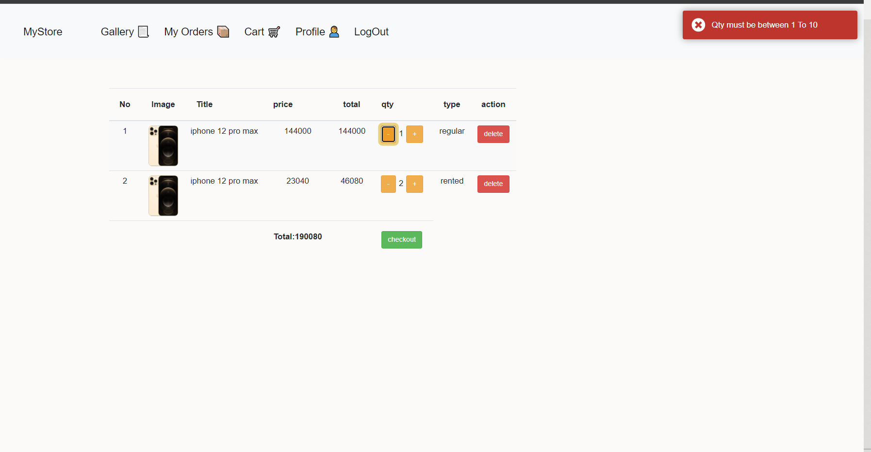
Cart

Slide 20
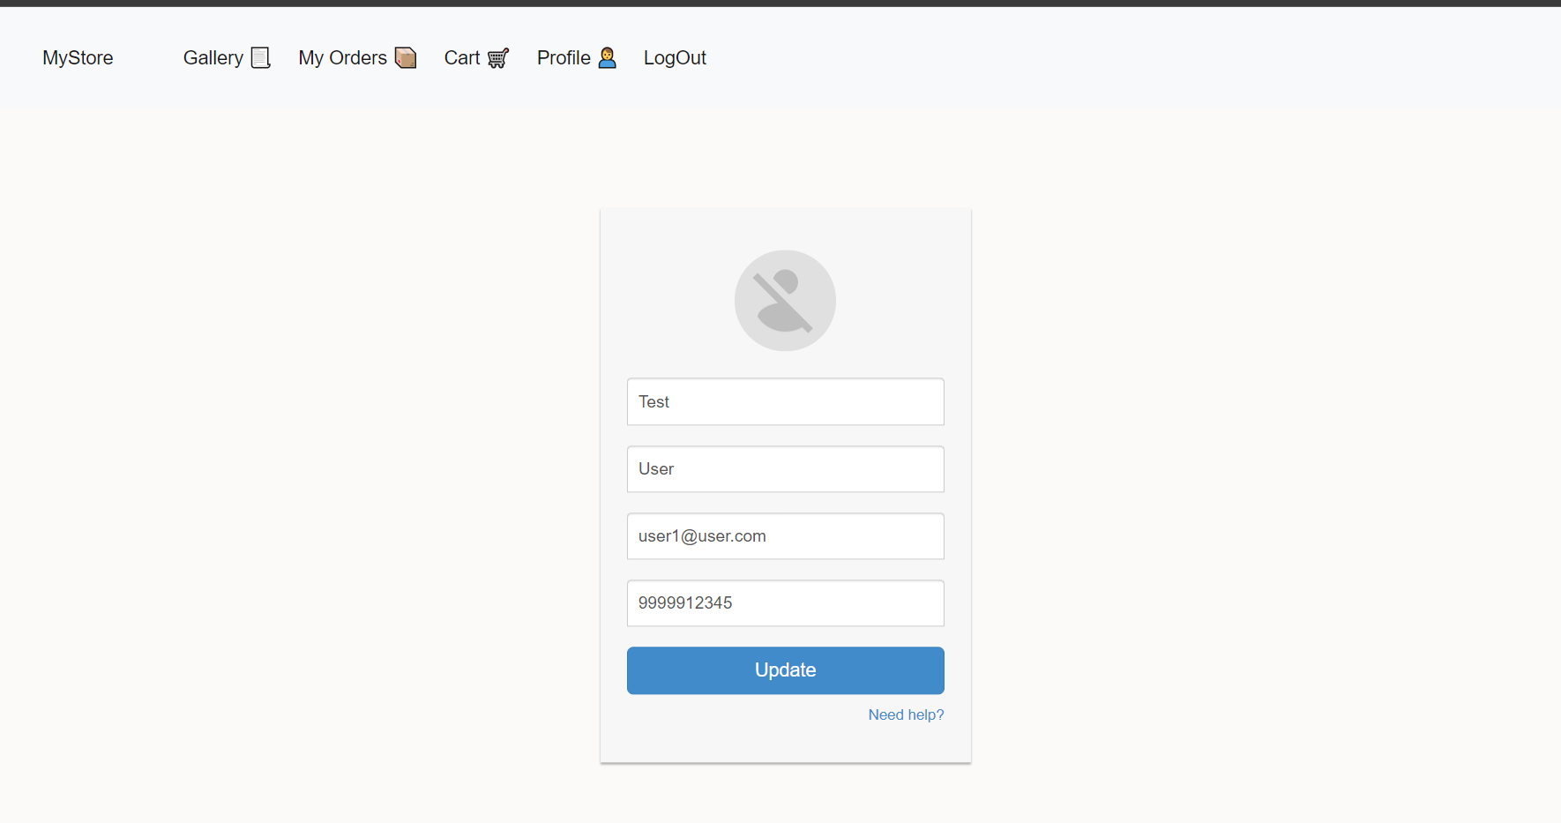
User Profile

Slide 21
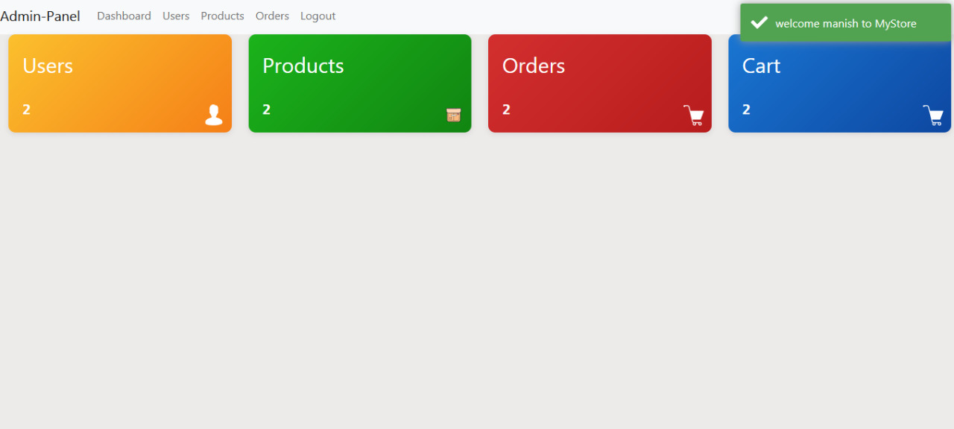
Admin Page

Slide 22
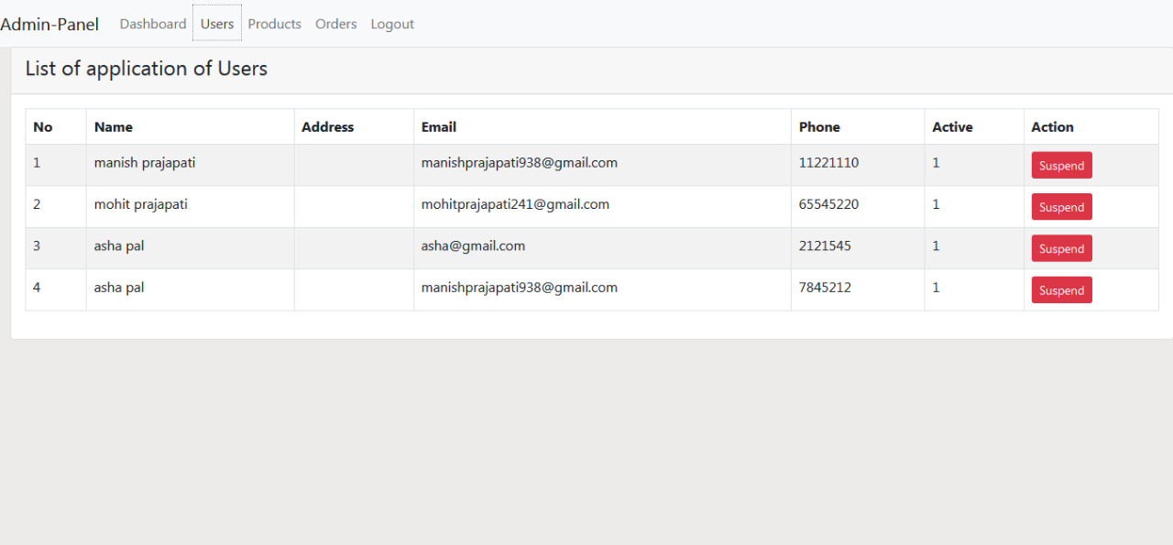
Admin User’s Dashboard

Slide 23
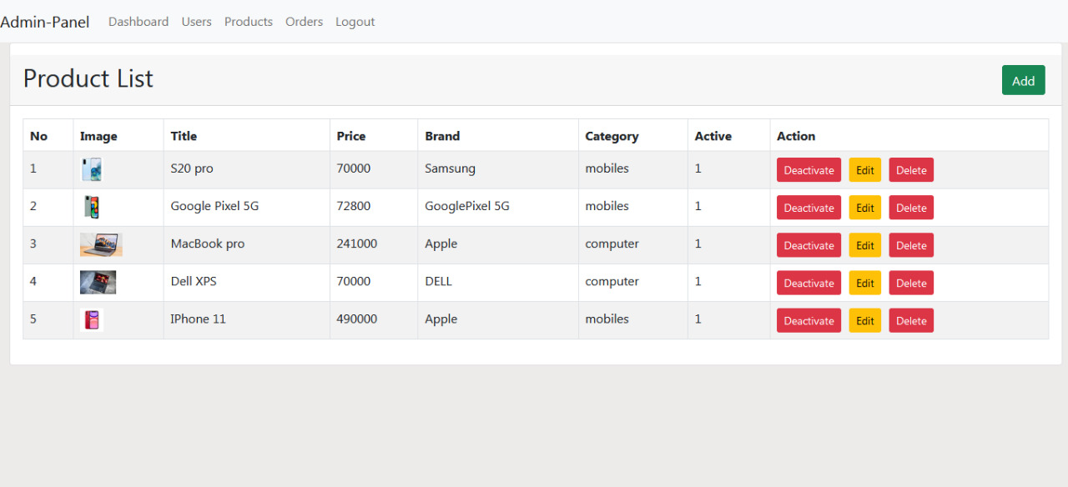
Admin Product Dashboard

Slide 24
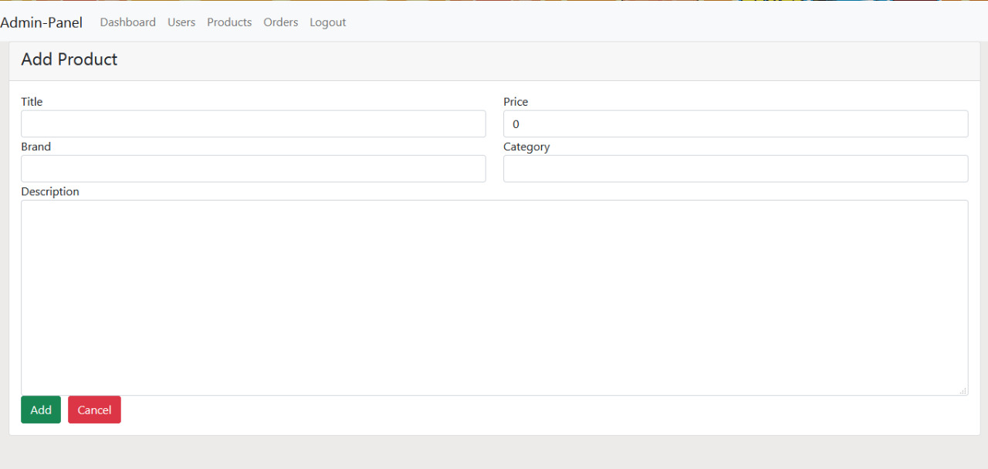
New Product Registration

Slide 25

Thank you!

