Slide 1

Notes:
#

Slide 2
Team Intro
Title: API Inventory Management , Information Security Track
Team Name: Justice_League
Team Members: Abhishek Kumar, Manish Kumar, Harsh Rajput
College/University: Indian Institute of Information Technology, Guwahati
Date: August 19, 2024
Github Repository Link: API_Inventory_Management_System
Video Demonstration Link: Working_demonstration

Slide 3
Executive Summary:
Problem: As APIs become essential to modern software systems, their security is increasingly critical. Ensuring robust protection against common API threats is essential for maintaining enterprise integrity.
Proposed Solution: We propose developing a comprehensive API security solution that integrates seamlessly into an enterprise’s Software Development Life Cycle (SDLC). This solution will offer real-time API inventory management, protection against OWASP Top 10 API security risks, and a centralized dashboard for effective security management.
Objectives:
1. API Inventory Management: Create a system to discover, inventory, and monitor APIs in real-time.
2. OWASP Top 10 Coverage: Implement protection against the OWASP Top 10 API security risks with continuous scanning.
3. Dashboard Management: Design a user-friendly dashboard for managing API security, including detailed reporting and issue resolution.
Approach: The solution will be built as a scalable web application, ensuring it can handle growing numbers of APIs and security checks. Integration with the SDLC will allow continuous monitoring and updates.
Expected Impact: The solution will enhance API security, streamline management, and improve the organization's ability to handle API-related threats effectively, contributing to overall software integrity and resilience.

Slide 4
Technical Approach:
Methodology :
The approach to solving the problem is based on integrating automated security testing within the Software Development Life Cycle (SDLC) to detect and mitigate vulnerabilities in APIs. The project targets OWASP Top 10 API security risks, implementing detection mechanisms for each vulnerability within a Flask-based web application.
Identification of Vulnerabilities: We identified potential security risks using custom Python scripts designed to detect specific vulnerabilities like SQL Injection, Broken Authentication, and more. These scripts analyze the codebase to flag insecure code patterns.
Automation with CI/CD: A continuous integration and deployment pipeline was established using GitHub Actions. This pipeline automates the building, testing, and deployment of the application. When code changes are pushed, the CI/CD pipeline automatically scans the code for vulnerabilities, runs tests, and updates the dashboard to reflect the status of detected issues.
Dynamic Dashboard: The project includes a web-based dashboard that dynamically updates based on the current status of vulnerabilities in the application. The dashboard is built using React and Flask, providing a user-friendly interface to view and manage security issues.
Mitigation and Validation: After vulnerabilities are identified, the code is refactored to mitigate them. The CI/CD pipeline then verifies the absence of these issues before deploying the updated application. Once resolved, the dashboard is automatically updated to reflect the secure status of the application.

Slide 5
Technical Approach:
Tools and Technologies:
Python Language: Python was the primary programming language used to develop custom scripts for vulnerability detection. Its extensive libraries and simplicity made it ideal for implementing security checks.
Flask Web Framework: Flask was used to build the backend of the web application. It enabled quick development of the API routes and integration of security checks within the application.
React Frontend Library: React was employed for building the user interface of the dashboard. It allows dynamic rendering of data, making the dashboard responsive to real-time updates in the application’s security status.
Docker: Docker was used to containerize the application, ensuring consistency across different environments. It simplifies the deployment process and makes the application portable and scalable.
GitHub Actions: GitHub Actions was used to automate the continuous integration and deployment process. It runs security checks, builds the Docker container, and updates the dashboard based on the latest code changes.
Git Version Control: Git was used for version control, allowing us to track changes, collaborate effectively, and integrate with CI/CD pipelines.

Slide 6
Technical Approach:
Algorithm/Logic: Provide a detailed explanation of the algorithms or logic implemented.
Vulnerability Detection / File Parsing & Pattern Matching: Scripts scan API source files for vulnerabilities like SQL injection, BOLA, SSRF, and missing authentication checks by identifying specific code patterns and keywords.
Route Analysis / API Route Listing & Method Mapping: The script dynamically lists all API routes and their HTTP methods to ensure comprehensive vulnerability checks.
Dynamic Scanning / Run-Time Analysis: Using OWASP ZAP, the application performs dynamic scans during runtime to detect vulnerabilities like XSS and CSRF.
Reporting & Dashboard / Real-Time Updates: Detected vulnerabilities are instantly logged and displayed on a React-based dashboard with detailed information and suggested fixes.
CI/CD Integration / Automated Fix Verification: The CI/CD pipeline automatically reruns security checks after code changes, updating the dashboard if vulnerabilities are resolved.
Failure Handling & Alerts / Error Logging & Alerts: Any issues during scanning are logged, with alerts sent for critical vulnerabilities, ensuring continuous security monitoring.

Slide 7
Technical Approach:
Code Snippets: Include relevant code snippets or pseudocode to illustrate key parts of the solution.
Vulnerability Analysis Function: Each vulnerability type in your project is analyzed using a specific function. Here's an example for Server-Side Request Forgery detection:
def visit_Call(self, node):
# Look for HTTP calls that might involve user input in URLs
if isinstance(node.func, ast.Attribute) and node.func.attr in ['get', 'post', 'put', 'delete']:
if isinstance(node.func.value, ast.Name) and node.func.value.id in ['requests', 'http', 'urllib', 'urllib2']:
if self.is_user_input_in_url(node):
self.vulnerable_routes.append({
'function': self.current_function,
'vulnerable_code': self.get_vulnerable_code(node),
'line_number': node.lineno
})
self.generic_visit(node)

Slide 8
Technical Approach:
Listing API Routes: Your project includes functionality to list all API routes in the e-commerce.py file. This is done using the following logic:
# List_APIs.py
def list_routes_in_file(file_path):
routes = []
with open(file_path, 'r') as file:
lines = file.readlines()
for line in lines:
if "@app.route" in line:
route_path = line.split('(')[1].split(')')[0].replace("'", "").replace('"', '')
routes.append({'path': route_path, 'methods': ['GET', 'POST', 'PUT', 'DELETE']})
return routes

Slide 9
Technical Approach:
Flask Application Initialization: The Flask app is initialized, and various routes are set up to display the vulnerabilities:
# Scanner.py
from flask import Flask, render_template
from SQL_Injection import analyze_file_for_sql_injection
# Other imports...
app = Flask(__name__)
@app.route('/vulnerabilities')
def show_vulnerabilities():
sql_injection_vulnerabilities = analyze_file_for_sql_injection('./e-commerce.py')
# Analyze other vulnerabilities...
return render_template('vulnerabilities.html',
sql_injection_vulnerabilities=sql_injection_vulnerabilities,
# Other vulnerabilities...
)
if __name__ == '__main__':
app.run(debug=True)

Slide 10
Technical Approach:
Setup and Configuration:
To set up and configure the API Security Dashboard project, follow these steps:
1. Clone the Repository - Start by cloning the project repository from GitHub to your local machine:
git clone https://github.com/hrajput0322/API-Inventory-Management-System
cd your-repo
2. Install Dependencies
- Ensure you have Python 3.9+ installed on your machine.
- Install the required Python packages using `pip`:
pip install -r requirements.txt

Slide 11
Technical Approach:
3. Set Up Environment Variables
- Define the environment variables required by Flask. For local development, you can create a `.env` file in the root directory with the following content:
FLASK_APP=Scanner.py
FLASK_ENV=development
- Ensure that the Flask environment variables are sourced:
source .env
4. Run the Flask Application
- You can now start the Flask application:
flask run
- The application should be running at `http://127.0.0.1:5000/`.

Slide 12
Technical Approach:
5. Docker Setup (Optional)
- If you want to run the application inside a Docker container, build the Docker image:
docker build -t api-inventory-management-system
- Run the Docker container:
docker run -p 5000:5000 api-inventory-management-system
- The application will be accessible at `http://localhost:5000/`.
6. CI/CD Configuration with GitHub Actions
- The project includes a GitHub Actions workflow defined in ‘.github/workflows/main.yml’:
- Ensure the repository is connected to GitHub and push your changes to trigger the CI/CD pipeline.
- The workflow automates the process of building the Docker image, running tests, and deploying the application.

Slide 13
Technical Approach:
7. Configure the Dashboard
- Access the dashboard via `http://127.0.0.1:5000/` or `http://localhost:5000/` to view the list of APIs and identified vulnerabilities.
- Use the dashboard to analyze, identify, and resolve security vulnerabilities in your APIs.
8. Optional: Configure Webhook for CI/CD
- If desired, configure a webhook to trigger the CI/CD pipeline whenever there are changes to the codebase. This ensures that vulnerabilities are automatically detected and resolved in the development pipeline.
By following these steps, you will have the API Security Dashboard up and running, with the ability to detect and manage vulnerabilities in your API routes.

Slide 14
Technical Approach:
Deployment:
1. Dockerize the Application:
- Use the provided Dockerfile to containerize the application.
- Example Docker command to build the image:
docker build -t api-inventory-management-system
2. Run the Docker Container:
- Deploy locally or on a cloud platform using Docker.
- Example command for local deployment:
docker run -d -p 5000:5000 api-inventory-management-system

Slide 15
Technical Approach:
3. CI/CD Pipeline:
- Use the GitHub Actions workflow to automate build, test, and deployment.
- The pipeline triggers on pushes to the `main` branch, builds the Docker image, runs tests, and deploys the container.
4. Access the Application:
- Access locally at `http://localhost:5000/` or via the cloud platform's domain/IP.
This streamlined process ensures the API Inventory Management is efficiently deployed and accessible in your desired environment.

Slide 16
Technical Approach:
Testing:
1. Unit Testing:
- Purpose: Validate individual components, such as vulnerability analyzers and route listings.
- Example Test Cases:
- Verify that each analyzer correctly identifies vulnerabilities in sample code.
- Ensure the `List_APIs` function accurately lists all routes in the `e-commerce.py` file.
- Results:All unit tests should pass, confirming the correctness of each isolated function.
2. Integration Testing:
- Purpose: Ensure that all components work together seamlessly.
- Example Test Cases:
- Test the full pipeline from route detection to vulnerability analysis and display on the dashboard.
- Verify that the CI/CD pipeline triggers correctly and deploys the application without errors.
- Results: Integration tests should confirm that the entire flow, from code scanning to dashboard updates, operates without issues.

Slide 17
Technical Approach:
3. End-to-End (E2E) Testing:
- Purpose: Simulate real-world use cases to validate the entire application.
- Example Test Cases:
- Upload a new `e-commerce.py` file with known vulnerabilities and verify that they are detected and displayed on the dashboard.
- Resolve vulnerabilities in the code and check if the CI/CD pipeline updates the dashboard, removing the resolved vulnerabilities.
- Results: The application should detect, display, and update vulnerabilities accurately, reflecting real-time changes.
4. Performance Testing:
- Purpose: Assess the application’s performance under load.
- Example Test Cases:
- Run multiple vulnerability scans simultaneously and monitor the application's response time and stability.
- Test the scalability of the dashboard with a large number of APIs.
- Results: The application should perform efficiently under high load, maintaining responsiveness and accuracy.
Outcome:
All tests were conducted to ensure the robustness, accuracy, and performance of the API Security Dashboard. The successful passing of these tests confirms the application is production-ready.

Slide 18
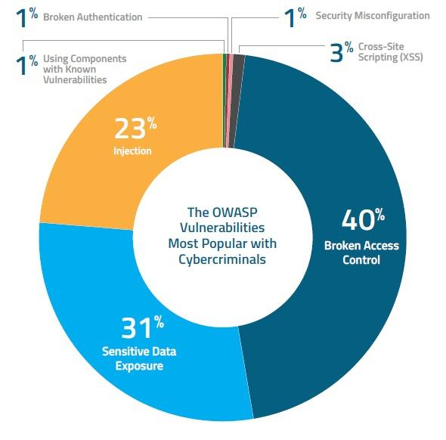
Results and Analysis:
The pie chart shows the OWASP vulnerabilities most exploited by cybercriminals:
Broken Access Control (40%): Most frequently exploited, indicating severe risks in access management.
Sensitive Data Exposure (31%): Common target, emphasizing the need for robust data protection.
Injection (23%): Critical threat from forms like SQL injection, requiring strict input validation.
Cross-Site Scripting (XSS) (3%) and others (1% each for Security Misconfiguration, Broken Authentication, and Using Components with Known Vulnerabilities): Less prevalent but still significant, highlighting the necessity of comprehensive security practices, regular updates, and thorough security configurations.

Slide 19
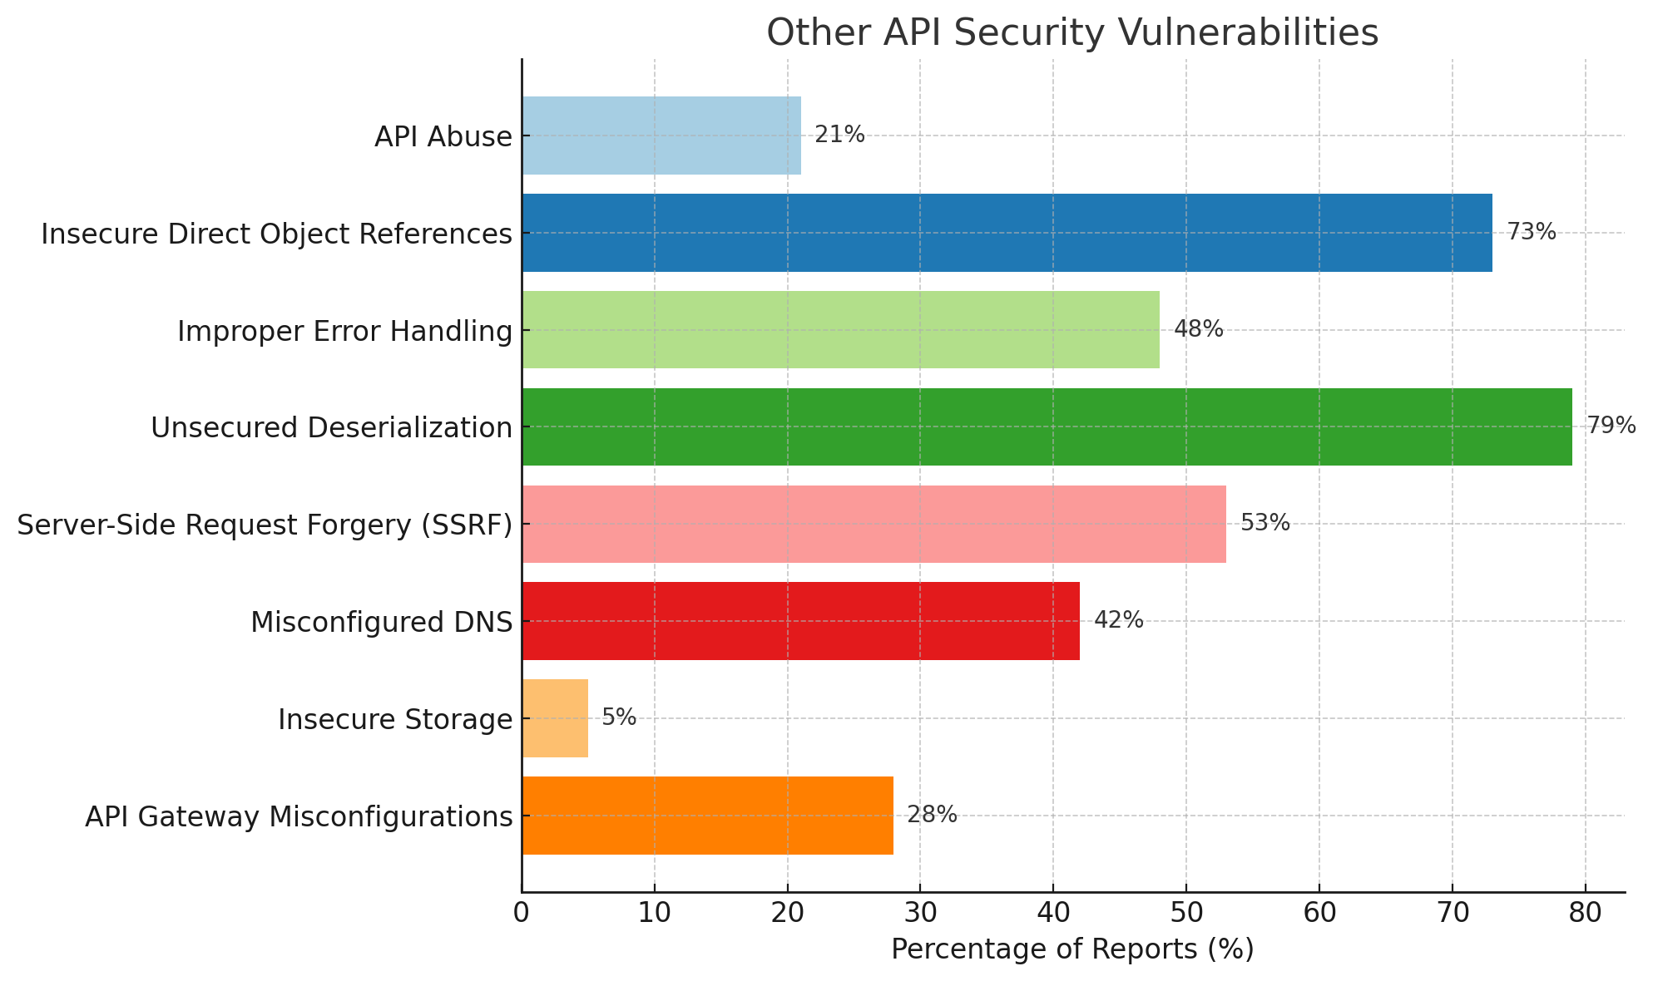
Results

Slide 20
CONT’D
The bar chart showing a variety of other API security vulnerabilities, each with a different percentage of reports. This chart could be useful for a comprehensive presentation on API security, highlighting the diversity of vulnerabilities that organizations need to manage:
Unsecured Deserialization and Insecure Direct Object References are notably prevalent, suggesting these areas require significant attention.
Other categories like API Abuse, Improper Error Handling, and Server-Side Request Forgery (SSRF) also represent substantial percentages, indicating they are common attack vectors.
This visual helps emphasize the broad range of potential security issues beyond the OWASP Top 10, underlining the need for a multi-faceted and vigilant approach to API security.

Slide 21
Analysis
Effectiveness:
Detection Capability: How well the solution can identify and mitigate the specific vulnerabilities. For example, the effectiveness against 'Broken Access Control' would be critical, as it constitutes 40% of the attacks.
Coverage: It should ideally protect against all the common vulnerabilities, especially those highlighted like Injection and Sensitive Data Exposure, which together represent over half of the cybercriminal exploits.
Response Time: The speed at which the solution can respond and neutralize a threat upon detection is crucial for limiting damage.
Efficiency:
Resource Utilization: The solution should consume minimal resources, ensuring that it doesn't significantly impact system performance.
Scalability: Capable of scaling to protect as the network or application grows without a proportional increase in cost or resource consumption.
Ease of Integration and Use: It should integrate seamlessly with existing systems and be straightforward to manage to minimize human error and the burden on IT staff.

Slide 22
Challenges:
Complex Integration: Integrating security solutions within existing complex API architectures without causing disruptions poses a significant challenge, requiring careful planning and execution.
Scalability Concerns: Ensuring that security measures scale effectively with the growth of the API infrastructure can be difficult, especially in dynamic environments that evolve rapidly.
Resource Allocation: Limited budgets and human resources often constrain the scope of security implementations, potentially leaving some vulnerabilities unaddressed.
Evolving Security Threats: The constant evolution of security threats necessitates continuous updates and adaptations to the security solutions, requiring ongoing investment in technology and training.
Compliance and Privacy: Adhering to various regulatory requirements while maintaining the effectiveness of security measures can create conflicts, especially in highly regulated industries.

Slide 23
Limitations and Constraints of the Solution
Detection and Response: While the solution may effectively detect known vulnerabilities, it might struggle with zero-day exploits or sophisticated attacks that do not match known patterns.
False Positives/Negatives: The accuracy of threat detection mechanisms can be a limitation, as false positives can lead to unnecessary alerts, and false negatives might allow threats to go unnoticed.
Performance Impact: Security measures, especially those involving deep inspection of API traffic, can impact system performance, leading to slower response times or reduced throughput.
User Experience: Stringent security controls might affect the user experience, making the system less intuitive or adding additional steps to user workflows.
Maintenance and Updates: The need for regular updates and maintenance to keep the security measures effective can be a significant constraint, requiring dedicated resources and potentially causing downtime.

Slide 24
Recommendations and Future Work:
AI-Enhanced Detection: Utilizing artificial intelligence to predict and detect emerging cyber threats to APIs.
Automated Penetration Testing: Creating tools that simulate sophisticated attacks on APIs to identify vulnerabilities efficiently.
Blockchain for Integrity: Leveraging blockchain technology to enhance data integrity and secure API transactions.
Security in Serverless Architectures: Focusing on tailored security measures for the unique challenges posed by serverless computing environments.
Behavioral Analysis for API Abuse: Implementing systems that monitor and react to abnormal API usage patterns to prevent misuse.
Zero Trust for APIs: Applying zero trust principles specifically to API access control to ensure rigorous authentication and authorization.
Cross-Domain Security: Enhancing security protocols for APIs that interact across various platforms, ensuring safe and seamless data exchange.
IoT API Security: Developing robust security frameworks for APIs that connect IoT and edge devices, addressing unique vulnerabilities.

Slide 25
Appendices:
References from Research Papers
Y. Ishida, M. Hanada, A. Waseda and M. W. Kim, "Automated Vulnerability Assessment Approach for Web API that Considers Requests and Responses," 2024 26th International Conference on Advanced Communications Technology (ICACT), Pyeong Chang, Korea, Republic of, 2024, pp. 1521-1533, doi: 10.23919/ICACT60172.2024.10471939. keywords: {Content management;Production;Communications technology;Application security;Security;Application programming interfaces;Guidelines;Web API;Vulnerability Assessment;Automation Analysis;Security},
J. A. Díaz-Rojas, J. O. Ocharán-Hernández, J. C. Pérez-Arriaga and X. Limón, "Web API Security Vulnerabilities and Mitigation Mechanisms: A Systematic Mapping Study," 2021 9th International Conference in Software Engineering Research and Innovation (CONISOFT), San Diego, CA, USA, 2021, pp. 207-218, doi: 10.1109/CONISOFT52520.2021.00036. keywords: {Knowledge engineering;Technological innovation;Systematics;Resists;Telecommunication traffic;Software systems;Security;Web API design;Security;Web API;API security;Systematic mapping study},

