Slide 1

INDIAN INSTITUTE OF INFORMATION TECHNOLOGY DEPARTMENT OF COMPUTER SCIENCE AND ENGINEERING
PROJECT PRESENTATION
on
Plant Leaf Classification and Information Retrieval Using Vision Transformers and Transfer Learning
Submitted by
Manish kumar
Roll No.:- 2101114 Project Supervisor
Dept:- CSE Dr. Subhasish Dhal

Slide 2
Content
Background
Literature Review
Problem Formulation
Methodology
Algorithm
Technology Summarization
Results
Conclusion and Future Work
References and links

Slide 3
Background
Significance: A reliable and efficient system for identifying plant species, especially in agriculture, forestry, and environmental conservation.
Manual Challenges: Manual classification is time-consuming and requires expert knowledge.
Limitations of Existing Tools: Existing tools may not be tailored for specific applications and often provide a broad range of results, which can be overwhelming and inaccurate.
Automation Benefits: Advances in deep learning and computer vision provide faster, more reliable, and scalable plant classification.
Real-Time Impact:Real-time classification, such as improving productivity for farmers and enabling rapid decision-making in critical situations like disease outbreaks in crops.

Slide 4
Literature review
Plant Species Identification based on Plant Leaf Using Computer Vision and Machine Learning Techniques[1]
Their study focuses on automated plant species identification using plant leaf images, employing Computer Vision and machine learning techniques.
The system involves four main steps: image acquisition, pre-processing, feature extraction, and classification using Multiclass-Support Vector Machine (MSVM).
The Swedish Leaf Dataset, containing 1,125 images of 15 species, was used, achieving a classification accuracy of 93.26%.
[1] Kaur, Surleen & Kaur, Prabhpreet. (2019). Plant Species Identification based on Plant Leaf Using Computer Vision and Machine Learning Techniques. Journal of Multimedia Information System. 6. 49-60. 10.33851/JMIS.2019.6.2.49.

Slide 5
Cont’d
2. Deep Learning for Plant Species Classification[2]
The paper presents an automated plant species classification system using a Convolutional Neural Network (CNN).
The model includes multiple layers, such as convolutional layers for extracting detailed features, pooling layers to reduce dimensionality, and fully connected layers for the final classification.
The process involves image pre-processing , feature extraction (texture and color), and classification with a CNN implemented using TensorFlow.
The model was trained on a dataset of 17 plant species, achieving an accuracy of 94.26%.
[2] Kiran S.Gawli Ashwini S. Gaikwad Mtech 2nd year Student Assistant professor Department Of Computer Science & Engg. Department Of Computer Science & Engg. Deogiri Institute Of Engg.& Management Deogiri Institute Of Engg.& Management Studies, Aurangabad. Studies, Aurangabad.

Slide 6
Cont’d
3. Alexey Dosovitskiy et al., 2021[3]
This study explores the application of Vision Transformers (ViTs) for image classification tasks, traditionally dominated by convolutional neural networks (CNNs).
They treat images as sequences of patches, similar to NLP tokens, avoiding CNN biases.
ViTs can outperform CNNs like ResNets when pre-trained on large datasets (e.g., ImageNet-21k and JFT-300M).
Achieved high accuracy: 88.55% on ImageNet and 94.55% on CIFAR-100 with reduced computational effort.
[3] Dosovitskiy, A., Beyer, L., Kolesnikov, A., Weissenborn, D., Zhai, X., Unterthiner, T., Dehghani, M., Minderer, M., Heigold, G., Gelly, S., Uszkoreit, J., and Houlsby, N. (2021). An image is worth 16x16 words: Transformers for image recognition at scale. Journal of Images. viii, 4, 12

Slide 7
Shortcomings
It uses a dataset of limited number of plant species, which restricts the model's ability to generalize effectively across a larger, more diverse range of plants.
The dataset appears to be captured under controlled conditions, which might not accurately reflect the challenges of real-world environments, like different lighting and backgrounds.
The research does not focus on real-time classification, which could limit the usability of the system in practical scenarios where immediate results are required.
It lacks comparison to newer deep learning models, which could provide better performance and robustness.

Slide 8
Problem Formulation
Current plant leaf classification systems, including CNNs, struggle to capture global features, often overfit on limited datasets, and lack adaptability to varying scales, leading to reduced accuracy and practical usability.
This project develops a real-time plant leaf classification system using Vision Transformers (ViTs)[3] and transfer learning for accurate species identification.
ViTs use a self-attention mechanism to capture global image features, overcoming CNN limitations and improving adaptability across varying scales.
By leveraging pretraining and transfer learning, ViTs reduce overfitting, allowing the model to achieve high performance with less data.
An integrated chatbot powered by Google Gemini Pro AI enhances user experience by providing instant, detailed information on identified plant species.

Slide 9
Methodology
Building an advanced plant species classification system, integrating deep learning, transfer learning, and AI-driven information retrieval.
Model : Fine-tuned Vision Transformer (ViT) for plant classification using transfer learning.
AI-Powered Chatbot: Google Gemini Pro LLM provides detailed plant insights interactively.
Streamlit Interface: Real-time plant classification via a user-friendly GUI.

Slide 10
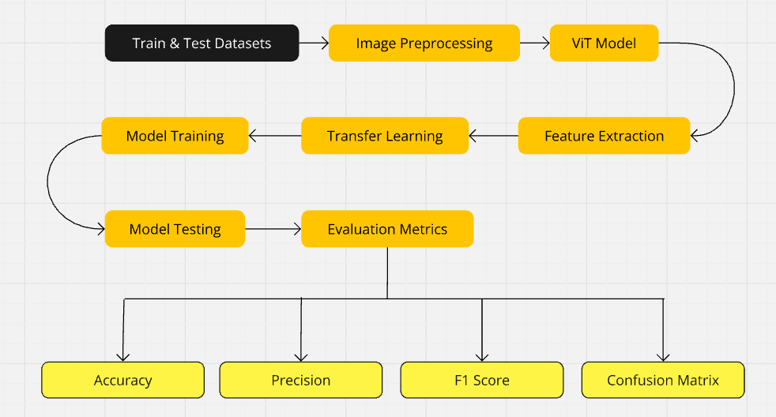
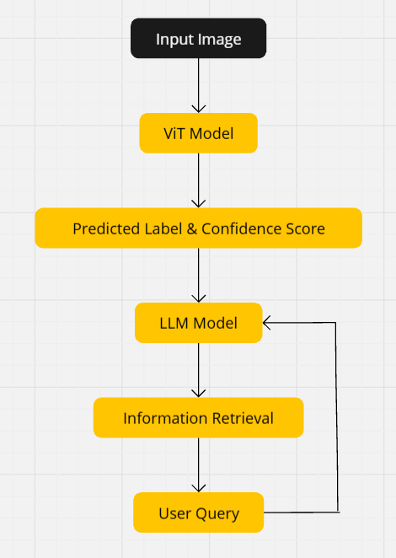

Slide 11
Algorithm
Image Preprocessing: Automate data handling with resizing, normalization, and augmentation (rotations, flips, shifts) for better generalization.
Feature Extraction: Utilize Vision Transformers (ViT) pre-trained on ImageNet by dividing images into patches, removing top layers, and adding a custom classifier for plant species classification.
Transfer Learning: Freeze initial layers of ViT, add a custom classifier (Linear layer (512 units) → ReLU activation → Dropout (0.5) → Output layer (matching number of classes)) and fine-tune final layers on the plant dataset for enhanced accuracy and faster convergence.
Model Training: Employed Adam optimizer (learning rate 0.001), Cross-entropy loss, learning rate scheduler (0.1 reduction every 5 epochs), and early stopping (patience of 3 epochs) to optimize model performance and prevent overfitting.

Slide 12
Cont’d
Model Testing: The model was evaluated on the test dataset using batch processing to calculate validation loss and accuracy, achieving a final accuracy score based on correct predictions against the total samples.
Generative AI Integration: Utilizes Google Generative AI to provide detailed information on plant leaves, seamlessly integrated with a chatbot powered by Gemini Pro LLM for real-time interaction.
Streamlit GUI Integration: Provides an interactive, web-based interface for users to upload plant leaf images.

Slide 13
TECHNOLOGY SUMMARIZATION
Framework: PyTorch
Python Version: 3.11.5
Key Libraries: torch, torchvision, transformers, scikit-learn, matplotlib, seaborn
Generative AI Integration: langchain-google-genai, langchain[openai,all], langchain-community, sentence-transformers
Hardware: NVIDIA A100 GPUs with CUDA
GUI Development: Streamlit

Slide 14
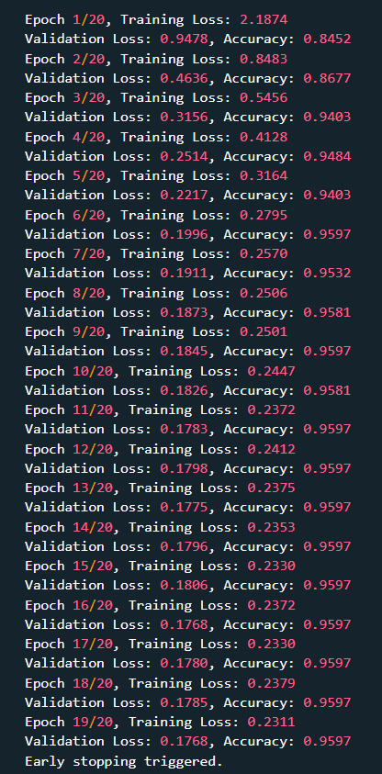

Results
Model Training Result

Slide 15
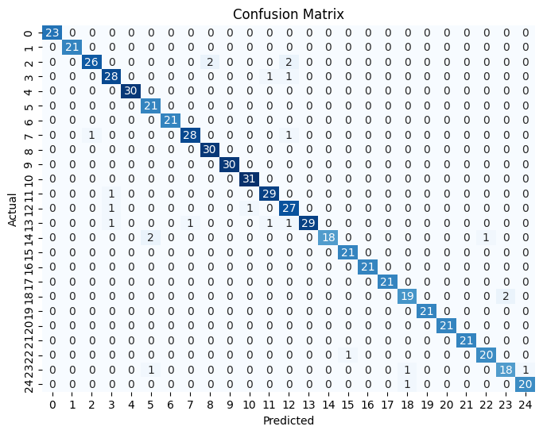
Cont’d

Slide 16
Conclusion
The model trained on a dataset of 25 classes with a total of 1,875 images, achieved a high accuracy of 95.97%, with precision, recall, and F1-score each at 0.96, demonstrating the effectiveness of Vision Transformers and transfer learning in automating plant leaf classification. This significantly reduces manual effort in species identification.
Additionally, integrating a chatbot powered by Google Generative AI (Gemini Pro) enriches user interaction by delivering real-time, informative insights about identified plant species, enhancing both accessibility and engagement.

Slide 17
Future Works
Multilingual Support: Implementing multiple language options in both the
classification model and chatbot to broaden accessibility, especially in regions
critical to plant conservation and research.
Disease Detection: Expanding the model to identify plant diseases from leaf symptoms, enabling early intervention in agriculture and aiding conservation efforts.

Slide 18
References and Links :
[1] Kaur, Surleen & Kaur, Prabhpreet. (2019). Plant Species Identification based on Plant Leaf Using Computer Vision and Machine Learning Techniques. Journal of Multimedia Information System. 6. 49-60. 10.33851/JMIS.2019.6.2.49.
[2] Kiran S.Gawli Ashwini S. Gaikwad Mtech 2nd year Student Assistant professor Department Of Computer Science & Engg. Department Of Computer Science & Engg. Deogiri Institute Of Engg.& Management Deogiri Institute Of Engg.& Management Studies, Aurangabad. Studies, Aurangabad.
[3] Dosovitskiy, A., Beyer, L., Kolesnikov, A., Weissenborn, D., Zhai, X., Unterthiner, T., Dehghani, M., Minderer, M., Heigold, G., Gelly, S., Uszkoreit, J., and Houlsby, N. (2021). An image is worth 16x16 words: Transformers for image recognition at scale. Journal of Images. viii, 4, 12

Slide 19
THANK YOU

