Slide 1
Python Programming

Slide 2
Python Features
Open source
No compiling or linking
No type declarations
High-level data types and operations
Object-oriented programming

Slide 3
Running Programs on UNIX
Call python program via the python interpreter
python sample.py

Slide 4
The print Statement
Produces text output on the console.
Example:
print "Python"
Result: Python
version= 3
print "Python version is", version, "..."
Result: Python version is 3...

Slide 5
The input Statement
Example:
version=input(“Enter the Python version:”)
print “Python version is”, version
Result:
Enter the Python version: 3
Python version is 3

Slide 6
Variables
Variables are not declared, just assigned
The variable is created the first time you assign it a value
You can assign to multiple names at the same time
x, y = 2, 3
print x
Result: 2
Assignments can be chained
a = b = x = 2
Simple syntax for swap two values
x, y = y, x

Slide 7
Operators
Relational operators:
==, !=, <, >, <=, >=
Logical operators
and , or, not
Example:
9 != 6 and 2 < 3 //True
not 7 > 0 //False

Slide 8
‘in’ Operator
Boolean test whether a value is inside a container
t = [1, 2, 4, 5]
3 in t //False
4 in t //True
4 not in t //False
For strings, tests for substrings
str = 'abcde'
'c' in str //True
'cd' in str //True
'ac' in str //False

Slide 9
‘+’ Operator
The + operator produces a new tuple, list, or string whose value is the concatenation of its arguments.
(1, 2, 3) + (4, 5, 6)
Result: (1, 2, 3, 4, 5, 6)
[1, 2, 3] + [4, 5, 6]
Result: [1, 2, 3, 4, 5, 6]
“python” + “ ” + “language”
Result: ‘python language’

Slide 10
‘*' Operator
The * operator produces a new tuple, list, or string that “repeats” the original content.
(1, 2, 3) * 3
Result: (1, 2, 3, 1, 2, 3, 1, 2, 3)
[1, 2, 3] * 3
Result: [1, 2, 3, 1, 2, 3, 1, 2, 3]
“python” * 3
Result: ‘pythonpythonpython’

Slide 11
Math commands
Python has useful commands for performing calculations.
To use many of these commands, you must write the following at the top of your Python program:
from math import *
Command name | Description
abs(value) | absolute value
ceil(value) | rounds up
cos(value) | cosine, in radians
floor(value) | rounds down
log(value) | logarithm, base e
log10(value) | logarithm, base 10
max(value1, value2) | larger of two values
min(value1, value2) | smaller of two values
round(value) | nearest whole number
sin(value) | sine, in radians
sqrt(value) | square root
Constant | Description
e | 2.7182818...
pi | 3.1415926...

Slide 12
Data Types
Integers
Floating Point
Complex: 3 + 2j
Lists: l = [ 1,2,3]
Tuples: t = (1,2,3)
Dictionaries: d = {‘name': ‘python, 'version’ : 3}

Slide 13
int to float, float to int conversion
int(x) - converts x to an integer
Example:
ans=int(2.2)
print ans
Result: 2
float(x) - converts x to a floating point
Example:
ans=float(2)
print ans
Result : 2.0

Slide 14
String
Strings are immutable
+ is used to do string concatenation
Example:
str1=”Python'
str2=”Language”
print str1+ “ “ + str2
Result: Python Language

Slide 15
String Operations
len(string) - number of characters in a string
str.lower(string) - lowercase of a string
str.upper(string) - uppercase of a string
str(Object) - returns a String representation of the Object
Example: str(10.67) is '10.67'
ord(text) - converts a string into a number
Example: ord("a") is 97
chr(number) - converts a number into a string
Example: chr(99) is "c"
substring:
str = “Python”
str[1] // y

Slide 16
List
List: [ ‘string’, 2, (3+2j)]
Mutable ordered sequence of items of mixed types
List: Modifying Content
Example:
x=[1,2,3]
y=x
x.append(4)
print x // [1,2,3,4]
print y // [1,2,3,4]

Slide 17
List: Modifying Content
The method append modifies the list and returns None
List addition (+) returns a new list
Example:
x = [1,2,3]
y = x
z = x.append(6)
print z // None
print y // [1, 2, 3, 6]
x = x + [12,24]
print x // [1, 2, 3, 6,12,24]
print y // [1, 2, 3, 6]

Slide 18
Tuple
Tuple:
A simple immutable ordered sequence of items
Items can be of mixed types
substring operation:
x = (1,2,3) // x is a tuple
x[1:] // (2, 3)

Slide 19
Dictionaries
A set of key-value pairs
Dictionaries are mutable
Example:
d={'name':'Python','version’:3}
print d //{'version’: 3, 'name': 'Python'}
print d['name'] //'Python'

Slide 20
Dictionaries: Modify / Add / Delete Operations
Modify:
d={'name':'Python','version’:2}
print d //{'version’: 2, 'name': 'Python'}
d['version']= 2.7
print d //{'version': 2.7, 'name': 'Python'}
Add:
d['platform']='linux'
print d //{'version': 2.7, 'name': 'Python', 'platform': 'linux'}
Delete:
del (d['platform'])
print d //{'version': 2.7, 'name': 'Python'}

Slide 21
Conditional Statement
if statement: Executes a group of statements only if a certain condition is true. Otherwise, the statements are skipped.
Syntax:
if condition:
statements
Example:
a,b = 10,10.01
if a < b:
print "a is smaller than b"

Slide 22
if/else Statement
if/else statement: Executes one block of statements if a certain condition is True, and a second block of statements if it is False.
Syntax:
if condition:
statements
elif condition:
statements
else:
statements

Slide 23
while Statement
Executes a group of statements as long as a condition is True.
good for indefinite loops (repeat an unknown number of times)
Syntax:
while condition:
statements
Example:
n= 1
while n< 100:
print n
n= n* 2
Result:
1 2 4 8 16 32 64

Slide 24
for loop
for loop: Repeats a set of statements over a group of values.
Syntax:
for variableName in groupOfValues:
statements
We indent the statements to be repeated with tabs or spaces.
variableName gives a name to each value, so you can refer to it in the statements.
groupOfValues can be a range of integers, specified with the range function.

Slide 25
for loop Example
for x in range(1, 5):
print "square of”,x,”is",x * x
Output:
square of 1 is 1
square of 2 is 4
square of 3 is 9
square of 4 is 16

Slide 26
range()
The range function specifies a range of integers:
range(start, stop) - the integers between start (inclusive) and stop (exclusive)
range(start, stop, step) - the integers between start (inclusive) and stop (exclusive) by step
Example:
for x in range(5, 0, -1): for x in range(1, 6, 1):
print x print x
Output: Output:
5 1
4 2
3 3
2 4
1 5

Slide 27
File
infile = open(‘data1.txt’, ‘r’) | Open the file ‘data’ for input
str= infile .read() | Read whole file into one String
str= infile .read(N) | Reads N bytes (N >= 1)
lines = infile .readlines() | Returns a list of line strings

Slide 28
File
outfile = open(‘data2.txt’, ‘w’) | Open the file ‘data’ for writing
outfile .write(str) | Writes the string str to file
outfile .close() | Closes the file

Slide 29
File Example
infile=open("test.txt",'r')
str1=infile.read(5)
print "Read first five characters from the file:",str1
infile=open("test.txt",'r')
str2=infile.read()
print "Read the whole file:",str2
infile=open("test.txt",'r')
count=0
for line in infile:
count = count + 1
print 'Line Count in the file:',count
#write in file
outfile=open("test1.txt",'w')
outfile.write("Python is a high-level, interpreted, interactive and object-oriented scripting language")
outfile.close()
infile=open("test1.txt",'r')
print infile.read()

Slide 30
FUNCTION:
A function is a block of organized, reusable sets of instructions that is used to
perform some related actions.
Re-usability of code minimizes redundancy (Unnecessary Repeatance).
Procedural decomposition makes things organized.
Function
Built-in Function
User Defined Function
USER-DEFINED FUNCTION:
User Defined Function are the one which is written by the programmer
and used anywhere in the program.

Slide 31
Functions
def myfun(x, y):
return x * y
a=myfun(3, 4)
print “Value of a is”,a // Value of a is 12
Function blocks begin with the keyword def followed by the function name and parentheses ( ).
Any input parameters or arguments should be placed within these parentheses.
The code block within every function starts with a colon : and is indented.

Slide 32
Modules
Modules are files containing Python definitions and statements (ex. name.py)
A module’s definitions can be imported into other modules by using “import name”
The module’s name is available as a global variable value
To access a module’s functions, type “name.function()”
Example:
import math
print("The value of pi is", math.pi)

Slide 33
Basic GPIO Programming

Slide 34
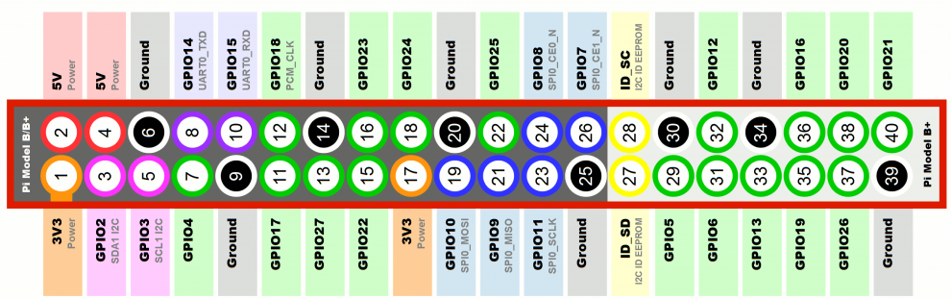

Slide 35
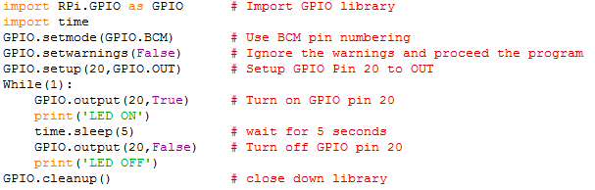
Blinking LED

Slide 36
import RPi.GPIO as GPIO
GPIO library is used for interacting with the GPIO in Python
GPIO.setmode(GPIO.BCM)
set up BCM (Broadcom) GPIO numbering
GPIO.setup(20,GPIO.OUT)
Set the GPIO pin 20 to output
GPIO.output(20,True)
Turn on GPIO pin 20
GPIO.cleanup()
close down library

Slide 37
Switch
import RPi.GPIO as GPIO #Import GPIO library
import time
GPIO.setmode(GPIO.BCM) # Use BCM pin numbering
GPIO.setwarnings(False) #Ignore the warnings and proceed the program
GPIO.setup(20,GPIO.OUT) #Set GPIO Pin 20 to OUT
GPIO.setup(16,GPIO.IN,pull_up_down=GPIO.PUD_DOWN) #GPIO pin 16 is the input
while True:
status=GPIO.input(16) #Read input value from Pin 16
if(status==1):
GPIO.output(20,1) #Turn on GPIO pin 20
print 'LED ON'
else:
GPIO.output(20,0) #Turn off GPIO pin 20
print 'LED OFF'
GPIO.cleanup() #close down library

Slide 38
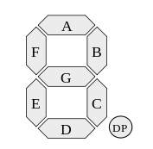
Seven segment display
GPIO.setup(18,GPIO.OUT) – set pin 18 for first
seven segment
GPIO.output(18,1)
GPIO.setup(12,GPIO.OUT) – set pin 12 for ‘A’
GPIO.setup(16,GPIO.OUT) - set pin 16 for ‘B’
GPIO.setup(20,GPIO.OUT) - set pin 20 for ‘C’
GPIO.setup(21,GPIO.OUT) - set pin 21 for ‘D’
GPIO.setup(23,GPIO.OUT) - set pin 23 for ‘E’
GPIO.setup(24,GPIO.OUT) - set pin 24 for ‘F’
GPIO.setup(25,GPIO.OUT) - set pin 25 for ‘G’

Slide 39
SMTP Mail Server
(SMTP) Simple Mail Transfer Protocol
used to communicate with mail servers from external services

Slide 40
Gmail's Default SMTP Settings
Gmail's Default SMTP Settings
Gmail SMTP server address: smtp.gmail.com
Gmail SMTP username: Your Gmail address (e.g. example@gmail.com)
Gmail SMTP password: Your Gmail password
Gmail SMTP port (TLS): 587
Gmail SMTP port (SSL): 465

Slide 41
Send Gmail using SMTP
import smtplib
library in Python to send email
server = smtplib.SMTP("smtp.gmail.com", 587)
parameters(server location, port) for the Gmail server
server.starttls()
starttls () method to upgrade the connection to secure
server.login(gmail_user, gmail_pwd)
server.sendmail(FROM, TO, msg.as_string())
msg.as_string() - Converts the Multipart msg into a string
server.sendmail () - sending the mail

Slide 42
Exception handling
try: f = open("file.txt") except IOError: print "Could not open“ else: f.close()
a = [1,2,3] try: a[7] = 0 except (IndexError,TypeError): print "IndexError caught”

Slide 43
Class & Objects:
Object:
Anything and everything in the real world are defined as objects.
Objects have states and behaviors.
Example:
Dog, have states – color, name, breed, behavior etc…
Car, also have states – color, model number, fuel type etc…
Class:
A class is defined as a template/ blue print that describes the state/ and behavior of the object in it.
A class can have many objects.

Slide 44
Example:
class Human:
def _init_(self, name, occupation):
self.name = name
self.occupation = occupation
def do_work(self):
if self.occupation == “cricketer”:
print(self.name,”cricketer”)
elif self.occupation == “actor”
print(self.name,”shoots film”)
def speaks(self):
print(self.name,”says how are you?”)
sachin = Human(“Sachin Tendulkar”,”cricketer”)
sachin.do_work()
sachin.speaks()
tom = Human(“Tom Cruise”,”actor”)
tom.do_work()
tom.speaks()

Slide 45
OOPS Concept In Python:
Inheritance
Encapsulation
Abstraction
Inheritance:
A class can inherit attributes and behavior from another class is called super class.
A class inherit from a super class is also called as subclass or child class

Slide 46
Encapsulation:
Encapsulation is the method of binding the data and code together as a single unit.
Securing the data by hiding the implementation details to the user
In python you can restrict access to methods and variables , this prevents the data being modified accidentally.
It is possible by “Private Method” here the function cannot be called on the object directly.
These private functions can be called only within the class only.
Private attribute will be denoted by two underscores in the beginning
Eg: __its private()

Slide 47
Abstraction:
Abstraction basically hides the implementation details and only provides the functionality to the user.
We can achieve abstraction using abstract classes and interfaces.
Eg: A mechanical engineer will have the knowledge about the inside and the out of the car, but a driver need not to know all these details.
Abstract class is similar to ordinary class itself.
But there will not be any object for the abstract class ,we need to inherit from other class.

Slide 48
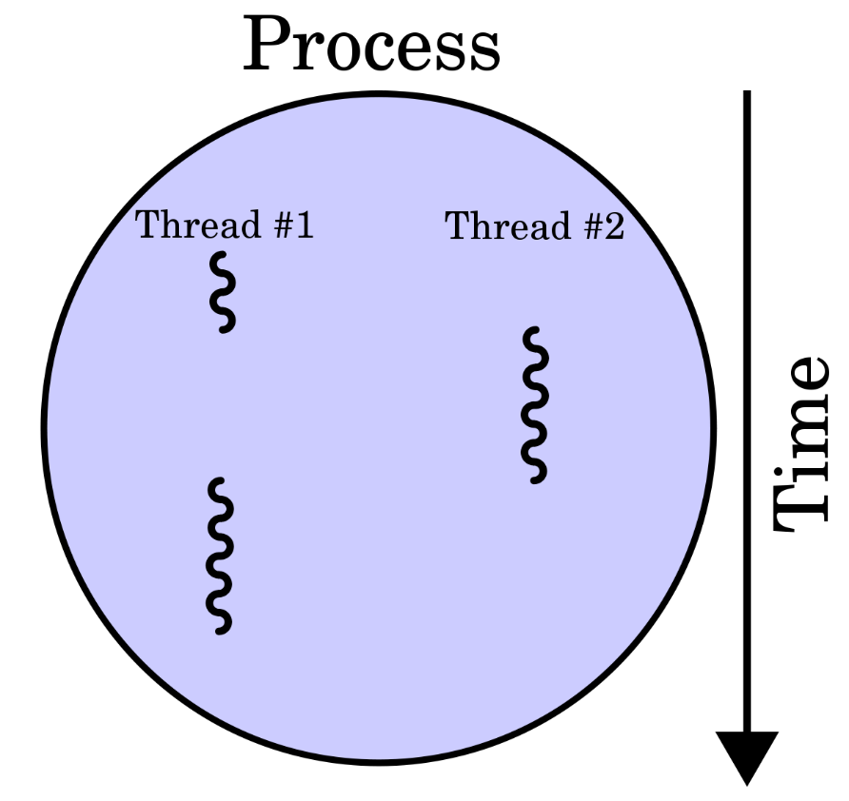
Multi Threading
Multiple threads within a process share the same data space with the main thread and can therefore share information or communicate with each other more easily than if they were separate processes.
A thread has a beginning, an execution sequence, and a conclusion. It has an instruction pointer that keeps track of where within its context it is currently running.

Slide 49
#!/usr/bin/python
import thread
import time
# Define a function for the thread
def print_time( threadName, delay):
count = 0
while count < 5:
time.sleep(delay)
count += 1
print ("%s: %s" % ( threadName, time.ctime(time.time()) ))
# Create two threads as follows
try:
thread.start_new_thread( print_time, ("Thread-1", 2, ) )
thread.start_new_thread( print_time, ("Thread-2", 4, ) )
except:
print ("Error: unable to start thread")
while 1:
pass

Slide 50
Python in Image Processing

Slide 51
Image Processing using OpenCV library
# 1 cv2.IMREAD_COLOR : Loads a color image. Any transparency of image will be neglected. It is the default flag.
# 0 cv2.IMREAD_GRAYSCALE : Loads image in grayscale mode
# -1 cv2.IMREAD_UNCHANGED : Loads image as such including alpha channel
Read an image
import numpy as np
import cv2
Img = cv2.imread(‘hqdefault.jpg',0)
Display an image
cv2.imshow('image',img)
cv2.waitKey(0)
cv2.destroyAllWindows()

Slide 52
Write an image
cv2.imwrite('gray.png',img)
Example:
import numpy as np
import cv2
img = cv2.imread('messi5.jpg',0)
cv2.imshow('image',img)
k = cv2.waitKey(0)
if k == 27: # wait for ESC key to exit
cv2.destroyAllWindows()
elif k == ord('s'): # wait for 's' key to save and exit
cv2.imwrite('messigray.png',img)
cv2.destroyAllWindows()

Slide 53
Using Matplotlib
import numpy as np
import cv2
from matplotlib import pyplot as plt
img = cv2.imread(‘hqdefault.jpg',0)
plt.imshow(img, cmap = 'gray', interpolation = 'bicubic')
plt.xticks([]), plt.yticks([]) # to hide tick values on X and Y axis
plt.show()

Slide 54
Capture Video from Camera
import numpy as np
import cv2
cap = cv2.VideoCapture(0)
while(True):
# Capture frame-by-frame
ret, frame = cap.read()
# Our operations on the frame come here
gray = cv2.cvtColor(frame, cv2.COLOR_BGR2GRAY)
# Display the resulting frame
cv2.imshow('frame',gray)
if cv2.waitKey(1) & 0xFF == ord('q'):
break
# When everything done, release the capture
cap.release()
cv2.destroyAllWindows()

Slide 55
Drawing Functions
Drawing Line
import numpy as np
import cv2
# Create a black image
img = np.zeros((512,512,3), np.uint8)
# Draw a diagonal blue line with thickness of 5 px
img = cv2.line(img,(0,0),(511,511),(255,0,0),5)

Slide 56
Drawing Rectangle
img = cv2.rectangle(img,(384,0),(510,128),(0,255,0),3)
Drawing Circle
img = cv2.circle(img,(447,63), 63, (0,0,255), -1)
Inserting Text in Image
cv2.putText(img,'OpenCV',(10,500), font, 4,(255,255,255),2,cv2.LINE_AA)

Slide 57
A demo
import cv2
import numpy as np
# mouse callback function
def draw_circle(event,x,y,flags,param):
if event == cv2.EVENT_LBUTTONDBLCLK:
cv2.circle(img,(x,y),100,(255,0,0),-1)
# Create a black image, a window and bind the function to window
img = np.zeros((512,512,3), np.uint8)
cv2.namedWindow('image')
cv2.setMouseCallback('image',draw_circle)
while(1):
cv2.imshow('image',img)
if cv2.waitKey(20) & 0xFF == 27:
break
cv2.destroyAllWindows()

Slide 58
Python in Machine Learning

Slide 59
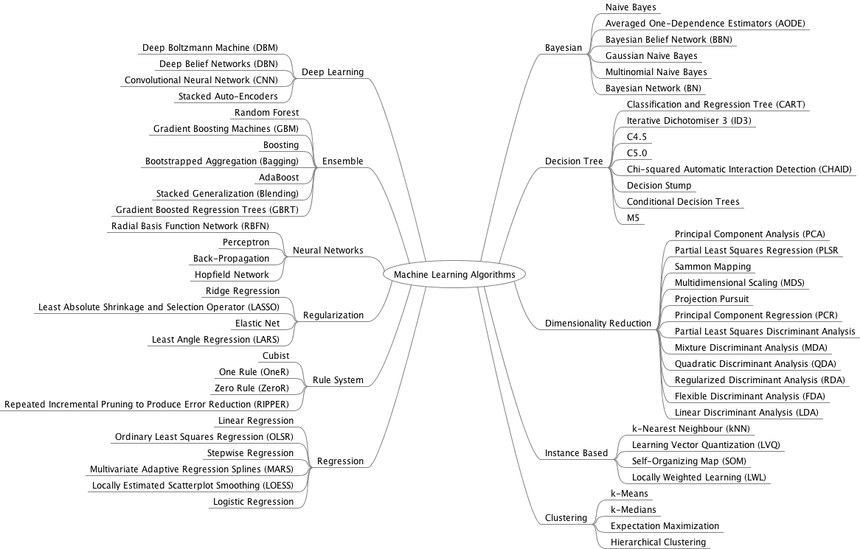
ML Algorithms

Slide 60
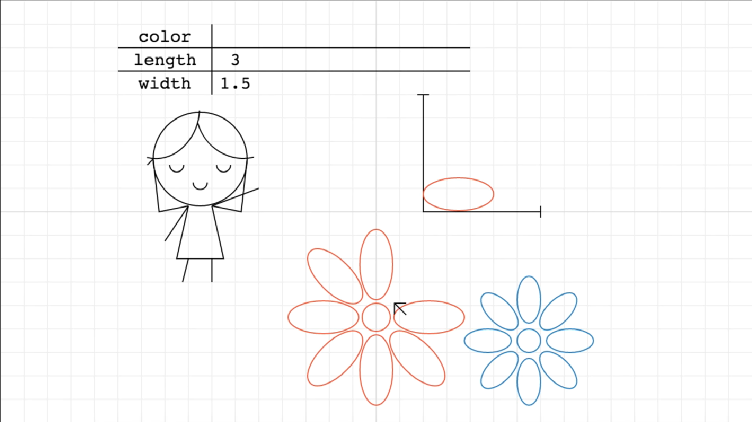
ML

Slide 61
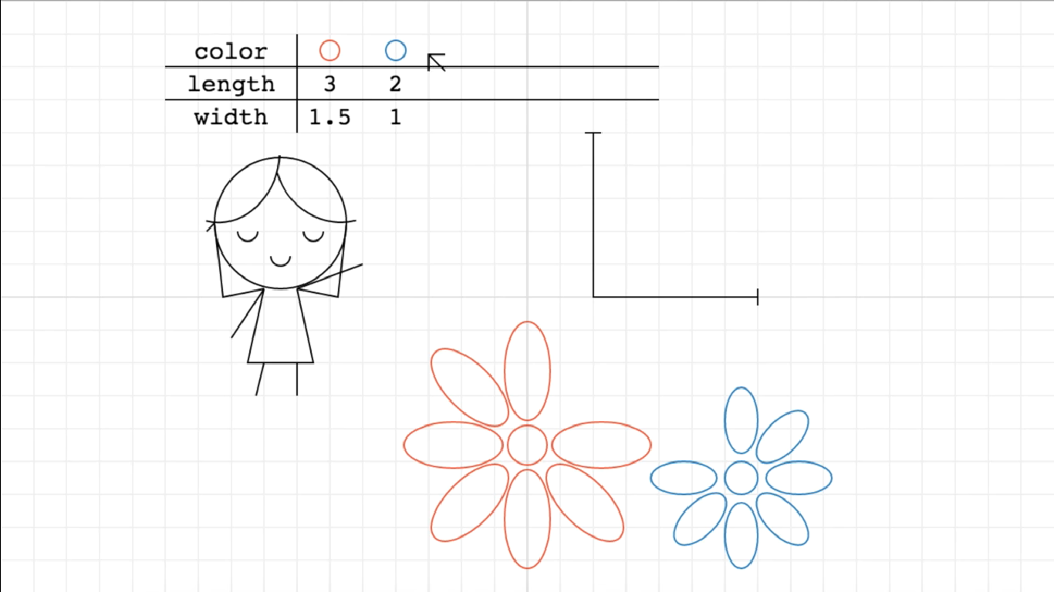
ML

Slide 62
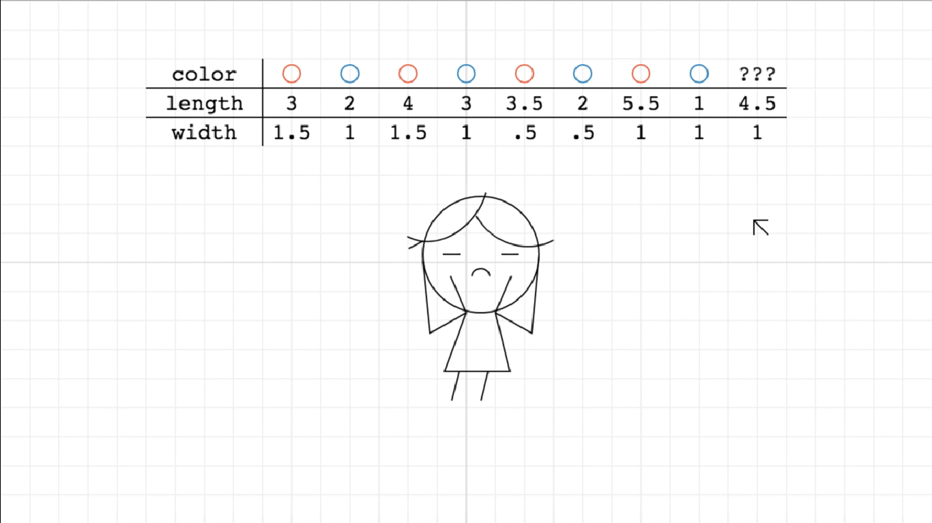
ML

Slide 63
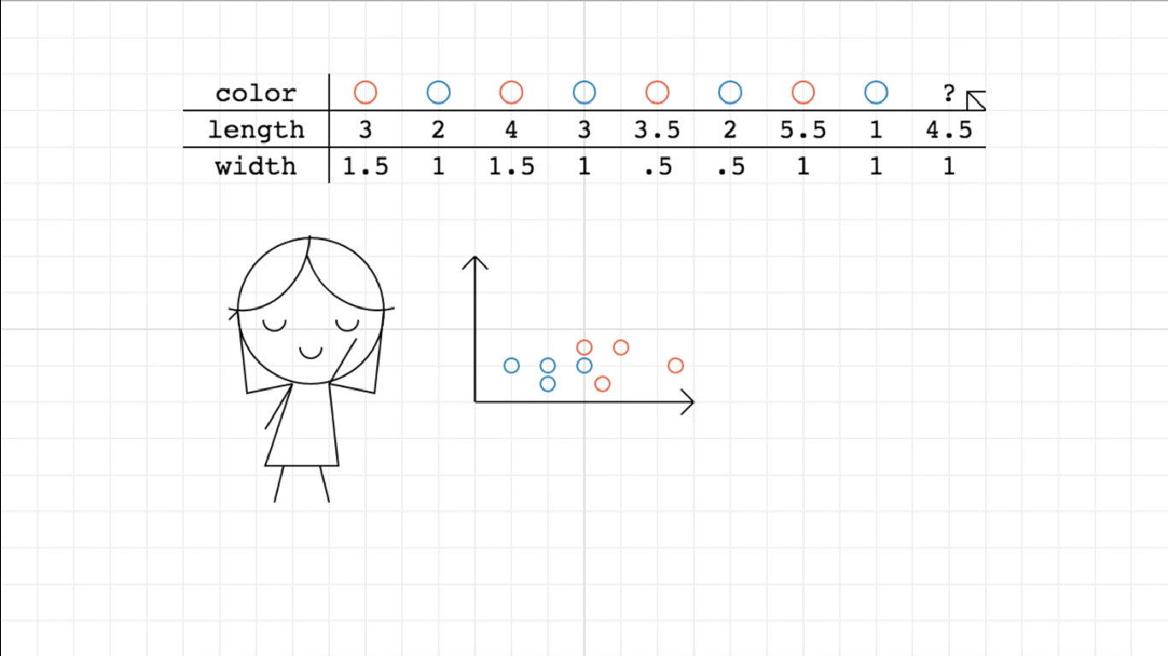
ML

Slide 64
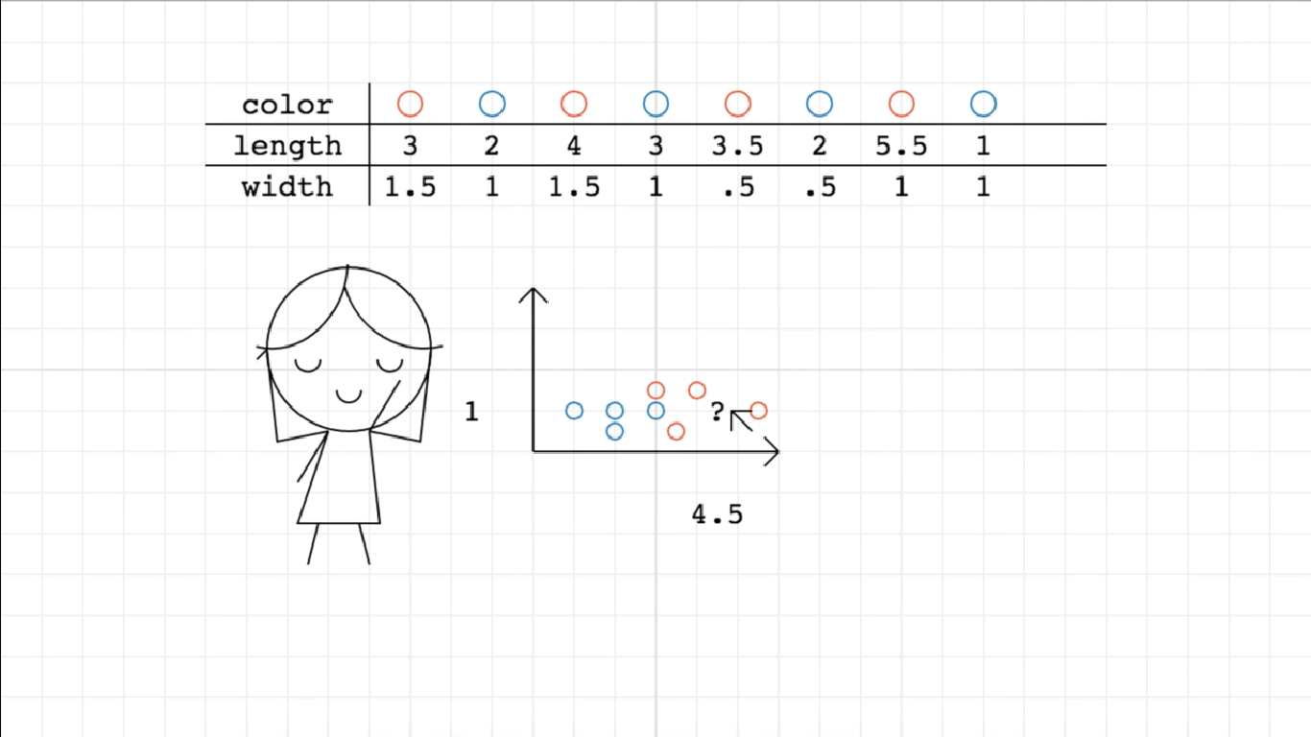
ML

Slide 65
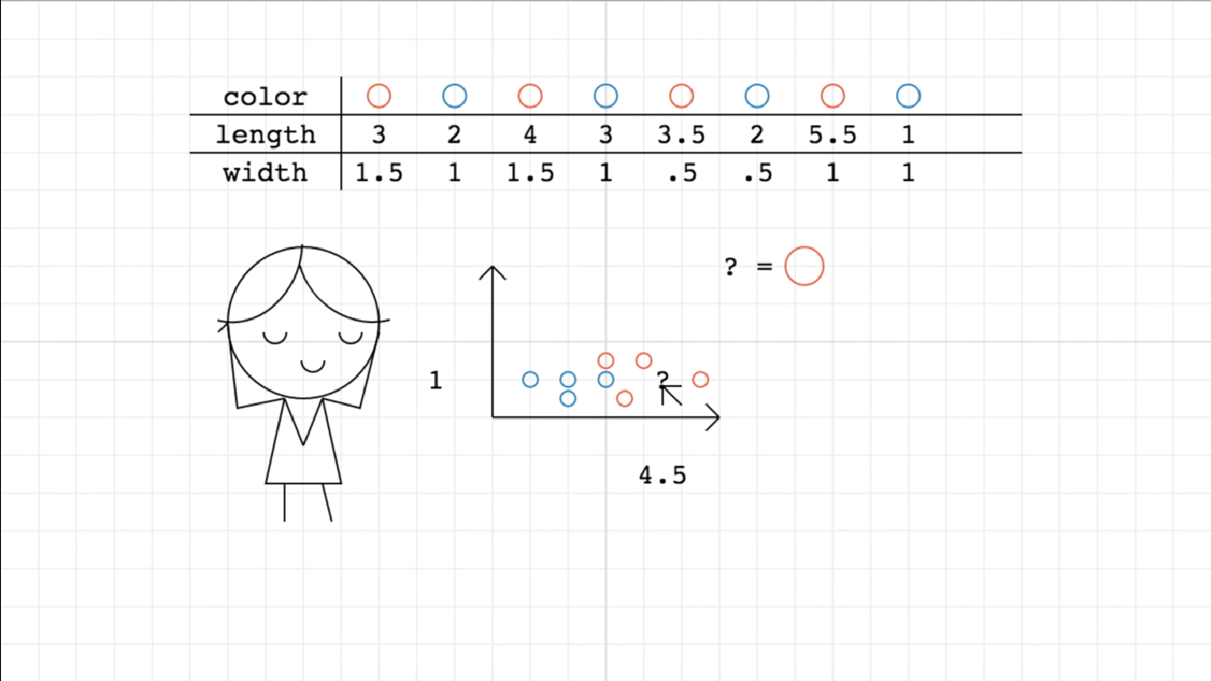
ML

Slide 66
Python in Machine Learning
Setting up the environment
Data set creation
Training
Prediction
Accuracy report

Slide 67
Setting up the environment
pip install numpy scipy scikit-learn
Dataset Creation
PETAL_SIZE | FLOWER_TYPE
1 | a
2 | b
1 | a
2 | b
3 | c
4 | d
3 | c
2 | b
5 | a

Slide 68
Example
from sklearn.datasets import load_iris
from sklearn.neighbors import KNeighborsClassifier
import numpy as np
from sklearn.model_selection import train_test_split
iris_dataset=load_iris()
X_train, X_test, y_train, y_test = train_test_split(iris_dataset["data"], iris_dataset["target"], random_state=0)
kn = KNeighborsClassifier(n_neighbors=1)
kn.fit(X_train, y_train)
x_new = np.array([[5, 2.9, 1, 0.2]])
prediction = kn.predict(x_new)
print("Predicted target value: {}\n".format(prediction))
print("Predicted feature name: {}\n".format
(iris_dataset["target_names"][prediction]))
print("Test score: {:.2f}".format(kn.score(X_test, y_test)))

Slide 69
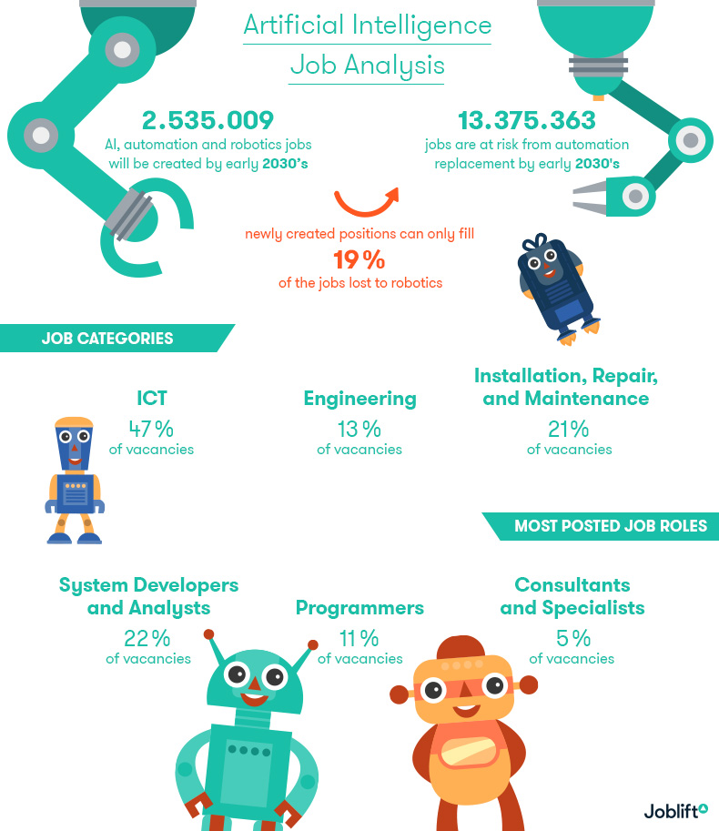

Slide 70
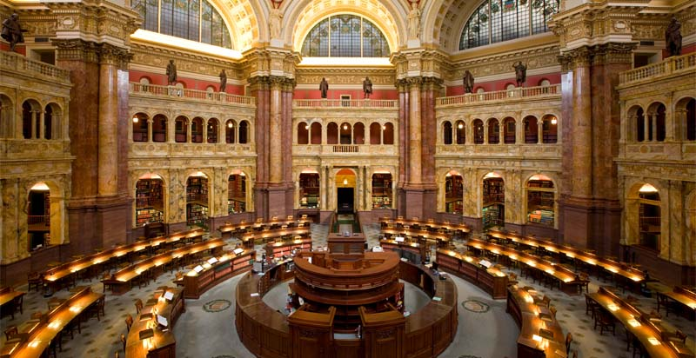
EXABYTE 10^18
All Text content of Library of congress X 100,000 = 1 Exabyte

Slide 71
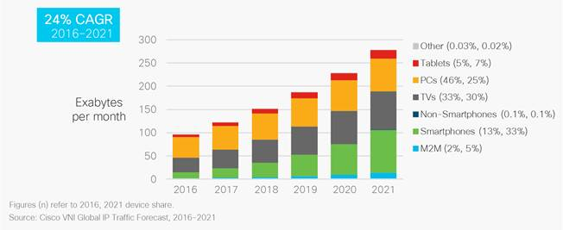

Slide 72


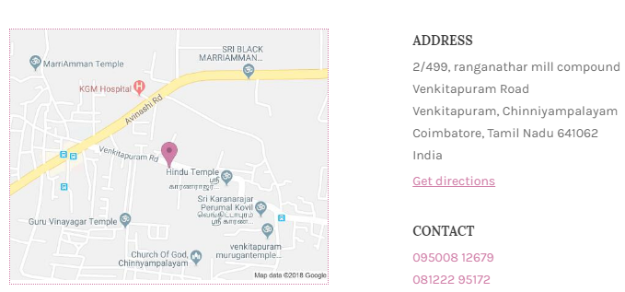

@Dinesh Ponnuswamy

