Slide 1
Voice based Email service for visually challenged people
Guide name : Ms. Fanny May Joseph Name : Manisha kumari
Designation : Assistant Proffessor, MCA Register number : 38118219

Slide 2
Abstract
Due to simplicity and accessibility, Internet is widely used in almost all the communication applications. In the recent times, number of application based on internet have been developed to make the communication as a more reliable and efficient in nature. Out of this numerous applications, E-mail is the most widely used and reliable way to communicate with each other.
The usage of e-mail is quiet easy for regular users but when it comes to the user with visual defect, the system is yet very difficult to use. This arises a significant need to upgrade the existing system to make it more useful for the visually impaired.
Thus, in this Project I used IVR- Interactive voice response, thus enabling everyone to control their mail accounts using their voice only and to be able to read,send, and perform all the other useful tasks. The system will prompt the user with voice commands to perform certain action and the user will respond to the same.
The main benefit of this system is that the use of keyboard is completely eliminated, the user will have to respond through voice and mouse click only.
this system will perform actions based on the clicks only that is left click or right click, it does not depends on the portion of the screen where the cursor is placed before the click giving user the freedom to click blindly anywhere on the screen.

Slide 3
Existing System
The existing system uses mainly two type of technologies like
STT (Speech to Text): here whatever we speak will be converted to text,
TTS (Text to Speech): this is opposite of STT method, here the text written on the screen will be read by the system and
If cursor moves over register icon it would sound register button, after clicking on register button it would give a voice notification like you are on registration page
After registration, user has to go to login page and type user id & password which will be recognized through database enabling the correct user to get access to his/her account
Also, there will be an icon for logout, which would read as logout when mouse goes or rolls over it. So, when the user wants can logout from the system
user should be well versed with the keyboard as to where each and every key is located. A user is new to computer can therefore not use this service as they are not aware of the key locations.

Slide 4
Disadvantage
The existing system uses mainly STT (Speech to Text): here whatever we speak will be converted to text
User will be very well guided with the help of voice commands, while registering all the necessary fields to be filled will be read by site, by clicking on that box he/she would have to fill in them.
user has to go to login page and type user id & password which will be recognized through database enabling the correct user to get access to his/her account.
the user cannot make use of mouse pointer as it is completely inconvenient if the pointer location cannot be traced
Not too much friendly for visually challenged people.

Slide 5
Proposed System
Unlike current system which emphasizes more on user friendliness of normal users, our system focuses more on user friendliness of all types of people including normal people visually impaired people as well as illiterate people. The complete system is based on IVR- interactive voice response.
When using this system the computer will be prompting the user to perform specific operations to avail respective services and if the user needs to access the respective services then he/she needs to perform that operation.
One of the major advantages of this system is that user won’t require to use the keyboard. All operations will be based on mouse click events.
This system will be perfectly accessible to all types of users as it is just based on simple mouse clicks and speech inputs and there is no need to remember keyboard shortcuts.
Also because of IVR facility those who cannot read, need not worry as they can listen to the prompting done by the system and perform respective actions

Slide 6
Advantage
The disabilities of visually impaired people are thrashed .
This system makes the disabled people feel like a normal user.
They can hear the recently received mails.
User will be very well guided with the help of voice commands
User Friendly.

Slide 7
Module Description
Home Page
Compose mail
Inbox
Sent mail
Trash

Slide 8
A. Home Page:
The user is redirected to this page once log in done successfully. From this page now the user can perform operations that the user wishes to perform. The options available are:
Inbox
Compose
Sent mail
Trash
B. Compose mail:
Here,User can directly record message that needs to be propagated and can send it. This voice massage will go in form of attachment. The receiver can hear the recording and get the message user wanted to send. User would not require attaching the file.
Record option will be provided in the compose window itself. Once recorded it will confirm whether the recording is perfect or not by letting the user hear it and if the user confirms it will be automatically attached to the mail

Slide 9
C. Inbox:
This option helps the user view all the mails that has been received to his/her account. The user can listen to mails he/she wants to by performing the click operation specified by the prompt.
In order to navigate through different mails prompt will specify which operations to perform. Each time the mail is selected the user will be prompted as whom the sender is and what is the subject of that particular mail.
Accordingly user can decide whether the mail needs to be read or not or it should be deleted. Deleted mails will be saved in trash section.
D. Sent mail:
This option will keep a track of all the mails sent by the user. If the user wants to access these mails, this option will provide them with their needs.
In order to access the sent mails user will need to perform the actions provided by the prompt to navigate between mails. When the control lands on particular mail user will be prompted as who the receiver was and what is the subject of the mail.
This will help the user in efficiently understanding and extracting the required mail.

Slide 10
E. Trash:
This option will keep a track of all the mails deleted by the user. Deleted mails could be the ones from inbox or sent mail. If at any time the user needs to retrieve a mail which was deleted it can be done from this option.

Slide 11
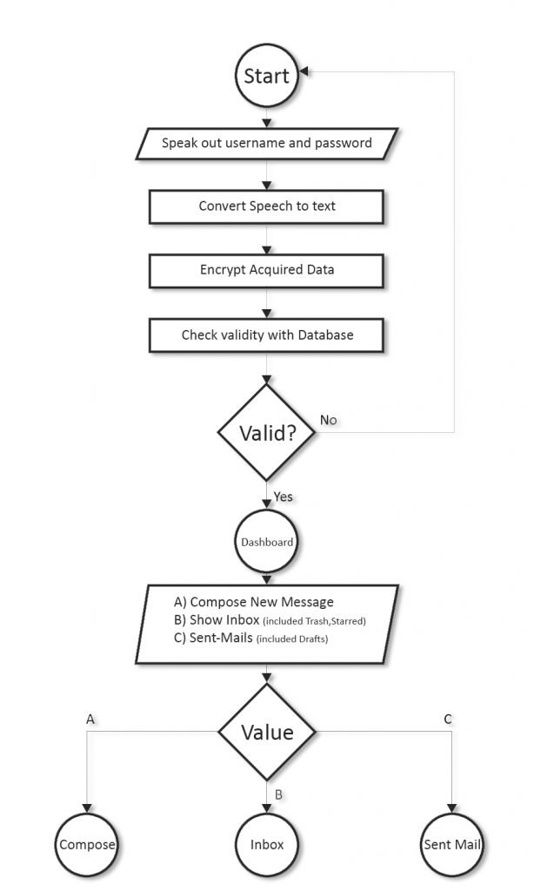
FLOW CHART

Slide 12
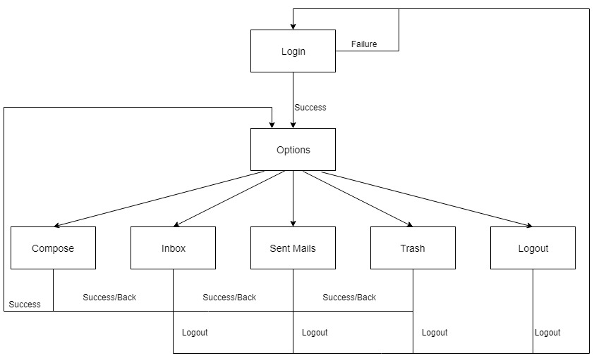
BLOCK DIAGRAM

Slide 13
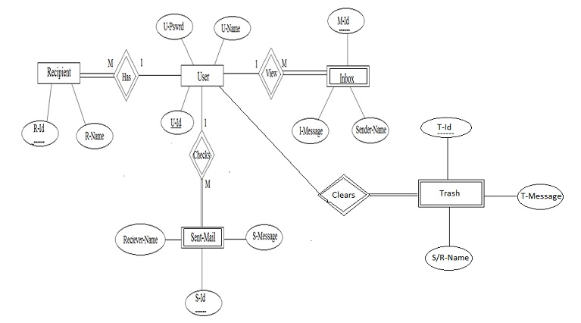
ER DIAGRAM

Slide 14
Thanks....

