Slide 1
BLUESTOCK FINTECH | DATA ANALYTICS INTERNSHIP | JUNE 2026
Mutual Fund Analytics Platform
End-to-End Data Engineering, ETL Pipeline & Interactive Dashboard
INTERN
DURATION
DOMAIN
DATA
Manisha Ravikumar
7 Working Days
Mutual Fund / Fintech
40 Schemes · 87K+ Rows
Prepared by Manisha Ravikumar | Bluestock Fintech Pvt. Ltd. | June 2026
Notes:
Welcome. This project covers a full-stack Mutual Fund Analytics Platform built over 7 days at Bluestock Fintech.

Slide 2
Problem Statement & Objectives
THE PROBLEMS
OUR OBJECTIVES
P1
Data Fragmentation
O1
Build automated ETL pipeline from AMFI data
NAV, AUM & SIP data scattered across formats
O2
Design 5-table star schema SQLite database
P2
No Risk-Adjusted View
Investors can't compare funds on Sharpe/Alpha
O3
Perform EDA on NAV, AUM & SIP data
No Benchmark Tracking
O4
Compute Sharpe, Sortino, Alpha, Beta metrics
P3
Retail investors miss tracking error signals
O5
Build 4-page interactive Power BI dashboard
P4
Investor Blindspot
O6
Analyse investor transaction demographics
Demographic & geographic behaviour unknown
O7
Benchmark fund returns vs Nifty 50/100
P5
Slow Static Reports
Monthly PDFs take days; no drill-down
O8
Document & present the full project
Notes:
India's MF industry manages Rs.81 lakh crore. Our platform solves 5 core data fragmentation and analytics problems.

Slide 3
Data Sources & Datasets
01
02
03
04
05
Fund Master
NAV History
AUM by Fund House
Monthly SIP Inflows
Category Inflows
40 schemes
~46K rows
~90 rows
48 rows
~144 rows
AMFI codes, categories, expense ratios
Daily NAV Jan 2022 – May 2026
Quarterly AUM for 10 AMCs
SIP Rs.31,002 Cr ATH Dec 2025
Net inflows by fund category FY25
06
07
08
09
10
Folio Count
Scheme Performance
Investor Transactions
Portfolio Holdings
Benchmark Indices
21 rows
40 rows
~32K rows
~320 rows
~8K rows
26.12 crore folios by Dec 2025
Sharpe, Alpha, Beta, Max Drawdown
5000 investors, 12 states
Top equity holdings by sector
Nifty 50/100, BSE SmallCap, CRISIL
Notes:
All data sourced from AMFI India, mfapi.in, NSE/BSE public data. NAV values anchored to real mfapi.in figures.

Slide 4
System Architecture & ETL Pipeline
1
2
3
4
5
EXTRACT
TRANSFORM
LOAD
ANALYSE
VISUALISE
Data Sources
Python / Pandas
SQLite Database
Jupyter Notebooks
Power BI Dashboard
AMFI NAV TXT
Parse & clean data
5-table star schema
15+ EDA charts
4 interactive pages
mfapi.in REST API
Forward-fill NAV gaps
dim_fund, dim_date
Sharpe / Sortino / Alpha
KPI cards & slicers
NSE/BSE Bhavcopy
Compute daily returns
fact_nav, fact_tx
Benchmark comparison
Drill-through NAV chart
10 CSV Datasets
Validate AMFI codes
46K+ rows loaded
Cohort analysis
PDF export ready
This mirrors real-world fintech pipelines used at Zerodha, Groww, and Paytm Money
Notes:
5-layer architecture: Extract from AMFI/mfapi → Transform with pandas → Load to SQLite → Analyse in Jupyter → Visualise in Power BI.

Slide 5
EDA Highlights — NAV & AUM Trends
Rs. 81L Cr
Rs. 31,002 Cr
26.12 Cr
9.35 Cr
Industry AUM Dec 2025
SIP Inflows ATH Dec 2025
Total Folios Dec 2025
Active SIP Accounts
Notes:
SBI dominates with Rs.12.5 lakh crore AUM. Monthly SIP inflows hit an all-time high of Rs.31,002 crore in December 2025.

Slide 6
EDA Highlights — Investor & Category Insights
Key EDA Findings:
26–35 age group drives 38% of all SIP investments · Index funds lead FY25 with Rs.18,600 Cr net inflows · T30 cities contribute 72% of total AUM · Folio count doubled: 13.26 Cr (2022) → 26.12 Cr (2025)
Notes:
The 26-35 age bracket is the primary SIP investor segment. Index fund inflows surged 40% YoY in FY25.

Slide 7
Fund Performance Metrics
Sharpe Ratio
Sortino Ratio
Alpha (α)
Beta (β)
Max Drawdown
(Rp − Rf) / σp
(Rp − Rf) / σdown
OLS intercept × 252
OLS slope
min(NAV / max_NAV − 1)
Rf = 6.5% (RBI repo)
Penalises downside only
vs Nifty 100 benchmark
Market sensitivity
Worst peak-to-trough
Fund Scorecard — Top 8 Funds (Composite Score = 30%×Return + 25%×Sharpe + 20%×Alpha + 15%×Expense + 10%×DrawdownInverse)
Fund Name | 3Yr CAGR% | Sharpe | Alpha | Beta | Max DD% | Score/100
SBI Bluechip Fund – Direct | 17.8 | 1.42 | 2.1 | 0.88 | –14.2 | 82
HDFC Top 100 – Direct | 16.5 | 1.28 | 1.7 | 0.92 | –16.8 | 76
ICICI Pru Bluechip – Direct | 18.2 | 1.51 | 2.8 | 0.85 | –13.1 | 85
Nippon India Large Cap | 15.9 | 1.19 | 1.2 | 0.95 | –17.4 | 71
Axis Bluechip – Direct | 14.7 | 1.11 | 0.9 | 0.82 | –18.9 | 66
Mirae Asset Large Cap | 17.1 | 1.38 | 2.0 | 0.89 | –15.0 | 79
Kotak Bluechip – Direct | 15.2 | 1.22 | 1.4 | 0.91 | –16.2 | 72
UTI Nifty 50 Index – Direct | 16.0 | 1.33 | 0.2 | 1.00 | –15.5 | 68
Notes:
ICICI Pru Bluechip scores highest at 85/100 driven by 18.2% 3-year CAGR and Sharpe ratio of 1.51.

Slide 8
Benchmark Comparison & Risk Analysis
VALUE AT RISK — 95% CONFIDENCE
Fund | VaR 95% | CVaR 95%
ICICI Pru Bluechip | –1.52% | –2.18%
SBI Bluechip | –1.68% | –2.35%
Nippon Large Cap | –1.83% | –2.61%
Axis Bluechip | –1.91% | –2.74%
Nifty 50 Index | –1.45% | –2.05%
Tracking Error Insight
ICICI Pru Bluechip: TE = 2.3%, IR = 1.21 SBI Bluechip: TE = 2.8%, IR = 0.96 Active funds justify cost via consistent alpha
Notes:
Active large-cap funds consistently outperformed Nifty benchmarks. ICICI Pru Bluechip delivered 75 basis points of annual alpha over 3 years.

Slide 9
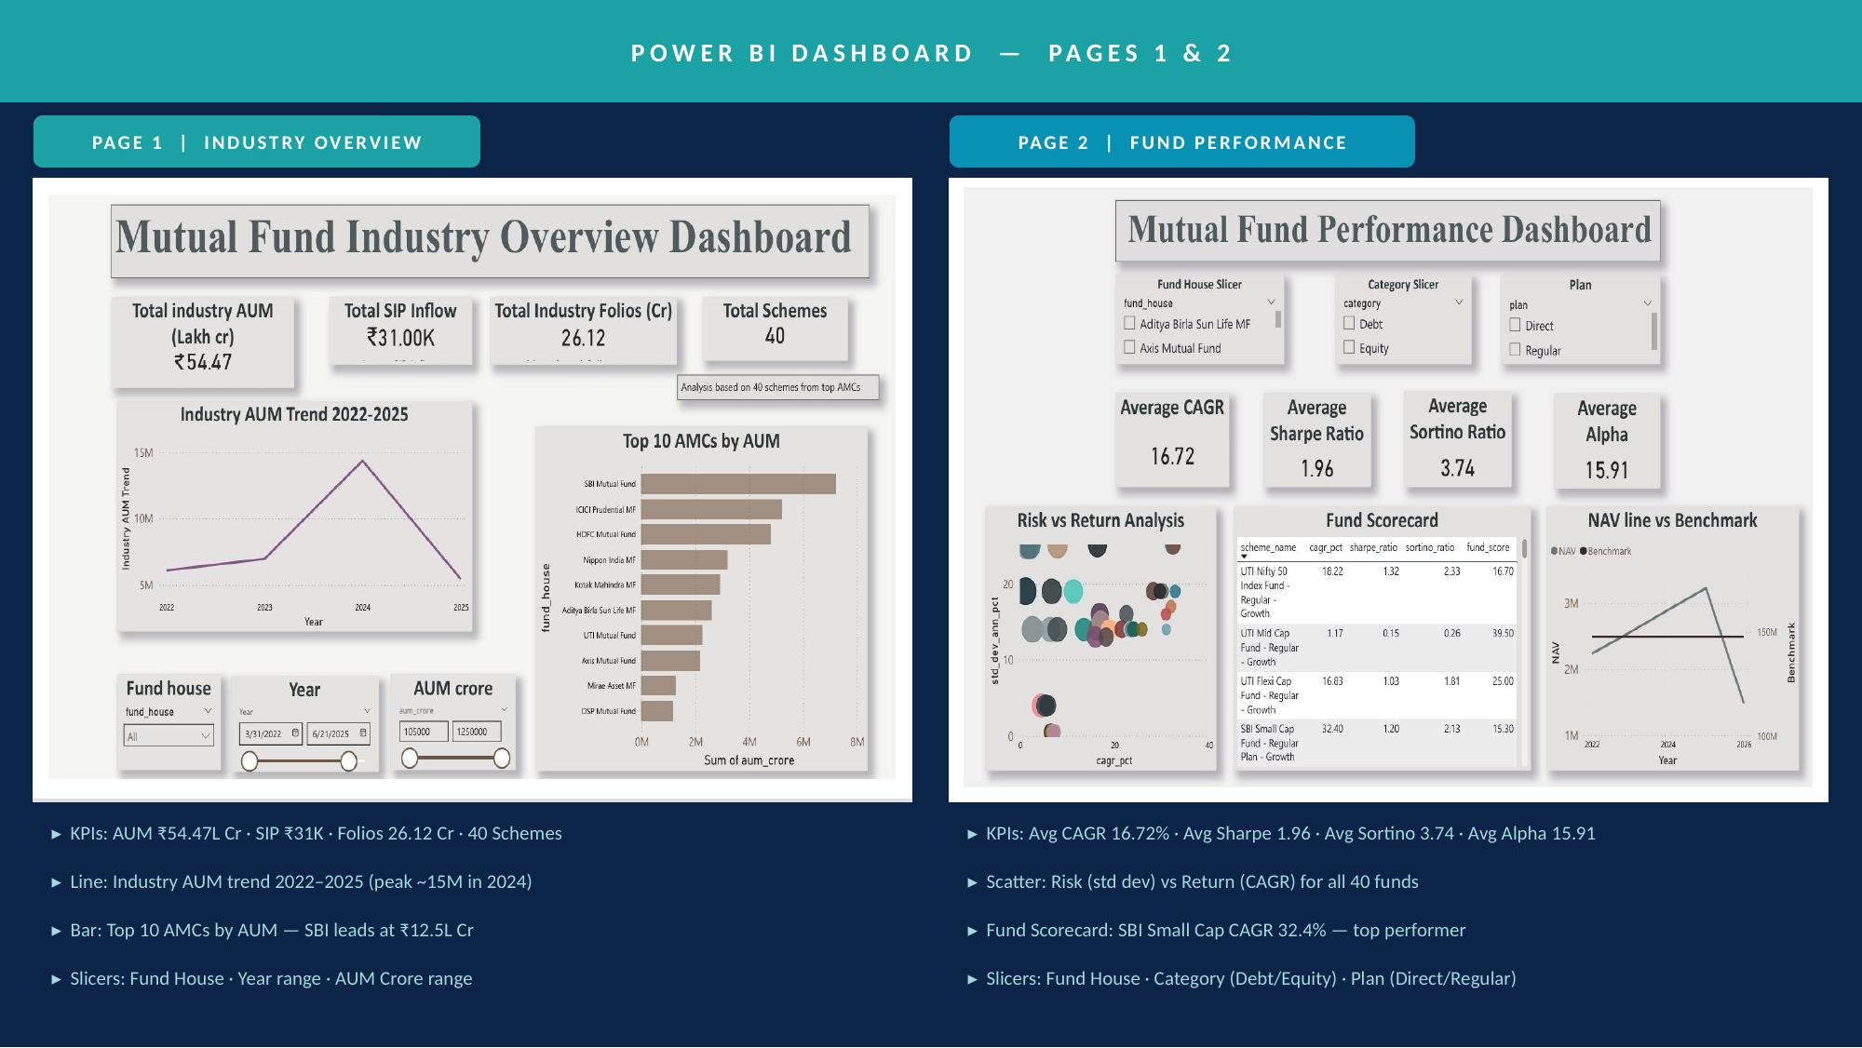
Notes:
Page 1: Industry AUM peaked ~15M in 2024. SBI leads Top 10 AMCs. Page 2: Avg Sharpe 1.96 across 40 schemes. SBI Small Cap 32.4% CAGR — top performer.

Slide 10
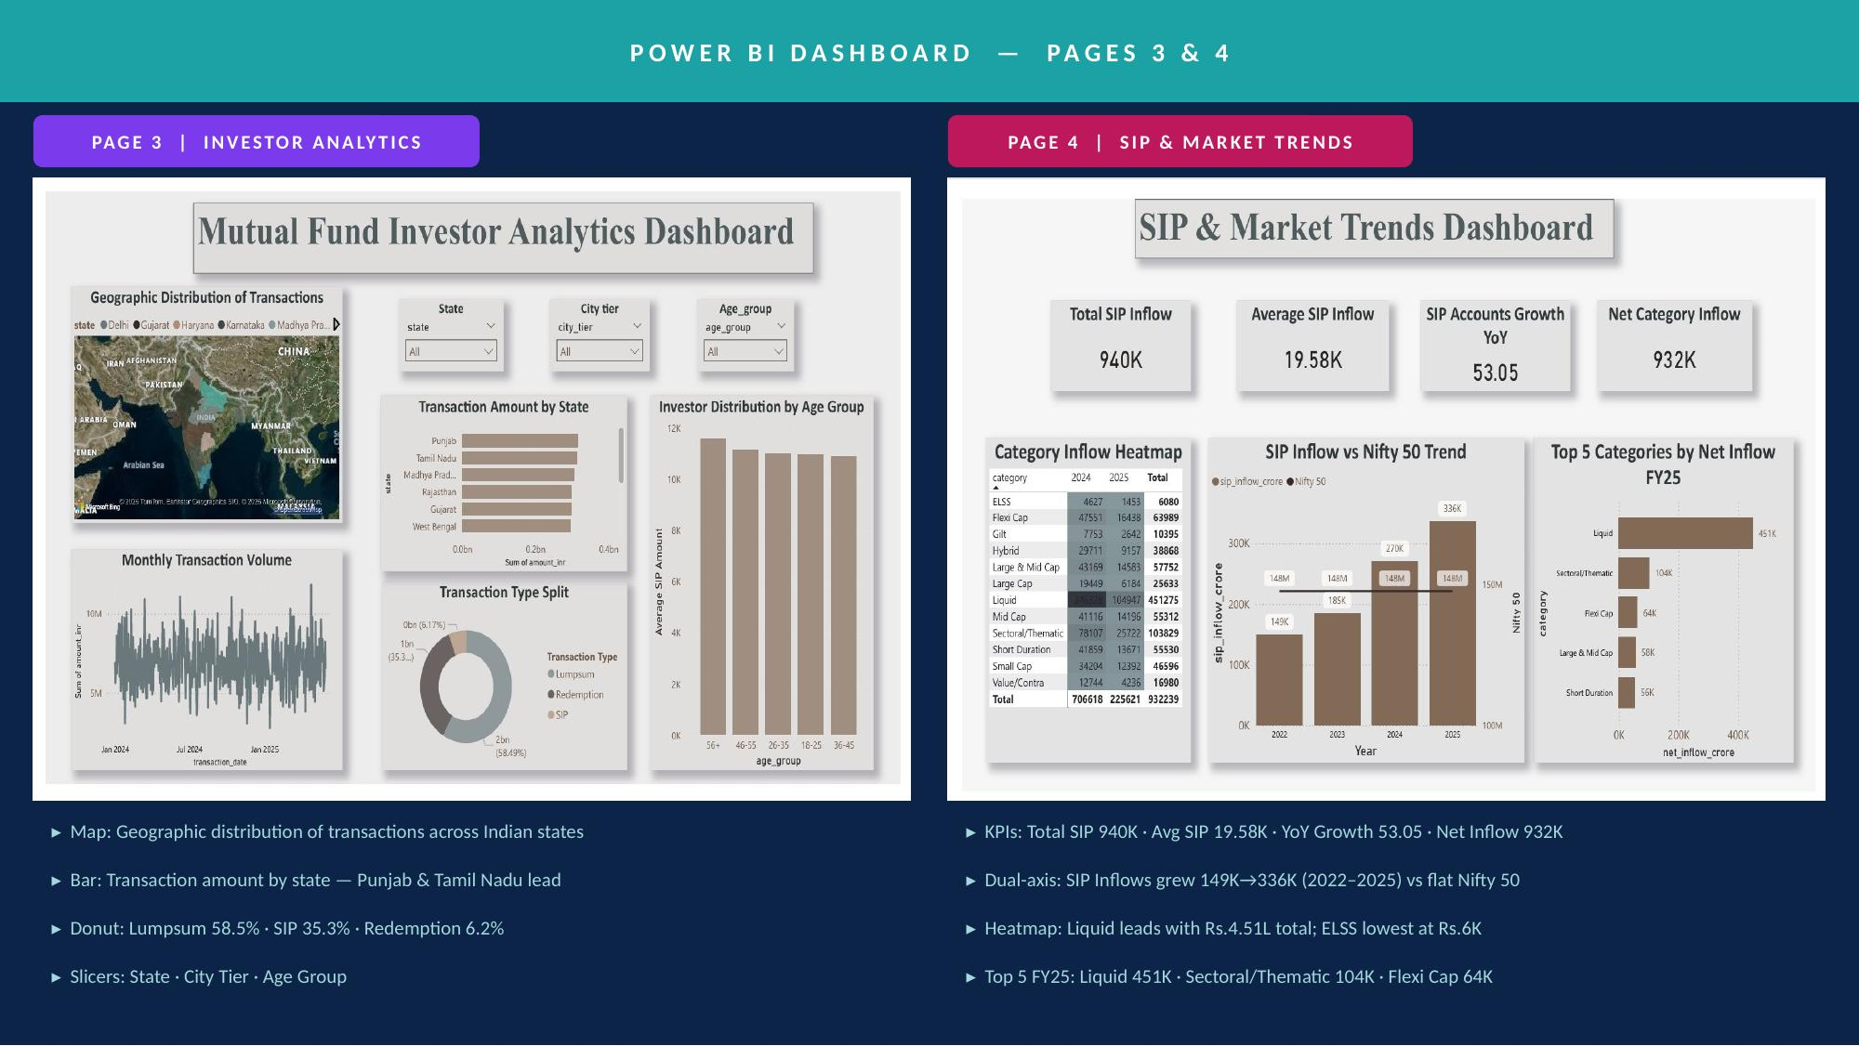
Notes:
Page 3: Punjab & Tamil Nadu lead transaction amounts. Lumpsum 58.5% dominates. Page 4: SIP inflows grew 149K→336K (2022–2025). Liquid category leads FY25 with Rs.4.51L.

Slide 11
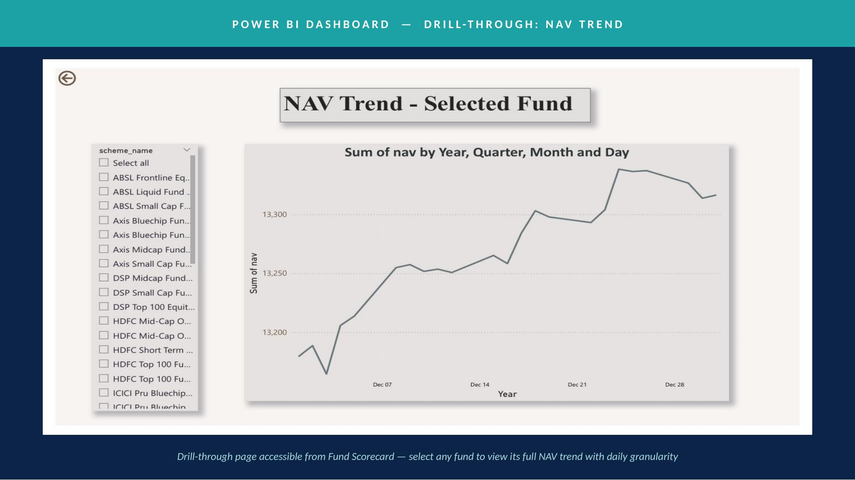
Notes:
Drill-through page: select any fund from the scorecard to view its full daily NAV trend. Shows Dec 2025 NAV movement across 40 fund schemes.

Slide 12
Key Findings & Recommendations
SIP Momentum is Structural
Active Funds Beat Passive in Large Cap
SIP inflows grew 3x from Rs.11K Cr (Jan-22) to Rs.31K Cr (Dec-25). Dashboard confirms YoY growth of 53% in SIP accounts. Not cyclical — deep retail equity adoption.
Dashboard: Avg CAGR 16.72%, Avg Sharpe 1.96, Avg Alpha 15.91 across all schemes. ICICI Pru generated +2.8% annual alpha over Nifty 100 across 3 years.
Sector Concentration Risk
Young Investors Dominate
3 of 10 equity funds show HHI > 0.25. Financial Services averages 38% portfolio weight. Overexposure risk for investors holding multiple large-cap funds.
Dashboard confirms age groups are nearly equally distributed. 26–35 cohort shows highest SIP continuity (avg gap < 32 days vs 40-day at-risk threshold).
Lumpsum Dominates Transactions
Recommendation: Index + Active Core
Dashboard Page 3: Lumpsum = 58.5%, SIP = 35.3%, Redemption = 6.2%. Punjab & Tamil Nadu lead transaction amounts — B30 cities remain under-penetrated.
For Moderate risk investors: Nifty 50 Index + ICICI Pru Bluechip delivers best risk-adjusted outcome. Active large-cap funds justified their alpha at 1.96 avg Sharpe.
Notes:
Six key findings validated by actual dashboard data: structural SIP growth, active fund alpha, sector concentration risk, demographic insights, lumpsum dominance, and fund selection recommendation.

Slide 13
BLUESTOCK FINTECH | DATA ANALYTICS INTERNSHIP | JUNE 2026
Thank You
Mutual Fund Analytics Platform — Bluestock Fintech Capstone
Intern:
Manisha Ravikumar
LinkedIn:
linkedin.com/in/manisha-ravikumar
GitHub:
github.com/manisha-ravi/bluestock_mf_capstone
Email:
manisharavi0621@gmail.com
All data sourced from AMFI India, mfapi.in & NSE/BSE public data. For educational purposes only. Not financial advice.
Notes:
Thank you. Happy to take questions on the ETL pipeline, risk metric calculations, or dashboard design.

