Slide 1
Ecommerce Website For Automative Parts
Manisha Laxman Khande- EBEON0622613392
Ashwini Ragendra Wagh-EBEON0622617092
Poonam Sanjay Unhale-EBEON0622617145
Rutuja Kundlik Tambe-EBEON0622617164
Guided by
---manisha khande

Slide 2
Ecommerce Website For Automative Parts
List Of Entire Modules
Home Page
Login and Registration
Admin module
Shop module
Cart to payment gateway integration

Slide 3
Ecommerce Website For Automative Parts
module(s) Goal
Its main purpose is to provide the controllability of the system to the admins.
Module and submodule : -
Admin module
Adding product
User details

Slide 4
Module 1 - Add product
Definition : – It contain specific group of products but may vary in industrial design or minor features.
Sub module details:
to describe and explain the benefits of your product. In other words, it provides all the information and details of your product on your ecommerce site

Slide 5
Module 2 - User details
Definition : -
A user model is the collection and categorization of personal data associated with a specific user.
Sub module details : -
A user model is a (data) structure that is used to capture certain characteristics about an individual user, and a user profile is the actual representation in a given user model.

Slide 6
Project overview
project architecture diagram : -
Project Architecture
Approved
Customer
Pending
Login
Dashboard
Stock maintenance
Report
Order
checkout

Slide 7
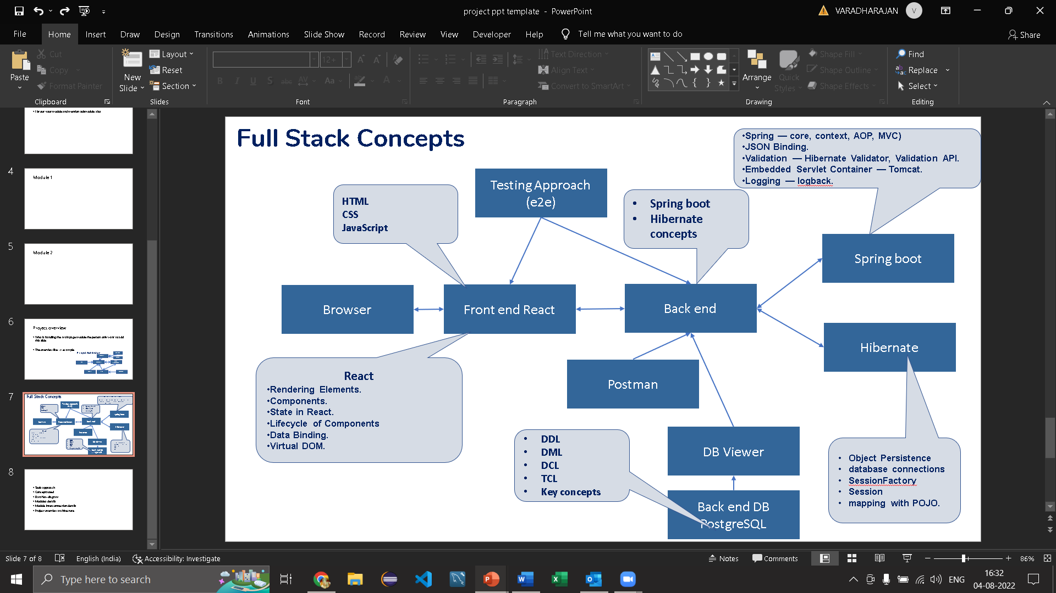
Tech architecture

Slide 8
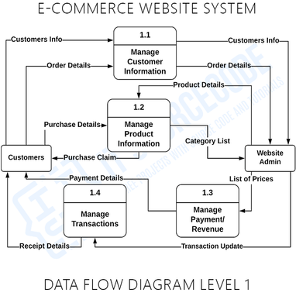
Dataflow diagram
Dataflow diagram

Slide 9
Challenging Issues
Challenging Issue During Project Implementation Time : -
Connectivity issue
Port is already in used issue
Error when installing ng add @ng-bootstrap/ng-bootstrap in angular
Less/No Network connection

Slide 10
Conclusion
The automotive parts ecommerce website is what greets your customers and gives them the information fetched in the backend, so you have to make it as presentable and detailed as possible.
We will be building dedicated modules that would provide an overview of each product or make.
Provide us a comprehensive list of all present products, and we will take it from there .

